Slide 1
Zsófia Kollányi, Lajos Bálint, Kitti Susovits, Péter Csépe, Katalin Kovács
Drivers of inequalities of diabetes mortality in Hungary,
2009-12 and 2013-16
EAPS HMMWG meeting
20-22 September, 2023, Budapest

Slide 2
Diabetes: major concern for public health
In most countries, prevalence and incidence are both increasing
According to the Diabetes Atlas (2021), 537 million adults (20-79 year old) live with diabetes worldwide (1:10) and 6,7 million die annually due to diabetes
95% of diabetes cases are of type 2 (developing in adulthood)
Number of adults registered as having diabetes in GP practices (Hungary)
Health consequences of diabetes
2-3 fold increase in risk of infarction and stroke
Neuropathy, can lead to amputation of the lower limb
Retinopathy – can lead to blindness
Renal diseases (dialysis), higher COVID19 risk

Slide 3
Our research project: Patients’ pathway in the Hungarian Health Care system
Addresses major public health issues (diabetes, heart diseases)
Spatial differences are in the focus – traditionally an important approach for Hungarian health status and health care research
Variety of methodologies
  statistical analysis of administrative health data and other macro-data
  interviews
In this lecture we present our results of a statistical analysis on spatial differences in diabetes mortality
Unit of analysis: micro-region (197) of Hungary
Major differences are expected regarding
  Mortality
  Accessibility of health care
  Quality of health care

Slide 4
Diabetes mortality by micro-regions, Hungary
2009-12, 2013-16

Slide 5
Microregional differences in frequency of lower limb amputation
(Dózsa et al, 2020)

Slide 6
Outpatient services in Hungary at the beginning of 2010’s

Slide 7
Independent variables suspected to be associated with diabetes mortality
Status of the micro-region:
  Educational composition
  Economic prosperity
  Deprivation
Lifestyle
  Alcohol-related mortality
  BMI for children
Health care capacity and quality
  GP availability
  Pharmacy availability
  In-patient services capacity
  Out-patient services capacity
  Traditional versus modern medicine use
  Preventive measures (such as leg examination)

Slide 8
Deprivation and new approaches in Hungarian rural sociology
Characteristics of settlements lagging behind
Apart from scarcity of work and low income, services of all kind are poorly supplied
Among others: food deserts

Slide 9
Food deserts in Hungary (Nagy et al, 2016)

Slide 10
OLS regression strategy and results for 2009-12
 | UNIVARIATE | M1 | M2 | M3 | M4 | M5 | M6 | M7 | M8 | M9 | M10 | M11 | M12 | M13 | M14 | M15
EDUCATION | 0,31*** | 0,35** |  |  |  | 0,09 | 0,22** | 0,19** |  |  |  | 0,08 | 0,11 | 0,15 * |  | 0,10
TAXPAYERS | 0,18* | 0,23** |  |  |  | 0,21** | 0,19 | 0,17 |  |  |  | 0,19** | 0,20** | 0,16 |  | 0,19
GROCERY | 0,44*** |  | 0,27** |  |  | 0,20* |  |  | 0,21** | 0,29* |  | 0,16* | 0,25* |  | 0,27* | 0,24
OTHER SER | 0,44*** |  | 0,28** |  |  | 0,30** |  |  | 0,18* | 0,25* |  | 0,21* | 0,30** |  | 0,17* | 0,22
ALCOHOL | 0,46*** |  |  | 0,46 |  |  | 0,36** |  | 0,27 |  |  | 0,24** |  | 0,29 | 0,28*** | 0,26
OBESITY | 0,27*** |  |  | -0,04 |  |  | -0,07 |  | -0,05 |  |  | -0,06 |  | -0,06 | -0,03 | -0,05
GP | 0,13(*) |  |  |  | 0,01 |  |  | -0,00 |  | -0,02 |  |  | -0,02 | -0,03 | -0,05 | -0,04
PHARMACY | 0,43*** |  |  |  | 0,41** |  |  | 0,04 |  | -0,01 |  |  | -0,06 | 0,22** | -0,07 | -0,11
OUTPATIENT | -0,15* |  |  |  | -0,09 |  |  | -0,06 |  | -0,07 |  |  | -0,05 | -0,05 | -0,07 | -0,05
HOSPITAL | -0,18* |  |  |  | -0,07 |  |  | 0,02 |  | -0,04 |  |  | 0,04 | 0,02 | -0,04 | -0,03
TRAD MED | -0,12 |  |  |  | -0,15* |  |  | -0,13* |  | -0,13* |  |  | 0,10 | -0,10 | -0,11* | -0,08
LEG INSPEC | 0,06 |  |  |  | -0,05 |  |  | -0,07 |  | -0,05 |  |  | -0,07 | -0,10 | -0,09 | -0,10
ADJ R2 |  | 0,140 | 0,234 | 0,203 | 0,199 | 0,272 | 0,258 | 0,228 | 0,284 | 0,236 | 0,266 | 0,312 | 0,267 | 0,288 | 0,288 | 0,311

Slide 11
OLS regression strategy and results for 2013-16
 | UNIVARIATE | M1 | M2 | M3 | M4 | M5 | M6 | M7 | M8 | M9 | M10 | M11 | M12 | M13 | M14 | M15
EDUCATION | 0,00 | 0,36 |  |  |  | 0,19 | 0,22 | 0,25 |  |  |  | 0,10 | 0,22* | 0,18* |  | 0,08
TAXPAYERS | 0,37 | -0,7 |  |  |  | -0,13 | -0,12 | -0,12 |  |  |  | -0,19** | -0,13* | -0,14 |  | -0,16*
GROCERY | 0,43 |  | 0,28 |  |  | 0,32** |  |  | 0,21 | 0,32 |  | 0,27*** | 0,33* |  | 0,30* | 0,31*
OTHER SER | 0,47 |  | 0,23 |  |  | 0,12 |  |  | 0,13 | 0,17 |  | 0,01 | 0,08 |  | 0,07 | -0,00
ALCOHOL | 0,22 |  |  | 0,47 |  |  | 0,42 |  | 0,31 |  | 0,34 | 0,31*** |  | 0,33*** | 0,33*** | 0,32***
OBESITY | 0,17 |  |  | -0,02 |  |  | -0,02 |  | 0,01 |  | 0,01 | 0,12 |  | 0,01 | 0,00 | 0,01
GP | 0,42 |  |  |  | 0,07 |  |  | -0,02 |  | 0,06 | 0,05 |  | -0,01 | -0,02 | 0,05 | -0,00
PHARMACY | -0,07 |  |  |  | 0,39*** |  |  | 0,35*** |  | -0,01 | 0,23 |  | 0,02 | 0,22** | -0,07 | -0,05
OUTPATIENT | -0,14 |  |  |  | 0,01 |  |  | 0,05 |  | 0,00 | 0,01 |  | 0,03 | 0,04 | 0,00 | 0,03
HOSPITAL | -0,14 |  |  |  | -0,06 |  |  | 0,00 |  | -0,04 | -0,04 |  | -0,00 | -0,01 | -0,03 | -0,02
TRAD MED | -0,07 |  |  |  | -0,09 |  |  | -0,10 |  | -0,07 | -0,08 |  | -0,09 | -0,09 | -0,07 | -0,09
LEG INSPEC | -0,04 |  |  |  | -0,06 |  |  | -0,05 |  | -0,08 | -0,09 |  | -0,08 | -0,08 | -0,12* | -0,11
ADJ R2 |  | 0,106 | 0,209 | 0,210 | 0,169 | 0,230 | 0,246 | 0,196 | 0,271 | 0,195 | 0,248 | 0,298 | 0,217 | 0,268 | 0,265 | 0,286

Slide 12
Coefficients and their changes: education
For 2009-12, in areas with less educated population, DM mortality is higher, but this association diminishes when service deprivation and health care are also considered
For 2013-16, less educated areas exhibit higher diabetes mortality, even after adjustments for all other factors

Slide 13
Coefficients and their changes: taxpayers
For 2009-12, in areas with more prosperous population, DM mortality is higher, and this association does not disappear when the effects of other variables are taken into account
For 2013-16 the situation changed: less prosperous areas had higher DM mortality but only after taken into account the effects of other variables

Slide 14
Coefficients and their changes: grocery stores
For both periods, there is a positive and strong association between the proportion of people living with 0 or 1 grocery stores and DM mortality. The association is somewhat stronger in the second period.

Slide 15
Coefficients and their changes: other services
Massive coefficients which disappear with the inclusion of other variables in both periods

Slide 16
Coefficients and their changes: alcohol
Massive coefficients decreasing but remaining strongly significant while adjusting for other variables in both periods, importance slightly increases

Slide 17
Coefficients and their changes: obesity (BMI)
Very similar pattern is seen in case of: GP, pharmacy, outpatient care inpatient care and traditional medicine use)
Strong association with DM mortality in univariate analysis, no association in case of inclusion of other variables

Slide 18
Summary of the results: coefficients in the full models
CONCLUSION
Alcohol and easiness of access to food (measured by presence of groceries) associated most and consistently with DM mortality

Slide 19
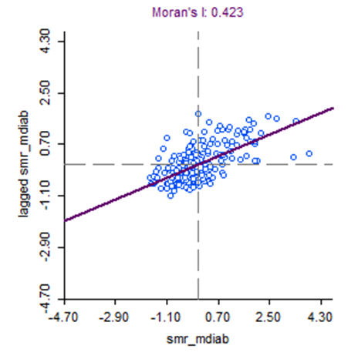
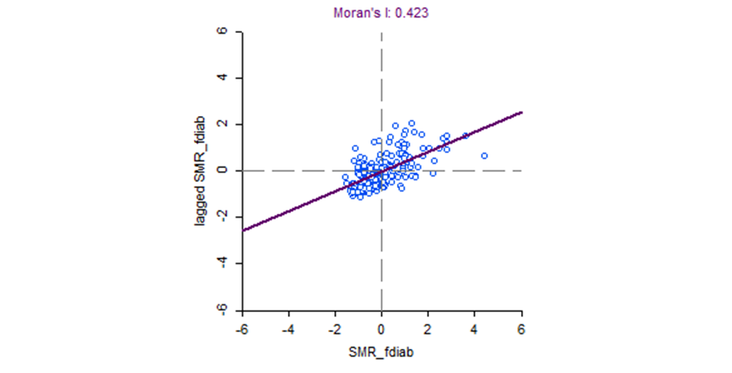
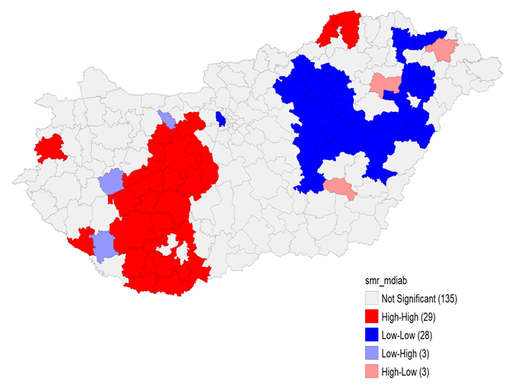
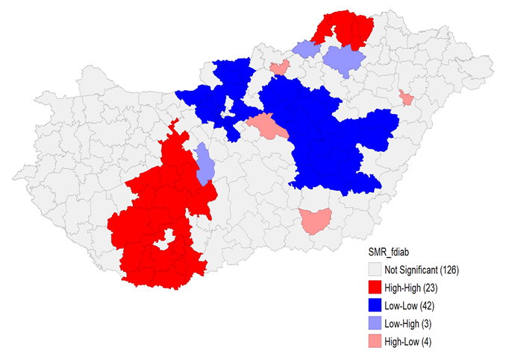
Spatial autocorrelation for men
2009-12
2013-16

Slide 20
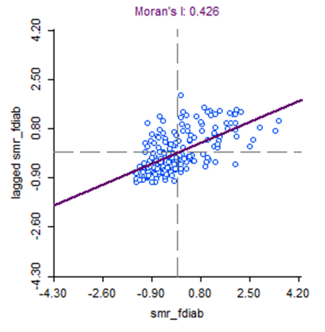
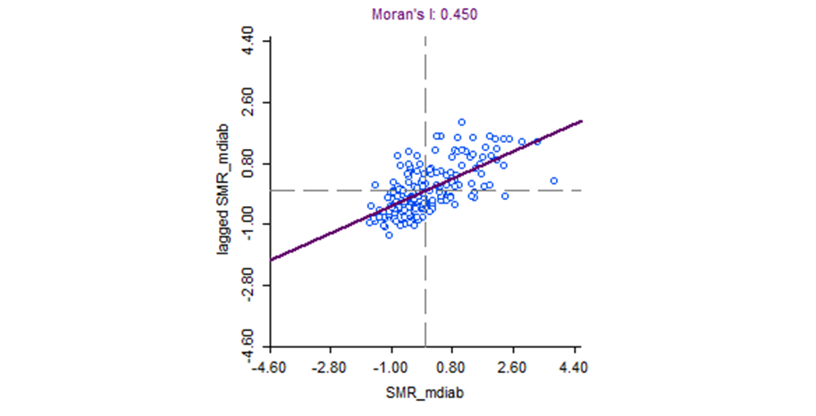
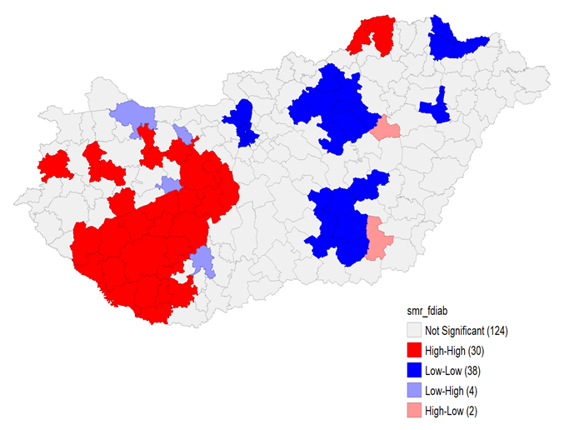
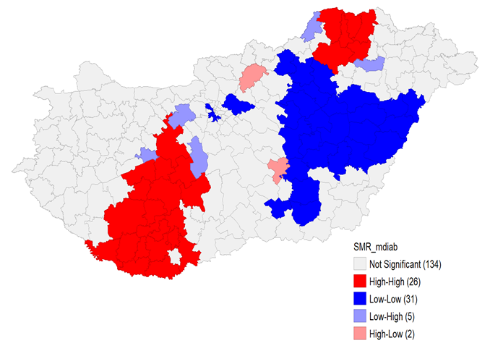
Spatial autocorrelation for women
2009-12 2013-16

