Slide 1
HMM workshop
Budapest, 20-22 September 2023
Recent trends in multiple causes of death associated with dementia in Spain: educational differences and its impact on life expectancy (work in progress)
Jeroen Spijker^{1*}, Elisenda Renteria¹, Julia Almeida¹, Sergi Trias-Llimós¹, Gabriele Doblhammer^{2,3}
¹Centre d’Estudis Demogràfics, Bellaterra, Spain. *jspijker@ced.uab.es.
²Department of Economics and Social Sciences, Institute for Sociology and Demography,
University of Rostock, Rostock, Germany
³Demographic Studies, German Center for Neurodegenerative Diseases, Bonn, Germany
twitter: @popageing

Slide 2
Background (I)
Current improvements in life expectancy in highly-aged societies are dominated by the rapidly declining death rates among the elderly.
These declines go along with changes in the cause-of-death structure
Today’s disease burden mainly comes from non-communicable diseases (NCD).
Survival for patients suffering from cardiovascular diseases (CVD) and cancer, the two leading NCD, have greatly improved (due to ∆ in behaviour (diet, ↓ tobacco/alcohol consumption, ↑ physical exercise), more efficient healthcare system, improved diagnostic methods/medical treatment, tobacco control measures, …)
→ other diseases have become more prevalent, especially those related to cognitive decline, incl. dementia. Although dementia deaths are increasing worldwide, this seems to be especially due to population ageing. Only a small part is caused by rising age-specific rates (GBD 2013).
Alzheimer’s disease and other dementias, age 70-79 both sexes, rate per 100,000 (% total mort): 1990: 362.8 (4.8%). 2013: 415.5 (6.3%).
J Spijker et al twitter: @popageing

Slide 3
Background (II)
At older ages, multiple medical conditions are more common, in particular dealing with dementia/Alzheimer disease.
Multiple cause of death (MCOD) data provides an excellent opportunity to improve our understanding of deaths from multimorbid conditions.
Not surprisingly, MCOD data leads to much higher estimates of dementia/Alzheimer disease as these data measure indirectly related mortality not captured as underlying cause of death.
e.g. 10000 dementia-related deaths were registered as UCOD in Australia in 2011 but 25000 if dementia was also considered as a contributory cause (ABS 2013), while in France and Italy it was underestimated by about half (Désesquelles et al 2014)
J Spijker et al twitter: @popageing

Slide 4
Objective
To examine recent trends in dementia-related mortality from a multiple cause of death (MCOD) perspective and its impact on life expectancy at age 60, looking into educational inequalities therein. We do this for Spain for the period 2016-21.
J Spijker et al twitter: @popageing

Slide 5
Data and Methods (I)
Mortality data from the Spanish National Statistics Institute (INE) from 2016 to 2021
We analyse mortality from dementia (ICD10 F01-F03, G30-G31) as underlying cause of death (UCOD) and MCOD (irrespective of their position within the death certificate).
But the following UCOD of other important causes are also analysed when dementia is the contributing cause:
J Spijker et al twitter: @popageing

Slide 6
Data and Methods (II)
Cause of death category ICD10
Dementia & Alzheimer’s disease (anywhere on death certificate) F01-F03, G30-G31
Other causes as UCOD, excl. deaths with dementia as contributing cause
Cancer (C00-D49)
Diabetes mellitus (E10-E14)
Parkinson’s disease (G20-G21)
Circulatory system diseases (I00-I99)
Ischaemic heart disease (I20-I25)
Cerebrovascular disease including stroke (I60-I69)
Other circulatory system diseases (Remainder of I00-I99)
Respiratory system diseases (J00-J99)
Chronic lower respiratory diseases (J40-J47)
Remaining respiratory system diseases (Remainder of J00-J99)
Chronic liver disease and cirrhosis (K70, K73-K74)
COVID-19 (U07.1, U07.2)
Other natural causes of death (Remainder of A00-R99)
External causes of death (S00-Y98)
Accidental falls (W00-W19)
Other external causes of death (Remainder of S00-Y98)
J Spijker et al twitter: @popageing

Slide 7
Data and Methods (III)
Two educational groups (this will permit international comparative research at a later date):
Low education: lower secondary education or less (incl illiterates)
High education: upper secondary education or more
<2% of the deaths did not have information on the educational level. These deaths were proportionally distributed among the two categories.
J Spijker et al twitter: @popageing

Slide 8
Data and Methods (IV)
Age standardised mortality rates (for descriptive analysis)
Using the decomposition by Horiuchi et al (2008) we calculate the contribution of dementia-related mortality based on underlying and contributing cause of death to the difference between life expectancy at age 60 between the most and least educated (educational gap)*.
*Previously, we applied the same
method on Covid-19:
J Spijker et al twitter: @popageing

Slide 9
Descriptive results
ASMR of total mortality and from dementia. Per 1,000.
Population aged 60+. Spain (2016-21)
 | Men |  |  | Women
 | Total | High | Low | Total | High | Low
Total Mortality | 49.0 | 43.9 | 50.0 | 32.4 | 27.6 | 31.9
UCOD Dementia | 3.4 | 3.0 | 3.4 | 4.0 | 3.4 | 4.1
MCOD Dementia (incl. UCOD Dementia) | 6.1 | 5.4 | 6.2 | 6.7 | 5.5 | 6.6
 | Men |  |  | Women
 | Total | High | Low | Total | High | Low
Total Mortality | 100% | 100% | 100% | 100% | 100% | 100%
UCOD Dementia | 7% | 7% | 7% | 13% | 13% | 13%
MCOD Dementia (incl. UCOD Dementia) | 12% | 12% | 12% | 21% | 20% | 21%
J Spijker et al twitter: @popageing

Slide 10
Dementia mortality rates (ln) by age groups over 60 years-old.
Spain (2016-21)
ASMR MCOD
6.2
5.4
ASMR MCOD
6.6
5.5
ASMR UCOD
3.4
3.0
ASMR UCOD
4.1
3.4
J Spijker et al twitter: @popageing

Slide 11
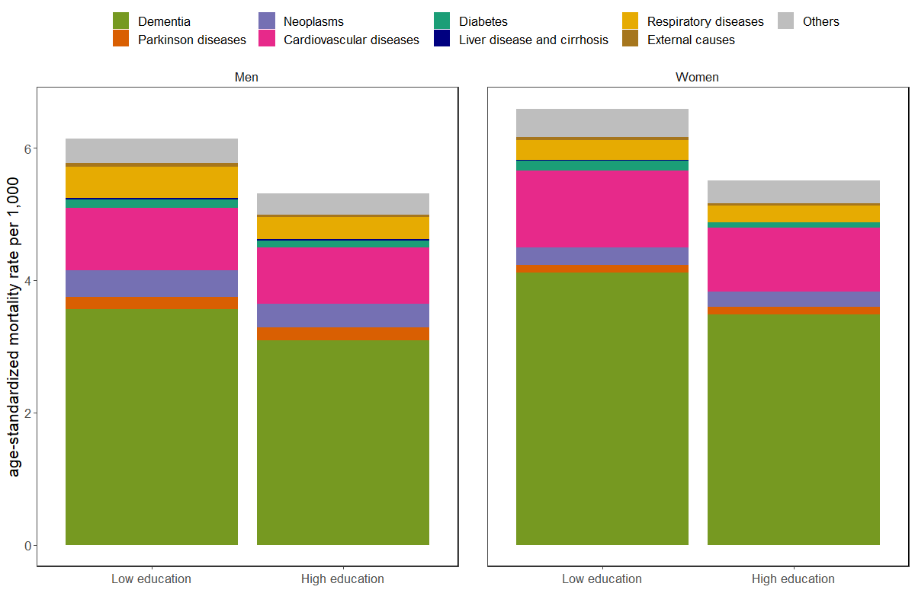
Distribution of the underlying cause of death among deaths with dementia mentioned anywhere on death certificate. 60+ population, Spain (2016-2017)
7%
4%
4%
17%
2%
63%
7%
5%
18%
4%
2%
62%
6%
8%
15%
7%
3%
58%
7%
7%
7%
15%
3%
8%
6%
6%
16%
7%
4%
58%
6%
4%
17%
4%
2%
<
62%
6%
4%
4%
17%
2%
63%
6%
6%
7%
15%
4%
59%
Source: Elaborated based on mortality information from the Instituto Nacional de Estadística (2023)

Slide 12
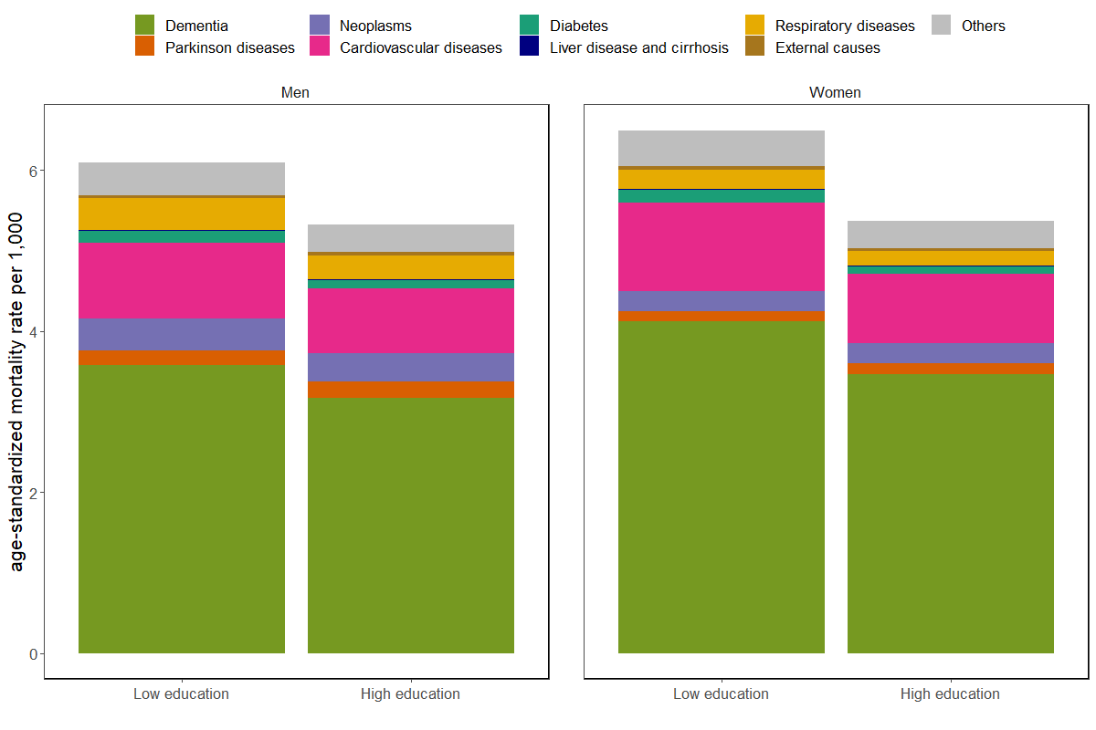
Distribution of the underlying cause of death among deaths with dementia mentioned anywhere on death certificate. 60+ population, Spain (2018-2019)
7%
4%
17%
4%
2%
64%
7%
6%
15%
7%
3%
59%
6%
6%
15%
7%
4%
59%
6%
4%
16%
4%
3%
<
65%
Source: Elaborated based on mortality information from the Instituto Nacional de Estadística (2023)

Slide 13
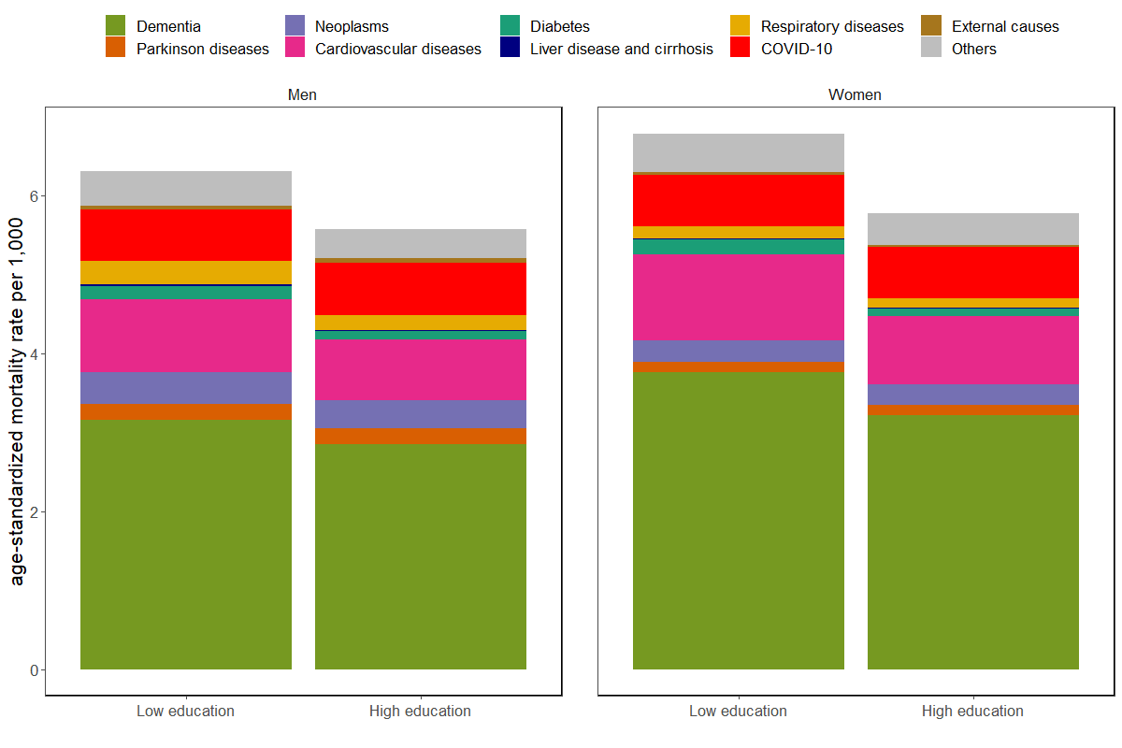
Distribution of the underlying cause of death among deaths with dementia mentioned anywhere on death certificate. 60+ population, Spain (2020-2021)
7%
9%
2%
17%
4%
2%
56%
7%
10%
5%
15%
6%
3%
50%
7%
11%
2%
15%
5%
2%
<
56%
7%
12%
4%
14%
6%
4%
51%
Source: Elaborated based on mortality information from the Instituto Nacional de Estadística (2023)

Slide 14
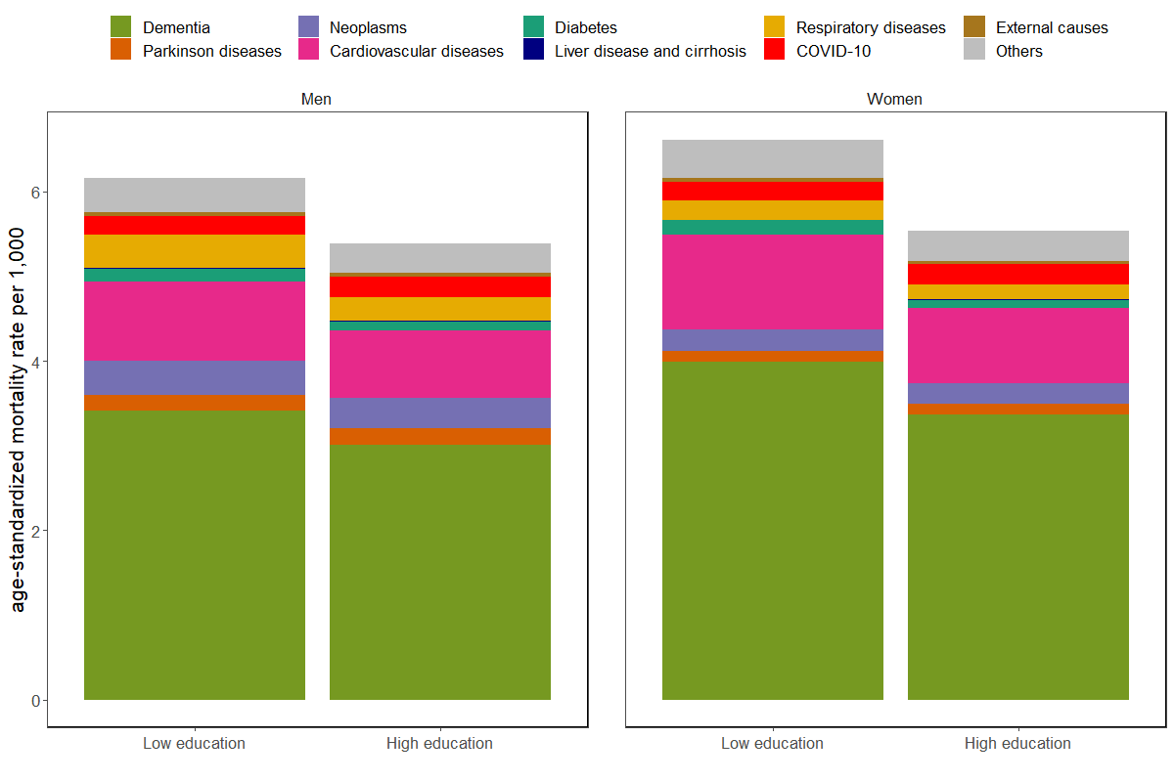
Distribution of the underlying cause of death among deaths with dementia mentioned anywhere on death certificate. 60+ population, Spain (2016-2021)
7%
3%
3%
17%
4%
2%
60%
7%
4%
6%
15%
7%
3%
55%
6%
5%
5%
15%
7%
4%
56%
7%
4%
3%
16%
4%
2%
<
61%
Source: Elaborated based on mortality information from the Instituto Nacional de Estadística (2023)

Slide 15
Main results. Decomposition of LE.
Life expectancy at age 60 – Spain (2016-2021)
 | Men | Women
Total | 23.02 | 27.39
High education | 24.17 | 28.59
Low education | 22.57 | 27.43
Educational gap (high – low) | 1.61 | 1.16
J Spijker et al twitter: @popageing

Slide 16
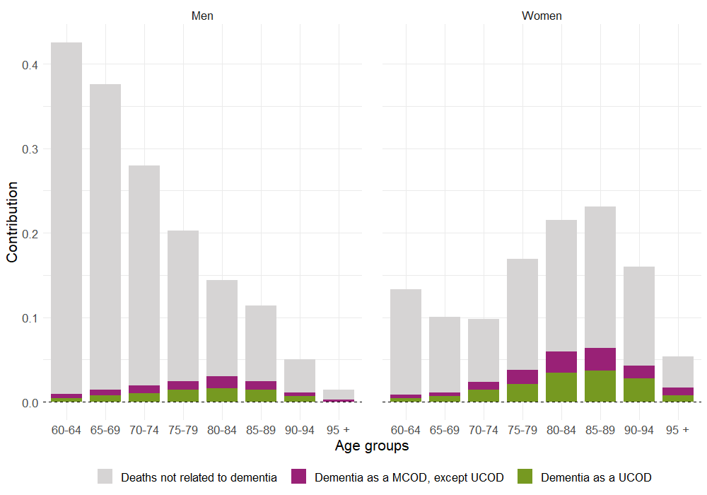
Dementia contribution to the educational gap in life expectancy at age 60
Spain (2016-2021)
Source: Elaborated based on mortality information from the Instituto Nacional de Estadística (2023)

Slide 17
Summary of results (2016-21 period)
Dementia-related mortality based on MCOD is 45% (men) and 40% (women) higher than when only the UCOD is used.
17% of mortality among the 60+ is dementia-related. Men: 12%, women 21%), but there are no educational differences in terms of relative proportions.
Causes of death closely linked to dementia include circulatory system diseases (15% of male/17% of female deaths had dementia as contributing cause), cancer (7%/4%) and respiratory system diseases (6%/4%).
The contribution of dementia-related mortality to the 1.6 (male) and 1.2 (female) year educational gap in life expectancy is 8% (men) and 23% (women) (up to 31% in the case of 90+ year-old women).
J Spijker et al twitter: @popageing

Slide 18
Summary of results – effect of COVID (2020-21)
Dementia-related mortality based on MCOD is 50% (men) and 44% (women) higher than when only the UCOD is used.
16% of mortality among the 60+ is dementia-related. Men: 12%, women 20%), but there are no educational differences in terms of relative proportions.
Causes of death closely linked to dementia include circulatory system diseases (15% of male/15% of female deaths had dementia as contributing cause), COVID (11%/10%) cancer (6%/4%) and respiratory system diseases (5%/2%).
The contribution of dementia-related mortality to the 1.6 (male) and 1.2 (female) year educational gap in life expectancy is 8% (men) and 21% (women) (up to 34% in the case of 90+ year-old women).
J Spijker et al twitter: @popageing

Slide 19
Discussion
Analysing all causes that mention dementia on the death certificate provides a more realistic estimate of the real impact of dementia on total mortality and life expectancy.
It also allows the researcher to study the diseases that are associated with dementia.
The MCOD approach is therefore a valuable tool to gain insights into the burden of ageing-related diseases.
We found few educational differences in dementia
COVID also did not alter ASMR from dementia when MCOD was considered, otherwise rate would have been slightly lower.
Our study was cross-sectional, so what about future trends?
According to Doblhammer et al (2015), trends in medical, lifestyle, and societal risk factors of dementia may have contributed to observed declines in prevalence and incidence in dementia in Germany. Should we be cautiously optimistic? But we need to die of something, right?
J Spijker et al twitter: @popageing

Slide 20
References
Australian Bureau of Statistics (ABS) (2013). Causes of Death, Australia, 2011. Available from: http://www.abs.gov.au/AUSSTATS/abs@.nsf/DetailsPage/3303.02011?OpenDocument.
Désesquelles A, Demuru E, Salvatore MA, et al. Mortality from Alzheimer’s disease, Parkinson’s disease, and dementias in France and Italy: a comparison using the multiple cause-of-death approach. J Aging Health. 2014;26(2):283-315.
Doblhammer G, Fink A, Zylla S, Willekens F (2015). Compression or expansion of dementia in Germany? An observational study of short-term trends in incidence and death rates of dementia between 2006/07 and 2009/10 based on German health insurance data. Alzheimer's research & therapy, 7(1), 1-11.
GBD 2013 Mortality and Causes of Death Collaborators (2015). Global, regional, and national age–sex specific all-cause and cause-specific mortality for 240 causes of death, 1990–2013: a systematic analysis for the Global Burden of Disease Study 2013. Lancet, 385, 117-171.
Horiuchi S., Wilmoth J.R., Pletcher S.D. (2008). A decomposition method based on a model of continuous change. Demography, 45(4), 785-801.
INE. Death statistics according to cause of death. Methodology (2020) Madrid: INE (Instituto Nacional de Estadistica). https://www.ine.es/en/daco/daco42/sanitarias/metodologia_00_en.pdf
INE. Asignación de nivel educativo, relación con la actividad laboral y ocupación a ficheros de Movimiento Natural de la Población (MNP). Método de obtención y advertencias a usuarios (2020). Madrid, Spain: INE (Spanish National Statistics Institute). https://www.ine.es/metodologia/t20/Nota_meto_MNP.pdf
Olshansky SJ, Ault AB (1986). The fourth stage of the epidemiologic transition: The age of delayed degenerative diseases. The Milbank Memorial Fund Quarterly. 1986;64(3):353-91
Spijker J, Trias-Llimós S (2023), Cause-specific mortality in Spain before and during the pandemic: educational differences and its impact on life expectancy using multiple causes of death data. European Journal of Public Health, ckad036, https://doi.org/10.1093/eurpub/ckad036
Trias-Llimós S, Spijker J (2022). Educational differences in alcohol-related mortality and their impact on life expectancy and lifespan variation in Spain (2016–2018): a cross-sectional analysis using multiple causes of death. BMJ Open, 12:e053205. https://doi.org/10.1136/bmjopen-2021-053205
Tsai S.P., Lee E.S., Hardy R.J. (1978). The effect of a reduction in leading causes of death: potential gains in life expectancy. American Journal of Public Health, 68(10), 966-971.
J Spijker et al twitter: @popageing

Slide 21
Acknowledgements
This work was supported by the research project “The health of people in advanced ages: the analysis of comorbidity, multiple causes of death and gender and socioeconomic inequalities in health (COMORHEALTHSES)” (PI: JS, Co-PI: ER), funded by the Spanish Ministry of Science and Innovation (PID2020-113934RB-I00). ER and STL also acknowledge research funding from the same Ministry (RYC2021-033123-I; RYC-2017-22586) and JA and JS from the European Research Council (ERC-2019-COGagreement No 864616, HEALIN). Funding also comes from the Catalan Government under the CERCA programme.
J Spijker et al twitter: @popageing

Slide 22
You want to know more about what we do on MCOD ?
R&D project on “The health of people in advanced ages: the analysis of comorbidity, multiple causes of death and gender and socioeconomic inequalities in health (COMORHEALTHSES)”* (PI: JS, Co-PI: ER).
Objective 2: To provide an accurate estimate of recent trends in old-age mortality from ageing-related diseases based on multiple cause of death data
Trias-Llimós S et al (2023). Frailty at death: An examination of multiple causes of death in four low mortality countries. Demographic Research 49(2):13-30. https://doi.org/doi:10.4054/DemRes.2023.49.2
Trias-Llimós S, Permanyer I (2023). Cause-of-Death diversity from a Multiple-Cause Perspective in the United States. Demography 60(1):73-98. https://doi.org/doi:10.1215/00703370-10410415
Trias-Llimós S, Spijker J (2022), Educational differences in alcohol-related mortality and their impact on life expectancy and lifespan variation in Spain (2016–2018): a cross-sectional analysis using multiple causes of death. BMJ Open, 12:e053205. https://doi.org/10.1136/bmjopen-2021-053205
Spijker J, Trias-Llimós S (2023), Cause-specific mortality in Spain before and during the pandemic: educational differences and its impact on life expectancy using multiple causes of death data. European Journal of Public Health, 33(3):543-549, https://doi.org/10.1093/eurpub/ckad036
* funded by the Spanish Ministry of Science and Innovation (PID2020-113934RB-I00).
J Spijker et al twitter: @popageing

Slide 23
Thank you!
^{Jeroen Spijker}
^{Elisenda Renteria}
^{Julia Almeida}
^{Sergi Trias-Llimós}
^{Gabriele Doblhammer}
^{Email: jspijker@ced.uab.es}
^{Twitter @popageing}

Slide 24
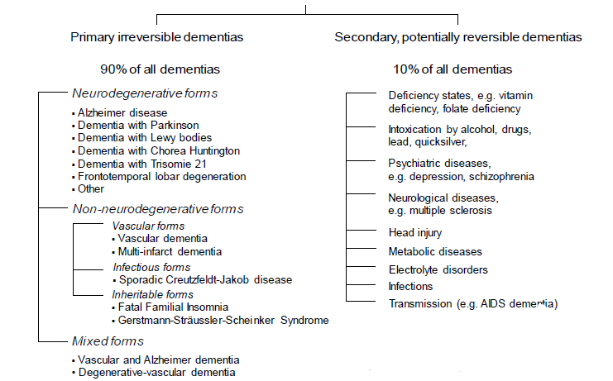
What are dementias?
Alzheimer’s disease (AD) is the most
common form of dementia, accounting
for 50–70% of cases.
* Source: Doblhammer et al. 2017; Winbladt et al. 2016

Slide 25
Descriptive results
ASMR of total mortality and from dementia. Per 1,000.
Population aged 60+. Spain (2020-21)
 | Men |  |  | Women
 | Total | High | Low | Total | High | Low
Total Mortality | 51.1 | 43.9 | 50.0 | 33.6 | 29.2 | 33.6
UCOD Dementia | 3.1 | 2.8 | 3.2 | 3.8 | 3.2 | 3.8
MCOD Dementia (incl. UCOD Dementia) | 6.2 | 5.6 | 6.3 | 6.8 | 5.8 | 6.8
 | Men |  |  | Women
 | Total | High | Low | Total | High | Low
Total Mortality | 100% | 100% | 100% | 100% | 100% | 100%
UCOD Dementia | 6% | 6% | 6% | 11% | 11% | 11%
MCOD Dementia (incl. UCOD Dementia) | 12% | 12% | 12% | 20% | 20% | 20%
J Spijker et al twitter: @popageing

Slide 26
Main results
Life expectancy at age 60 – Spain (2016-2017)
 | Men | Women
Total | 23.09 | 27.44
High education | 24.35 | 28.74
Low education | 22.83 | 27.65
Educational gap (high – low) | 1.52 | 1.10
J Spijker et al twitter: @popageing

Slide 27
Main results
Life expectancy at age 60 – Spain (2018-2019)
 | Men | Women
Total | 23.33 | 27.65
High education | 24.51 | 28.89
Low education | 22.83 | 27.66
Educational gap (high – low) | 1.68 | 1.23
J Spijker et al twitter: @popageing

Slide 28
Main results
Life expectancy at age 60 – Spain (2020-2021)
 | Men | Women
Total | 22.62 | 27.08
High education | 23.66 | 28.14
Low education | 22.03 | 26.99
Educational gap (high – low) | 1.62 | 1.15
J Spijker et al twitter: @popageing

Slide 29
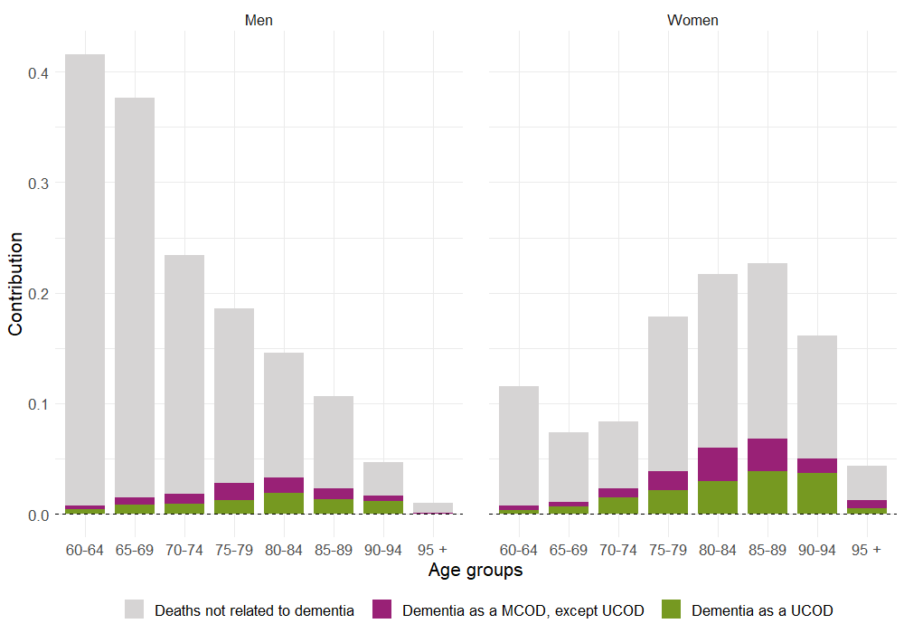
Dementia contribution to the educational gap in life expectancy at age 60
Spain (2016-2017)
Source: Elaborated based on mortality information from the Instituto Nacional de Estadística (2023)

Slide 30
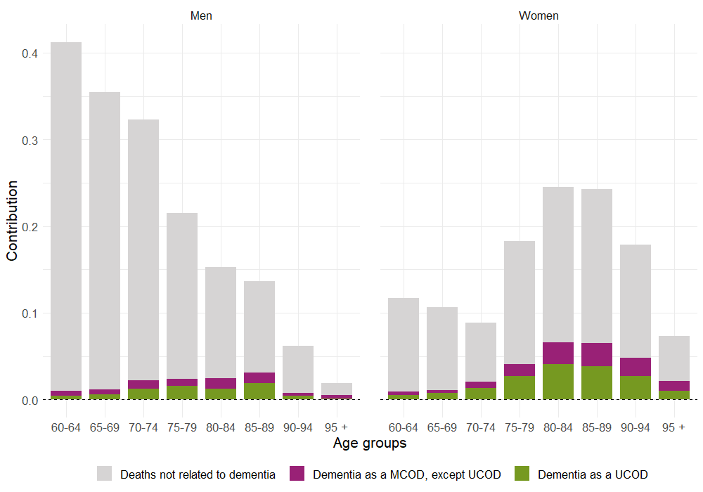
Dementia contribution to the educational gap in life expectancy at age 60
Spain (2018-2019)
Source: Elaborated based on mortality information from the Instituto Nacional de Estadística (2023)

Slide 31
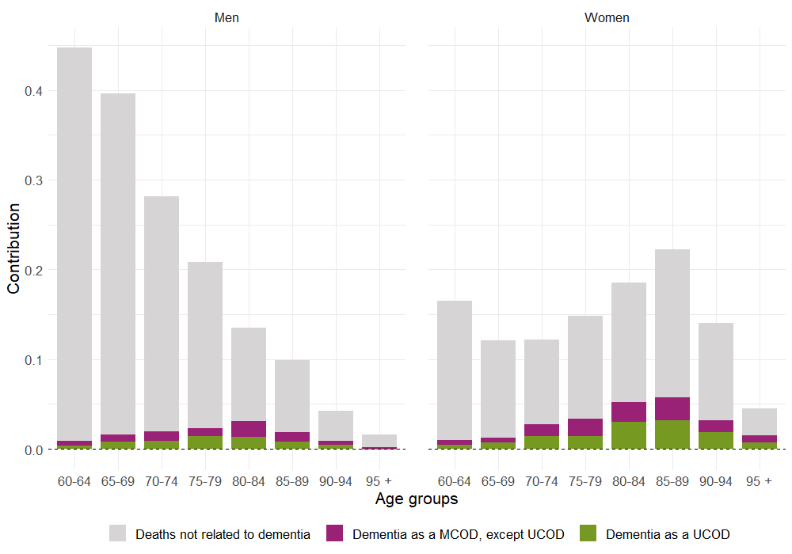
Dementia contribution to the educational gap in life expectancy at age 60
Spain (2020-2021)
Source: Elaborated based on mortality information from the Instituto Nacional de Estadística (2023)

