Slide 1
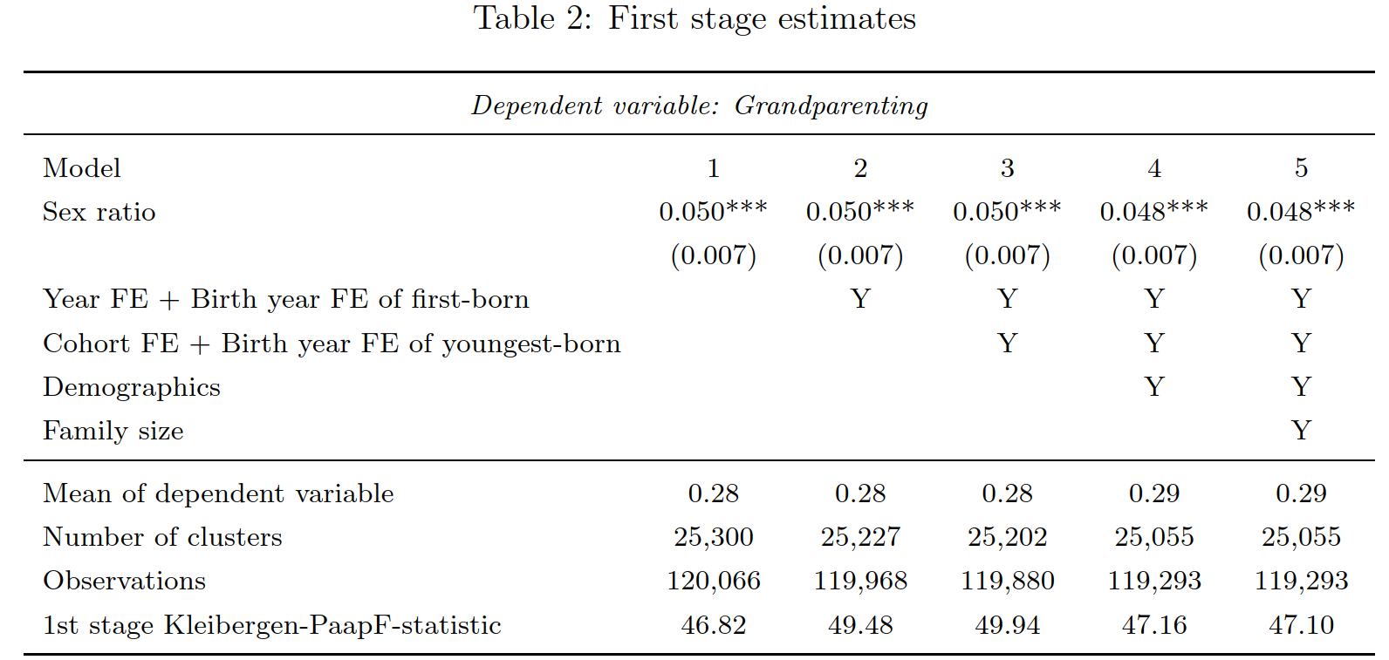
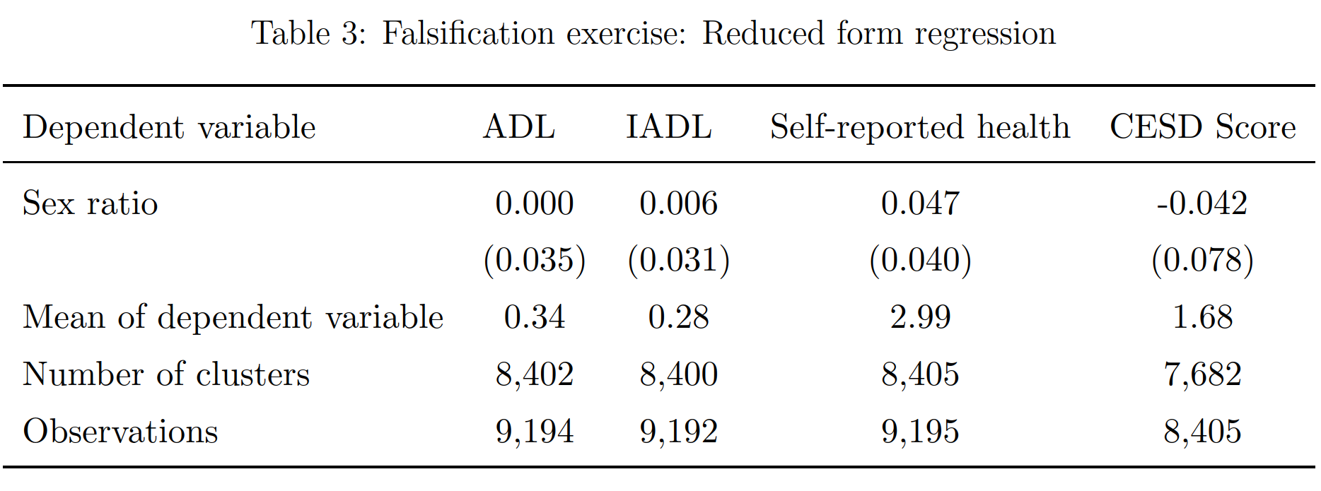
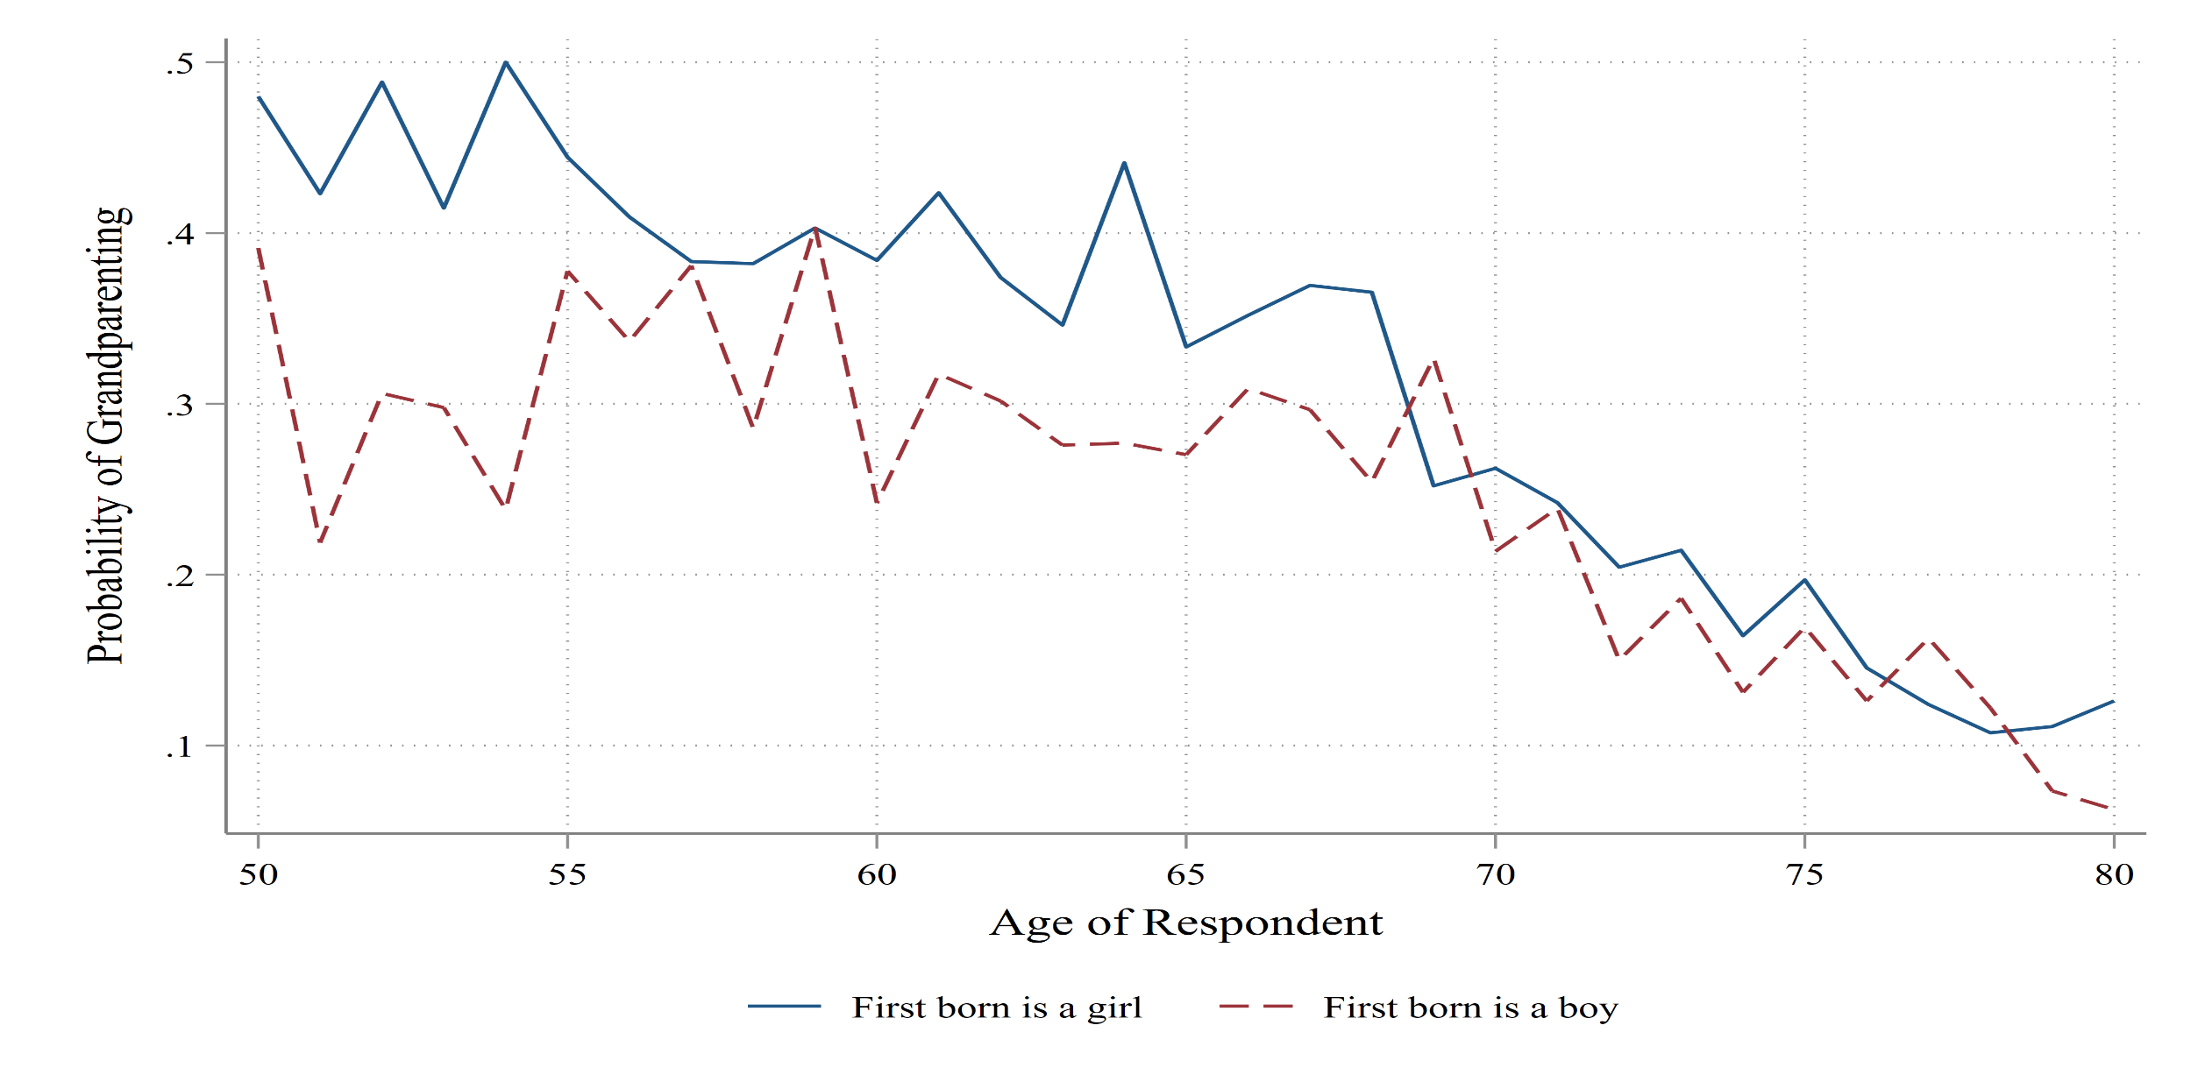
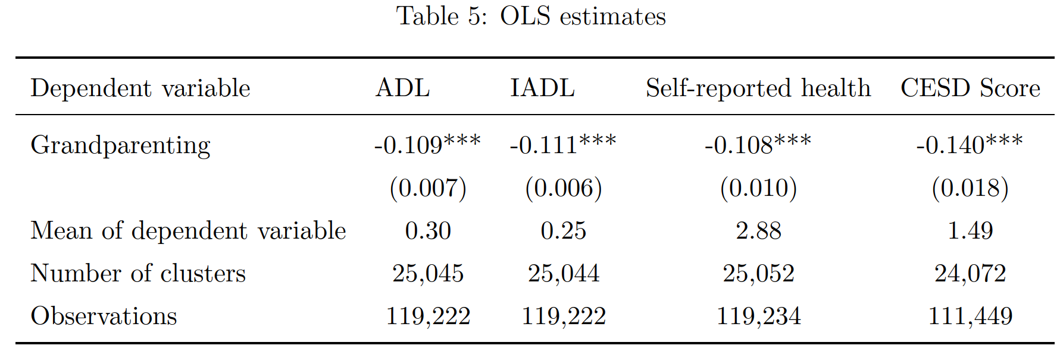
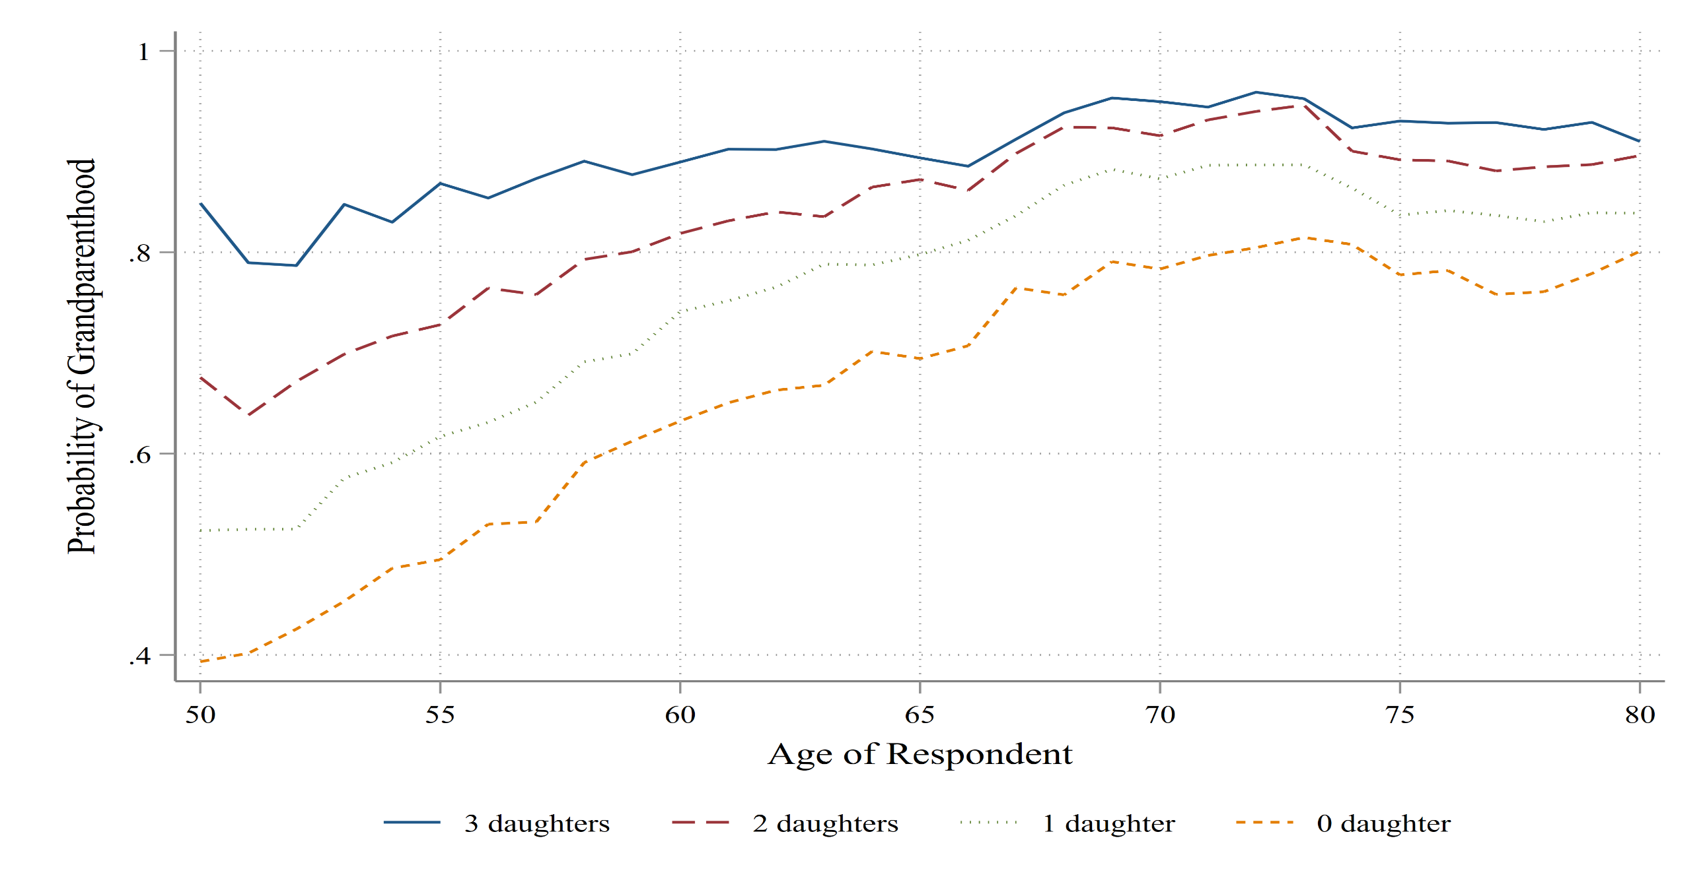
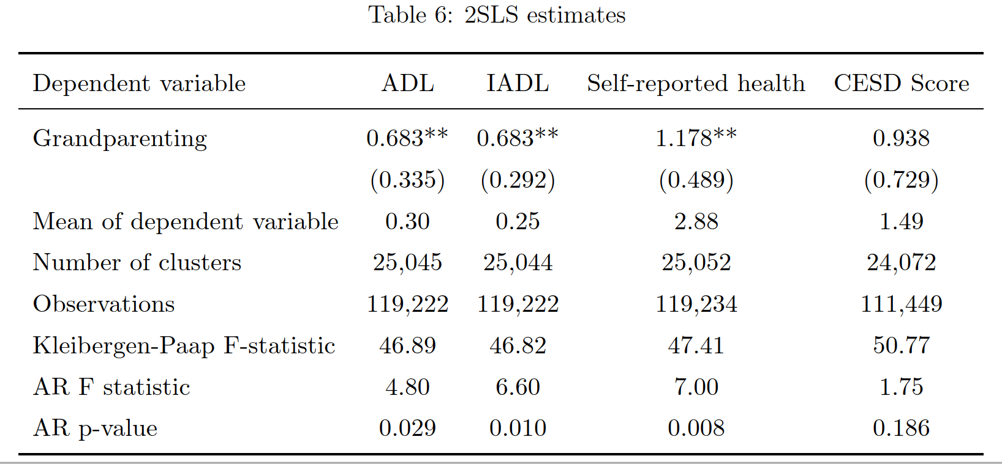
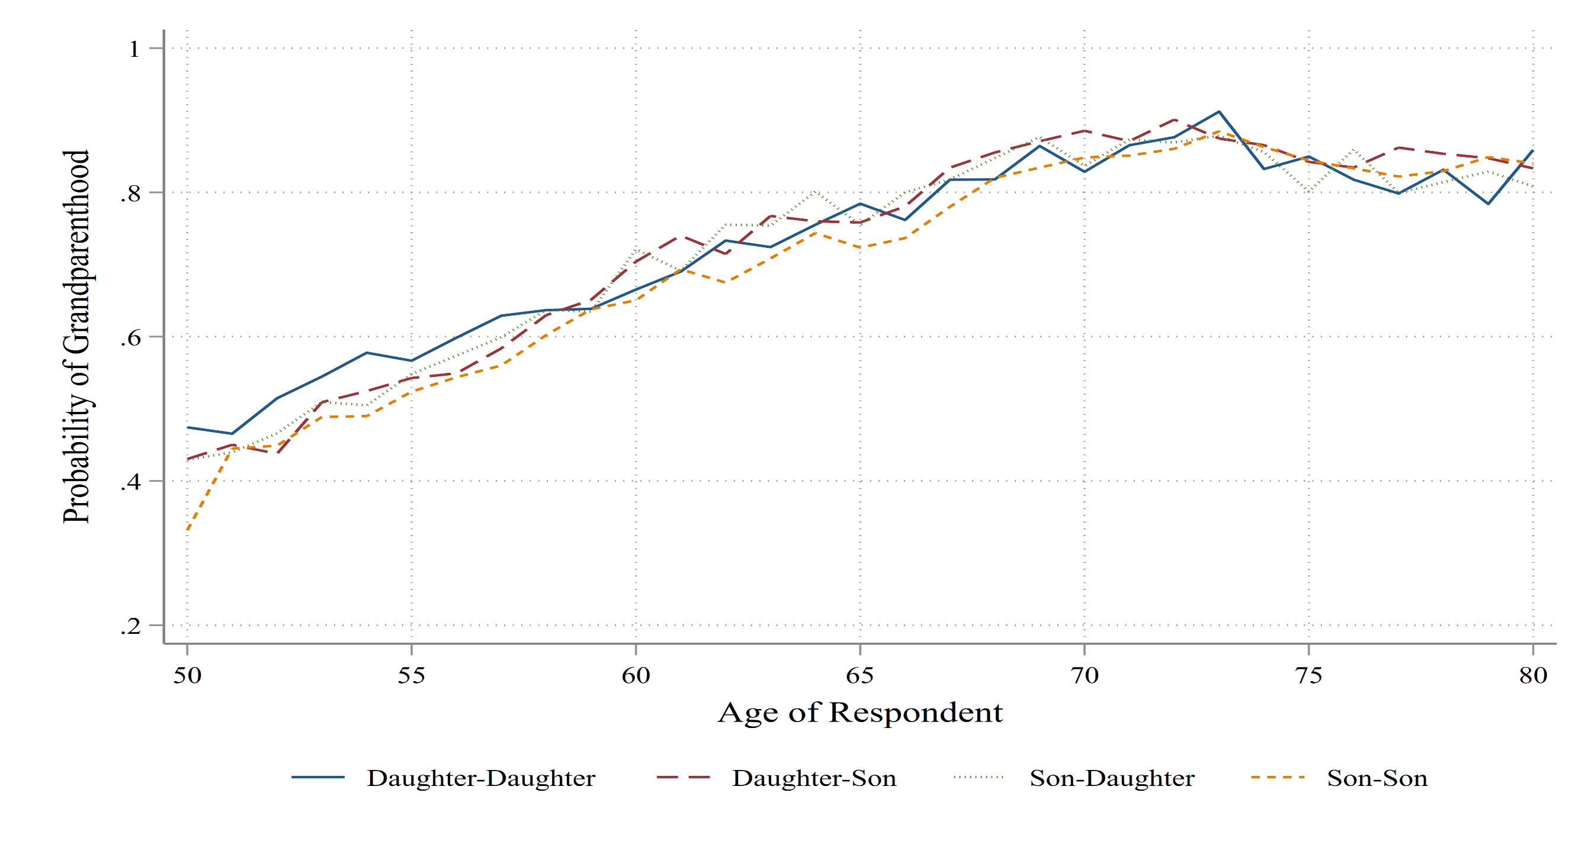
Are the Grandparents Alright? Health consequences of grandparental childcare provision
Peter Eibich, PSL Université Paris Dauphine and Xianhua Zai, MPIDR @EmmaXianhua_Zai
Motivation
Empirical strategy
Grandparents matter!
4.8 million children <5 received care from their grandparents in the US in 2011
40% of the grandparents in the UK look after their grandchildren regularly
21% of EU children <3 received care from “other” sources in 2020
Grandparenting is beneficial for mothers’ labor force participation
How does childcare provision affect grandparents themselves?
Active ageing
Burden of caregiving
Instrument: $sex ratio=\frac{number of daughters}{number of children}$
Exploits variation in grandparenting due to gender composition
Uses more variation than the first-born instrument
Avoids endogeneity of family size
Relevance of the instrument
In a nutshell
Research question: How does caring for grandchildren affect grandparents’ health?
Data: Health and Retirement Study (HRS), 1996-2014; Aged 50-80 with at least one child
Methods: IV using children’s sex ratio as an instrument
Outcomes: ADL, IADL, self reported health, and depression
Results: Grandparenting does not improve grandparents’ health. Evidence for some negative effects
Validity of the instrument
Stylized facts about grandparenthood
#1 Women tend to give birth earlier than men (Margolis and Vedery, 2019)
Parents of daughters transition to grandparenthood earlier
→ Gender of the first-born child as an instrument for grandparenthood (Rupert and Zanella, 2018)
OLS estimates
#2 Parents with larger families are more likely to become grandparents
IV estimates
#3 Parents of daughters transition to grandparenthood/grandparenting earlier, regardless of birth order
Conclusions
OLS estimates are upward biased:
Healthier older adults are more likely to become grandparents
Health is an important precondition for childcare provision
Sex ratio as a novel instrumental variable:
Gender composition of children is as good as random
Parents of daughters become grandparents earlier and invest more
IV estimates show negative effects on ADLs/IADLs and self-reported health
→ Grandparenting is not beneficial and might even be detrimental for grandparents’ health!

