Slide 1
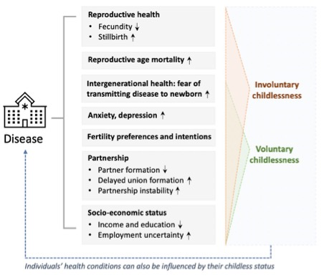
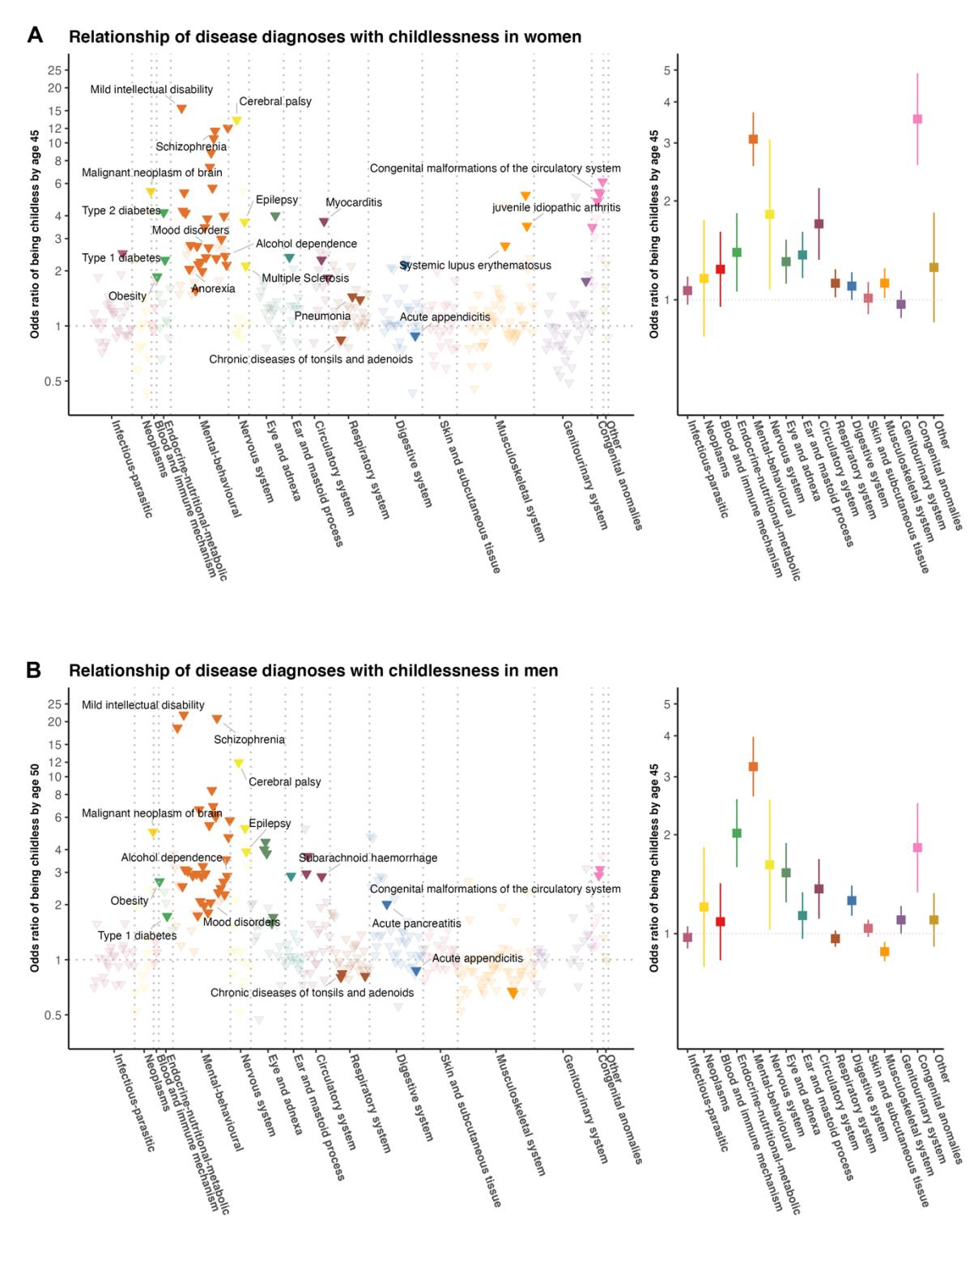
The relationship of major diseases with childlessness:
A sibling matched case-control and population register study in Finland and Sweden
Aoxing Liu, Evelina Akimova, Xuejie Ding, Sakari Jukarainen, Pekka Vartiainen, Tuomo Kiiskinen, Sara Kuitunen,
Aki S Havulinna, Mika Gissler, Stefano Lombardi, Tove Fall, Melinda C Mills, Andrea Ganna
Objectives
Approximately 20% of men and 15% of women remain childless at the end of their reproductive lifespan, with childlessness increasing over time, yet we lack a comprehensive understanding of the role and relative importance of diseases associated with childlessness, particularly among men.
Findings
Mental-behavioral, congenital anomalies, and endocrine-nutritional-metabolic disorders had the strongest associations with childlessness.
Novel associations were discovered with inflammatory (eg. myocarditis) and autoimmune diseases (eg. juvenile idiopathic arthritis).
For most diseases, the associations were mediated by singlehood, especially in men.
Background
Conclusion
We provide evidence that disease burden across multiple domains is associated with childlessness, identifying modifiable mental-behavioral disorders and novel autoimmune and inflammatory diseases.
Figure 1. Relationship of 403 disease diagnoses with childlessness by age 45 (women) and age 50 (men) in 71,524 full-sister and 77,622 full-brother pairs
Data and Methods
We examined all individuals born in Finland (n=1,035,928) and Sweden (n=1,509,092) between 1956 and 1968 (men) or 1956 and 1973 (women) and followed them up until the end of 2018. Socio-demographic, health, and reproductive information was obtained from nationwide registers. We used a matched pair case-control design based on full-sisters and full-brothers who were discordant for childlessness.
Acknowledgements
This research has benefited from funding from the Leverhulme Trust Large Centre Grant, the European Research Council Advanced Grants 835079 and 945733
@akimova_eva
evelina.akimova@demography.ox.ac.uk
Preprint available here: https://www.medrxiv.org/content/10.1101/2022.03.25.22272822v2
Notes:
Important info:
There are no exact size requirements for posters at PAA although they have to fit on the poster boards that are 8 feet wide by 4 feet high. Please read: https://www.populationassociation.org/paa2023/presenter-information/guidelines-for-poster-presenters
This poster is A0 landscape (118.9 x 84.1 cm) and we recommend using these dimensions as this is a standard printing size
You are responsible for creating, ordering, and transporting your posters. Suggested printers are 1) University Print Studio https://estates.admin.ox.ac.uk/place-your-order-online 2) University of Oxford Department of Physics printing https://www.physics.ox.ac.uk/about-us/our-facilities-and-services/media-services 3) FedEx Office Print & Ship Center at PAA conference hotel https://local.fedex.com/en-us/la/new-orleans/office-5008
Notes:
- Bold Headline and sub headfis Helvetica Neue Bold Extra Black Condensed. If this Font is NOT available, Helvetica Bold Condensed or a similar Arial may be substituted.
- When designing, try to allow consistent/equal spacing between items. (an easy, cheat way it to make a text box and use it as a tool to create accurate spacing top to bottom between items, as well as for alignment).
- Left align all items in columns.
- Head, subhead, body text, bulleted list styles are all provided.
- If heading needs to take 2 lines, reduce the point size and then decrease the space between lines until it is tight and fits correctly.
- Image boxes should align as seen left and right with text and not extend the column with if possible.

