Slide 1
Wiktoria Wróblewska
Institute of Statistics and Demography, Warsaw School of Economics
Childbearing intentions
and the health of women of reproductive age
HEALTH, MORBIDITY, AND MORTALITY WORKING GROUP EAPS
Bilbao, September 25–27, 2024

Slide 2
Aim & Data & Method
Do health problems limit women’s childbearing intentions?
The aim of this study is to investigate the significance of women’s health in their short-term childbearing intentions
The Generations and Gender Survey in the Czech Republic (2020/2022), Croatia (2023) and Finland (2021/2022) (GGS-II)
The study sample: Women aged 20-44 at the time of the interview
Logistic regression: analysis to verify effects of health on intention to have a child
Dependent variable: (A negative) intention to have a child in the next three years i.e. (Probably) NOT intending to have a child in the next three years versus (probably) intending a(nother) child
Explanatory variables – health indicators:
Self-rated health (Poorer than good/ Very good or Good)
Health-related limitations on daily (Severely limited/Limited, but not severely/Not limited)
Control variables: Age, Parity, Marital status, Importance of religion, Activity status and education

Slide 3
Results

Slide 4
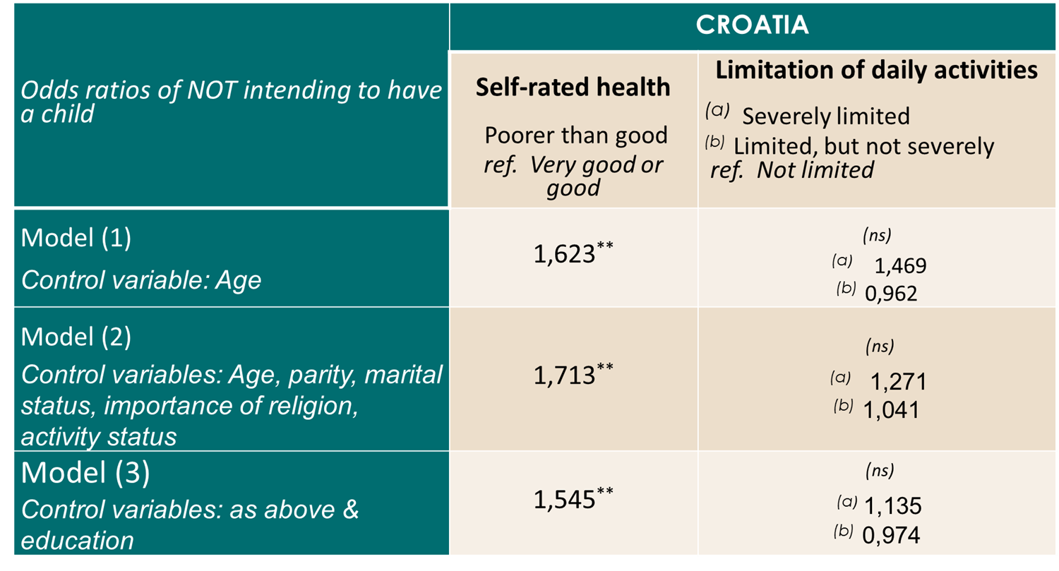
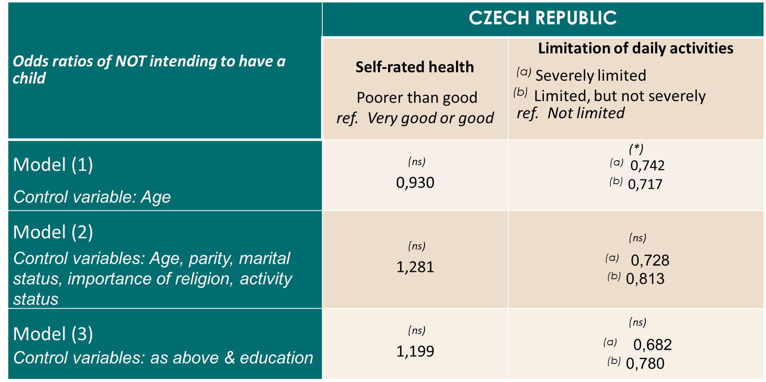
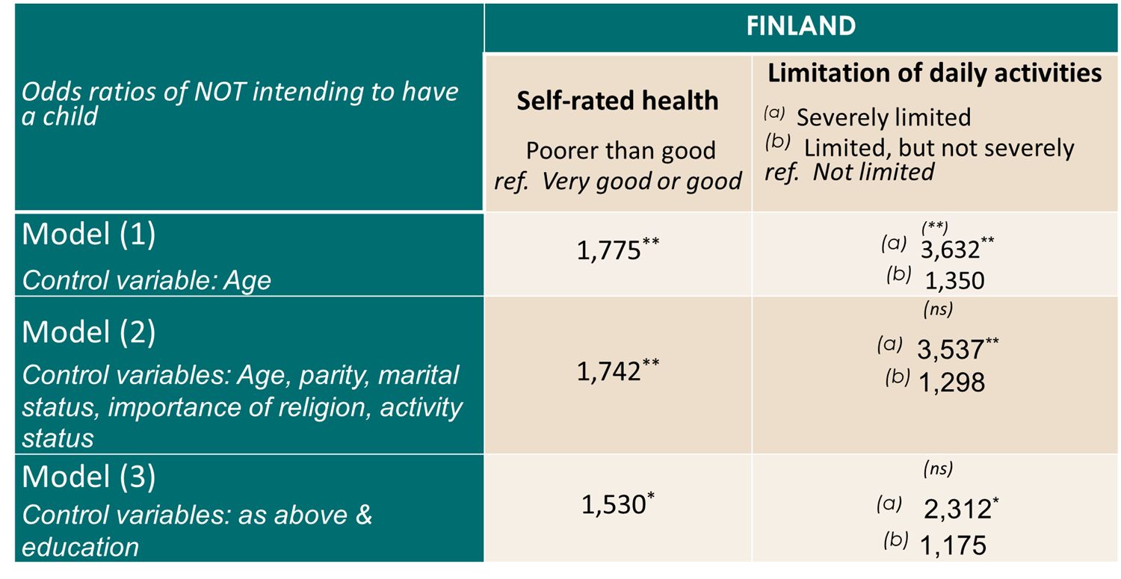
Results

Slide 5
Conclusions
Health matters, particularly a subjective evaluation of general health, remained significant when other individual characteristics were controlled for.
The results vary from country to country. In Croatia, self-reported health status was significant, and in Finland also GALI. However, in the Czech Republic, these physical health indicators were not significant.
This result raises the question, if there are other factors, that compensate for the negative impact of health limitations on childbearing intentions in this country?
The next steps of our work are:
research involving other countries
investigating the role of mental health.
Poor self-rated health limits women’s childbearing intentions!
Thank you for your attention!
wwrobl@sgh.waw.pl
Notes:
It is not only about a lack of symptoms, but about whether a person feels fit for various activities and life choices.

