Slide 1
The ripples of loss: Estimating the bereaved population due to conflict deaths and enforced disappearances in Colombia
Enrique Acosta†, Diego Alburez-Gutiérrez†, Maria Gargiulo, and Catalina Torres
HMMWG 2024
Work, love, and death
Bilbao, Sep 26, 2024

Slide 2
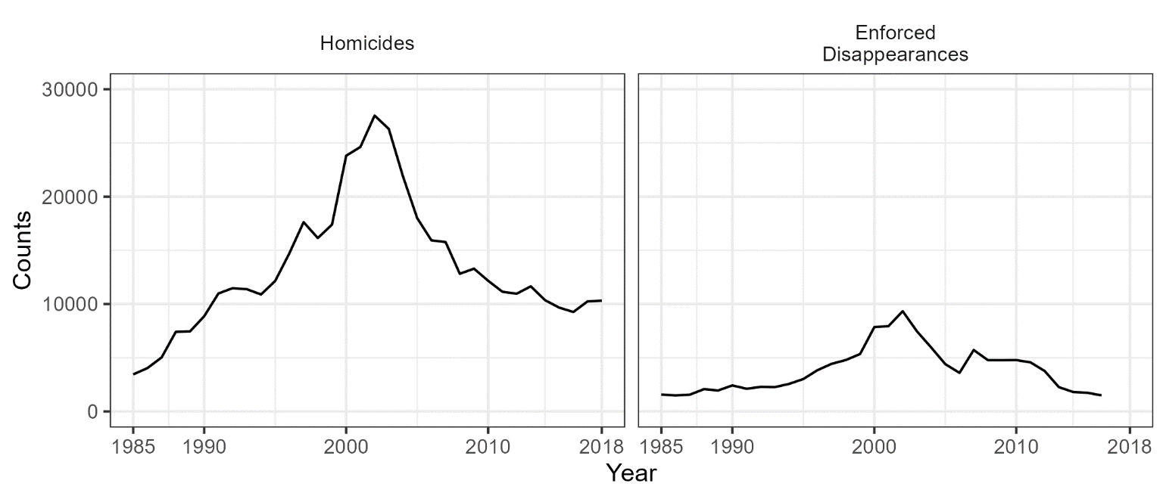
Background: Colombian conflict
Started in the early 1960s: One of the longest armed conflicts in Latin America
Political conflict in the context of the cold war, confronting guerrillas, paramilitary, and state agents (police and army)
Strong escalation since the 1980s, due to drug trafficking resources
1985-2018: Records of more than 450K homicides, 100K enforced disappearances, 8 million internally displaced persons, among many other HRs violations
Two critical periods
War with drug cartels (around 1990)
Expansion of Paramilitary groups and Guerrilla (around 2000)
Two inflection points for de-escalation
Negotiation with AUC (largest paramilitary group) in 2002-2006
Negotiation with FARC-EP (largest guerrilla) in 2011-2016

Slide 3
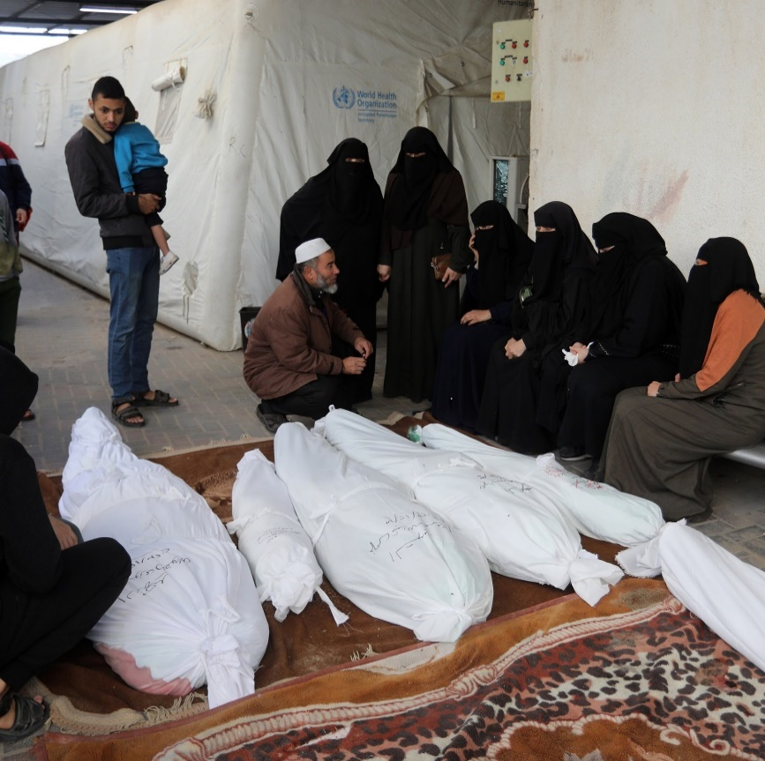
Background
Most analyses on demography on conflict
Focus on those who were killed
Number of fatal victims
Effect on life loss (changes in life expectancy, years of life lost, lifespan inequalities, etc.)
Less attention on those who survive the conflict, bereave those losses, and endure the consequences
Three characteristics of bereavement:
Multiplicative; one loss causes multiple bereavements
Accumulates over the life course in prolonged conflicts
Lingering effects after the end of conflicts

Slide 4
Background
Effects of conflict-related bereavement at individual and population levels in at least three dimensions
Emotional: It relates to traumatic experiences, not only the experience of loss but also the violence implied in that loss
Political and social: The greater the level of bereavement inflicted on a population, the greater the risk of radicalization and efforts necessary for reconciliation in the future
Material: Considerable reduction in care and economic support, which can be critical for young offspring and old parents

Slide 5
Background
Previous work proposing methods for estimating the prevalence of bereavement events from conflict deaths, and their dynamics over time
Estimation of bereavement events (≠ bereaved persons)
1 person can suffer multiple loses
Innovation here:
New method for obtaining bereaved persons
Accounts for family overlapping
Allows us to identify segments of the population with strong implications at emotional, material and political dimensions
Accounting for enforced disappearances, in addition to homicides

Slide 6
Aim
Propose and apply a set of methods that allow us to estimate the bereaved population from conflict in Colombia, according to its potential to:
Develop psychological trauma and other disorders
Carry and reproduce collective memory
Suffer loss of support in critical life stages
Questions:
How many people in Colombia, as of 2018, had experienced during their life course the conflict loss of:
members of the nuclear family? (trauma)
members of the extended family? (memory)
sources of support during critical age stages? (support)

Slide 7
Data
Databases from the Comisión de la verdad (Truth commission) final report (1985 - 2018) – Colombian peace process
Record linkage across 34 databases
Information on date of death/disappearance, age (5y), gender, place
Homicides related to conflict: 454,842 persons
Enforced disappearances related to conflict: 124,021 persons
WPP 2024 data by gender and single-year age (1950-2018)
Population exposures
All-cause mortality rates
Fertility rates

Slide 8
Analytical strategy
Estimation of homicides and disappearances completness
Estimation of kinship structures
Estimation of conflict bereavement events over time
Estimation of bereaved population in 2018, by loss type (extended and nuclear family, and critical ages)

Slide 9
1. Homicides and disappearances completeness
Example of linked homicides data
Multiple estimation systems (MES)
A generalization of capture-recapture methods
Estimation of unregistered deaths and disappearances, based on the registration patterns across databases

Slide 10
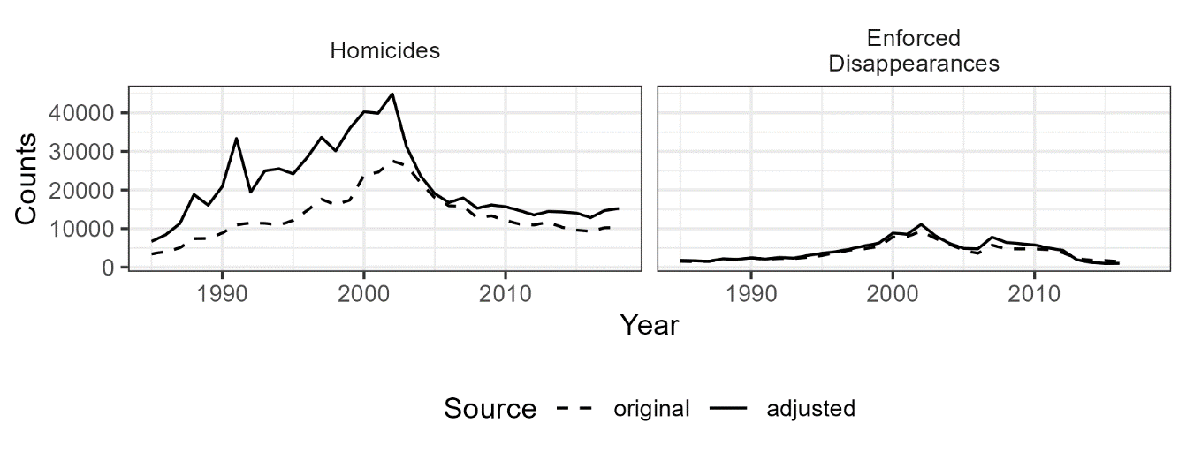
1. Homicides and disappearances completeness
 | Original | Estimate | Under abs | Under (%)
Homicides | 454,842 | 732,744 | 277,902 | 38%
Disappearances | 124,021 | 139,227 | 15,206 | 11%

Slide 11
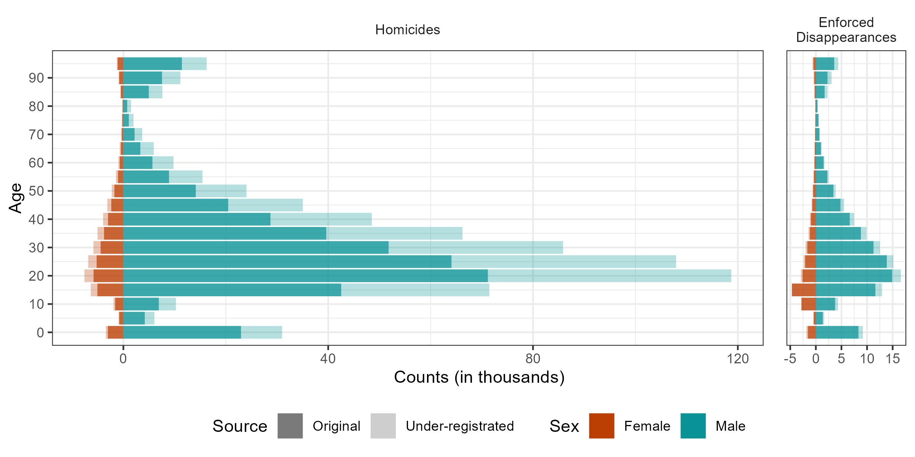
1. Homicides and disappearances completeness

Slide 12
2. Kinship structures
Year | Sex | Age | Kin | Age kin | Living
1985 | f | 0 | Children | 0 | …
… | … | … | … | … | …
2000 | m | 19 | Mother | 40 | 0.0549
 |  |  |  | 41 | 0.0568
 |  |  |  | 42 | 0.0575
 |  |  |  | 43 | 0.0570
 |  |  |  | 44 | 0.0554
 |  |  |  | 45 | 0.0526
 |  |  |  | 46 | 0.0492
 |  |  |  | 47 | 0.0456
 |  |  |  | 48 | 0.0418
 |  |  |  | 49 | 0.0379
 |  |  |  | 50 | 0.0344
 |  |  |  | 51 | 0.0314
 |  |  |  | 52 | 0.0288
 |  |  |  | 53 | 0.0265
 |  |  |  | 54 | 0.0243
 |  |  |  | 55 | 0.0219
… | … | … | … | … | …
2018 | f | 100 | Aunts | 100 | …
Using demographic kinship models
Goodman et al. (1974), Caswell & Song (2021)
DemoKin package (Williams et al. 2023)
Input: Annual gender- and age-specific rates on fertility and mortality
Output: Average number of living relatives by gender and age, for each ego person by gender and age

Slide 13
3. Conflict bereavement events
Here, we assume that the ego dies or disappear, and the relatives bereave him/her
Year | Sex | Age | Kin | Age kin | Living (n) | $×$ conflict deaths | = Bereav. Events
… | … | … | … | … | … | … | …
2000 | m | 19 | Mother | 40 | 0.0549 | $$×d_{19, m,2000}$$ | $$=b_{40,m,2000}^{m}$$
 |  |  |  | 41 | 0.0568 | $$×d_{19,m,2000}$$ | $$=b_{41,m,2000}^{m}$$
 |  |  |  | 42 | 0.0575 | $$×d_{19,m,2000}$$ | $$=b_{42,m,2000}^{m}$$
 |  |  |  | 43 | 0.0570 | $$×d_{19,m,2000}$$ | …
 |  |  |  | … | … | … | …
 |  |  |  | 52 | 0.0288 | $$×d_{19,m,2000}$$ | …
 |  |  |  | 53 | 0.0265 | $$×d_{19,m,2000}$$ | …
 |  |  |  | 54 | 0.0243 | $$×d_{19,m,2000}$$ | …
 |  |  |  | 55 | 0.0219 | $$×d_{19,m,2000}$$ | $$=b_{50,m,2000}^{m}$$
… | … | … | … | … | … | … | $$…$$
Total amount of child losses in year 2000
$$b_{2000}^{m}=\sum_{sex}{\sum_{age}{b_{y,s,2000}^{m}}}$$

Slide 14
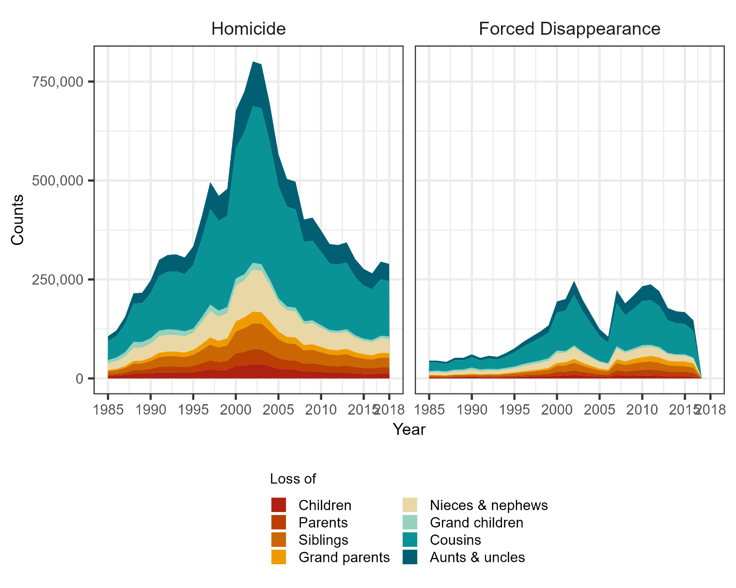
3. Conflict bereavement events over time
Extended family
Note these are not bereaved persons but events. i.e., a person losing five relatives to conflict will appear five times in the plot

Slide 15
3. Conflict bereavement events
Bereavement multiplier effect: Average bereavement events resulting from each conflict loss
 | Homicide | Enforced Disappearance
Parents | 1.45 | 1.51 | Nuclear | Extended
Children | 1.44 | 1.23
Siblings | 2.95 | 2.76
Grandparents | 1.04 | 1.33
Nieces & nephews | 5.97 | 5.15
Grandchildren | 1.77 | 1.71
Cousins | 29.16 | 26.39
Aunts & uncles | 6.62 | 6.68

Slide 16
4. Estimation of bereaved population in 2018
Change in perspective: Here, we assume that the ego losses relatives to the conflict
This change allows us to account for loss overlapping within families (e.g., a person losing several siblings)
Based on probabilities
Conflict death/disp. rates ${(m}_{x})$→ probability of death/disap. ${(q}_{x})$
Example: A male aged 42 has n sisters aged 20
The probability that each sister survives $p_{20}=1−q_{20}$
The probability that all survive $p_{s,20}^{0}={\left(p_{20}\right)}^{n}$
Probability of losing at least one sister $p_{s,20}^{>0}=1−p_{s,20}^{0}$
Bereaved persons (sisters aged 20) $p_{s,20}^{>0}×{pop}_{m,42}$

Slide 17
4. Estimation of bereaved population in 2018
Year | Sex | Age | Kin | Age kin | Living (n) | Probability of surviving
… | … | … | … | … | … | …
2000 | m | 19 | Mother | 40 | 0.0549 | $${{(p}_{2000, 40,f,2000})}^{n}$$
 |  |  |  | 41 | 0.0568 | $${{(p}_{2000, 41,f,2000})}^{n}$$
 |  |  |  | … | … | …
 |  |  |  | 54 | 0.0243 | …
 |  |  |  | 55 | 0.0219 | …
… | … | … | … | … | … | …
Probabilities of not losing a relative k to conflict in 2000, by age and sex (ego)
$$p_{k,x,s,t}^{0}=\prod_{sex kin g}{\prod_{age kin y}{{(1−q_{y,g,t})}^{n}}}$$
Losses during the life course, until 2018
Intra-cohort cumulative probability of all relatives surviving over the life course, until 2018 (by kin category)
Probability of losing at least one relative over the life course, until 2018 (by kin category)
$$p_{ k,s,2018}^{0A}=\prod_{age focal x}{p_{k,x,s,t}^{0}}$$
$$p_{ k,s,2018}^{>0A}=1−p_{ k,s,2018}^{0A}$$

Slide 18
4. Estimation of bereaved population in 2018
Several kin categories
Combining the probabilities of all surviving
$$p_{ nuclear,a,s,2018}^{0A}=p_{ parents,s,2018}^{0A}∗p_{ siblings,s,2018}^{0A}∗p_{children,s,2018}^{0A}$$
$$p_{ nuclear,a,s,2018}^{>0A}={1−p}_{ nuclear,a,s,2018}^{0A}$$
From probabilities to bereaved persons
$$f_{nuclear, a,s,2018}^{A}=p_{ nuclear,a,s,2018}^{>0A}\text{∗}{pop}_{a,s,2018}\text{∗(}1−{mig}_{a,s,2018})$$
Where ${mig}_{a,s,2018}$ is the proportion of immigrants by age and sex in 2018

Slide 19
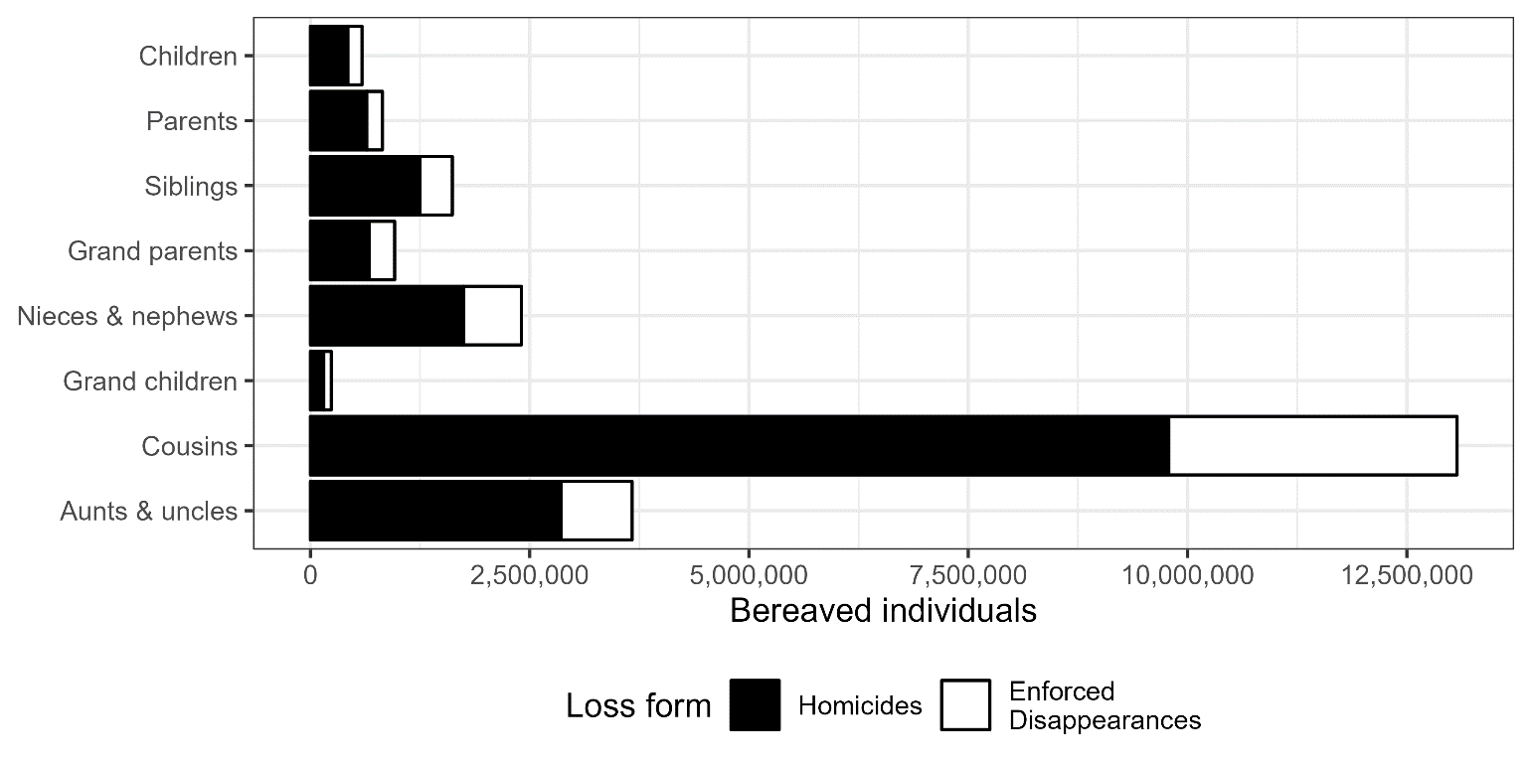
Results
Persons in 2018 having experienced in their life course the loss of:
Enforced disappearance accounting for 27% of bereavement

Slide 20
Results
Persons in 2018 having experienced in their life course the loss of a member of the :
Nuclear family (children, siblings, parents)
Extended family (nuclear + grand parents + grand children, aunts, uncles, cousins, nieces, and nephews)
~3 M, 6%
20.5 M, 42%

Slide 21
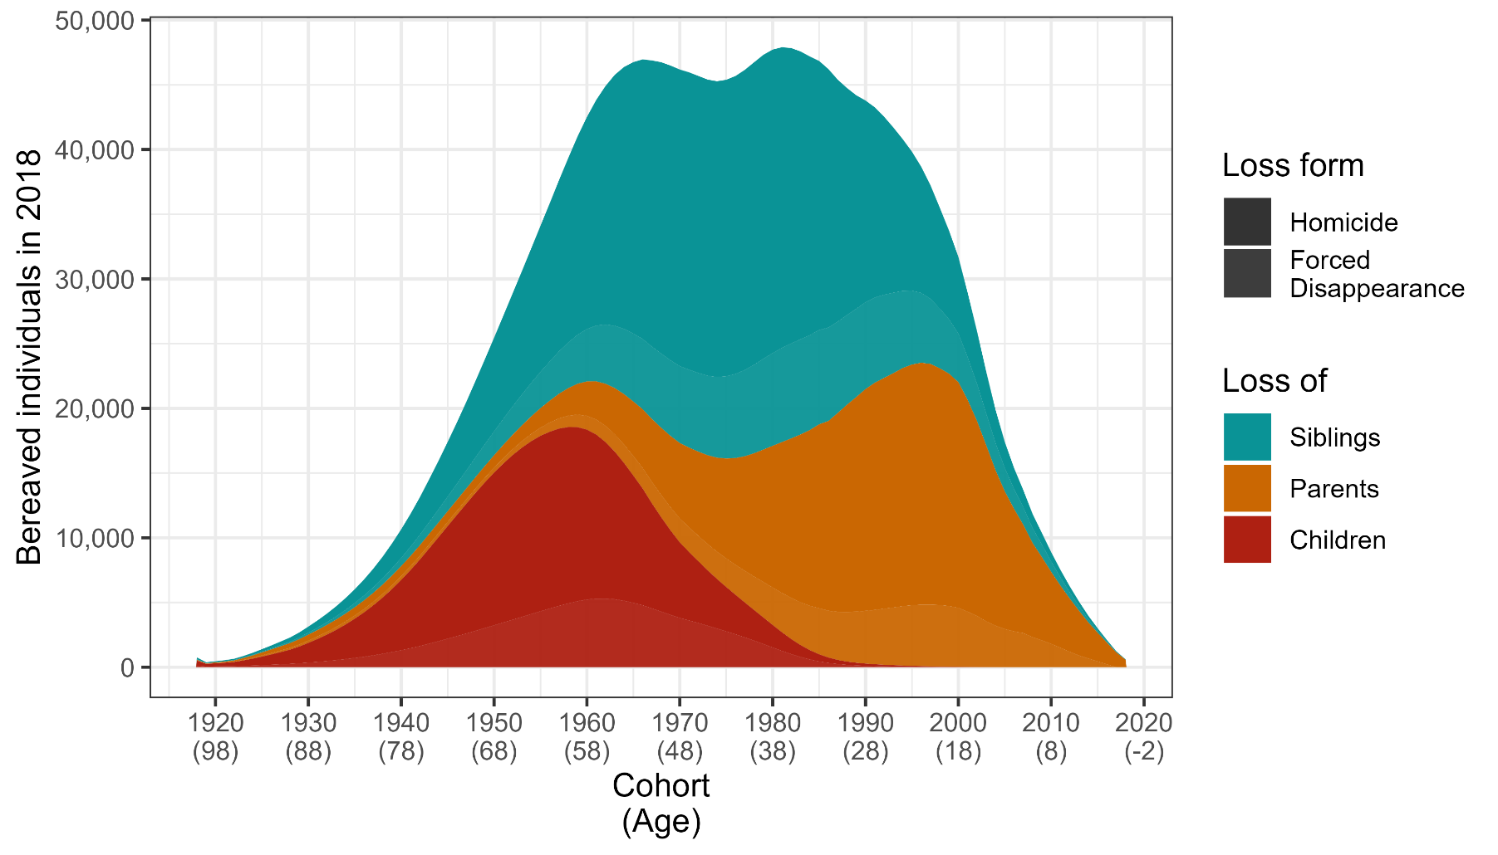
Results
Persons in 2018 having experienced in their life course the loss of a member of a member of the Nuclear family (children, siblings, parents)
~3 M, 6%
Conflict bereavement cohort profiles
Considerable differences across birth cohorts, depending on the kin loss

Slide 22
Results
Loss of support in critical life stages
Old adults (>65y) experiencing the loss of children in 2018
Young children (<5y) that lost any parent in 2018
~340 K
~150 K

Slide 23
Results summary
We proposed a set of methods for quantifying bereaved persons from conflict
Accounting for family loss overlapping
Different levels of bereavement with various potential implications
Three central findings on conflict bereavement in Colombia
Bereavement has a multiplicative effect
Each death result in several bereavements
Enforced disappearances contribute considerably (27%) to conflict bereavement in Colombia
Dramatic levels of family bereavement in the population in 2018

Slide 24
Results summary
Dramatic levels of family bereavement in the population in 2018
20.5 millions (42% of the population) have experienced the loss of a relative in the extended family
Bearers and transmitters of collective memory
3 millions (6%) have experienced the loss of a loved one within the nuclear family
High risk of developing mental health issues (trauma, grief disorder, suicide, substance abuse, etc.)
~500K losing support in critical ages
Increased vulnerability, especially in a country with week institutions and welfare state

Slide 25
Limitations
Our analyses implied several assumptions given the data limitations
Lack of accuracy in kinship structures, death and disappearance rates
Only considering direct conflict deaths
Strong evidence of considerable indirect mortality due to disruption of health and food systems
Not accounting for clustering of conflict deaths within families
Extreme cases like Gaza (78% of 30K deaths in 825 families, Dec 2023)
Not accounting for partner losses (widowhood)
One of the losses with the strongest impact at emotional and material leves
Not accounting for regional differences in kinship structures
Next step as we have place of occurrence and kinship structures
Not including uncertainty
Next step, within a Bayesian framework to include several sources of uncertainty

Slide 26
Implications
Public health: about 3 million persons in need of psychological interventions
Political: about 21 million persons in need of social and political education
Socioeconomic: 500 thousand in need of emotional and economic support in the most vulnerable life stages

Slide 27
Many thanks!!
eacosta@ced.uab.es

Slide 28
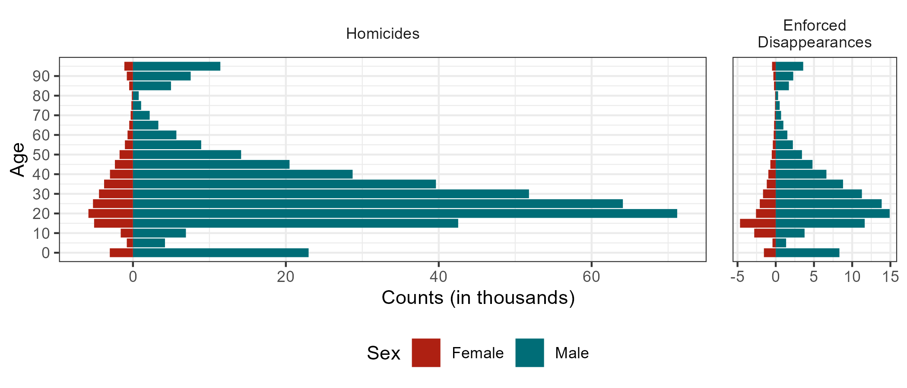
Data

