Slide 1
Life-threatening Illness in a Partner
A Mixed-methods Study of Implications for Labor Market Efforts, Health and Welfare Uptake
Astri Syse (NIPH) & Nina Høy-Petersen (UiO)
Coauthors: Øystein Kravdal (NIPH/UiO), Siri Rostoft (OUS/UiO), Michael Thomas (SSB) & Rannveig K. Hart (UiO/NIPH)

Slide 2
Background I
Preliminary results from the FAMCAN project, examining the impact of illness on close family members
We begin by examing the impact of a well-defined disease (cancer)
What holds for cancer, is likely to hold for also other diseases of similar severity
Demographic changes will put pressure on public spendings and the formal health and welfare system and impact markedly on family members’ overall care burdens
Understanding who experiences the greatest burdens, and what these burdens are, is crucial for formulating policies that safeguard family members’ coping skills and ability to work, as well as grasping impacts in terms of productivity loss and costs
References: OECD 2019a 2019b, 2021; Norwegian Ministry of Labour and Inclusion 2019, 2021; Norwegian Ministry of Health and Care Services 2023; Thomas & Tømmerås 2024

Slide 3
Background II
FAMCAN is ‘grounded’ in a multi-disciplinary team of researchers, stakeholders and users, but firmly set within the Norwegian context
Our research is policy-oriented
Few Norwegian policies aimed at close family members
We work closely with partners in the Ministry og Labour and Social Inclusion, the Norwegian Labour and Welfare Administration (NAV), municipal health care providers (GPs and cancer coordinators), specialized health care providers (hospitals) and the Norwegian Cancer Society
Mixed-methods: Today we will present preliminary results from quantitative register data and qualitative interviews

Slide 4
Theoretical framework
We draw on the linked lives perspective of Elder (1995), in combination with Halfon & Hochstein (2002) aspects of life course theory
The life course perspective emphasizes the interdependence of human lives and the ways in which people are interconnected
Life paths are embedded in and transformed by conditions and events occurring within the family
A life course perspective also demands that we consider links to the wider social and institutional contexts (Bernardi 2019)

Slide 5
What is already known
Today’s measures for next-of-kin are inadequate in Norway
Unless employers provide paid welfare leave or ensure facilitation that makes work compatible with caregiving, few formal options exist for partners in Norway
Ill health in partners is resource-demanding and costly for both families and societies
A scoping review (Coumoundouros 2019), document significant declines in employment and earnings among both sexes (Xiang et al 2022; Jeon et al. 2016; Humphries et al. 2020), suggesting that time is (rather) spent providing care and joint leisure with the sick partner (Jeon et al. 2016)
Caregivers often experience high levels of burdens due to the efforts and costs of care time (Coumoundouros 2019)

Slide 6
Social support for next of kin: A blind spot for the welfare system?
The National Insurance Act explicitly states that disability due to social or economic problems does not entitle one to sickness benefits. The fundamental requirement is that the person himself/herself is sick or injured
Sickness benefits are granted to "... those who are unable to work due to a functional impairment clearly caused by illness or injury. … Incapacity for work due to social or economic problems does not trigger the right to sick pay” (National Insurance Act § 8-4, 1st paragraph)
The same applies to work assessment allowance and disability pension (but different sections)
It is likely that one would see an impact during three main periods
1) at diagnosis; 2) active treatment; and 3) around death

Slide 7
Quantitative Findings

Slide 8
Data and Methods
Longitudinal data set of 10.3 mill person-years 2011-2018 aged 25-60
1.62 million individuals, 49% male partners
8,355 men and 6,672 women (partners) with cancer 2013-2015
Time-to-event models (Roth et al. 2023), controlling for unobservable individual characteristics constant across time, and compare labor market efforts (employment/earnings) and welfare uptake of individuals before and after a cancer diagnosis in the partner
The (at the time) population without cancer in a partner serves as a comparison group

Slide 9
Methods
Time-to-event-models with stacked data
$$y_{it }=\sum_{dur=−4}^{5}{β_{dur}D_{i,t}^{dur}}+θ_{i}+ θ_{y}+ βX_{it}+ ε_{it}$$
Main explantory variable of interest: time to/from partner’s cancer diagnosis
Fixed effects for individual and year
Age change:
Match on partner’s and individual’s age
$βX_{it}$ includes controls for partner’s age
Separate analyses for men and women

Slide 10
Descriptive trend plot: sickness benefit uptake

Slide 11
Modelled results (DiD)

Slide 12
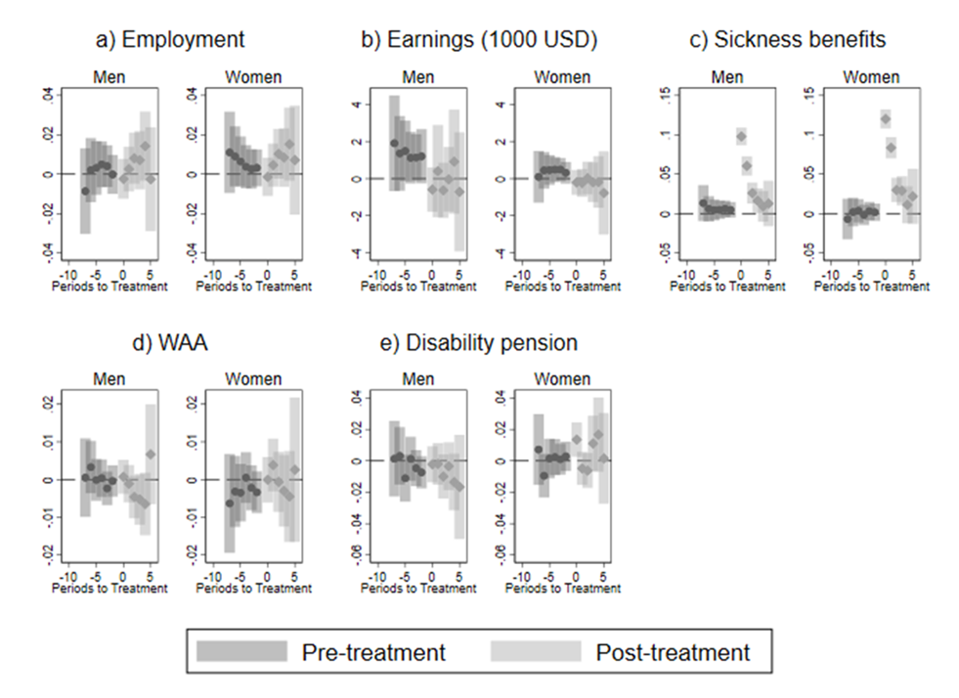
Modelled results (DiD) by sex

Slide 13
Summary/discussion of quantitative results
For work related outcomes:
No significant effects for employment and earnings
Noisy trends
Partner’s cancer diagnosis is linked to a jump in use of sickness benefits
No similar increase in longer-term benefits
Suggests that the increase in health benefits is temporary – an opportunity for «care leave» is unlikely to lead to an increase in long-term benefits “down the road”
For all health-related benefits, trends in diagnosis/comparison groups are similar prior to diagnosis
Support that the increase we see is driven by the partner’s diagnosis
However, we cannot determine from data whether this is due to own health change, or use of sick benefits to care for a sick partner
The line need not be sharp between the two
If own health changes is the driver, the subsequent decline after the year of diagnosis is surprising
To understand more of the work-health balance: Qualitative interviews

Slide 14
Qualitative Findings
Recruitment: through NGO user panels (Kreftforeningen/UngKreft)
21 young adult next of kin
Partner with cancer (N9) parent(s) with cancer (N12)
Norwegian-born women
10 deceased; 6 palliative; 5 poor prognosis
9 students, 12 employed
Conversational interviewing
Grounded approach (list of themes)
In person and on Teams, 1-2 hours
Thematic coding
Recorded (transcribed by AI)

Slide 15
Young adult next-of-kin’s reflections on work, health, and sick leave through stages of cancer
Register data can’t tell us why people go on sick leave (or why they don’t)
Diagnosis
Treatment (and palliative care)
After completed treatment (or death)

Slide 16
Diagnosis
Sick leave: 4 out of 21 interviewees (2-4 weeks)
Reasons: “Shock”, “not functioning”, “no concentration”, anxiety and depression
KT (mother now palliative): When I was told the diagnosis my life just stopped, and I was home locked in my room, in my bed for weeks just withering away. I lost myself completely. I was so deeply depressed. [Continued education without break]
Notes:
For students who haven’t has any noteworthy income in the past year, there’s

Slide 17
Diagnosis: Why not more/longer sick leave?
Being ineligible
9 students (4 continuted studies, 3 got jobs, 2 became fulltime caregivers w/o welfare benefits)
2) Restrictions by GP
MS2 (partner palliative): In some ways we were lucky that we got the brain-cancer diagnosis during our summer vacation, because my GP said “you’re not the one who’s sick” [starts crying]. […] I used my vacation days and time off in lieu.
3) Social (internalized) expectations (less mentioned)
HA (mother now palliative): “When she told me the diagnosis I was hysterical. But I felt I had to be successful in all aspects of my life. As an employee, a mother, and a daughter”
4) Uninformed about disease severity (less mentioned)
MG (father now deceased): “Because I didn’t know how bad it would get”

Slide 18
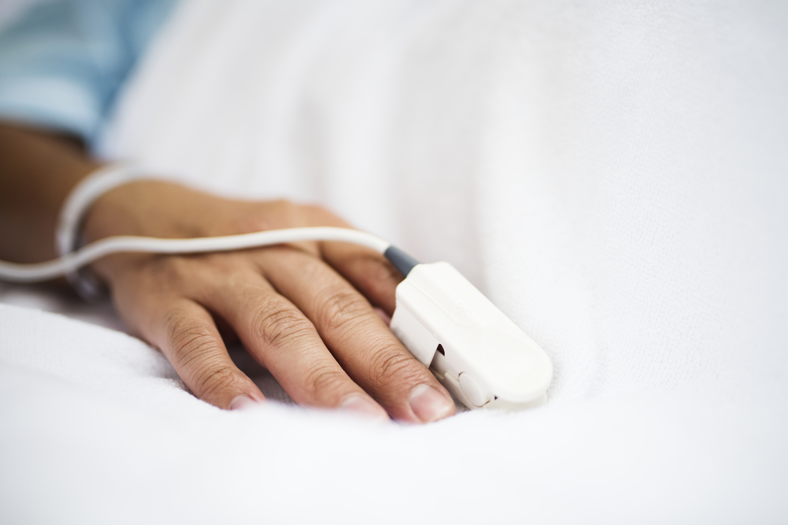
Treatment (and palliative care)
Reasons for sick leave
1) Caregiving duties (inadequate health care services)
AL: The municipality said he was too healthy to be in an institution or get homecare services. At the same time, he was too sick to live alone. We were told by the hospital that family often becomes the support system until the patient qualifies for care.
MØ: We were told after the first round of chemo to administer the the following treatments at home, most likely due to a shortage of hospital beds. He wouldn’t be allowed to come home if I wasn’t there.

Slide 19
Treatment (and palliative care)
Reasons for sick leave
2) Psychosomatic illness, declining mental health, exhaustion (less often mentioned as reason for sick leave)

Slide 20
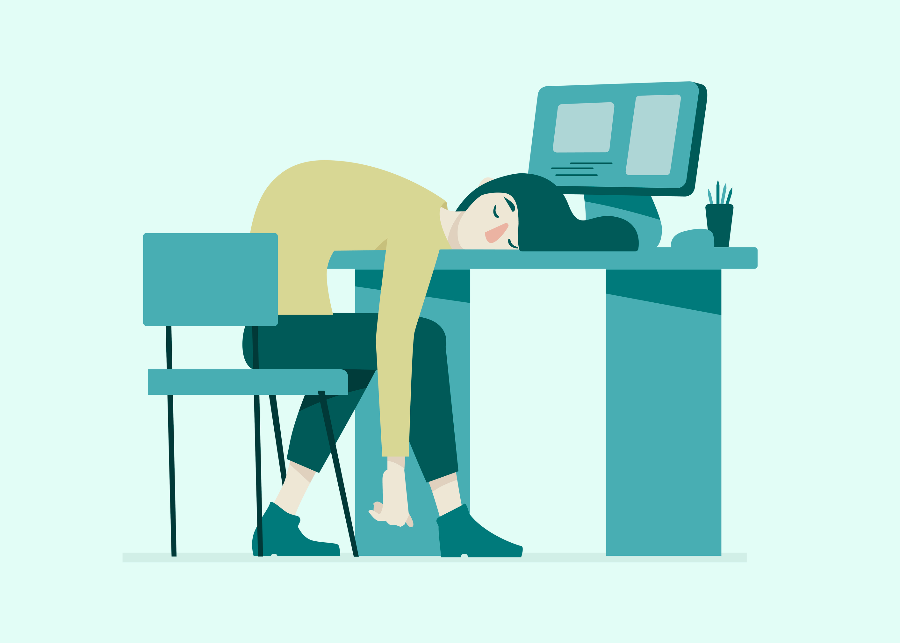
Treatment (and palliative care) Work is described as a struggle, but most all keep working as much as they can. Why? Reasons to keep working
1. Sick leave is more emotionally and physically demanding
“I think it was easier to keep my head above water when I was working, because during sick leave I had so much more I had to deal with, emotionally, and taking care of her” (HA)

Slide 21
Treatment (and palliative care) Reasons to keep working
2. Using work/studies as a distraction (frequent theme)
LHR: ‘Being at work was my break. Sometimes I almost dreaded the thought of going home. Sick leave would probably give me the breakdown I’m expecting to have at some point’.
MG: When I’m at work, I sort of switch roles and become “work-Sarah”. Then on the bus home, I’m like «fuck, work was ok, but life really sucks”. I don’t think being on sick leave is good for me.
KB: ‘I think I had a greater need to work than what was good for me, because it was a break from everything.’

Slide 22
Treatment (and palliative care)
Reasons to keep working
3. Following the ‘life script’ (identity, individuality)
TSS: I knew I could reduce my position, but I didn’t want to put my life on hold and it would have made me feel even more like my mother’s nurse.
HSE: I realize that, Ok, I just have to keep working on my masters degree, and hold on to that, or else I’ll be buried in being a next of kin. I wish I was 50 years old and established in my profession when this happened. Then I could have told my employer that I’m taking time off indefinitely. I couldn’t do that as a student, or when I got my first full-time teaching position. I had to give it my all to keep that position.

Slide 23
Treatment (and palliative care)
Reasons to keep working
4. Not being deemed eligible for sickness benefits
MM[for context]: He woke up multiple times during the night, and I gave him painmedications and changed his intravenous- and pain-pump every hour. I had to get up at 7 or 8am to go to work or school. When I came home, I tried to get him out of bed, make him eat, maybe try to get him some fresh air. After that I was totally worn out. I had no energy for a social life. My focus was on him, you don’t prioritize yourself. It affected everything. I struggled with food, lost a lot of weight. I had stomach problems and nausea – psychosomatic issues. Lots of headaches and fatigue. If I’d told the doctor my symptoms without mentioning that my partner has cancer, I would have gotten sick leave [cries]’

Slide 24
Treatment (and palliative care)
4. Not being eligible for sickness benefits

Slide 25
‘After’ the crisis
N12 done with treatments or their loved one has died
7 poor health but working, 5 on long term sick leave
Reasons for sick leave
1) “hitting a wall”, “crashing”, ”collapsing”, “falling apart”
KB: People think the worst times were those spent in the hospital with mom, but I’m extremely good at managing crises. It wasn’t until after the funeral that my world completely fell apart, when I had time to think. I go to work. But I’m not doing well. Actually, everything’s a struggle. I think I’m in a survival-mode where I just get through the day. I’m very exhausted. I don’t take care of myself. I don’t shower unless I absolutely have to. Food has no taste anymore. I’ve lost my memory, concentration, and all my energy to a point where I think this can’t be normal. I’m not healthy. At some point I’m going to have a serious breakdown.

Slide 26
‘After’ the crisis
1) “hitting a wall”, “crashing”, ”collapsing”, “falling apart”
AL: When he died, everyone kept saying “it’s over, now you can finally breathe, you can live again”, but that was actually when the worst part started. The reality is, you get sick. I’ve had a lot of anxiety. I struggle with a type of exhaustion that doesn’t go away when I rest. I can’t sleep cause my body is on high alert, like it thinks the crisis is still ongoing. … Dizziness, heart palpitations, loss of concentration, weightloss. I got through the first year after he died, just barely, but then I really broke down, and passed out on the bus.

Slide 27
‘After’ the crisis
1) “hitting a wall”, “crashing”, ”collapsing”, “falling apart”
EKS: After her death, after I started to unwind my health started to really bother me. I had physical pains and struggled mentally. I couldn’t shower on my own. I got depressed. I was suicidal. I have fibromyalgia which my doctor says is caused by stress and worries. I’m depressed, and I have anxiety, particularly about my health. My thinking is not normal for my age, like, I’ve planned my own funeral. The worst part’s probably that I’m scared constantly. The first few times I was alone with the kids for a week, I couldn’t sleep because I thought, if I die now, the kids won’t be fed, they’ll die, and my husband will come home and find three dead people. It’s not just mom who got sick. I got sick. The whole family got sick.

Slide 28
‘After’ the crisis
1) “hitting a wall”, “crashing”, ”collapsing”, “falling apart”
VEJ: After she died, I was tired for a few months. That’s really my lowest point. Then a few years later, I had a major mental breakdown, and spent a month in a psychiatric hospital. I was a year in therapy, and they told me that I’ve been suppressing what’s happened until it blew up in my face. For a long time I was anxious about having cancer, checking my body two-three times a day. I have alot of anxiety about most things, really. I often think about death, and my dad dying. I have medication lined up on my nightstand in case of urgent needs. My mental problems are still not resolved, and they could have been avoided. That’s what I miss the most, someone to talk to.

Slide 29
‘After’ the crisis
The let down effect
TSS: After she died, it didn’t take long before I had a migraine attack so severe that I had to be hospitalized, I broke down basically, and was diagnosed with PTSD. I started realizing just how traumatic this has been.
HSE: I collapsed after two and a half months. I mean completely. I felt dizzy and nauseous in the morning, the whole room was spinning like crazy, but I thought I better get to work. I get to school, walk out into the school yard, say hi to a colleague, and then just pass out and hit the pavement. I wake up in an ambulanse, see people in white coats, and I remember thinking, if you’re about to tell me I have cancer, that we’re headed to the oncology department, just fuck off, I can’t do it. I’ll kill you.

Slide 30
‘After’ the crisis
Long term vulnerability
“It has opened the basement hatch to the pitch black room underneath, and I’m always afraid to fall back down there“.
“My body hurts from being tense for so long. I have complex grief syndrome and PTSD because my problems weren’t dealth with sooner. I’m terrified I might be broken for the rest of my life“
“I’m still struggling to get back on my feet [3 yrs later] because there was no follow-up so I didn’t know how to handle things. I was denied any mental healthcare services because being a next of kin isn’t a diagnosis”

Slide 31
Preliminary conclusion
Qualitative data shows that cancer has marked spill-over effects to partners and adult children
Changing reasons for benefit uptake at different stages:
Diagnosis: shock, “not functioning”, “no concentration”, some anxiety/depression (4/21, 2-4 weeks)
Treatment phase: Caring work through critical phases due to lacking health care services (up to 1 year)
After treatment/death: ‘collapse’ of mental health, psychosomatic illness, and ‘let down effect’ (18 ‘collapse” but only 5 on sick leave >1 year)
Limited sick leave is not necessarily indicative of good health (work/studies used as “life-raft”)

Slide 32
Taken together:
Results are much less pronounced in full-population registry data than in qualitative interviews
Next steps :
incorporate qualitative and quantitative findings to a larger extent;
Examine findings at death also in register data;
Examine the (direct) impact on partners’ health proxied by health services uptake (in register data);
A next-of-kin survey (N >300) to aid in the interpretation of register results and examine the generalizability of the qualitative interviews

Slide 33
On behalf of the researcher, stakeholder and user group: Thank you for your attention!

Slide 34
References
Norwegian Ministries. [We, the Next-of-kin: The Government’s Next-of-kin Strategy and Action Plan 2021–2025]. 2020.
Norwegian Directorate of Health. [National Next-of-kin Survey]. Oslo; 2022.
National Insurance Act; 1997.
Norwegian Ministry of Labour and Inclusion. NOU 2019:7. [Labour and Income Security]. 2019.
Norwegian Ministry of Labour and Inclusion. NOU 2021:2. [Measures to Increase Work Efforts]. 2021.
Norwegian Ministry of Health and Care Services. NOU 2023:5. [The major difference. Women's health in a gender perspective]. 2023.
Norwegian Ministry of Health and Care Services. NOU 2023:4. [Time for action]. Oslo; 2023.
Oslo Economics. [Work, Health and Cancer]. Oslo; 2022.
OECD. Pensions at a Glance 2019: OECD and G20 indicators. Paris: OECD; 2019.
OECD. Health for Everyone? Social Inequalities in Health and Health Systems. Paris: OECD Health Policy Studies; 2019.
OECD. Health at a Glance 2021. OECD Indicators. Paris: OECD; 2021.
Roth J, Sant’Anna PHC, Bilinski A, Poe J. What’s trending in difference-in-differences? A synthesis of the recent econometrics literature. J Econometrics. 2023.
Syse A, Artamonova A, Thomas M, Veenstra M. Do characteristics of family members influence older persons' transition to long-term healthcare services? BMC Health Serv Res. 2022;22(1):362.
Syse A, Thomas M, Gleditsch RF. Norway’s 2020 population projections. Report 2020/25. Oslo: Statistics Norway; 2020.
Syse A, Tretli S, Kravdal O. The impact of cancer on spouses' labor earnings: a population-based study. Cancer. 2009;115(18 Suppl):4350-61.
Xiang E, Guzmán P, Mims M, Badr HJ. Balancing Work and Cancer Care: Challenges Faced by Employed Informal Caregivers. Cancers (Basel). 2022;14.
Coumoundouros C, Ould Brahim L, Lambert SD, McCusker J. The direct and indirect financial costs of informal cancer care: A scoping review. Health & Soc Care Comm. 2019;27(5):e622-e36
Cancer Registry of Norway. Cancer in Norway 2023. Oslo: Cancer Registry of Norway; 2024.
Elder Jr GH. The life course paradigm: Social change and individual development. Examining lives in context: Perspectives on the ecology of human development. Washington, DC, US: Am. Psychol. Asso.; 1995. p. 101-39.
Halfon N, Hochstein M. Life course health development: an integrated framework for developing health, policy, and research. Milbank Q. 2002;80(3):433-79, iii.
Humphries B, Lauzier S, Drolet M, Coyle D, Mâsse B, Provencher L, et al. Wage losses among spouses of women with nonmetastatic breast cancer. Cancer. 2020;126(5):1124-34.
Jeon S-H, Pohl VR. Health and work in the family: Evidence from spouses’ cancer diagnoses2016; 381/2016. Available from: https://www150.statcan.gc.ca/n1/pub/11f0019m/11f0019m2016381-eng.pdf.
Menon Economics. [Attitudes to employers as next-of-kin. A Survey among Norwegian Enterprises].Oslo; 2022.
Menon Economics. [Challenges of Next-of-kin on Sick Leave in Norway]. Oslo; 2021.
Menon Economics. [Gross Production Losses of Next-of-kins’ Care Efforts in Norway]. Oslo; 2021.

Slide 35
Modelled estimates of benefit uptake for female and male partners of a person diagnosed with cancer

