Slide 1
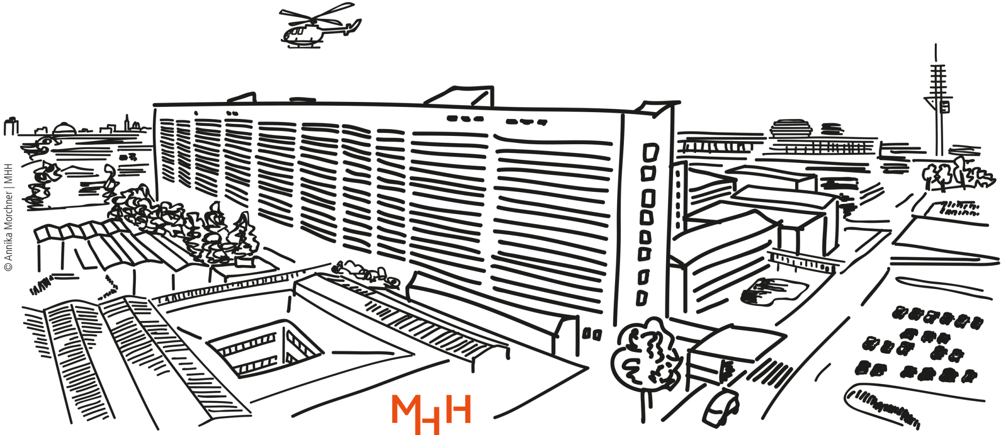
Healthier at work for longer?
Trends in life years free of cardiovascular and musculoskeletal diseases in the employed and general population based on health insurance data
Jelena Epping
Juliane Tetzlaff
Medical Sociology Hanover, Germany | HMMWG Bilbao 2024

Slide 2


ChatGPT

Slide 3
Schedule
Why do we bother about LY free of diseases?
What data we used
How many years do people spend free of MSD and CVD?
Which groups are most affected?
What are the reasons and implications?

Slide 4
Why bother about LY free of disease?
Average retirement age in Germany since 2000
Source: https://www.demografie-portal.de/DE/Fakten/renteneintrittsalter.html

Slide 5
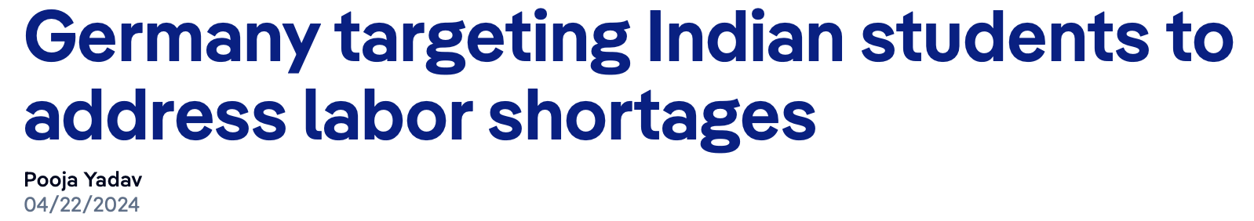
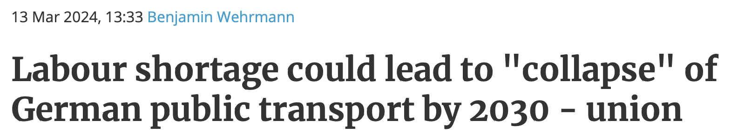
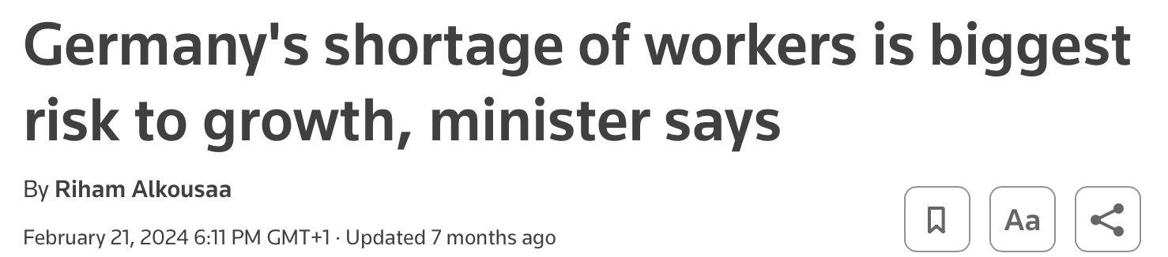
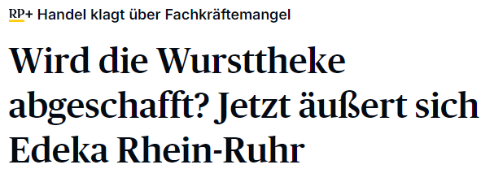
Why bother about LY free of disease?

Slide 6
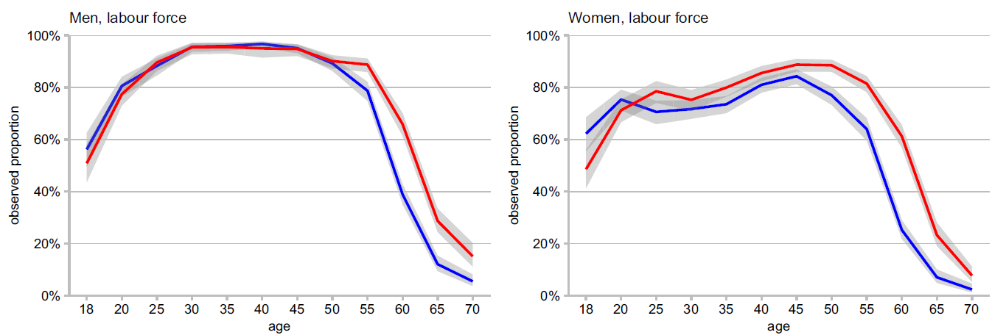
Proportion of labour force in total population,
according to age and sex
Source: German Socio-Economic Panel, Heller et al 2022

Slide 7
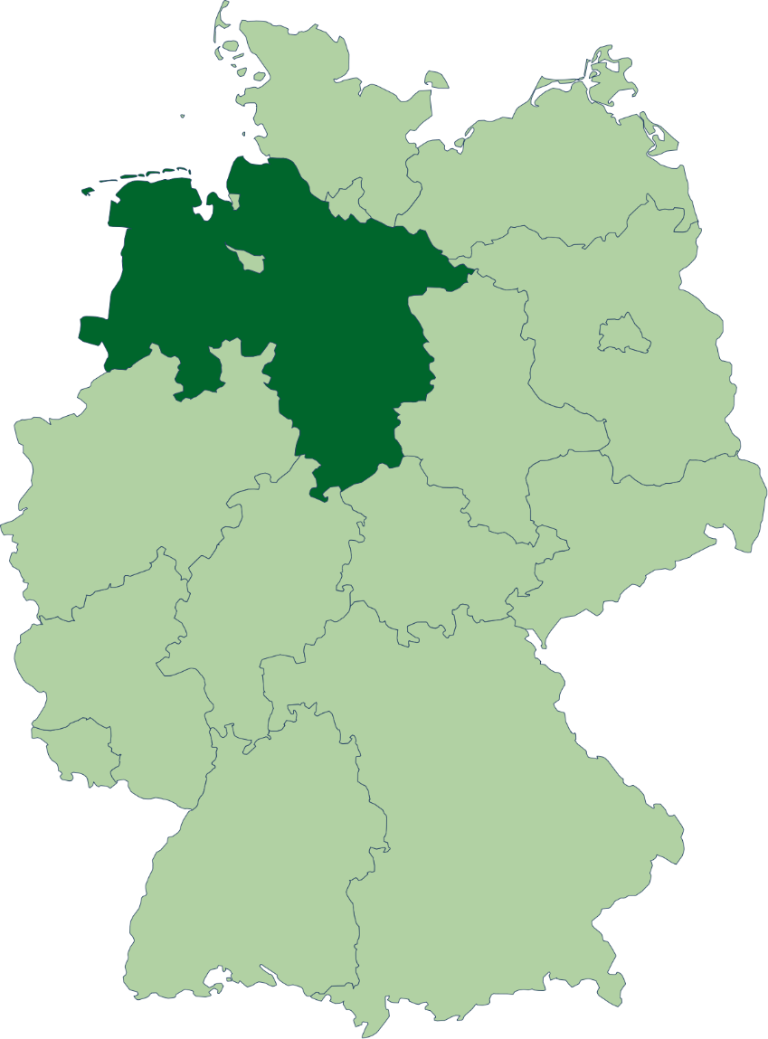
Data
Claims data from statutory health insurance AOK Niedersachsen (Lower Saxony)
Lower Saxony (~ 10 % of German population)
Mandatory health insurance
  < 69 300 € pre-tax income
  7,3% of income
Access to all health services for disease curation → data
N=3,225,337 (~ 40% of the population of Lower Saxony)

Slide 8
Data
Insurance episodes (on daily basis)
Employment history (mandatory report by employers)
Employed individuals: three occupational groups
  Semi-skilled (e.g. logistics, cleaning services)
  Skilled (e.g. physiotherapist, bus driver)
  Highly skilled (e.g. ingenieur, university teacher)
Three time periods 2006-2008, 2011-2013, 2016-2018

Slide 9
Diagnoses
Outpatient and inpatient health care
Cardiovascular diseases
  Angina Pectoris (I20)
  Myocardial infarction (I21)
  Chronic ischaemic heart disease (I25)
  Chronic heart failure (I50)
  Stroke (I60-I64)
Musculoskeletal diseases
  All diagnoses in the chapter M (ICD-10)

Slide 10
CVD: Illness-Death-Model with 2 absorbing states
CVD-free
with CVD
MSD: Illness-Death-Model with 1 transitional and 1 absorbing state
death
MSD-free
with MSD
death

Slide 11
Statistical Analysis
Transition rates calculated based of longitudinal data
Transition rates used as an input for multistate life tables
Life years estimated within multistate models
  Separately for employed individuals and general population
  ... for three occupational groups
  stratified by sex

Slide 12
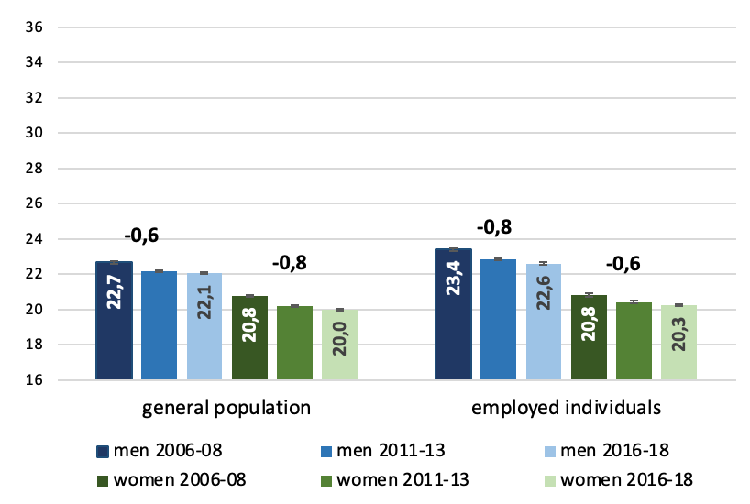
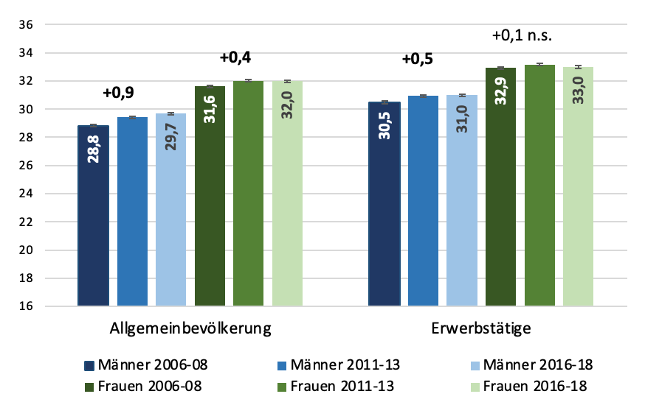
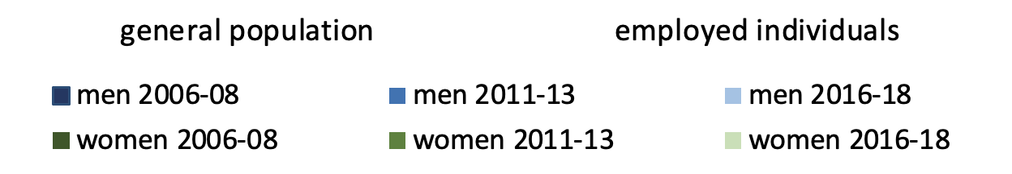
Life years free of MSD and CVD for employed individuals and general population at age of 30 (till max 65 years)
Musculoskeletal diseases
Cardiovascular diseases

Slide 13
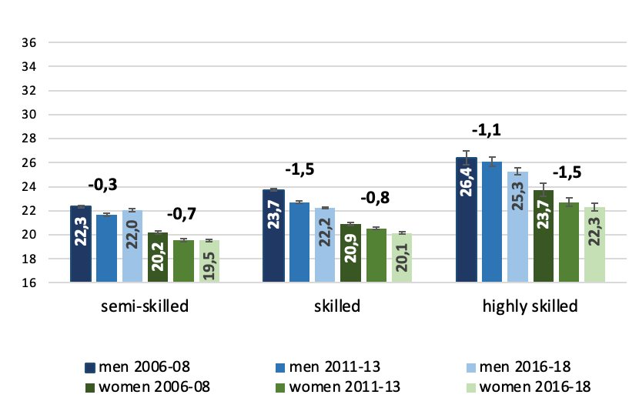
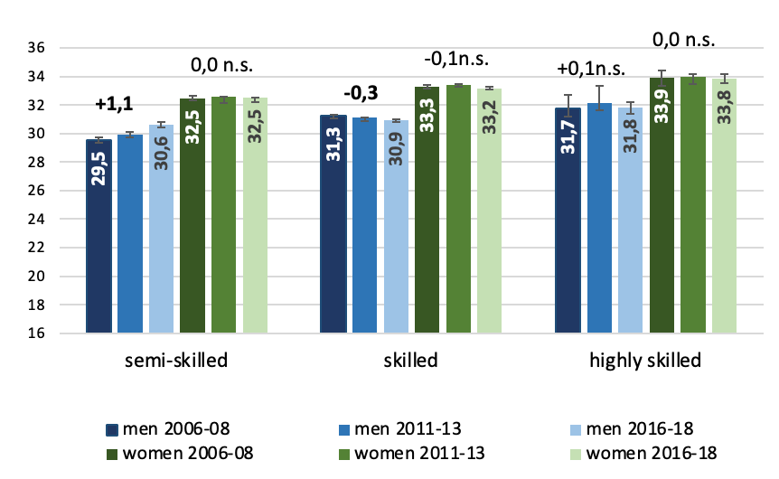
Life years free of MSD and CVD according to occupational groups at age of 30 (till max 65 years)
Musculoskeletal diseases
Cardiovascular diseases

Slide 14
Summary
Employed individuals slightly healthier
  healthy-worker-effect?
MSD in highly qualified get worse
  digital working environment + sedentary life style?
CVD remain stable
  Ceiling-effect in women?
  Preventive medication → less serious CVD problems?

Slide 15

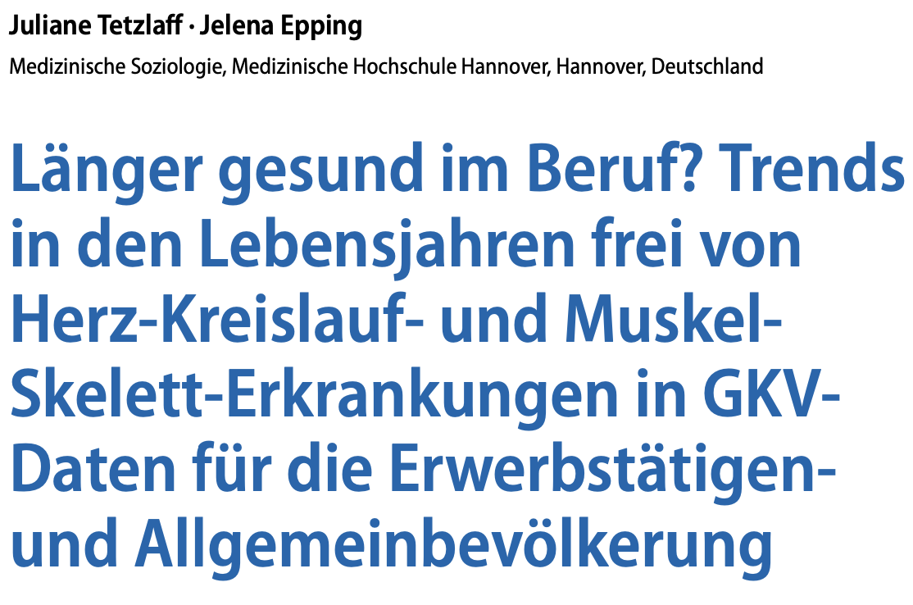

Published in a Special Issue at Bundesgesundheitsblatt
„Life Expectancy and Health“ 2024

Slide 16

Create a picture of employed individuals who are eating healthy food and move themselves
ChatGPT
This is a picture of employed individuals who are eating healthy food and move themselves. It shows a harmonic environment with people who are dealing achtsam with their health.

Slide 17
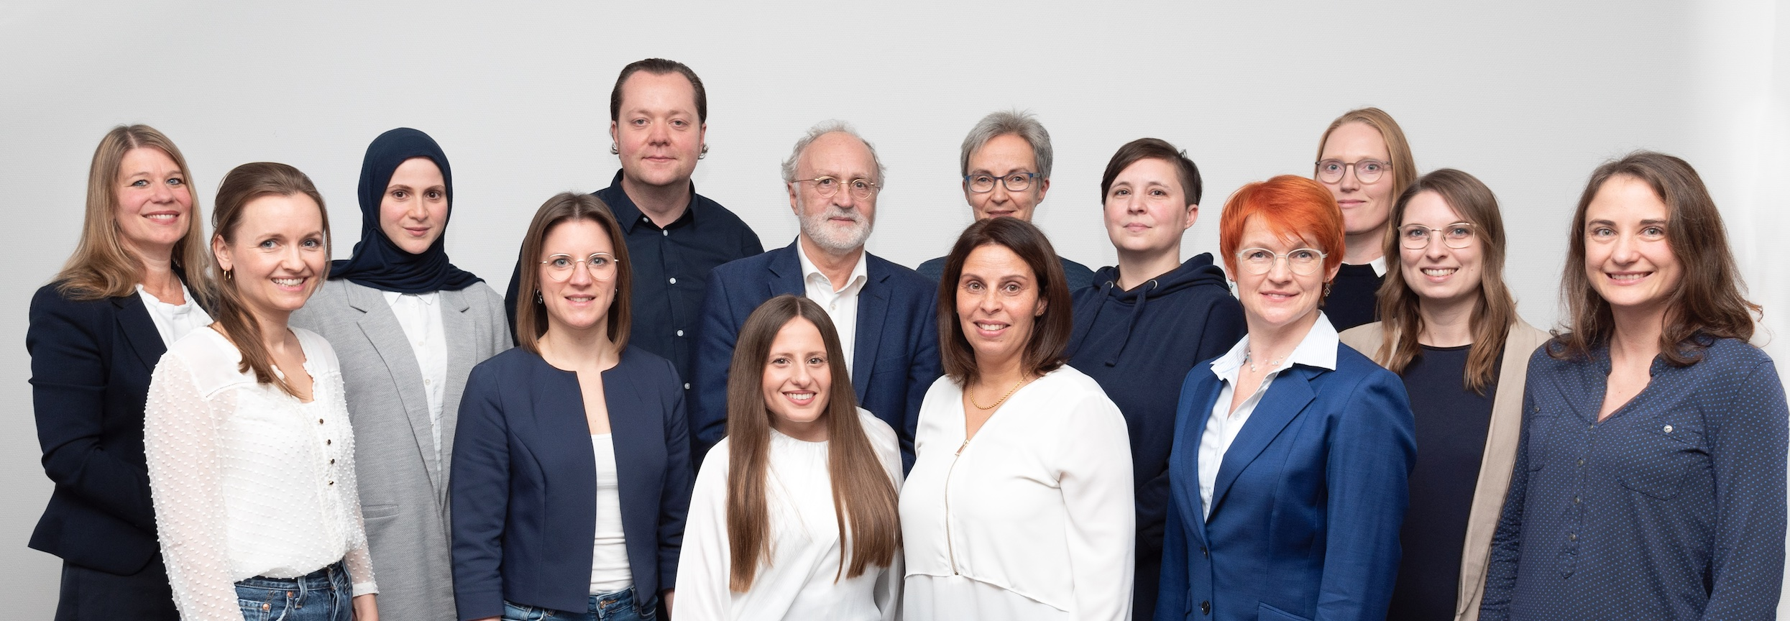
Thank you for your attention!
And to my team of Medical Sociology for the tremendous scientific output!
Looking forward to discuss with you ☺
Contact: Jelena Epping (LinkedIn)
epping.jelena@mh-hannover.de
tetzlaff.juliane@mh-hannover.de

Slide 18
Supplement

Slide 19
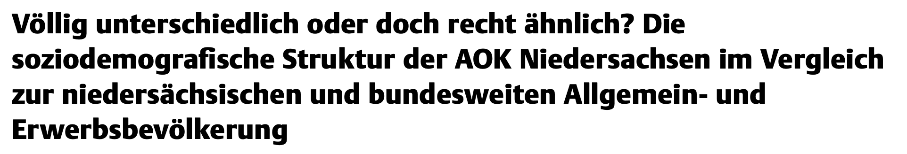
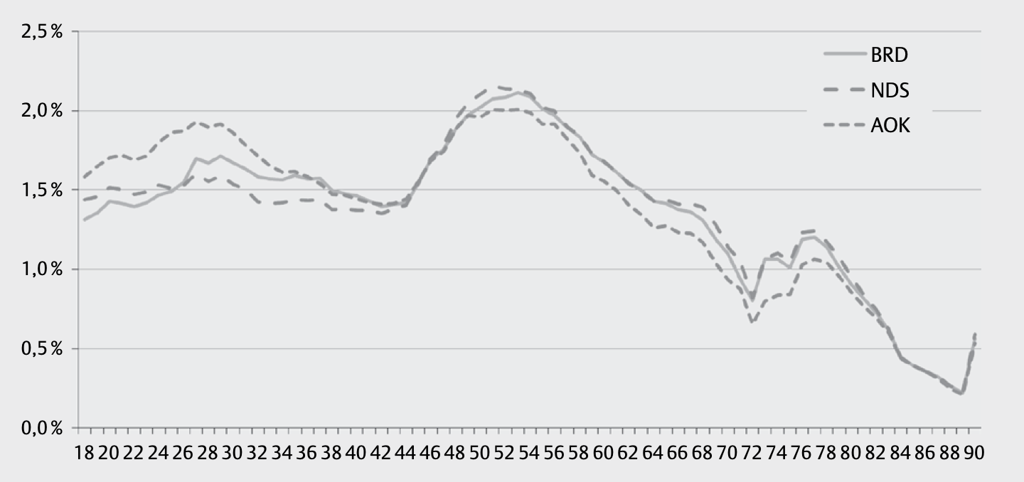
Altersstruktur AOKN vs. NDS vs. BRD
Männer, Stichtag 31.12.2017

Slide 20
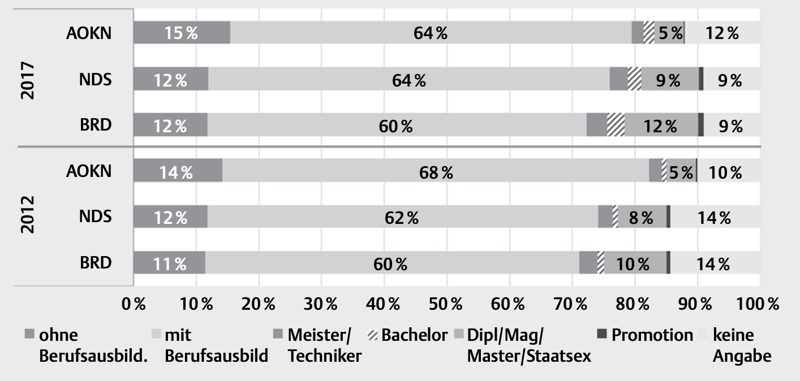

Berufsbildende Abschlüsse der SVP-Beschäftigten in AOKN, NDS und BRD; Frauen, 2012 vs 2017

