Slide 1
Effect of holding in sickness and in health The potential for changes in the demand for healthcare regarding changes in the population structure by partner status
Lukáš Kahoun
Charles University, Faculty of Science, Department of Demography and Geodemography
Institute of Health Information and Statistics of the Czech Republic (ÚZIS)
EAPS Health, Morbidity and Mortality WG, 25–27 September 2023, Bilbao

Slide 2
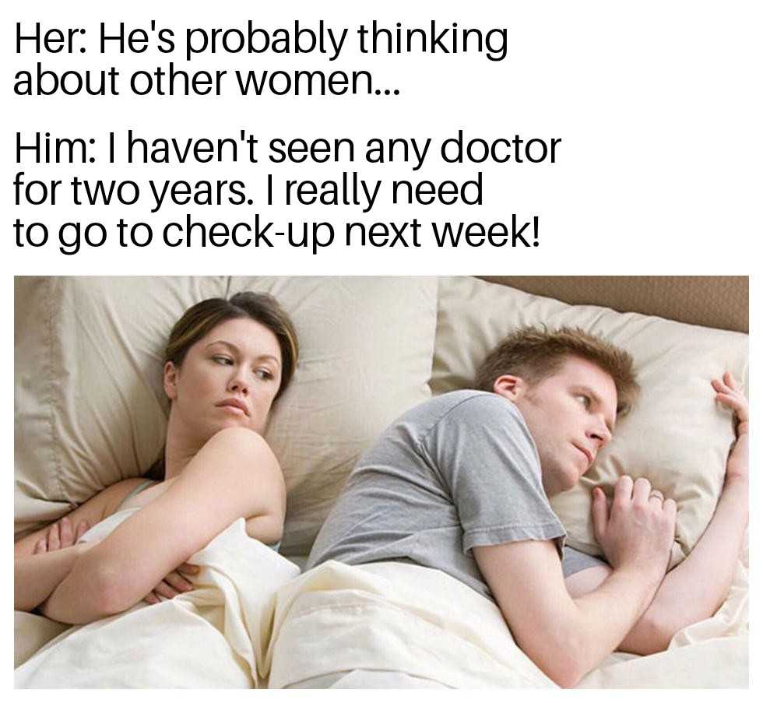
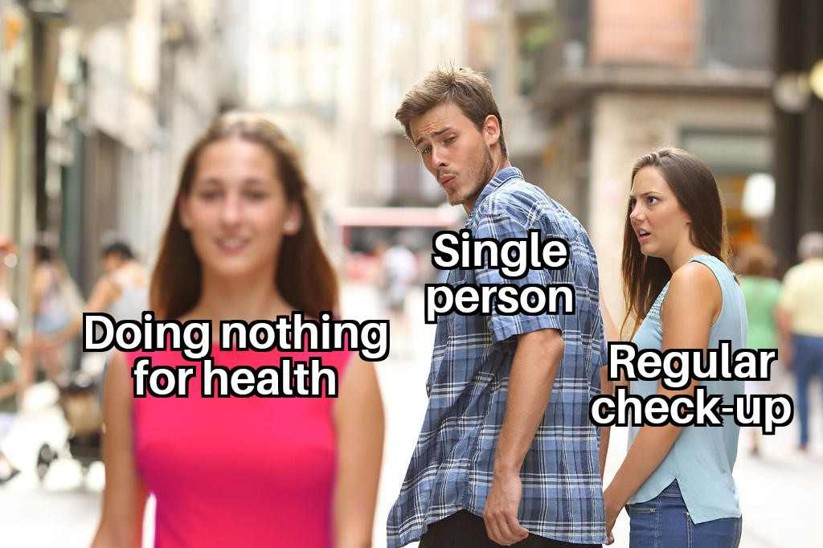
In theory…
< persons with partner
People in relationships tend to be healthier.
Is that so? Why? Why they would be? => this study focus on one specific area: GP check-up participation
Different GP check-up participation rates (persons with a partner X person without a partner).
It starts „unstoppable stream of consequences“…
…
… and ends up in differences in the number of days spent in hospitals.
persons without partner >
Lukáš Kahoun: Effect of holding in sickness and in health
EAPS Health, Morbidity and Mortality WG, 25–27 September 2023, Bilbao
2

Slide 3
In practice…
Having a partner means more check-ups with a general practitioner!
Notes: *never married; **divorced (included separated) or widowed
Sources: author calculations; Society of General Practice CzMA, 2021; Schülein et al., 2017:
Lukáš Kahoun: Effect of holding in sickness and in health
EAPS Health, Morbidity and Mortality WG, 25–27 September 2023, Bilbao
3

Slide 4
In practice…
Age, sex, and partner status are factors influencing check-up participation!
Sources: author calculations; Institute of Health Information and Statistics of the Czech Republic, 2024
Lukáš Kahoun: Effect of holding in sickness and in health
EAPS Health, Morbidity and Mortality WG, 25–27 September 2023, Bilbao
4

Slide 5
In practice…
Population check-up participation may vary based on partner status!
Sources: author calculations; Institute of Health Information and Statistics of the Czech Republic, 2024; Czech Statistical Office, 2024
Lukáš Kahoun: Effect of holding in sickness and in health
EAPS Health, Morbidity and Mortality WG, 25–27 September 2023, Bilbao
5

Slide 6
In practice…
Not attending GP check-ups is linked to increased time spent in hospitals!
Sources: author calculations; Institute of Health Information and Statistics of the Czech Republic, 2024
Lukáš Kahoun: Effect of holding in sickness and in health
EAPS Health, Morbidity and Mortality WG, 25–27 September 2023, Bilbao
6

Slide 7
In practice…
Hospitalization demand may change differently than expected, either slightly amplifying or slowing the anticipated increase, due to shifts in partner status!
Source: author calculations
Lukáš Kahoun: Effect of holding in sickness and in health
EAPS Health, Morbidity and Mortality WG, 25–27 September 2023, Bilbao
7

Slide 8
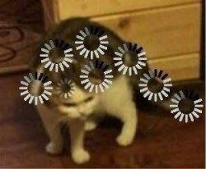
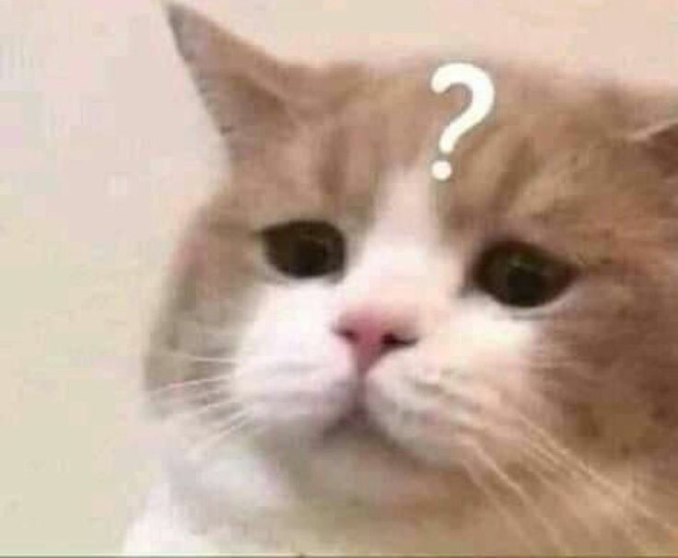
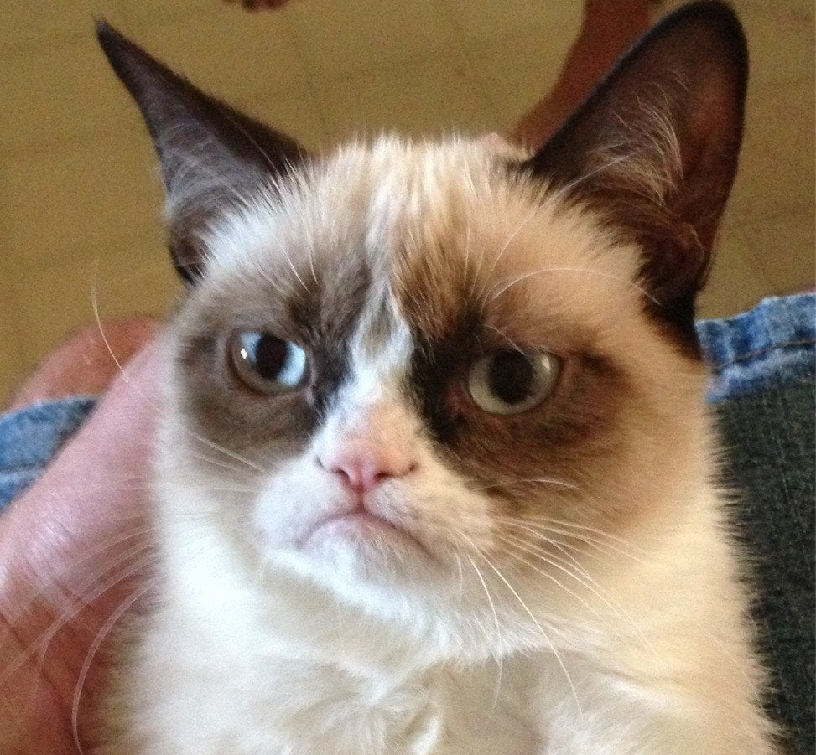
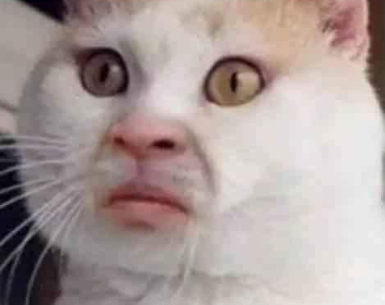
I hope you will enjoy my poster. You can also try to interact with it. Please don't be afraid to find me and ask me anything about it in person! Thank you.
Me: Man! I slayed this presentation. They love it.
Audience:
Lukáš Kahoun: Effect of holding in sickness and in health
EAPS Health, Morbidity and Mortality WG, 25–27 September 2023, Bilbao
8

