Slide 1
The Covid-crisis and the Impact on Health & Mortality in Belgium Patrick Deboosere – Sylvie Gadeyne – Laura Van den Borre Vrije Universiteit Brussel
EAPS Mortality and Health Workshop
Bilbao 25-27 september 2024

Slide 2
Outline
The COVID-19 epidemy in Belgium
Data and methods
SES inequalities in COVID-19 mortality in 2020
A focus on the subgroup aged 40-74
Discussion and conclusions

Slide 3
COVID-19 in Belgium: the beginning
First known COVID-19 infection in Belgium a 54-year old man returning from Wuhan confirmed positive on February 4th 2020
Virus infections spread rapidly after the school holidays in the week of 22 February upon return from ski vacation in Northern Italy and Austria, and local carnival festivities
11 March 2020: a 90-year-old lady from Brussels was declared the first COVID-19 death on Belgian territory; two other patients died the same day
12 March 2020: the Belgian government decides to close schools, cafes and restaurants, and to cancel all public gatherings.

Slide 4
COVID-19 in Belgium in 2020
1 April 2020: Belgium has the highest death toll in absolute cases after Italy and Spain
30 April: Belgium has the highest number of reported COVID-19 deaths per head worldwide
end 2020: Belgium still has the third highest number of officially registered COVID-19 deaths per head worldwide

Slide 5
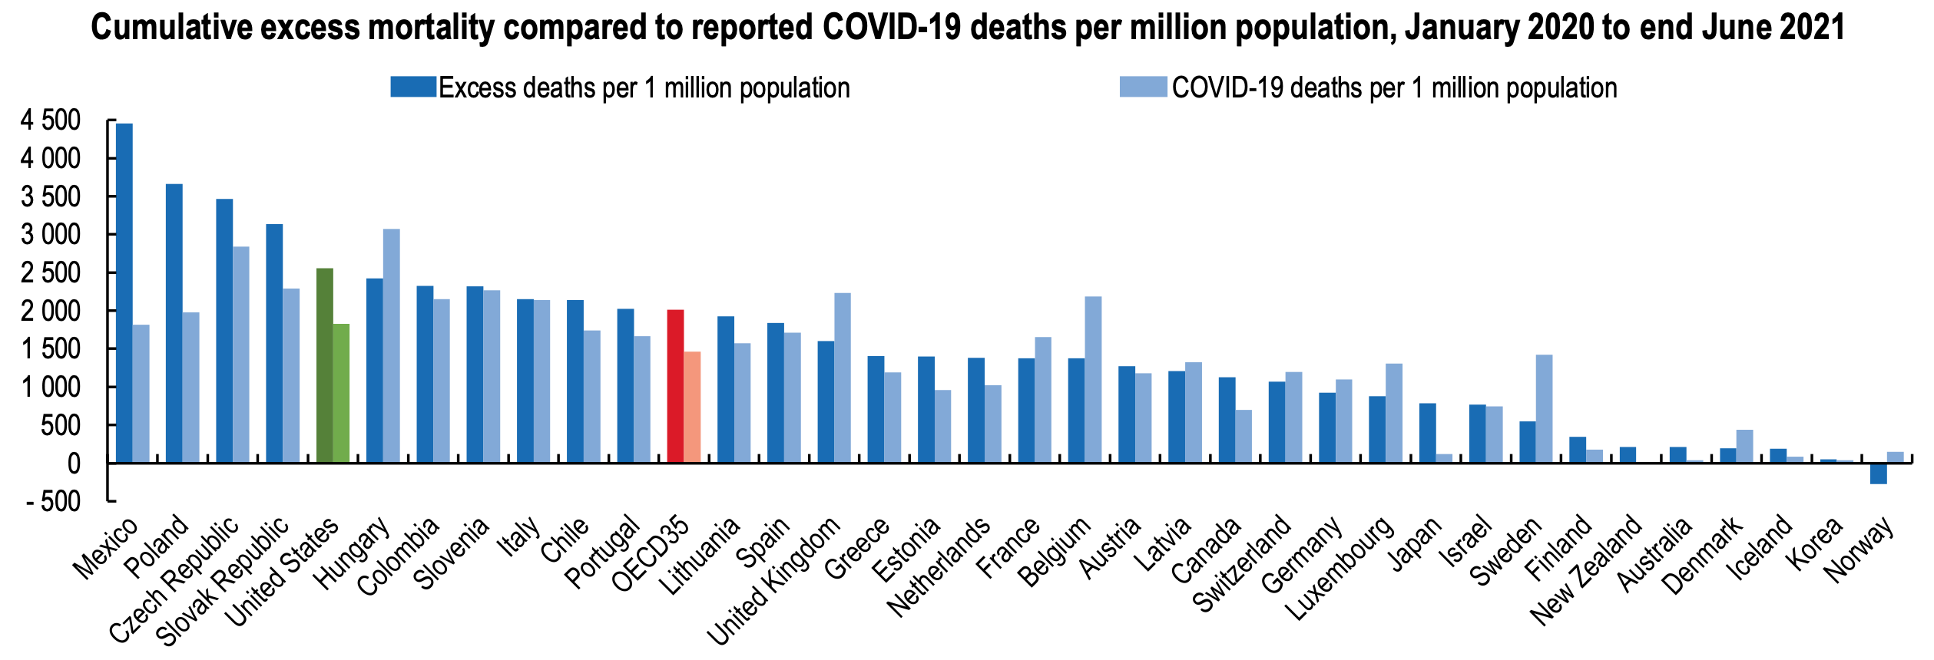
Health at a Glance 2021: How does the United States compare?
OECD Indicators 2022 (3/7/22)

Slide 6
COVID-19 in Belgium in 2020
Excess mortality in 2020 was about 18.000 deaths (16.6%)
In 3 waves:
a COVID-wave from 1st March to 21st June
a short heat wave in the summer
and a second COVID-wave from 31st August onwards
COVID-19 mortality based on the death certificates corresponds to the observed waves of excess mortality

Slide 7
Circulatory diseases
Respiratory diseases

Slide 8
COVID-19
Circulatory diseases
Respiratory diseases
Notes:
Interestingly this suggests also that COVID-19 has not replaced mortality that anyway should have happened

Slide 9
Data
Total Belgian population by age and sex on 1/1/2020 in the National Register: 11.492.625 persons
Information on income: tax declarations 2011 and 2017
Information on educational level, work status, housing, etc.: administrative census of 2011 (11.000.638 persons)
Cause specific mortality for 126.850 deaths in 2020: death certificates

Slide 10
Population at risk aged 35-94, mortality in 2020 by educational level
 | men |  |  | women
35-94 | N | Deaths |  | N | Deaths
total population | 3.260.199 | 59.132 |  | 3.488.518 | 58.041
primary | 312.149 | 14.744 |  | 400.453 | 19.811
lower secondary | 645.403 | 14.965 |  | 660.536 | 16.183
higher secondary | 905.790 | 11.318 |  | 866.650 | 8.955
higher education | 903.183 | 9.226 |  | 1.065.970 | 6.342
no diploma | 74.205 | 3.962 |  | 103.079 | 5.039
missing info | 247.099 | 5.892 |  | 263.038 | 7.043
not in census | 177.675 | 903 |  | 147.848 | 657

Slide 11
Population at risk aged 35-94, mortality and COVID-19 mortality in 2020 by educational level
 | men |  |  | women
35-94 | N | Deaths | COVID | N | Deaths | COVID
total population | 3.260.199 | 59.132 | 10.320 | 3.488.518 | 58.041 | 10.169
primary | 312.149 | 14.744 | 2.701 | 400.453 | 19.811 | 3.362
lower secondary | 645.403 | 14.965 | 2.401 | 660.536 | 16.183 | 2.581
higher secondary | 905.790 | 11.318 | 1.669 | 866.650 | 8.955 | 1.195
higher education | 903.183 | 9.226 | 1.389 | 1.065.970 | 6.342 | 738
no diploma | 74.205 | 3.962 | 873 | 103.079 | 5.039 | 979
missing info | 247.099 | 5.892 | 1.132 | 263.038 | 7.043 | 1.207
not in census | 177.675 | 903 | 155 | 147.848 | 657 | 107

Slide 12
Methods
Analyses are limited to the population aged 35 and older
Direct Age standardisation:
multiplying the age-specific mortality rates of the subpopulation with the agegroups of the national population gives the expected deaths and, divided by the national population, the age-adusted mortality rate
the Comparative Mortality Figure (CMF) is the age-adjusted mortality rate of each subgroup divided by the national mortality rate
Cox proportional hazard models fitted to attained age
Age-adjusted hazard ratios by sex, educational level, income and nationality of origin for all-cause mortality and for COVID-19 mortality in 2020

Slide 13
 | men |  | women
 | CMF |  | CMF
total population | 123 |  | 83
primary | 150 |  | 95
lower secondary | 128 |  | 86
higher secondary | 114 |  | 74
Higher education | 93 |  | 63
no diploma | 160 |  | 110
missing info | 152 |  | 98
not in census | 136 |  | 93
Direct standardization
Belgian population
35-94 as standard
All-cause mortality

Slide 14
 | men |  | women
 | CMF | COVID | CMF | COVID
total population | 123 | 128 | 83 | 81
primary | 150 | 151 | 95 | 94
lower secondary | 128 | 125 | 86 | 81
higher secondary | 114 | 115 | 74 | 65
Higher education | 93 | 93 | 63 | 54
no diploma | 160 | 194 | 110 | 127
missing info | 152 | 171 | 98 | 105
not in census | 136 | 200 | 93 | 108
Direct standardization
Belgian population
35-94 as standard
COVID-19 mortality

Slide 15
Socioeconomic gradient of COVID-19 mortality by educational level
population 35-94 |  |  | Exp(B) | 95.0% CI for Exp(B)
 |  | Frequency |  | Lower | Upper
sex | male | 3260199 | 1.912 | 1.860 | 1.966
 | female | 3488518 | ref
education | no diploma | 175653 | 1.751 | 1.645 | 1.864
 | primary | 703889 | 1.330 | 1.265 | 1.398
 | lower secondary | 1300631 | 1.335 | 1.268 | 1.404
 | higher secondary | 1769468 | 1.229 | 1.162 | 1.300
 | Higher education | 1966637 | ref
 | missing info | 507092 | 1.550 | 1.461 | 1.644
 | not in census | 325347 | 2.356 | 2.072 | 2.679

Slide 16
Socioeconomic gradient of COVID-19 mortality by educational level
and region
population 35-94 |  |  | Exp(B) | 95.0% CI for Exp(B) |  | Exp(B) | 95.0% CI for Exp(B)
 |  | Frequency |  | Lower | Upper |  | Lower | Upper
sex | male | 3260199 | 1.912 | 1.860 | 1.966 | 1.965 | 1.911 | 2.021
 | female | 3488518 | ref |  |  | ref
education | no diploma | 175653 | 1.751 | 1.645 | 1.864 | 1.714 | 1.610 | 1.825
 | primary | 703889 | 1.330 | 1.265 | 1.398 | 1.470 | 1.398 | 1.546
 | lower secondary | 1300631 | 1.335 | 1.268 | 1.404 | 1.402 | 1.332 | 1.475
 | higher secondary | 1769468 | 1.229 | 1.162 | 1.300 | 1.290 | 1.219 | 1.364
 | Higher education | 1966637 | ref |  |  | ref
 | missing info | 507092 | 1.550 | 1.461 | 1.644 | 1.574 | 1.483 | 1.669
 | not in census | 325347 | 2.356 | 2.072 | 2.679 | 2.100 | 1.846 | 2.388
region | Flanders | 4001850 |  |  |  | ref
 | BCR | 625710 |  |  |  | 1.877 | 1.792 | 1.965
 | Wallonia | 2121157 |  |  |  | 1.711 | 1.661 | 1.762

Slide 17
40-74 years old in 2020
36.164 deaths in 2020 among them 4.184 COVID-19 deaths (11,6%)
Why focus on the 40-74 years old?
Deaths before the age of 75 can be considered premature
Cohorts are more homogeneous – all born after the second world war
Most still active in the census of 2001 and 2011 which gives information for the oldest on covariates during their active life before entering the pension age
The lower age range of 40 still captures almost all younger COVID-19 deaths and contains information on education level and activity

Slide 18
Mortality by sex and educational level population 40-74
 | Frequency | Exp(B)
male | 2.477.593 | 1.822
female | 2.512.167 | ref
no diploma | 104.130 | 1.757
primary | 401.238 | 1.574
lower secondary | 960.926 | 1.448
higher secondary | 1.420.450 | 1.427
no information | 356.919 | 2.013
not in census | 221.014 | 2.073
higher education | 1.525.083 | ref

Slide 19
COVID-19 mortality by sex and educational level population 40-74
 | Frequency | Exp(B)
male | 2.477.593 | 1.822
female | 2.512.167 | ref
no diploma | 104.130 | 1.757
primary | 401.238 | 1.574
lower secondary | 960.926 | 1.448
higher secondary | 1.420.450 | 1.427
no information | 356.919 | 2.013
not in census | 221.014 | 2.073
higher education | 1.525.083 | ref
Exp(B)
2.078
ref
3.571
2.278
1.810
1.591
3.603
3.188
ref

Slide 20
mortality by sex and family income population 40-74
36164 deaths in total |  | Exp(B) | 95.0% CI for Exp(B)
 | Frequency |  | Lower | Upper
male | 2477593 | 1.946 | 1.905 | 1.988
female | 2512167 | ref
no taxable income | 274956 | 7.040 | 6.621 | 7.485
less than 10.000 | 129890 | 2.449 | 2.246 | 2.669
11-20.000 | 883997 | 2.566 | 2.429 | 2.711
21-30.000 | 869776 | 1.489 | 1.408 | 1.576
31-40.000 | 782418 | 1.284 | 1.212 | 1.361
41-50.000 | 555923 | 1.246 | 1.170 | 1.328
51-60.000 | 402100 | 1.109 | 1.031 | 1.192
61-74.000 | 392407 | 1.085 | 1.004 | 1.172
75.000 + | 698293 | ref

Slide 21
COVID-19 mortality by sex and family income population 40-74
4184 COVID deaths |  | Exp(B) | 95.0% CI for Exp(B)
 | Frequency |  | Lower | Upper
male | 2477593 | 2.236 | 2.098 | 2.383
female | 2512167 | ref
no taxable income | 274956 | 10.716 | 8.783 | 13.074
less than 10.000 | 129890 | 3.359 | 2.577 | 4.379
11-20.000 | 883997 | 3.299 | 2.743 | 3.969
21-30.000 | 869776 | 1.771 | 1.467 | 2.138
31-40.000 | 782418 | 1.438 | 1.185 | 1.745
41-50.000 | 555923 | 1.323 | 1.071 | 1.634
51-60.000 | 402100 | 1.180 | 0.929 | 1.498
61-74.000 | 392407 | 1.132 | 0.876 | 1.463
75.000 + | 698293 | ref

Slide 22
COVID-19 mortality Education controlled for income
age 40-74 |  | 4184 COVID | 95.0% CI for Exp(B)
 | Frequency | Exp(B) | Lower | Upper
men | 2477593 | 2.262 | 2.122 | 2.411
women | 2512167 | ref
no diploma | 104130 | 2.544 | 2.201 | 2.940
primary | 401238 | 1.781 | 1.584 | 2.003
lower secund | 960926 | 1.564 | 1.402 | 1.744
higher secund | 1420450 | 1.445 | 1.293 | 1.616
missing info | 356919 | 2.066 | 1.815 | 2.353
not in census | 221014 | .981 | .783 | 1.227
higher education | 1525083 | ref
no taxable income | 274956 | 8.281 | 6.713 | 10.216
less than 10.000 | 129890 | 2.555 | 1.951 | 3.347
11-20.000 | 883997 | 2.361 | 1.947 | 2.863
21-30.000 | 869776 | 1.329 | 1.093 | 1.615
31-40.000 | 782418 | 1.126 | .923 | 1.374
41-50.000 | 555923 | 1.119 | .903 | 1.387
51-60.000 | 402100 | 1.068 | .840 | 1.358
61-74.000 | 392407 | 1.087 | .841 | 1.405
75.000 + | 698293 | ref

Slide 23
Mortality by nationality of origin
 |  | Exp(B) | 95.0% CI
 | Frequency |  | Lower | Upper
male | 2.477.593 | 1.80 | 1.76 | 1.84
female | 2.512.167 | ref
belgium | 3.742.451 | ref
asia | 63.625 | 1.12 | 0.98 | 1.27
africa | 79.896 | 1.92 | 1.74 | 2.12
afgh, syr & iraq | 17.741 | 1.22 | 0.95 | 1.57
turkey | 79.081 | 1.51 | 1.37 | 1.67
north africa | 194.959 | 1.26 | 1.18 | 1.35
central & south america | 36.601 | 1.17 | 1.00 | 1.37
other EU | 608.191 | 1.11 | 1.07 | 1.15
other europe | 167.215 | 1.56 | 1.46 | 1.68

Slide 24
Mortality & COVID19mortality by nationality of origin
 |  | Exp(B) | 95.0% CI |  | Exp(B) | 95.0% CI
 | Frequency |  | Lower | Upper |  | Lower | Upper
male | 2.477.593 | 1.80 | 1.76 | 1.84 | 2.01 | 1.89 | 2.15
female | 2.512.167 | ref |  |  | ref
belgium | 3.742.451 | ref |  |  | ref
asia | 63.625 | 1.12 | 0.98 | 1.27 | 2.63 | 1.99 | 3.47
africa | 79.896 | 1.92 | 1.74 | 2.12 | 6.24 | 5.17 | 7.54
afgh, syr & iraq | 17.741 | 1.22 | 0.95 | 1.57 | 3.38 | 2.07 | 5.52
turkey | 79.081 | 1.51 | 1.37 | 1.67 | 3.53 | 2.85 | 4.38
north africa | 194.959 | 1.26 | 1.18 | 1.35 | 3.34 | 2.91 | 3.83
central & south america | 36.601 | 1.17 | 1.00 | 1.37 | 2.26 | 1.58 | 3.24
other EU | 608.191 | 1.11 | 1.07 | 1.15 | 1.56 | 1.42 | 1.71
other europe | 167.215 | 1.56 | 1.46 | 1.68 | 1.78 | 1.43 | 2.21

Slide 25
Discussion
The high levels of COVID-19 mortality amongst persons with missing information on educational level and newcomers is largely the effect of high mortality in the population with a migrant background
Contributing factors:
More intense international contacts
Residing in poorer and densely populated neighbourhoods.
Occupational exposure related to type of work
The widespread virus circulation in nursing homes and the vulnerability of the population with a migrant background have significantly contributed to the high COVID-19 mortality in Belgium

Slide 26
Conclusions
We were not all in the same boat, but as adequately pointed out we have been in the same storm, but in different boats
Inequality in COVID-19 mortality appears to be bigger than inequality in overall mortality
It is an important challenge for public health policies to take into account socio-economic inequalities and have particular attention for vulnerable populations when confronted with future pandemics

Slide 27
Dank voor je aandacht
Thanks for your attention

Slide 28
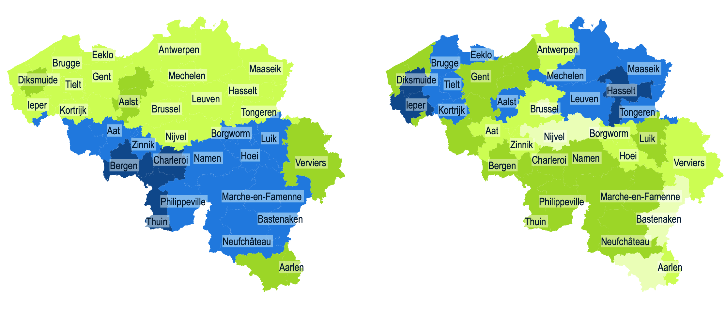
IMA – 2019 SMR men and women
IMA – 2019 mean number of contacts with general practitioner

