Slide 1
Poverty effects of onset of limiting health conditions in Europe – heterogeneity and population impact
Aapo Hiilamo, EAPS workshop 24/9/2024
Notes:
Comments:
Focus on role of health as explainer of poverty. No much research on this, not much cross-country level.
Argue for heterogeneity – why these groups…or just go very fast.

Slide 2
EU – poverty reduction daydreamer
Lisbon strategy - “a decisive impact on the eradication of poverty by 2010”
The Europe 2020 strategy – “national poverty line by 25 % and to lift more than 20 million people out of poverty by 2020”.
European Pillar of Social Rights Action Plan by 2030 -”reducing the number of people at risk of poverty or social exclusion” by at least 15 million.

Slide 3
Health selection ignored in poverty research
There are significant differences in poverty (entry) risks between countries and populations.
Notes:
?

Slide 4
Health selection ignored in poverty research
There are significant differences in poverty (entry) risks between countries and populations.
Health has causal effect on socioeconomic outcome but little research on health selection to poverty.

Slide 5
Health selection ignored in poverty research
There are significant differences in poverty (entry) risks between countries and populations.
Health has causal effect on socioeconomic outcome but little research on health selection to poverty.
The limited available research has ignored country differences and heterogeneity within them. Countries have different mechanisms to offset poverty effects of health conditions.

Slide 6
This study
How much onset of limiting long-standing health condition link to the risk of entering to subjective poverty in different populations? (Individual level risk)
How much limiting long-standing health conditions explain between and within country differences in poverty entry rates? (Population impact)

Slide 7
Longitudinal EU-SILC from 25 countries (EUSILCPANEL)
Restricting sample to non-poor, no health conditions and aged 18-64 at year t, in ~2004-2019. 1 person per household.
Key exposure is an onset of self-reported limiting long-standing health condition (reporting health condition year t+1)
Outcome “Subjective poverty” entry: household head reporting making ends meet with great difficulty at year t+1
Controls year t: education, gender, age, level of economic difficulties, married, equivalized household size, employment, year, income (ln(income/poverty line))
(“objective poverty” entry: income below 60% national median at year t+1. in supplementary materials)

Slide 8
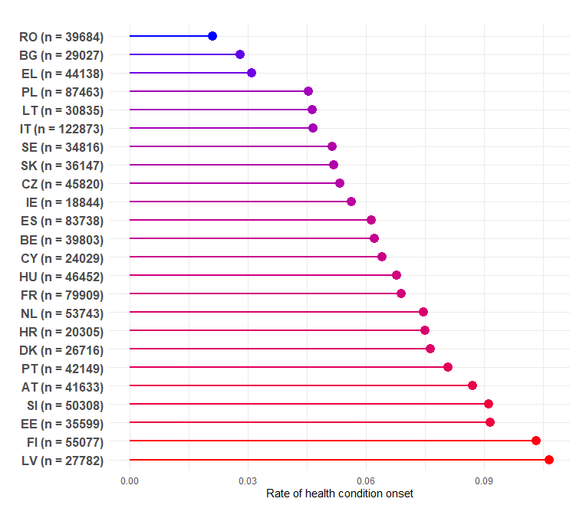
Share of people who develop self-reported (!) LL health conditions (sample size)
Notes:
Don’t spend too much time in explaining individual countries.

Slide 9
Estimands
Risk ratio:
E(poverty entry, onset)/E(poverty entry, !onset)
Population attributable risk (PAR):
(E(poverty entry) - E(poverty entry, !onset))
Methods of estimation
Adjusted logistic regression models (with interactions) clustered by id
Use the models to simulate ratio of two potential outcomes means (RR) and prevalence of poverty entry if no single onset in the population (PAR, Stata margins).

Slide 10
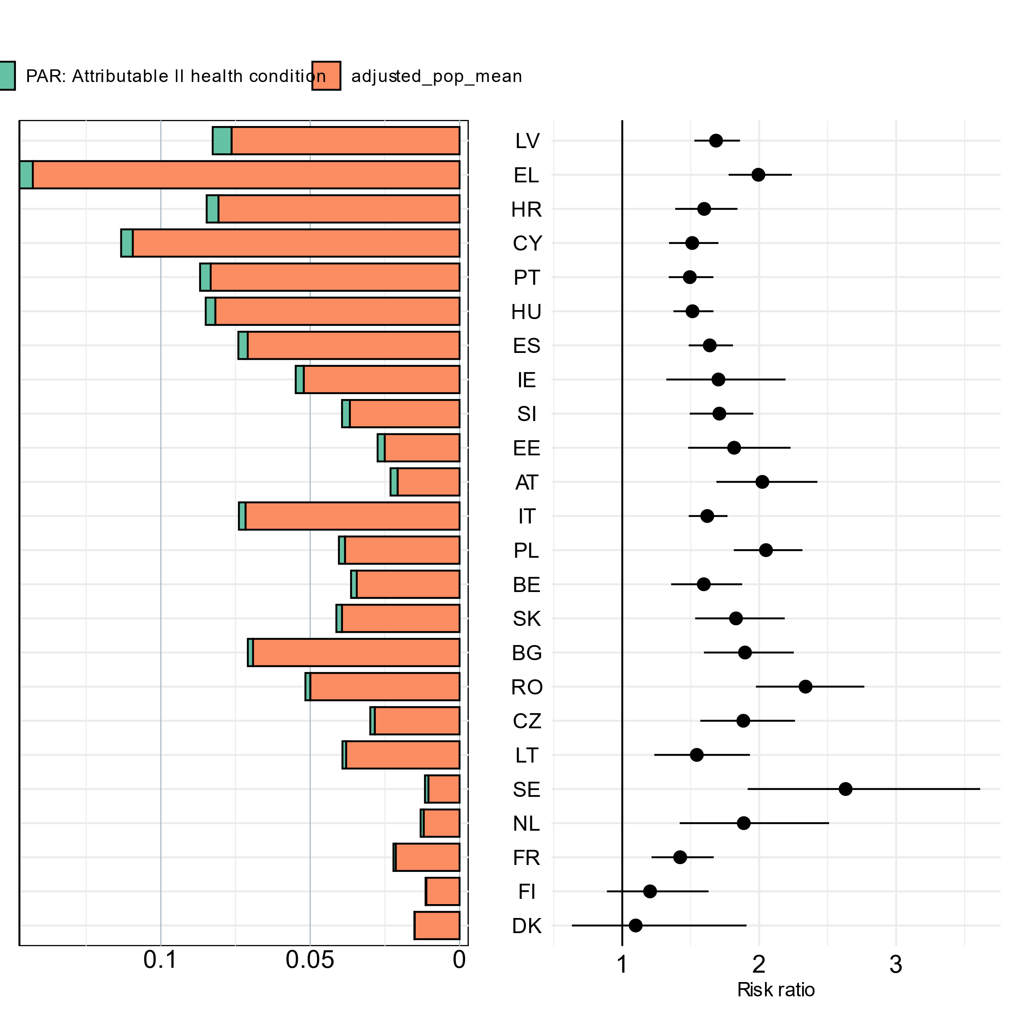
Risk ratios and pars by country
Poverty entry population mean
Risk ratio
Notes:
Emphasise more the geen part and the order of the countries depends on the thickness of the PAR
Define risk ratio more clear
What do you see on the left side
Why are the countries order how they are
Highlight the main results – among the countries with low effects are Nordic.

Slide 11
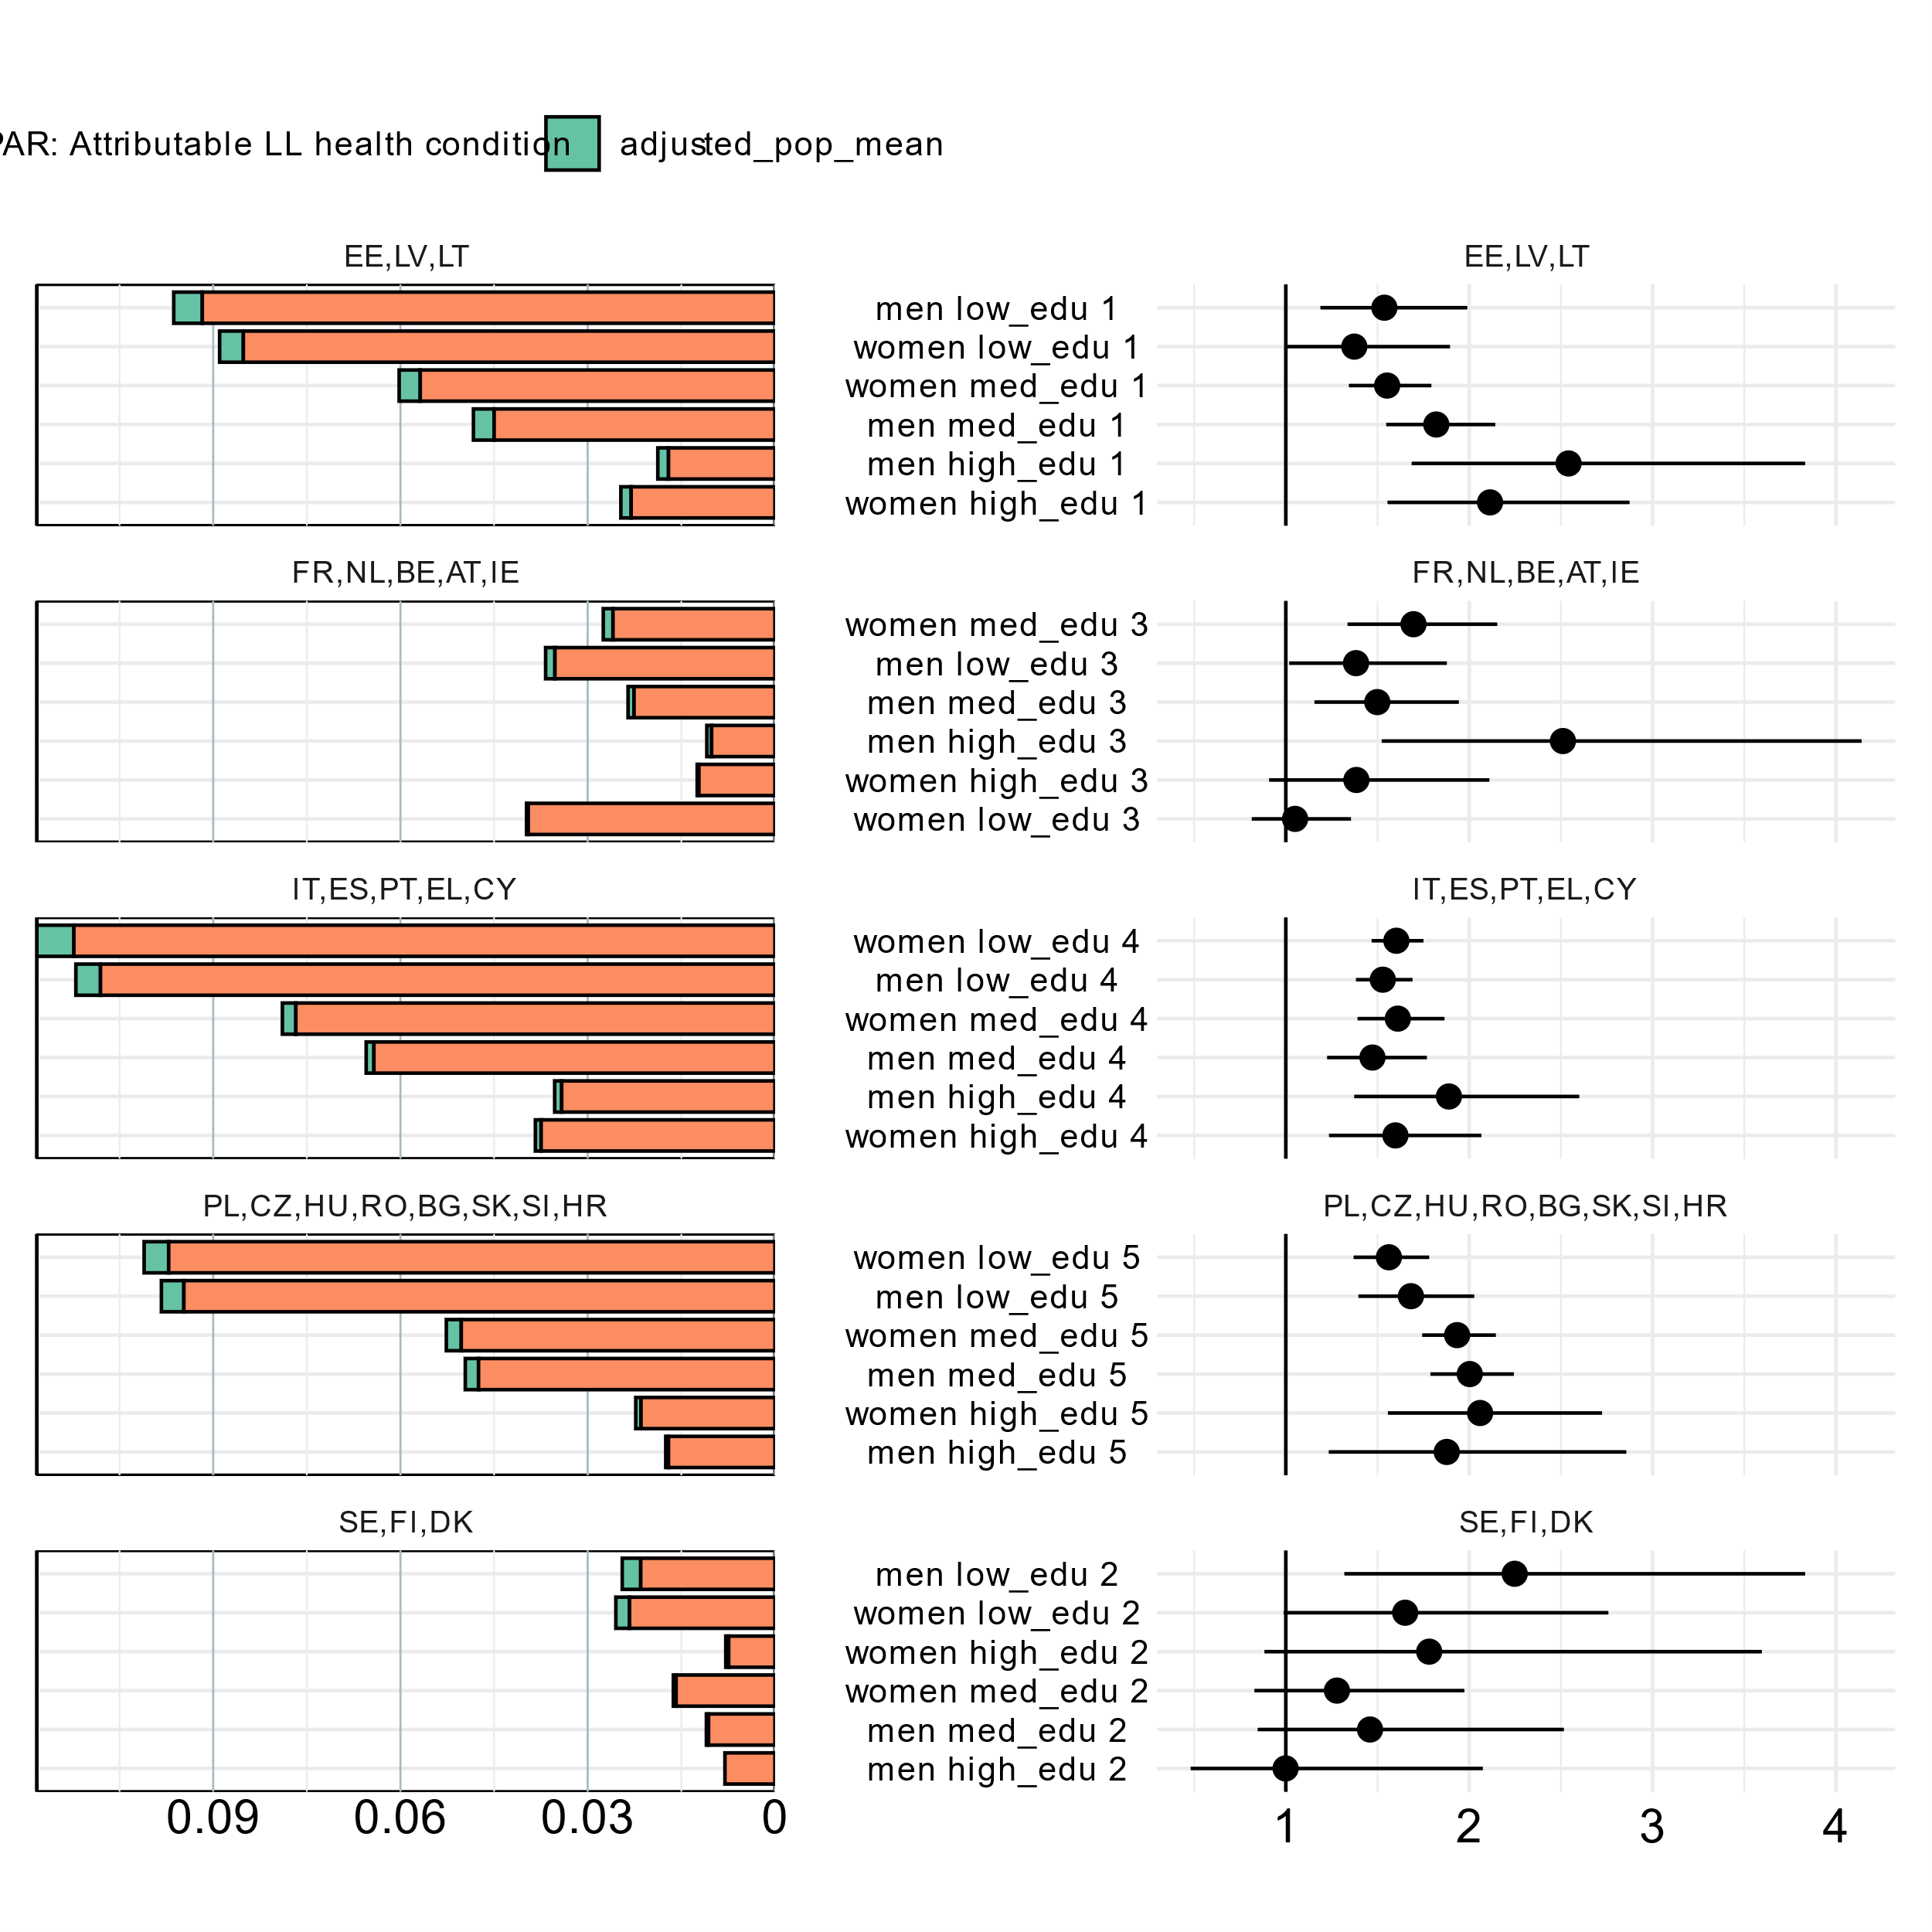
Heterogeneity subjective poverty entry
Poverty entry population mean
Risk ratio

Slide 12
Takeaways
How much could we reduce poverty by reducing ill-health or reducing its poverty effects? Not much.
Still, at individual level, (subjective) poverty entry risks are substantially elevated after onset of health conditions.
Little consistent and theoretically expected heterogeneity in (multiplicative) individual effects. But in terms of absolute numbers of poverty entries, health most important among low educated.

