Slide 1
Disparities in cancer incidence, treatment, and mortality across socioeconomic groups in Finland
Xianhua Zai*, Peng Li*, Luca Dei Bardi, Kaarina Korhonen , Margherita Moretti, Mikko Myrskylä, Pekka Martikainen
HMMWG, Bilbao, 2024.09.25

Slide 2
Background: Cancer Disparity
Associated factors:
Biology
Genetics
Behavior
Environment
Social determinants
Aim of this study:
Disparities of cancer across different socioeconomic levels.

Slide 3
Study Design
Data source: Cancer Registry
Sample: Total dwelling population in Finland
Period: 2000 until 2020
Age: 30+
SES factors: education, income (5-year average)
Cancer types:
All cancers
Women: breast, lung, colorectum, uteri, melanoma and others
Men: prostate, lung, colorectum, bladder, melanoma and others
Outcomes:
Cancer incidence
Stage
Treatments
Overall survival

Slide 4
Methods
Incidence: Age standardized rates (ASR)
Stage: Logistic regression:
Early stage vs. later stage
Adjusted with age at diagnosis, region, urbanization, marital status, birth cohort.
Treatments: Logistic regression:
Treated vs. non-treated
Adjusted with stage, age at diagnosis, region, urbanization, marital status, birth cohort
Overall survival: Cox regression model:
Adjusted with age at diagnosis, region, urbanization, marital status, birth cohort characters of cancer and treatments

Slide 5
Summary table
 | Total | Men | Women
 | N=377,986 | N=191,341 | N=186,645
Education (N, %)
Low | 166,495 (44.05%) | 89,573 (46.81%) | 76,922 (41.21%)
Medium | 112,019 (29.64%) | 54,461 (28.46%) | 57,558 (30.84%)
High | 99,472 (26.32%) | 47,307 (24.72%) | 52,165 (27.95%)
Income (N, %)
Low | 205,645 (54.41%) | 108,032 (56.46%) | 97,613 (52.30%)
Medium | 71,047 (18.80%) | 35,468 (18.54%) | 35,579 (19.06%)
High | 101,294 (26.80%) | 47,841 (25.00%) | 53,453 (28.64%)
Nativity (N, %)
Natives | 370,250 (97.95%) | 187,838 (98.17%) | 182,412 (97.73%)
Migrants | 7,736 (2.05%) | 3,503 (1.83%) | 4,233 (2.27%)
Urbanization (N, %)
Urban area | 242,019 (64.03%) | 118,042 (61.69%) | 123,977 (66.42%)
Semi-urban area | 64,150 (16.97%) | 33,750 (17.64%) | 30,400 (16.29%)
Rural area | 71,817 (19.00%) | 39,549 (20.67%) | 32,268 (17.29%)
Region (N, %)
Uusimaa | 98,492 (26.06%) | 46,691 (24.40%) | 51,801 (27.75%)
Varsinais-Suomi | 34,279 (9.07%) | 17,283 (9.03%) | 16,996 (9.11%)
Satakunta | 17,974 (4.76%) | 9,390 (4.91%) | 8,584 (4.60%)
Åland | 2,287 (0.61%) | 1,303 (0.68%) | 984 (0.53%)
Age at diagnosis (mean, SD) | 66.38 (12.38) | 67.76 (11.25) | 64.96 (13.29)

Slide 6
Summary table (cont.)
 | Total | Men | Women
Cancer types (N, %)
Bladder | 8,189 (2.17%) | 8,189 (4.28%) | 0 (0.00%)
Breast | 75,960 (20.10%) | 0 (0.00%) | 75,960 (40.70%)
Colorectum | 39,049 (10.33%) | 20,190 (10.55%) | 18,859 (10.10%)
Lung | 22,044 (5.83%) | 14,391 (7.52%) | 7,653 (4.10%)
Melanoma | 18,800 (4.97%) | 9,688 (5.06%) | 9,112 (4.88%)
Others | 118,660 (31.39%) | 56,911 (29.74%) | 61,749 (33.08%)
Prostate | 81,972 (21.69%) | 81,972 (42.84%) | 0 (0.00%)
Uteri | 13,312 (3.52%) | 0 (0.00%) | 13,312 (7.13%)
Cancer stage (N, %)
Missing | 114,095 (30.18%) | 68,956 (36.04%) | 45,139 (24.18%)
Stage I-II | 125,361 (33.17%) | 59,946 (31.33%) | 65,415 (35.05%)
Stage III-IV | 138,530 (36.65%) | 62,439 (32.63%) | 76,091 (40.77%)
Treatment: surgery
No | 75,704 (20.03%) | 56,871 (29.72%) | 18,833 (10.09%)
Yes | 246,468 (65.21%) | 100,391 (52.47%) | 146,077 (78.26%)
Missing | 55,814 (14.77%) | 34,079 (17.81%) | 21,735 (11.65%)
Treatment: radiation
No | 144,162 (38.14%) | 72,543 (37.91%) | 71,619 (38.37%)
Yes | 171,442 (45.36%) | 82,589 (43.16%) | 88,853 (47.61%)
Missing | 62,382 (16.50%) | 36,209 (18.92%) | 26,173 (14.02%)
Treatment: chemo
No | 164,644 (43.56%) | 85,632 (44.75%) | 79,012 (42.33%)
Yes | 150,855 (39.91%) | 69,366 (36.25%) | 81,489 (43.66%)
Missing | 62,487 (16.53%) | 36,343 (18.99%) | 26,144 (14.01%)
Number of death (N, %) | 181,206 (47.94%) | 102,578 (53.61%) | 78,628 (42.13%)
Survival years (mean, SD) | 6.20 (5.18) | 5.83 (4.97) | 6.57 (5.36)

Slide 7
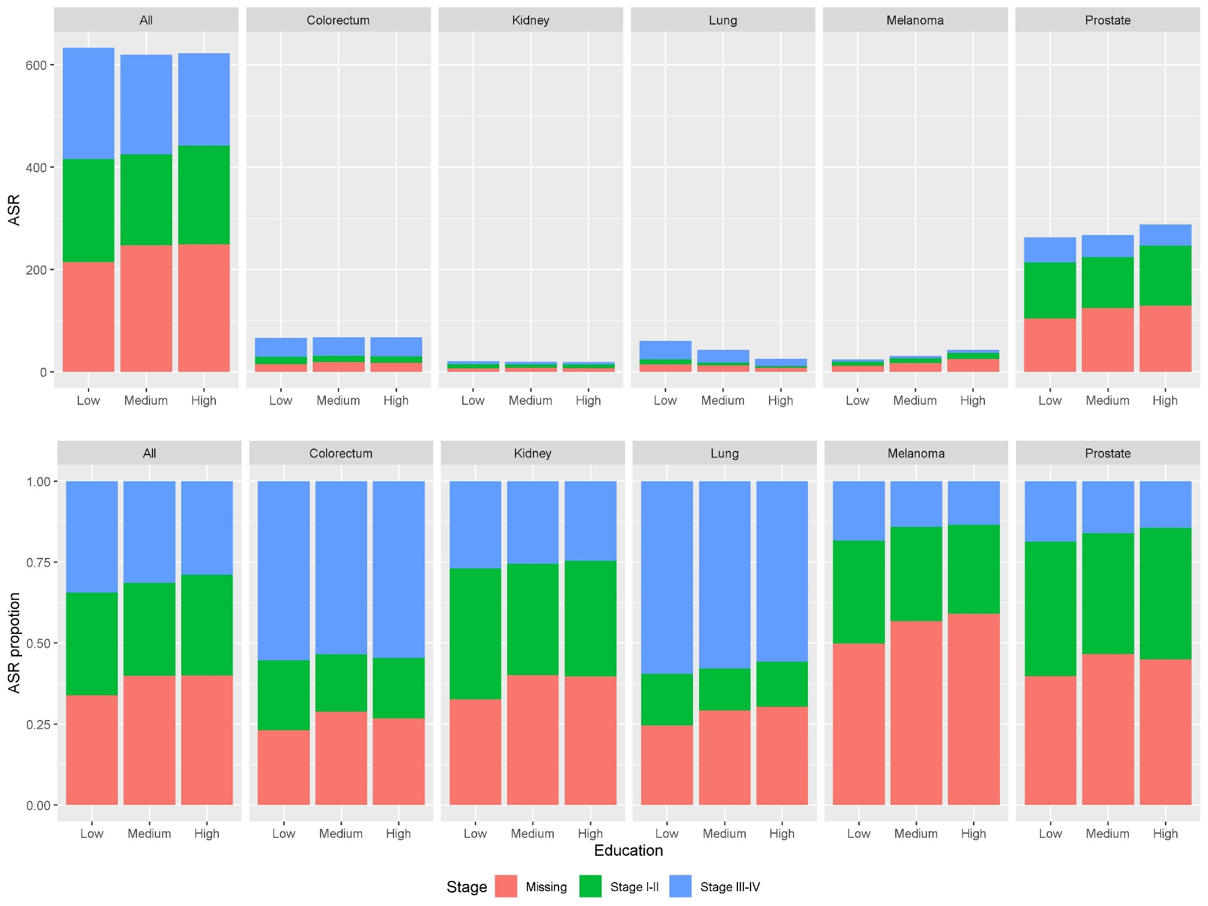
Cancer Incidences: men, by education

Slide 8
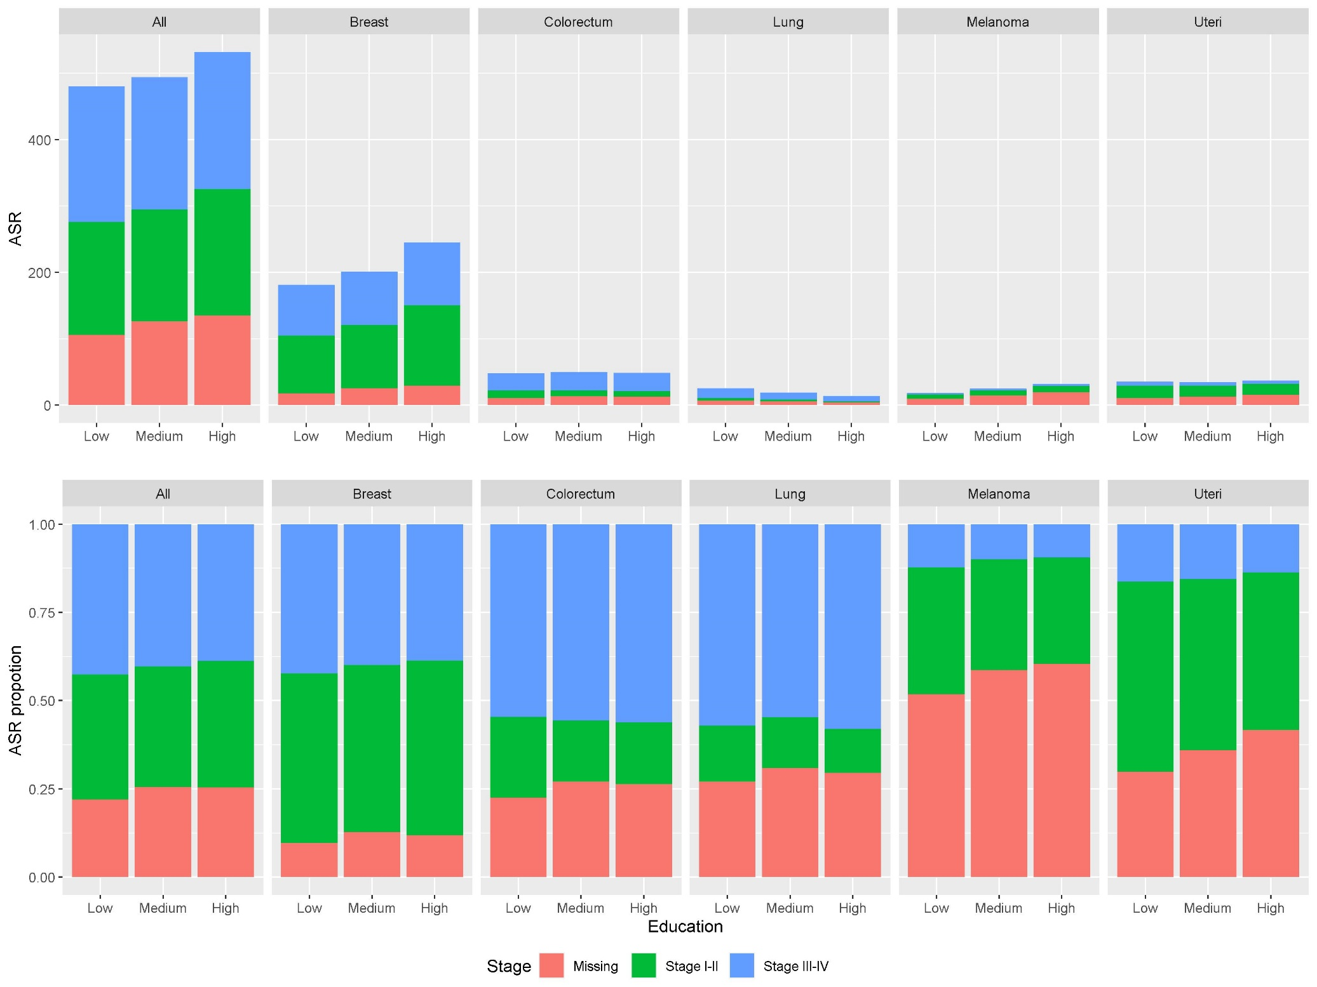
Cancer Incidences: women , by education

Slide 9
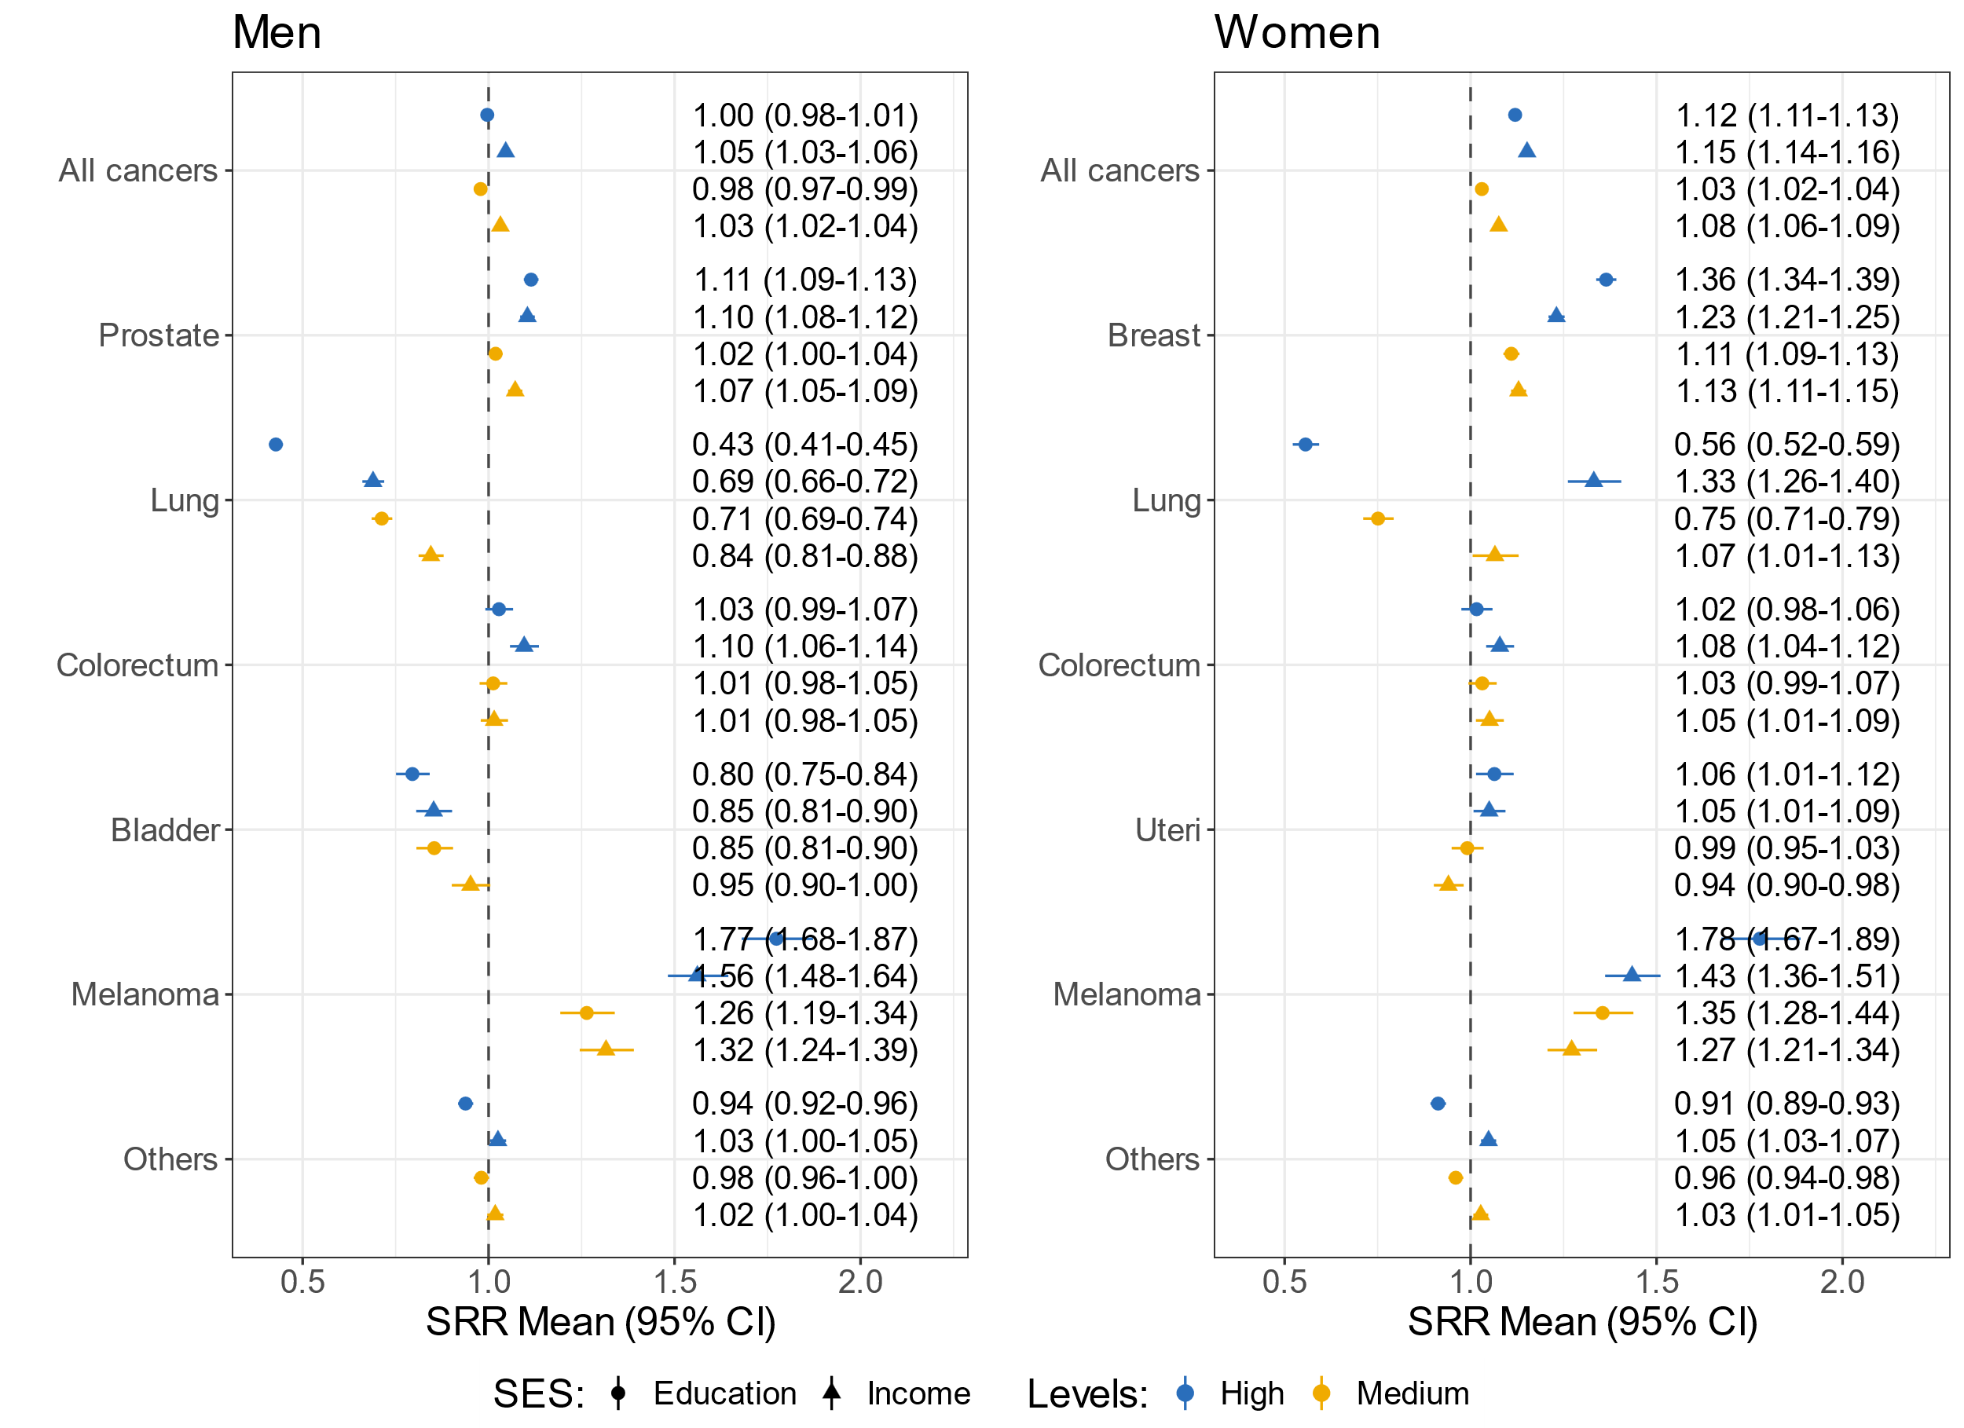
Cancer Incidences: Standardized Rate Ratio

Slide 10
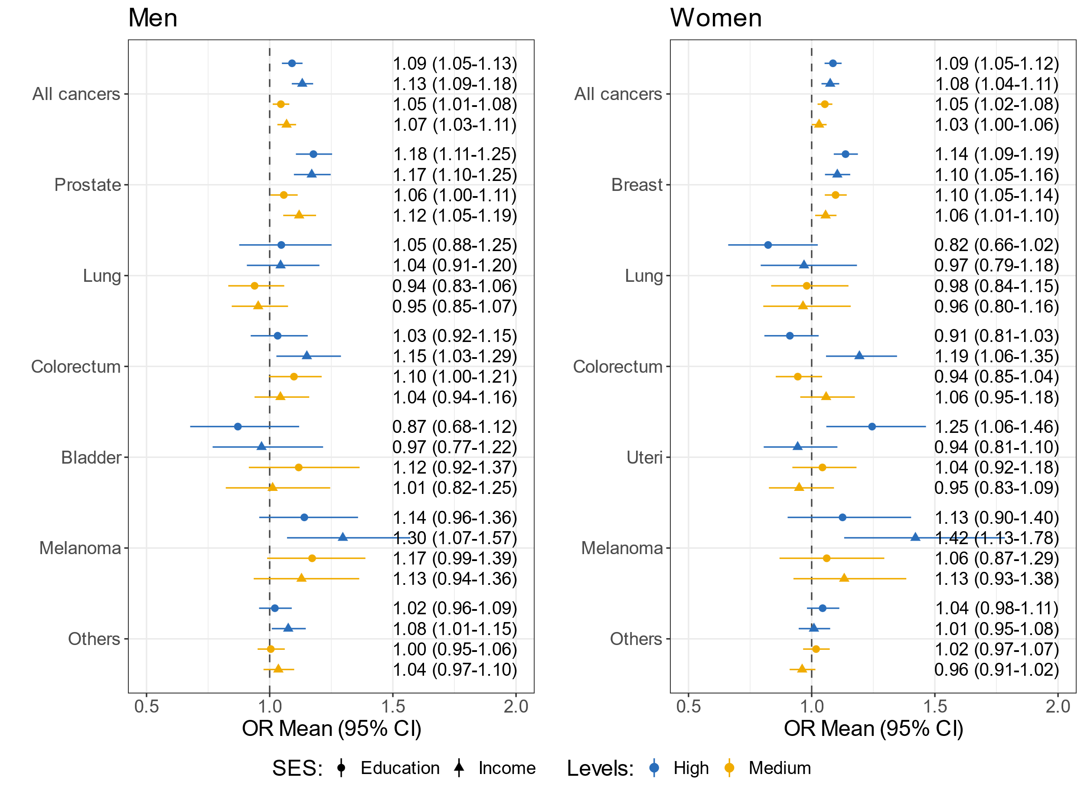
Disparities in Stage of Diagnoses: Early vs. Late

Slide 11
Summary on cancer diagnoses
Men with high/medium SES:
Higher risk of prostate cancer
Higher probabilities of diagnosing with early-stage
Women with high/medium SES:
Higher risk of breast cancer
Higher probabilities of diagnosing with early-stage
Similar patterns were shown in melanoma and colon cancer.
These might be related with the effects of cancer screening policies.

Slide 12
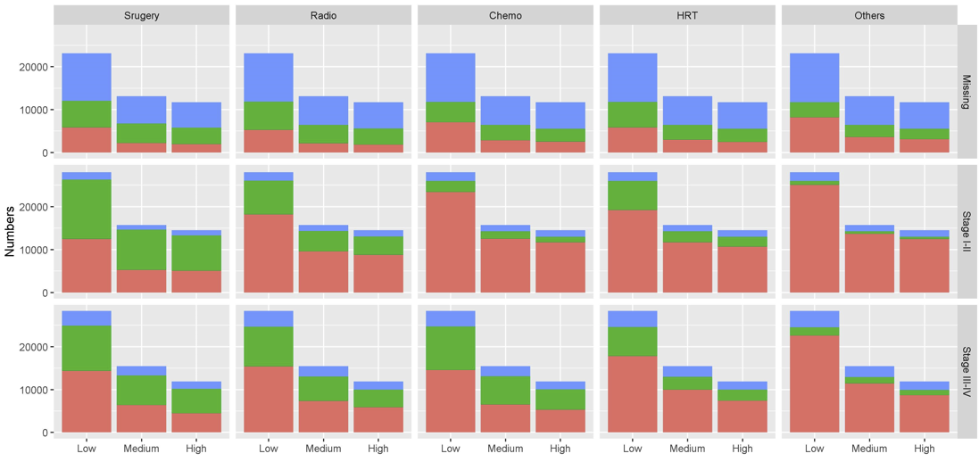
Cancer Treatments: men, by education

Slide 13
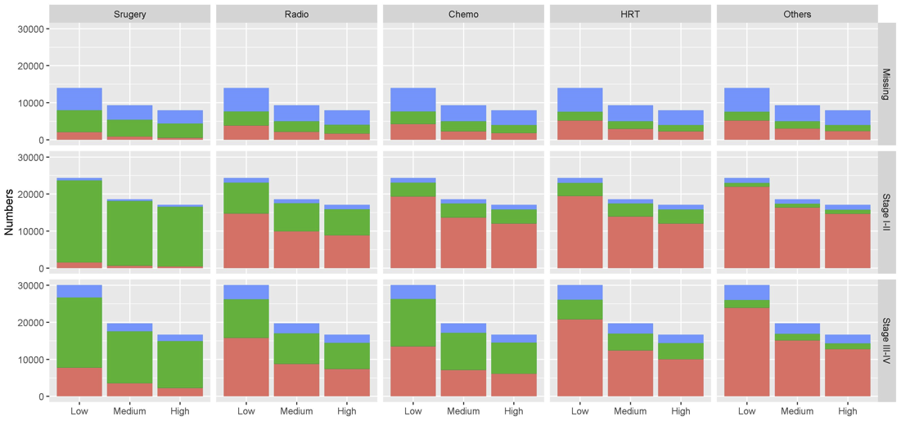
Cancer Treatments: women, by education

Slide 14
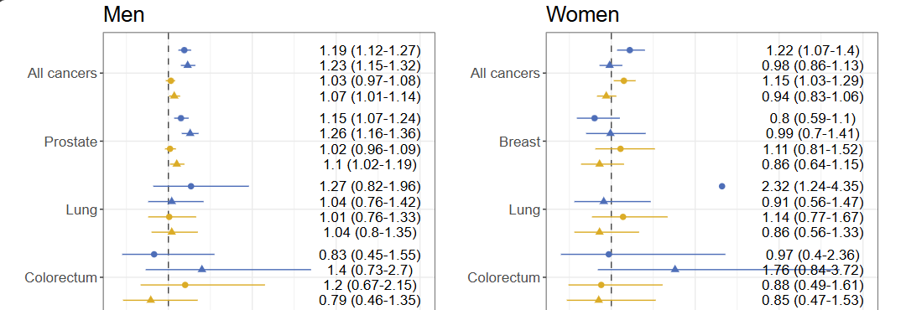
Disparities in Surgery: yes vs. no

Slide 15
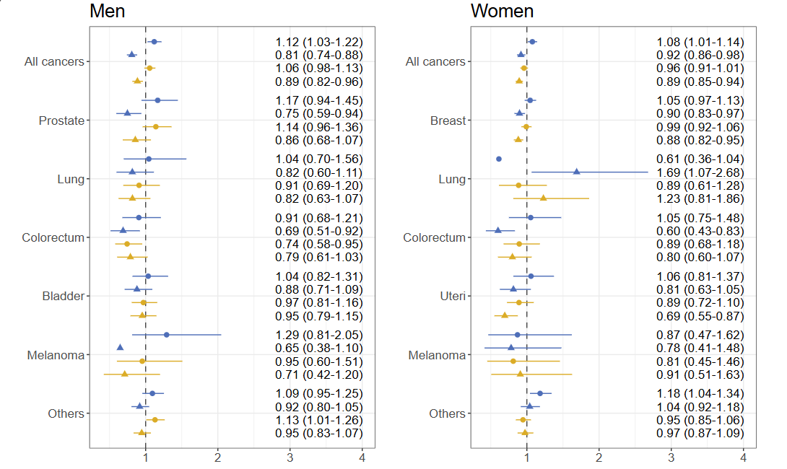
Disparities in Chemo: yes vs. no
Notes:
The outcome is diagnosed with early stage cancer (I,II) compared to later stage (III, IV). For all cancers, covariates including cancer types, age at diagnosis, marital status, country of origin, education level, income level and the interaction of education and income were adjusted in the models. For subtype of cancers, age at diagnosis, marital status, country of origin, education level, income level and the interaction of education and income were adjusted in the models.

Slide 16
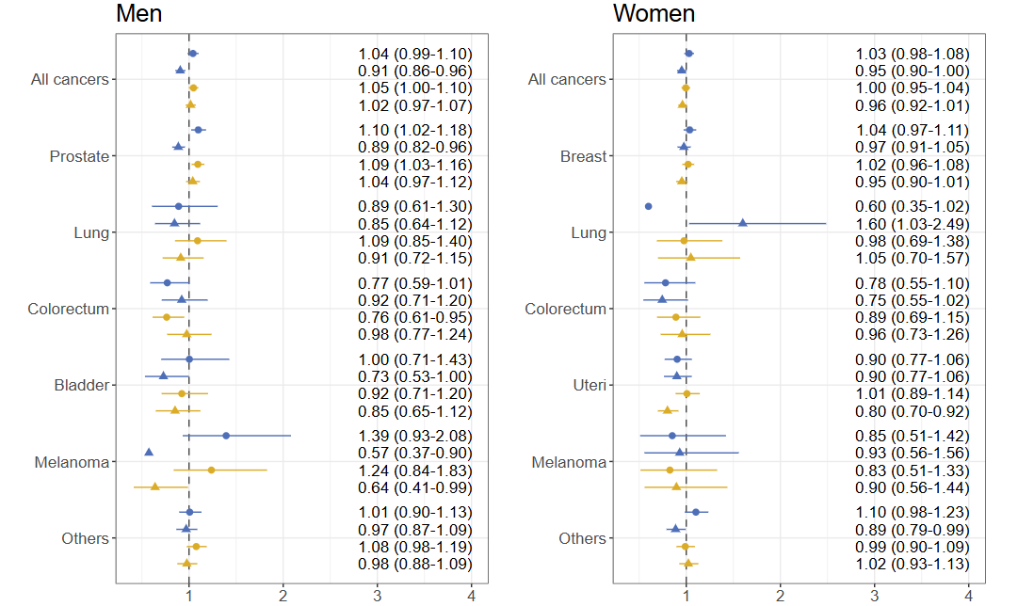
Disparities in Radiation: yes vs. no
Notes:
The outcome is diagnosed with early stage cancer (I,II) compared to later stage (III, IV). For all cancers, covariates including cancer types, age at diagnosis, marital status, country of origin, education level, income level and the interaction of education and income were adjusted in the models. For subtype of cancers, age at diagnosis, marital status, country of origin, education level, income level and the interaction of education and income were adjusted in the models.

Slide 17
Summary on cancer treatments
For all cancers in total, the high/medium SES group had higher probabilities to take surgery for men, only women with high/medium education had higher surgery probabilities.
For all cancers in total and prostate cancer, the high/medium education group had higher probabilities to take chemotherapy or radiotherapy for men, but not income.

Slide 18
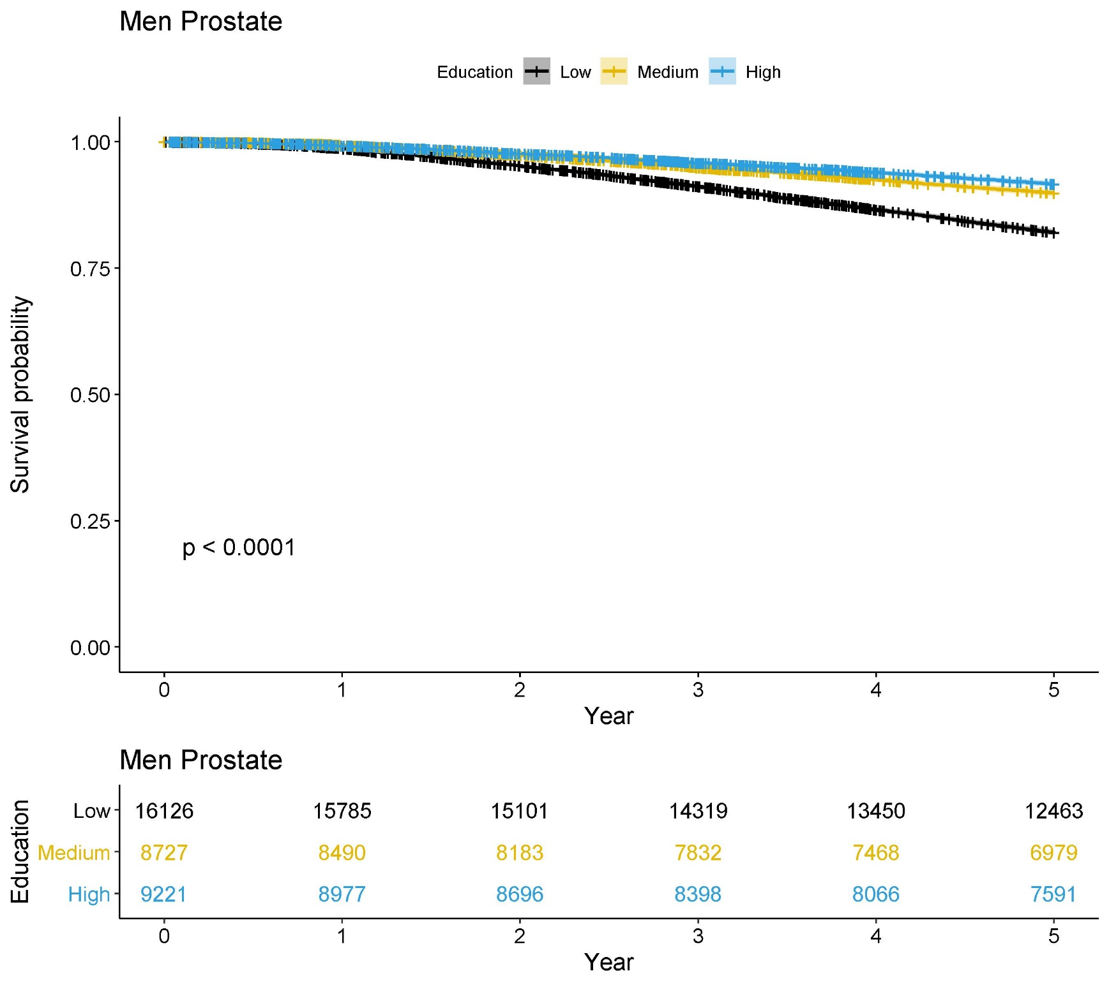
Survival: men with prostate cancer, stage I-II, KM plot
Notes:
The outcome is diagnosed with early stage cancer (I,II) compared to later stage (III, IV). For all cancers, covariates including cancer types, age at diagnosis, marital status, country of origin, education level, income level and the interaction of education and income were adjusted in the models. For subtype of cancers, age at diagnosis, marital status, country of origin, education level, income level and the interaction of education and income were adjusted in the models.

Slide 19
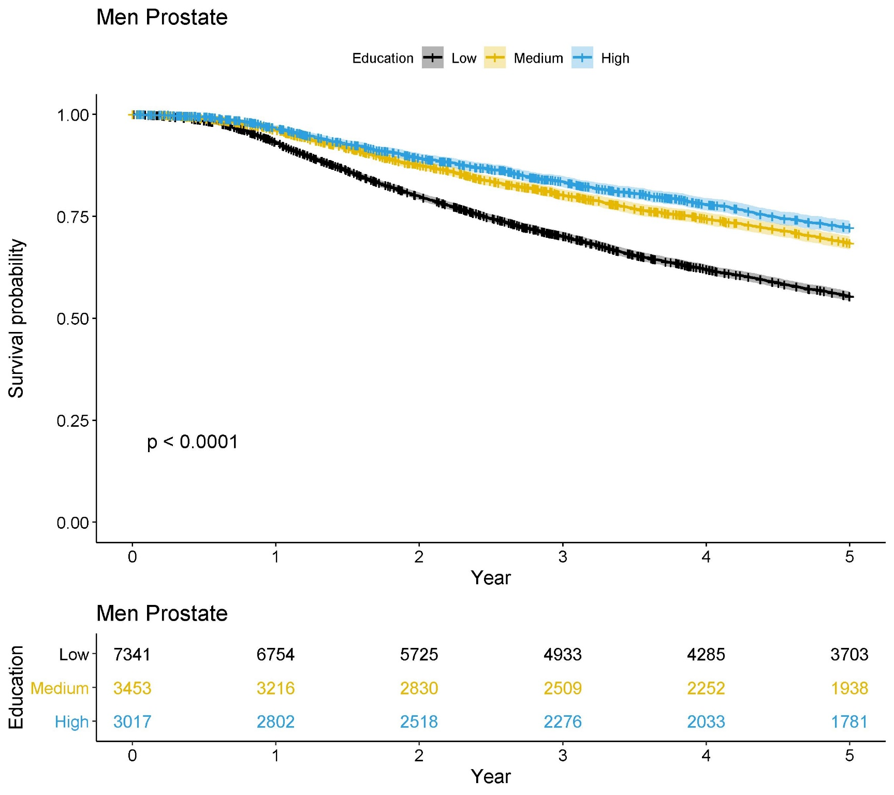
Survival: men with prostate cancer, stage III-IV, KM plot
Notes:
The outcome is diagnosed with early stage cancer (I,II) compared to later stage (III, IV). For all cancers, covariates including cancer types, age at diagnosis, marital status, country of origin, education level, income level and the interaction of education and income were adjusted in the models. For subtype of cancers, age at diagnosis, marital status, country of origin, education level, income level and the interaction of education and income were adjusted in the models.

Slide 20
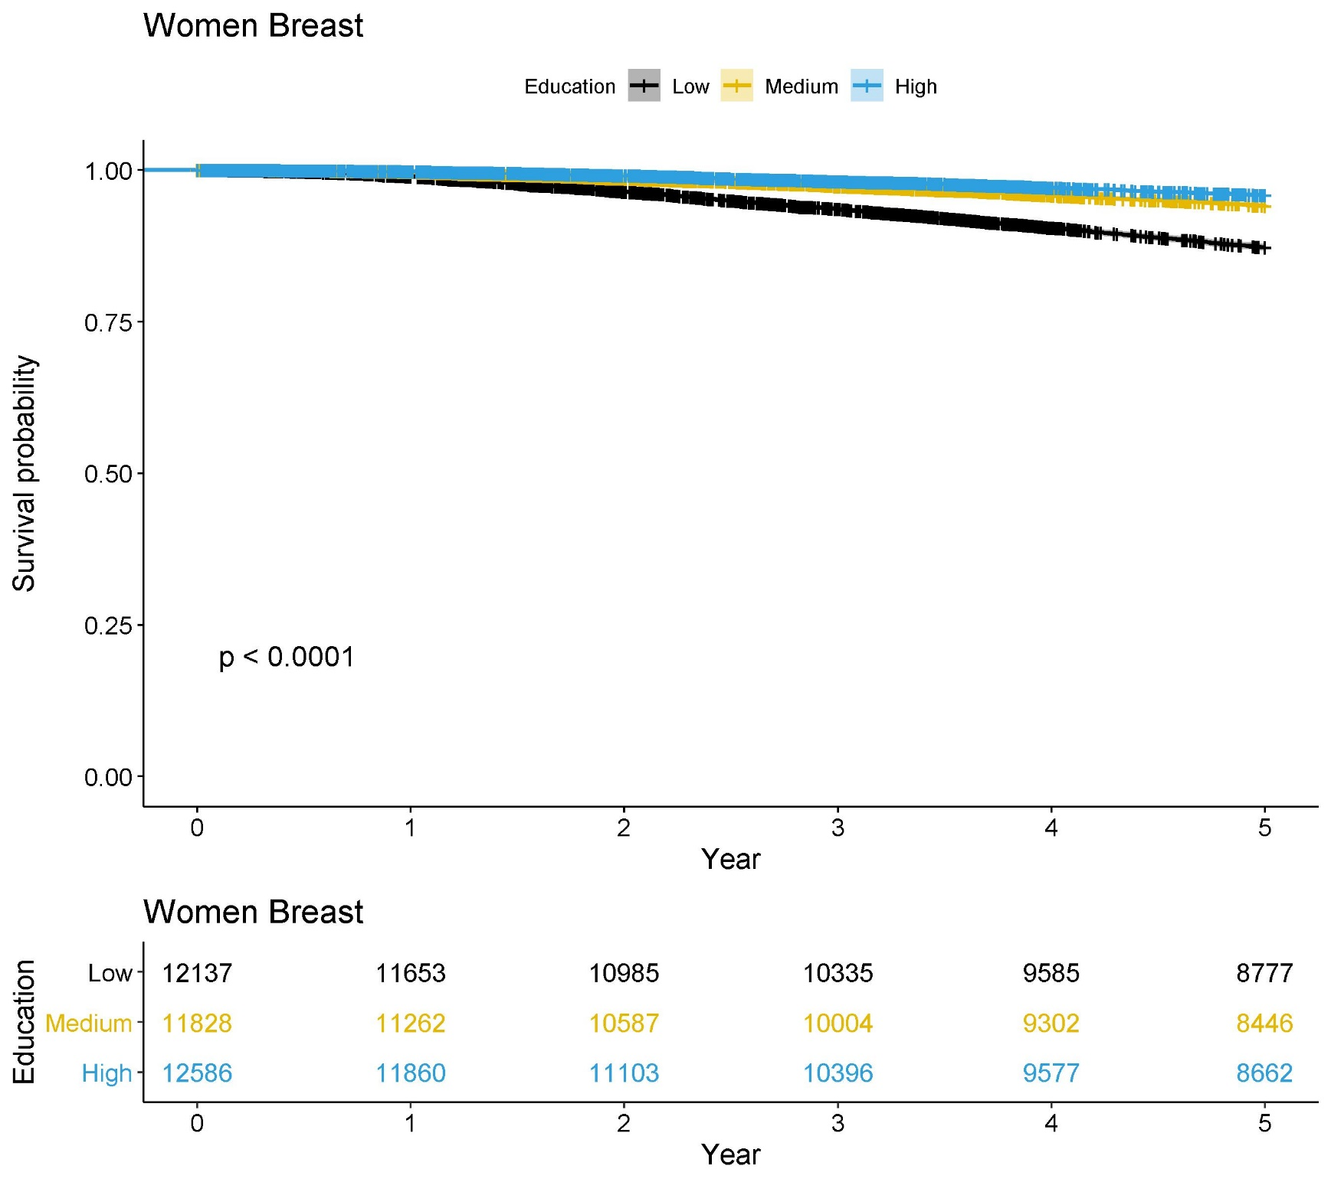
Survival: women with breast cancer, stage I-II, KM plot
Notes:
The outcome is diagnosed with early stage cancer (I,II) compared to later stage (III, IV). For all cancers, covariates including cancer types, age at diagnosis, marital status, country of origin, education level, income level and the interaction of education and income were adjusted in the models. For subtype of cancers, age at diagnosis, marital status, country of origin, education level, income level and the interaction of education and income were adjusted in the models.

Slide 21
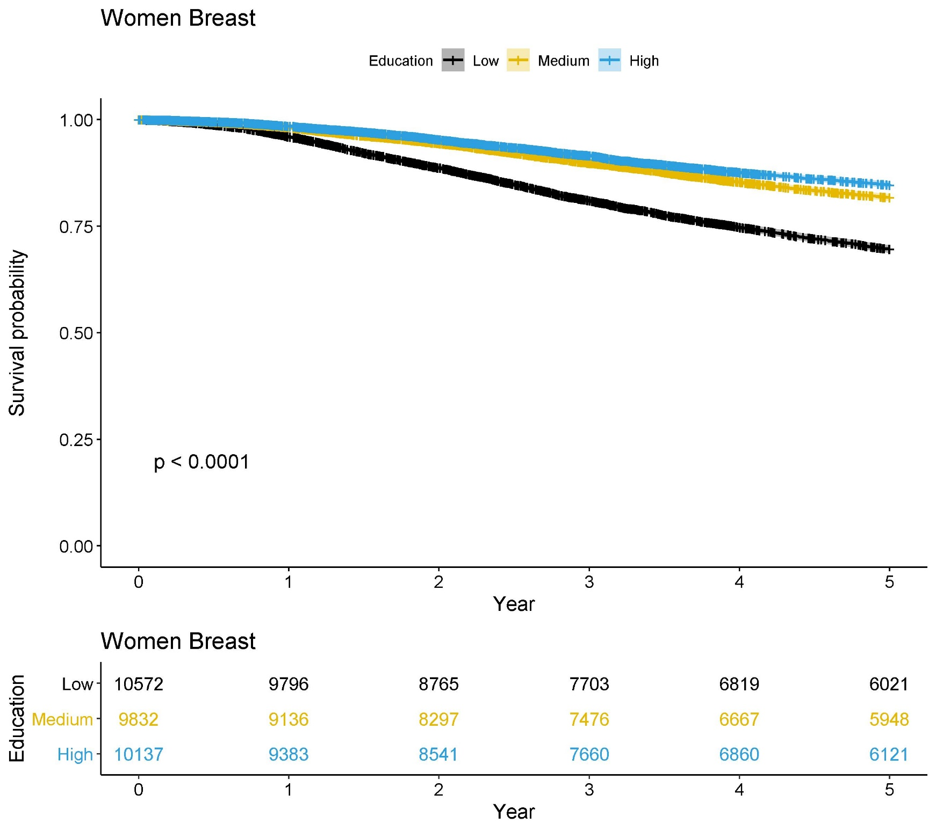
Survival: women with breast cancer, stage III-IV, KM plot
Notes:
The outcome is diagnosed with early stage cancer (I,II) compared to later stage (III, IV). For all cancers, covariates including cancer types, age at diagnosis, marital status, country of origin, education level, income level and the interaction of education and income were adjusted in the models. For subtype of cancers, age at diagnosis, marital status, country of origin, education level, income level and the interaction of education and income were adjusted in the models.

Slide 22
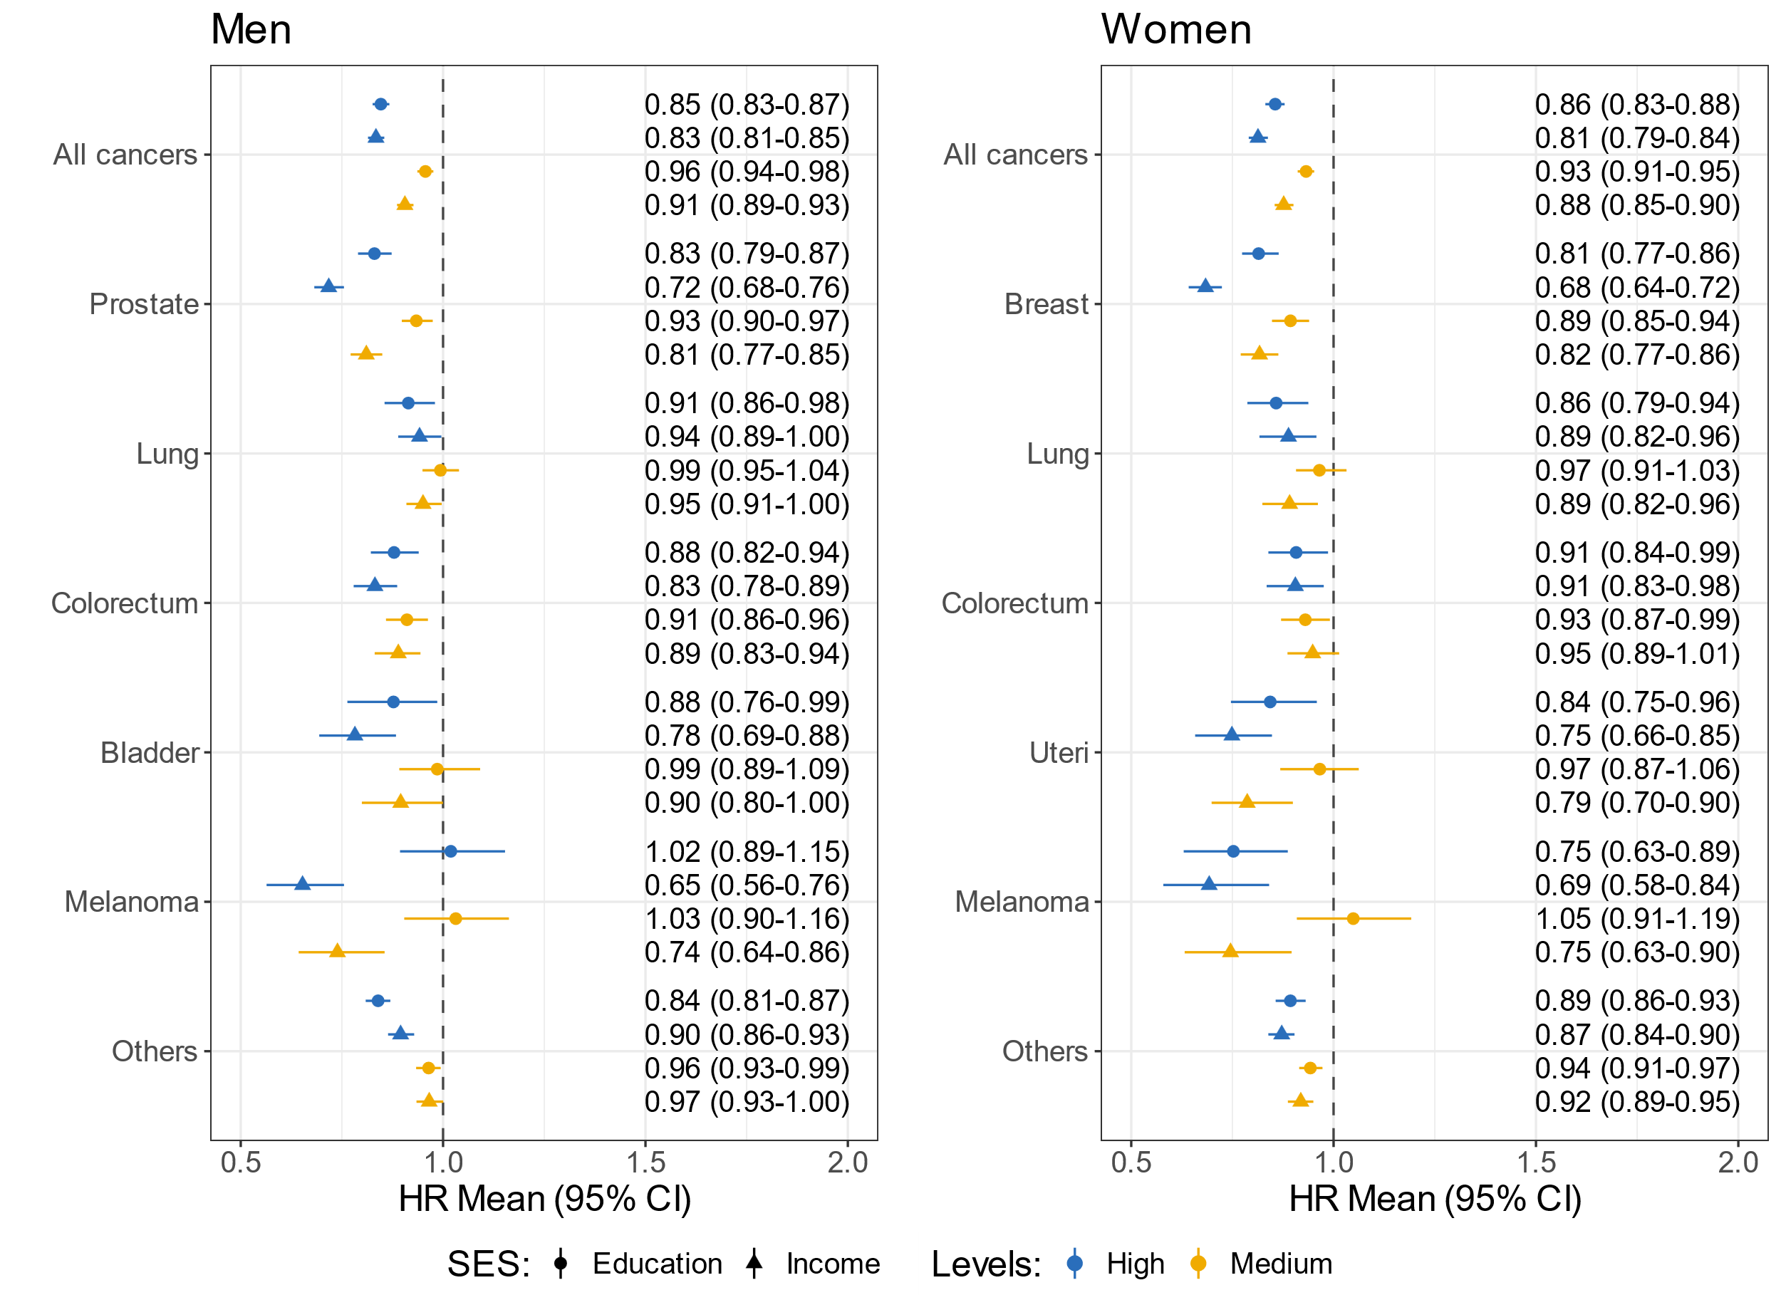
Disparities in Survival: Cox model
Notes:
The outcome is diagnosed with early stage cancer (I,II) compared to later stage (III, IV). For all cancers, covariates including cancer types, age at diagnosis, marital status, country of origin, education level, income level and the interaction of education and income were adjusted in the models. For subtype of cancers, age at diagnosis, marital status, country of origin, education level, income level and the interaction of education and income were adjusted in the models.

Slide 23
Summary on survival
For most of the cancer types, patients with high/medium SES had better survival for both men and women.

Slide 24
Discussion
would it be possible that high educated are more likely to follow screening programs than low educated?
Or may it be the case that low educated have less access to those programmed?
The differences of survival across SES groups might be related with treatment selection. But are there other factors?

Slide 25
Thanks for your attention!

Slide 26
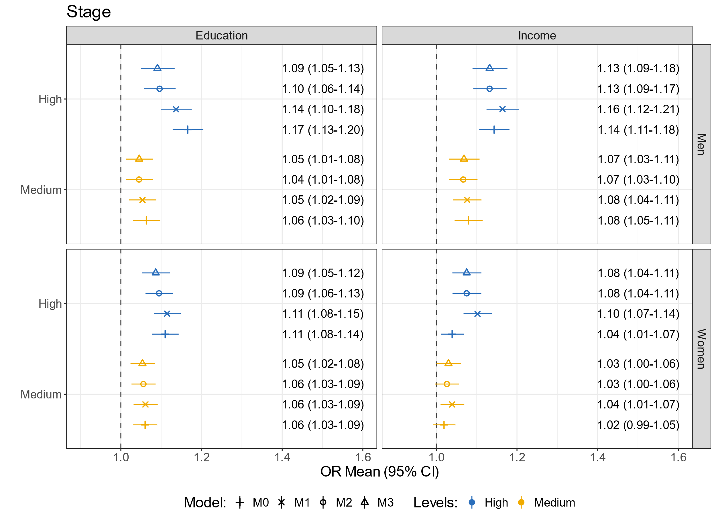
Disparities in Stage of Diagnoses: sensitivity test, all cancers
Notes:
The outcome is diagnosed with early stage cancer (I,II) compared to later stage (III, IV). For all cancers, covariates including cancer types, age at diagnosis, marital status, country of origin, education level, income level and the interaction of education and income were adjusted in the models. For subtype of cancers, age at diagnosis, marital status, country of origin, education level, income level and the interaction of education and income were adjusted in the models.

Slide 27
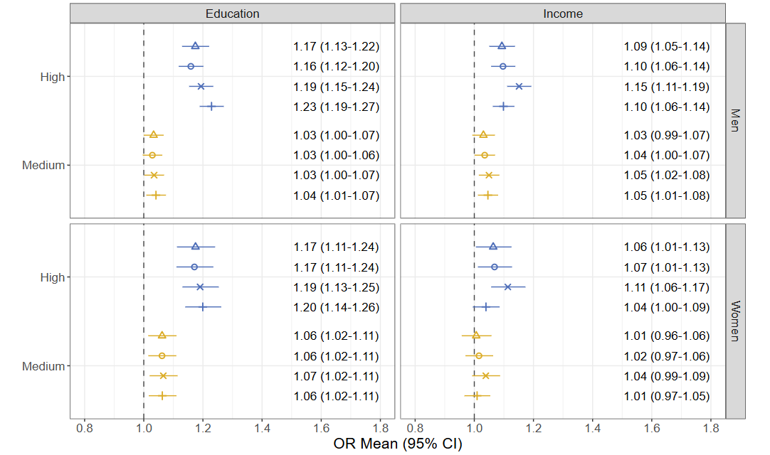
Disparities in Surgery: sensitivity check
Notes:
The outcome is diagnosed with early stage cancer (I,II) compared to later stage (III, IV). For all cancers, covariates including cancer types, age at diagnosis, marital status, country of origin, education level, income level and the interaction of education and income were adjusted in the models. For subtype of cancers, age at diagnosis, marital status, country of origin, education level, income level and the interaction of education and income were adjusted in the models.

Slide 28
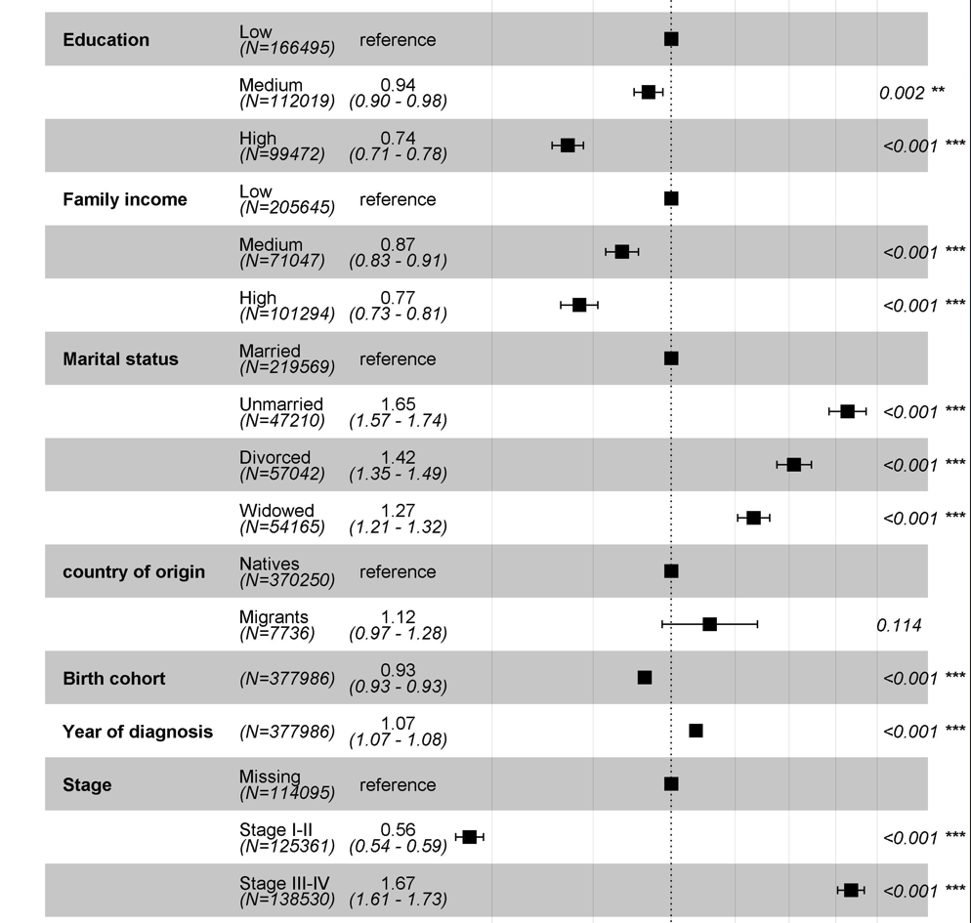
Survival: men with prostate cancer, Cox model
Notes:
The outcome is diagnosed with early stage cancer (I,II) compared to later stage (III, IV). For all cancers, covariates including cancer types, age at diagnosis, marital status, country of origin, education level, income level and the interaction of education and income were adjusted in the models. For subtype of cancers, age at diagnosis, marital status, country of origin, education level, income level and the interaction of education and income were adjusted in the models.

Slide 29
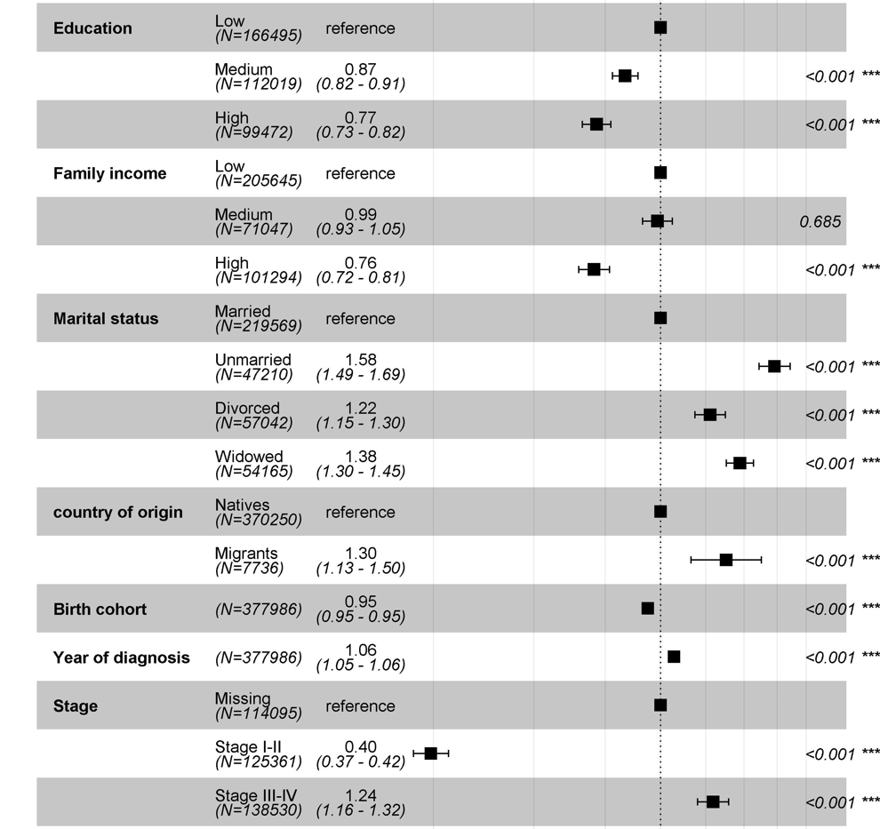
Survival: women with breast cancer, Cox model
Notes:
The outcome is diagnosed with early stage cancer (I,II) compared to later stage (III, IV). For all cancers, covariates including cancer types, age at diagnosis, marital status, country of origin, education level, income level and the interaction of education and income were adjusted in the models. For subtype of cancers, age at diagnosis, marital status, country of origin, education level, income level and the interaction of education and income were adjusted in the models.

