Slide 1
Regional and educational inequalities in Cardiovascular mortality in Spain and the role of well-established risk factors
Enrique Pérez-Miguel, Sergi Trias-Llimós.
Bilbao / 25th September 2024

Slide 2
Background
Pérez-Miguel & Trias-Llimós
2
CVD mortality is the leading cause of death in the world and in Europe.
In Spain, they are the leading cause of death for women and the second for men.
CVDs have important regional and socioeconomic inequalities (Girolamo et al., 2020; Müller-Nordhorn et al., 2008), which might stem from inequalities in risk factors
Figure 1. Share of deaths by cause and sex. Spain, 2022. (Spanish National Statistics Institute, INE)
Notes:
CVDs are the leading cause of death in the world, in Europe and in Spain

Slide 3
Objectives
3
To assess educational inequalities in CVD mortality by sex in Spanish regions.
To estimate the contribution of educational and regional inequalities of well established risk factors on CVD mortality and all cause mortality.
Pérez-Miguel & Trias-Llimós
Notes:
CVDs are the leading cause of death in the world, in Europe and in Spain

Slide 4
Data & Methods
4
DATA:
Individual-level multiple cause-of-death mortality data in Spain, ages 35+, 2016-21 (2,5M deaths) (Spanish National Statistics Institute).
CVD
As underlying cause (UC)
CVD with DKOLH
Diabetes, Chronic Kidney Disease, Obesity, Lipidemias, Hypertension as Contributory Cause
Two main metrics:
Adair & Lopez (2020)
CVD deaths
Figure 2. Share of CVD with DKOLH out of total CVD deaths (INE)
Pérez-Miguel & Trias-Llimós
Notes:
CVDs are the leading cause of death in the world, in Europe and in Spain

Slide 5
Methods
5
To estimate age standardised CVD mortality rates by Autonomous Community (CCAA), sex and educational level using all deaths with a code I00 I99 (ICD 10) as underlying cause.
Measure of inequalities : Relative Index of Inequality (RII)
1.
2.
To estimate the potential contribution of educational and regional inequalities in CVD with DKOLH on CVD and all cause mortality using potential gains in life expectancy at age 35 (PGLE , upward levelling) in three different counterfactual scenarios
Pérez-Miguel & Trias-Llimós
Notes:
CVDs are the leading cause of death in the world, in Europe and in Spain

Slide 6
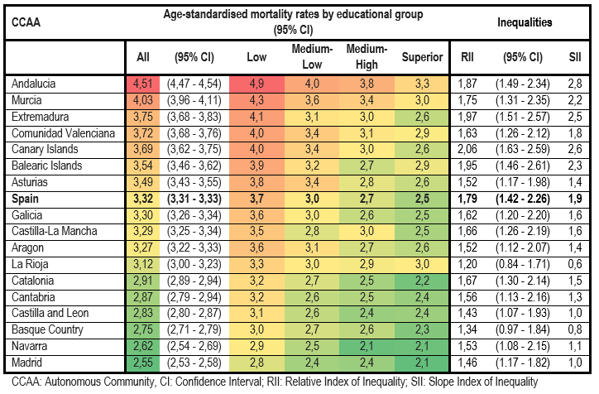
Results
6
1.
Table 1. Age Standardised CVD mortality rates (per 1,000 persons-years), Relative Index of Inequality (RII) and Slope Index of Inequality (SII) by sex, CCAA and educational level, ages 35+, Spain 2016-2021. Females
Pérez-Miguel & Trias-Llimós

Slide 7
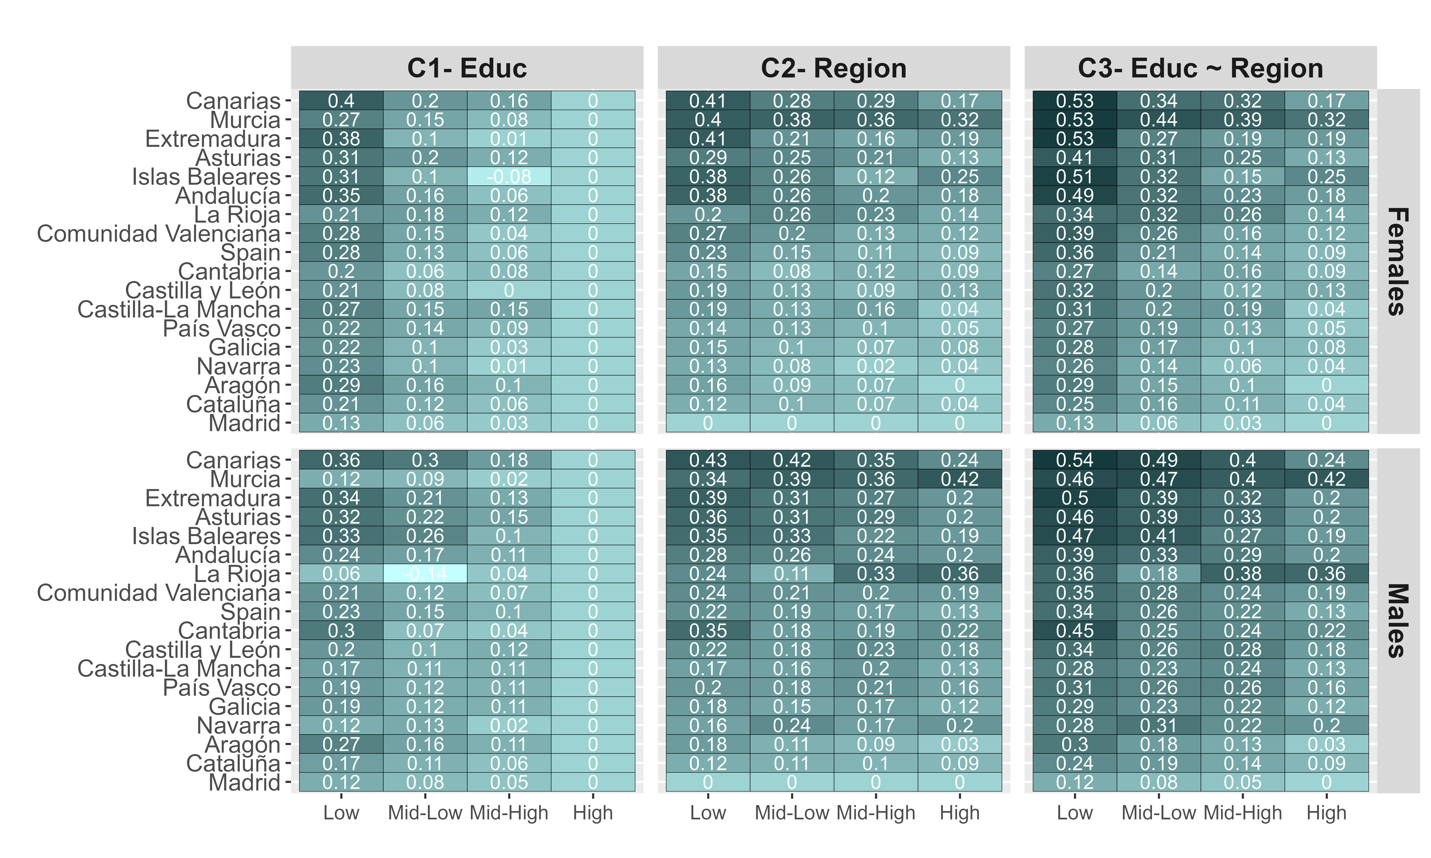
Results
7
2.
How much would life expectancy increase if …
Figure 4. PGLE at age 35 by CCAA, sex, educational level and scenario.
Pérez-Miguel & Trias-Llimós

Slide 8
Results
2.
How much would life expectancy increase if …
C1 :
Educational inequalities in CVD with DKOLH were eliminated
Figure 4. PGLE at age 35 by CCAA, sex, educational level and scenario.
Pérez-Miguel & Trias-Llimós
7

Slide 9
Results
2.
How much would life expectancy increase if …
C2 :
Regional inequalities in CVD with DKOLH were eliminated
Figure 4. PGLE at age 35 by CCAA, sex, educational level and scenario.
Pérez-Miguel & Trias-Llimós
7

Slide 10
Results
2.
How much would life expectancy increase if …
C3 :
Regional and educational inequalities in CVD with DKOLH were eliminated
Figure 4. PGLE at age 35 by CCAA, sex, educational level and scenario.
Pérez-Miguel & Trias-Llimós
7

Slide 11
Conclusions
8
Educational inequalities exist in CVD mortality in Spain and its regions. They are greater for women and in the Balearic and Canary Islands.
DKOLH risk factors play an important role in CVD mortality.
Eliminating both dimensions of inequalities in CVD with DKOLH risk factors would have an important impact on Spanish overall mortality (PGLE): 0,26 years for females and 0,27 years for males (C3).
Pérez-Miguel & Trias-Llimós

Slide 12
References
9
Adair, T., & Lopez, A. D. (2020). The role of overweight and obesity in adverse cardiovascular disease mortality trends: an analysis of multiple cause of death data from Australia and the USA. BMC medicine, 18, 1-11.
Di Girolamo, C., Nusselder, W. J., Bopp, M., Brønnum-Hansen, H., Costa, G., Kovács, K., ... & Mackenbach, J. P. (2020). Progress in reducing inequalities in cardiovascular disease mortality in Europe. Heart, 106(1), 40-49.
Müller-Nordhorn, J., Binting, S., Roll, S., & Willich, S. N. (2008). An update on regional variation in cardiovascular mortality within Europe. European heart journal, 29(10), 1316–1326.
Funding
This study was supported with funding provided by the BBVA Foundation (Beca Leonardo 2023, LEO23-2-9669-ECS-DEM-16 ).
STL acknowledges research funding from the Spanish Ministry of Science and Innovation (RYC2021-033123-I)
Pérez-Miguel & Trias-Llimós

Slide 13
Gràcies
Enrique Pérez-Miguel
eperez@ced.uab.es
Sergi Trias-Llimós
strias@ced.uab.es
Consorci Members
@CEDemografia

