Slide 1
Visualization of half a century’s Hungarian cancer mortality dynamics on Lexis diagrams, 1970-2020
András Wéber (NIO), Mátyás Árvai (HUN-REN-ISS), Lászlóné Hilbert (HCSO), Dávid Kelemen (HCSO), Péter Nagy (NIO), István Kenessey (NIO)
European Association for Population Studies – Health, Morbidity, and Mortality Working Group
25 – 27 September 2024, Bilbao – Spain

Slide 2
Background
Cancer will become the main cause of morbidity and mortality in all regions of the world and its relevance in premature mortality is also increasing (Bray et al., 2021).
Hungary is a leader in Europe in deaths caused by malignant neoplasms (GLOBOCAN).
Aim: present the dynamics of Hungarian cancer mortality over a half-century in order to express age-period-cohort effects using Lexis diagrams by selected tumor localizations.
Bray F, Laversanne M, Weiderpass E, Soerjomataram I. The ever-increasing importance of cancer as a leading cause of premature death worldwide. Cancer. 2021 Aug 15;127(16):3029-3030.
Ferlay J, Ervik M, Lam F, Laversanne M, Colombet M, Mery L, Piñeros M, Znaor A, Soerjomataram I, Bray F (2024). Global Cancer Observatory: Cancer Today (version 1.1). Lyon, France: International Agency for Research on Cancer. Available from: https://gco.iarc.who.int/today
1/9

Slide 3
Interpretation
Mortality surfaces (Rau et al., 2018) – smoothed rates (assumed Poisson distribution using p-splines models) of mortality change per previous time unit (Camarda, 2012) for lung, breast, colon, pancreas and myeloid cancers.
Horizontal patterns represent age effects (i.e.: biological mechanisms),
vertical patterns represent period effects (variation of risk factors over a period of time, equal impact on different ages and birth cohorts),
diagonal patterns represent cohort effects (impact affecting individuals born in the same year, which persist throughout the lifecycle of the generation) (Holford et al., 1991).
Camarda, C. G. (2012). MortalitySmooth: An R Package for Smoothing Poisson Counts with P-Splines. Journal of Statistical Software, 50(1), 1–24.
Rau R, Bohk-Ewald C, Muszyńska MM, Vaupel JW. Visualizing Mortality Dynamics in the Lexis Diagram [Internet]. Cham (CH): Springer; 2018.
Holford TR. Understanding the effects of age, period, and cohort on incidence and mortality rates. Annu Rev Public Health. 1991;12:425-57.
2/9

Slide 4
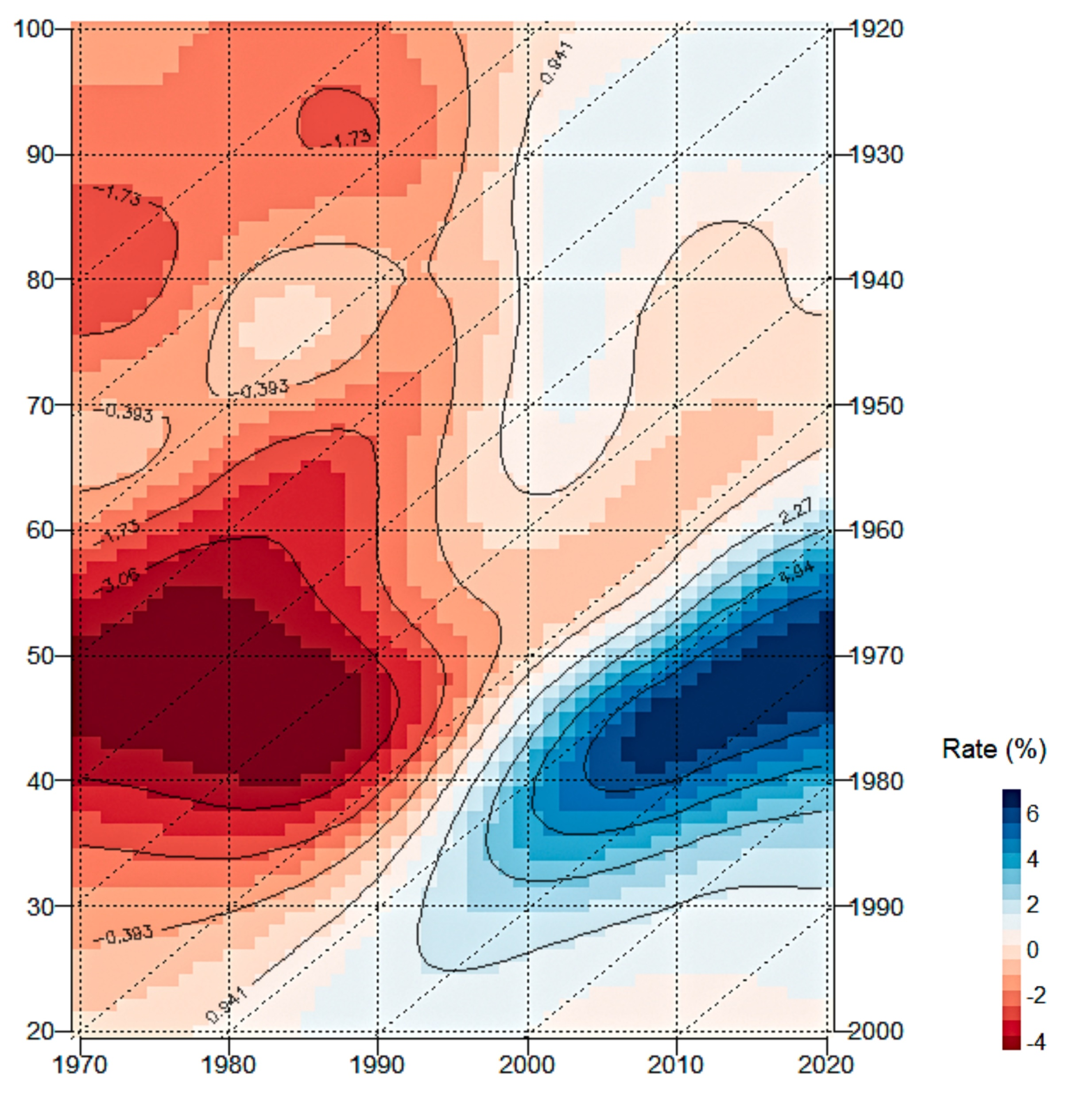
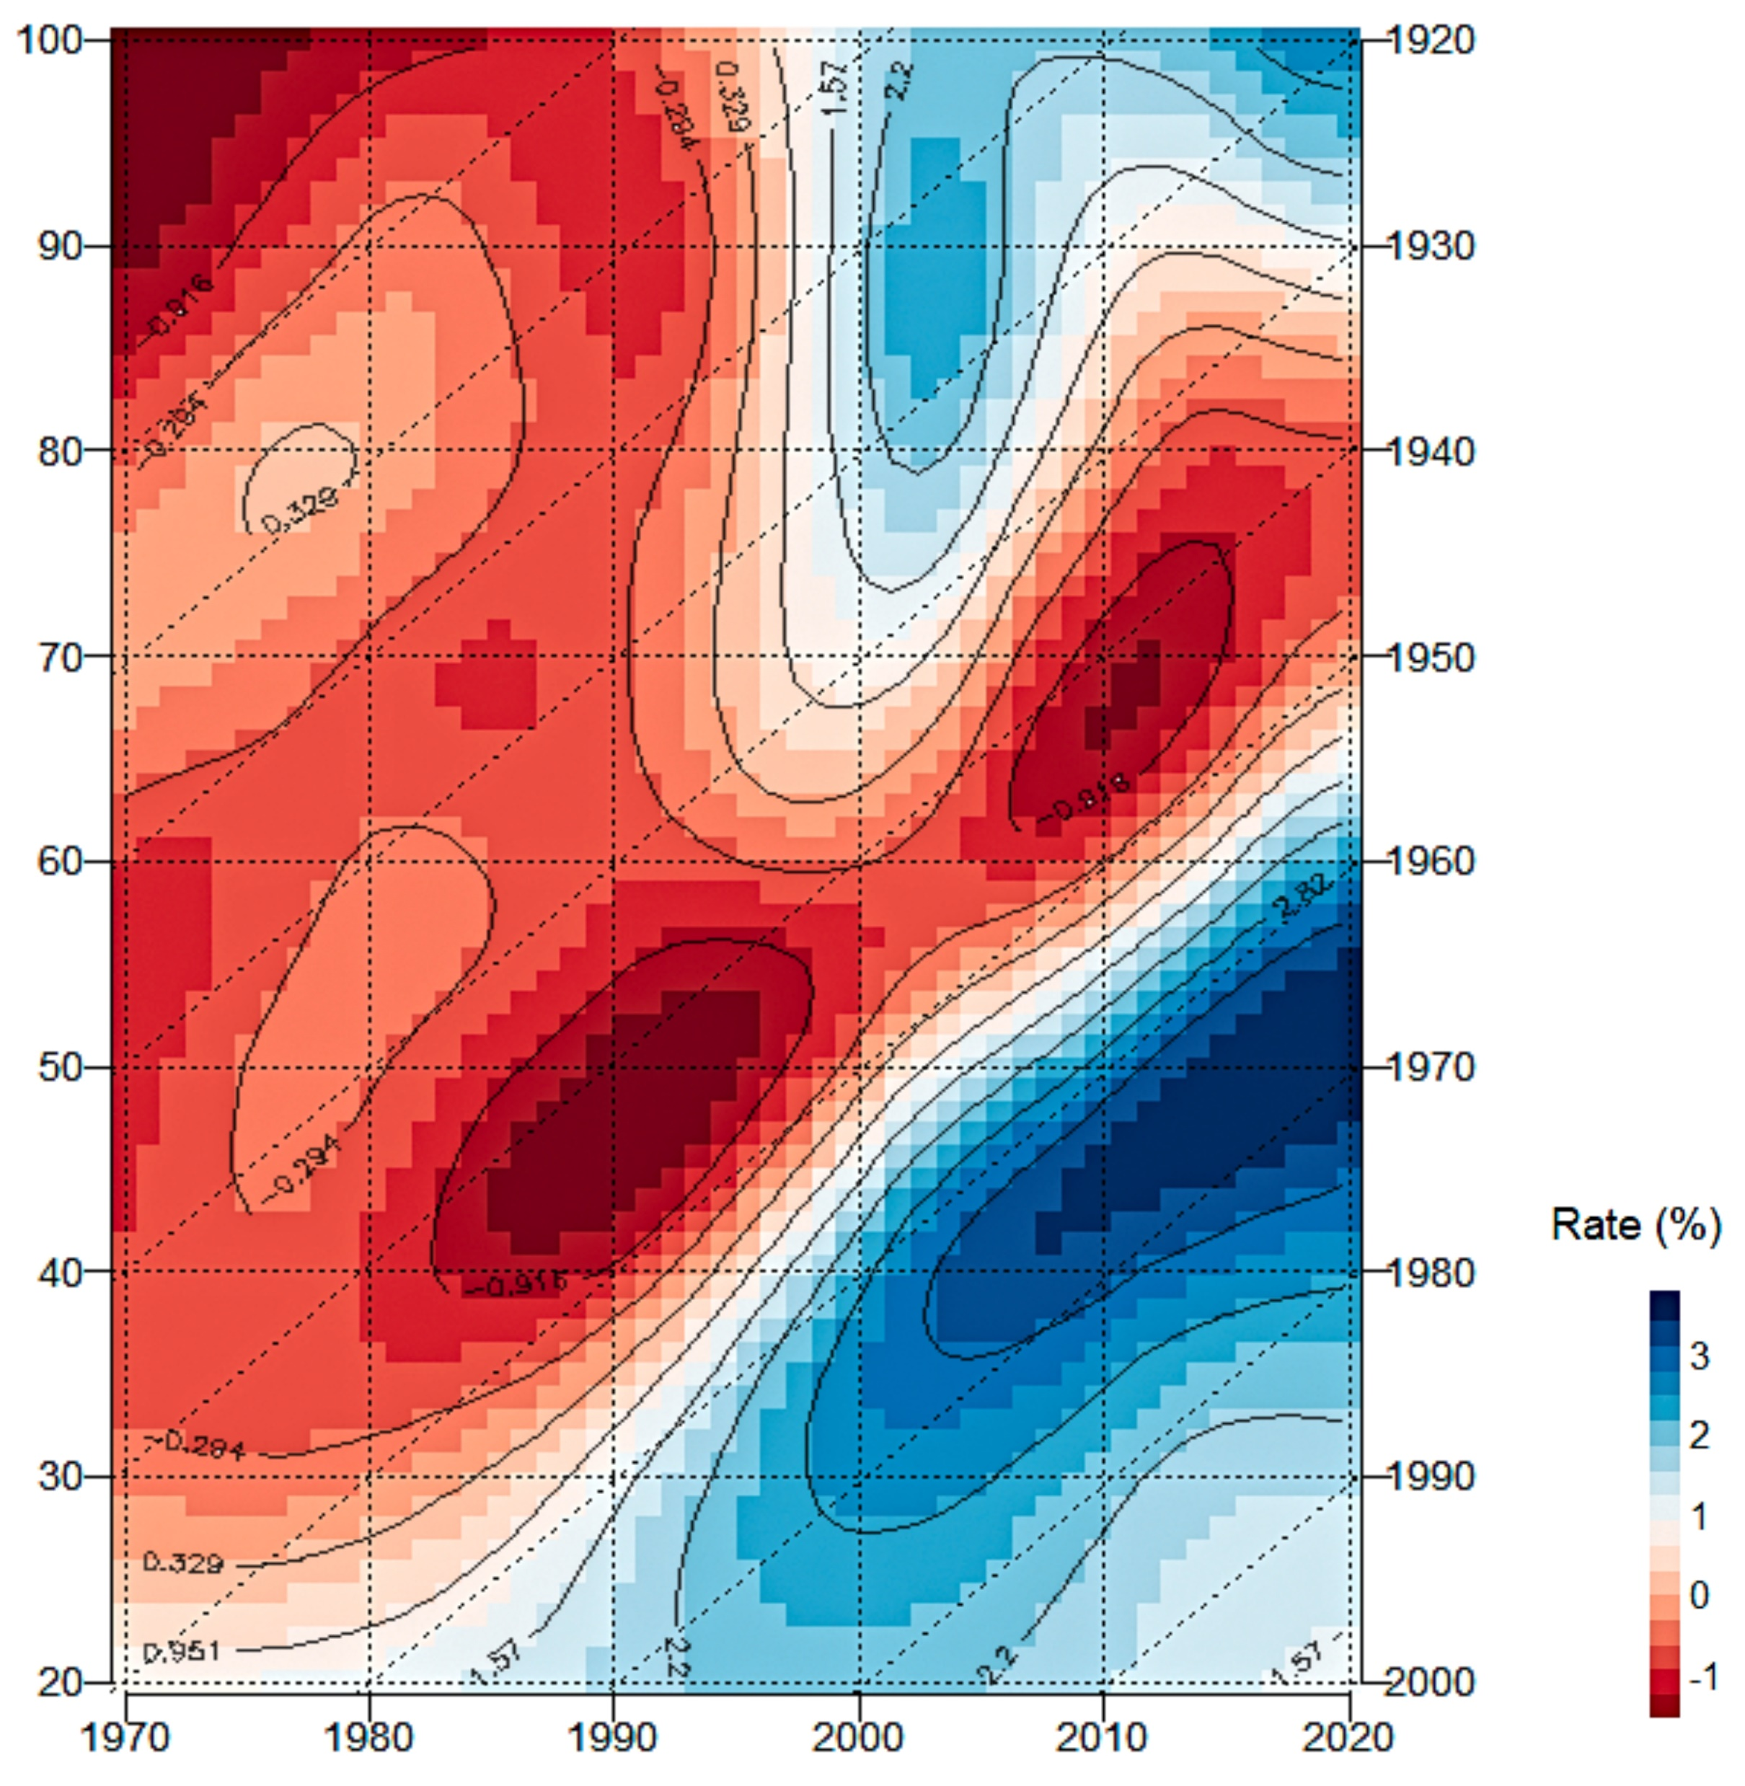
Rates of mortality improvement for all and selected cancers in Hungary aged 20 – 100 between 1970 and 2020
Men
Total cancers
Women
Epidemiological renewal can be experienced from 1994 for both sexes (period effect) and women are affected by a prolonged negative cohort effect compared to men in the new era.
3/9

Slide 5
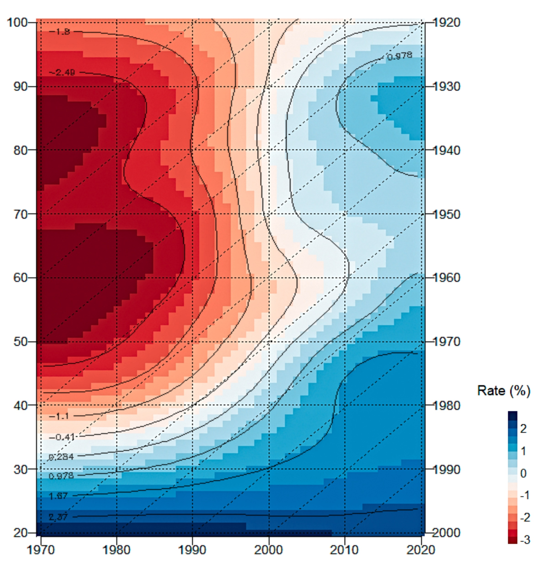
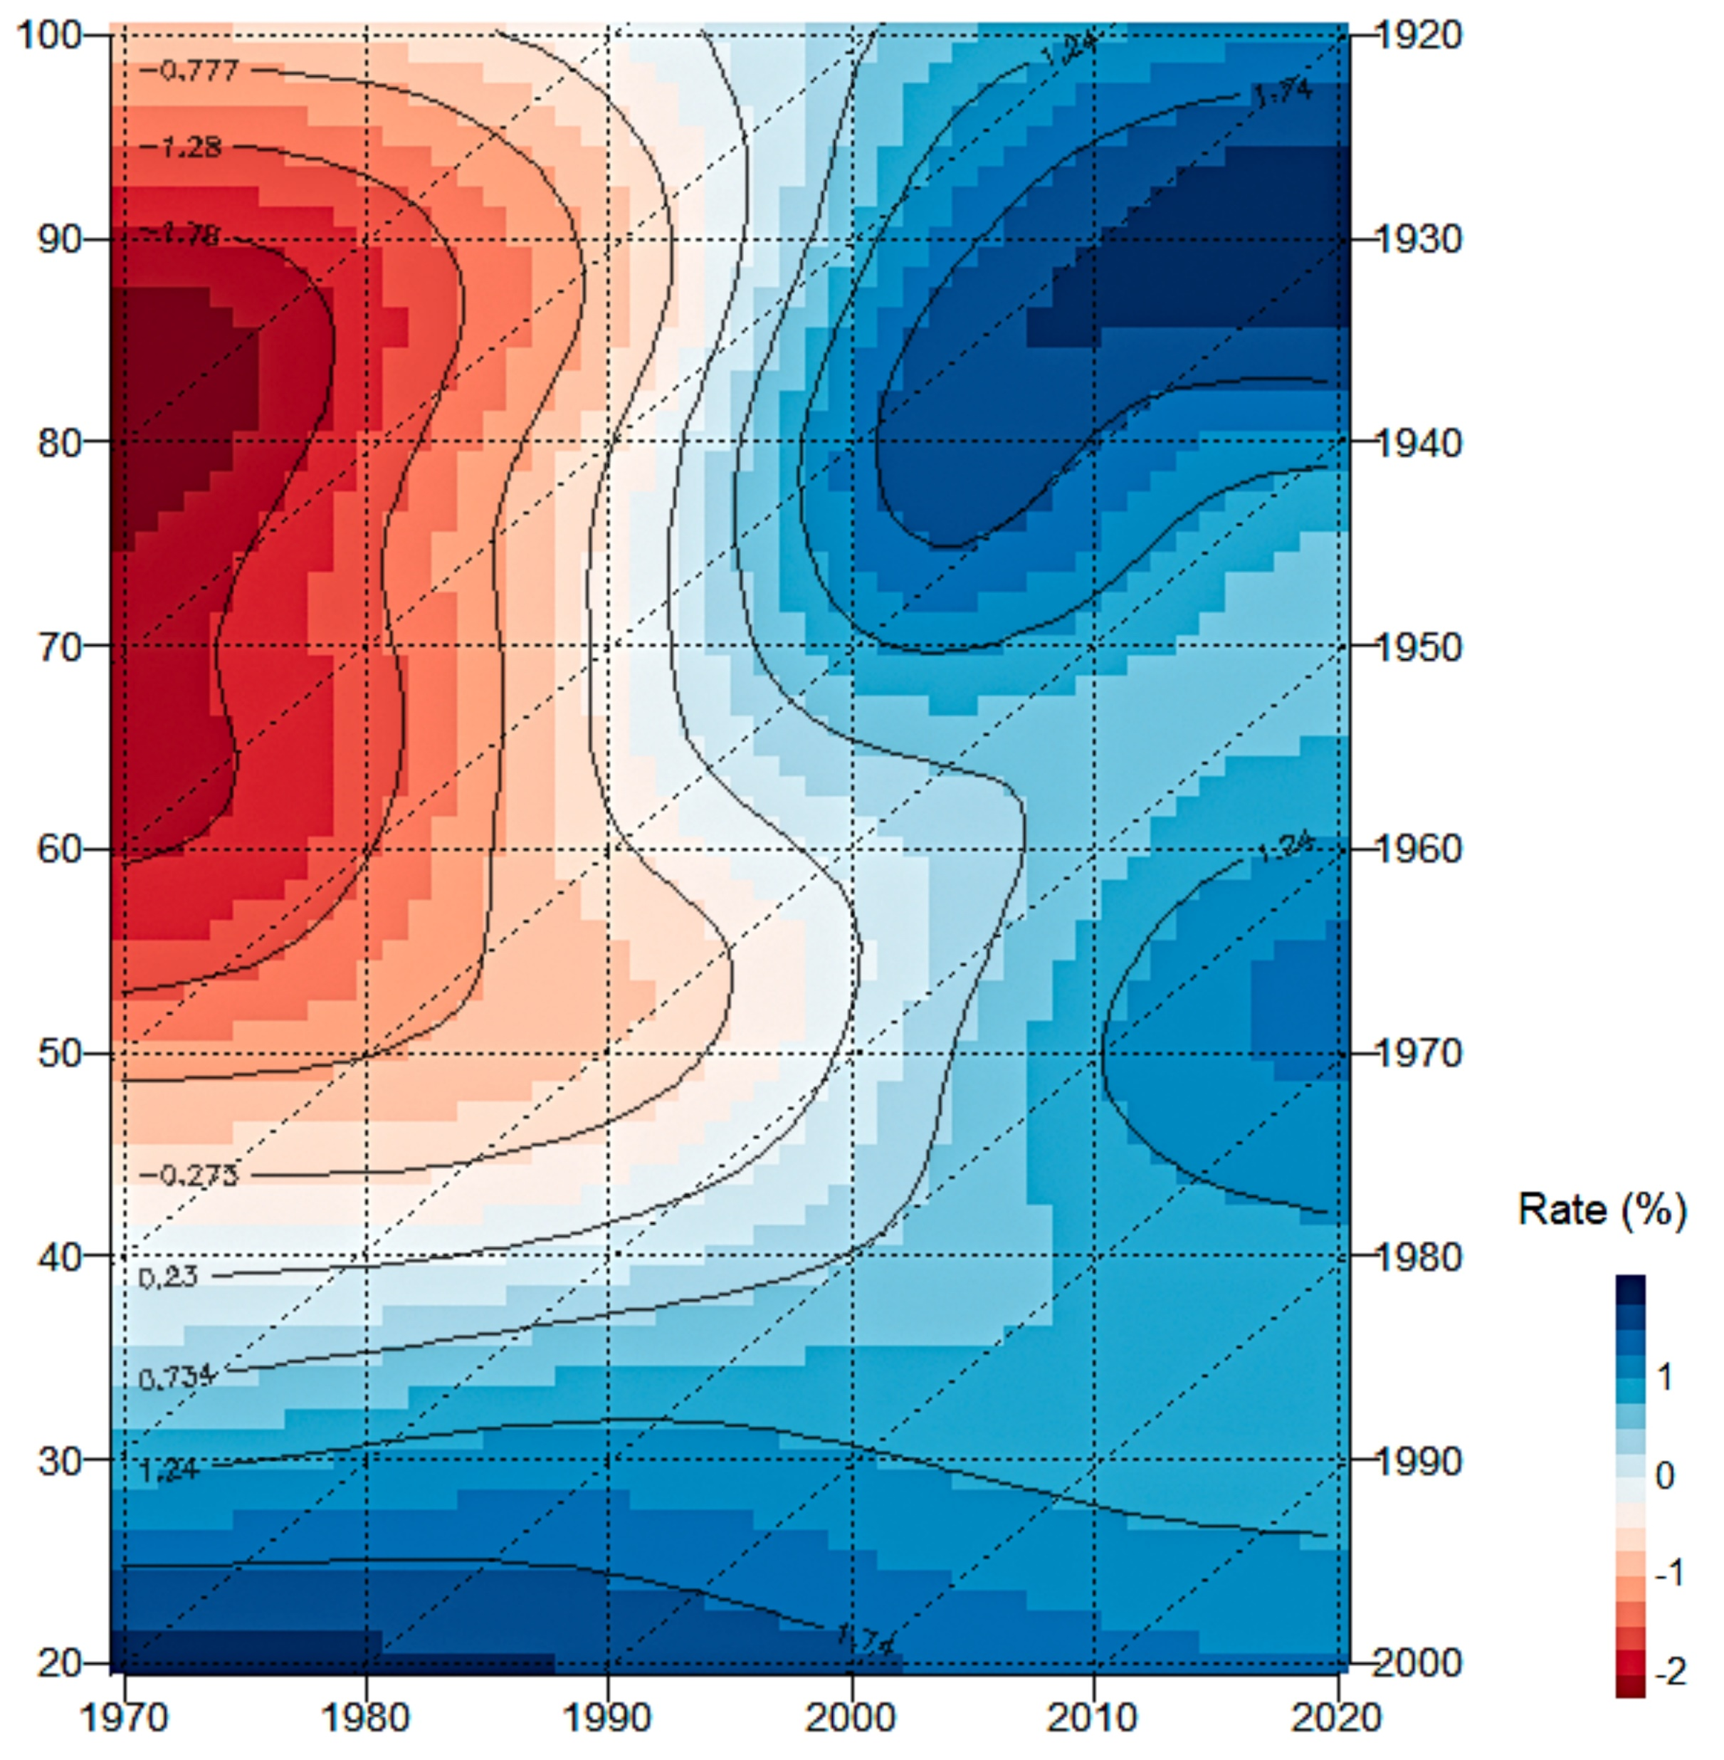
Rates of mortality improvement for all and selected cancers in Hungary aged 20 – 100 between 1970 and 2020
Men
Colorectal cancers
Women
In socialist times, women were much less affected by colon cancer mortality at younger ages compared to men, in addition their improvement in the new era is also greater.
4/9

Slide 6
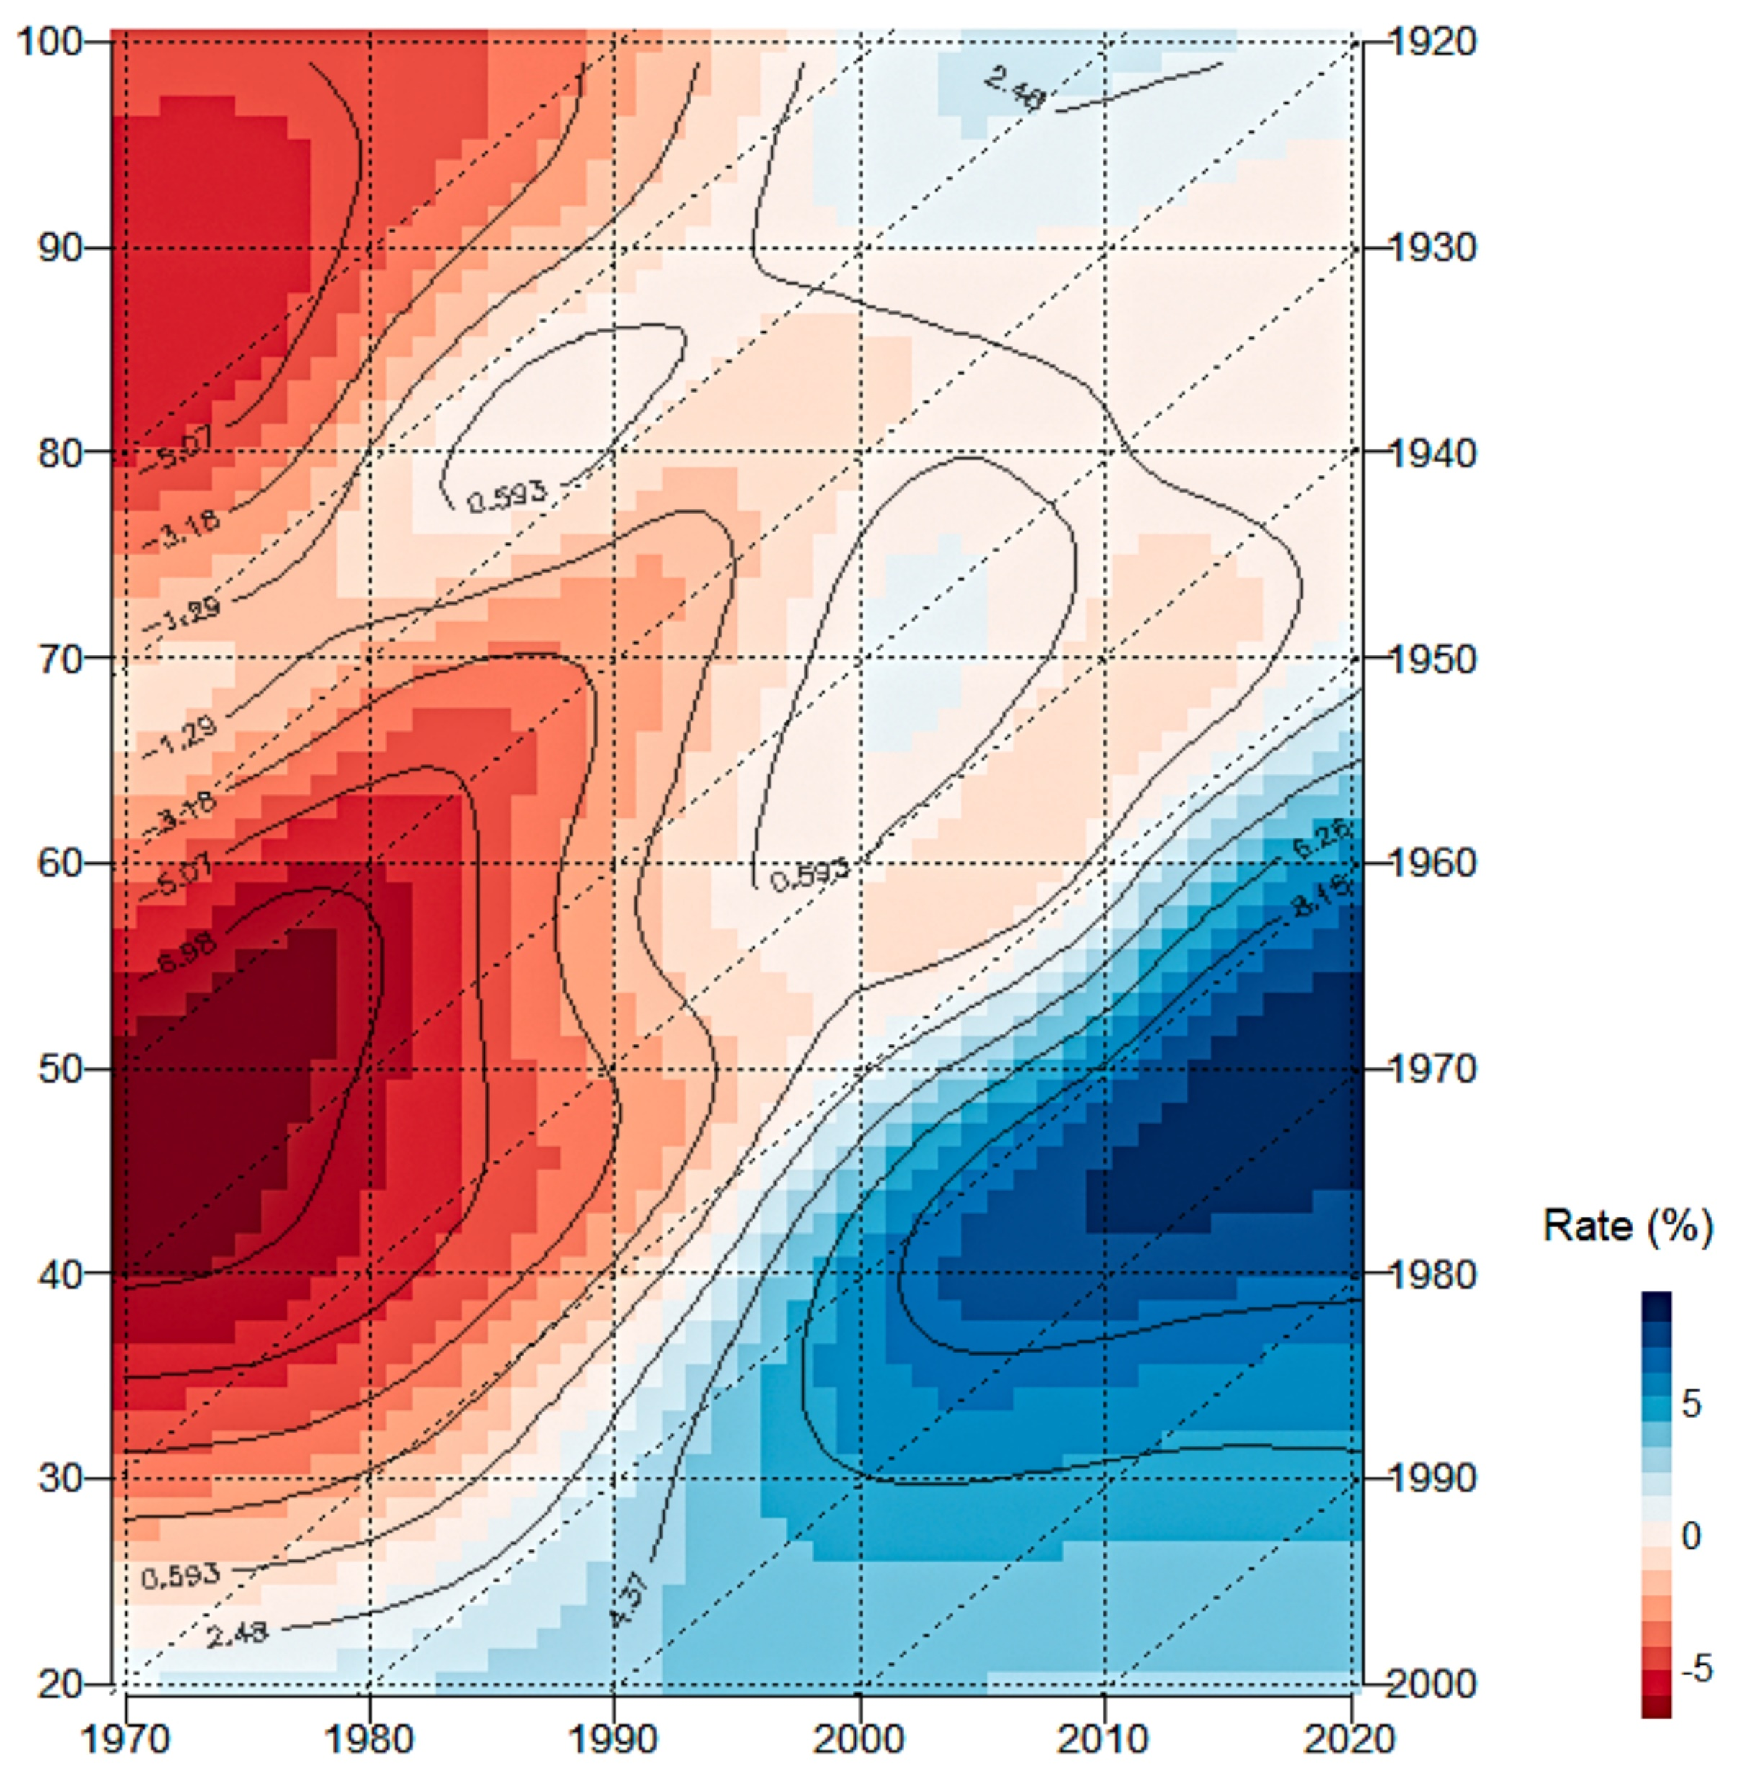
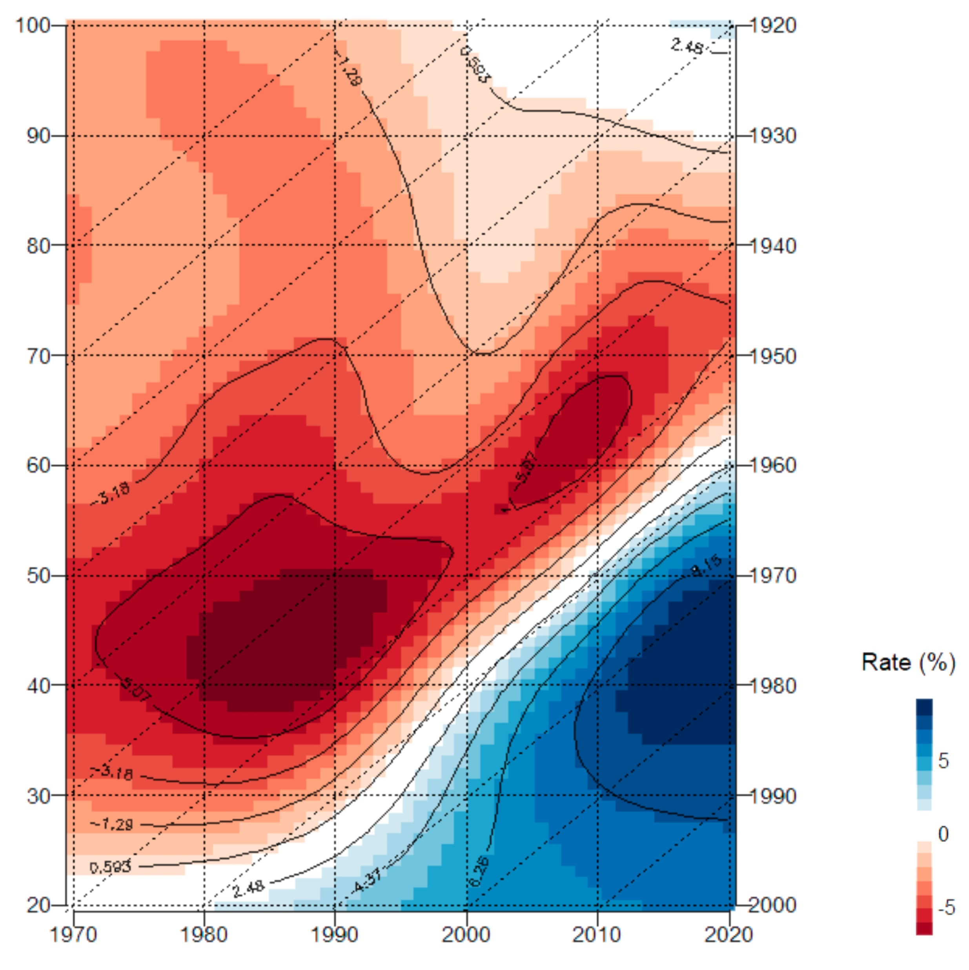
Rates of mortality improvement for all and selected cancers in Hungary aged 20 – 100 between 1970 and 2020
Men
Lung cancers
Women
Women born between 1940-50 experienced two mortality lows due to lung cancer, unlike men, emphasizing the delayed nature of the global smoking epidemic between sexes.
5/9

Slide 7
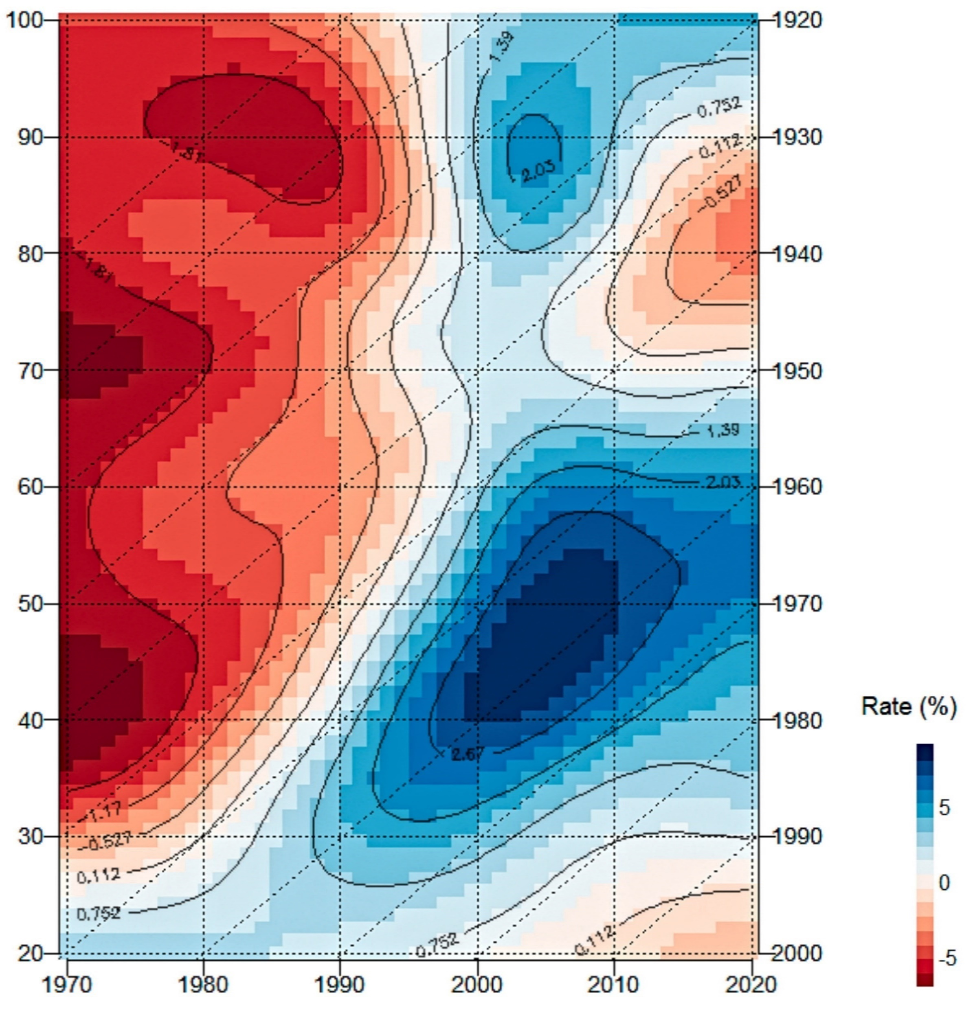
Rates of mortality improvement for all and selected cancers in Hungary aged 20 – 100 between 1970 and 2020
Female breast cancers
Since 2010, breast cancer mortality among women aged 70-90 (born between 1930 and 1950) has been deteriorating.
6/9

Slide 8
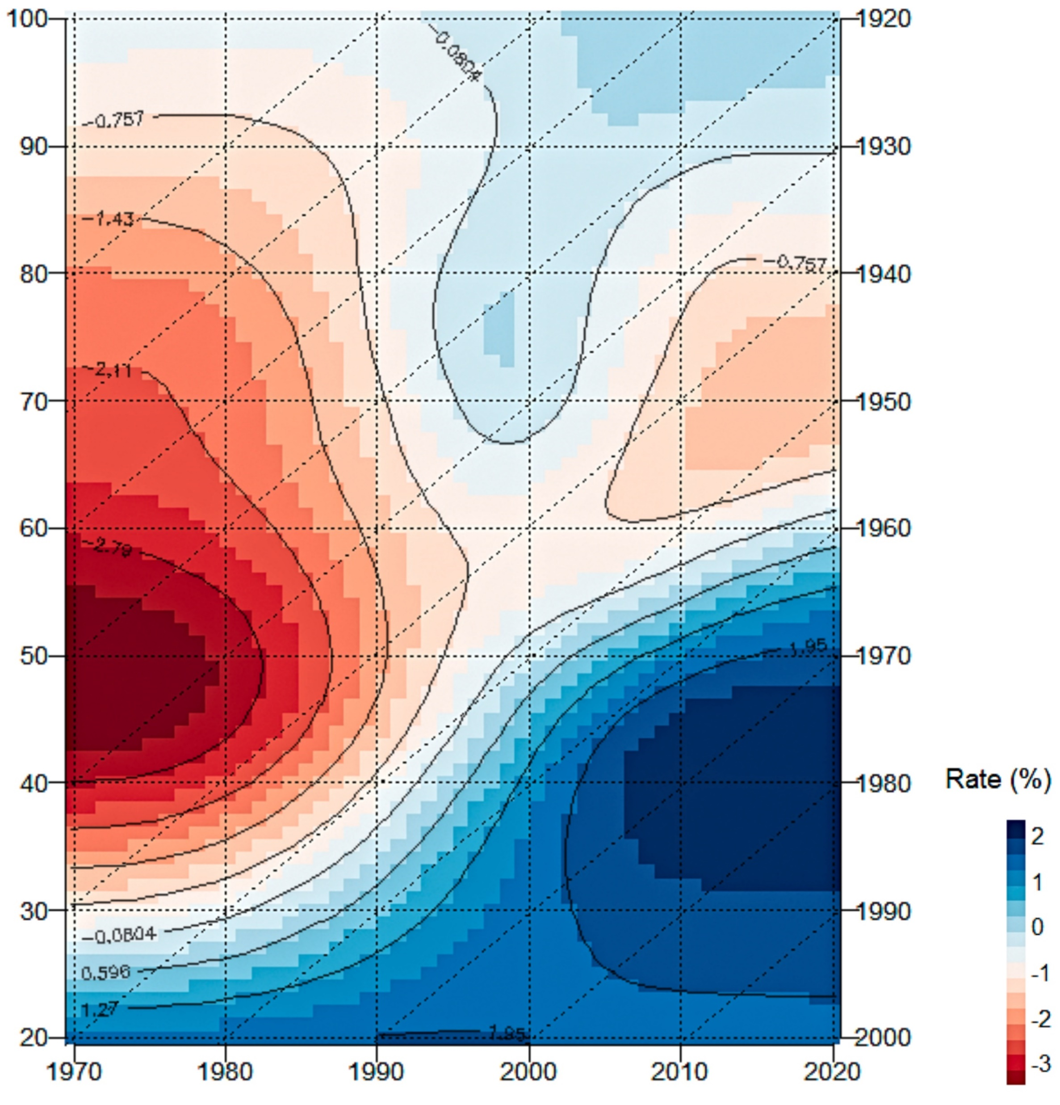
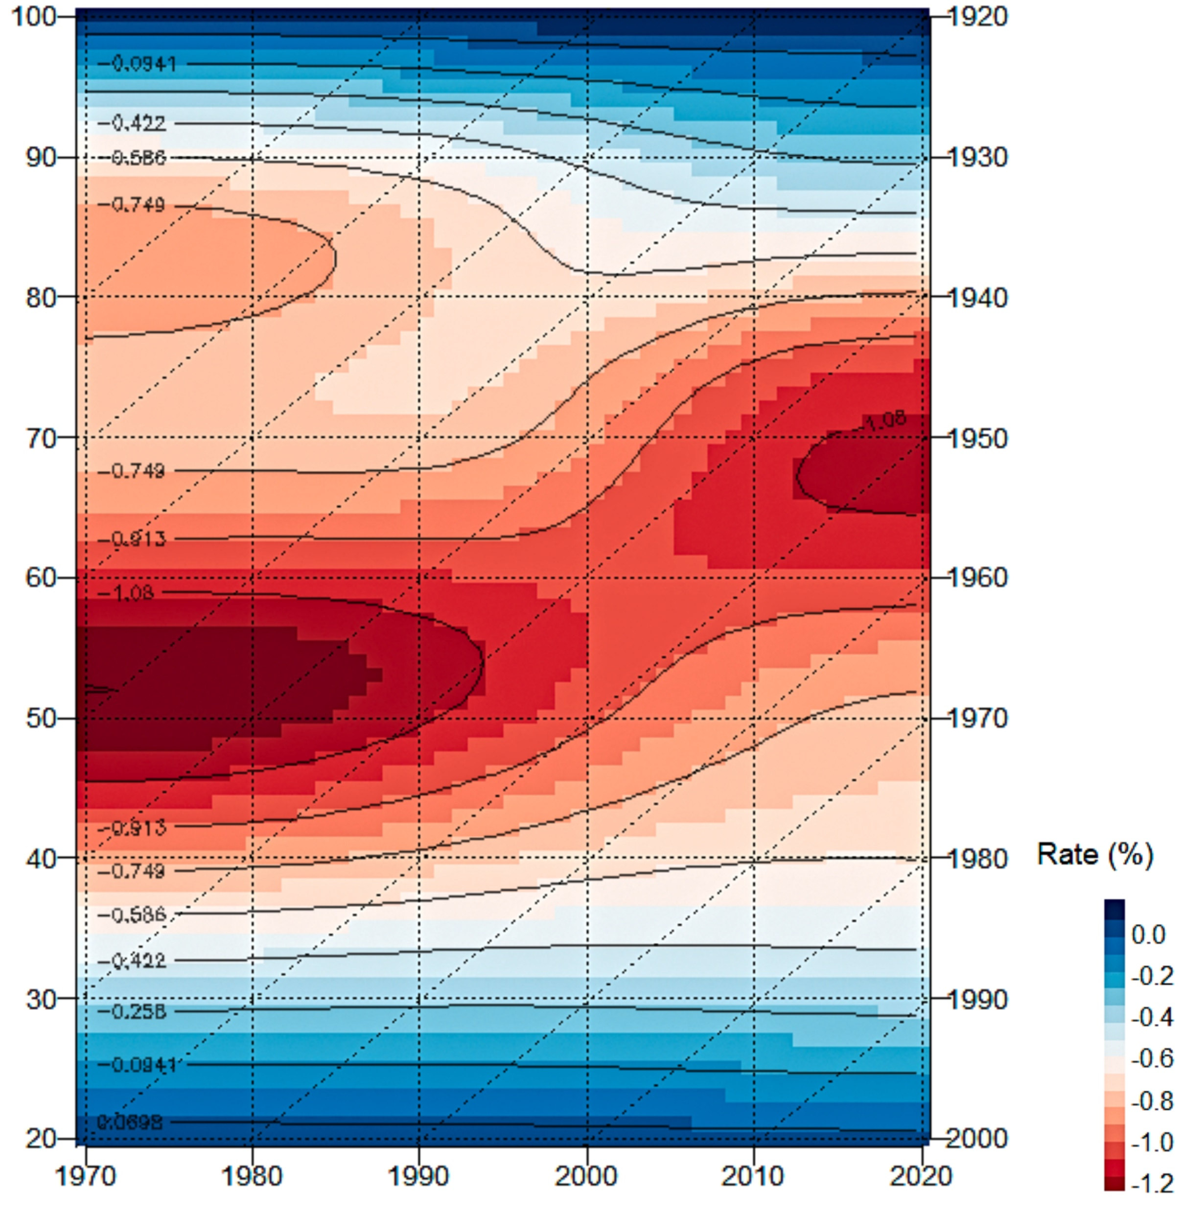
Rates of mortality improvement for all and selected cancers in Hungary aged 20 – 100 between 1970 and 2020
Men
Pancreas cancers
Women
Since 2005 pancreatic cancer mortality has been deteriorating in men aged 60-80, however it is greatly improving at younger ages. Among women, worsening is strong between the ages of 55-80 recently and there is no improvement at younger ages.
7/9

Slide 9
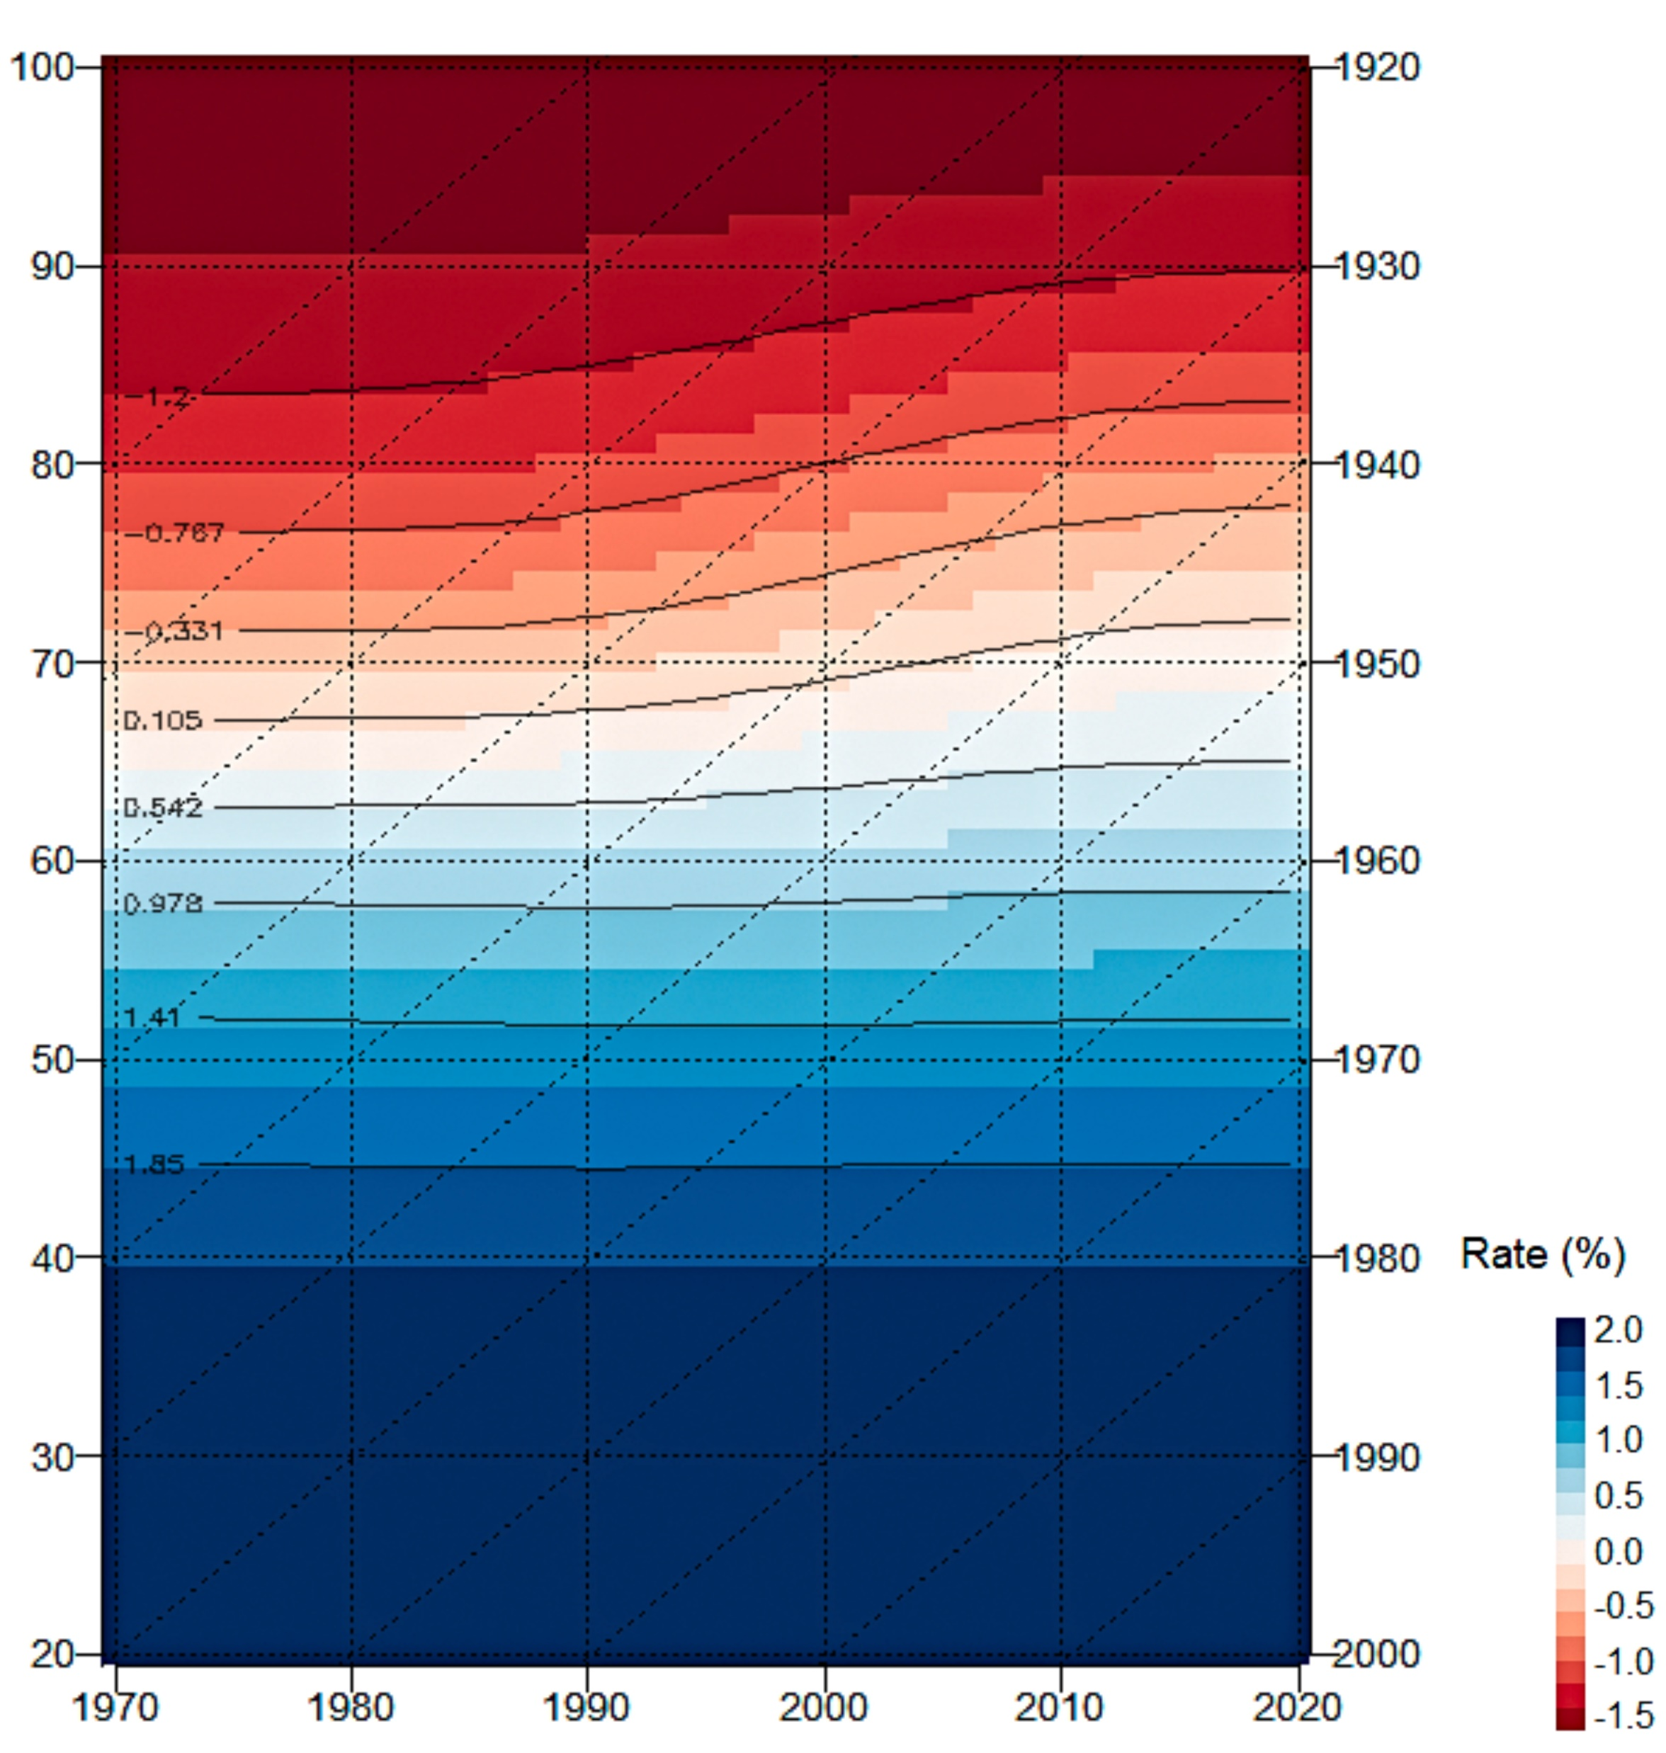
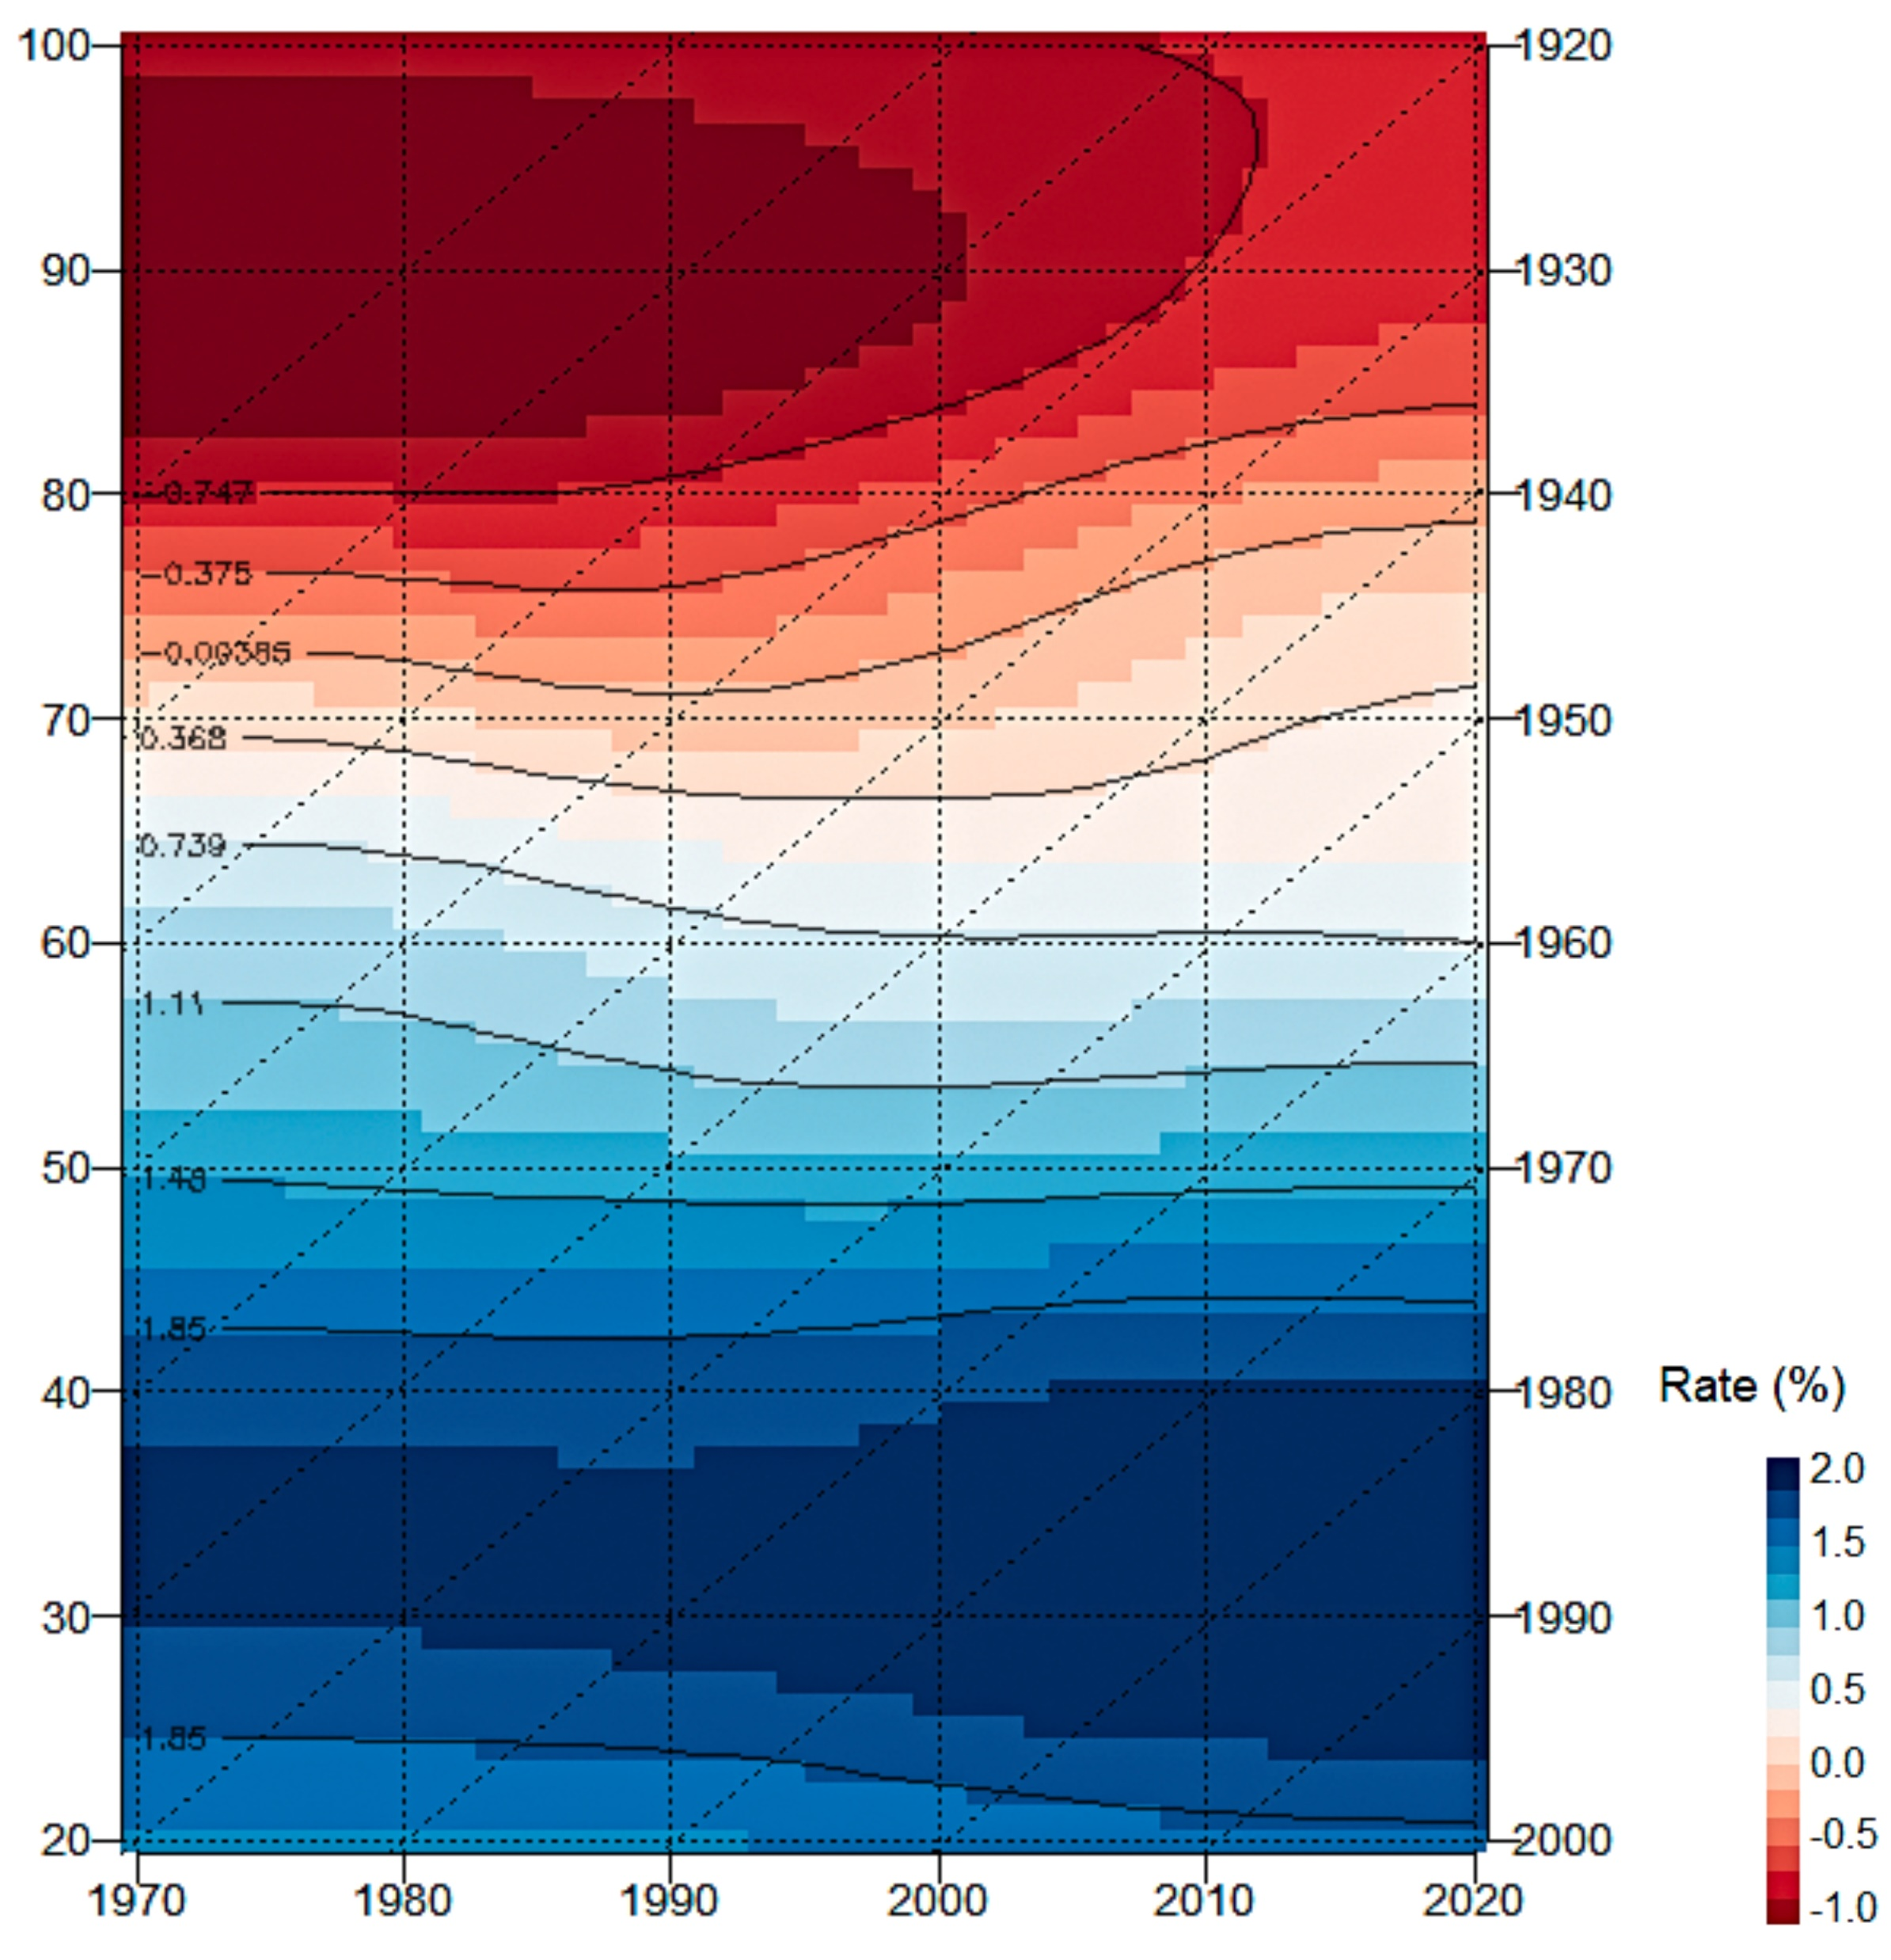
Rates of mortality improvement for all and selected cancers in Hungary aged 20 – 100 between 1970 and 2020
Men
Myeloid cancers
Women
Strong age effect can be experienced for both sexes, however with a more noticeable improvement over time among women.
8/9

Slide 10
Discussion
Monitoring progress in the global smoking epidemic (Lopez et al., 1994), results in health policies, changes in therapeutic opportunities.
Introduction of low-dose lung CT screening for both sexes in the ages of 60 and 80 as a public health program (Vokó et al., 2017) + increase mammography participation rates for women in the same age group.
No breakthrough in the case of pancreatic and myeloid tumors.
Focus: the reduction in the population prevalence of key modifiable risk factors particularly and but not exclusively tobacco smoking and obesity (Cabasag et al., 2022).
Lopez AD, Collishaw NE, Piha T. A descriptive model of the cigarette epidemic in developed countries. Tob Control. 1994 Sep;3(3):242–7.
Vokó Z, Barra M, Molnár A, Kerpel-Fronius A, Bajzik G, Horváth I, Moizs M, Nagy B. Az alacsony dózisú CT-vel végzett tüdőrákszűrés magyarországi egészség-gazdaságtani elemzésének koncepcionális terve [Model concept of the health economic evaluation of low-dose CT lung cancer screening in Hungary]. Orv Hetil. 2017 Jun;158(25):963-975. Hungarian.
Cabasag CJ, Ferlay J, Laversanne M, Vignat J, Weber A, Soerjomataram I, Bray F. Pancreatic cancer: an increasing global public health concern. Gut. 2022 Aug;71(8):1686-1687.
9/9

Slide 11
Thank you for your time and attention! weber.andras@oncol.hu

