Slide 1
Investigating differences in Healthy Life Expectancy between migrants and natives in Germany using Multistate Lifetables
EAPS HMMWG Meeting
26/09/2024
Adrian Kunz
Tilburg University
a.kunz@tilburguniversity.edu
Adrien Remund
University of Groningen
a.p.p.remund@rug.nl
Karsten Hank
University of Cologne
hank@wiso.uni-koeln.de

Slide 2
Does the Healthy Life Expectancy at age 50/51 based on multistate models differ between migrants and natives?
Computation of the (healthy) life expectancies separately for migrants and natives
Decomposition of the differences in (healthy) life expectancies into the transition probabilities between the different health and death states

Slide 3
Data and Method
Data
Method
German Data of the waves 4-7 from
the Survey of Health, Ageing and
Retirement in Europe (SHARE)
Self-rated Health (5-point Likert Scale)
Healthy: 1-3; Unhealthy: 4-5
Death information
Migrants if born outside Germany
Sex: binary
Age (two-year age groups)
Multistate models to compute the (healthy) life expectancies
Horiuchi decomposition to decompose differences in the (healthy) life expectancies between migrants and natives

Slide 4
(Healthy) Life Expectancies at age 50/51
Women
Men
Total Life Expectancy
Migrants: ≈ 33.08 years
Natives: ≈ 32.28 years
Diff.: ≈ + 0.79 years
Total Life Expectancy
Migrants: ≈ 27.99 years
Natives: ≈ 27.25 years
Diff.: ≈ + 0.74 years
Migrants tend to live longer…
… but they also tend to live shorter in good health…
Healthy Life Expectancy
Migrants: ≈ 13.16 years
Natives: ≈ 15.94 years
Diff.: ≈ -2.78 years
Healthy Life Expectancy
Migrants: ≈ 12.01 years
Natives: ≈ 14.29 years
Diff.: ≈ -2.28 years
Unhealthy Life Expectancy
Migrants: ≈ 19.91 years
Natives: ≈ 16.34 years
Diff.: + 3.57 years
Unhealthy Life Expectancy
Migrants: ≈ 15.98 years
Natives: ≈ 12.96 years
Diff.: + 3.02 years
… and longer in bad health.

Slide 5
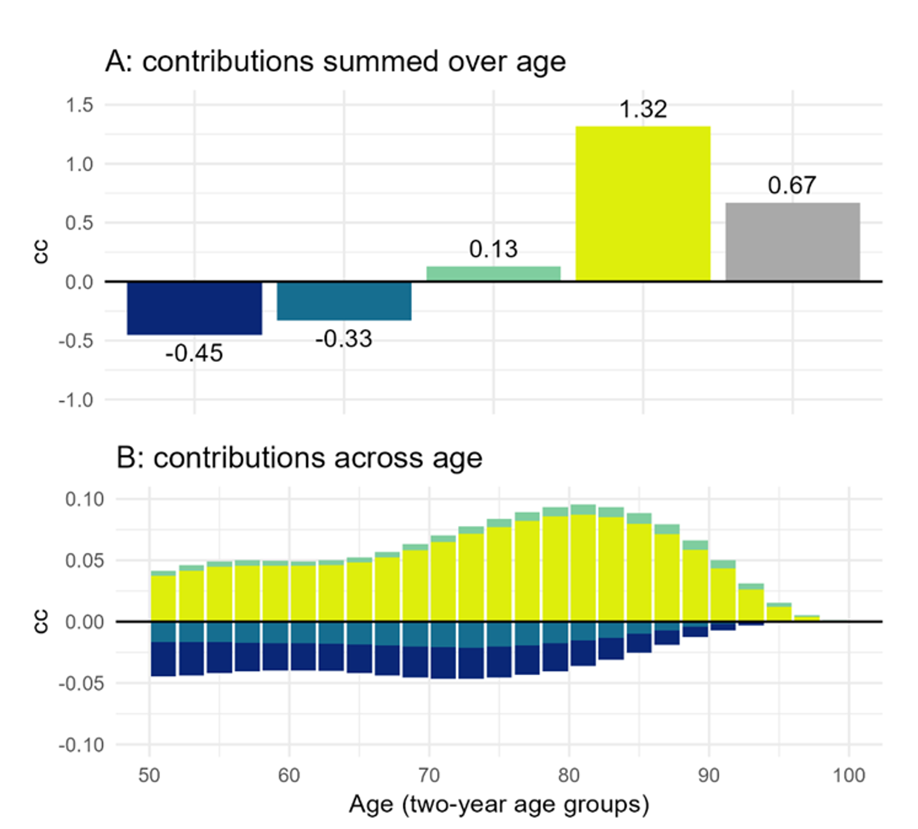
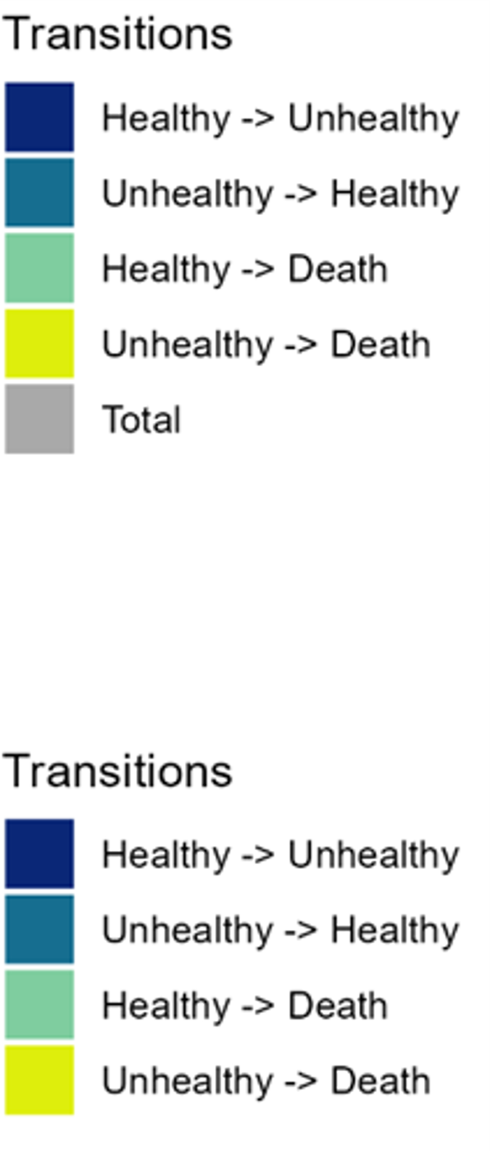
Contributions by transitions and age
Unhealthy migrants’ lower death probability is the main contributor to migrants’ longer life expectancy. Migrants’ higher incidence and lower recovery probabilities shorten their life expectancy
Both, migrants’ higher incidence and lower recovery probabilities contribute to migrants’ lower healthy life expectancy
Healthy Life Expectancy
Total Life Expectancy

Slide 6
Conclusions
Migrants live longer but this additional time is lived in bad health
Migrants suffer from shorter healthy life expectancy and live much longer in bad health
Death probability for unhealthy (but not for healthy) people is the main contributor to the Migrant mortality advantage
The reason for this remains unclear (Salmon bias, death reporting…)
These different contributions of the death probabilities contradict the use of the Sullivan method
Shorter healthy life expectancy mainly explained by migrants’ higher incidence and lower recovery probabilities

