Slide 1
Seasonality in mortality and its impact on life expectancy levels and trends across Europe
Isabella Marinetti^{1,2},
Dmitri Jdanov¹, Domantas Jasilionis¹, Marília Nepomuceno¹, Fanny Janssen^{2,3}
¹Max Planck Institute for Demographic Research, Rostock, Germany
²Population Research Centre, Faculty of Spatial Sciences, University of Groningen, The Netherlands
³Netherlands Interdisciplinary Demographic Institute - KNAW/University of Groningen, The Hague, The Netherlands

Slide 2
Seasonality in mortality

Slide 3
seasonality
Pivotal role in shaping current mortality trends
Extreme temperatures → higher mortality rates (Zanobetti et al. 2012)
Temperate climates have higher mortality rates in winter than summer (Rau 2006)
20th century: seasonal mortality lessened due to economic, scientific and medical development → increased heterogeneity between countries (Sakamoto-Momiyama 1978)
Quijal-Zamorano M. et al. (2021) Seasonality reversal of temperature attributable mortality projections due to previously unobserved extreme heat in Europe

Slide 4
Seasonality in mortality
Ageing populations
Climate change

Slide 5
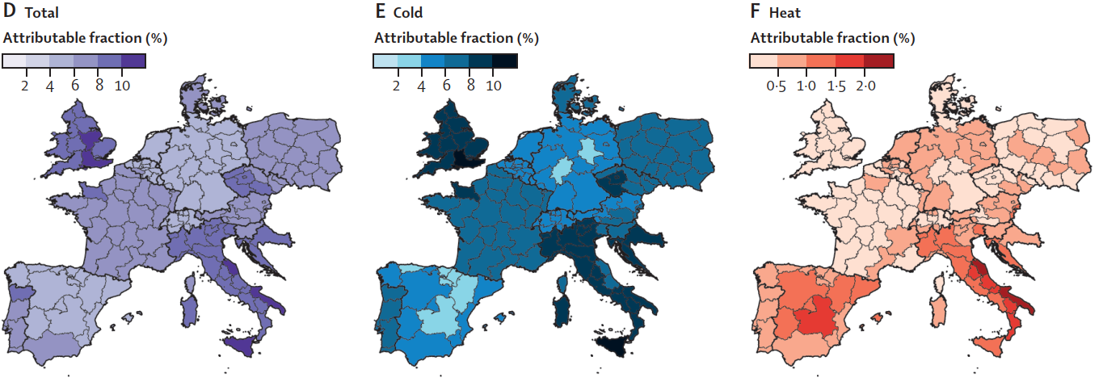
Seasonality, ageing and climate change
Ageing populations: growing elderly population increases people at higher risk during extreme temperature events (flu epidemics, heatwaves) (Ballester et al. 2011, Ledberg 2020)
Not only meteorological factors: inequalities in socio-economic status, educational attainment, urbanization (Burkart 2011)
Martínez-Solanas et al. (2021) Projections of temperature-attributable mortality in Europe: a time series analysis of 147 contiguous regions in 16 countries

Slide 6
Gap in the literature
Majority of studies on life expectancy trends focus on annual estimates
Most of the literature emphasizes temperature-attributable mortality as a seasonal factor
Studies on specific flu epidemics season

Slide 7
Seasonality in mortality
Ageing populations
What are the implications of recent trends? How can we quantify the impact of seasonal excess mortality on life expectancy?
Climate change

Slide 8
AIM of the study
Assess the impact of seasonal fluctuations on all-cause mortality in 20 European countries between 2000 and 2019, understanding the impact of seasonality on annual life expectancy
Decomposition of life expectancy losses by season
Annual and seasonal e₀
Weekly mortality data from the HMD
Upper* e₀
Analysis of observed and upper e₀ trends
Countries: Austria, Belgium, Bulgaria, Croatia (from 2001), Estonia, Finland, France, Germany, Hungary, Lithuania, Latvia, Netherlands, Norway, Poland, Portugal, Russia, Slovakia, Spain, Sweden, Switzerland

Slide 9
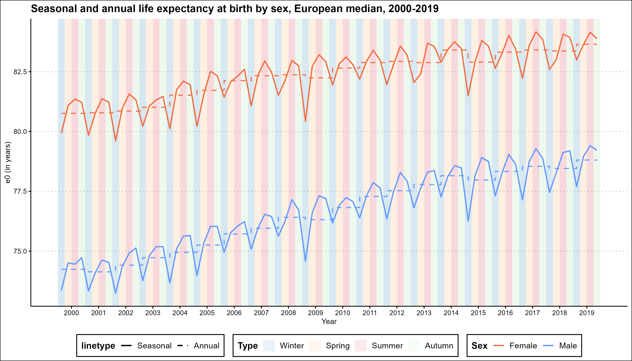
Annual and seasonal life expectancy at birth, European median*,
by sex, 2000-2019
Drops during wintertime but not systematic increase/decrease
Largest drops in seasonal life expectancy at birth in winter 2009 (1-year ca.) and 2015 (1.2 years ca.)
*median life expectancy of 20 selected European countries

Slide 10
Annual and seasonal e₀
Decomposition of life expectancy losses by season
Weekly mortality data from the HMD
Upper* e₀
Analysis of observed and upper e₀ trends
*in the absence of seasonal excess mortality. Based on mortality schedule of 13 weeks with lowest death counts

Slide 11
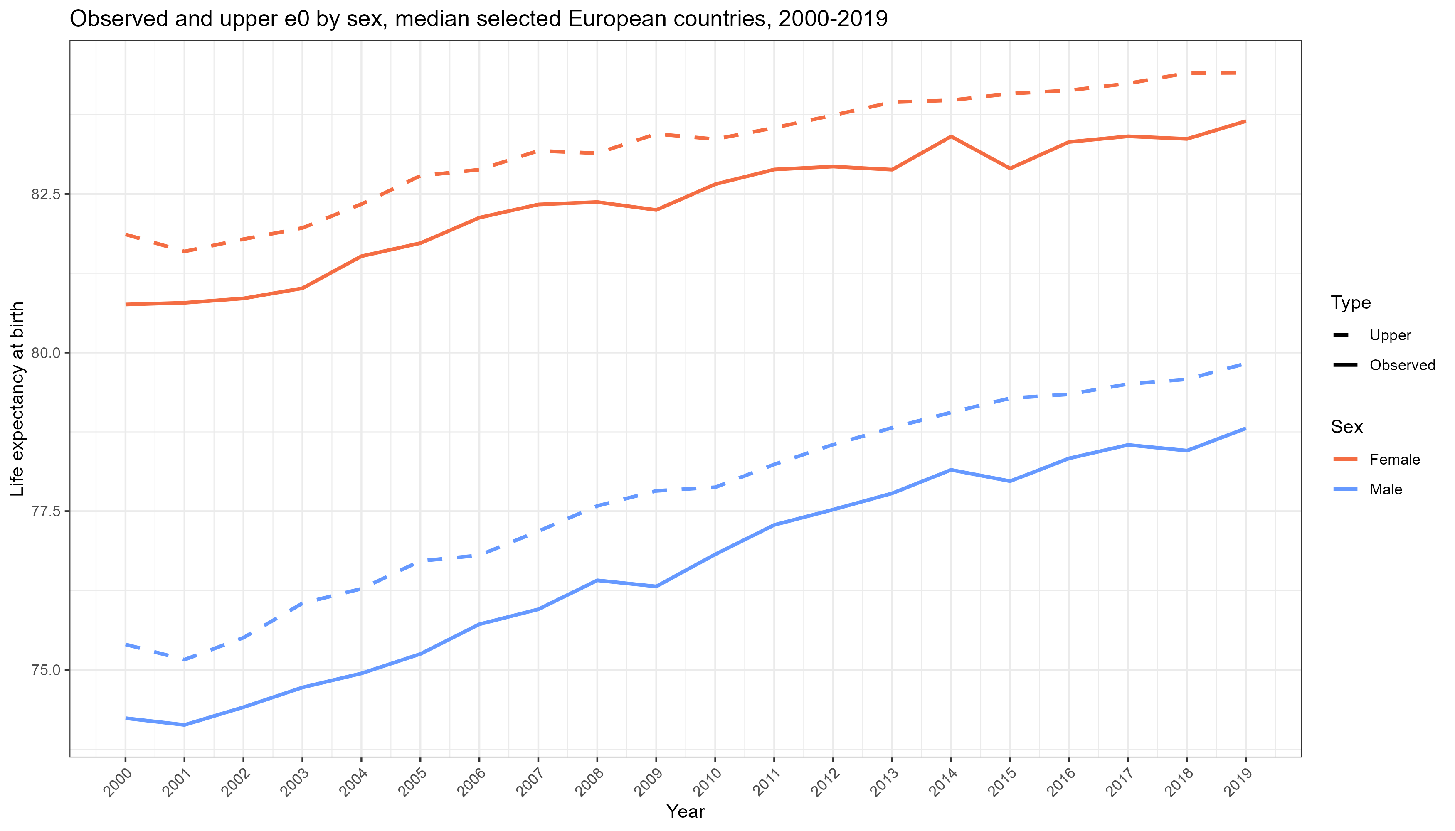
Observed and upper life expectancy at birth by sex, European median
Life expectancy losses due to seasonality

Slide 12
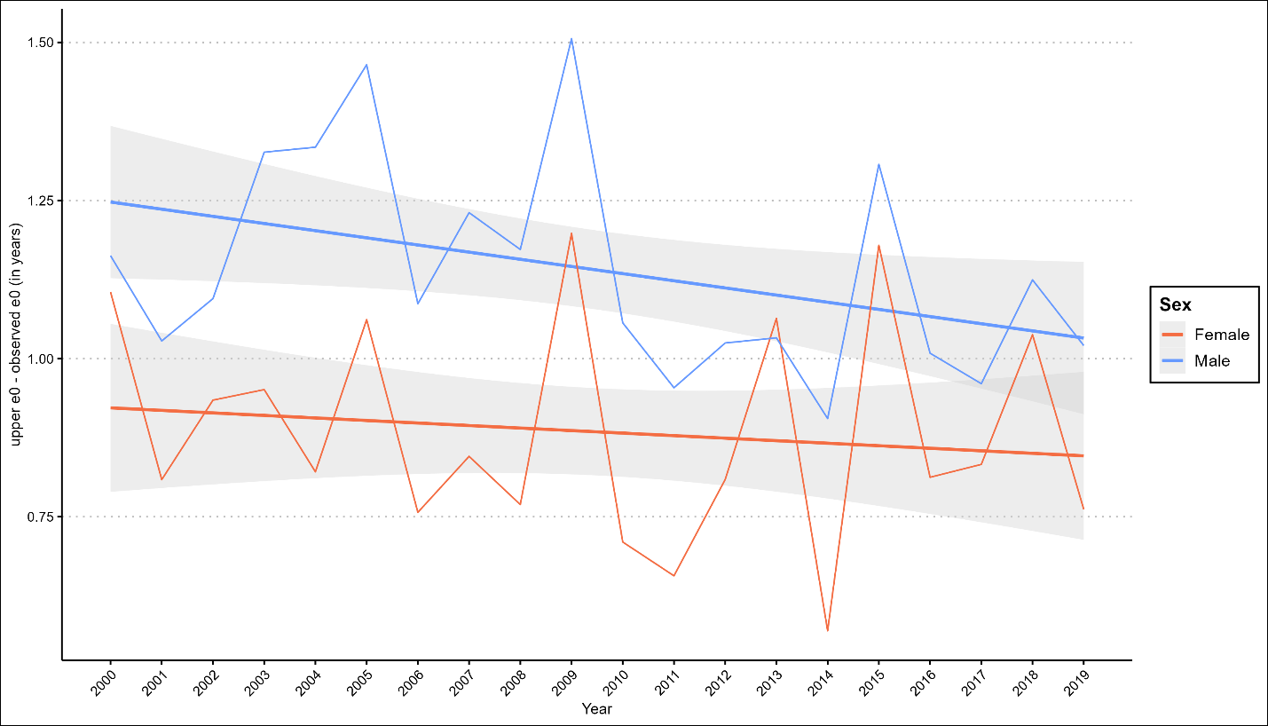
Seasonal excess mortality
Annual reduction in life expectancy due to seasonal excess mortality of 1.1 (males) and 0.8 years (females) on average
Around 70% and 90% of these reductions were attributable to older ages
Difference between the upper and observed life expectancy at birth by sex (in grey the 95% CI), median across the selected 20 European countries, 2000-2019

Slide 13
Decomposition of life expectancy losses by season
Annual and seasonal e₀
Weekly mortality data from the HMD
Upper* e₀
Analysis of observed and upper e₀ trends

Slide 14
Losses due to season-specific excess mortality to annual life expectancy at birth, European countries, 2000-2019
Wintertime most significant losses (0.6 years average) and highest variations across countries (var = 0.15 years)
Summers had a minor relevance for annual life expectancy and less heterogeneity
WINTER
SPRING
SUMMER
AUTUMN
Highest winter mortality shocks Portugal (1.2 years), Latvia and Bulgaria (1.1 years)
No trend

Slide 15
Annual and seasonal e₀
Decomposition of life expectancy losses by season
Weekly mortality data from the HMD
Upper* e₀
Analysis of observed and upper e₀ trends

Slide 16
Impact on trends
Observed and upper estimated e₀ were compared under two hypothetical scenarios of
a) no overall excess seasonal mortality and
b) no season-specific (spring, summer, autumn, and winter) excess mortality
no significant effect on the change in life expectancy at birth eliminating excess seasonal mortality
Exceptions: Hungary, Poland and Slovakia would have gained 0.4 years more between 2000 and 2019 without excess seasonal mortality (particularly winter mortality)

Slide 17
conclusions
Significant cross-country variations losses due to seasonal mortality
The impact was substantial for some countries, particularly among older adults, and predominantly driven by excess mortality during winter
No trends observed for the impact of overall seasonality › counterbalancing factors (healthcare and living conditions improvements vs. increasing climate change threats and epidemics)
Effects of seasonal variations may become stronger, with an increasing frequency and severity of temperature shocks › compensated by a reduction in the impact of the winter mortality

Slide 18
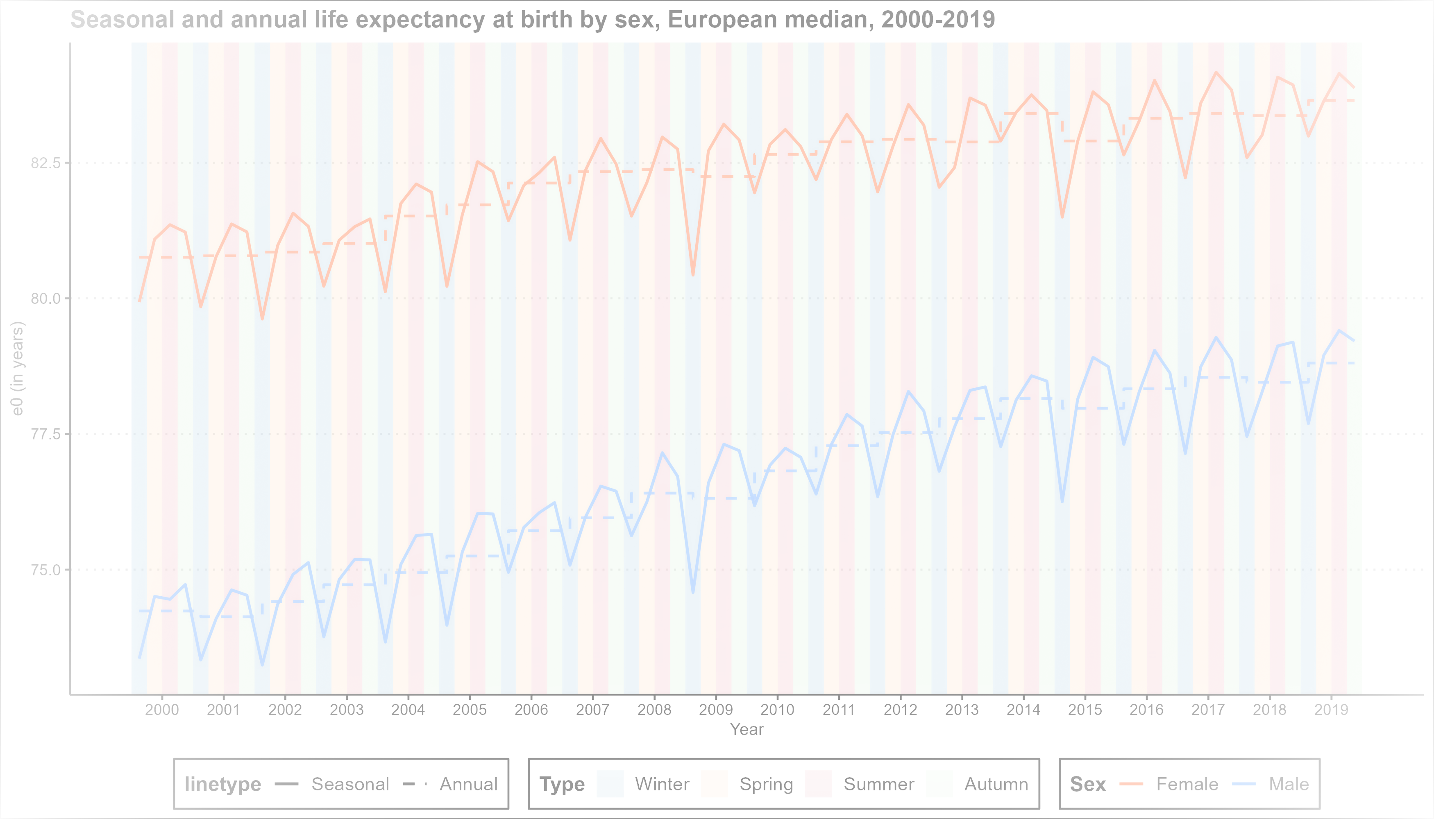
Thank you for your attention!
Isabella Marinetti
PhD Student Laboratory of Demographic Data
marinetti@demogr.mpg.de
@isa_marinetti

Slide 19
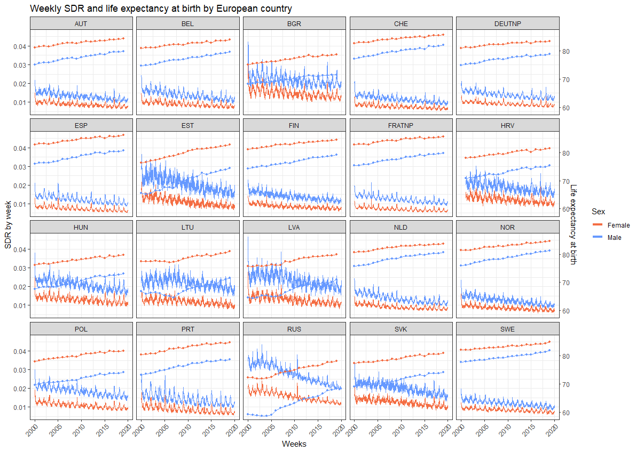
SDR by week and annual life expectancy at birth by European country and sex, 2000-2019

Slide 20
Weeks selected for the upper life expectancy at birth, total population, 2000-2019

Slide 21
Potential increase in life expectancy if excess mortality due to seasonality would not occur (expressed in % of the observed life expectancy levels), 2000-2019

Slide 22
Impact of seasonality on the change in life expectancy at birth in selected European countries
Males |  | Difference with the observed change in e₀ 2000–2019 (in years)
Country | Observed change | Without seasonality | Without winter | Without spring | Without summer | Without autumn
Austria | 4.69 | -0.07 | 0.01 | 0.00 | -0.02 | -0.06
Belgium | 4.84 | 0.11 | 0.03 | 0.08 | -0.03 | 0.02
Bulgaria | 3.54 | -0.32 | -0.11 | -0.11 | -0.01 | -0.03
Croatia¹ | 4.7 | -0.30 | 0.00 | -0.11 | -0.09 | -0.09
Estonia | 10.02 | -0.35 | -0.08 | 0.01 | -0.13 | -0.14
Finland | 5.04 | -0.09 | -0.01 | -0.01 | -0.12 | 0.05
France | 4.62 | 0.10 | 0.07 | 0.04 | -0.05 | 0.04
Germany | 3.84 | 0.25 | 0.13 | 0.08 | 0.01 | 0.04
Hungary | 5.86 | 0.33 | 0.28 | 0.02 | -0.07 | 0.04
Latvia | 7.01 | -0.30 | 0.01 | 0.03 | -0.08 | -0.24
Lithuania | 5.69 | -0.07 | 0.09 | 0.04 | -0.03 | -0.15
Netherlands | 5.08 | 0.03 | 0.03 | -0.05 | -0.03 | 0.05
Norway | 5.28 | -0.07 | -0.03 | -0.01 | -0.04 | 0.01
Poland | 4.65 | 0.33 | 0.19 | 0.07 | 0.02 | 0.04
Portugal | 5.63 | -0.12 | 0.02 | -0.05 | -0.06 | 0.01
Russia | 10.71 | 0.00 | 0.07 | 0.06 | -0.03 | -0.09
Slovakia | 5.35 | 0.27 | 0.20 | 0.06 | 0.00 | 0.00
Spain | 5.08 | 0.07 | 0.07 | 0.02 | -0.02 | -0.01
Sweden | 3.91 | 0.17 | 0.10 | 0.03 | -0.02 | 0.05
Switzerland | 4.73 | -0.01 | 0.04 | 0.00 | -0.04 | -0.03
Median country | 5.08 | -0.07 | 0.01 | 0.00 | -0.02 | -0.06
Females |  | Difference with the observed change in e₀ 2000–2019 (in years)
Country | Observed change | Without seasonality | Without winter | Without spring | Without summer | Without autumn
Austria | 3.11 | 0.08 | 0.06 | 0.05 | -0.05 | 0.03
Belgium | 3.00 | 0.16 | 0.05 | 0.12 | -0.02 | 0.00
Bulgaria | 3.65 | -0.53 | -0.19 | -0.18 | -0.02 | -0.05
Croatia¹ | 3.43 | -0.06 | 0.04 | -0.04 | -0.02 | -0.03
Estonia | 6.66 | -0.59 | -0.30 | -0.05 | -0.04 | -0.16
Finland | 3.27 | -0.04 | 0.00 | -0.04 | -0.08 | 0.08
France | 2.88 | 0.05 | 0.05 | 0.04 | -0.07 | 0.03
Germany | 2.41 | 0.14 | 0.08 | 0.06 | -0.01 | 0.01
Hungary | 3.60 | 0.30 | 0.22 | 0.04 | 0.00 | 0.01
Latvia | 5.01 | -0.50 | -0.22 | -0.04 | -0.06 | -0.14
Lithuania | 3.80 | -0.15 | -0.02 | -0.07 | 0.07 | -0.11
Netherlands | 3.11 | 0.22 | 0.10 | 0.09 | -0.02 | 0.06
Norway | 3.31 | 0.10 | 0.00 | 0.05 | 0.01 | 0.03
Poland | 3.76 | 0.11 | 0.08 | 0.04 | -0.02 | 0.00
Portugal | 4.53 | -0.19 | -0.05 | -0.03 | -0.05 | -0.02
Russia | 6.86 | -0.30 | -0.15 | -0.03 | 0.01 | -0.11
Slovakia | 3.77 | 0.29 | 0.20 | 0.10 | 0.00 | -0.01
Spain | 3.30 | 0.03 | 0.06 | 0.02 | -0.06 | 0.01
Sweden | 2.61 | 0.36 | 0.15 | 0.10 | 0.00 | 0.08
Switzerland | 2.87 | 0.01 | 0.02 | 0.02 | -0.03 | -0.01
Median country | 3.31 | 0.02 | 0.04 | 0.02 | -0.03 | 0.01
¹data from 2001

