Slide 1
Mortality risks and prevalence at death of key medical factors:
Diabetes, dementia and hypertension
Health, Morbidity and Mortality Working Group
24-27 September 2024, Bilbo
^{Sergi Trias-Llimós (CED)}
^{Jordi Gumà (CED)}
^{Aïda Solé-Auró (UPF)}
^{Iñaki Permanyer (CED)}
Notes:
Patterns and dynamics in causes-of-death are key population health indicators.
Underlying causes of death mortality trends have been massively studied
But…
Very little is known about the diversity of causes from which individuals die!

Slide 2
Aim
We aim to describe the role of diabetes, hypertension and dementia in mortality in Catalonia
Specific questions:
To what extent diagnosed diseased are mentioned as underlying causes of death?
Are individuals suffering diabetes, dementia and hypertension at higher mortality risk?
At the population level, how would life expectancy change if all population had the mortality risk form the disease-free group(s)?

Slide 3
Data: HEALIN cohort
HEALIN cohort is a representative population-based data following a representative sample of 1.5M people (22%) in Catalonia from 2005 onwards.
Primary care diagnostics of 48 diseases and underlying causes of death.
Settings: 2010-19 with a wash out period of 2005-09
Diseases and causes of death: Diabetes, Dementia and Hypertension.
Variables of interest: age, sex, date of diagnosis, date of death, and basic multimorbidity (2+).
SES data: Co-pharmacy payment (3 groups) and educational attainment

Slide 4
Methods
Estimate age-specific prevalence of hypertension, diabetes, and dementia
Estimate age-specific prevalence at death for each cause.
Kaplan-Meier and Cox PH models to assess the risk of dying by disease condition to build survival curves
Cox PH models stratifying by 10-year age group and sex to obtain HR for each disease of interest (crude and multi-morbidity adjusted)
Life tables to estimate life expectancy at age 40 and counterfactual life expectancy if all individuals had the mortality risks from those free of diseases (using HR and prevalence data)

Slide 5
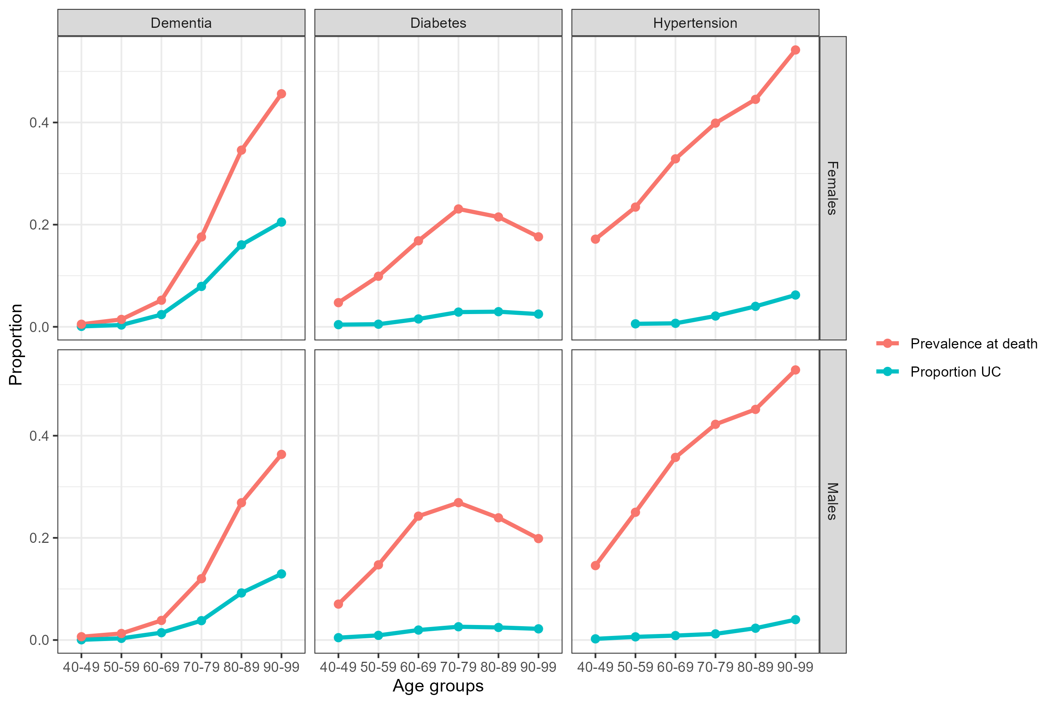
Key medical factors as i) underlying causes of death versus all-causes (%) and 2) prevalence at death (%) by age and sex
Results
Notes:
Res_by_age in “codi1.R”
gg1

Slide 6
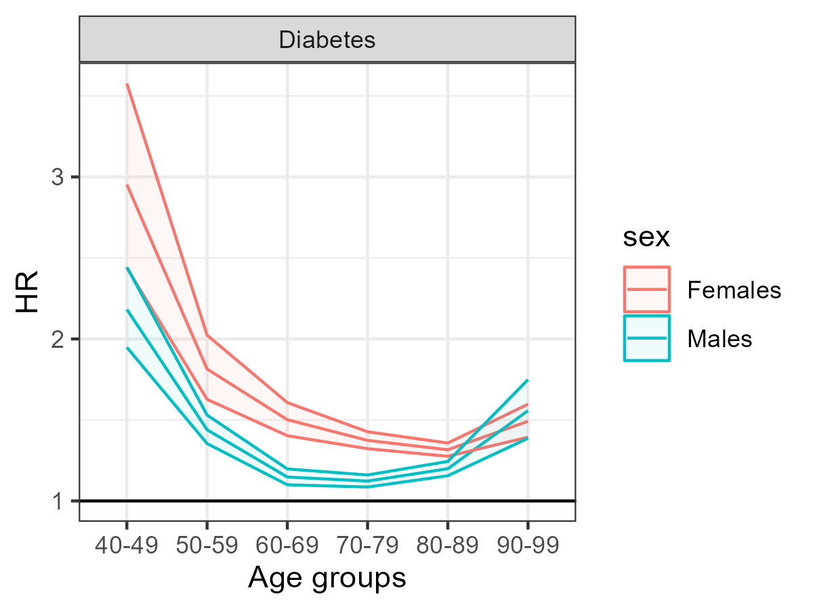
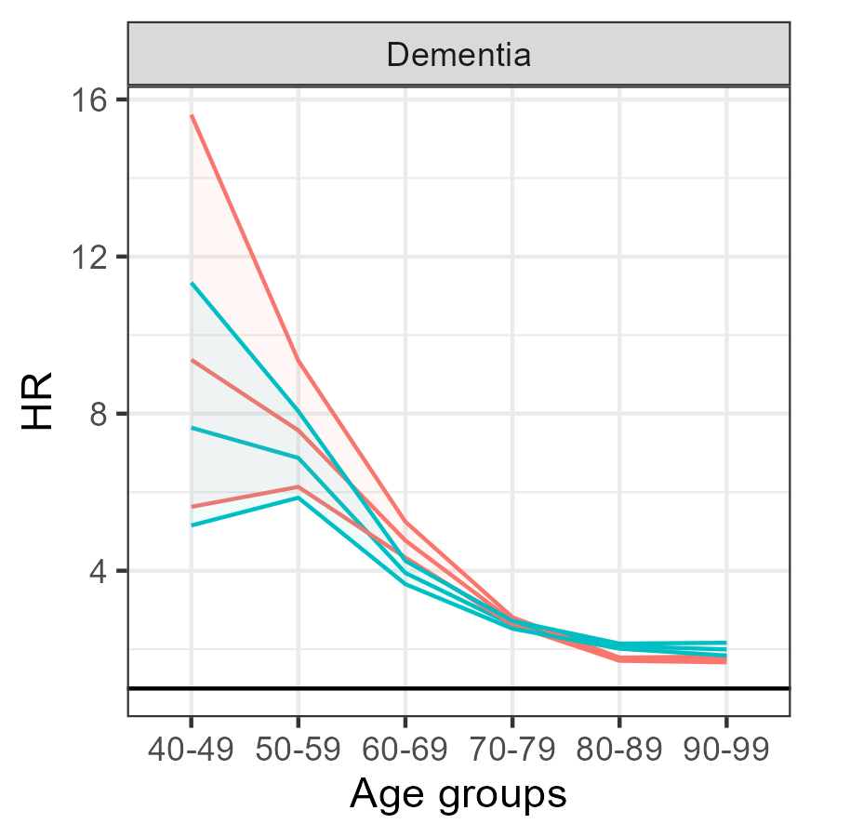
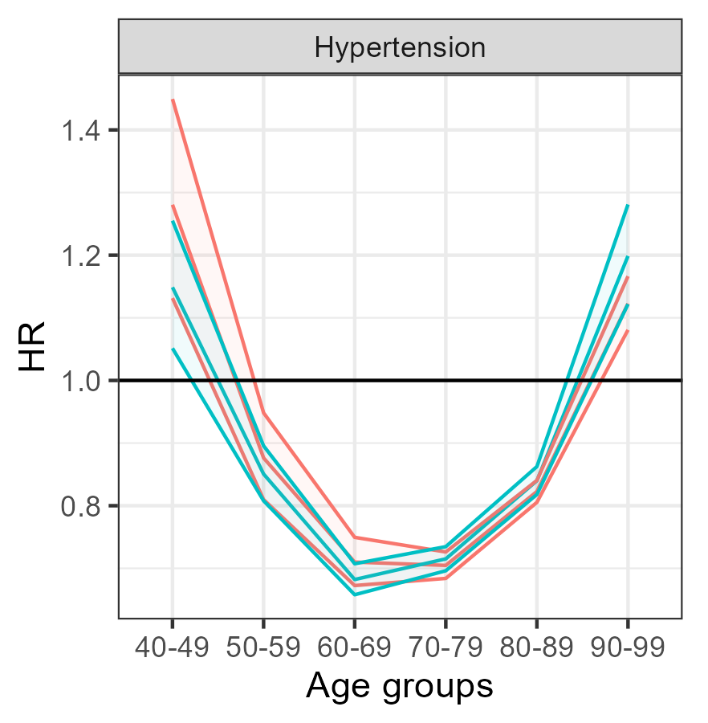
Results
Cox HR of all-cause mortality
by age groups
Notes:
To be done from sex-age independent models
Results_hr_age in “code1.R”
Very strange for hypertension no? In my view there should be some errors as these results do not seeem to fit the KM curves from the previous slide.

Slide 7
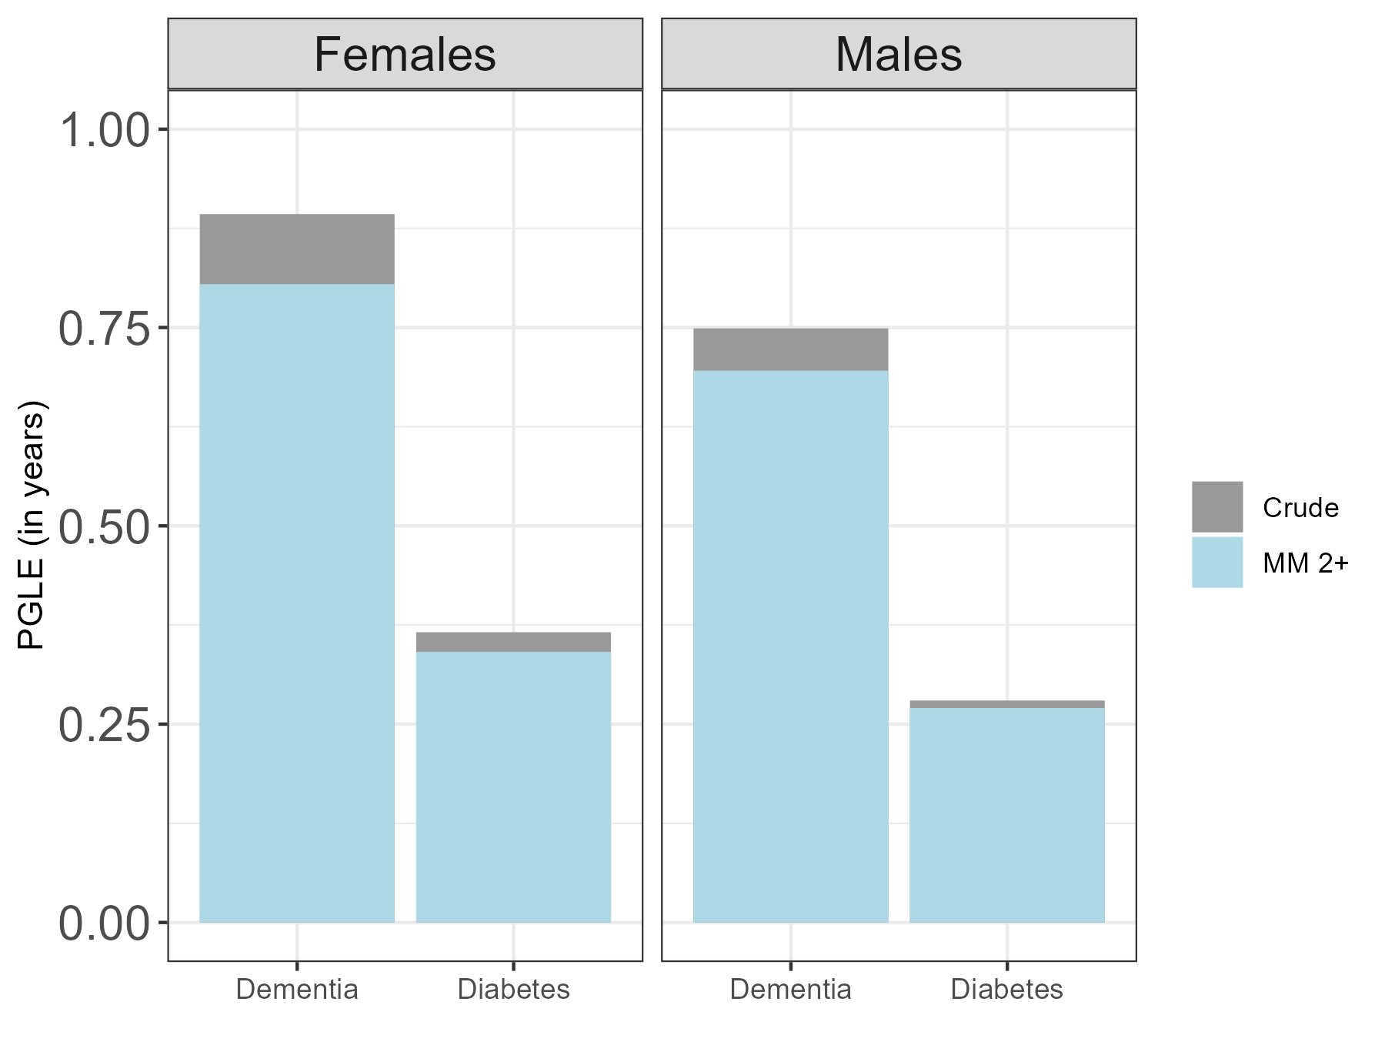
Impact of dementia and diabetes on life expectancy at age 40 (PGLE), controlling for multimorbidity (MM)
Results
Notes:
Res_by_age in “codi1.R”
Diabetes, dementia hyper
F 0.37, 0.89, -0.37
M 0.28, 0.75, -0.53
Idem controling basic MM
F 0.34, 0.80, -0.46
M 0.27, 0.70, -0.60

Slide 8
Conclusions and further research
Dementia, and particularly diabetes and hypertension, have high prevalence at death, which mismatch with their role as underlying cause of death.
Using primary care data prove to be of added value for understanding the role of specific diseases on mortality
Further research is needed to understand how the estimated risks evolve over time, across socioeconomic groups.
Extend the analyses including multiple causes of death

Slide 9
This study was supported with funding provided by the European Research Council (ERC-2019-COG agreement 864616, HEALIN) and by the Spanish Ministry of Science and Innovation (project PID2021-128892OB-I00; and fellowship RYC2021-033123-I)
Thank you!
^{strias@ced.uab.cat}
^{@sergi_tl}

