Slide 1
Lifeineq: an R-package for all of your lifespan inequality estimation needs
Alyson van Raalte
in collaboration with Tim Riffe, Christian Dudel
EAPS-HMM Meeting Bilbao
Autumn 2024

Slide 2
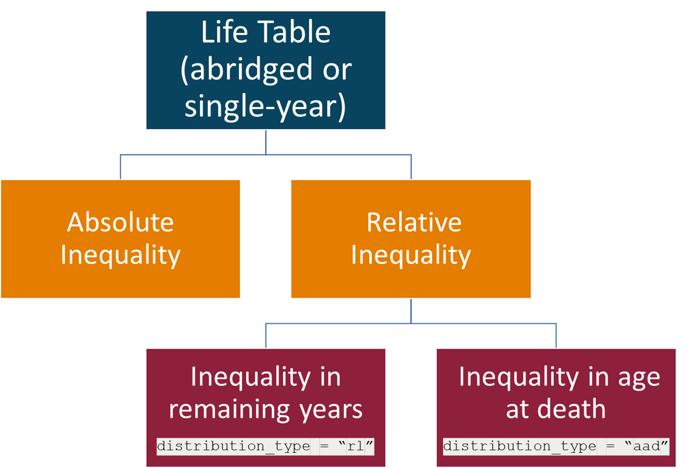
Choosing an index

Slide 3
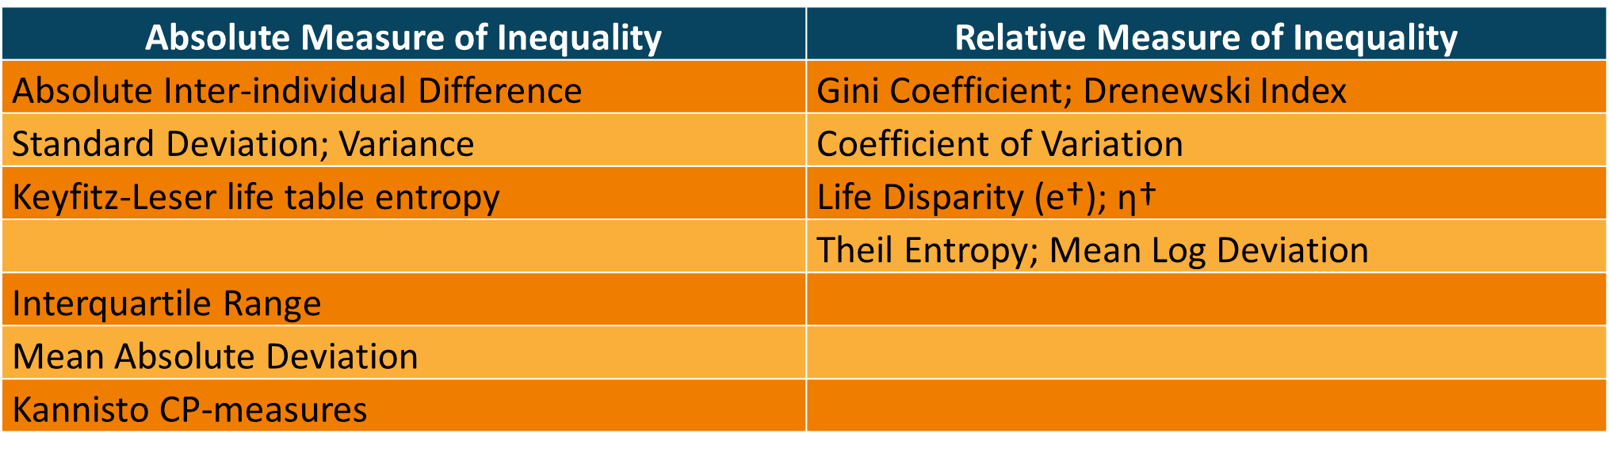
The built-in indices of inequality

Slide 4
Choosing an index

Slide 5
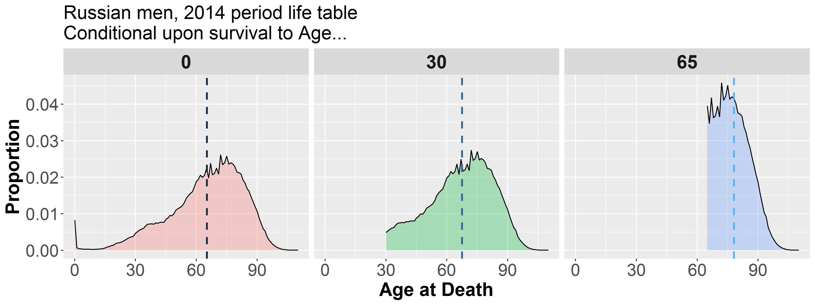
Attainment distribution
Mean = 65.3
Mean = 67.5
Mean = 78.2

Slide 6
Attainment distribution shortfall distribution
Mean = 65.3
Mean = 67.5
Mean = 78.2
e₀ = 65.3
e₃₀ = 37.5
e₆₅ = 13.2
0 30 60
0 25
REMAINING LIFE EXPECTANCY

