Slide 1
Multimorbidity Profiles of Immigrants and Natives in Norway
Maskileyson, Dina ¹ Hünteler, Bettina ^{2,3}
¹ University of Luxembourg
² Institute for Sociology and Social Psychology, University of Cologne
³ Kinship Inequalities Research Group, Max Planck Institute for Demographic Research
Notes:
Good afternoon, everyone! I'm really glad to be here today, to share the work we've been doing together with Bettina Huenteler.
First off, we'd like to express our gratitude to the Research Council of Norway and their Centers of Excellence funding scheme for making this project possible.
We want to express a big thanks to Jonathan Worn and Oystein Kravdal for their help in gaining access to the data.
The topic of todays presentation is…

Slide 2
Focus of the Study
Multimorbidity - presence of two or more chronic diseases in the same individual (Larsen et al. 2017)
To identify patterns of multimorbidity in immigrant and native-born populations in Norway and to examine how these patterns are related to sociodemographic and socioeconomic factors.

Slide 3
Research Questions
To what extent do multimorbidity profiles differ among first-generation (FG) immigrants, second-generation (SG) immigrants, and Norwegian natives?
To what extent do the multimorbidity profiles differ by country of origin and reason for migration?
What are the main determinants (e.g., gender, socioeconomic status) of multimorbidity across different groups?
Notes:
This study aims to examine whether there are

Slide 4
Motivation behind this Study
Multimorbidity is linked to:
Increased risks of premature death, hospitalization, polypharmacy, and reduced quality of life.
A significant economic burden on healthcare systems.
Healthcare systems are primarily designed for single-disease treatment, which may increase the risk of:
Iatrogenic harm and complex drug interactions due to polypharmacy in multimorbid patients.
There is a growing need for improved management of multimorbidity due to the aging population.
Notes:
Why it is important?
Multimorbidity is the co-existence of several conditions where none are considered an index condition that is the specific focus of attention (The Academy of Medical Sciences, 2018). Multimorbidity is, therefore, a highly heterogeneous concept and can be used to describe a wide array of patients experiencing a multitude of different combinations of conditions. These concepts are particularly relevant for understanding health disparities because they demonstrate how health outcomes are distributed across different populations. They allow researchers to examine the associations between health outcomes and socioeconomic, demographic, and health-behavioral factors.
iatrogenesis refers to harm experienced by patients resulting from medical care, whereas negligence is more narrowly conceived as deviation from standard care. While all harm resulting from negligence is iatrogenic, not all iatrogenic injury is negligent.

Slide 5
Research Gap
Limited knowledge on the prevalence of disease combinations in immigrant populations.
Need for studies that:
Identify common clusters of chronic diseases.
Simplify care processes and improve understanding of health disparities.

Slide 6
Morbidity Profiles by Nativity Status and Country of Origin
First-generation (FG) immigrants:
Lower multimorbidity rates compared to natives.
Greater complexity in health patterns, especially among non-Western immigrants (Diaz et al. 2015).
Second-generation (SG) immigrants:
Higher rates of mortality and chronic diseases, particularly among those with non-Western parents (Bennet et al. 2021; Wallace et al. 2023).

Slide 7
Norwegian context
FG immigrants ∼ 15% of the population.
Diverse immigrant backgrounds by country of origin and reasons for migration:
Nordic, outside EU/EEA, EU/EEA (particularly CEE) (Brochmann & Kjeldstadli, 2008; Friberg, 2016)
Notes:
The European Economic Area (EEA)
Central and Eastern Europe (CEE)

Slide 8
Data
Source: Norwegian Population Register and KUHR register, 2014-2019
Analytical sample:
2,743,181 native-born individuals,
550,471 FG immigrants (= not born in Norway) &
190,910 SG immigrants (= at least one parent not born in Norway)
Lived in Norway between 2014 and 2019
Aged 20+ years in 2014
10% probability sample was used for the current analysis
Notes:
The data were obtained from..
Our analytical sample includes
Studies of multimorbidity have primarily been based on self-reported information on selected diseases. It is relevant to study the pattern of multimorbidity using register-based information. This source ensures that the included diseases have been clinically validated.

Slide 9
Measures of chronic diseases
Data on 39 chronic conditions, grouped into 15 disease categories (adopted from Larsen et al., 2017).
Conditions chosen for their seriousness (fatal or limiting) and high economic cost.
Disease recorded by a general practitioner during the last 5 years.
Multimorbidity defined as having 2+ chronic diseases.
Notes:
Data on 18 chronic conditions were collected using a revised version of a survey instrument recommended by the World Health Organization for national health surveys (following Larsen at al. 2017)
The conditions were selected because of their serious nature (potentially fatal and/or limiting daily activities) and high economic cost.
Respondents were recorded as having a particular disease if they currently had the disease or if they had previously had the disease and still suffered from aftereffects.
The case was excluded from the analysis if none of the items on the list were completed. For the present analyses, some of the disease categories were combined to enhance the quality of data, producing a total of 15 disease categories.
Multimorbidity was defined as having two or more of these 15 chronic diseases

Slide 10
Migration background
Immigrant status (FG immigrants, SG immigrants, native-born Norwegians)
Nativity status (Norway, Nordic, EU 15, other EU, other OECD, other)
Reason for migration for FG (Nordic, economic, educational, family reunion, political, reason unknown/missing (for migrants immigrating before 1990)
Notes:
Since immigrants it is not a homogenous group, we also distinguish them by nativity status i.e. country of origin as well as reason for migration,.
Reason unknown/missing linked to when they immigrated
Nordic
- Denmark, Finland, Iceland, Sweden
EU-15 (since 1995)
- Belgium, Germany, France, Greece, Ireland, Italy, Luxembourg, Netherlands, Austria, Portugal, Spain, the United Kingdom
Other EU (2004 + ROM & BUL in 2007)
- Czech Republic, Estonia, Cyprus, Latvia, Lithuania, Hungary, Malta, Poland, Slovakia and Slovenia + Romania and Bulgaria
Other OECD (that are not in EU)
- Australia, Canada, Chile, Israel, Japan, South Korea, Mexico, New Zealand, Switzerland, Turkey, USA
Other
- rest

Slide 11
Sociodemographic and Socioeconomic variables
Age
Gender
Years since migration
Number of children
Marital status
Education (proxy for SES)
Previous studies show:
Older people, not married, women, less educated tend to have worse health

Slide 12
Method
Objective (1): Identify multimorbidity clusters across the entire sample using Latent Class Analysis (LCA).
Latent Class Analysis (LCA):
Identifies statistically distinct and clinically meaningful disease patterns.
Classifies individuals into mutually exclusive groups based on morbidity profiles.
Individuals in the same class share a common disease probability profile.
Allows for heterogeneity analysis within immigrant and native populations.
Selection of number of classes based on statistical model fit + interpretability.
Notes:
As a method we used

Slide 13
Method
Objective (2): Examine how multimorbidity clusters are linked to sociodemographic and socioeconomic factors.
Multinomial Logistic Regression:
Predicts probability of belonging to one of the multimorbidity clusters by:
Migration status
Nativity
Reason for migration
Their interactions with gender

Slide 14
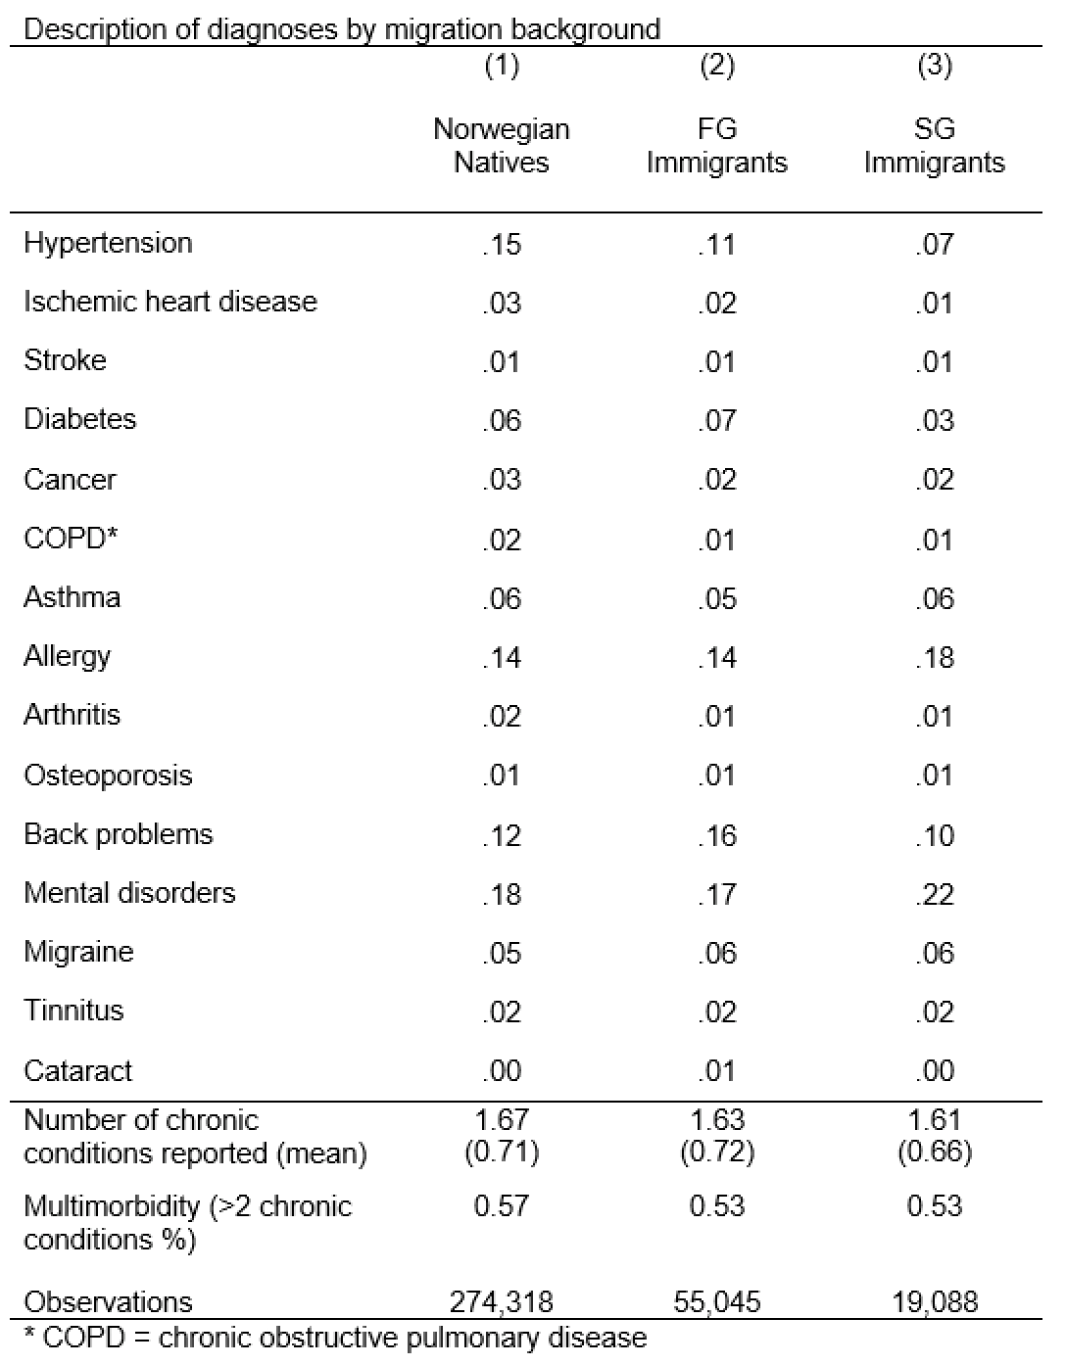
Notes:
To point out to the relatively equal number of the conditions among the groups.
In summary, Norwegian natives tend to report slightly higher levels of certain chronic conditions and multimorbidity than immigrants, with some variation in conditions such as diabetes, mental disorders, and back problems.
Hypertension is more prevalent among Norwegian natives (15%) than among first-generation (FG) immigrants (11%) and second-generation (SG) immigrants (7%).
Ischemic heart disease, stroke, and cancer have similar low prevalence across all groups.
Diabetes is slightly higher among FG immigrants (7%) compared to Norwegian natives (6%) and SG immigrants (3%).
COPD, mental disorders, and back problems are more prevalent in Norwegian natives, while allergy is most common in SG immigrants (18%).
Multimorbidity (more than 2 chronic conditions) is slightly lower in FG and SG immigrants (53%) compared to Norwegian natives (57%).

Slide 15
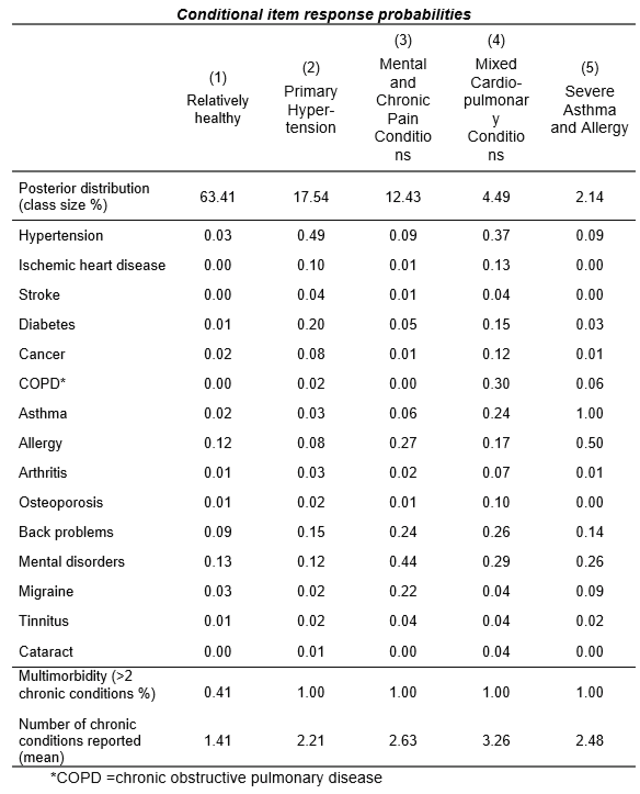
Notes:
Those are the conditional item response probabilities (similar to class loadings) (Larsen’s Table 3)
the conditional item response probabilities across different multimorbidity classes:
Relatively Healthy (63.41%):
Low probabilities for all chronic conditions.
Most individuals in this group report no or very few chronic conditions (mean = 1.41).
Primary Hypertension (17.54%):
High probability of hypertension (0.49).
Moderate likelihood of diabetes (0.20) and back problems (0.15).
Multimorbidity is common (100%), with an average of 2.21 chronic conditions.
Mental and Chronic Pain Conditions (12.43%):
High probabilities of mental disorders (0.44) and back problems (0.24).
Elevated chances of migraine (0.22) and allergy (0.08).
Multimorbidity prevalent, with an average of 2.63 conditions.
Mixed Cardiopulmonary Conditions (4.49%):
High probability of COPD (0.30), asthma (0.24), and back problems (0.26).
Individuals also commonly have hypertension (0.37) and mental disorders (0.29).
High multimorbidity, with an average of 3.26 chronic conditions.
Severe Asthma and Allergy (2.14%):
Extremely high probabilities of asthma (1.00) and allergy (0.50).
Moderate likelihood of mental disorders (0.26) and COPD (0.06).
High multimorbidity, with an average of 2.48 conditions.
Summary:
Most people belong to the relatively healthy group.
The other classes reflect different patterns of multimorbidity, such as hypertension, mental health/pain, and respiratory issues.
The highest multimorbidity is observed in the Mixed Cardiopulmonary Conditions group, with an average of 3.26 conditions.

Slide 16
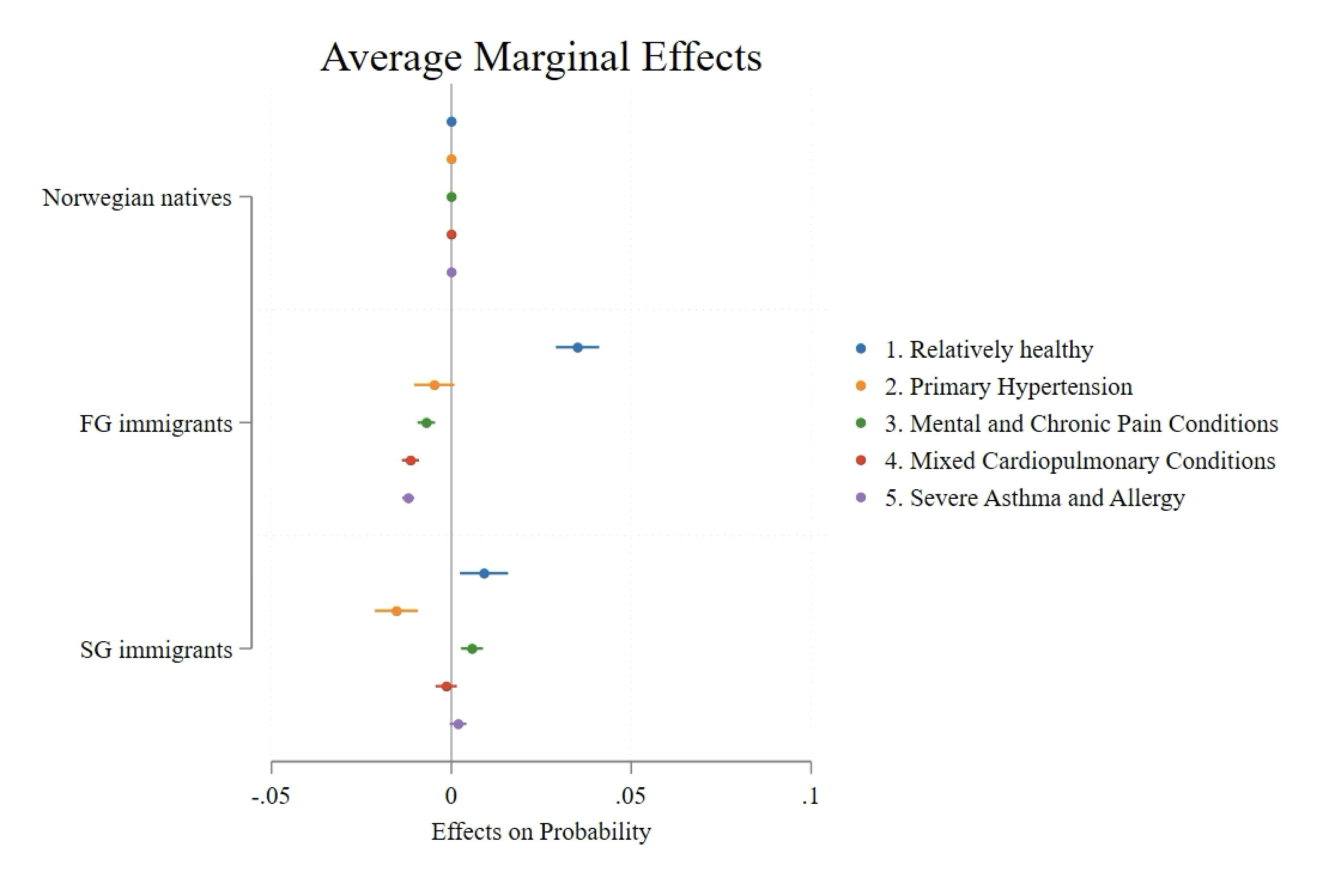
Notes:
The graph shows the Average Marginal Effects of being in different multimorbidity classes for First-generation (FG)and Second-generation (SG) immigrants, relative to Norwegian natives (the baseline group) [BH: the models control for years since immigration, gender, number of kids, marital status, highest education and can be interpreted as differences in percentage points]:
First-generation (FG) immigrants:
More likely to belong to the Relatively healthy class compared to Norwegian natives.
Slightly less likely to be in the Primary Hypertension class.
Lower likelihood of being in the Mixed Cardiopulmonary Conditions class compared to natives.
Less likely to be classified into the Severe Asthma and Allergy class.
Second-generation (SG) immigrants:
More likely to belong to the Relatively healthy class compared to Norwegian natives.
More likely to belong to the Mental and Chronic Pain Conditionsyclasses than both Norwegian natives and FG immigrants.
Lower likelihood of being classified into the Primary Hypertension class.
To sum uo:
First-generation immigrants are generally healthier compared to natives, with a higher probability of being in the Relatively healthy group.
Second-generation immigrants show higher probabilities of being in more severe health conditions, especially in the Mental and Chronic Pain lasses.
Both FG and SG immigrants are less likely to be in the Primary Hypertension or Mixed Cardiopulmonary Conditions classes compared to Norwegian natives.

Slide 17
Absolute prevalence of multimorbidity in the Norwegian population
 | Nativity
Group | Natives | FG | SG
1. Relatively Healthy | 2,030,076 | 426,275 | 143,026
2. Primary Hypertension | 459,900 | 90,264 | 29,106
3. Mental and Chronic Pain Conditions | 113,618 | 18,909 | 8,982
4. Mixed Cardiopulmonary Conditions | 70,622 | 7,820 | 4,642
5. Severe Asthma and Allergy | 68,964 | 7,203 | 5,154
Total | 2,743,180 | 550,471 | 92,063
Notes:
[Suggestion BH] Now you might wonder, how these relative risks translate into actual prevalences in the Norwegian population. To this end, we estimated the predicted probabilities for each subgroup and multiplied them with the respective group sizes in the Norwegian population. What we find striking, for instance, is that around half a million Norwegian natives suffer from (2) primary hypertension. Also, when looking at the smallest of these population groups, the SG immigrants, we find that, for instance, around 9,000 individuals experience the (3) mental/chronic pain multimorbidity pattern.

Slide 18
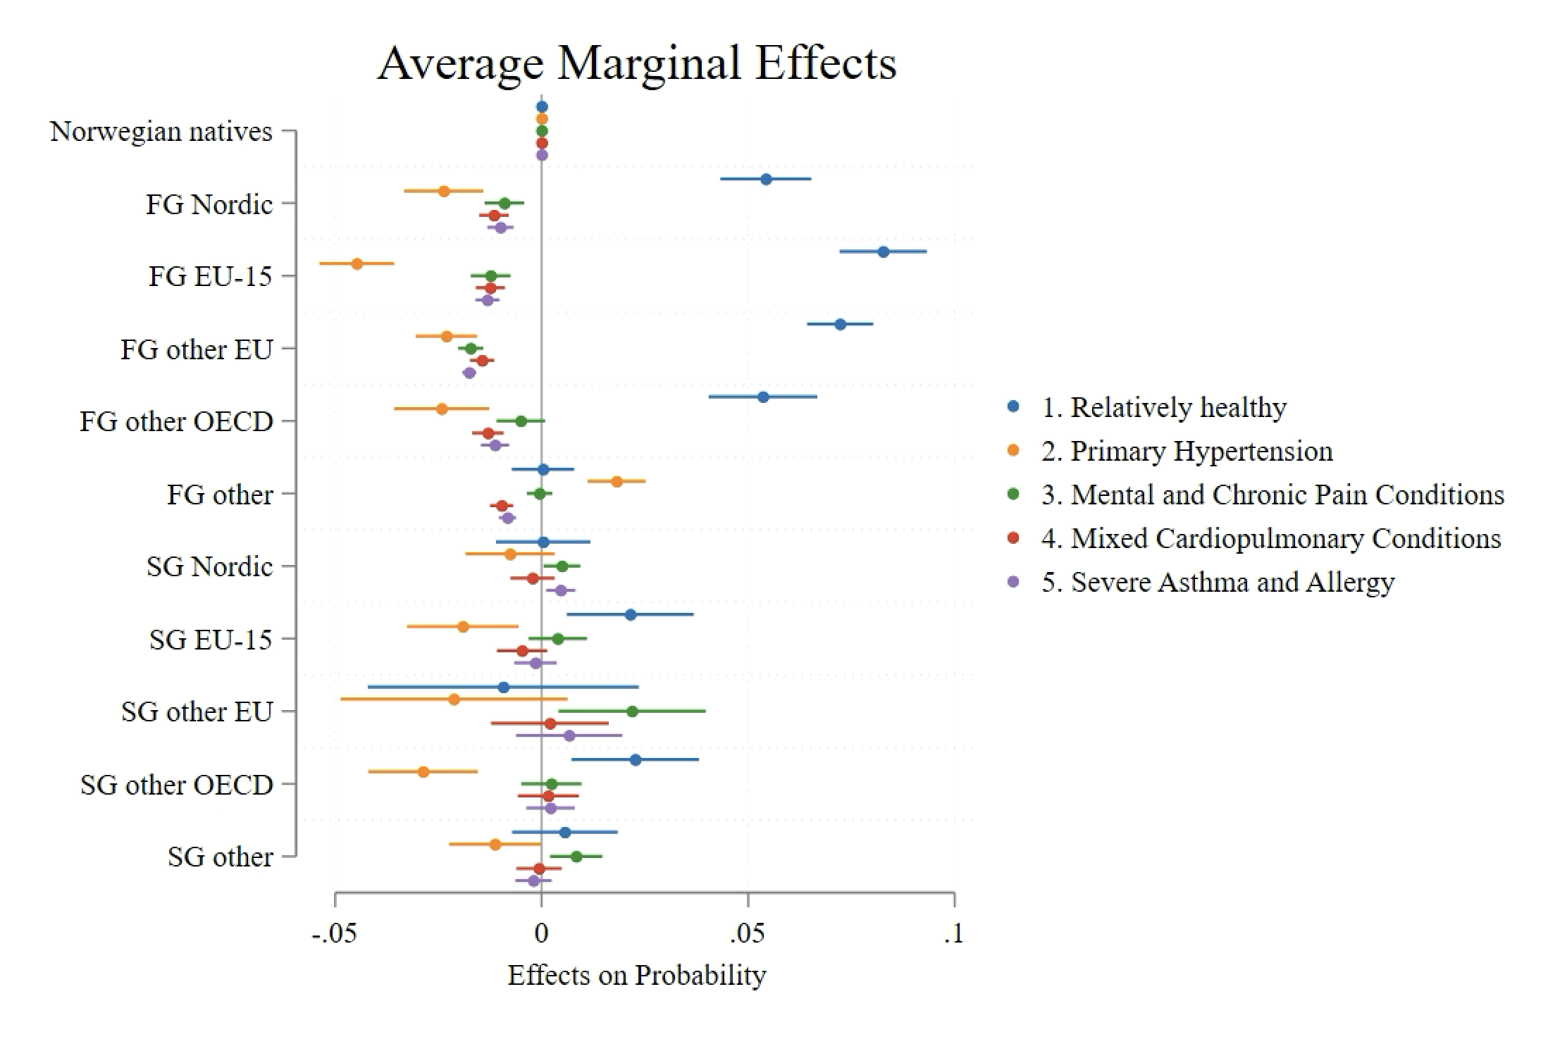
Notes:
1. Healthier Profile of Nordic Immigrants (FG and SG):
Nordic immigrants FG are more likely to be classified as Relatively healthy compared to Norwegian natives and other immigrant groups.
This group stands out for having better overall health outcomes.
2. Greater Health Challenges for Non-Western Immigrants (FG and SG):
Non-Western immigrants (both FG and SG) are significantly less likely to be Relatively healthy and more likely to belong to the Primary Hypertension, Mental and Chronic Pain clusters.
This points to potential social factors affecting their health, such as socioeconomic disparities and access to care.
3. Second-generation Immigrants (SG) Show Higher Vulnerability:
Second-generation immigrants (especially from non-Western countries) are more likely to experience worse health outcomes, particularly in terms of mental health, chronic pain.
This suggests that health challenges persist or worsen across generations, which could imply ongoing challenges related to integration and social determinants of health.
4. Patterns Vary by Region of Origin:
European immigrants (both FG and SG) show mixed outcomes, with some subgroups facing higher risks of mental health conditions (e.g., EU-15 and other EU groups).
These variations highlight the need to consider specific regional origins when analyzing health outcomes.

Slide 19
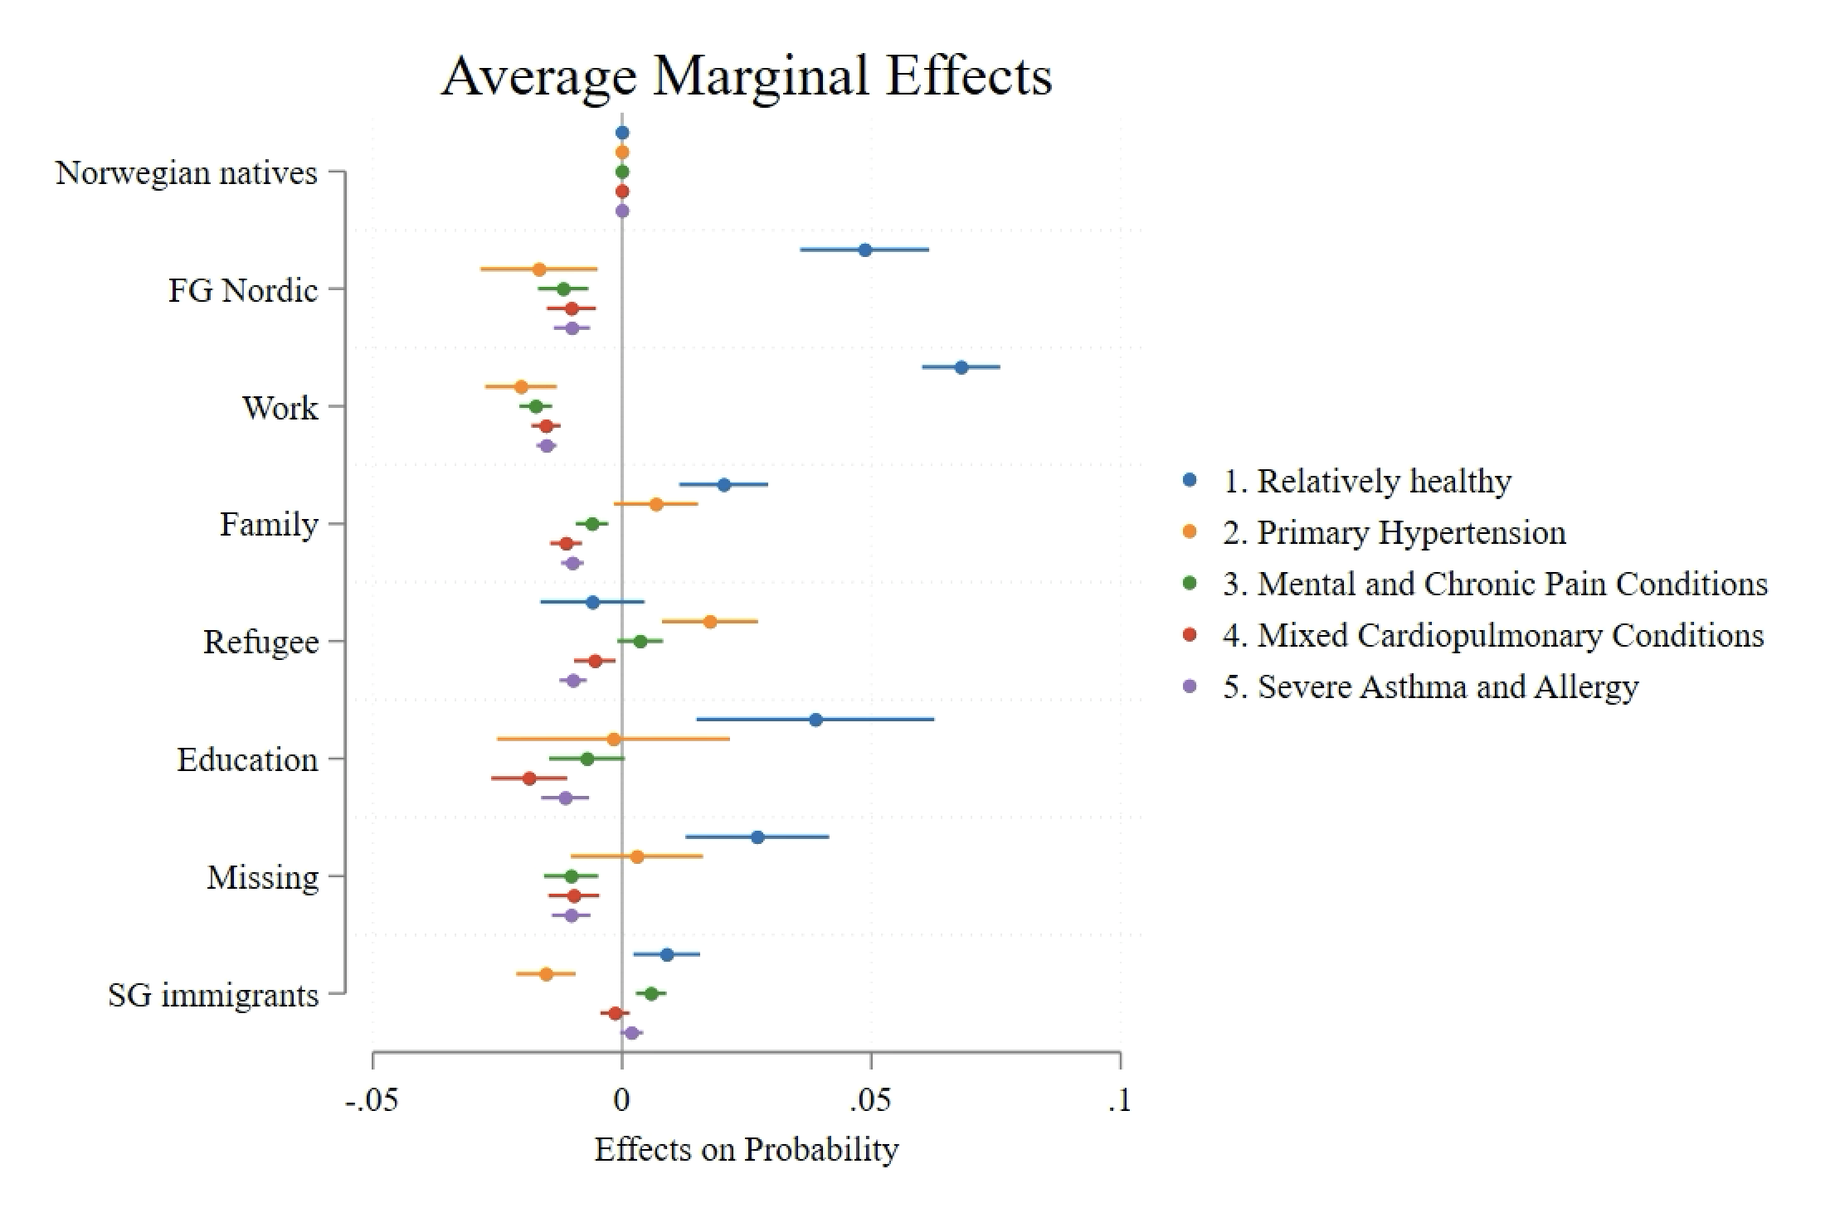
Notes:
1. Work and Education Migrants Are Healthier:
Work migrants and education migrants show a higher likelihood of being in the Relatively healthy class compared to Norwegian natives.
These groups face lower risks of conditions like Primary Hypertension, Mental and Chronic Pain, and Severe Asthma and Allergy, highlighting their overall better health profiles.
2. Refugees Are Highly Vulnerable:
Refugees are significantly less likely to be healthy and more likely to belong to the hypertension cluster.
This highlights the unique health struggles of refugees, such as pre-migration trauma and post-migration stress, beyond what is seen in non-Western groups by origin.
3. Second-Generation Immigrants Have Poorer Health Regardless of Migration Reason:
Across migration reasons, Second-generation (SG) immigrants have a higher likelihood of being in the Mental and Chronic Pain class, showing the their health converge to the level of that of natives/

Slide 20
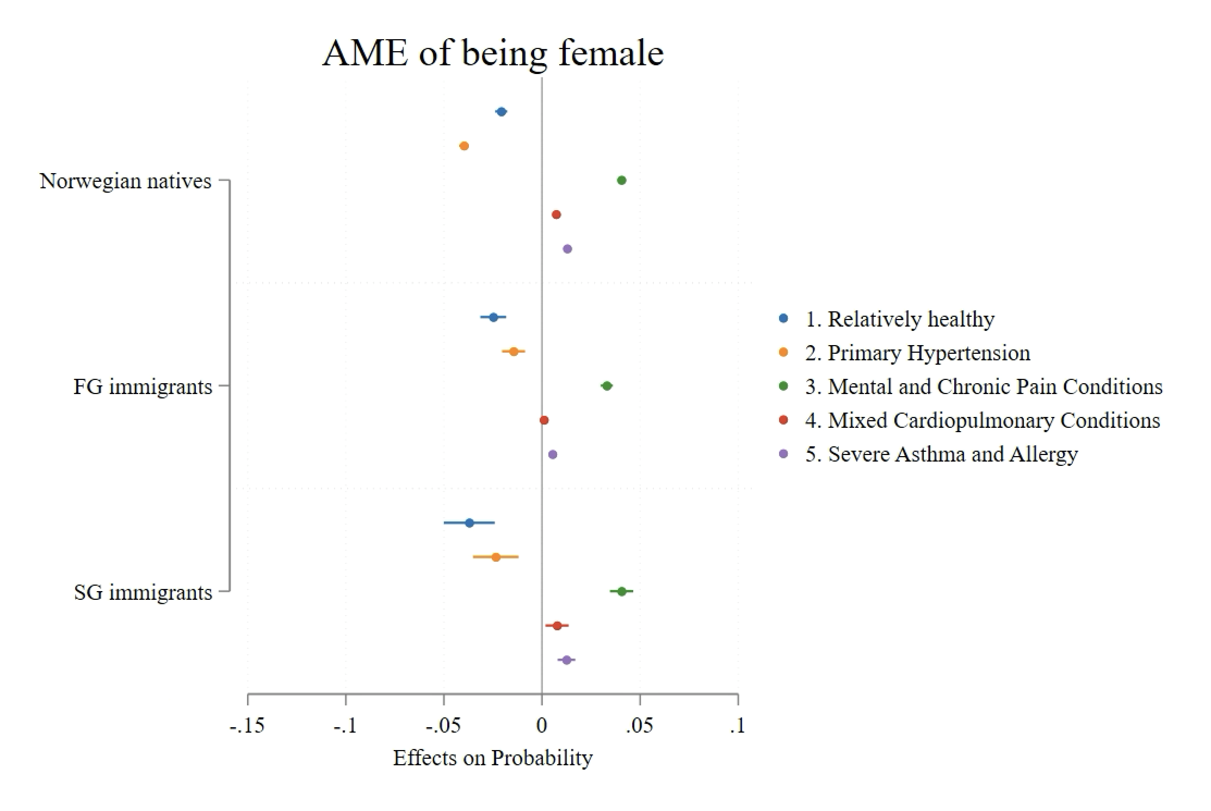
Notes:
Here you see the average marginal effects of being sorted into each multimorbidity pattern for women compared to men, for each population group. Positive values indicate that women have a higher likelihood of experiencing this pattern compared to men. (e.g. The risk for SG immigrant women to have the (3) mental/chronic pain multimorbidity pattern is around 4 percentage points higher than that of men).
Key Points:
Across all groups, women are less likely to be classified as Relatively healthy.
Mental and Chronic Pain Conditions are the most significant burden for women across all groups, especially in Second-generation immigrants.
Women are at higher risk for Severe Asthma and Allergy in Norwegian natives and Second-generation immigrants, indicating potential gender disparities in respiratory conditions.
This graph suggests that women, particularly in Second-generation immigrant groups, face greater health challenges, with a strong propensity towards chronic pain, mental health issues, and respiratory conditions.
Norwegian natives:
Women are more likely to have Mixed cardiopulmonary conditions, Mental and Chronic Pain Conditions, and Severe Asthma and Allergy.
Women are less likely to be classified as Relatively healthy compared to men.
First-generation (FG) immigrants:
Women in this group are more likely to be in the Mental and Chronic Pain Conditions class.
Women are less likely to be classified as Relatively healthy, with a noticeable difference compared to men.
Second-generation (SG) immigrants:
Women in the SG immigrant group are significantly more likely to be in the Mental and Chronic Pain Conditions, Mixed Cardiopulmonary Conditions, and Severe Asthma and Allergy classes.
Similar to FG immigrants, women in this group are less likely to be classified as Relatively healthy.

Slide 21
Absolute prevalence of multimorbidity in the Norwegian population
 |  | Nativity
Group | Sex | Natives | FG | SG
1. Relatively Healthy | Male | 1,059,111 | 221,136 | 75,836
 | Female | 971,275 | 205,097 | 67,216
2. Primary Hypertension | Male | 263,632 | 48,067 | 16,191
 | Female | 195,735 | 42,131 | 12,909
3. Mental and Chronic Pain Conditions | Male | 30,790 | 5,164 | 2,709
 | Female | 82,946 | 13,835 | 6,257
4. Mixed Cardiopulmonary Conditions | Male | 31,430 | 3,861 | 2,037
 | Female | 39,230 | 3,962 | 2,603
5. Severe Asthma and Allergy | Male | 26,730 | 2,954 | 2,074
 | Female | 42,302 | 4,266 | 3,078
Total | Male | 1,411,693 | 281,181 | 98,848
 | Female | 1,331,488 | 269,291 | 92,063
Notes:
Again, turning to the absolute prevalence of the multimorbidity patterns in the Norwegian population, we find that these relatively small gender differences, translate into substantial differences in numbers between the subgroups. The relatively small relative difference of 4 percentage points in the mental/chronic pain patterns when comparing men and women result in an absolute difference of around 31,000 Norwegian born men to 83,000 Norwegian born women, or 2,700 SG men to 6,000 SG women, for instance.
[Calculated as the predicted probability to be sorted into each pattern for each subgroup multiplied with the size of the subgroup in the Norwegian population]

Slide 22
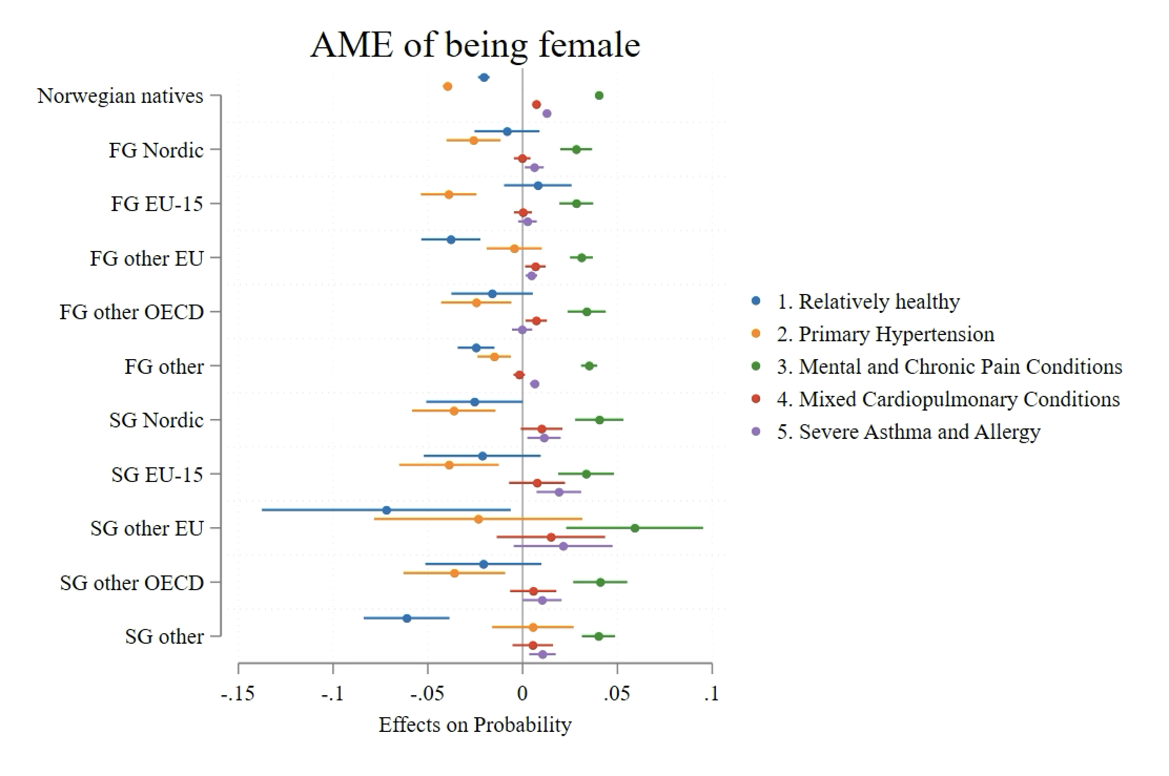
Notes:
across all groups, women have a higher likelihood for mental/pain and asthma/allergy and a smaller likelihood for relatively healthy and hypertension, with few exceptions]
Key Points:
Across all groups, women are generally less likely to be classified as Relatively healthy.
Mental and Chronic Pain Conditions and Asthma and allergies are more prevalent among women in most immigrant groups as compared to men.
Non-Western women (both FG and SG) show particularly higher risks for conditions like Severe Asthma and Allergy and Mental and Chronic pain conditions.
SG immigrants show consistently worse health outcomes for women, particularly in the Other categories, indicating persistent health disparities across generations.
These insights emphasize the gender disparities in health, with immigrant women, particularly those from non-Western regions, facing higher health burdens.

Slide 23
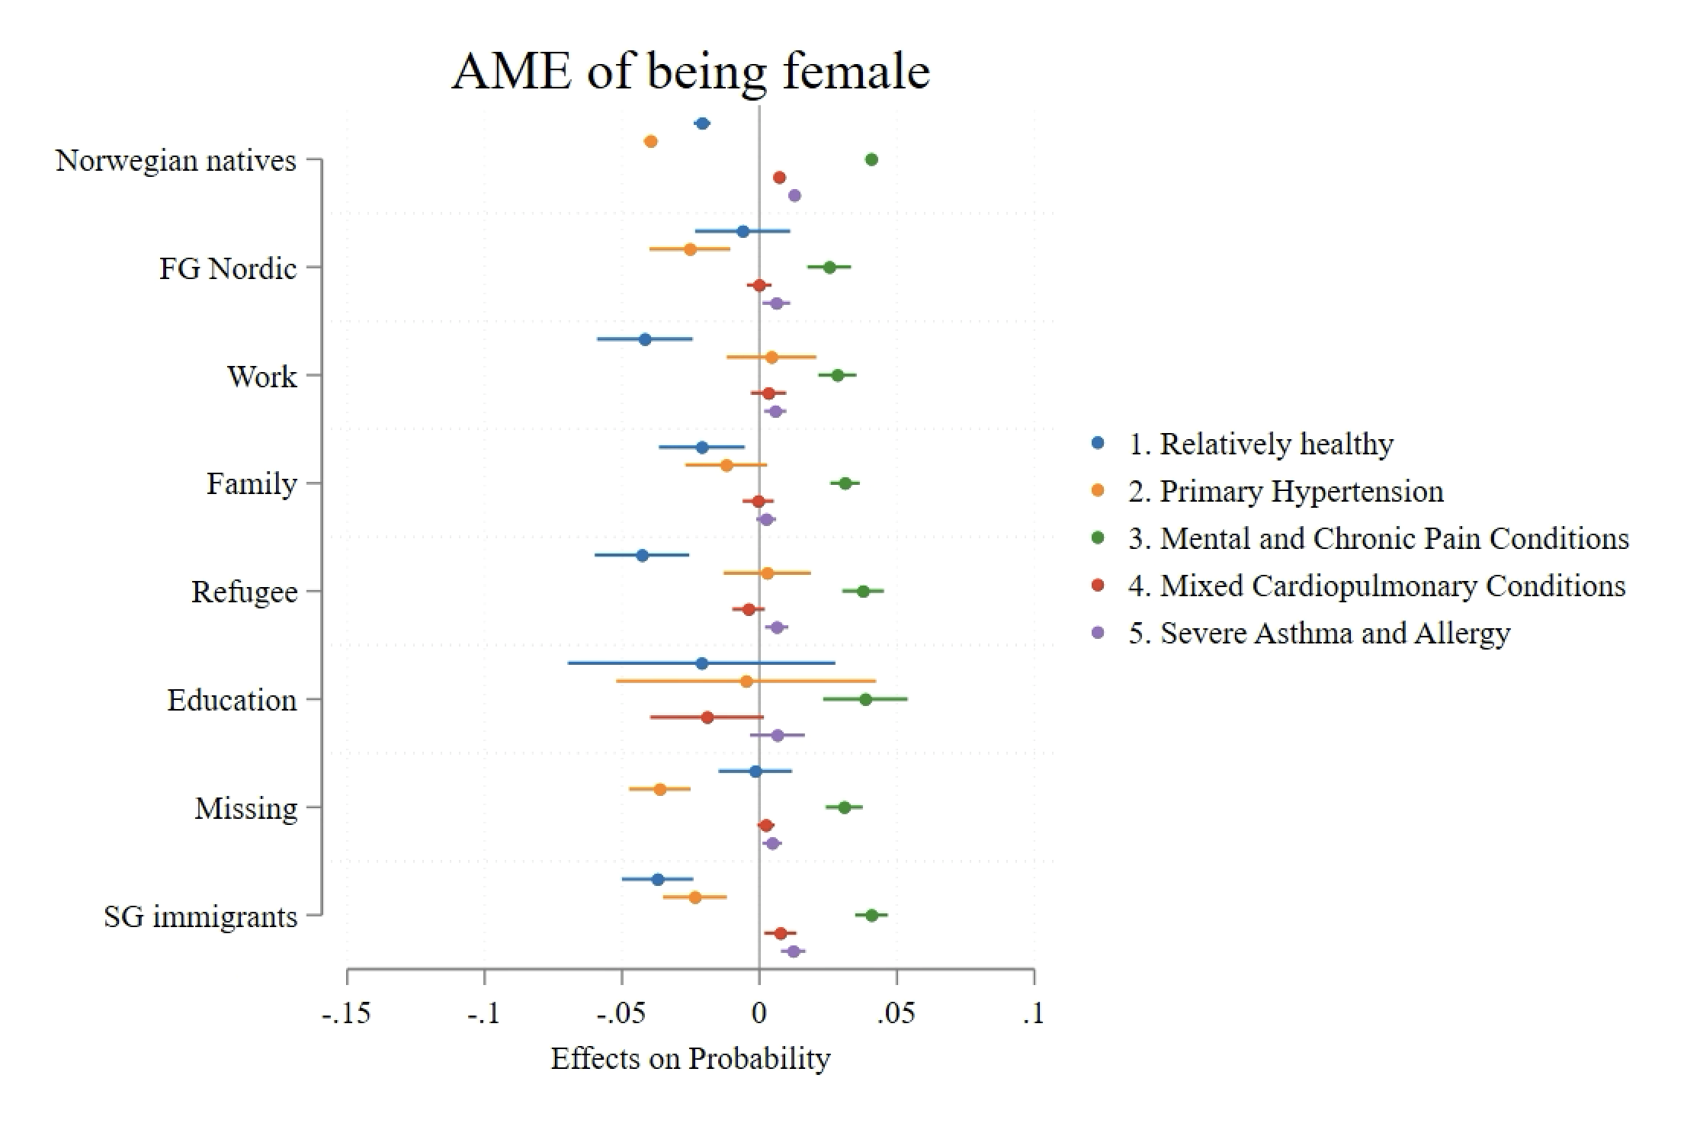
Notes:
[BH: previous patterns largely consistent across reason for migration groups]
Education migrants:
Women are more likely to experience Mental and Chronic Pain Conditions
Refugees:
Women are significantly more likely to belong to the Mental and Chronic Pain Conditions group.
Lower likelihood of being Relatively healthy compared to men.
Work – interestingly less healthy than men.
Across nearly all groups, women are more vulnerable to chronic pain and hypertension and are generally less healthy compared to men.
Refugee and family migrants face the greatest health disparities by gender, with women in these groups being particularly vulnerable.

Slide 24
Summary
Five Latent Classes were identified using Latent Class Analysis (LCA):
Qualitative (types of diseases) and quantitative (prevalence) differences
63% of the population belongs to a Relatively Healthy class.
Four multimorbidity classes represent distinct disease patterns and varying disease burdens.
Multimorbidity prevalence:
More common among Natives and non-Western immigrants, and women.

Slide 25
Summary
Generation:
FG immigrants are generally healthier compared to natives.
SG immigrants' health converges towards natives.
Country of Origin:
Nordic and EU migrants tend to have lower multimorbidity, often aligning more closely with the native-born population.
Non-Western immigrants show higher risks of chronic diseases, particularly mental health issues and hypertension.
Reason for Migration:
Work migrants are generally healthier, with a higher likelihood of being in the Relatively healthy group.
Refugees are most vulnerable, with increased risks of hypertension.
+ Women:
have a higher risk for mental/chronic pain, severe asthma & allergy, and mixed cardiopulmonary diseases
Notes:
2. How do the country of origin and reason for migration shape multimorbidity profiles?
Country of Origin:
Nordic and EU migrants tend to have lower multimorbidity, often aligning more closely with the native-born population.
Non-Western immigrants (particularly FG and SG) show higher risks of chronic diseases, particularly mental health issues and respiratory conditions.
Reason for Migration:
Work migrants are generally healthier, with a higher likelihood of being in the Relatively healthy group.
Refugees are most vulnerable, with increased risks of mental health disorders and Mixed Cardiopulmonary Conditions.
Family migrants show higher rates of Primary Hypertension compared to other groups.

Slide 26
Discussion and Conclusions
Multimorbidity patterns are complex and cannot be fully understood by simply counting chronic diseases.
Using Latent Class Analysis (LCA) reveals that multimorbidity involves distinct patterns that vary greatly by immigrant status, country of origin, and reason for migration.
Gender further shapes these patterns.
These findings demonstrate that multimorbidity should be addressed through tailored prevention and treatment policies rather than generalized approaches based solely on the number of chronic conditions.

Slide 27
THANK YOU!
dina.maskileyson@uni.lu
huenteler@wiso.uni-koeln.de
Thanks to the Research Council of Norway and its Centers of Excellence funding scheme (project number 262700) for their financial support of this project.
Notes:
Thank you for your attention. We are happy to receive any feedback and to answer any questions.

Slide 28
Morbidity profiles by reason for migration
Labor and Educational Migrants
Lower morbidity rates (chronic diseases, mental health issues) (Diaz et al., 2015b).
Healthier due to higher economic status and education.
Family Reunification
Higher risks of chronic diseases and mental health issues (Diaz et al., 2015b).
Challenges due to socioeconomic disadvantages.
Refugees
High rates of mental health disorders (e.g., PTSD, depression) (Diaz et al., 2015b).
Pre-migration trauma and post-migration stress contribute to worse health outcomes (Qureshi et al., 2022).
Notes:
Second-Generation Immigrants
Influenced by parents' migration reasons.
Children of refugees face higher mortality and poorer health outcomes (Wallace et al., 2023).

Slide 29
Social Determinants of Morbidity Profiles
Gender:
Women are more likely to suffer from chronic conditions, mental health issues, and more complex morbidity patterns (Case & Paxson, 2005; Larsen et al., 2017).
Socioeconomic Status (SES)
Lower SES is linked to higher rates of multimorbidity, including mental health issues (Violan et al., 2014).
Notes:
Immigrants face compounded challenges, such as discrimination and lower access to healthcare (Qureshi et al., 2022).

Slide 30
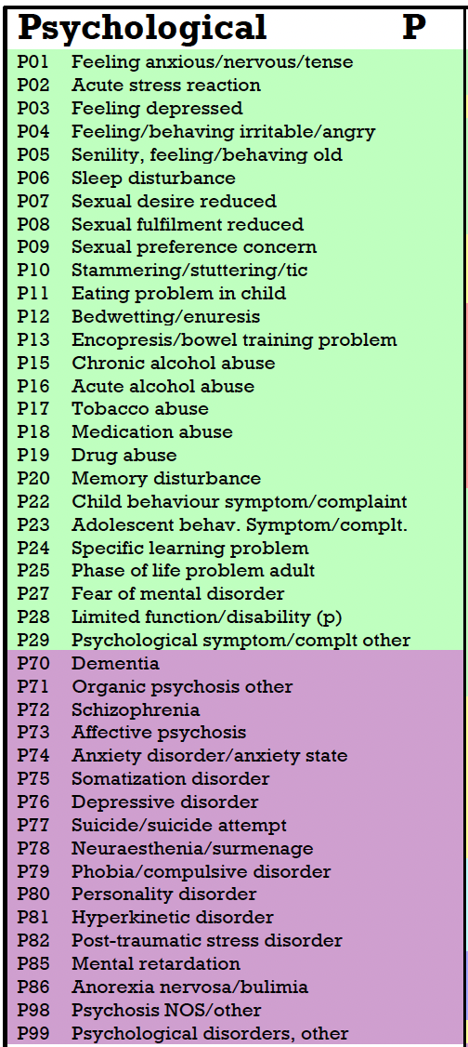
Notes:
Personal health status is the dependent variable in the current study, and is measured using
(ICPC-2 – International Classification of Primary Care – 2nd Edition
Wonca International Classification Committee (WICC))

Slide 31
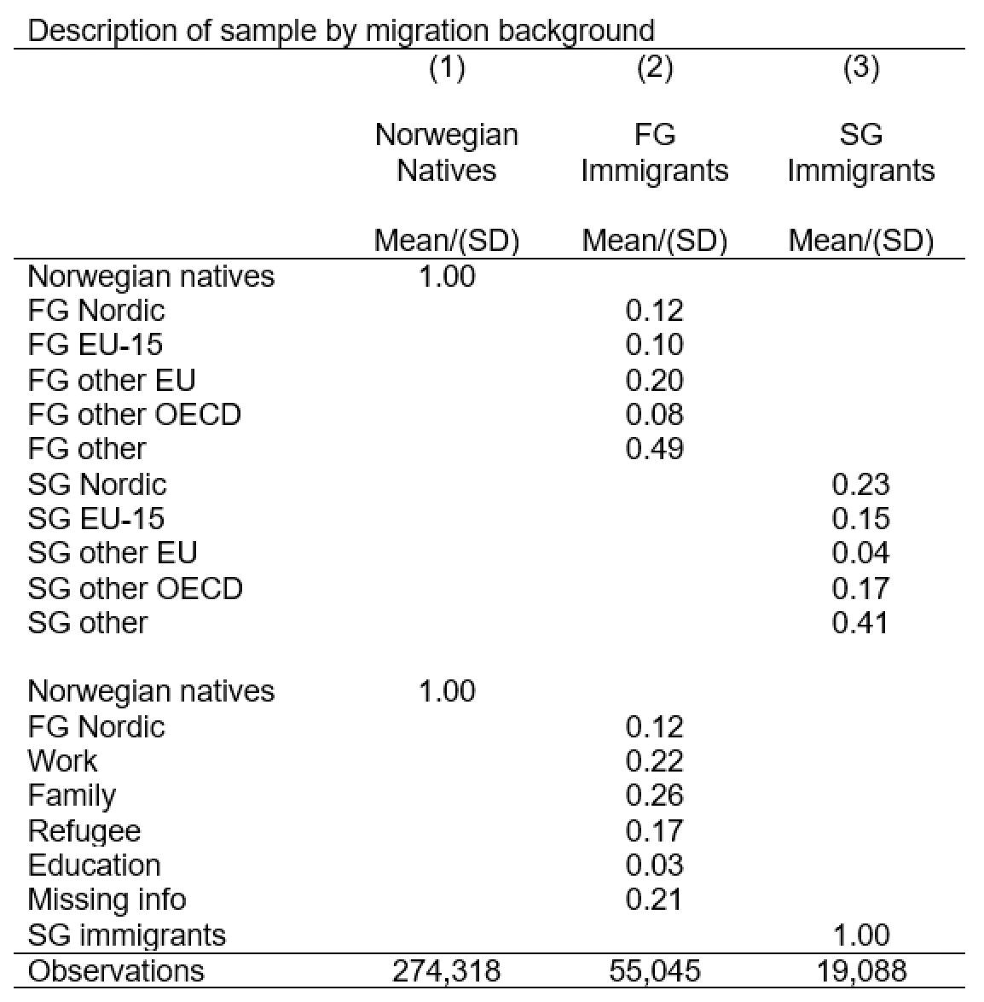

Slide 32
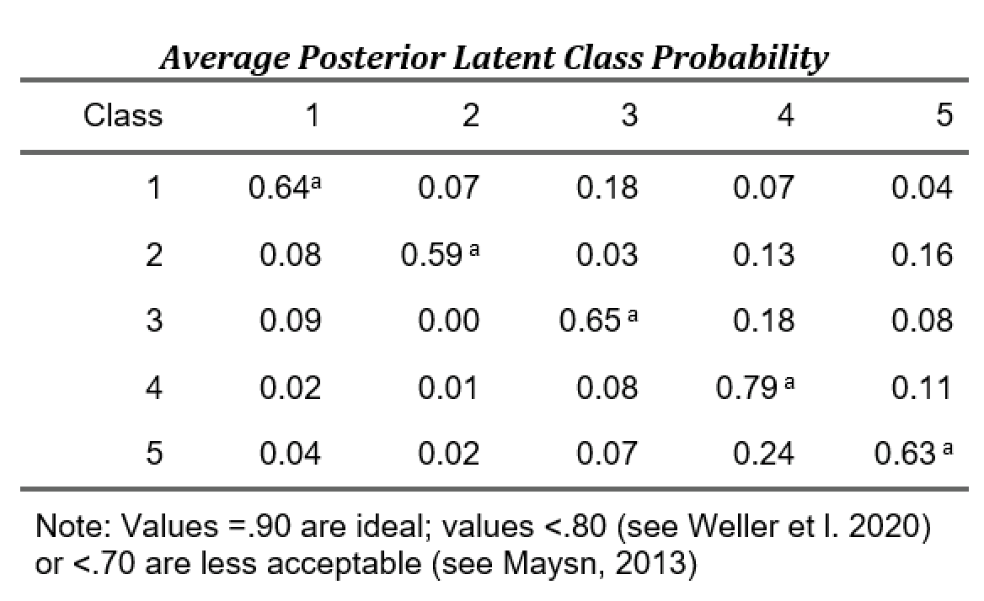

Slide 33
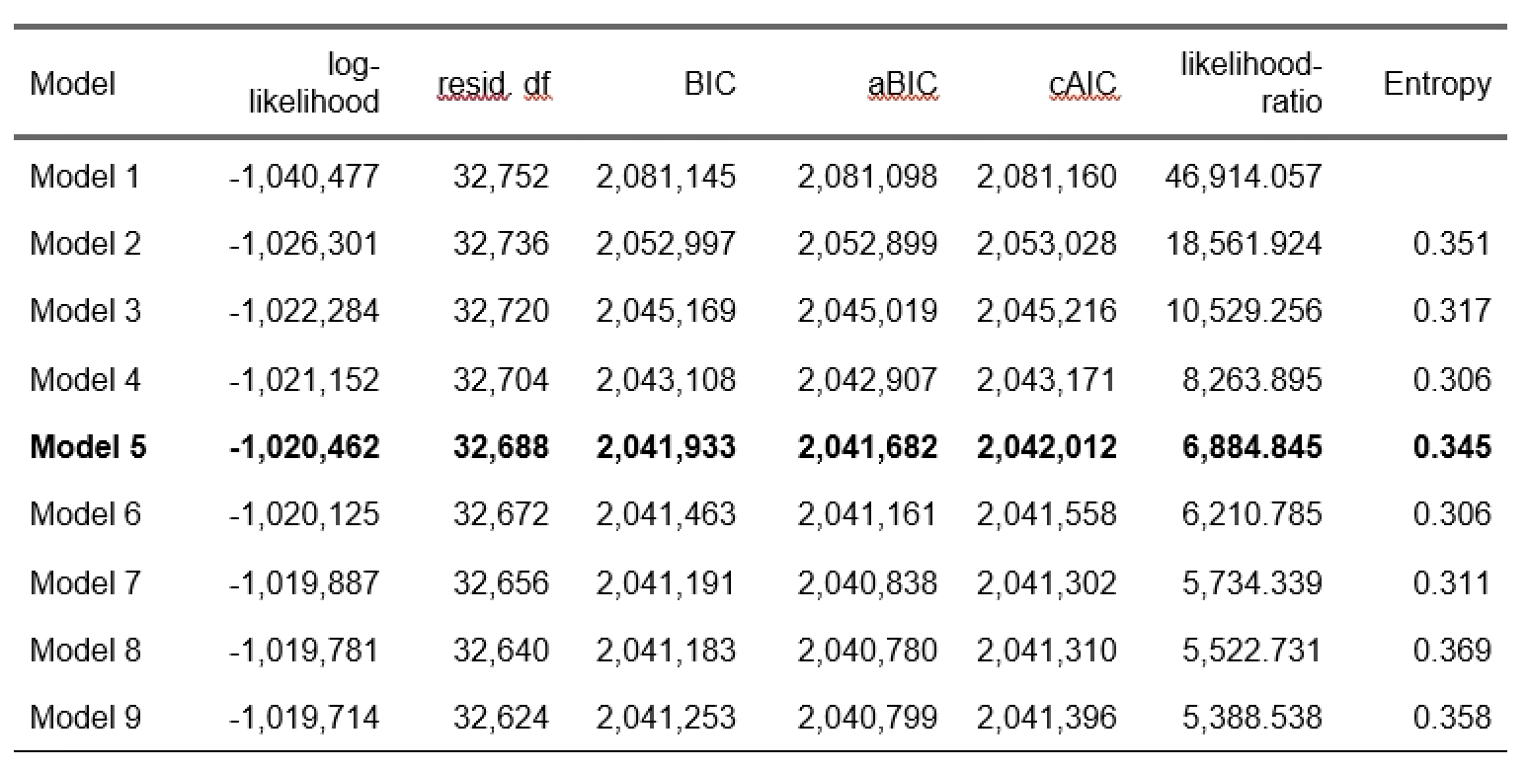
Notes:
This is the table with the model specification fit for our LCA for the estimated cluster solutions from 1-9 (as can be found in Larsen et al.). Our solution (5 classes) in bold. Note that these measures (except entropy) are relative and we always have to consider interpretability of the cluster solution.

