Slide 1
From the Cardiovascular Revolution to the Cancer Transition: 80 years of mortality change across US states
Magali Barbieri^{1,2}, Nadine Ouellette³, Nicholas Reynolds⁴,
Timothy Riffe⁵ and Celeste Winant¹
¹ University of California, Berkeley, US
² French Institute for Demographic Studies (INED), Paris, France
³ Université de Montréal, Montréal, Canada
⁴ University of Essex, United Kingdom
⁵ University of the Basque Country, Spain
EAPS Health, Morbidity and Mortality Working Group Meeting
25-27 September 2024
Notes:
Let me first acknowledge my co-authors, NO, TR, and CW, without whom this study would not have been possible.

Slide 2
Study aims
General objective: uncover regularities in mortality patterns across the 50 US states + DC
Specific objectives:
  What happened at the state level during
  the “Age of [delayed] degenerative diseases”
  Is there a unique pattern or multiple patterns of mortality change within the U.S. over the period 1941-2019?
Notes:
The overall purpose of our research project is relatively simple, that is to increase our empirical knowledge about actual transition experiences within a national population
We focus on that stage of the transition called the Age of Degenerative diseases by Omran and the Age of delayed degenerative diseases by Olshansky and Ault, when cardiovascular diseases and cancer have replaced infectious diseases as the leading causes of death
We simply want to assess how diverse the mortality patterns of sub-groups of the population are compared to the national average as a country progresses through this major stage of the epidemiologic transition

Slide 3
Data sources
United States Mortality Database (USMDB):
(usa.mortality.org)
  Life tables by sex for each US state and DC
  for 1941-2021
Vital statistics:
  Cause of death data by state, year, age group
    Very broad cause-of-death category for 1941-1958 (paper)
    Detailed cause-of-death category (ICD code) for 1959-2021 (electronic)

Slide 4
Methods : modeling
Regression models
  To assess the timing and magnitude of dominant turning points in the trends of the age-standardized death rate at ages 40-84 years since 1941
    For all causes
    For 3 large cause-of-death categories
      Cardiovascular diseases
      Cancer
      All other causes
  Allowing turning points to occur in any given year
  Using 2-, 3- or 4-slope models
  Selecting the model that best describes the data
  (max. goodness-of-fit in R², low BIC and stat. significant coefficient on slopes)
Notes:
The challenge was to reduce the mortality experience of each of the 51 geographic units to a manageable number of parameters
Our strategy was to use a 2, 3 or in some cases, a 4-slope regression model to identify, for each sex and cause-specific series in each state, the main discontinuities in trends
The models estimate the timing and the magnitude of each turning point, that is the year when the main change or changes occurred and the intensity of this change (in terms of the difference between the slope before and the slope after the change)
Experimenting with a range of statistical approaches, we found not only that fitting such trend lines using a grid-search algorithm based on R² goodness-of-fit criteria led to fits that were as good as those obtained with more sophisticated methods but also that this simple approach was less arbitrary
For instance, segmented regression models require an initial guess that must first be provided for the turning points parameters and this introduces undesirable subjectivity into the analysis.

Slide 5
Main initial findings
Remarkable coincidence in the timing of a major turning point in mortality trends in all states around 1970
Cardiovascular disease mortality was clearly the main driver everywhere for this first major turning point
The cancer transition occurred in all states in the 1980s and 1990s but not so much simultaneity in timing
Cardiovascular disease mortality is also driving the stagnation in progress observed everywhere since 2010
Notes:
The first dominant turning point occurred fairly suddenly after either a plateau has been reached in all-cause mortality or after mortality has been increasing (in all southern states in particular).
It occurred in every state around 1970, for males at least (some exceptions for females)
Starting around 1970, mortality started to decline precipitously.

Slide 6
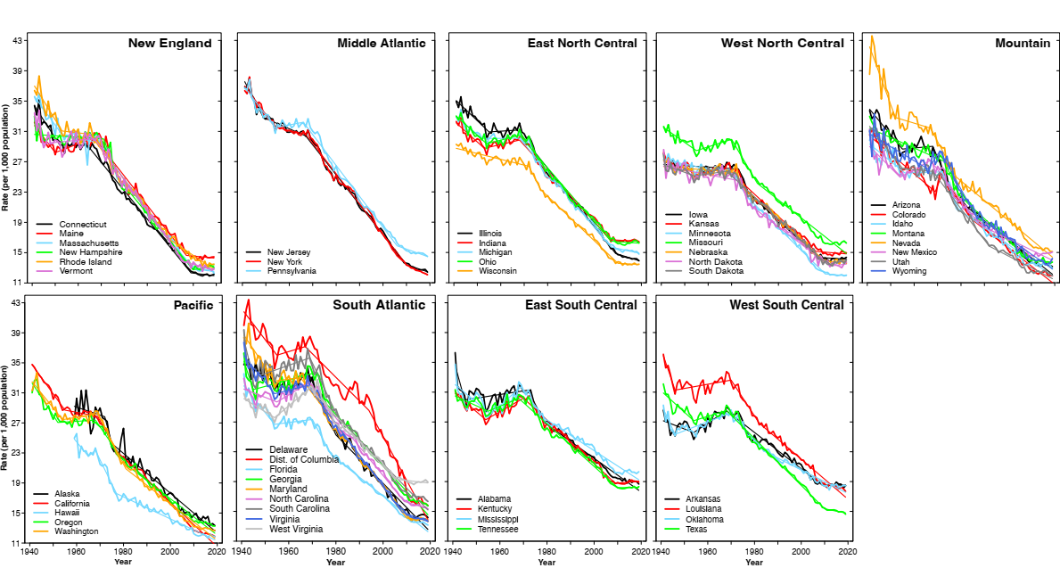
All causes ASDR 40-84 years, Males

Slide 7
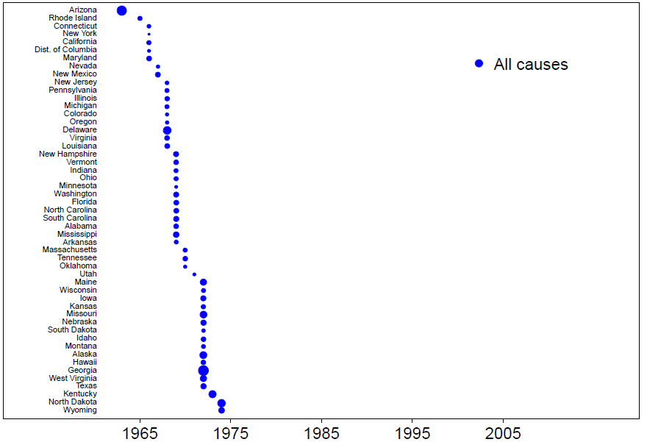
Onset of declining trends for all causes and by cause
Notes:
Here we have a time scale (on the x-axis) and a dot in front of every state listed on the left
The location of the dot corresponds to the year of the main discontinuity in overall mortality trends and the size of the dot is proportionate to the magnitude of the change in trends
Note that all states experienced either a plateau or an increase in mortality before the discontinuity and each and every state experienced a decline in all-cause mortality after the turning point

Slide 8
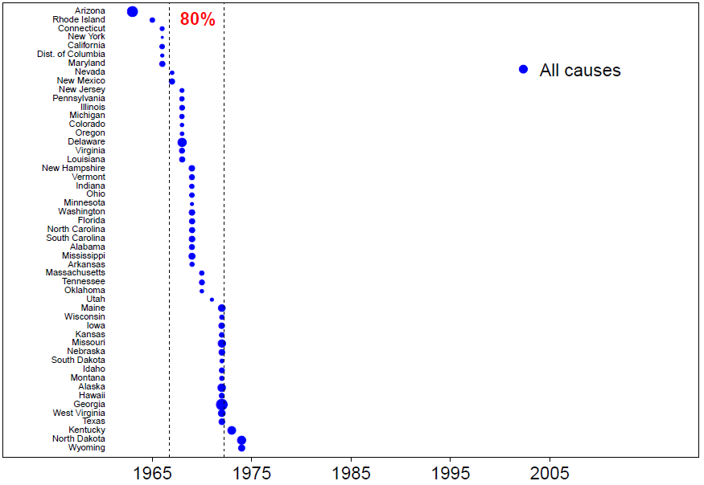
Onset of declining trends for all causes and by cause
Notes:
Our first main finding here is that there was very little spread in the year of discontinuity across the states
A major change occurred everywhere in the US between 1963 and 1974, though for the vast majority of states (over 80%), the change took place within a narrow time window covering the 5 years between 1967 and 1972

Slide 9
Main initial findings
Remarkable coincidence in the timing of a major turning point in mortality trends in all states around 1970
Cardiovascular disease mortality was clearly the main driver everywhere for this first major turning point
The cancer transition occurred in all states in the 1980s and 1990s but not so much simultaneity in timing
Cardiovascular disease mortality is also driving the stagnation in progress observed everywhere since 2010
Notes:
The first dominant turning point occurred fairly suddenly after either a plateau has been reached in all-cause mortality or after mortality has been increasing (in all southern states in particular).
It occurred in every state around 1970, for males at least (some exceptions for females)
Starting around 1970, mortality started to decline precipitously.

Slide 10
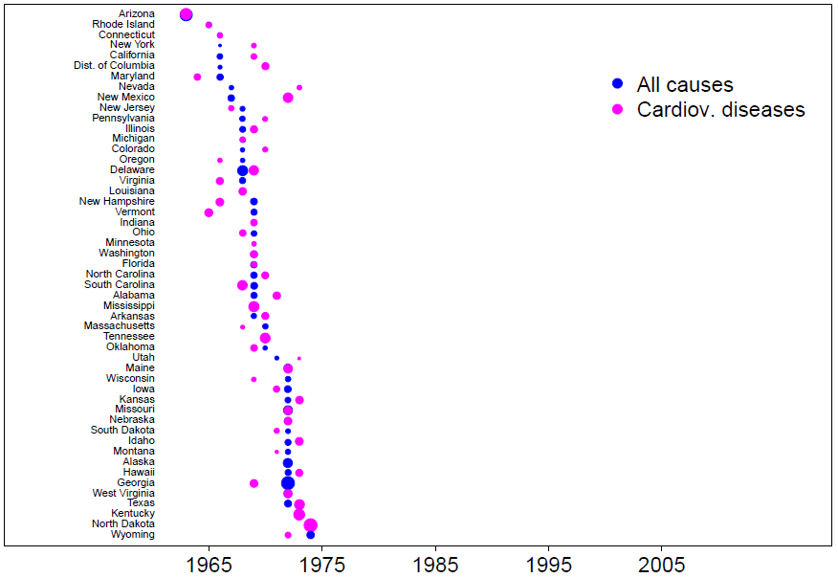
Onset of declining trends for all causes and by cause
Notes:
The third important result is that, again nearly everywhere, there was a very strong coincidence in timing between the discontinuities in all-cause mortality and in cardiovascular mortality (corresponding to the pink dots on this graph)
Also, the correlation between the rate of decline in all-cause and in cardiovascular mortality over the period is extremely high (90% and highly significant), not surprising given the heavy share of total mortality attributable to heart and cerebrovascular diseases

Slide 11
Main initial findings
Remarkable coincidence in the timing of a major turning point in mortality trends in all states around 1970
Cardiovascular disease mortality was clearly the main driver everywhere for this first major turning point
The cancer transition occurred in all states in the 1980s and 1990s but not so much simultaneity in timing
Cardiovascular disease mortality is also driving the stagnation in progress observed everywhere since 2010
Notes:
The first dominant turning point occurred fairly suddenly after either a plateau has been reached in all-cause mortality or after mortality has been increasing (in all southern states in particular).
It occurred in every state around 1970, for males at least (some exceptions for females)
Starting around 1970, mortality started to decline precipitously.

Slide 12
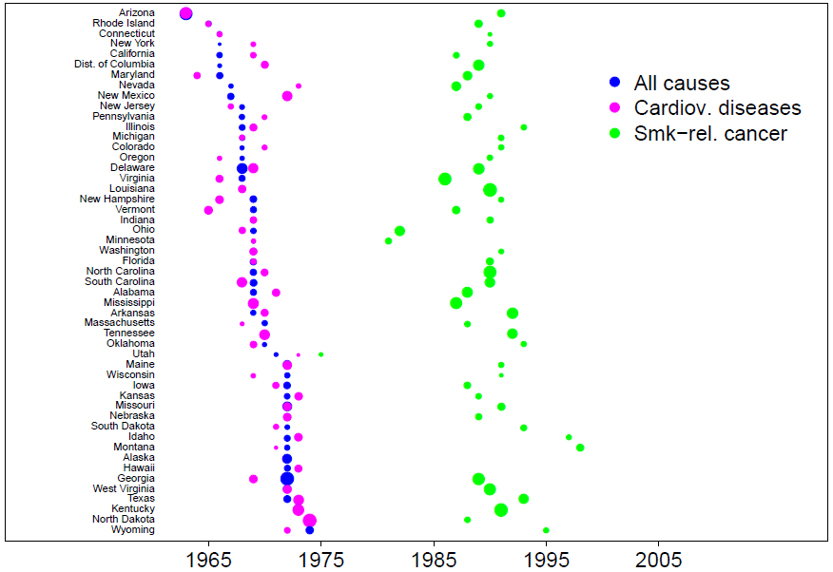
Onset of declining trends for all causes and by cause
Notes:
This is clearly not the case for the other large cause-of-death groupings
Here the green dots represent the timing and magnitude of the change in mortality from smoking-related cancer (most of which correspond to years around 1990, so about 2 decades later)

Slide 13
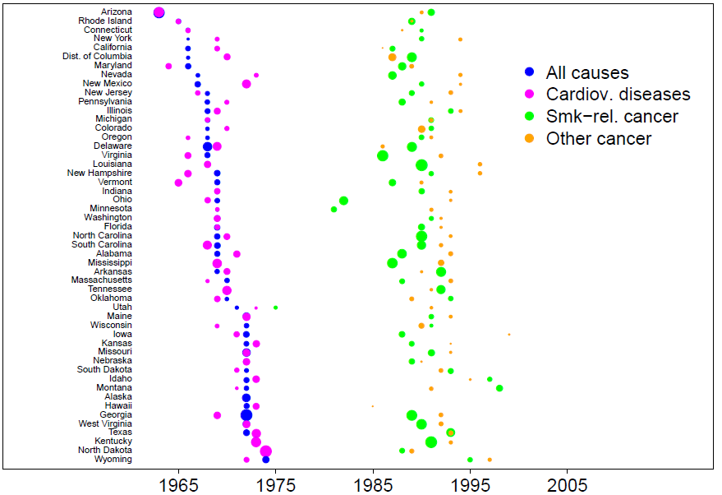
Onset of declining trends for all causes and by cause
Notes:
And again here for other cancers

Slide 14
Main initial findings
Remarkable coincidence in the timing of a major turning point in mortality trends in all states around 1970
Cardiovascular disease mortality was clearly the main driver everywhere for this first major turning point
The cancer transition occurred in all states in the 1980s and 1990s but not so much simultaneity in timing
Cardiovascular disease mortality is also driving the stagnation in progress observed everywhere since 2010
Notes:
The first dominant turning point occurred fairly suddenly after either a plateau has been reached in all-cause mortality or after mortality has been increasing (in all southern states in particular).
It occurred in every state around 1970, for males at least (some exceptions for females)
Starting around 1970, mortality started to decline precipitously.

Slide 15
Acknowledgments
Support provided by the U.S. National Institute on Aging (grants R01-AG011552 and R01-AG040245) and the AXA Research Fund (MODICOD).
Disclaimer: The authors are solely responsible for the content of this presentation, which does not necessarily represent the official views of the National Institutes of Health and other funders.

Slide 16
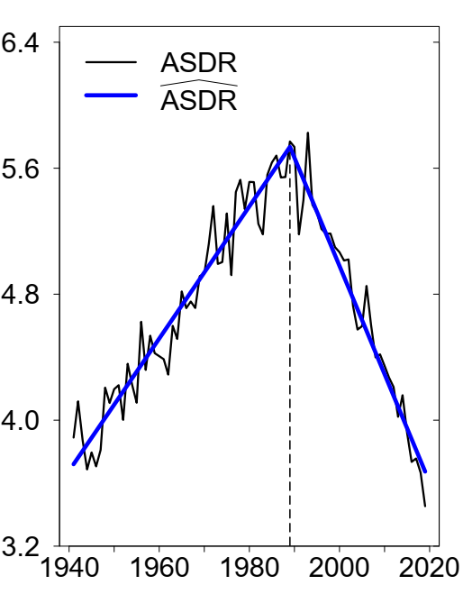
Methods : The two-slope model
  Ex.:Nebraska, Males,
  all cancer
  ASDR = β₀ + β₁ (year – 1941) + β₂ (year– 1989)I_{year>1989}
Age-adj. Death Rate (per 1,000)
change in
slope
year of dominant turning point
Notes:
Example of the two slope model: the figure shows that based on the ASDR 40-84 series for all cancers over the period 1941 to 2019, the dominant turning point occurred in 1989, yielding the following model (plus an error term not indicated here for simplification) where I(year>1989) is an indicator variable that equals one after 1989 and zero otherwise
Of the 3 parameters, beta 0 correspond to the estimated level of mortality at the origin (1941), beta 1 is the slope (best thought of as the rate of change in mortality) between the origin and the first break point, and beta 2, the change in slope before and after the break point (a higher beta 2 suggests a sharper mortality change, whereas a lower beta 2 indicates a milder discontinuity)

Slide 17
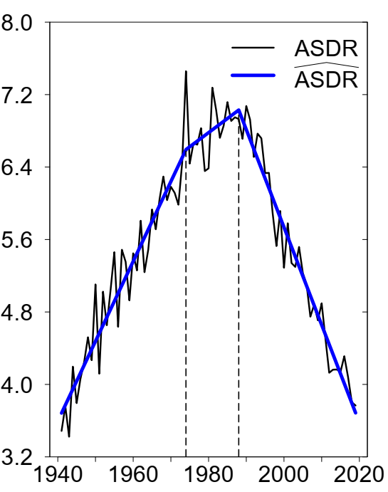
Methods : The three-slope model
  Ex.: Delaware, Males,
  all cancers
  ASDR = β₀ + β₁ (year – 1941) + β₂ (year – 1974)I_{year>1974} + β₃ (year – 1988) I_{year>1988}
Age-adj. Death Rate (per 1,000)
1st change in slope
year of 1st turning point
2nd change in slope
year of 2nd turning point
Notes:
But 2-slope models did not always describe the data well and in many instances, 3-slope models fared much better (in most cases in fact, except for heart diseases for men; smoking-related cancer mortality for women in many states; and all other cancers for both sexes)
In the 3-slope model, there is an additional parameter, beta 3, which corresponds to a second turning point in trends
We selected one model per state, choosing the model (2 slope or 3 slope) best describing the data as measured by the goodness-of-fit in R-squared, the BIC (Bayesian information criterion) and whether or not the coefficient characterizing the second break point (beta 3) was significant

Slide 18
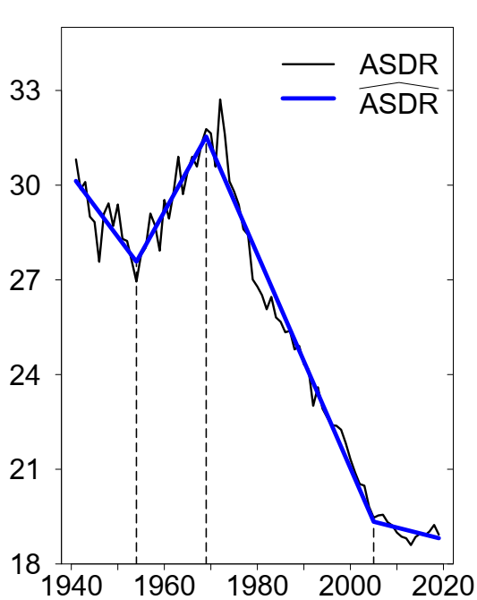
Methods : The four-slope model
  Ex.: West Virginia, Males,
  all causes combined
  ASDR = β₀ + β₁ (year – 1941) + β₂ (year – 1954)I_{yr>1954} + β₃ (year – 1969) I_{yr>1969} + β₄ (year – 2005) I_{yr>2005}
Age-adj. Death Rate (per 1,000)
1st change in slope
2nd change in slope
3rd change in slope

Slide 19
Life expectancy at birth, Males, 1941
Source: United States Mortality Database, usa.mortality.org
Notes:
And indeed, here is a map of e0 in the US at the beginning of our study period.
The range of life expectancy covered about 15 years

Slide 20
A shift in the geography of mortality
Age-standardized death rate at 40-84 years, Males
1941
1968
1995
2019

Slide 21
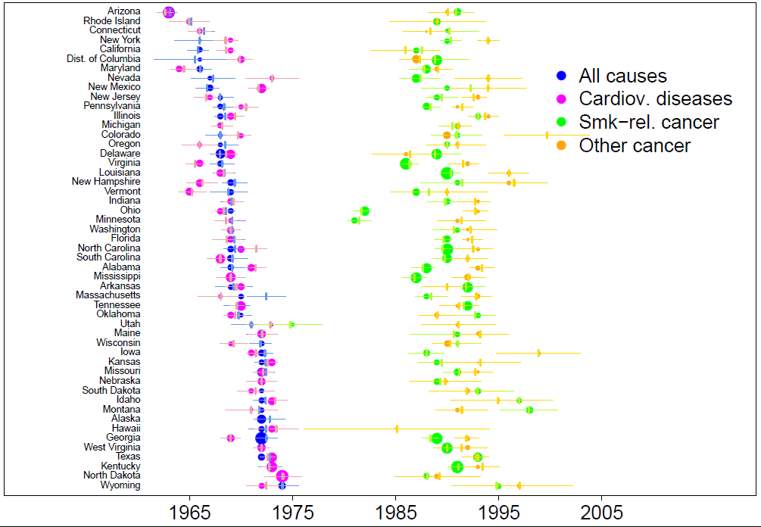
Onset of declining trends for all causes and by cause
Notes:
Same thing but with the result of another statistical approach (segmented regression model) which has the advantage of providing confidence intervals for the timing (and not only the magnitude) of the disruptions; disadvantage of complexity and arbitrarity.

Slide 22
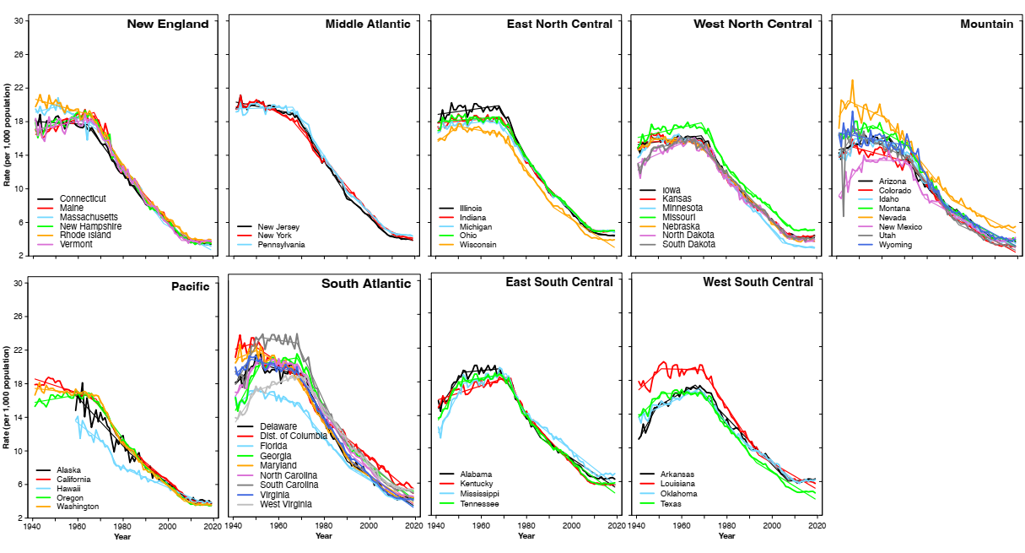
ASDR 40-84 years from cardio-vascular diseases, Males

Slide 23
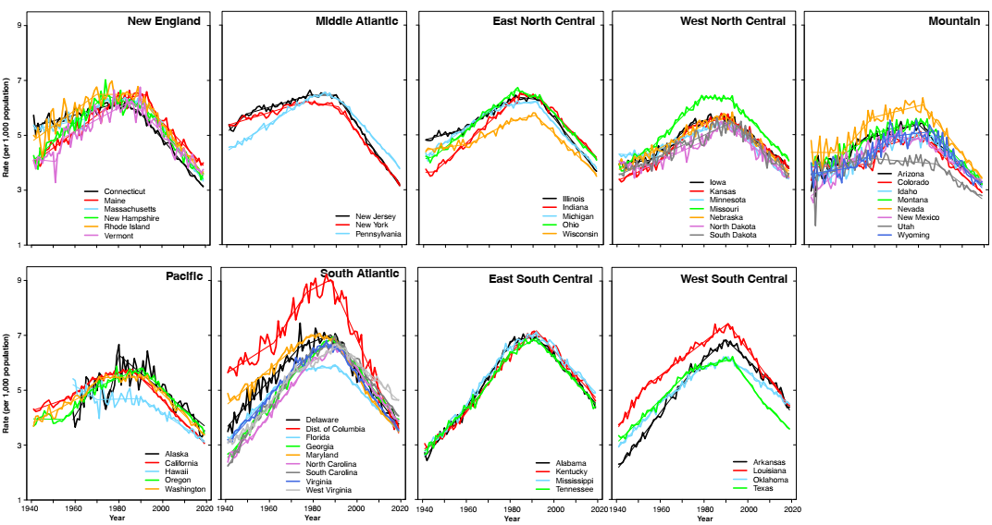
ASDR 40-84 years for cancer, Males

