Slide 1
Does Diversity in Causes of Death Explain Advances in Epidemiological Transition: A Decomposition Analysis using Global Burden of Disease Study 2021 in Seven Regions of World with Focus on South Asia (India), East Asia, USA, UK and High-Income Countries 1990–2021 Suryakant Yadav*¹, Solveig A. Cunningham² Dilip TR¹, Arokiasamy Perianayagam^{1,3,} Udaya Mishra¹, Chandan Kumar¹, Ajay Kumar¹, Neha Shri¹, Himanshu Jaiswal¹ ¹International Institute for Population Sciences (IIPS), Mumbai (India) , ²Emory University, Atlanta (USA), ³Qatar University

Slide 2
Developed nations show a large contribution of noncommunicable diseases (NCDs) for a low inequality in age at death and driven by the low diversity in causes of death.
The epidemiological transition apace in LMICs such as India and LICs such as Bhutan, Burundi and Sudan were attributed mainly to reducing the burden of communicable diseases (CDs) but with increasing diversity in causes of death.
Causes of Death (COD) Diversity has significance to unearth the progression in epidemiological transition
The study aims to examine the diversity in causes of death and inequality in age at death for assessing the epidemiological transition.

Slide 3
GBD 2021 provides mortality data by causes of death to analyse cause-age-specific contributions to mortality measures. 2 country in each 7 Continents and South Asia.
Life expectancy (e₀), Gini coefficient at birth (G₀), Shannon entropy (H), and Fractionalization index (F) were decomposed by causes of death and age groups using mortality rates retrieved from the GBD (2021) study.
We computed Fractionalization Index (F) and Shannon entropy as measure of diversity in causes of death
$$F\left(x\right)=1−\sum{P_{xi}^{2}}$$
$$H\left(x\right)=−\sum{P_{i}^{}log⁡(P_{i}^{})}$$
where, $P_{i}^{}$ is the share of $i$th causes of death

Slide 4
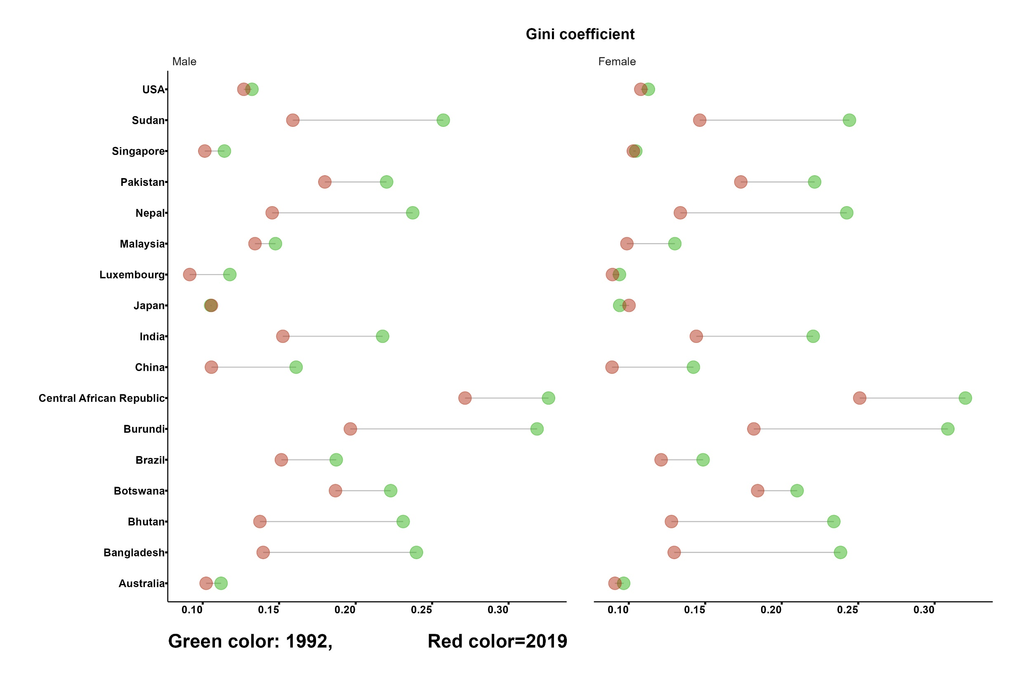

Slide 5
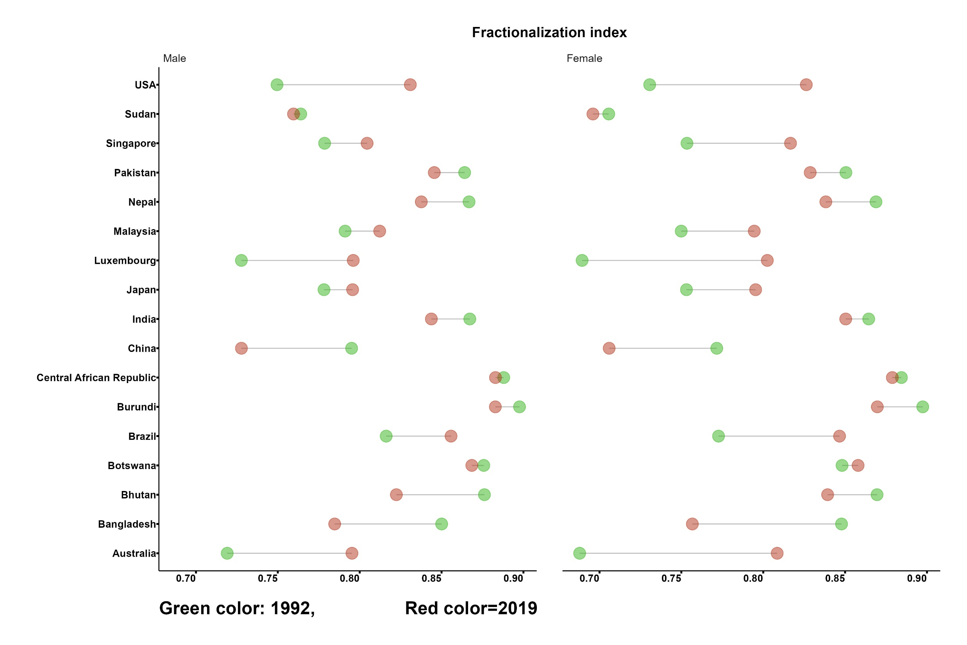

Slide 6
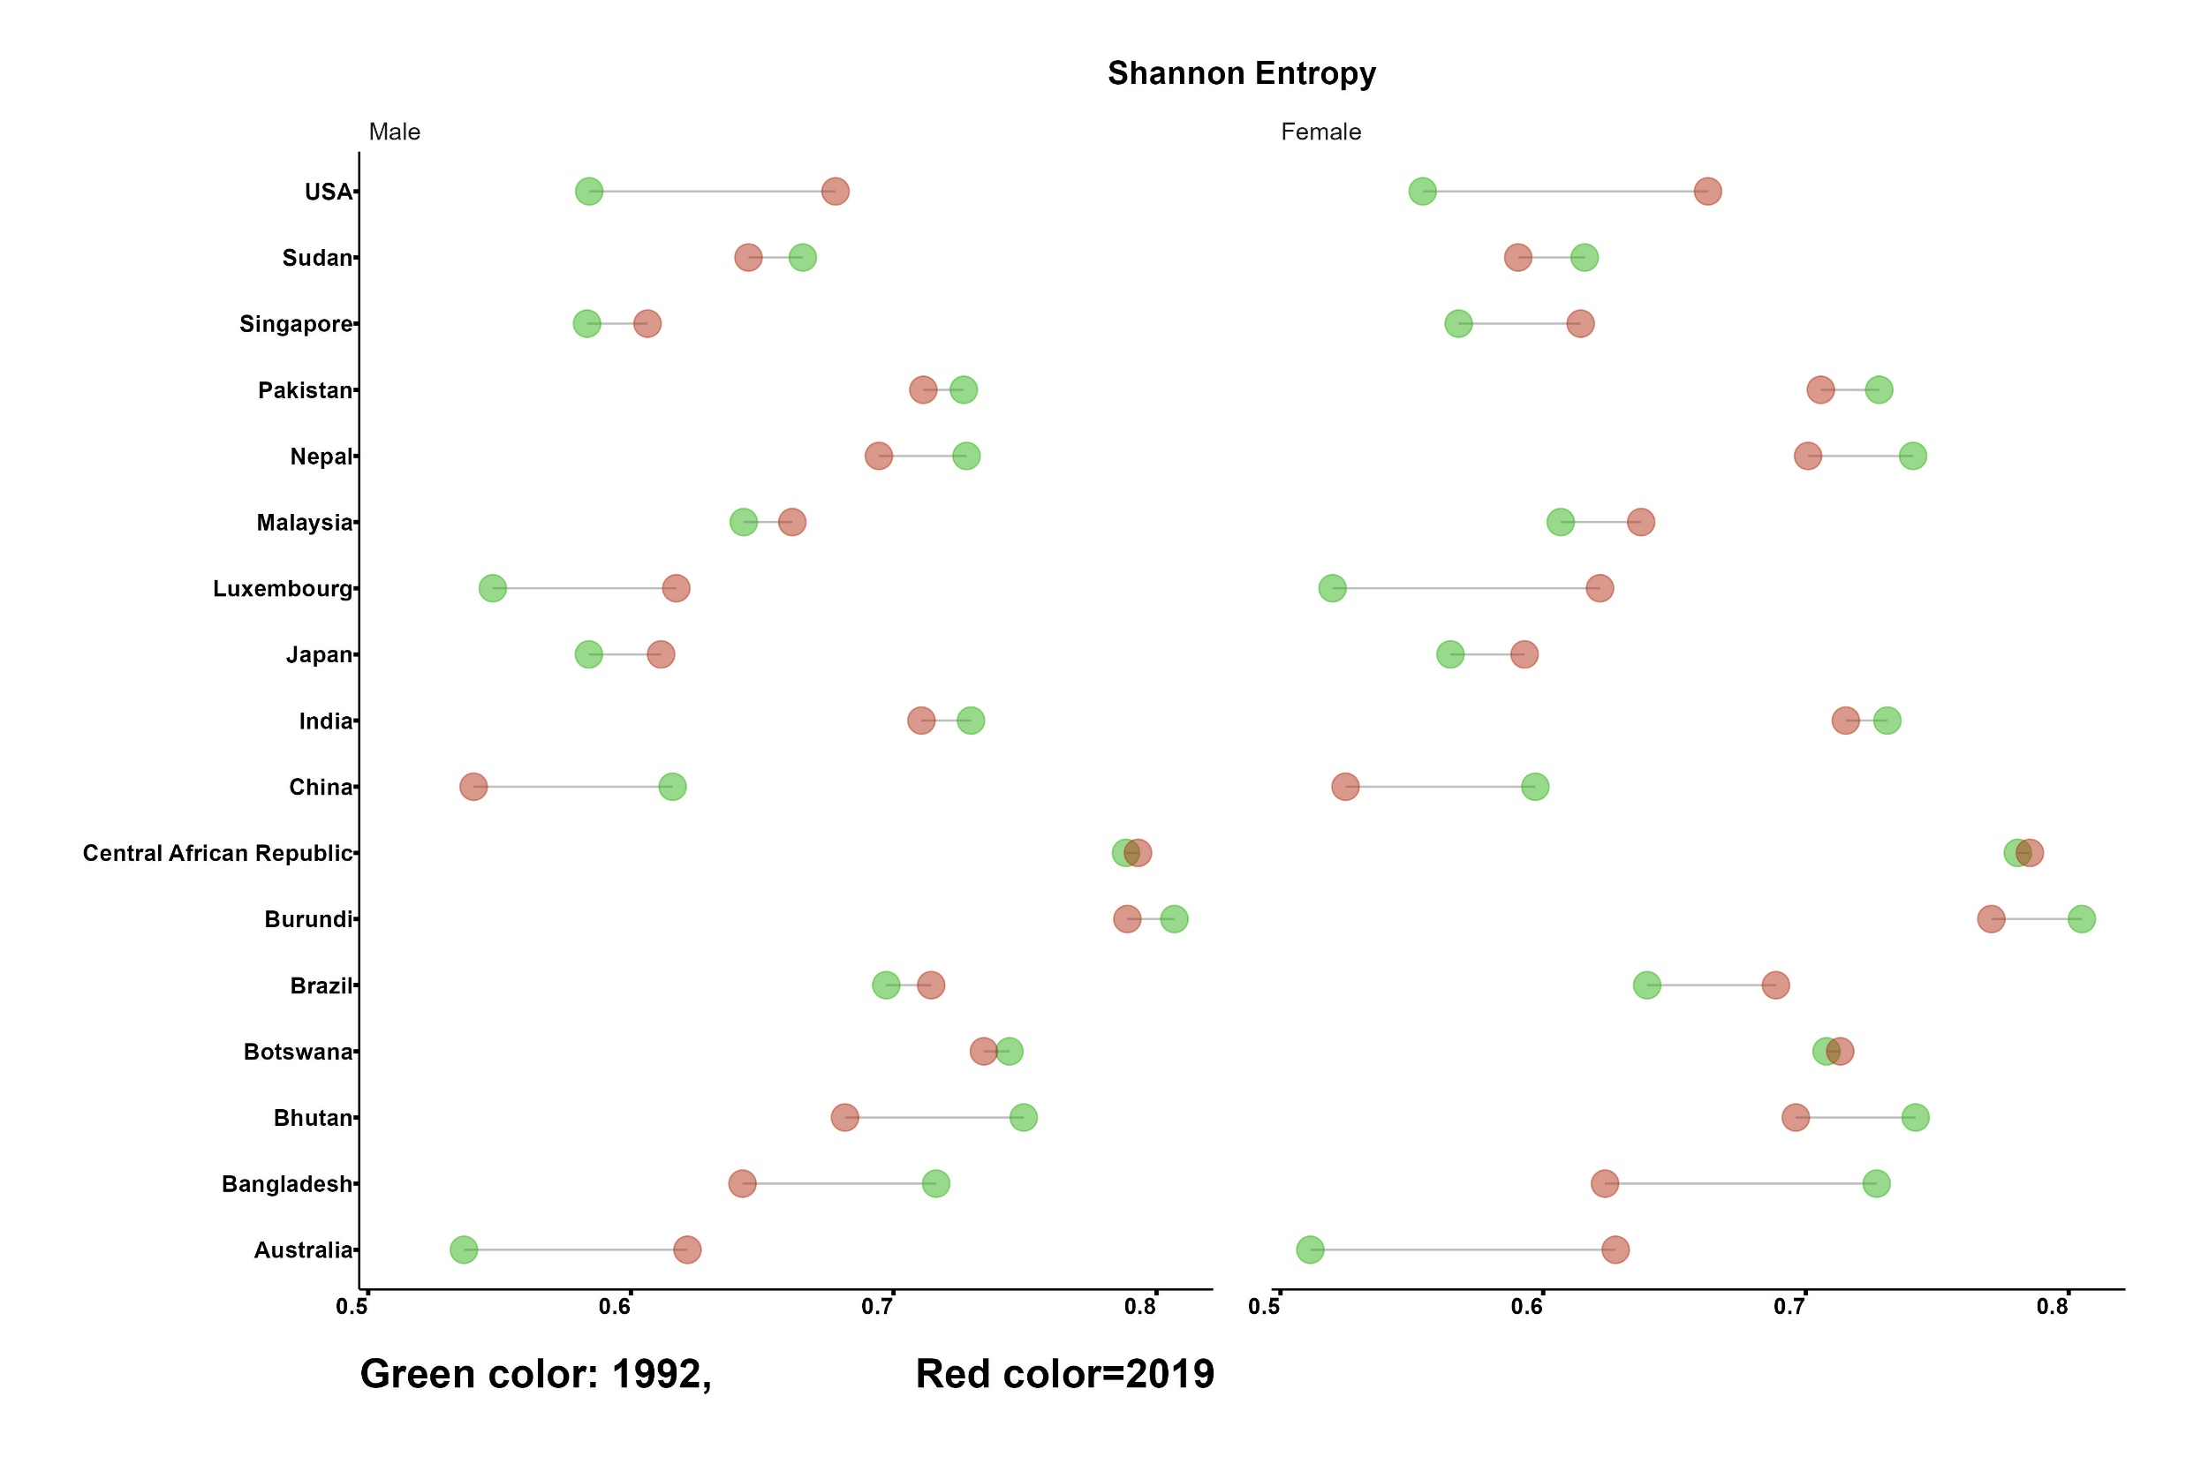

Slide 7
India (LMICs)
USA (HICs)

Slide 8
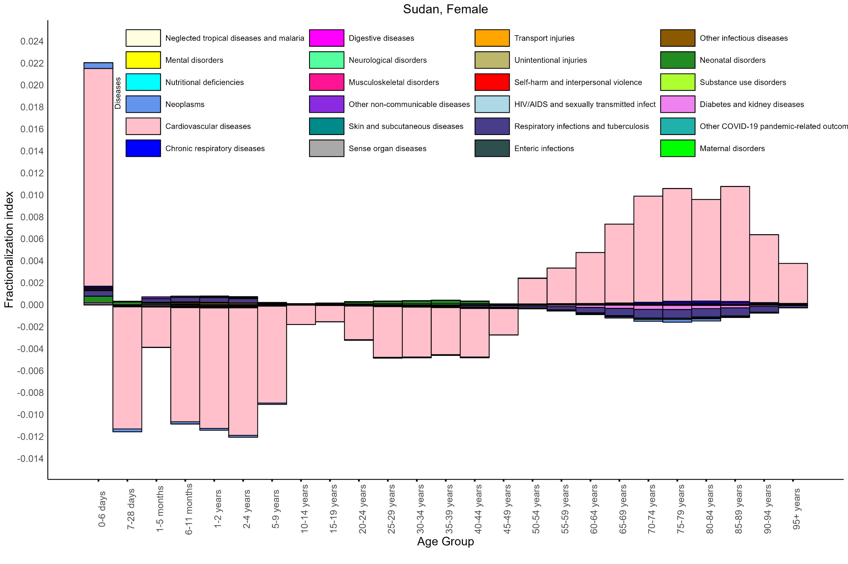

Slide 9
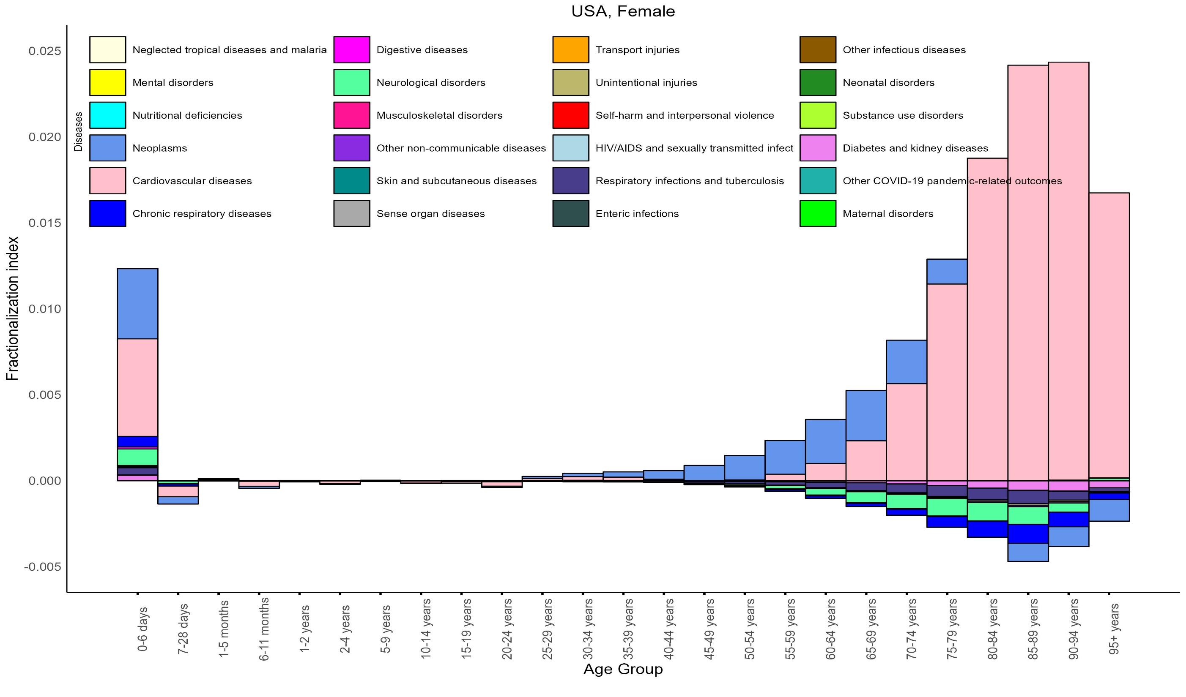

Slide 10
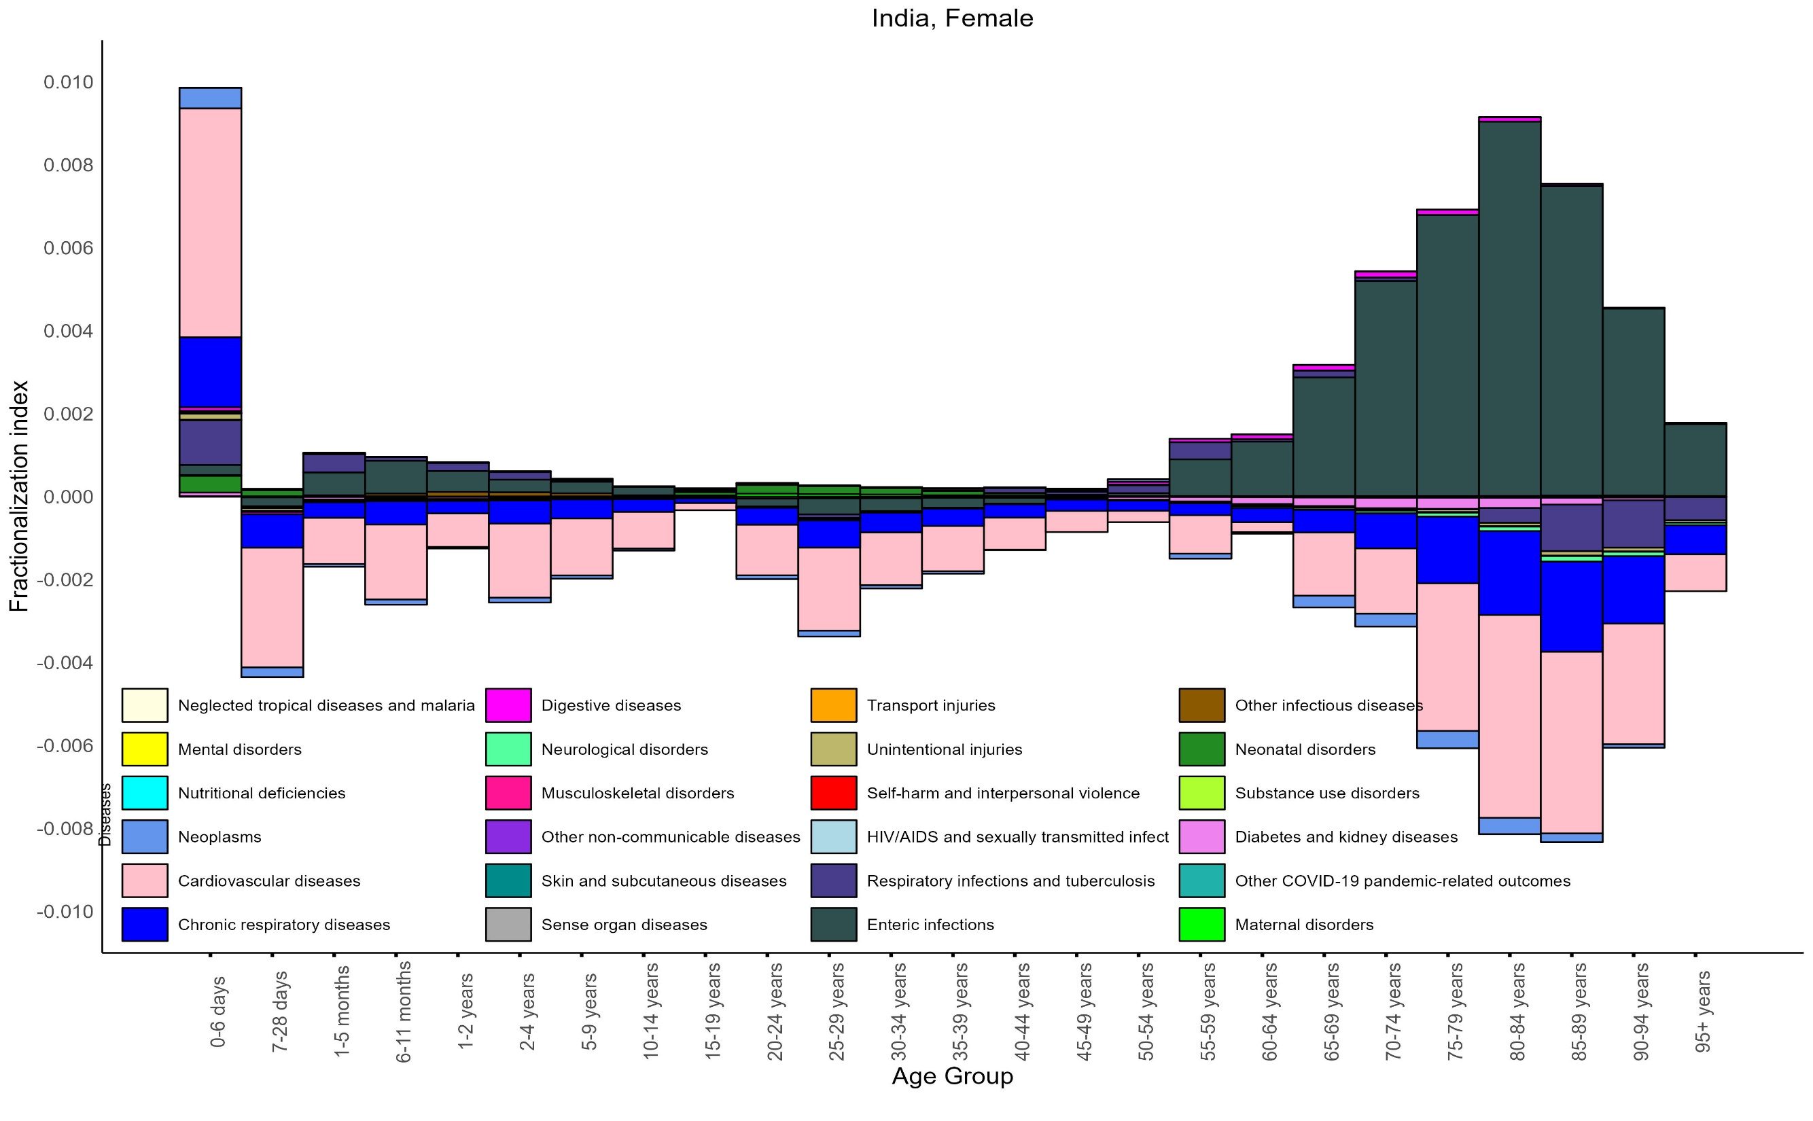

Slide 11
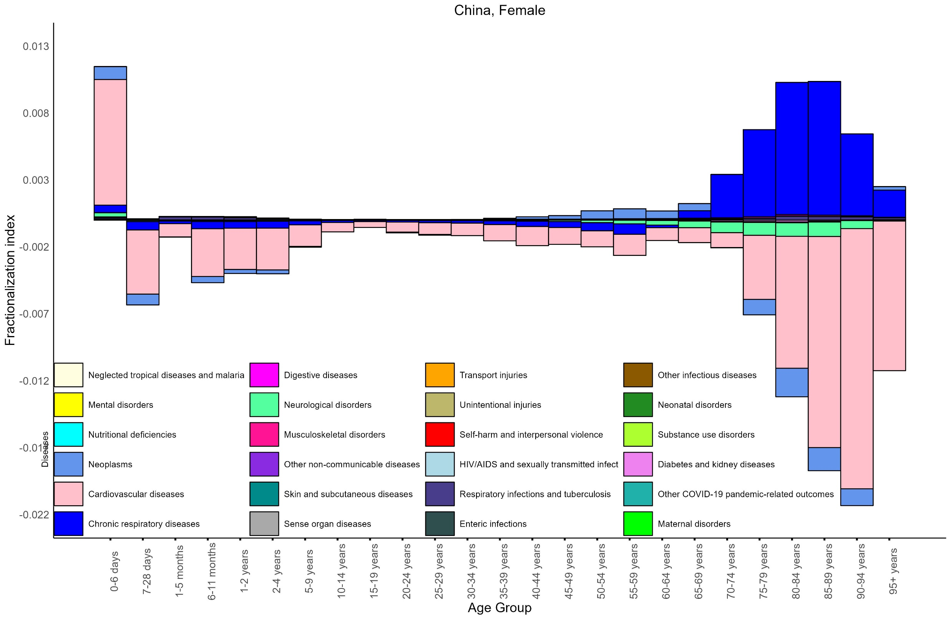

Slide 12
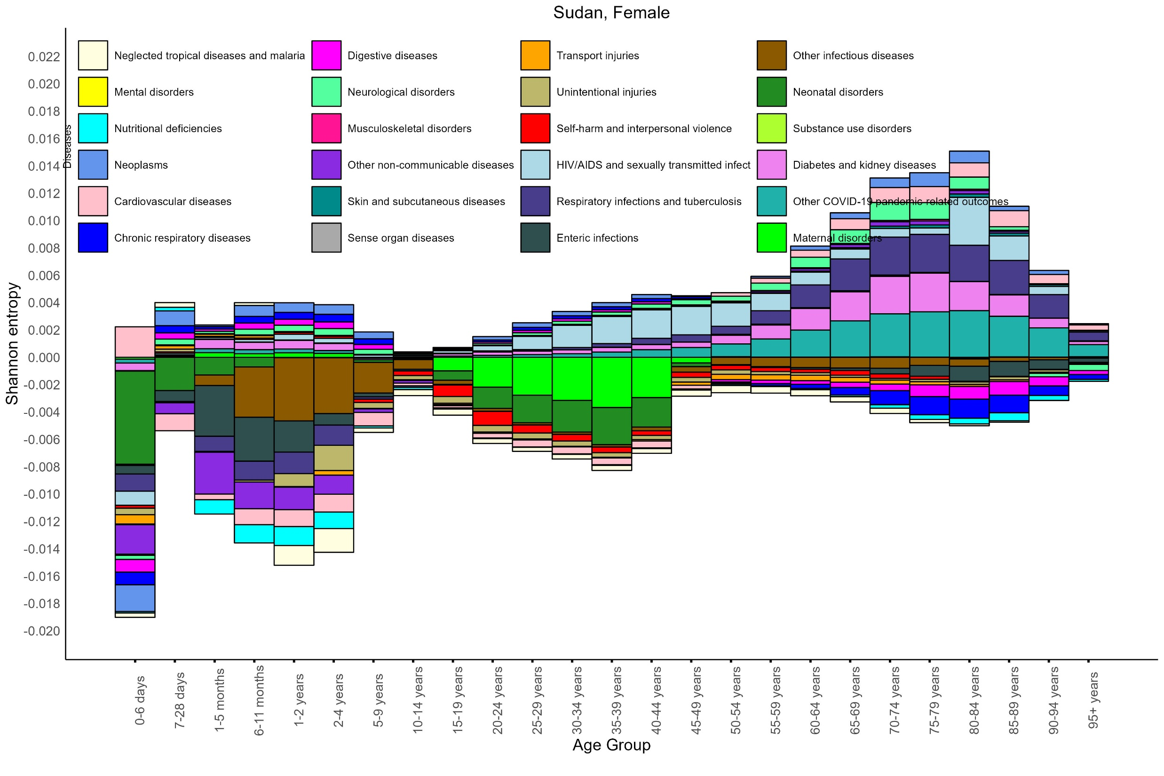

Slide 13
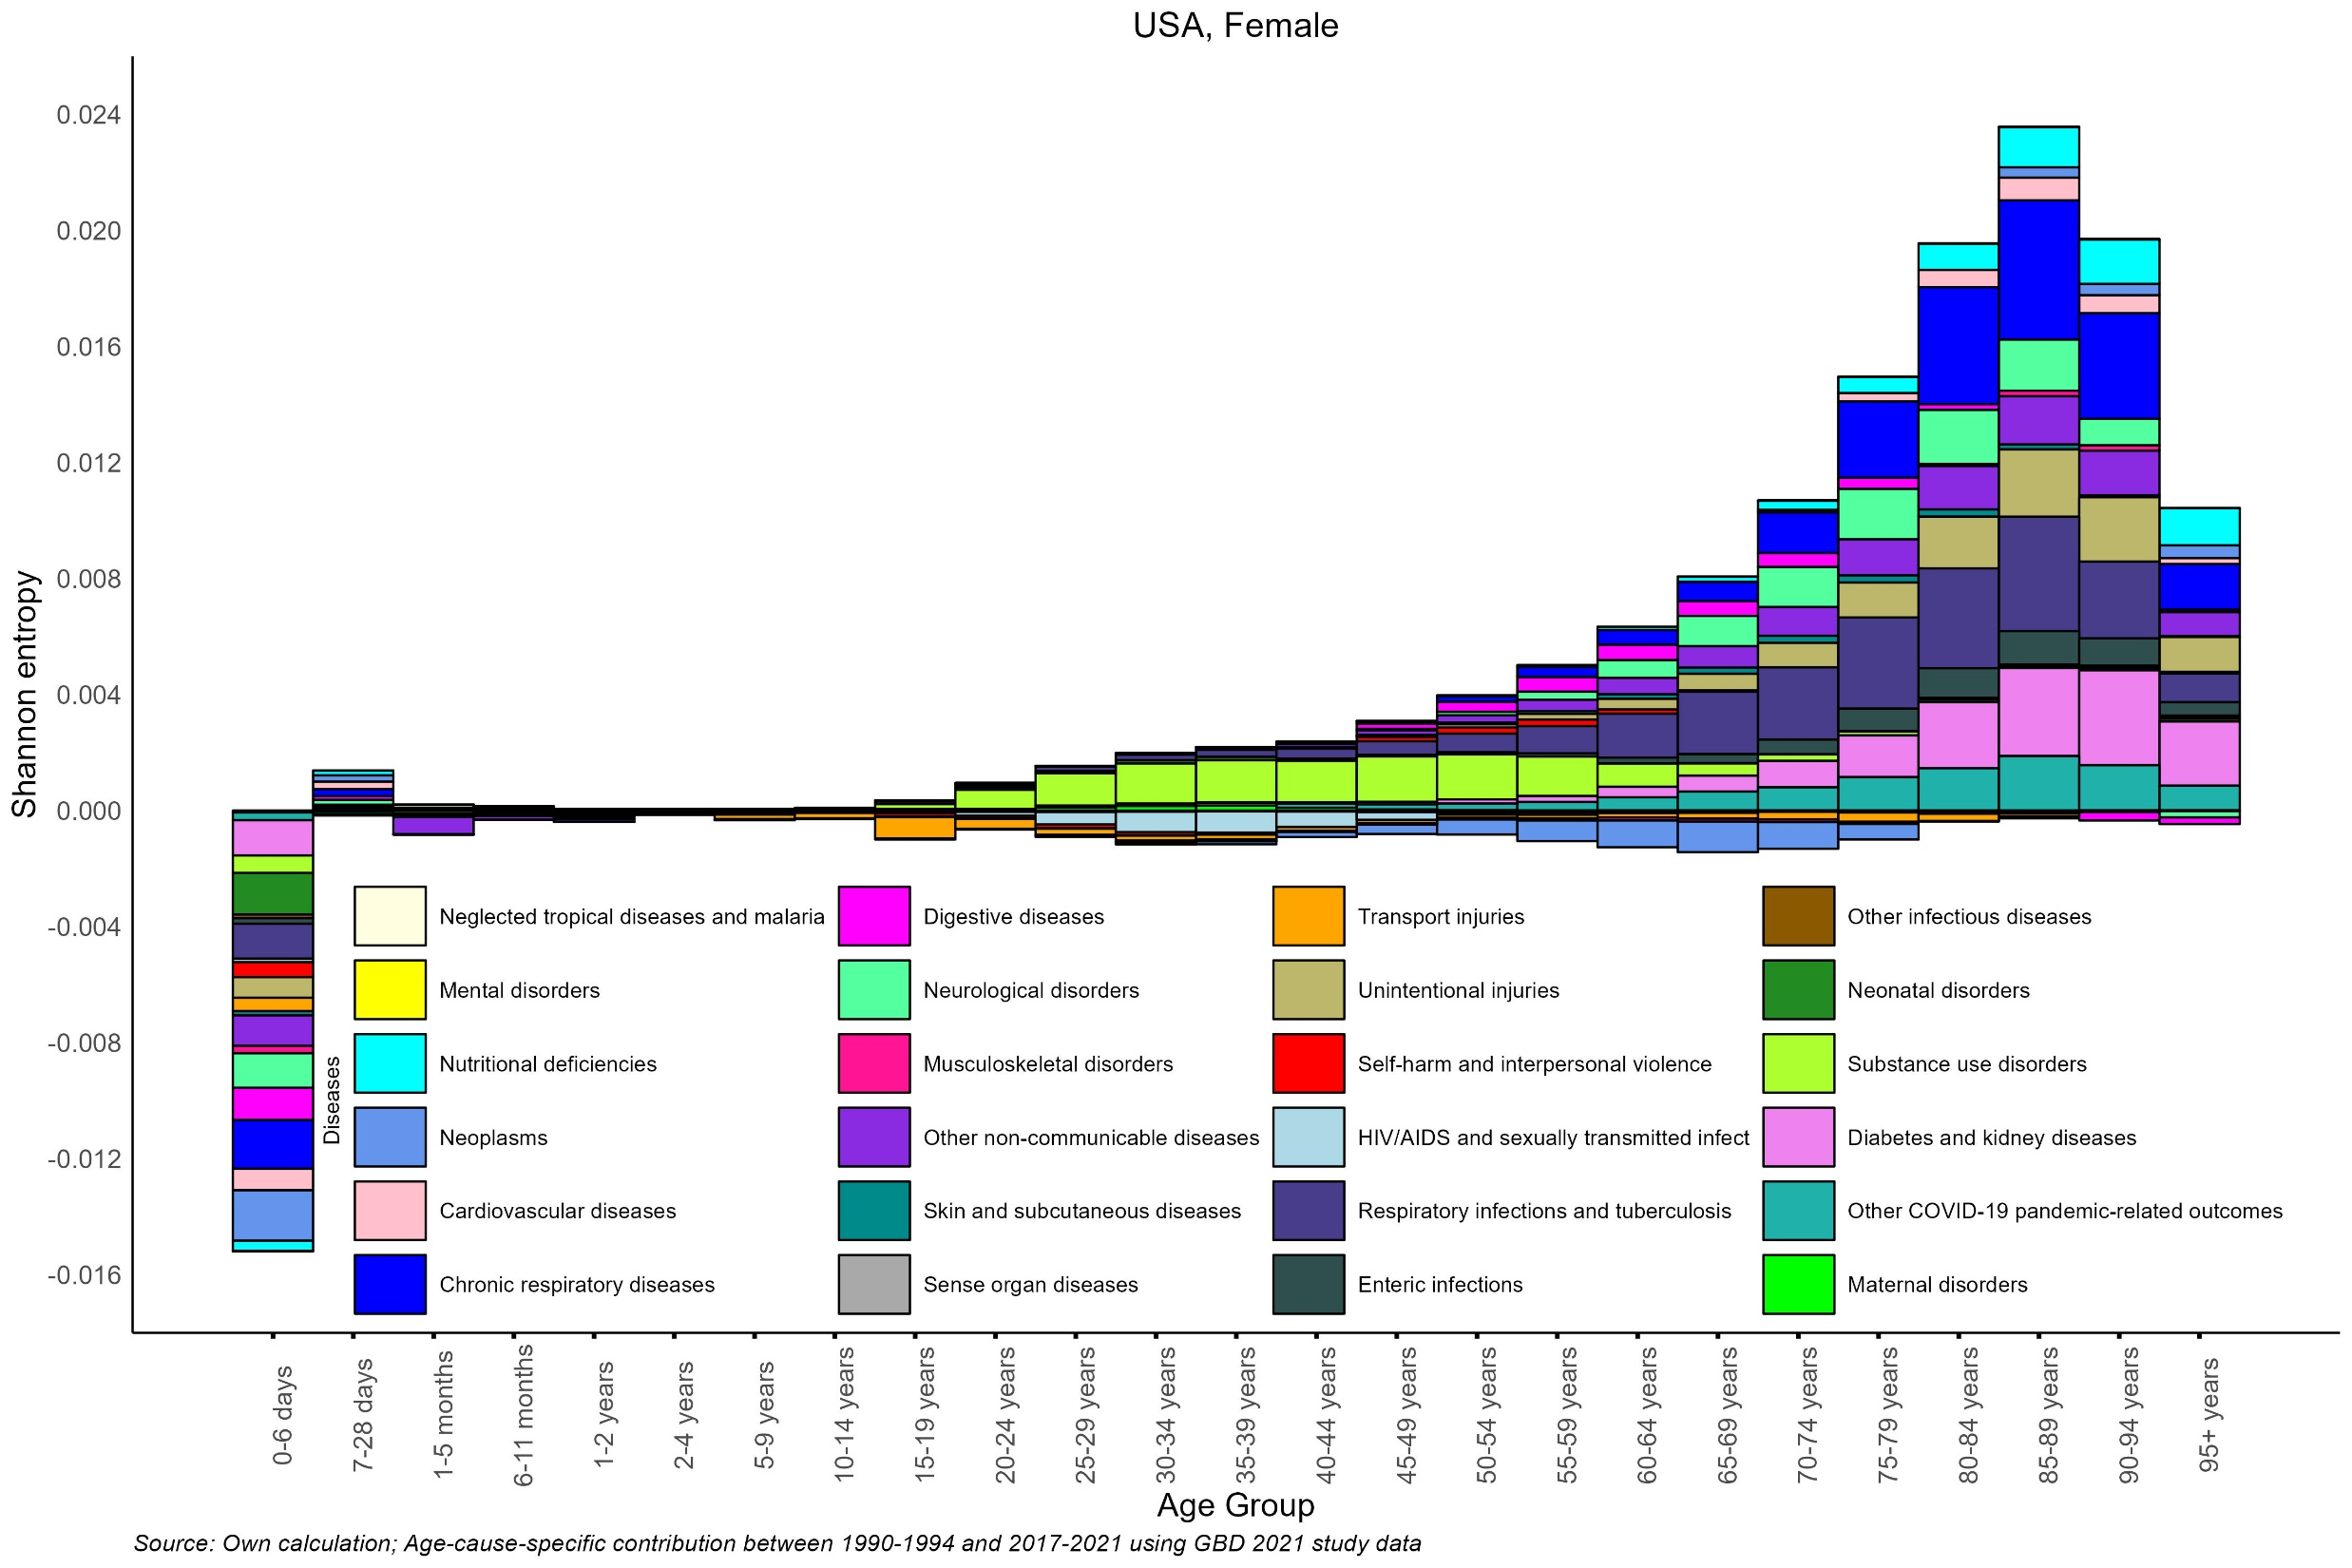

Slide 14
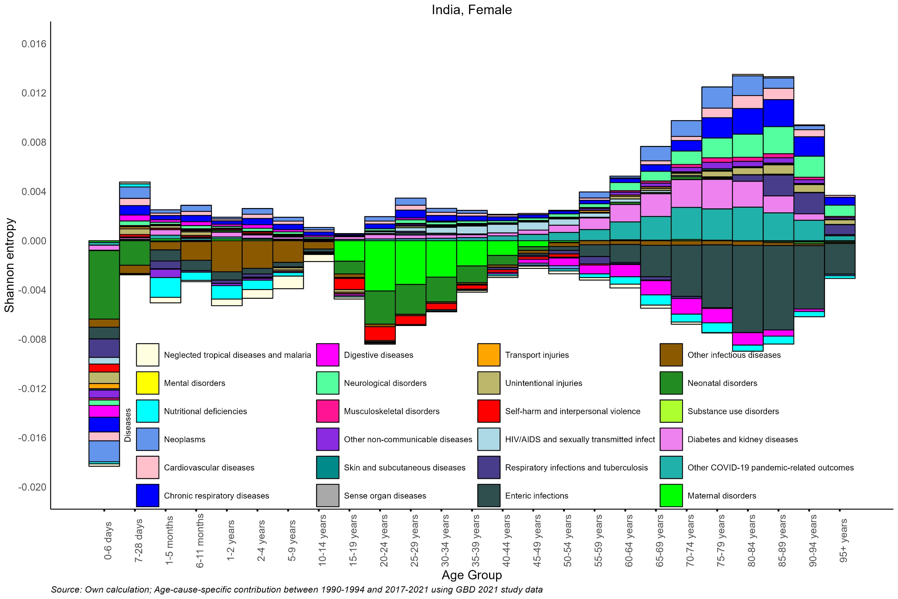

Slide 15
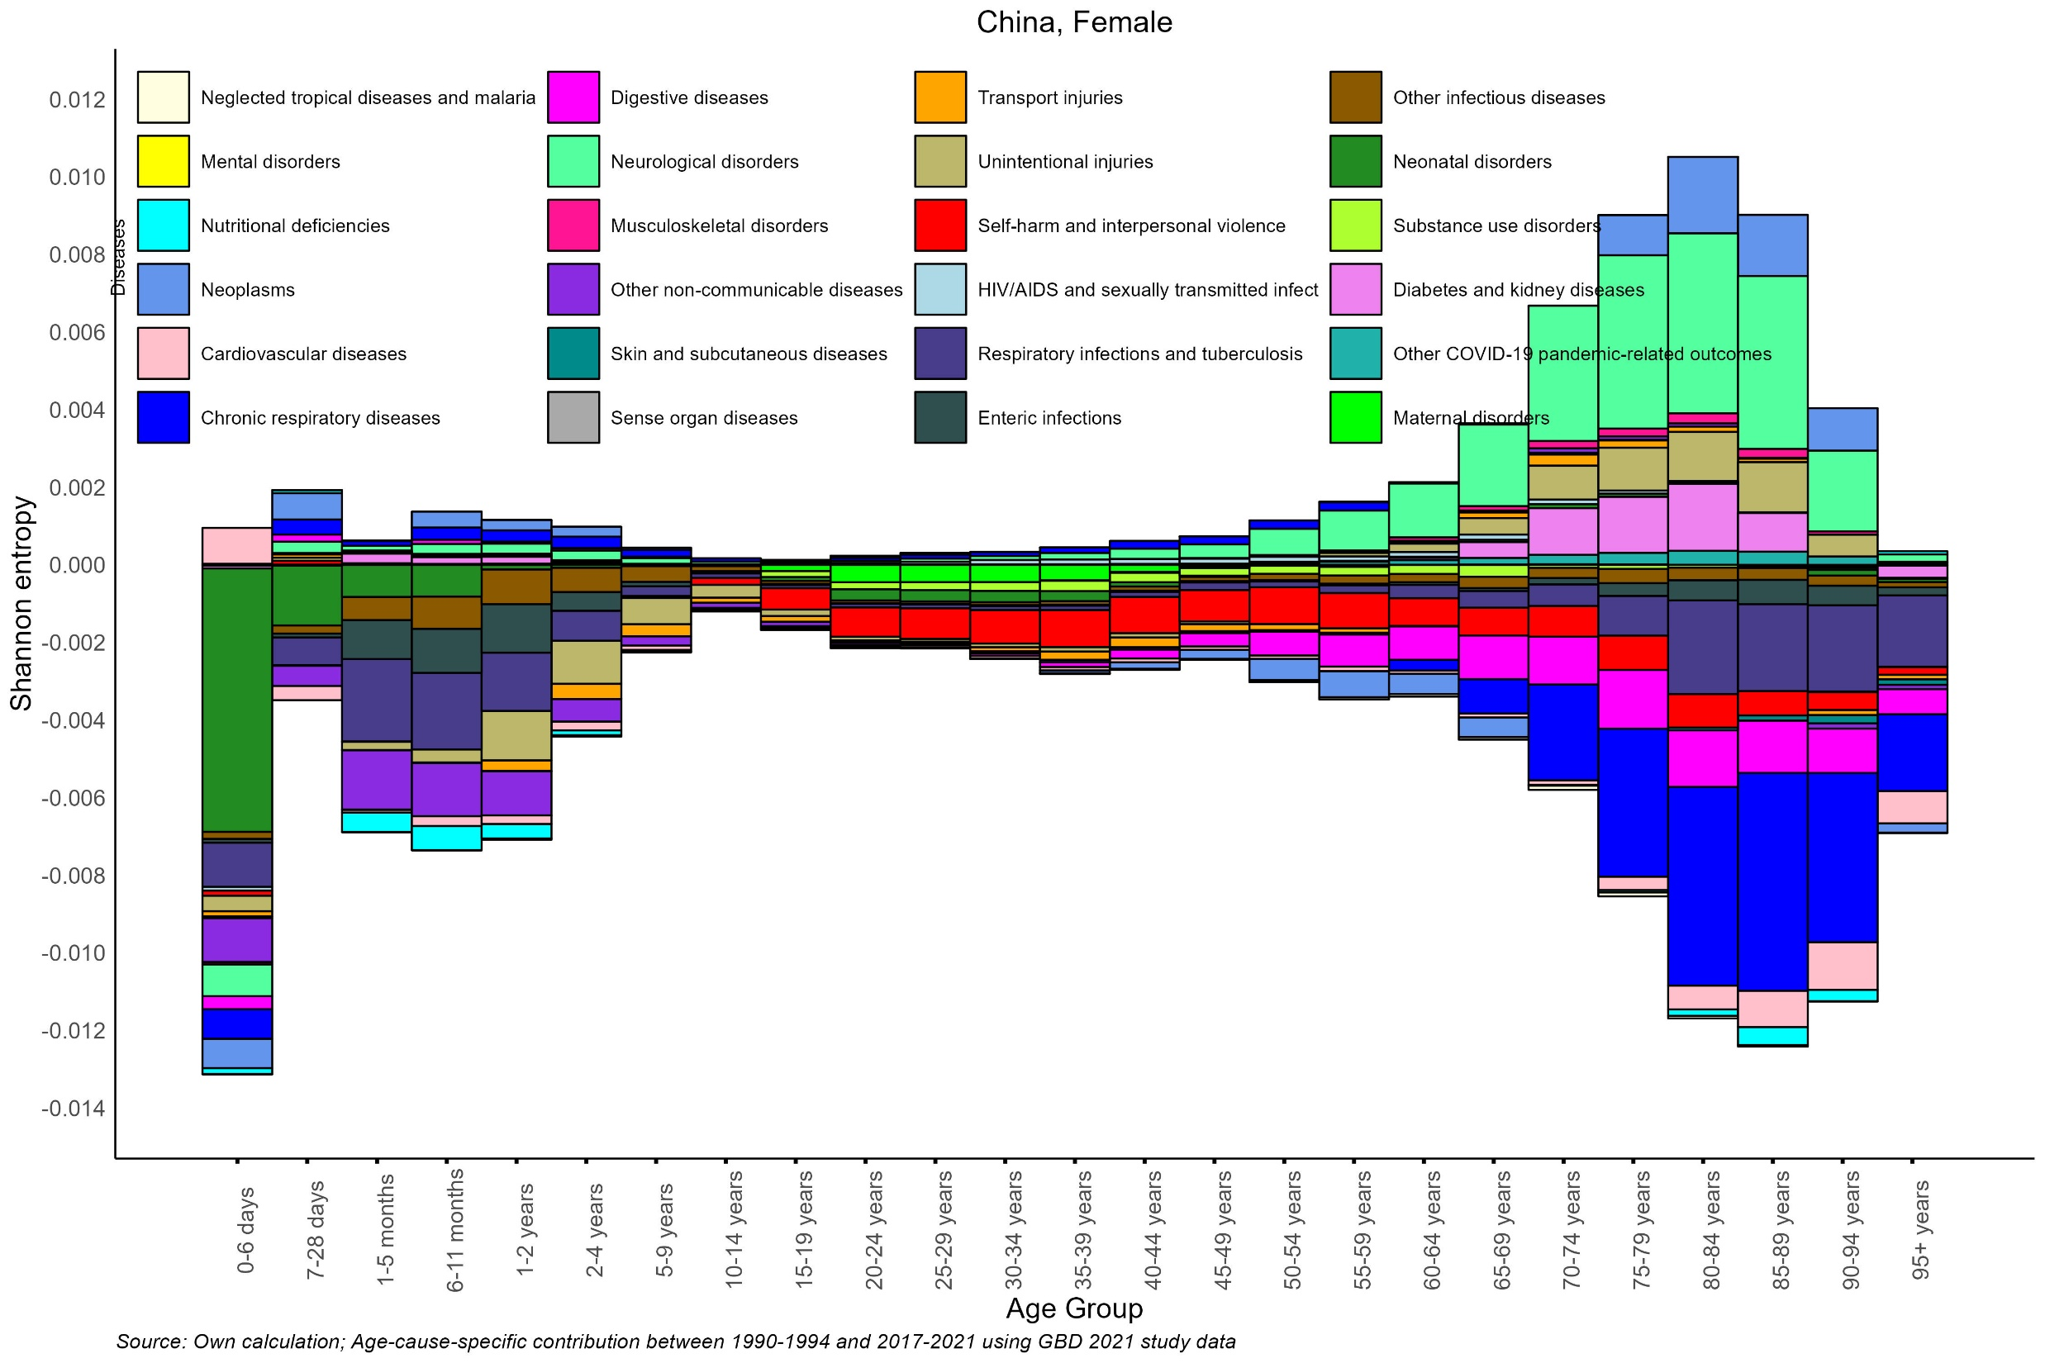

Slide 16
Conclusion
COD Diversity (F & S) indices declined for LMICs and LICs but on rise for HICs
Causes of death Structure differentiates the apace epidemiological transition by LMICs, LICs and HICs
Increase in COD diversity distinguish burden of diseases in LMICs and LICs vs HIC revealing a variance in Omran’s hypothesis across the selected regions

Slide 17
Thanks for your attention
IIPS, Mumbai (India)

Slide 18
