Slide 1
Characterization of the centenarian population of the Basque Country
26/09/2024
SARA CRUCES SALGUERO
Cellular Oncology Group
IIS Biogipuzkoa

Slide 2
Aging and centenarians
INTRODUCTION
AGING is a systemic, multifactorial, and degenerative process characterized by the decline and loss of physical and mental capacities
Different individuals display different aging trajectories
CENTENARIANS
Compression of morbidity
Expansion of morbidity
reduced healthspan
MODEL OF HEALTHY AGING
Notes:
· Definición de envejecimiento
· Marcadores biológicos
· Nos centramos en células madre

Slide 3
C
Objectives and methods
METHODS
Basque Country population is aged
Centenarian profile?
INFORMATION ABOUT CLINICAL HISTORY
DEMOGRAPHIC
DIAGNOSES
USE OF RESOURCES
PHARMACEUTIC PRESCRIPTION
LABORATORY
DATABASE FROM BASQUE HEALTH SERVICE
47,656 deceased individuals
CENTENARIANS
vs
NON- CENTENARIANS
2014/01/01
2020/12/31
Do centenarians have any characteristic that distinguishes them from the rest of the population?

Slide 4
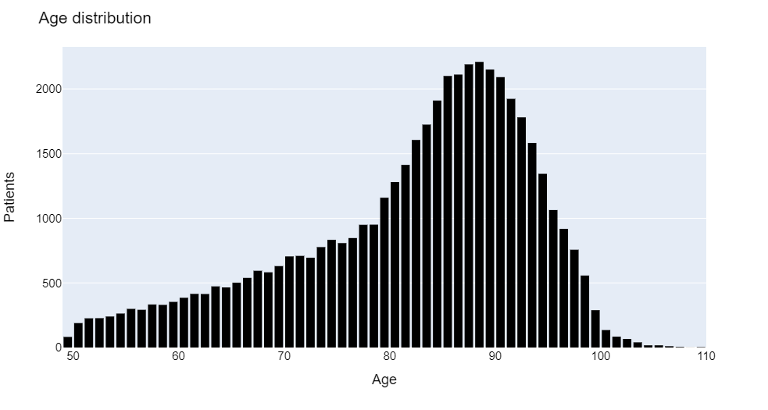
Demographic description
RESULTS
 | NC (n = 47,277) | C (n = 379) |  | p-value
Demographic data
Sex | 23,959 women (50.68%) 23,318 men (49.32%) | 325 women (85.75%) 54 men (14.25%) | 325 women (85.75%) 54 men (14.25%) | <0.001
Residence | 41,138 no (87.01%) 6,139 yes (12.99%) | 282 no (74.41%) 97 yes (25.59%) | 282 no (74.41%) 97 yes (25.59%) | <0.001
Caretaker | 22,438 yes (47.46%) 2,930 no (6.2%) | 197 yes (51.98%) 15 no (3.96%) | 197 yes (51.98%) 15 no (3.96%) | 0.0542
Age | n (%)
<50 | 82 (0.17%)
>50 & <60 | 2,752 (5.77%)
>60 & <70 | 4,999 (10.49%)
>70 & <80 | 8,794 (18.45%)
>80 & <90 | 18,701 (39.24%)
>90 years & <100 | 12,309 (25.83%)
> 100 years | 379 (0.8%)

Slide 5
Analysis of diagnoses
RESULTS
Centenarians had fewer diagnoses
DIAGNOSES | NC | C | p-value
Infection and Parasitic Diseases | 0.027 ± 0.28 | 0.005 ± 0.07 | 0.138
Neoplasms | 1.35 ± 4 | 0.08 ± 0.42 | <0.001
Endocrine, Nutritional and Metabolic Diseases, and Immunity Disorders | 0.85 ± 3.78 | 0.25 ± 1.28 | 0.002
Diseases of Blood and Blood Forming Organs | 0.2 ± 1.15 | 0.069 ± 0.44 | 0.025
Mental Disorders | 0.29 ± 1.52 | 0.1 ± 0.45 | 0.0165
Diseases of the Nervous System and Sense Organs | 0.56 ± 1.96 | 0.23 ± 0.95 | <0.001
Diseases of the Circulatory System | 2.06 ± 7.54 | 0.69 ± 2.58 | <0.001
Diseases of the Respiratory System | 0.67 ± 3.2 | 0.35 ± 1.93 | 0.05
Diseases of the Digestive System | 0.49 ± 2.36 | 0.14 ± 0.76 | <0.001
Diseases of the Genitourinary System | 0.52 ± 2.36 | 0.21 ± 1.03 | 0.01
Complications of Pregnancy, Childbirth, and the Puerperium | 0.002 ± 0.08 | 0 ± 0 | 0.5798
Diseases of the Skin and Subcutaneous Tissue | 0.12 ± 0.8 | 0.02 ± 0.18 | 0.0261
Diseases of the Musculoskeletal System and Connective Tissue | 0.31 ± 1.63 | 0.11 ± 0.64 | 0.0148
Congenital Anomalies | 0.01 ± 0.21 | 0 ± 0 | 0.319
Certain Conditions Originating in the Perinatal Period | 0.0001 ± 0.1 | 0 ± 0 | 0.84
Symptoms, Signs, and Ill-defined Conditions | 0.43 ± 1.58 | 0.19 ± 0.97 | 0.0024
Injury and Poisoning | 0.35 ± 1.28 | 0.25 ± 0.92 | 0.11
Supplementary Factors Influencing Health Status and Contact with Health Services | 2.41 ± 8.16 | 0.86 ± 2.95 | <0.001
FEWER AGING-RELATED DISEASES

Slide 6
Analysis of clinical resources
RESULTS
USE OF RESOURCES | NC | C | p-value
Infirmary | 76.5 ± 83.8 | 83.24 ± 97.89 | 0.12
Family Doctor | 105.77 ± 74.67 | 91.72 ± 76.51 | <0.001
Consultations | 31.52 ± 34.35 | 7.2 ± 11.02 | <0.001
Hospitalizations | 33.36 ± 43.65 | 12.38 ± 17.17 | <0.001
Hospitalizations at home | 1.84 ± 7.25 | 0.81 ± 3.04 | 0.0058
ICU | 0.09 ± 0.34 | 0 ± 0 | <0.001
Days at ICU | 0.58 ± 3.57 | 0 ± 0 | 0.0015
Emergencies | 4.39 ± 5.34 | 2.39 ± 3.51 | <0.001
Centenarians used fewer resources
Procedures
Operations on the Eye | 0.95 ± 2.33 | 0.29 ± 1.2 | <0.001
Other Miscellaneous Diagnostic and Therapeutic Procedures | 0.08 ± 0.41 | 0 ± 0 | <0.001
Operations on the Ear | 0.01 ± 0.17 | 0 ± 0 | 0.2518
Operations on the Nose, Mouth, and Pharynx | 0.01 ± 0.55 | 0.01 ± 0.1 | 0.0208
Operations on the Respiratory System | 0.26 ± 1.1 | 0.01 ± 0.1 | <0.001
Operations on the Cardiovascular System | 0.63 ± 2.11 | 0.08 ± 0.66 | <0.001
Operations on the Hemic and Lymphatic System | 0.19 ± 0.79 | 0.01 ± 0.1 | <0.001
Operations on the Digestive System | 1.06 ± 2.79 | 0.15 ± 0.81 | <0.001
Operations on the Urinary System | 0.3 ± 1.53 | 0.04 ± 0.26 | <0.001
Operations on the Male Genital Organs | 0.06 ± 0.38 | 0 ± 0 | 0.004
Operations on the Female Genital Organs | 0.12 ± 0.7 | 0.01 ± 0.1 | 0.0012
Operations on the Musculoskeletal System | 0.51 ± 1.55 | 0.41 ± 0.95 | 0.229
Operations on the Integumentary System | 0.17 ± 0.89 | 0.07 ± 0.49 | 0.036
Obstetrical Procedures | 0.01 ± 0.12 | 0.01 ± 0.01 | 0.9155
Miscellaneous Diagnostic and Therapeutic Procedures | 7.09 ± 11.33 | 2.68 ± 5.15 | <0.001
Centenarians had fewer operations

Slide 7
Analysis of drugs
RESULTS
PRESCRIBED DRUGS | NC | C | p-value
Alimentary Tract and Metabolism Drugs | 4.9 ± 5.01 | 3.13 ± 3.39 | <0.001
Blood and Blood Forming Organs Drugs | 2.67 ± 3.27 | 1.82 ± 2.39 | <0.001
Cardiovascular System Drugs | 5.16 ± 5.56 | 3.55 ± 4.02 | <0.001
Dermatologicals | 1.62 ± 3.12 | 1.33 ± 2.54 | 0.065
Genitourinary System and Sex Hormones Drugs | 0.51 ± 1.23 | 0.19 ± 0.73 | <0.001
Systemic Hormonal Preparations, Excluding Sex Hormones and Insulins | 1.55 ± 2.75 | 0.82 ± 1.73 | <0.001
Antiinfectives for Systemic Use | 4.55 ± 5.98 | 4.25 ± 6.12 | 0.322
Antineoplastic and Immunomodulating Drugs | 0.25 ± 1.04 | 0.08 ± 0.43 | 0.0017
Musculoskeletal System Drugs | 1.8 ± 2.56 | 0.88 ± 1.6 | <0.001
Nervous System Drugs | 10.25 ± 10.25 | 7.63 ± 7.75 | <0.001
Antiparasitic Products, Insecticides, and Repellents | 0.04 ± 0.26 | 0.02 ± 0.13 | 0.093
Respiratory System Drugs | 2.77 ± 4.52 | 2.18 ± 4.42 | 0.0117
Sensory Organs Drugs | 1.2 ± 2.5 | 1.08 ± 2.08 | 0.3478
Various Drugs | 0.36 ± 0.95 | 0.41 ± 1.02 | 0.2743
Total Number of Drugs | 37.62 ± 29.76 | 27.36 ± 25 | <0.001
Centenarians took fewer drugs
FEWER AGING-RELATED DISEASES

Slide 8
Analysis of laboratory
RESULTS
LABORATORY ANALYSIS | NC | C | p-value
HDL | 51.12 ± 17.61 | 52.39 ± 17.7 | 0.208
LDL | 120.33 ± 35.96 | 111.46 ± 30.83 | 0.654
Total cholesterol | 178.07 ± 47.72 | 177.32 ± 41.34 | 0.785
Glucose | 110.98 ± 41.61 | 98.98 ± 28.95 | <0.001
Creatinine | 1.15 ± 1.37 | 1.11 ± 0.59 | 0.578
Hemoglobin | 12.73 ± 2.06 | 12.25 ± 1.71 | <0.001
Glycosylated hemoglobin | 6.26 ± 1.14 | 6.01 ± 0.94 | 0.0099
INR | 61.26 ± 44.72 | 53.44 ± 48.03 | 0.093
Platelets | 230.59 ± 92.83 | 222.48 ± 71.11 | 0.122
Potassium | 4.59 ± 6.97 | 4.56 ± 0.55 | 0.691
Sodium | 141.03 ± 4.73 | 141.53 ± 4.58 | 0.041
Triglycerides | 114.86 ± 64.88 | 103.71 ± 44.06 | 0.0026
Urea | 56.67 ± 37.74 | 60.3 ± 33.11 | 0.12
Centenarians presented smaller levels of
GLUCOSE
HEMOGLOBIN
GLYCOSYLATED HEMOGLOBIN
TRIGLYCERIDES
BETTER
HEALTH STATUS

Slide 9
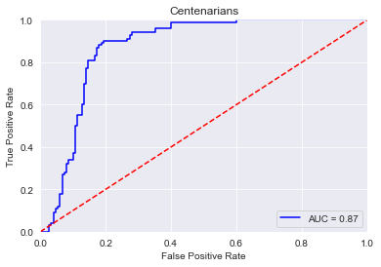
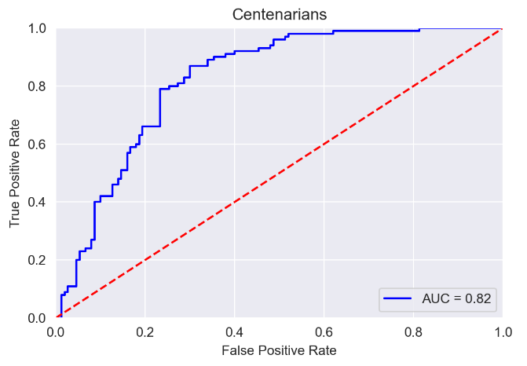
Classification models
RESULTS
INCREASE THE ODDS OF BEING CENTENARIAN
LOGISTIC REGRESSION
MODELS
BEING WOMAN
BEING IN NURSING HOME
SUPPORT VECTOR MACHINE
DECREASE THE ODDS OF BEING CENTENARIAN
CONSULTATIONS
HEMOGLOBIN INCREASE
NEOPLASMS
Notes:
· 2 caminos de células madre, determinado por tf
· Nos centramos en Sox2

Slide 10
SUMMARY
DEMOGRAPHIC
Most centenarians were women and lived in nursing homes
Centenarians developed fewer diseases, took fewer drugs, and required fewer medical attendances
CLINICAL
Centenarians showed better biological profiles, with lower levels of glucose, hemoglobin, glycosylated hemoglobin, and triglycerides
BIOLOGICAL

Slide 11
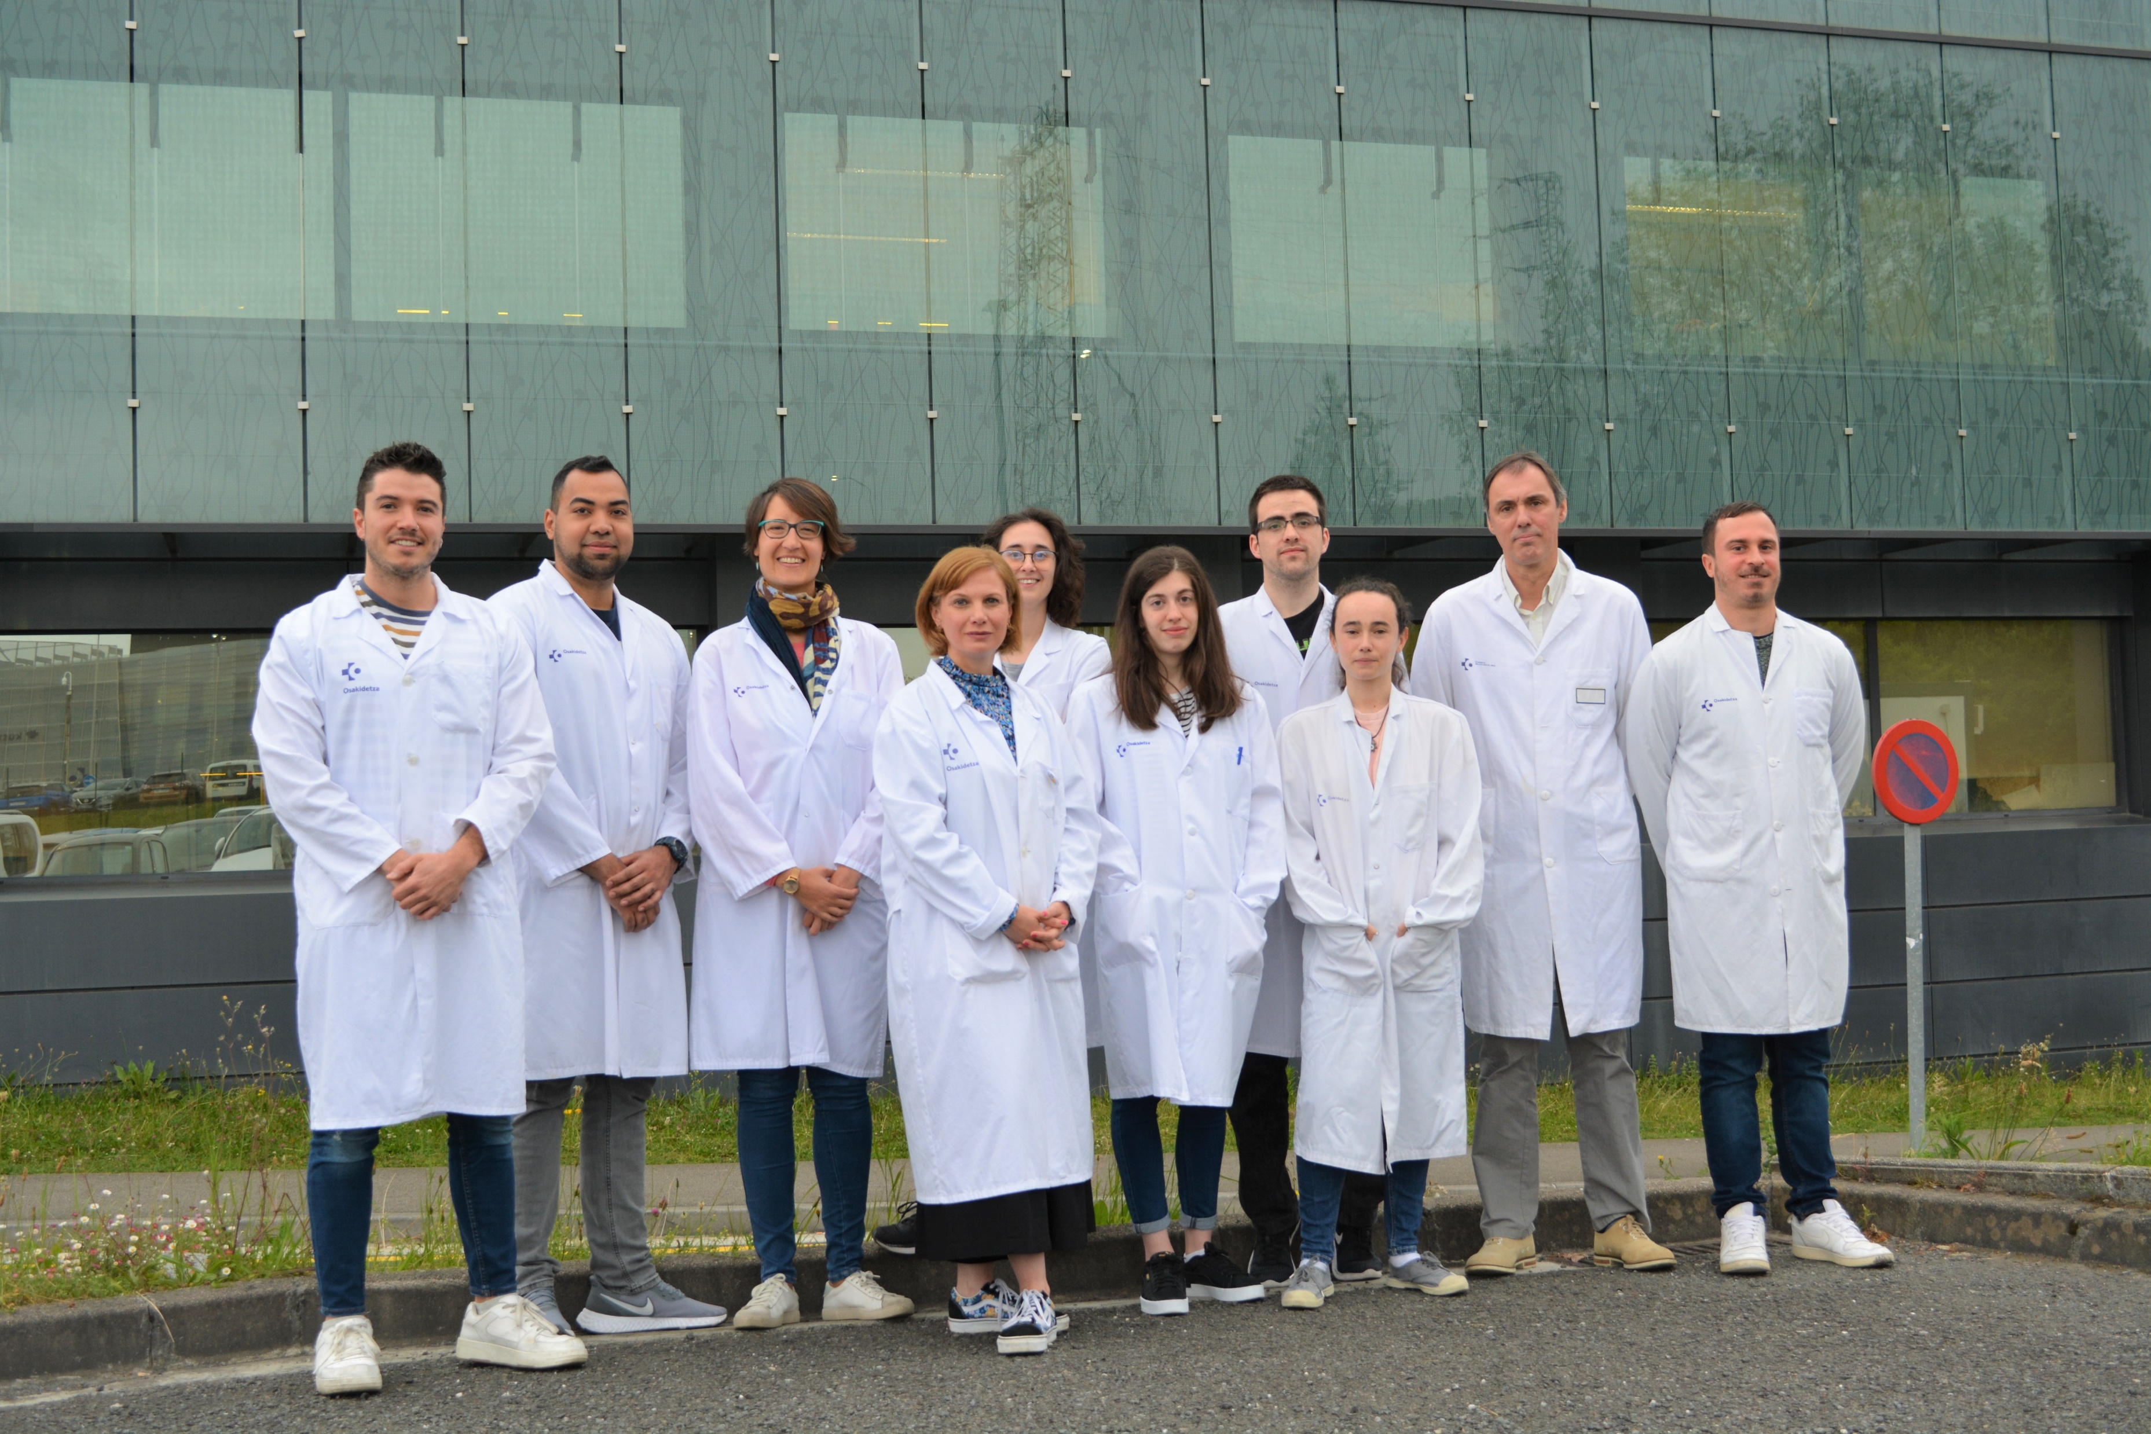
THANK YOU!
Cellular Oncology Group
Ander Matheu
Estefania Carrasco
Verónica Moncho
Diego Marcos
Nerea Iturrioz
Jhonatan Vergara
Jon Landa
Maddalen Otaegi
Aizpea Artetxe
Joseba Elizazu
Itxaso Aguirre
Collaborators: Osakidetza Basque Health Service
Javier Mar
Igor Larrañaga
Contact: sara.crucessalguero@bio-gipuzkoa.eus
Supervisor: ander.matheufernandez@bio-gipuzkoa.eus

