Slide 1
EAPS Health, Morbidity and Mortality
Working Group
September 25–27, 2024 Bilbao, Spain
Filling Gaps: A Methodological Proposal to Estimate Life Expectancy at Birth in the Regions of Minas Gerais, Brazil*
Denise Helena França Marques Maia
Igor Augusto Tadeu de Souza
Marcos Damasceno
*Agradecemos o apoio financeiro da Fundação de Amparo à Pesquisa do Estado de Minas Gerais (Fapemig)

Slide 2
OBJECTIVE
Presenting a methodological proposal to calculate life expectancy at birth of 13 planning regions in Minas Gerais (Brazil) to the year of 2022
Motivation:
Population projection for the regions in Minas Gerais through a cohort component method, aiming the period from 2027 to 2072

Slide 3
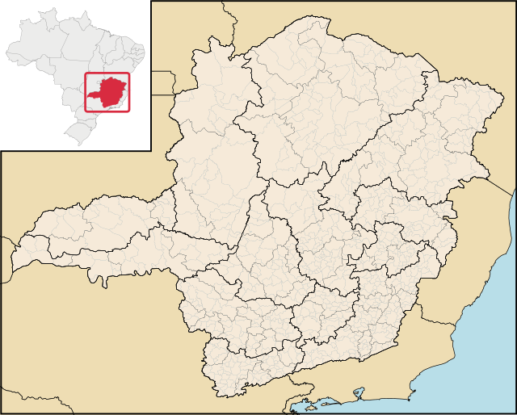
Minas Gerais: municipalities and regions
In 2022:
Population: 20,5 milion of inhabitants (10% of Brazilian population)
GDB: U$ 166,0 billions (9,3% of Brazil’s GDB)
13 Regions: 853 municipalities

Slide 4
CHALLENGES
Poor quality of death data: issues such as underreporting and errors in the declaration of age at death and in the population data
COVID-19 pandemic: In 2021, Brazil registered around 619 thousand deaths due to COVID-19 (Ministério da Saúde, 2020), and the regional differences in the capacity for death registration became more evident
The IMRS presents the situation of the population in a given year concerning Education; Sanitation, Housing, and Environment; Health; Public Safety; and Vulnerability, as well as the efforts of the public sector to improve this situation through the implementation of public policies, plans, programs, projects, and actions (Fundação João Pinheiro, 2020). (worst) 0<=IMRS<=1 (best)
Regions of Minas Gerais: medians of life expectancy at birth calculated directly and IMRS – 2021 and 2022
Regions | Life expectancy at birth | IMRS
Ipatinga | 80,5 | 0,628
Belo Horizonte | 80,3 | 0,625
Teófilo Otoni | 80,0 | 0,566
Montes Claros | 79,6 | 0,564
Patos de Minas | 79,1 | 0,629
Uberlândia | 79,1 | 0,644
Divinópolis | 79,0 | 0,602
Governador Valadares | 79,0 | 0,581
Barbacena | 79,0 | 0,646
Pouso Alegre | 78,5 | 0,662
Juiz de Fora | 78,4 | 0,629
Varginha | 78,3 | 0,662
Uberaba | 77,9 | 0,659
Synthetic index of social responsibility in state public management
Source: FUNDAÇÃO JOÃO PINHEIRO, 2020; IBGE (2022); Brasil (2023).

Slide 5
CHALLENGES
Regions of Minas Gerais versus Sweden: LN specific mortality rates directly estimated (underreporting considered)– 1980 and 2022
Sources: United Nations (2022). IBGE. Censo Demográfico de 2022. Brasil (2023). Note: the data of Sweden are from 1980, when e₅=71,3 and were chosen because of the similarity with Minas Gerais in 2022, when e₅=71,5.

Slide 6
RESULTS
Regions of Minas Gerais versus Sweden: LN specific mortality rates estimated by log-quadratic – 1980 and 2022
Sources: United Nations (2022). IBGE. Censo Demográfico de 2022. Brasil (2023). Note: the data of Sweden are from 1980, when e₅=71,3 and were chosen because of the similarity with Minas Gerais in 2022, when e₅=71,5.

Slide 7
RESULTS
Regions of Minas Gerais versus Sweden: LN specific mortality rates directly estimated – 1974 and 2010
Sources: United Nations (2022). IBGE. Censo Demográfico de 2022. Brasil (2023). Note: the data of Sweden are from 1974, when e₅=70,8 and were chosen because of the similarity with Minas Gerais in 2010, when e₅=70,8.

Slide 8
RESULTS
Regions of Minas Gerais versus Sweden: LN specific mortality rates estimated by log-quadratic – 1974 and 2010
Sources: United Nations (2022). IBGE. Censo Demográfico de 2022. Brasil (2023). Note: the data of Sweden are from 1974, when e₅=70,8 and were chosen because of the similarity with Minas Gerais in 2010, when e₅=70,8.

Slide 9
RESULTS
Regions of Minas Gerais: medians of life expectancy at birth calculated by the log-quadratic and IMRS – 2010
Regions | Life expectancy at birth 2010 | IMRS
Varginha | 72,4 | 0,605
Belo Horizonte | 72,9 | 0,599
Pouso Alegre | 72,6 | 0,596
Divinópolis | 72,4 | 0,59
Uberlândia | 73,2 | 0,587
Uberaba | 72,4 | 0,585
Patos de Minas | 72,7 | 0,583
Barbacena | 71,2 | 0,582
Juíz de Fora | 71,4 | 0,582
Ipatinga | 72,3 | 0,569
Governador Valadares | 71,1 | 0,555
Montes Claros | 71,5 | 0,552
Teófilo Otoni | 69,7 | 0,54
The mortality curves’ patterns and levels estimated by the model are consistent with the socioeconomic realities of the regions in Minas Gerais in 2010
Source: FUNDAÇÃO JOÃO PINHEIRO, 2020; IBGE (2010); Brasil (2023). Note: Life expectancy at birth calculated using population projections

Slide 10
CONCLUSIONS
The results of the direct calculation of life expectancy at birth for the regions of Minas Gerais in 2022 do not align with the regional socioeconomic reality;
Existence of problems in the numerator and/or denominator of the rates:
Errors in declaration of age in the Demographic Census?
Errors in declaration of age in the death certificate?
Need to investigate the issue that also occurs in the 2010 data;
The Log-quadratic method (Wilmoth et al., 2012) fixes the issue of result alignment when applied to the 2010 data therefore allowing the projection of the mortality structure of the regions.

Slide 11
Thank you!
E-mail: denise.maia@fjp.mg.gov.br

