Slide 1
Life expectancy by religious affiliation over five decades in two ethnolinguistic groups.
Finnish and Swedish speakers in Finland 1972 – 2023.
Julia Klein, Jan Saarela & Martin Kolk
26.09.2024, EAPS HMMWG, Bilbao
Åbo Akademi University image bank

Slide 2
Classic demography
Classic methods
Classic variable
Brand
new
results
Åbo Akademi University image bank

Slide 3
What has been done before?
Survey study + linked health follow-up
Typically in the US
Having faith is not important.
Which faith you follow is not important.
What is important is that you attend services at least once a week.
Beneficial for health and reduces mortality.

Slide 4
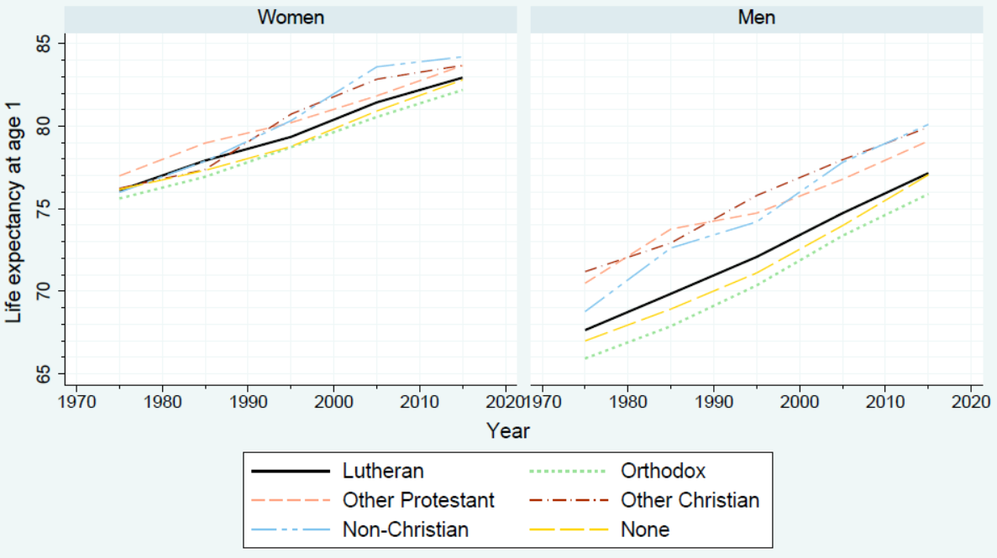
Life expectancy at age 1

Slide 5
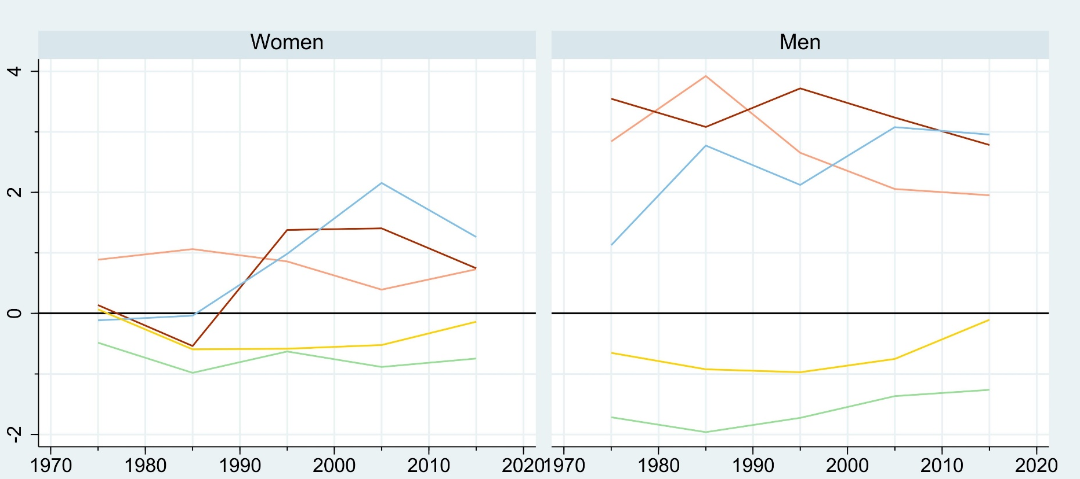
Relative differences
Difference compared to Lutherans in years
None

Slide 6
Relative differences
Other protestant Christians
Other Christians
Non-Christians
Difference compared to Lutherans in years
Orthodox

Slide 7
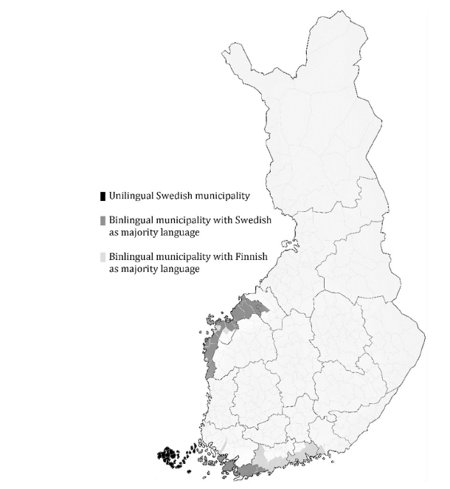
The Finlandswedes
300,000 out of 5,5 million Finns
Native minority
Well-integrated
Resource strong minority with strong shared identity
Slightly better outcomes for most socioeconomic & health variables
Why?
Åbo Akademis Bildbank
Klein (2022)

Slide 8
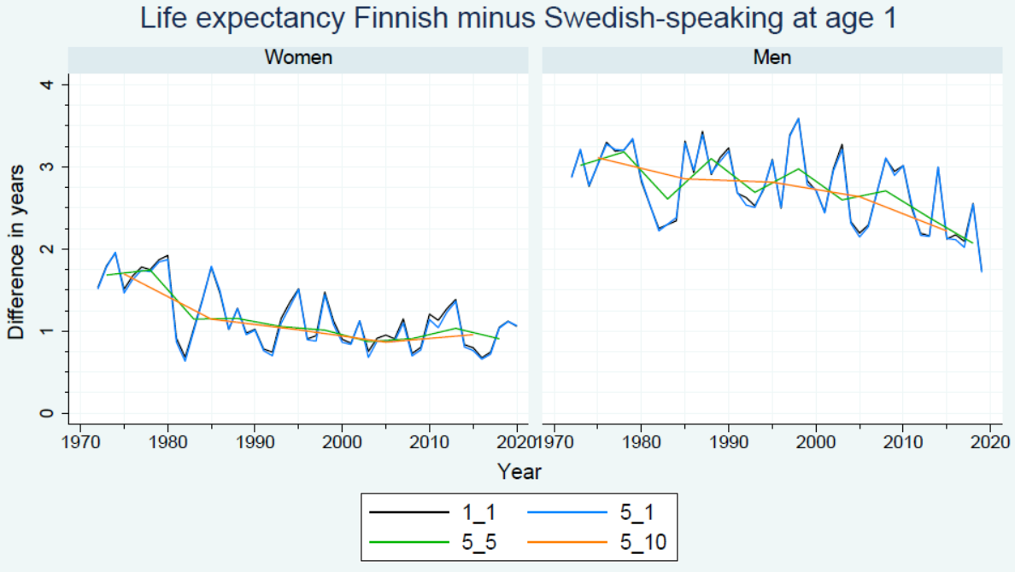
Life expectancy at age 1

Slide 9
Tackar.
Thank you.
Åbo Akademi University image bank

