Slide 1
The Cost of Widowhood: A Matching Study of Process and Event
Zachary Van Winkle
Notes:
Thank you for having me today. My name is Zachary Van Winkle, and I am currently an associate professor of sociology at Sciences Po.
Today I am going to present some joint work with Thomas Leopold on the cost of widowhood – a matching study of process and event.
This paper is one of the keystones of my ERC starting grant project “A Social Demography of Widowhood across Ageing Societies” that will start in September 2024.
And so I am going to take this chance to give you a brief introduction to the project before moving on to the paper.

Slide 2
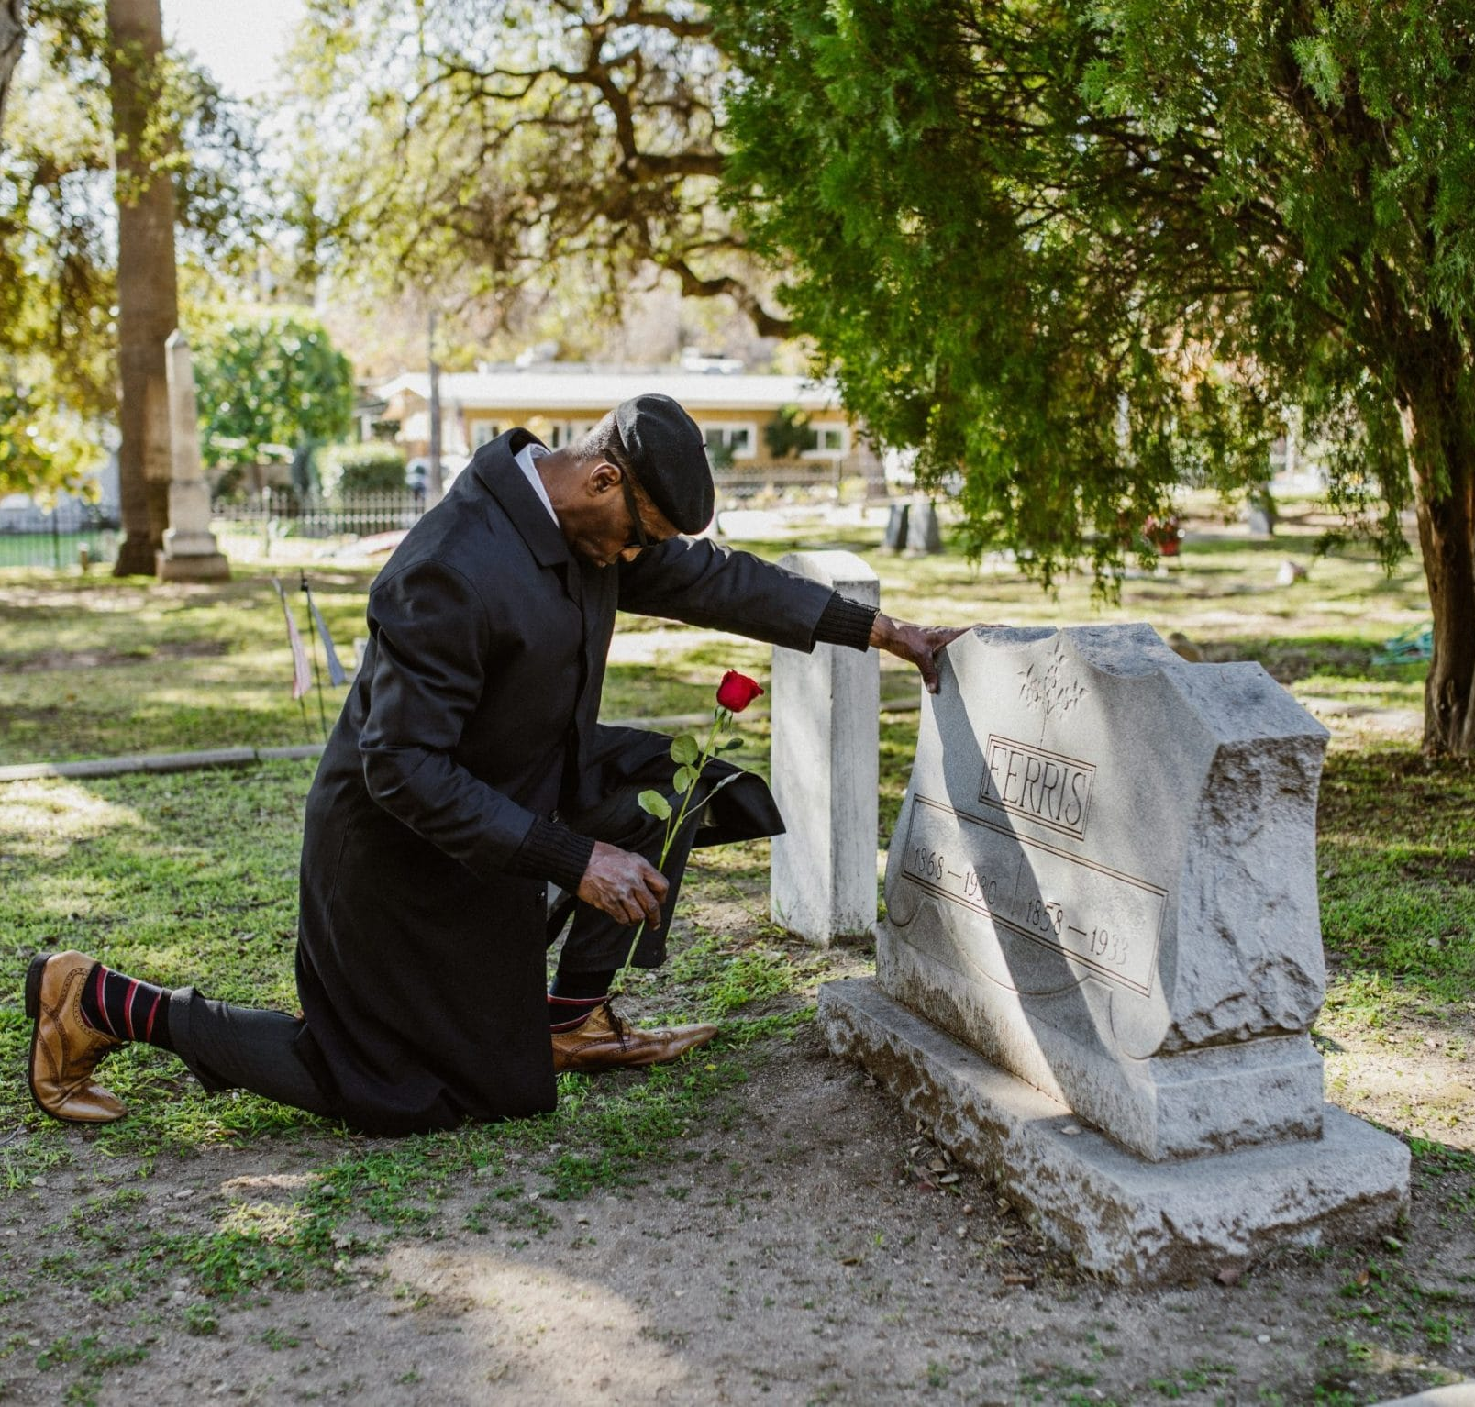
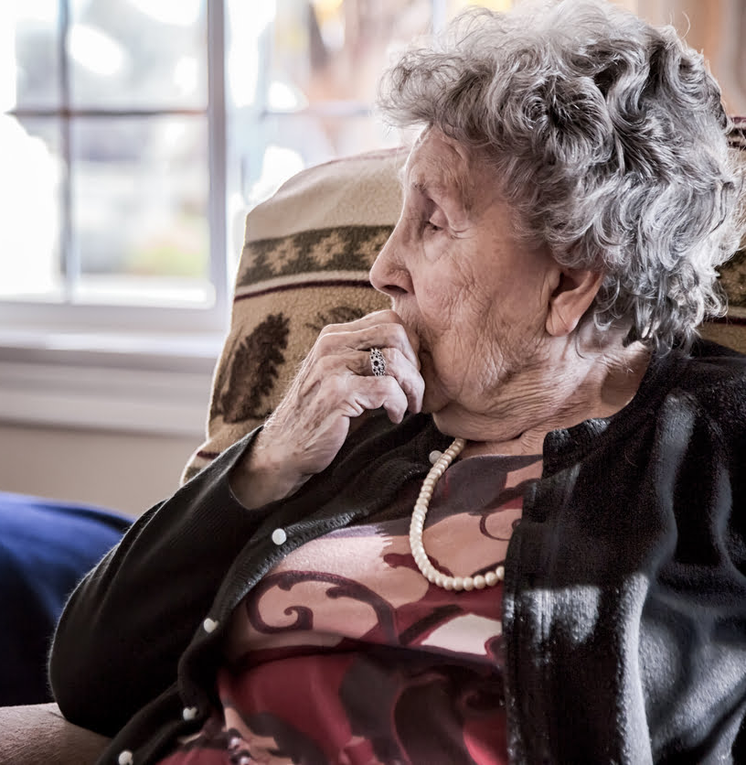
WIDOW
A Social Demography of Widowhood across Ageing Societies
Zachary Van Winkle
Notes:
Widowhood affects every member of the family, but requires the most adjustment from surviving spouses.
However, widows and widowers themselves are a diverse population and are affected by widowhood differently.
For example, younger widowers may be resilient in terms of mental and economic wellbeing, while older widows may need to contend with longer-term chronic depression and poverty.
However, we actually don’t know many of the most basic facts on widowhood risk and vulnerability.

Slide 3
WIDOW
A Social Demography of Widowhood across Ageing Societies
Zachary Van Winkle
Notes:
One thing we do know is that widowhood is becoming more frequent across all ageing societies, at a time where many countries are curtailing survivor benefits.
And just to highlight how common widowhood is compared to other critical life events, in all of these countries and most others, there are two to three spousal deaths per divorce each year.

Slide 4
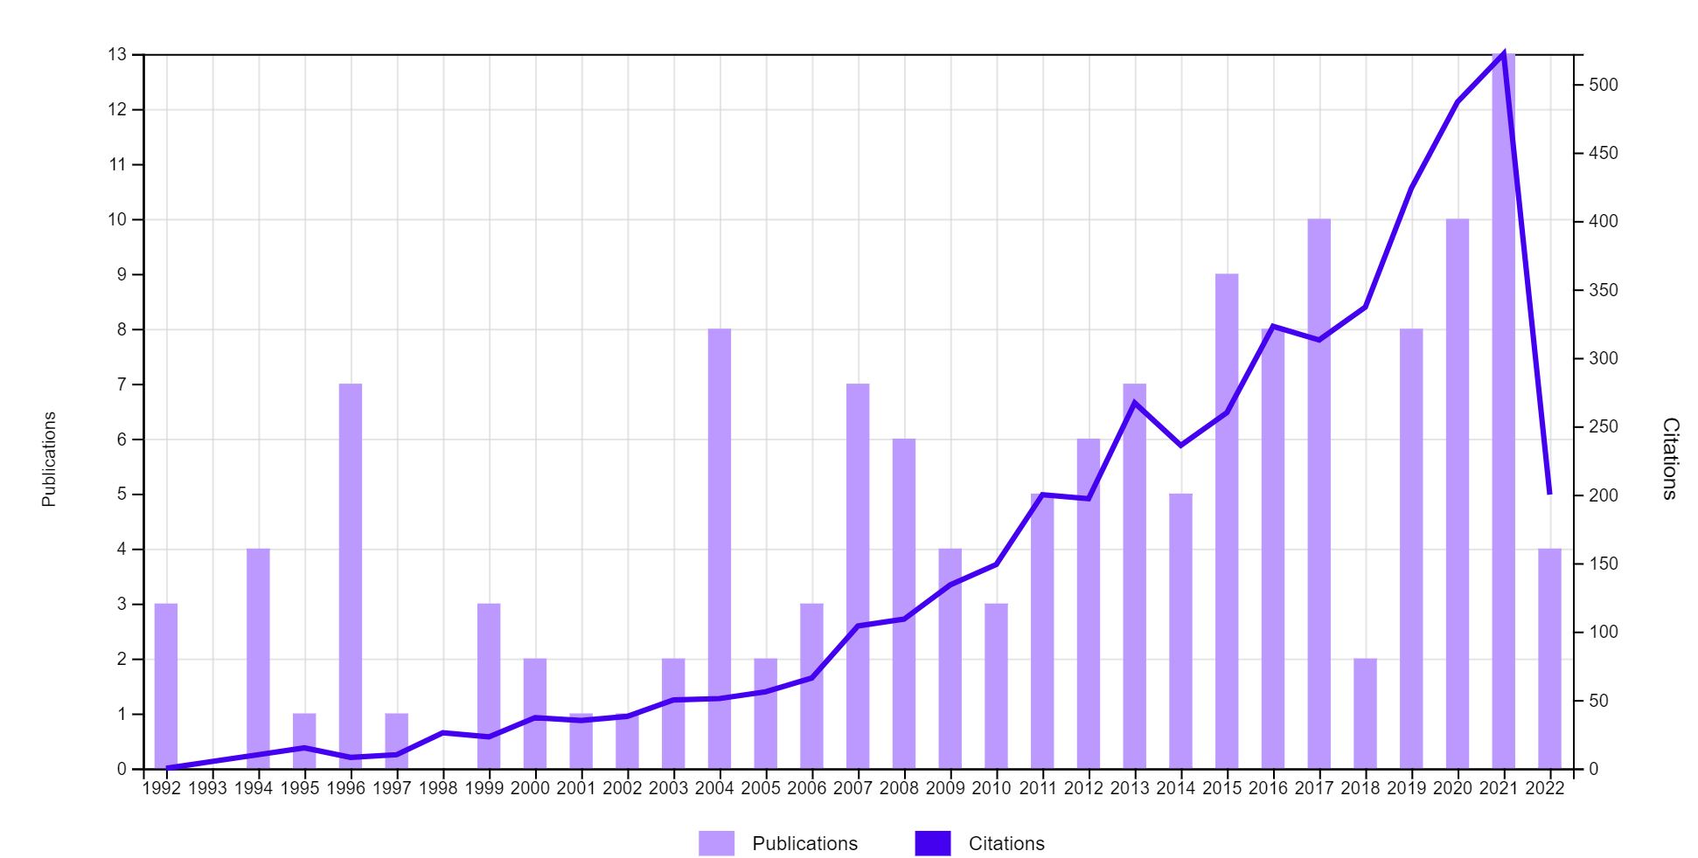
Academic Research on Widowhood in Sociology
WIDOW
A Social Demography of Widowhood across Ageing Societies
Zachary Van Winkle

Slide 5
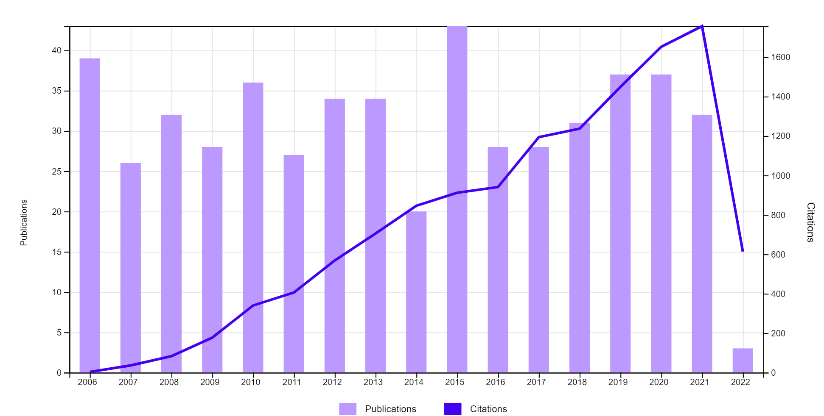
Academic Research on Divorce in Sociology
WIDOW
A Social Demography of Widowhood across Ageing Societies
Zachary Van Winkle

Slide 6
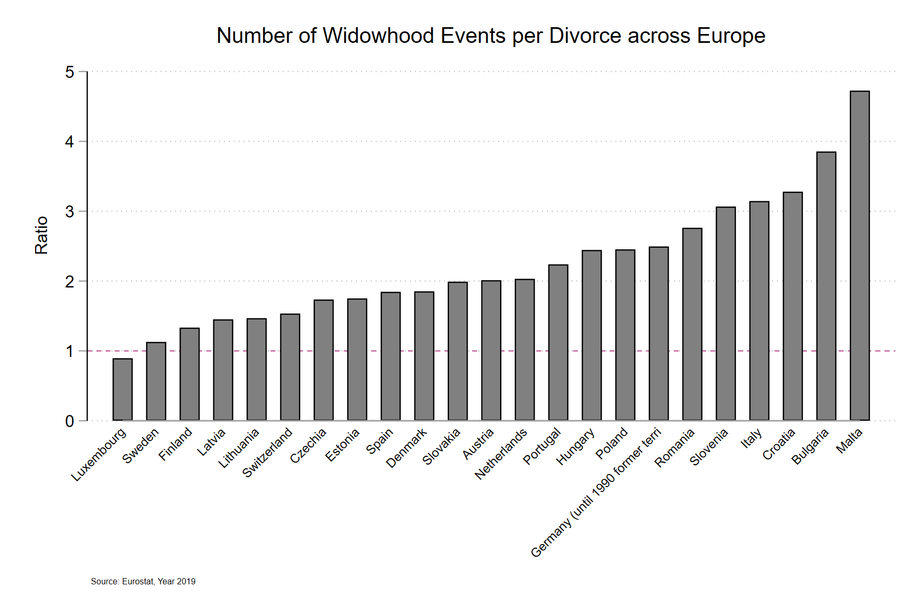
WIDOW
A Social Demography of Widowhood across Ageing Societies
Zachary Van Winkle

Slide 7
WIDOW
A Social Demography of Widowhood across Ageing Societies
Zachary Van Winkle
Widowhood Previous Research
Demography
Psychology
Sociology
Gerontology
Limitations
Concepts
Methods
Generalizability
Stratification
Comparative scope
Notes:
Within the social sciences, demographers tend to study the risk of spousal loss, sociologists the economic and mental health consequences, and gerontologists plus psychologists the resilience of widows and widowers.
While I’ve only just highlighted a few disciplines working on widowhood, all disciplines share some key limitations:
Their conceptualization and estimation of widowhood risk and vulnerability is selective and narrow in scope.
Many studies are based on non-representative samples, overlook social inequalities, and focus on a single country or a single point in time.
This leaves us with a fragmented state-of-the-art that makes it difficult to draw any solid conclusions on variation in widowhood risk and vulnerability.
The WIDOW project will remedy these limitations.

Slide 8
WIDOW
A Social Demography of Widowhood across Ageing Societies
Zachary Van Winkle
The foundation
Risk of widowhood
→ Lifetime probability
→ Conditional probability
→ Duration of widowhood
Notes:
The foundation of my project lies in a novel conceptual and methodological approach to the risk and vulnerability to widowhood.
First, I will assess three dimensions of risk: the overall probability of ever becoming widowed, the conditional probability of widowhood among married adults, and the expected duration of widowhood among surviving spouses.
Contrasting these three elements facilitates a better understanding of how widowhood risks arise from processes related to marriage, divorce, remarriage and mortality.
To do this I will use numerous cross-sectional surveys and a mix of regression modeling and life table analysis.

Slide 9
WIDOW
A Social Demography of Widowhood across Ageing Societies
Zachary Van Winkle
The foundation
Vulnerability to widowhood
→ Mental health & economic wellbeing
→ Processual approach
→ Expected vs. unexpected death
Notes:
Second, I will assess the consequences of widowhood for mental health and economic wellbeing across the entire process of spousal death.
That means looking at change before, during, and long after the event of spousal loss occurs for two distinct groups.
Expecting survivors who anticipated the death of their spouse as well as unexpecting survivors who did not.
This is important, because statements on general resilience to spousal loss may be overstated if they are based on shorter process of unexpected widowhood rather than the longer and burdensome process of expected widowhood .
For vulnerability, I will use a large number of household panel studies and matched random effects modeling approach.

Slide 10
WIDOW
A Social Demography of Widowhood across Ageing Societies
Zachary Van Winkle
1st Pillar - Inequality
Gender & age
Socioeconomic status
Race-ethnicity & nativity
Social support networks
Notes:
Three pillars will then build on that conceptual and methodological foundation…
The first pillar not only examines how risks and vulnerabilities vary by gender and age, but also assess differences by socioeconomic status, race-ethnicity and nativity as well as social support and kinship networks.
This will be the first comprehensive effort to document and understand how social inequalities result from selective family formation and mortality as well as differential access to protective resources, such as the option to out-source or share care duties.

Slide 11
WIDOW
A Social Demography of Widowhood across Ageing Societies
Zachary Van Winkle
2nd Pillar – Countries
Compositional differences
Survivor benefits & pensions
Comparison of 60 countries
Notes:
The second pillar assesses how risks and vulnerabilities as well as their social inequalities vary across 60 ageing countries, spanning North America, Europe and Asia.
The comparative logic focuses on compositional differences across countries, but also the role of old-age pension and survivor benefit schemes.
This will be made possible through an extensive harmonization of cross-sectional and longitudinal data sources.

Slide 12
WIDOW
A Social Demography of Widowhood across Ageing Societies
Zachary Van Winkle
3rd Pillar – Time
Size and composition
Change since 1980
Projection to 2050
Notes:
My third pillar expands the comparative element of my project to assess change over time since 1980, including how the size and composition of the widowed population will evolve up to 2050.
This is especially relevant as care-intensive pre-death phases, associated with dementia for example, are expected to increase dramatically.

Slide 13
WIDOW
A Social Demography of Widowhood across Ageing Societies
Zachary Van Winkle
Contributions
Team and expertise
Novel concepts
Methodological toolbox
Data harmonization
Comprehensive evidence
Notes:
The WIDOW project will set the stage for future research by building an expert team, providing a coherent set of concepts, methods and data, as well as delivering comprehensive evidence on widowhood across ageing societies.

Slide 14
WIDOW
A Social Demography of Widowhood across Ageing Societies
Zachary Van Winkle
Give your favorite student(s) their Emily in Paris moment!
Call for two PhD positions
Starting in September 2025
Notes:
The WIDOW project will set the stage for future research by building an expert team, providing a coherent set of concepts, methods and data, as well as delivering comprehensive evidence on widowhood across ageing societies.

Slide 15
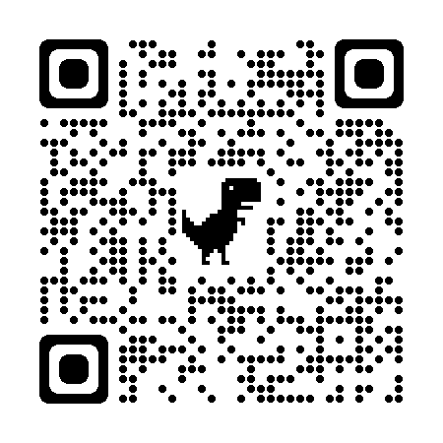
The Cost of Widowhood: A Matching Study of Process and Event
Zachary Van Winkle & Thomas Leopold
Notes:
The paper that I am presenting today is the proof-of-concept for the foundation my project, specifically the vulnerability to widowhood.

Slide 16
Research Aims
The Cost of Widowhood
Zachary Van Winkle
What are the consequences of widowhood for mental health?
Before, during and after the event of spousal death
How do those consequences differ relative to meaningful comparison groups?
Unexpected and expected widowhood compared to continuously married individuals
Notes:
We are going to address two questions day…
Many ways to motivate this – from population aging, to looking at an understudied group…

Slide 17
Introduction
The Cost of Widowhood
Zachary Van Winkle
Life course transitions have an impact on individual wellbeing
Job loss, marriage, parenthood, separation and divorce, retirement, widowhood, and more
General expectation of change and adjustment over time following a stressful life event
Notes:
I want to start this presentation by talking about life course transitions and individual wellbeing more generally, because numerous life events have an impact on our wellbeing, both positive and negative.
Classic examples are job loss, marriage, parenthood, separation and divorce, retirement, widowhood, and children leaving the parental home, but we can certainly think of more.
A long line of social scientific literature conceptualizes these life events as stressors which have an immediate impact on individual wellbeing and demand adjustment or a return to pre-event levels of wellbeing.

Slide 18
The Cost of Widowhood
Zachary Van Winkle
Notes:
Here you can see a simplified depiction of this: change in some outcome at the time of the event followed by a recouperation, compared to someone else who does not expierence the transition.

Slide 19
Introduction
The Cost of Widowhood
Zachary Van Winkle
Considerable variation in the impact of life transitions
Differences across events
Differences between individuals
Trait approach (Thoits 1983; Dohrenwend 1974)
Events vary in stressfulness, e.g. unpredictability or undesirability
Differential vulnerability argument (Kessler 1979; Pearlin et al. 1981)
Variation in coping resources or strategies, dispositions, or social location influence the impact of life events
Notes:
However, we know from decades of research that there is variation in the impact of life transitions not just across event types, but also between individuals.
One traditional approach links event variation with traits of the event, such as whether it is a desirable transition or not.
Another links between individual variation with individuals’ capacity to cope with the immediate stress of the transition and their ability to adjust.
Note that both of these approaches tend to be focused on variation in event and post-event periods.

Slide 20
Introduction
The Cost of Widowhood
Zachary Van Winkle
Contextual role history approach (Wheaton 1990)
Prior “role history” influences post-event change and adjustment
Pre-transition chronic stress moderates change and facilitates adjustment
Highlights pre-transition heterogeneity
Notes:
A third approach attributes event and post-event variation to differences in the pre-event phase.
Specifically, individuals with a role history characterized by chronic stress should be alieved by the transition and be able to adjust quicker.
This approach opens the relevant window of observed to the time leading up to a life course transition.
It not only asks how wellbeing changes prior to the event, during the event, and after the event, but it also asks whether there is variation in pre-transition levels of wellbeing.

Slide 21
The Cost of Widowhood
Zachary Van Winkle
Notes:
Here are two

Slide 22
Introduction
The Cost of Widowhood
Zachary Van Winkle
Role histories not well conceptualized or measured
Substantive meaning of “lead” or “anticipation” effects unclear
Are these caused by the impending transition?
Link pre-event changes to the transition via the process that leads to the event
Example 1: Spousal health decline & widowhood
Example 2: Relationship quality decline & divorce
Two event (treatment) groups
Unexpected → Those who do not experience the process
Expected → Those who do experience the process
Notes:
A current limitation of research that focuses on pre-event changes in wellbeing is that role histories are not well conceptualized and measured.
We don’t really know what those so called lead or anticipation effects really are. For example, caused by stress arising by conditions not at all related to the impeding event, or really somehow really an impact of the transition yet to come.
We are argue in this paper that the process leading to the event should be leveraged to conceptualize and measure pre-transition effects.
The example we’ll be looking at is… but we can certainly think of others…
For today, we’ll concentrate on two meaningful groups…

Slide 23
Theoretical background Unexpected widowhood
The Cost of Widowhood
Zachary Van Winkle
Notes:
Let’s think theoretically about the case of unexpected widowhood and mental health…
First, note that this is a two period model: It includes a widowhood and post-widowhood period.
In the widowhood period… In the post-widowhood period…

Slide 24
Theoretical Background Expected widowhood
The Cost of Widowhood
Zachary Van Winkle
Notes:
However, this model will need to be expanded for the majority of to-be widows and widowers who expierence the process of spousal terminal health decline.
This is a three period model that includes the pre-widowhood period.

Slide 25
Theoretical Background Expected widowhood
The Cost of Widowhood
Zachary Van Winkle
Notes:
In the pre-widowhood period… And then in the widowhood and post-widowhood periods…

Slide 26
Analytical approach
The Cost of Widowhood
Zachary Van Winkle
Appropriate reference to observe the consequences of a transition before, during and after the event?
Individuals who neither experience the event nor the process
Otherwise similar to to-be widows and widowers
Two comparison groups
Unexpected widowhood
Expected widowhood
Notes:
Before we move on to the data and methods, we need to take a moment to think about the appropriate reference to observe the consequences of expected and unexpected widowhood.
The approach that I am going to argue for is to use individuals that neither experience the event of widowhood nor the process of spousal health decline, but are otherwise similar to our to-be expected and unexpected widows and widowers, as a reference or control group.
This gives us two comparison groups: one for unexpected widowhood and one for expected widowhood.

Slide 27
Unexpected comparison group
The Cost of Widowhood
Zachary Van Winkle
Notes:
Let‘s just visualize this quickly, first for our unexpected comparision group. He were have individuals who expierence widowhood but not the process – group C – and compare them to individuals who expierence neither event nor process – group A. Importantly, these groups should be maximally similar to each other before widowhood occurs.

Slide 28
expected comparison group
The Cost of Widowhood
Zachary Van Winkle
Notes:
Our second comparison groups contrasts individuals who experience the process of spousal health decline and the event of spousal death – group A – with individuals who experience neither, but again are similar before the process of widowhood begins.
By building and contrasting these two groups, we are trying to link those pre-event differences to the transition via the process.

Slide 29
Analytical approach
The Cost of Widowhood
Zachary Van Winkle
Split sample into those who transition and those who do not
Split sample into those who experience the process and those who do not
Match on process and event to create “unexpected” and “expected” comparison groups
Estimate differences between treated and controls in comparison groups
Notes:
The analytical approach that we’ve developed entails four steps…

Slide 30
Analytical approach (1)
The Cost of Widowhood
Zachary Van Winkle
US Health and Retirement Study
Married at first interview between 1994-2008
Treated sample
Transition to widowhood with a min. of 5 pre-death observations
Control sample
Continuously married respondents with a min. of 6 observations
Restrict to respondents with excellent, very good, or good spousal self-rated health
Notes:
Initial sample includes all HRS respondents observed in marriage at first interview between 1994-2008
Treated sample: those who transition to widowhood with a minimum of 5 pre-widowhood observations (10 or 9 years)
Control sample: continuously married respondents with a minimum of six observations (12 or 11 years)
Restrict to respondents with spouses who rate their health as excellent, very good, or good

Slide 31
Analytical approach (2)
The Cost of Widowhood
Zachary Van Winkle
Random coefficient regression of time on spousal health
Allow the time coefficient to vary across individuals
Lower 33% corresponds to the THD process
Large decrease in spousal self-rated health over ten years
Upper 50% corresponds to no THD process
Spousal health remains relatively constant over ten years
Notes:
Estimate random effects regression where process time (pre-widowhood) predicts spousal self-rated health and allow process time coefficient to vary across individuals
Lower 33% corresponds to the THD process: Large decrease in spousal self-rated health over ten years
Upper 50% corresponds to no THD process: Spousal health remains relatively constant over ten years

Slide 32
Descriptive Results Spousal self-rated health over time by process and event
The Cost of Widowhood
Zachary Van Winkle

Slide 33
Analytical Approach (3):
The Cost of Widowhood
Zachary Van Winkle
Propensity score matching
Create a similar control group for each treated group at first observation
Matching on the event after matching on the process
Sample indicator as treatment for outcome variable
Center for Epidemiologic Studies Depression Scale (CESD)
Controls assigned treated year of widowhood
3 controls per treated

Slide 34
Matched Treatment and Control Samples Unexpected widowhood
The Cost of Widowhood
Zachary Van Winkle

Slide 35
Matched Treatment and Control Samples Expected widowhood
The Cost of Widowhood
Zachary Van Winkle

Slide 36
Analytical Approach (4)
The Cost of Widowhood
Zachary Van Winkle
Linear regressions on CESD score for each comparison group:
Transition (widowed/not widowed)
Duration to/since widowhood (years)
Sample indicator (control/treatment)
Cross-sectional difference between controls and treated
Estimated widowhood effect at each period in the process
Cumulative cost of the process
Sum of differences up to each period in the process

Slide 37
Results Cross-sectional differences across process time
The Cost of Widowhood
Zachary Van Winkle

Slide 38
Results Cross-sectional differences across process time
The Cost of Widowhood
Zachary Van Winkle

Slide 39
Results Cumulative differences across process time
The Cost of Widowhood
Zachary Van Winkle

Slide 40
Discussion
The Cost of Widowhood
Zachary Van Winkle
No pre-death differences in mental wellbeing amongst unexpected widows and widowers
Considerable declines six years prior to loss for expected bereavement
Recuperation to pre-death levels, but not pre-process levels
Statements on the resilience likely be overstated
Total cost of widowhood tend to be greater for expected widows and widowers
Notes:
So, to sum up the findings…
No pre-bereavement differences in mental wellbeing between the treated and control samples who did not experience a THD. However, considerable pre-bereavement differences up to five years prior to spousal loss for treated who experienced a THD
Mental wellbeing may reach levels experienced one year prior to spousal loss, but not pre-process levels. Statements on the resilience of the bereaved may be overstated
Total costs of widowhood are considerable for both the expected and unexpected bereaved. However costs tend to be greater for expected bereaved for whom the process began much earlier

Slide 41
Discussion
The Cost of Widowhood
Zachary Van Winkle
Theoretical contribution in defining role history in terms processes
Identifies meaningful event-by-process comparison groups
Links pre-transition differences to the event by means of the process
Methodological innovation in the event-by-process analytical approach
Unexpected and expected widowhood
Easily adaptable to other life events
Divorce and marital relationship decline
Notes:
We make both a theoretical and methodological contributions.
Our theoretical contribution lies in defining “role history” in terms of the process leading to the event, which allows us to identify meaningful event-by-process comparison groups and links pre-transition differences to the event by means of the process
Our methodological innovation lies in developing an approach to create event-by-process and comparison groups, in this study unexpected widowhood and expected widowhood.
However, the approach is easily adaptable to other life events. For example, in another project we are already investigating divorce and the process of the declining quality in marital relationships using pairfam data.

Slide 42
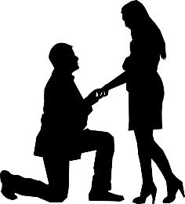
Thank you!
The Cost of Widowhood
Zachary Van Winkle
Contact Information: Zachary Van Winkle
Sciences Po Paris
Centre for Research on Social Inequalities
zachary.vanwinkle@sciencespo.fr
www.zachary-vanwinkle.com

