Slide 1
Work, Love, and Death
EAPS Health, Morbidity, and Mortality Working Group
Immigration Background and the Widowhood Effect on Health and Mortality
Prof. Dr. Anna Oksuzyan
School of Public Health, Bielefeld University
September 25-27, 2024
Notes:
Good morning. I am very excited to be here today. One reason is that it is my first participation in the EAPS Health, Morbidity, and Mortality Workshop. I am lucky that this year it’s in such a beautiful city. Thank you, Tim and other organizers, for this invitation!
Another reason is that as a keynote speaker I would normally talk about my research on gender and health. Some year ago as a response to the migration crisis in Europe in 2015, I (also Silvia Loi and Andreas Edel) received funding from Max Planck Society to study how migration background intersects with gender and migration background of the spouse to shape immigrants’ health in host countries.

Slide 2
Structure of my talk
Project 1: Immigration Background and the Widowhood Effect on Mortality
Project 2: Widowhood and Health: The Role of Spouses‘ Migration Background
Project 3: Is it Better to Intermarry? Immigration Background of Married Couples and Suicide Risk Among Native‑Born and Migrant Persons in Sweden
Notes:
Once when having dinner my son asked “Mom, what you are working now?” I said that I am studying whether it was good for your dad and me to marry or it would have been better for our mental health if your dad married a German woman and I married to another immigrant.
My husband looked surprised and said: Anna, I understand gender – health, gender – migration – health, but now it’s intermarriage – suicide and widowhood. Should I be worried?
I will bring to your attention two projects. Project 1: Immigration Background and the Widowhood Effect on Mortality (Caputo et al. 2021. J Gerontol B Psychol Sci Soc Sci: 76)
Project 2: Widowhood and Health: The Role of Spouses‘ Migration Background (in progress)

Slide 3
Project 1: Immigration Background and the Widowhood Effect on Mortality
Jennifer Caputo, P. Li, M. Kühn, H. Brønnum-Hansen, A. Oksuzyan
Caputo et al. 2021. J Gerontol B Psychol Sci Soc Sci: 76(10)
Notes:
I would like to acknowledge that the study was led by Jennifer Caputo who is now at Westat, US and the contribution of other co-authors who most of you know well.

Slide 4
Background: Widowhood effect on health
One of the most stressful events (Holm et al., 2019; Moon et al., 2011; Shor et al., 2012)
Notes:
Spousal bereavement is one of the most stressful events that individuals can encounter over the life course, helping to explain why widowed individuals have poorer health and are at greater risk of their own subsequent death than nonwidowed persons—a phenomenon known as “the widowhood effect”.

Slide 5
Background: Widowhood effect on health
Grief: long-lasting and complex emotional experience
(Holm et al., 2019; Onrust & Cuijpers, 2006)
Faced with the task of dramatically restructuring day-to-day lives
(Carr & Bodnar-Deren, 2009; Holm et al., 2019; Lillard & Waite, 2008)
Removed health benefits of marriage (social, emotional, and material support and the promotion of healthy behaviors)
(Holm et al., 2019; Iwashyna & Christakis, 2003; Lillard & Waite, 2008)
Notes:
Explanations for how widowhood affects health and reduces life spans are multilevel.
The emotional experience of grief can be long-lasting, complex, and debilitating.
Widows are frequently faced with the task of dramatically restructuring their day-to-day lives.
Widowhood also removes the health benefits of marriage, which include social, emotional, and material support and the promotion of healthy behaviors. Studies indicate that widowhood may be followed by feelings of isolation, the loss of material resources, and poorer health behaviors.

Slide 6
Background: Variations across social groups
A greater toll on men’s than women’s health
(Carr & Bodnar-Deren, 2009; Moon et al., 2011)
More detrimental at younger than older ages
(Martikainen & Valkonen, 1996; Schaefer et al., 1995; Shor et al., 2012)
Stronger for persons of lower socioeconomic status
(Sullivan & Fenelon, 2014)
Stronger for White than Black Americans
(Elwert & Christakis, 1995)
Notes:
Research also suggests that these impacts vary across social groups.
For example, widowhood appears to take a greater toll on men’s than women’s health, partly because women have wider social networks.
Research also shows that widowhood is more detrimental at younger than older ages, and that higher socioeconomic status is protective against the widowhood effect.
Relatively fewer studies have assessed racial, ethnic, and cross-cultural differences in the health effects of widowhood. A key U.S.-based analysis found that the relationship between widowhood and mortality was stronger for White than Black Americans. The authors suggest that because Black families tend to have broader social networks and less gendered divisions of labor than White families, less adjustment is required after a spouse’s death.

Slide 7
Motivation: Variations by migration background
Initial health advantage (Abraído-Lanza et al., 1999; Razum, 2006)
=> More resilience to the bereavement stress
Social, economic, and health disadvantages (Ciobanu et al., 2017; Kristiansen, et al., 2016)
=> The stress of losing a spouse more potent
Coping with widowhood in an unfamiliar cultural context (Kokou-Kpolou et al., 2017; Saito, 2014)
=> Worsening of the experience of grief
Notes:
There are several reasons to expect that widowhood may be especially detrimental for some immigrants.
Immigrants may face social, economic, and health disadvantages relative to native-born persons, which could make the stress of losing a spouse especially potent.
Once in the receiving country, immigrants may face stress adapting to a new culture and language, encounter discrimination, and have fewer privileges than native-born persons.
Also, coping with widowhood in an unfamiliar cultural context may worsen the experience of grief.
Cultural beliefs about death and bereavement can mean that grief is felt more profoundly among persons from certain backgrounds than others.
Discontinuities between personal and local mourning rituals may further complicate immigrants’ widowhood experiences.

Slide 8
Research Questions
Does the relationship between widowhood and mortality differ between native- and foreign-born persons residing in Denmark?
Are there country-of-origin differences in these patterns?
Notes:
We set out this study to investigate whether the relationship between widowhood and health differs between native- and foreign-born persons.
We expect that immigrants will have a greater increase in mortality after widowhood than native Danes.
We also expect country-of-origin differences in these patterns. Specifically, we predict that immigrants who arrived from more traditionally gendered or culturally distinct countries as well as those who may have been pushed by economic or social crises (e.g., Turkey, former Yugoslavia, Poland, former Soviet Union, and Vietnam) will have a greater increase in post-bereavement mortality relative to native Danes than those who likely moved for specific economic and schooling opportunities (e.g., from Germany, Norway, Sweden, the United Kingdom, and the United States).

Slide 9
Methods: Study population
Danish register data, 1980-2014
Enter the study population:
the month they turned 50 if married,
at the time of marriage if 50 or older, or
at the time of immigration for married persons who moved to Denmark when they were 50 and older.
2,198,043 persons (37,841,825 person-years)

Slide 10
Methods: Measures
Immigrant: born outside of Denmark
Widowhood status (ref. married): 0–2 years (0–24 months), 3–5 years (25–60 months), and 6+ (61+ months)
Country of origin: Denmark (ref.), Germany, Norway, Sweden, UK, USA, Poland, f. Soviet Union , f. Yugoslavia, Turkey, Vietnam
SES characteristics: Income (tertiles), employment (employed vs. not working), Parental status (childless vs. parent)
Cox proportional hazard models
Notes:
We employed Cox proportional hazard models, with death due to any cause as the failure event. The baseline hazard is a function of age.

Slide 11
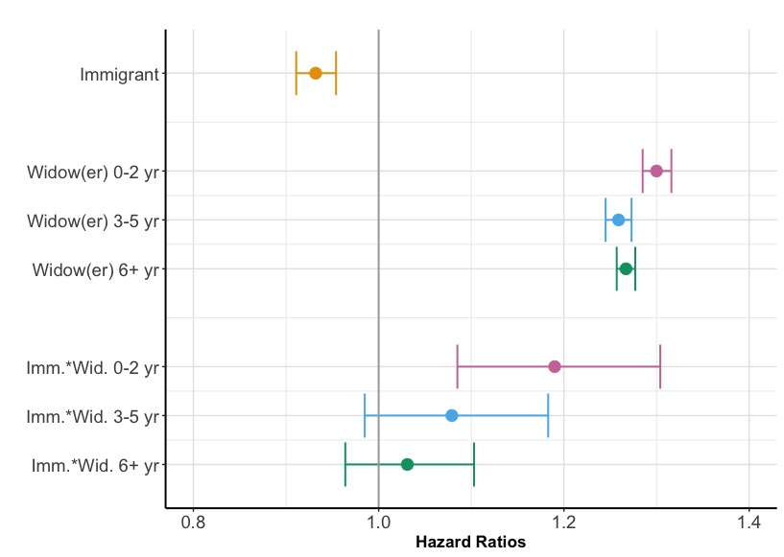
Figure 1: Post-widowhood mortality hazard: Men
Notes:
The figure shows post-widowhood mortality hazard for men. Relative to married men, widowed men had nearly 30% elevated hazard of death in the first 2 years after losing their spouse, 26-27% greater hazard in the next 3–5 years and 6 and more years post-widowhood. The interaction terms indicate that excess mortality within the first 2 years after a spousal loss was 18% greater among immigrant than Danish men (1.016, 1.369), but there were no immigration background differences in mortality 3 or more years post-widowhood.

Slide 12
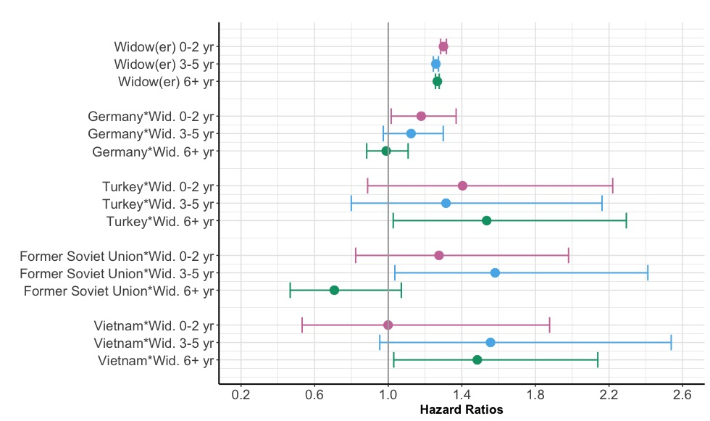
Figure 2: … by country of birth: Men
Notes:
Incluidng the interaction term between widowhood status and immgiration background reveals that excess mortality following a spousal death
was greater among men from Germany than Danish-born men within 2 years (HR = 1.179) after widowhood.
Men from the former Soviet Union had an elevated hazard of death 3–5 years post-widowhood (HR = 1.581)
while Turkish (HR = 1.535) and Vietnamese men (HR = 1.484) had greater mortality hazard 6+ years after widowhood than Danish-born men.

Slide 13
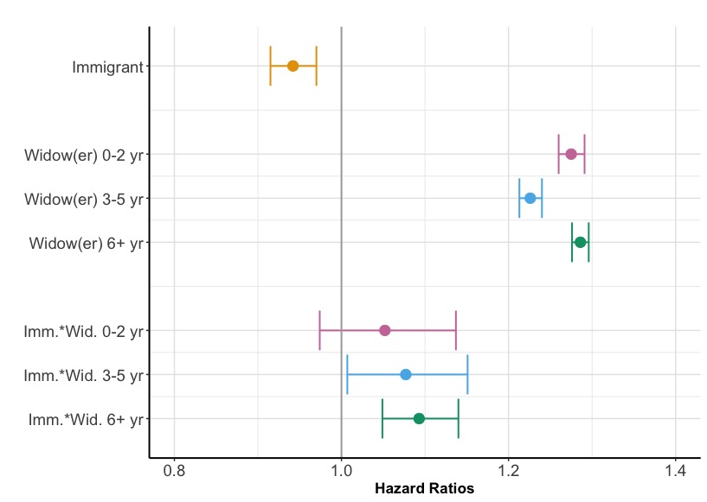
Figure 4: Post-widowhood mortality hazard: Women
Notes:
The next figure shows post-widowhood mortality hazard for women. Relative to married women, widowed men had about 28% elevated hazard of death in the first 2 years after losing their spouse, 23-29% greater hazard in the next 3–5 years and 6 and more years post-widowhood.
The effect of spousal death on mortality was 7-9% greater for immigrant than native Danish women 3-5 years (HR=1.08, 1.01, 1.15) and 6+ years post-widowhood (HR = 1.09, 1.05, 1.14), while the excess mortality shortly after widowhood was similar among Danish-born and foreign-born women.

Slide 14
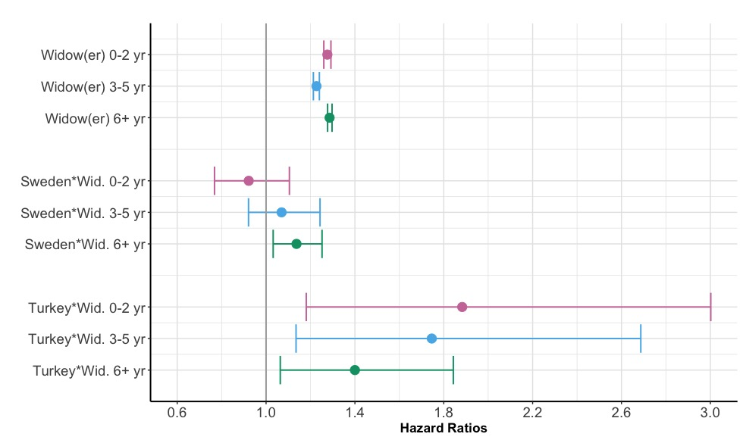
Figure 5: … by country of birth: Women
Notes:
Incluidng the interaction term between widowhood status and immgiration background reveals that the hazard of death associated with widowhood:
was greater for Turkish than Danish-born women over all post-widowhood periods (HRs = 1.88 for 0–2 years, 1.75 for 3–5 years, and 1.40 for 6+ years).
Additionally, Swedish women had a greater hazard of death 6+ years after widowhood (HR = 1.14)
and Vietnamese women had greater mortality in the first 2 years of widowhood (HR = 1.70) than Danish women.

Slide 15
Key findings project 1: Widowhood - Mortality
The elevated mortality risk in the first 2 years post-widowhood among immigrant vs. native Danish men (not significant at longer durations of widowhood)
A greater risk of dying vs. Danish-born women 3+ years post-widowhood (not significant shortly after widowhood) vs. Danish women
Notes:
Our analyses showed that the elevated risk of death in the first 2 years after being widowed was greater among immigrants than native Danish men, although this difference was not significant at longer durations of widowhood.
Immigrant women experienced a greater risk of dying than Danish-born women 3 and more years post-widowhood when controlling for income and employment status.

Slide 16
Key findings project 1: Widowhood – Mortality (cont.)
Elevated risk of post-widowhood death among German men (short durations), Turkish and Vietnamese, f. Soviet Union men (longer durations) widowhood suffer more from widowhood vs. Danish men
Elevated risk of post-widowhood death among Turkish women (all durations), Vietnamese women (short durations) and Swedish women (longer durations) after widowhood vs. Danish women
Notes:
Analyses disaggregating the immigrant sample provide mixed support for our predictions.
Turkish- origin persons were among the most socioeconomically disadvantaged immigrant groups and the most likely to be married to persons from their same ethnicity.
Even within Denmark, gender roles among people of Turkish origins tend to be patriarchal, with men acting as the primary breadwinners. Perhaps Turkish men are more reliant on their wives with respect to control of their health behaviors that have long-term longevity consequences. Thus, Turkish-origin women and men may encounter more dramatic life adjustments after their spouse dies than Danish women.
Likewise, in traditional Vietnamese culture, women bear responsibility for the family and men for work. Vietnamese immigrants are also among the lowest income. It is possible that chronic disadvantages associated with losing their spouse add to other vulnerabilities and begin to affect mortality for men and women of this group after several years have passed.
Immigrants from f. Soviet Union were likely driven to Denmark by economic difficulties or political persecution, which may similarly help explain their excess mortality 3–5 years post-widowhood.
Findings for elevated risk of post-widowhood death at different periods among German men and Swedish women are less clear to interpret. The somewhat more traditional distribution of gender roles in German culture, in which men tend to rely on their wives for social support, may help explain the mortality disadvantage of German-origin widowers in the first 2 years after widowhood.

Slide 17
Project 2: Widowhood and Health: The role of own and spouse’s immigration background
A. Oksuzyan, S. Bohlourihajjar, P. Li, J. Caputo, K. Christensen, M. Myrskylä

Slide 18
Project 2: Research Questions
Is widowhood more disruptive for immigrants’ health/treatment-seeking behavior than for native-born persons?
Does the change in health/treatment-seeking behavior depend on the migration background of the spouse?

Slide 19
Project 2: Study population
1990 – 2014
50+ married
Immigrant: born outside of Denmark
Migration background of the spouse:
Native intramarriage: DK-DK
Native intermarriage: DK-Im
Immigrant intramarriage: Im-Im (same country)
Immigrant – Immigrant intermarriage: Im-Im (different country)
Immigrant – Native intermarriage: Im-DK
Country of birth: Germany, Poland, f. Soviet Union, Sweden, Turkey, UK, USA, Vietnam, f. Yugoslavia

Slide 20
Analytic Strategy
RQ1: Doctors’ visits within 3 years before and 3 years after widowhood – Fixed-effects models (negative binomial distribution)
RQ2: First all-cause hospitalization after widowhood – Accelerated Failure Time (AFT) models

Slide 21
Change in the number of doctors’ visits within 3 years before and 3 years after widowhood

Slide 22
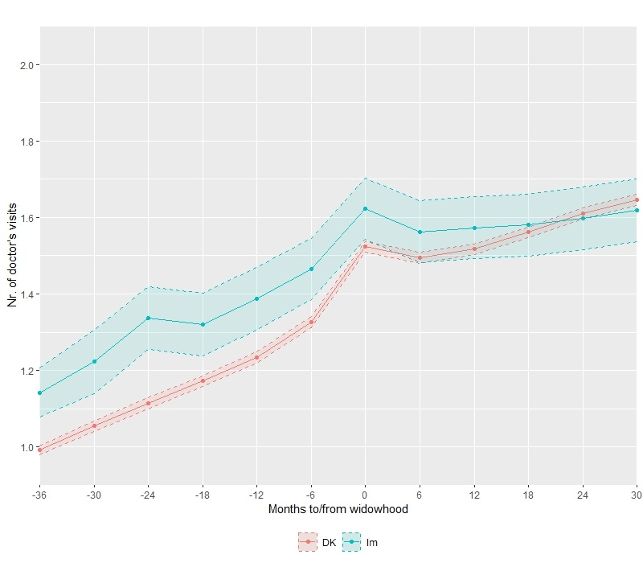
Figure 6: Predicted number of doctor’s visits among men
Adjusted for age, age^2, employment, income
Notes:
The figure shows the predicted number of GP visits 36 months before and after widowhood among native-born and immigrant men. Immigrant men have a higher number of GP visits up until spousal loss compared to the native-born persons. They also have a smaller increase in the number of GP visits post-widowhood which results in a narrower difference or no difference in the number of GP visits post-widowhood between the two groups.

Slide 23
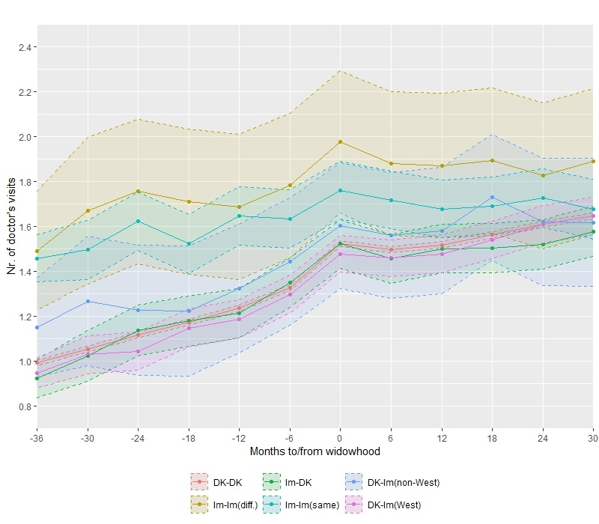
Figure 7: … among men by spouse’s migration background
Notes:
Figure 7 shows the predicted number of GP visits 36 months before and after widowhood among native-born and immigrant men, considering the migration background of their spouses. Immigrant men married to another immigrants from the same country have a higher number of GP visits over the whole observation period, but they also have a smaller increase in the number of GP visits before and especially after widowhood.

Slide 24
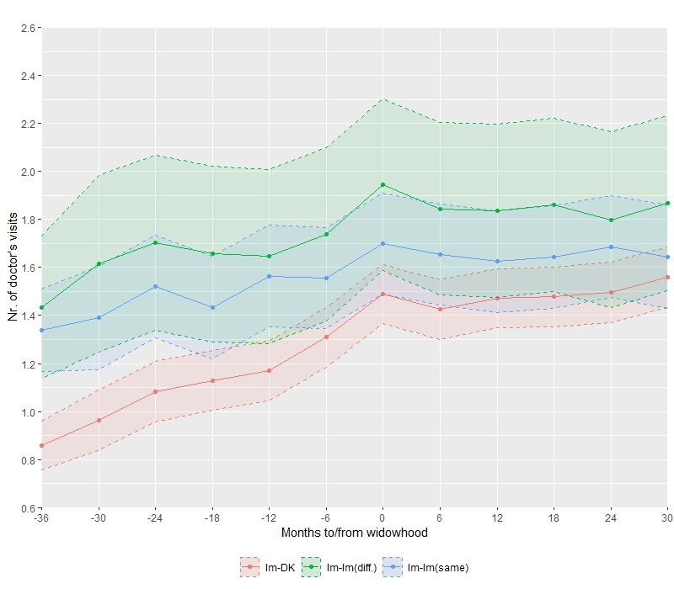
Figure 8: …among immigrant men by spouse’s migration background
Notes:
To get a better understanding of the role of spouses’ migration background, we analyzed the trajectories of GP visits among native-born and immigrant persons separately. I do not show the results for native-born men and women because these trajectories were very similar across all marriage groups among native men. This figure shows the number of GP visits by marriage type (Imm-Nat, Imm-Imm(same), Imm-Imm(diff.)) among immigrant men. Relative to Imm-Nat, immigrant men married to other immigrants from the same country have higher levels of GP visits but they also have a smaller increase in the number of GP visits, especially post-widowhood.

Slide 25
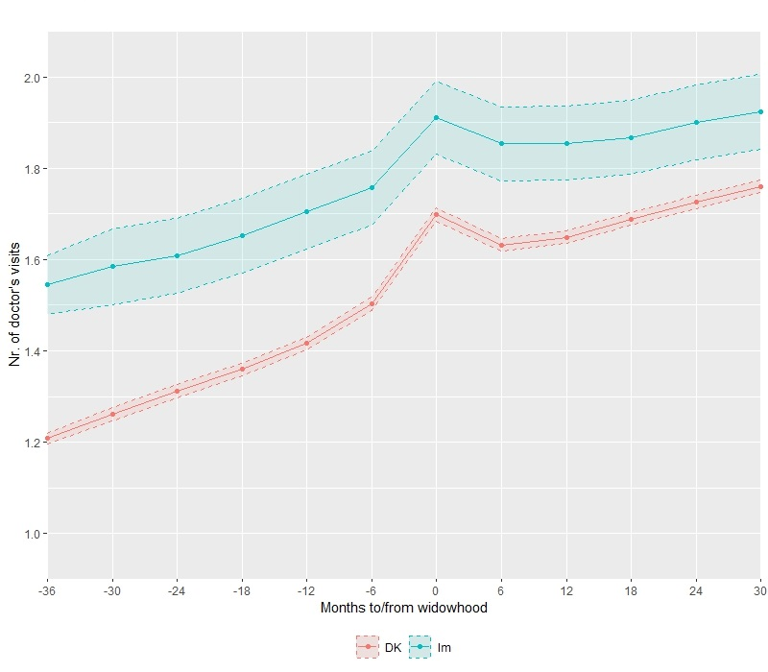
Figure 9: Predicted number of doctor’s visits among women
Notes:
Figure 9 shows the predicted number of GP visits 36 months before and after widowhood among native-born and immigrant women. Similar to the patterns among men, immigrant women have a higher number of GP visits up until spousal loss compared to the native-born women, but they also have higher levels of GP visits post-widowhood. The interaction between years since widowhood and marriage type suggests that immigrant women have a smaller increase in the number of GP visits post-widowhood.

Slide 26
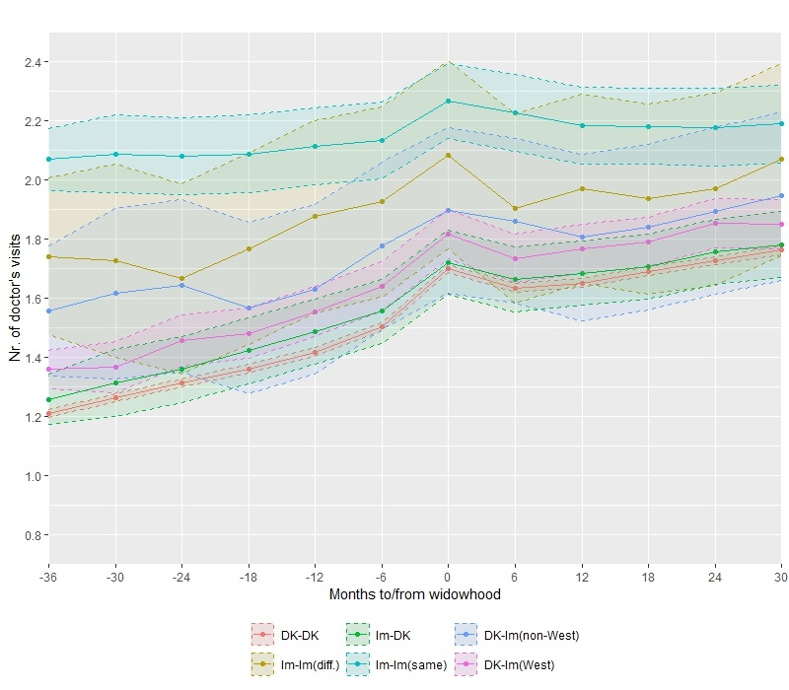
Figure 10: … among women by spouse’s migration background
Notes:
Figure 10 shows the predicted number of GP visits 36 months before and after widowhood among native-born and immigrant men, considering the migration background of their spouses. As among men, immigrant women married to other immigrants from the same country have a higher number of GP visits over the whole observation period, but they also have a smaller increase in the number of GP visits before and especially after widowhood relative to immigrants married to native-born persons. In contrast to men, we observe also a smaller increase in GP visits post-widowhood among immigrant women married to other immigrants from different county.

Slide 27
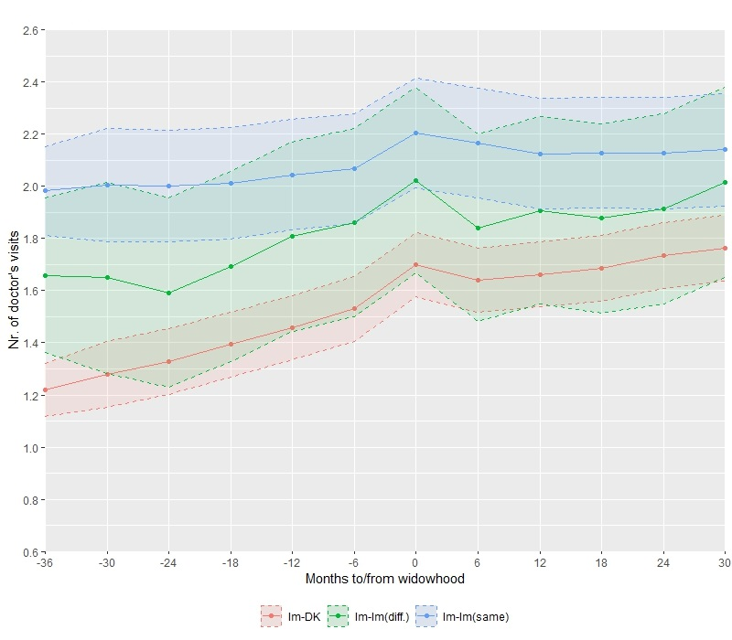
Figure 11: among immigrant women by spouse’s migration background
Notes:
The analysis among native-born women separately again showed that native-born women have similar trajectories of GP visits before and after widowhood, irrespective of who they married. However, as shown in Figure 11, immigrant women married to other immigrants from the same country and from different country have a smaller increase in the number of GP visits after widowhood relative to immigrant women married to Danish men.

Slide 28
Key points: Change in GP visits after widowhood
Widowhood is more detrimental for
immigrant men & women vs. Danish-born peers
immigrant men & women married to other immigrants from the same country vs. immigrant men & women married to native-born peers

Slide 29
First all-cause hospitalization after widowhood
All hospitalizations (1 overnight stay)
Urgent (less likely to be influenced by knowledge of the Danish health care system, language proficiency, spouse’s migration background, etc.)
Planned
Adjusted for age (5-year groups, employment, income)

Slide 30
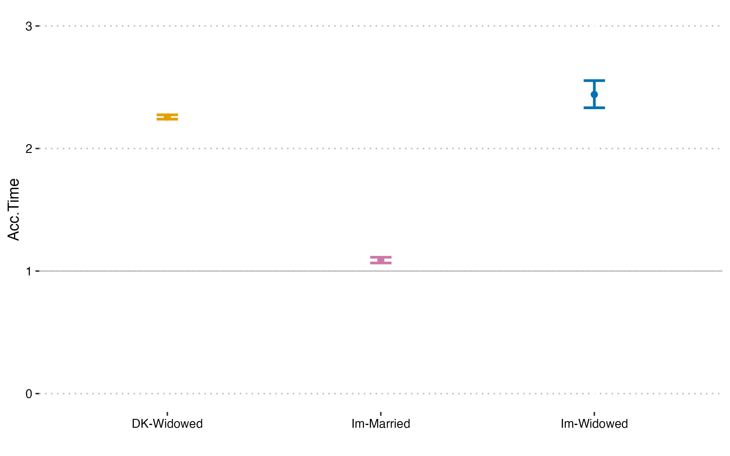
Urgent post-widowhood hospitalization among men

Slide 31
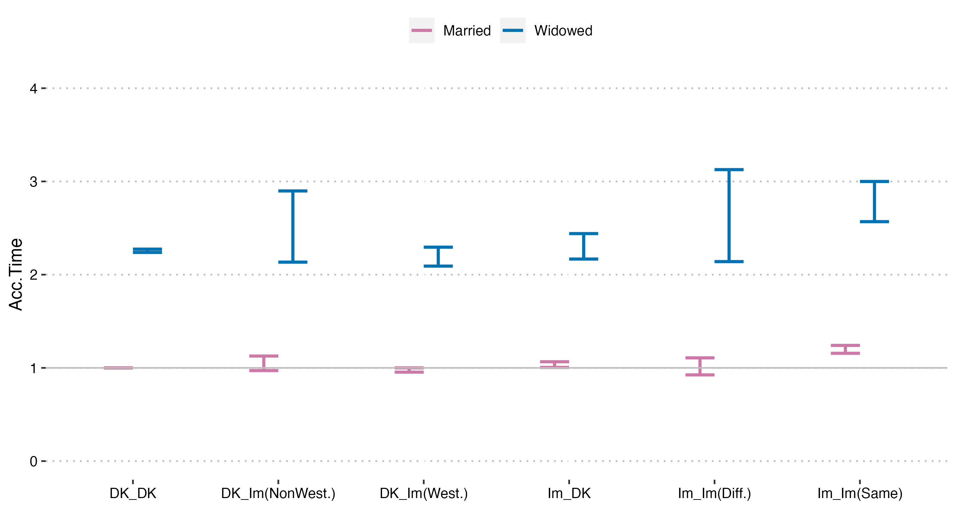
Urgent hospital. by marriage type among men

Slide 32
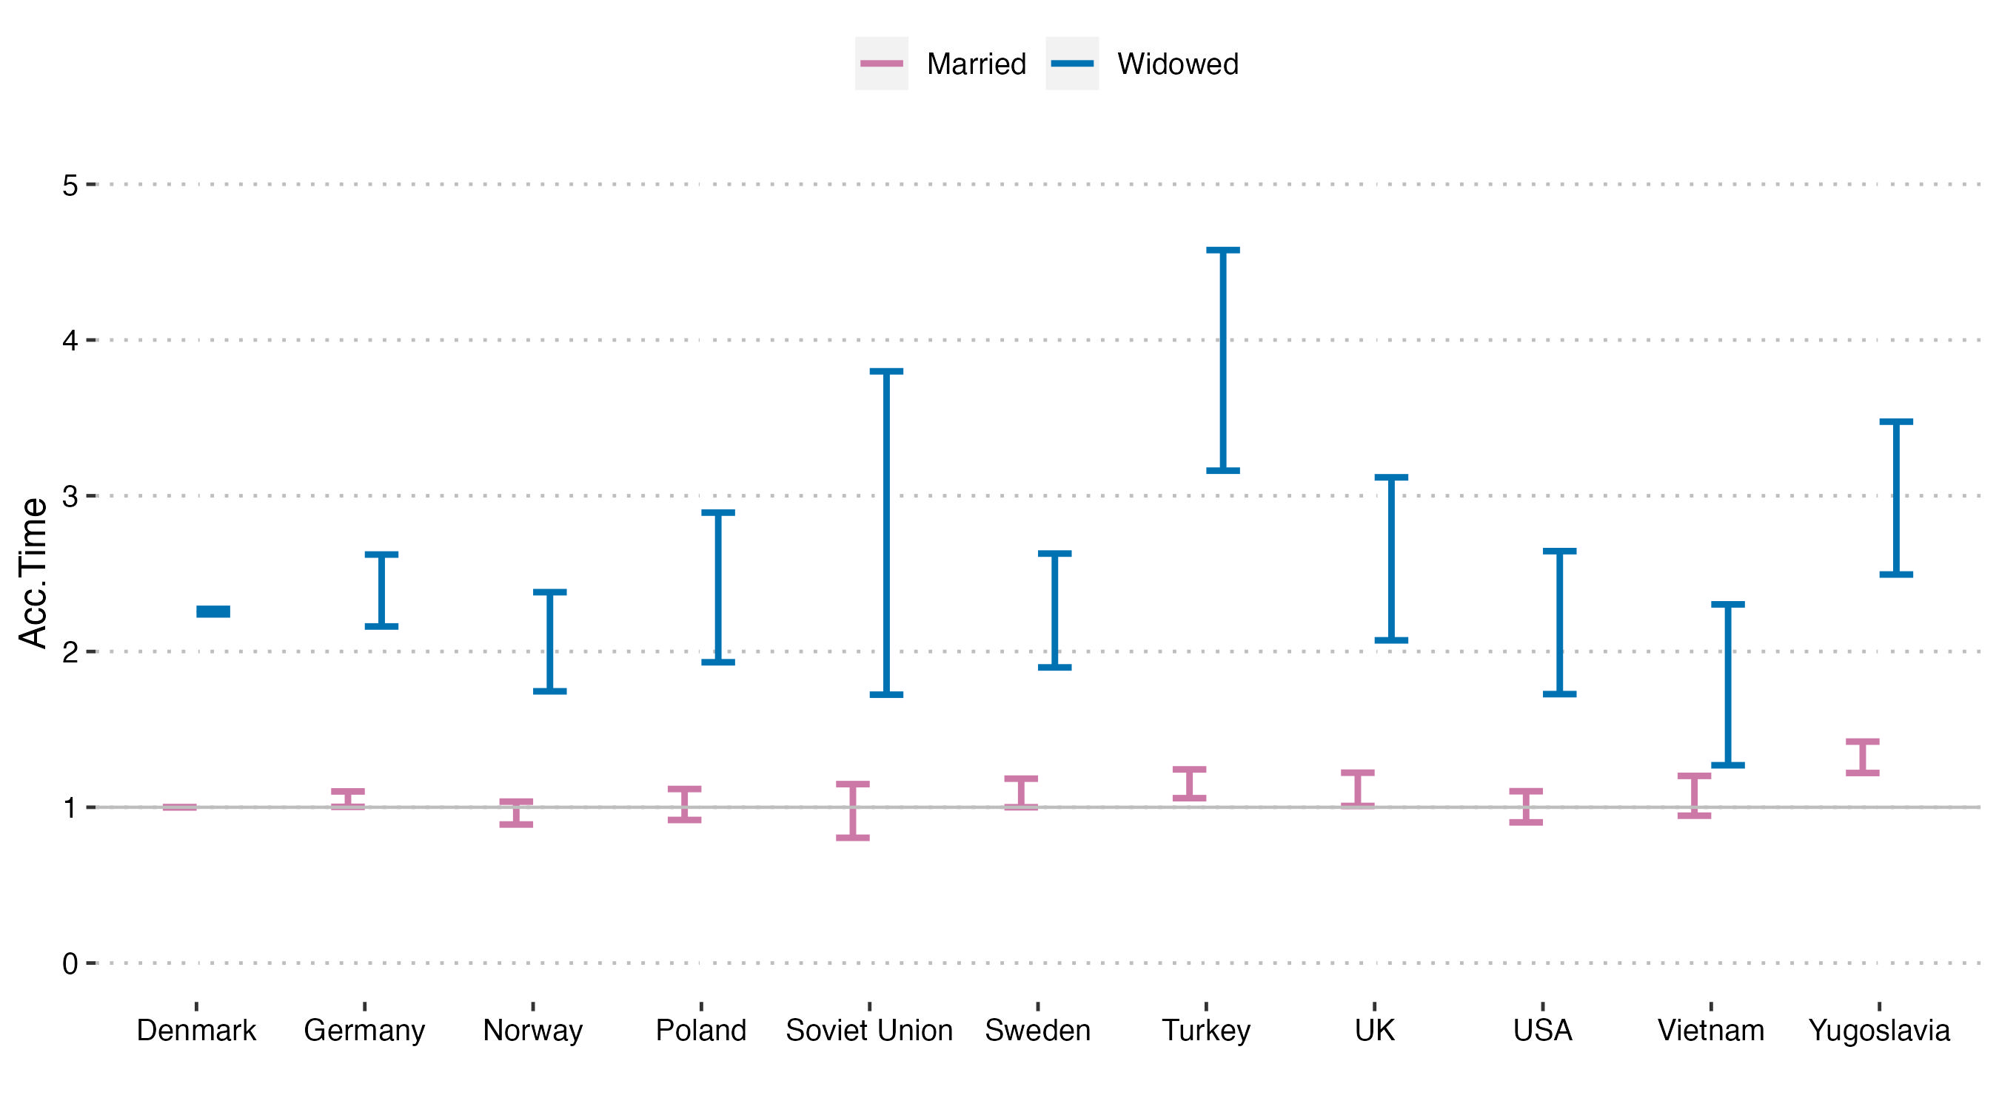
Urgent hospital. by country of birth among men

Slide 33
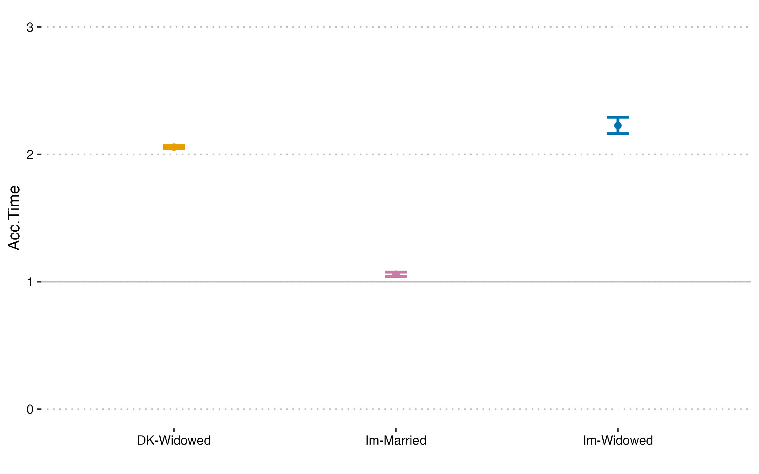
Urgent post-widowhood hospitalizations among women

Slide 34
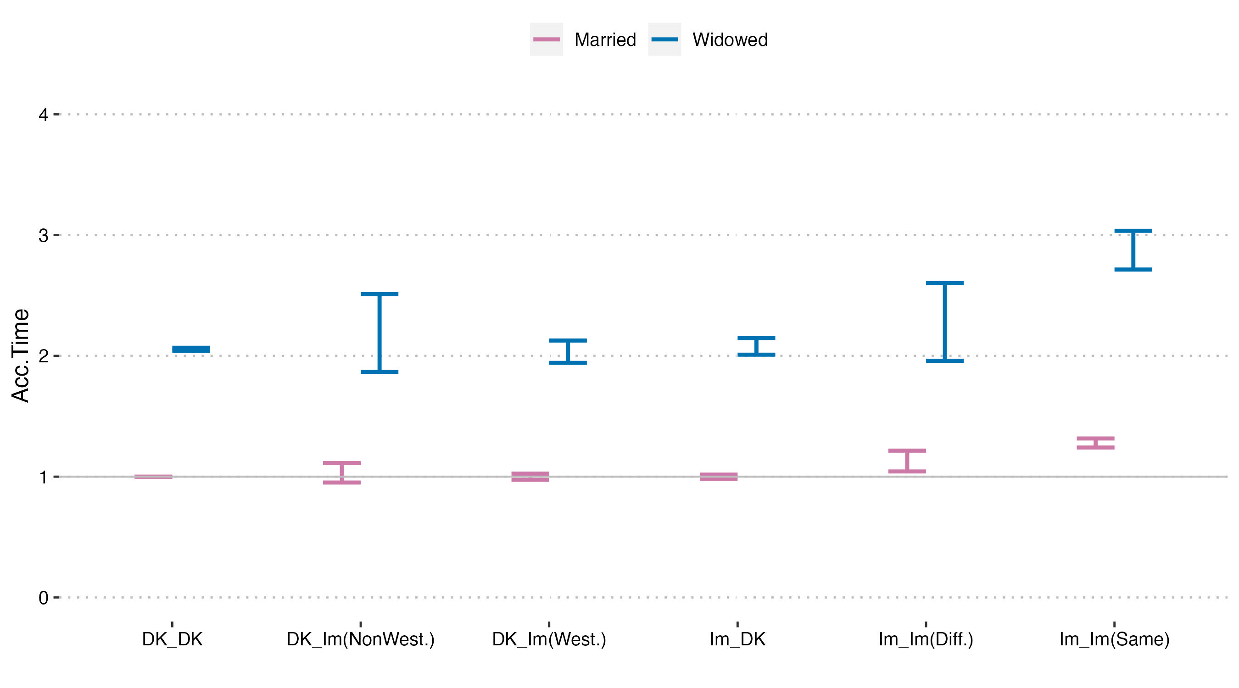
Urgent hospital. by marriage type among women

Slide 35
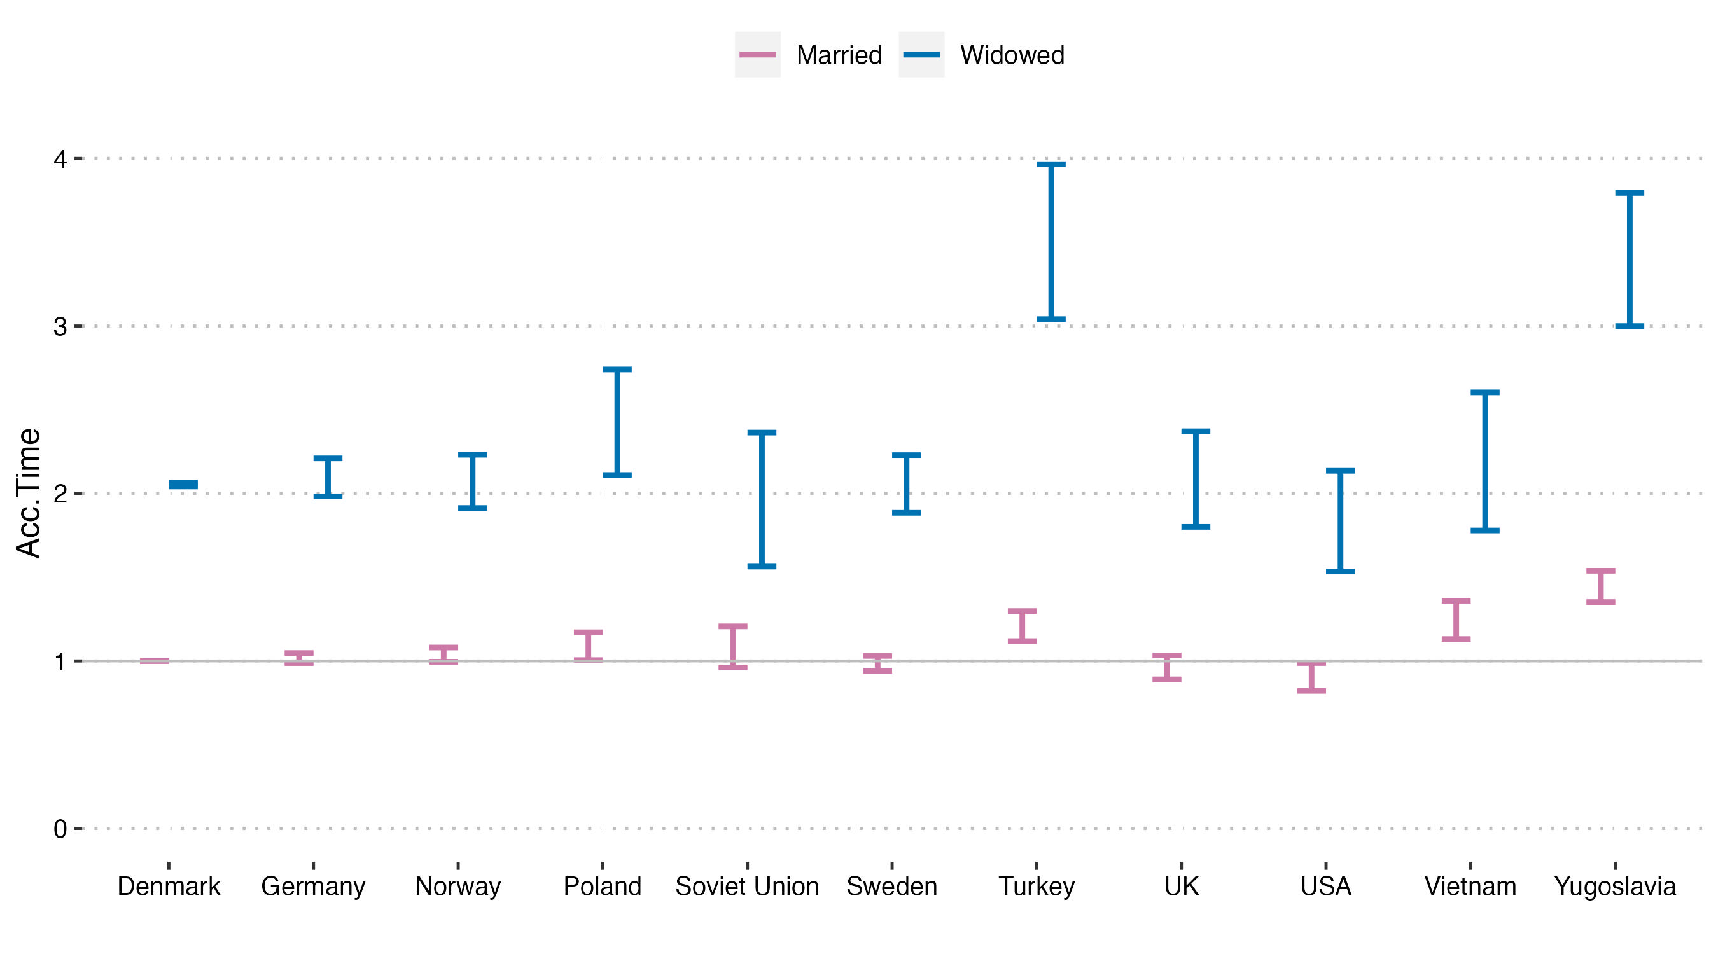
Urgent hospital. by country of origin among women

Slide 36
Key points: post-widowhood urgent hospitalization
Widowhood is related to a higher risk of hospitalization among:
Immigrant men and women
Widowed men and women in the Imm-Imm(same) marriages vs. DK-DK (and vs. Im-DK) marriages
Widowed men & women from Turkey vs. Danish widowed women & men (and vs. Im-DK widowed men & women)

Slide 37
Outlook: Immigrants vs. Native-born persons
A major life event and mental health
Treatment seeing behavior/access to healthcare: Waiting time to get a hospital treatment
By country of origin?
By marriage type?

Slide 38
LINKED LIVES:
CONSEQUENCES OF LONG COMMUTING FOR THE HEALTH OF ALL FAMILY MEMBERS
COMFAM

Slide 39
Additional slides

Slide 40
Motivation: Immigrants’ potentially heightened vulnerability to the widowhood effect
Cultural beliefs about death and bereavement
(Rosenblatt, 2001)
Discontinuities between personal and local mourning rituals
(Kokou-Kpolou et al., 2017; Saito, 2014)
Notes:
Although quantitative analyses are nearly absent, there are reasons to expect that widowhood may be especially detrimental for some immigrants.

Slide 41
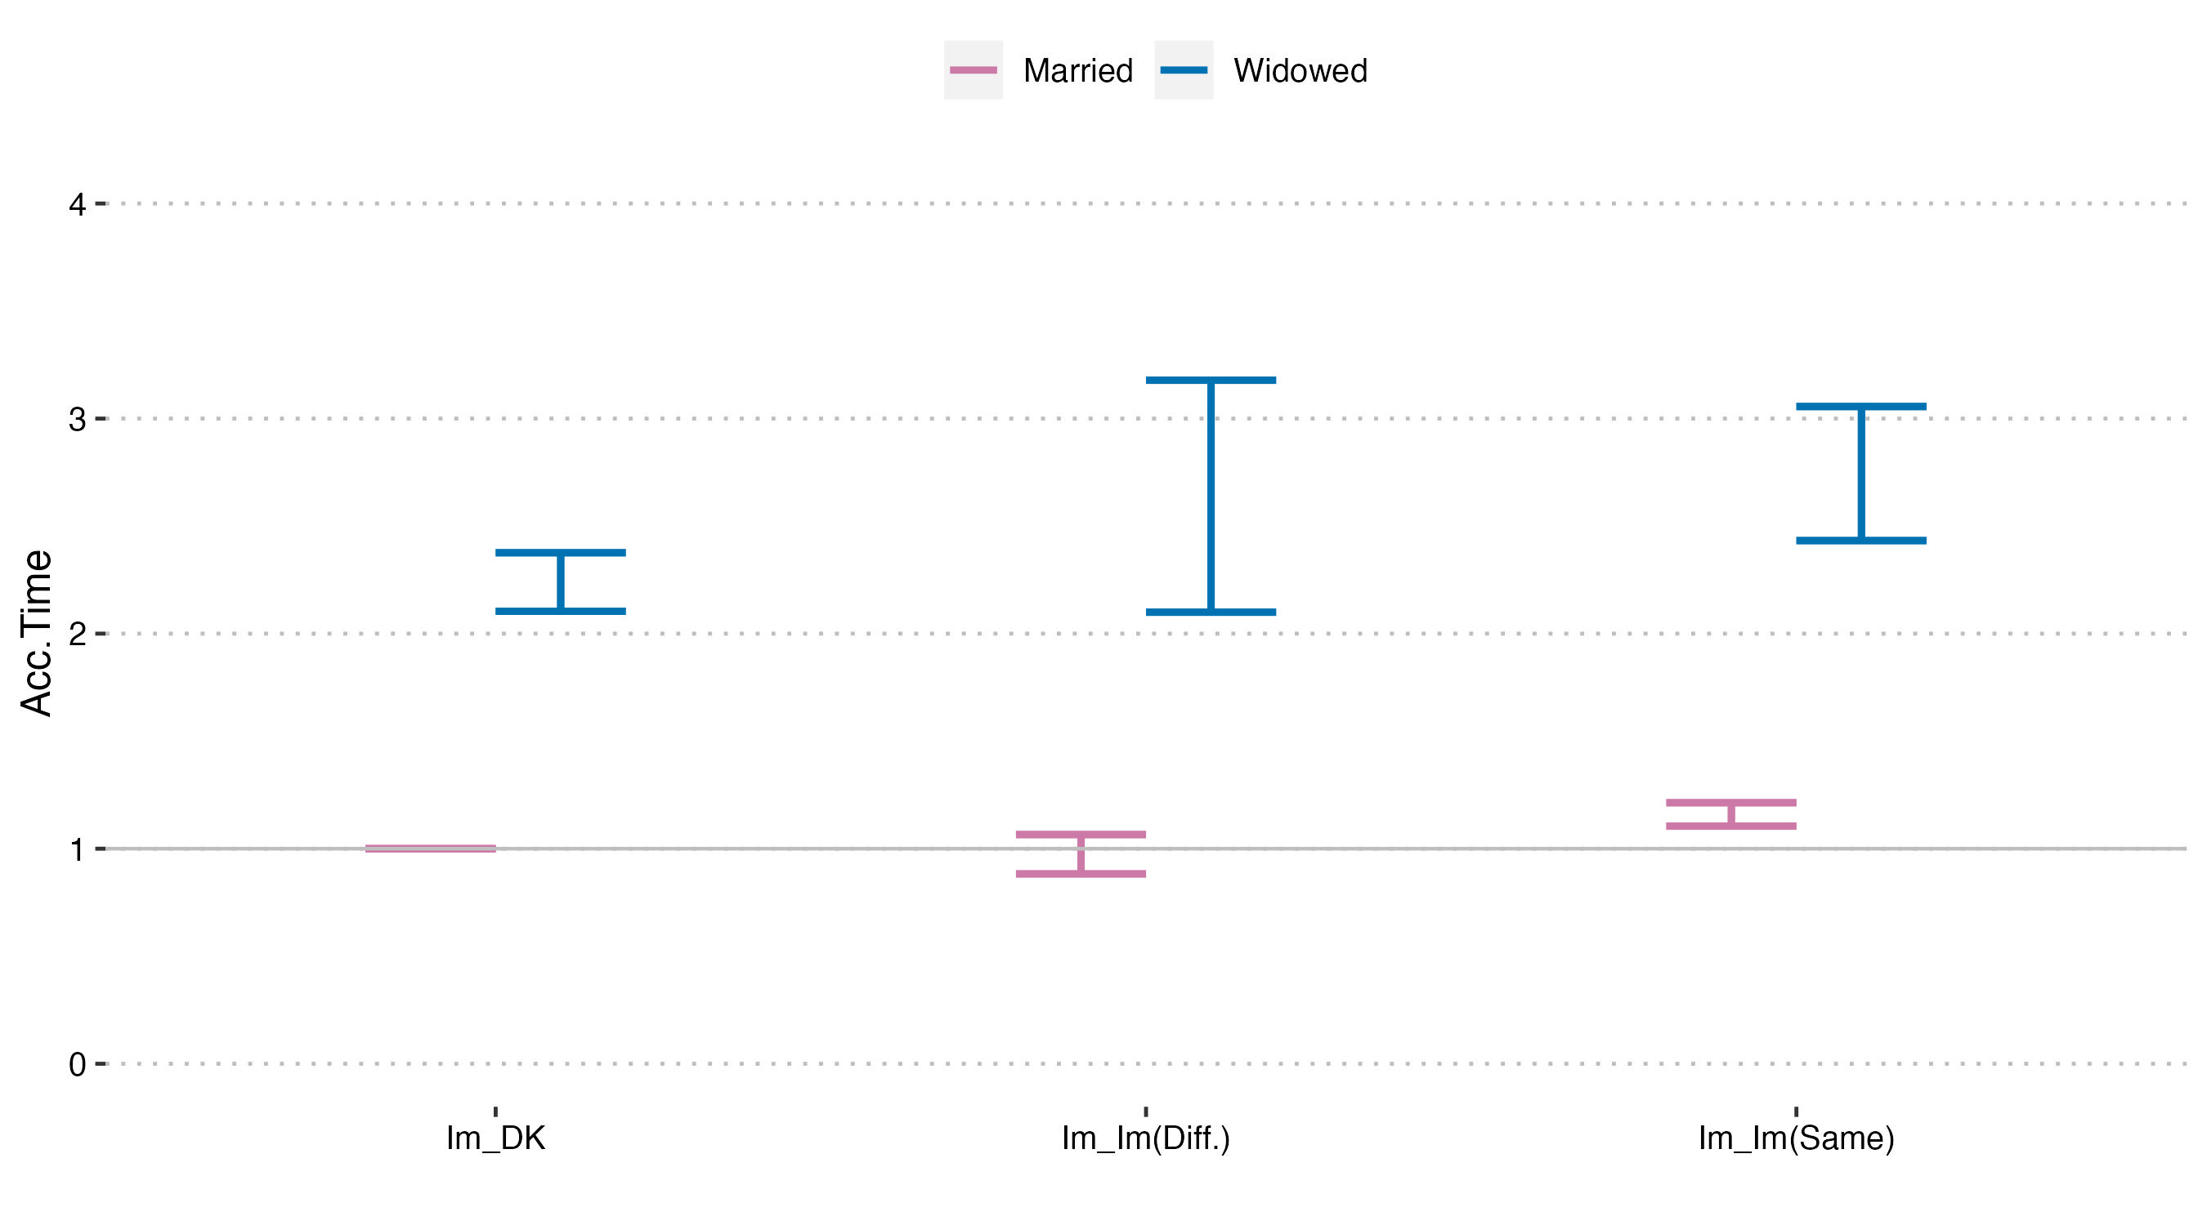
… by marriage type among immigrant men

Slide 42
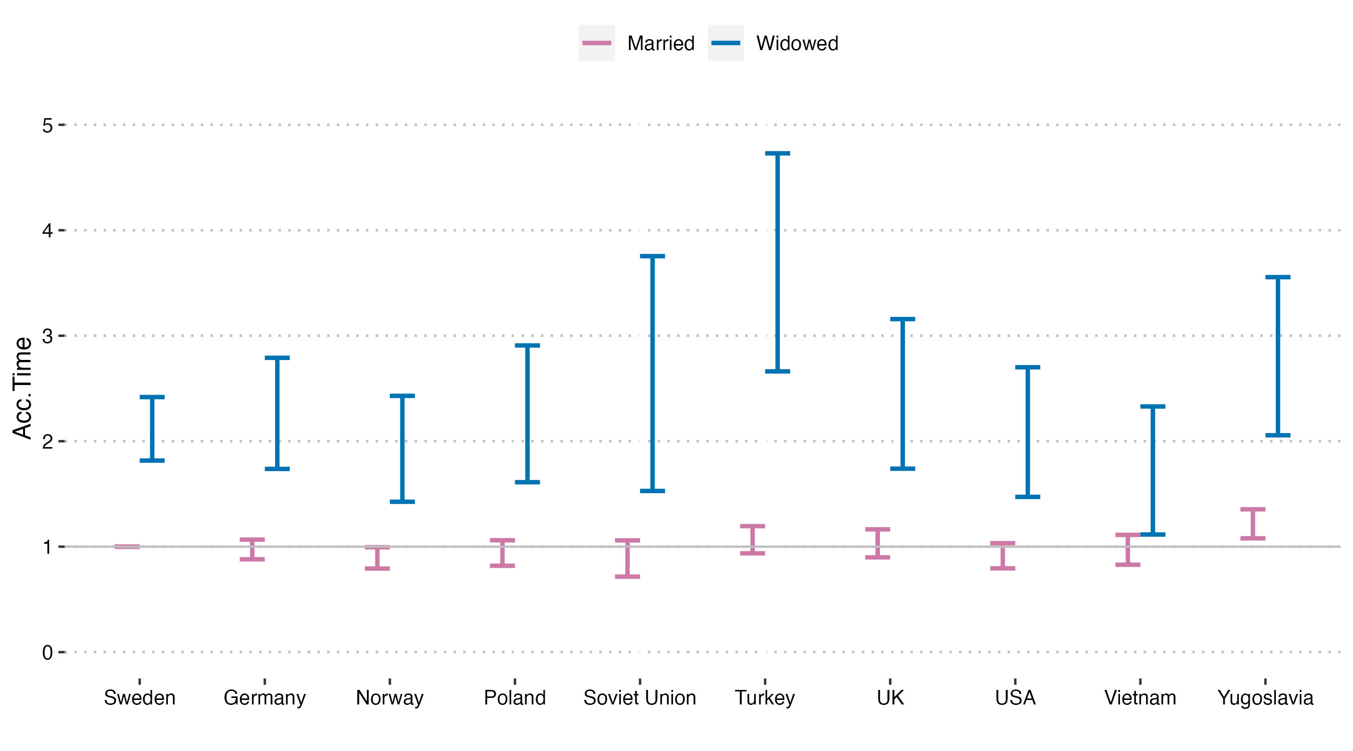
… by country-of-origin among immigrant men

Slide 43
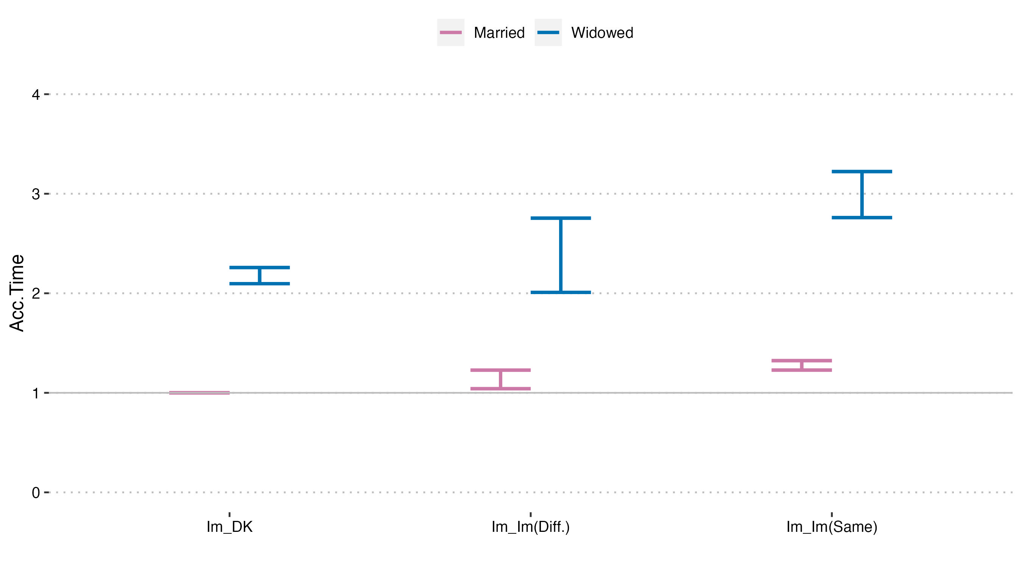
… by marriage type among immigrant women

Slide 44
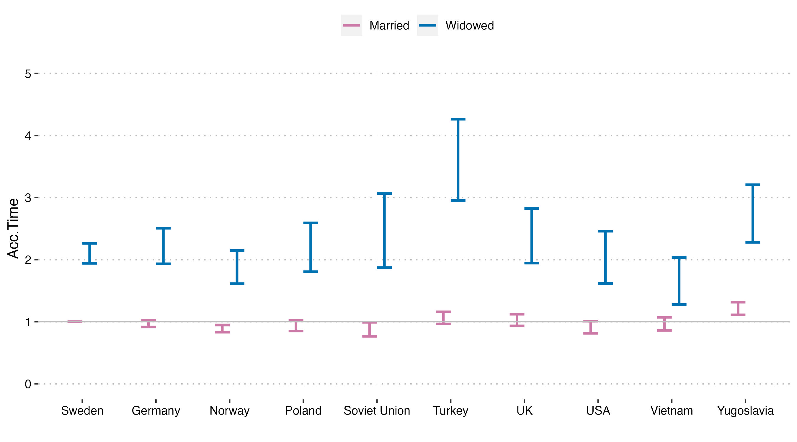
… by country-of-origin among immigrant women

