Slide 1
Mortality and Inequality Revisited
Jon Anson
Dept. of Social Work
Ben-Gurion University of the Negev
Beer Sheva, Israel
HMMWG workshop, Luxembourg, 10-12 September, 2025
LIVING LONGER, LIVING BETTER? INEQUALITY IN HEALTH AND LONGEVITY

Slide 2
A no brainer?
The more unequal a society, the higher the level of mortality and the younger the average at death. Really?

Slide 3
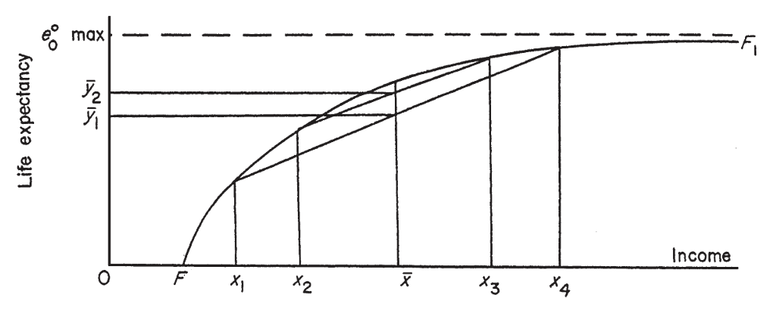
Life expectancy as a function of income and inequality
From Rodgers, 2002, p534.

Slide 4
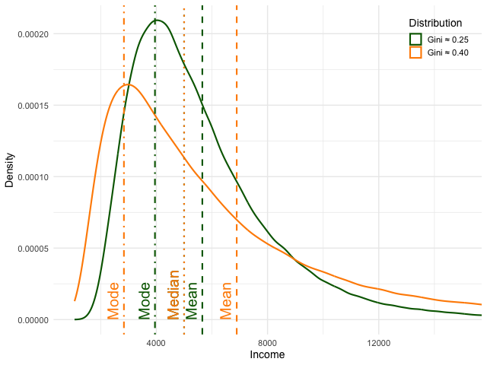
Income distributions with low and high inequality (Gini)
Figure courtesy of ChatGPT

Slide 5
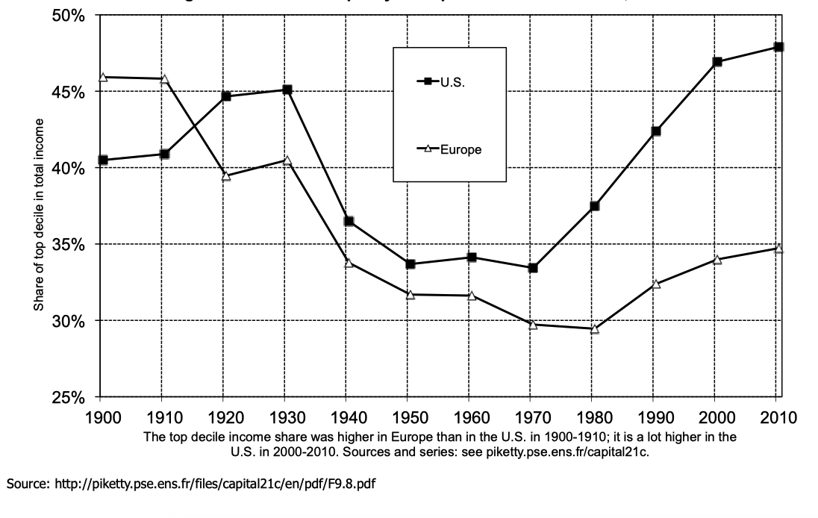
Changing inequality in the USA and Europe

Slide 6
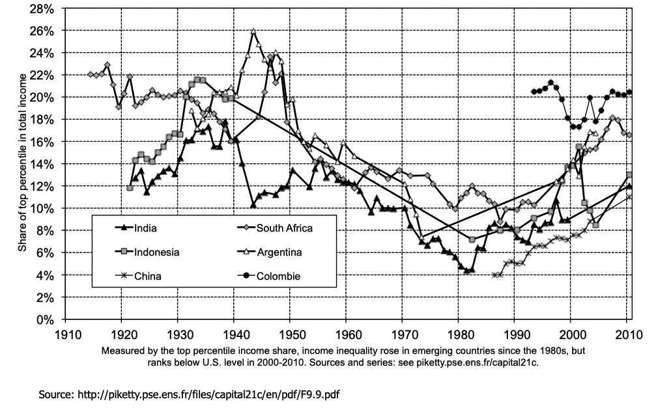
Changing Inequality in Less Developed Countries

Slide 7
Data and Sources
Mortality: OECD
Social and Economic Data: World Bank
Governance: V-Dem Institute
Years: 1990 to 2022
Countries: 45

Slide 8
Multilevel model of life expectancy, null model
Fixed effects | Estimate | Standard Error | z
Intercept | 81.3 | 0.528 | 154
Sex (Male = 1) | -6.42 | 0.278 | -23.1
Random Effects | Variance | N | Deviance
Country:Female | 6.78 | 45 | 9602
Country:Male | 15.9
Year | 4.18 | 33 | df
Residual | 1.49 | 2790 | 2783

Slide 9
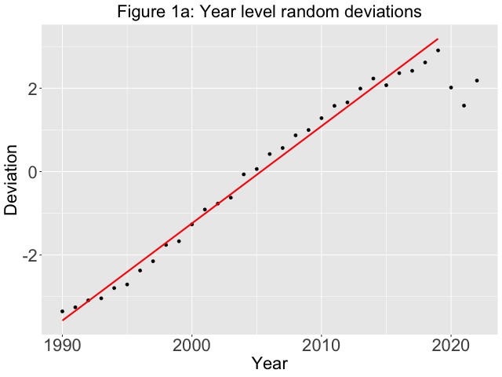
Year Level Random Deviations

Slide 10
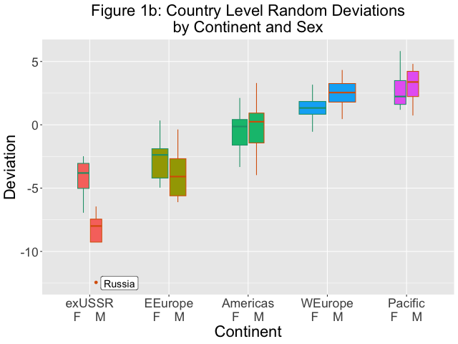
Country Level Random Deviations, by Sex and Continent

Slide 11
Baseline model, Year and Continent as fixed effects
 | Females |  |  | Males
Variable | Estimate | Standard Error | z | Estimate | Standard Error | z
Intercept | 82.9 | 0.310 | 267 | 77.5 | 0.337 | 230
Year | 0.202 | 0.00395 | 51.2 | 0.267 | 0.00398 | 67.0
Covid | -1.66 | 0.132 | 12.6 | -1.81 | 0.132 | -12.6
Western Europe | 1 |  |  | 1
Pacific Rim | 1.49 | 0.789 | 1.88 | 0.604 | 0.860 | 0.702
Americas | -1.94 | 0.632 | -3.06 | -2.73 | 0.688 | -3.97
Eastern Europe | -4.17 | 0.599 | -6.95 | -6.34 | 0.653 | -9.71
exUSSR | -5.58 | 0.790 | -7.06 | -11.3 | 0.861 | -13.1
Random Effects | Variance | N | Deviance
Country: Females | 2.06 | 45 | 9210
Country: Males | 2.46 |  | df
Residual | 1.43 | 2790 | 2772

Slide 12
Multilevel model of life expectancy, with Control variables
 | Females |  |  | Males
Variable | Estimate | Standard Error | z | Estimate | Standard Error | z
Intercept | 82.6 | 0.329 | 251 | 77.2 | 0.336 | 230
GDPc | 53.4 | 19.0 | 2.82 | 68.9 | 19.3 | 3.56
Total Fertility | 0.689 | 0.166 | 4.15 | 1.43 | 0.165 | 8.65
Matriculation | 0.184 | 0.108 | 1.70 | 0.190 | 0.109 | 1.74
(Year and Continent effects removed)
Random Effects | Variance | N | Deviance | Gain
Country: Females | 2.12 | 45 | 9081 | 521
Country: Males | 2.20 |  | df
Residual | 1.37 | 2790 | 2766 | 17

Slide 13
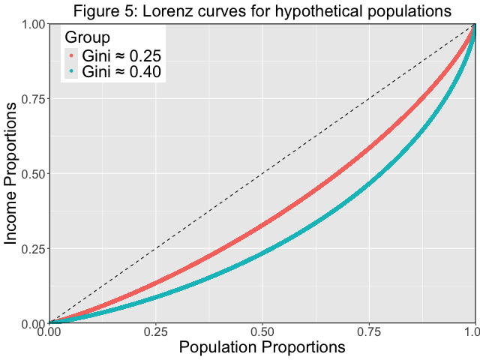
Lorenz Curves for Hypothetical Populations

Slide 14
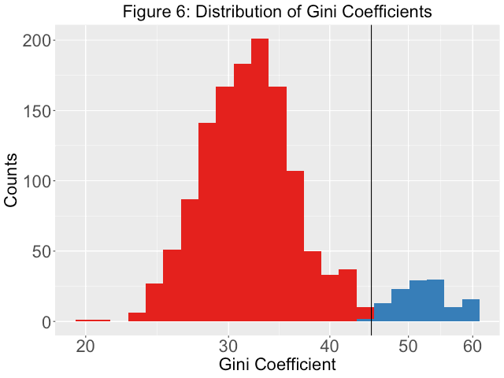
Distribution of Gini Coefficients

Slide 15
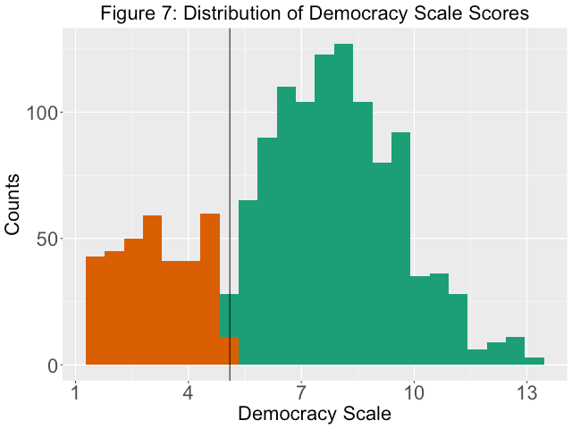
Distribution of Democracy Scores

Slide 16
 |  | Female |  |  | Male
 | Estimate | Std.Error | z-value | Estimate | Std.Error | z-value
Intercept | 82.0 | 0.362 | 226.49 | 76.6 | 0.364 | 210.80
(Coefficients for Year, Continent and Socio-Economic Variables removed)
Inequality: Baseline = Low
Medium Low | 0.127 | 0.109 | 1.16 | 0.174 | 0.111 | 1.57
Medium High | 0.00927 | 0.132 | 0.07 | 0.0295 | 0.133 | 0.22
High | -0.0539 | 0.169 | -0.32 | -0.434 | 0.167 | -2.6
Democracy:Low
Medium Low | 0.478 | 0.147 | 3.25 | 0.373 | 0.147 | 2.53
Medium High | 0.673 | 0.172 | 3.91 | 0.554 | 0.172 | 3.21
High | 0.866 | 0.186 | 4.65 | 0.981 | 0.187 | 5.26
 | Deviance | df |  | Variance | Model | Null
Null Deviance | 9602 | 2783 |  | Country: female | 2.063 | 6.78
Model Deviance | 9012 | 2754 |  | Country:male | 2.085 | 15.90
Gain | 69 | 8 |  | Residual | 1.334 | 1.49

Slide 17
What happened?
The logic is faultless
Inequality has negative social effects
Inequality reduces life expectancy.
Should be self-evident!
BUT
The data do not corroborate the theory!
Why not?

Slide 18
Explanations
The logic, and the theory, are wrong. There really is no relation between the degree of social inequality and the level of mortality in the population.
Unlikely: Too committed to the idea that social inequality is bad for people.
2. The statistical model is wrong. It’s there, but we can’t see it
Also unlikely: No real bivariate relation

Slide 19
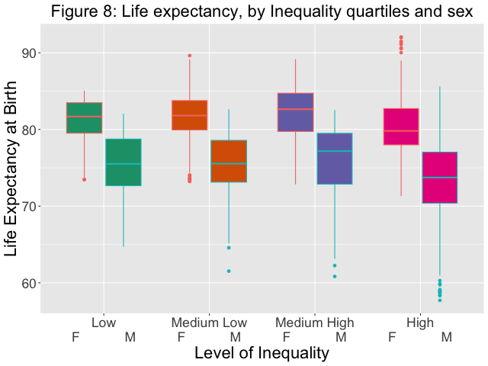
Life Expectancy, by Inequality quartiles and Sex

Slide 20
Lag models?
Collected data problematic?

Slide 21
Measures of Inequality
Gini measures individual gross income from work
  Need net income
  From all sources
  By household
2. Inequality is multidimensional
Material capital (income, housing, amenities)
Cultural capital (education)
Social capital (networks, ethnicities)

Slide 22
Conclusion
Argument compelling, results, at best, inconclusive
Need to clarify meaning of inequality
Compute from the ground up, not rely on off-the-shelf measures designed for a different analysis
Combine with information on regime type. As important, if not more so
Luxembourg (home of LIS) good place to start!

Slide 23

Thank you
Vilmools Merci
Questions? Comments?
anson@bgu.ac.il

