Slide 1


European Association of Population Studies
Health, Morbidity and Mortality Working Group 2025 Annual Meeting
LIVING LONGER, LIVING BETTER? INEQUALITY IN HEALTH AND LONGEVITY
Organized by the University of Luxembourg
in collaboration with EAPS, Prague University of Economics and Business, Charles University, and Ben Gurion University
September 10-12, 2025, Belvas Campus
Great Recession, health, and inequality in Europe: reassessing the Thomas Effect at the individual level
Presenter: Gianni Carboni¹ (gcarboni3@uniss.it)
A cowork with Giovanni Busetta², Marcantonio Caltabiano², Maria Gabriella Campolo², Gabriele Ruiu¹, Giambattista Salinari¹, Alessandra Trimarchi²
¹ University of Sassari
² University of Messina
Notes:
The main object of my study is…

Slide 2
European Association of Population Studies
Health, Morbidity and Mortality Working Group 2025 Annual Meeting
LIVING LONGER, LIVING BETTER? INEQUALITY IN HEALTH AND LONGEVITY
Organized by the University of Luxembourg
in collaboration with EAPS, Prague University of Economics and Business, Charles University, and Ben Gurion University
September 10-12, 2025, Belvas Campus
Great Recession, health, and inequality in Europe: reassessing the Thomas Effect at the individual level
Presenter: Gianni Carboni¹ (gcarboni3@uniss.it)
A cowork with Giovanni Busetta², Marcantonio Caltabiano², Maria Gabriella Campolo², Gabriele Ruiu¹, Giambattista Salinari¹, Alessandra Trimarchi²
¹ University of Sassari
² University of Messina

Slide 3

Background
What’s the Thomas Effect?
(also called the Healthy Recession Paradox)

Slide 4
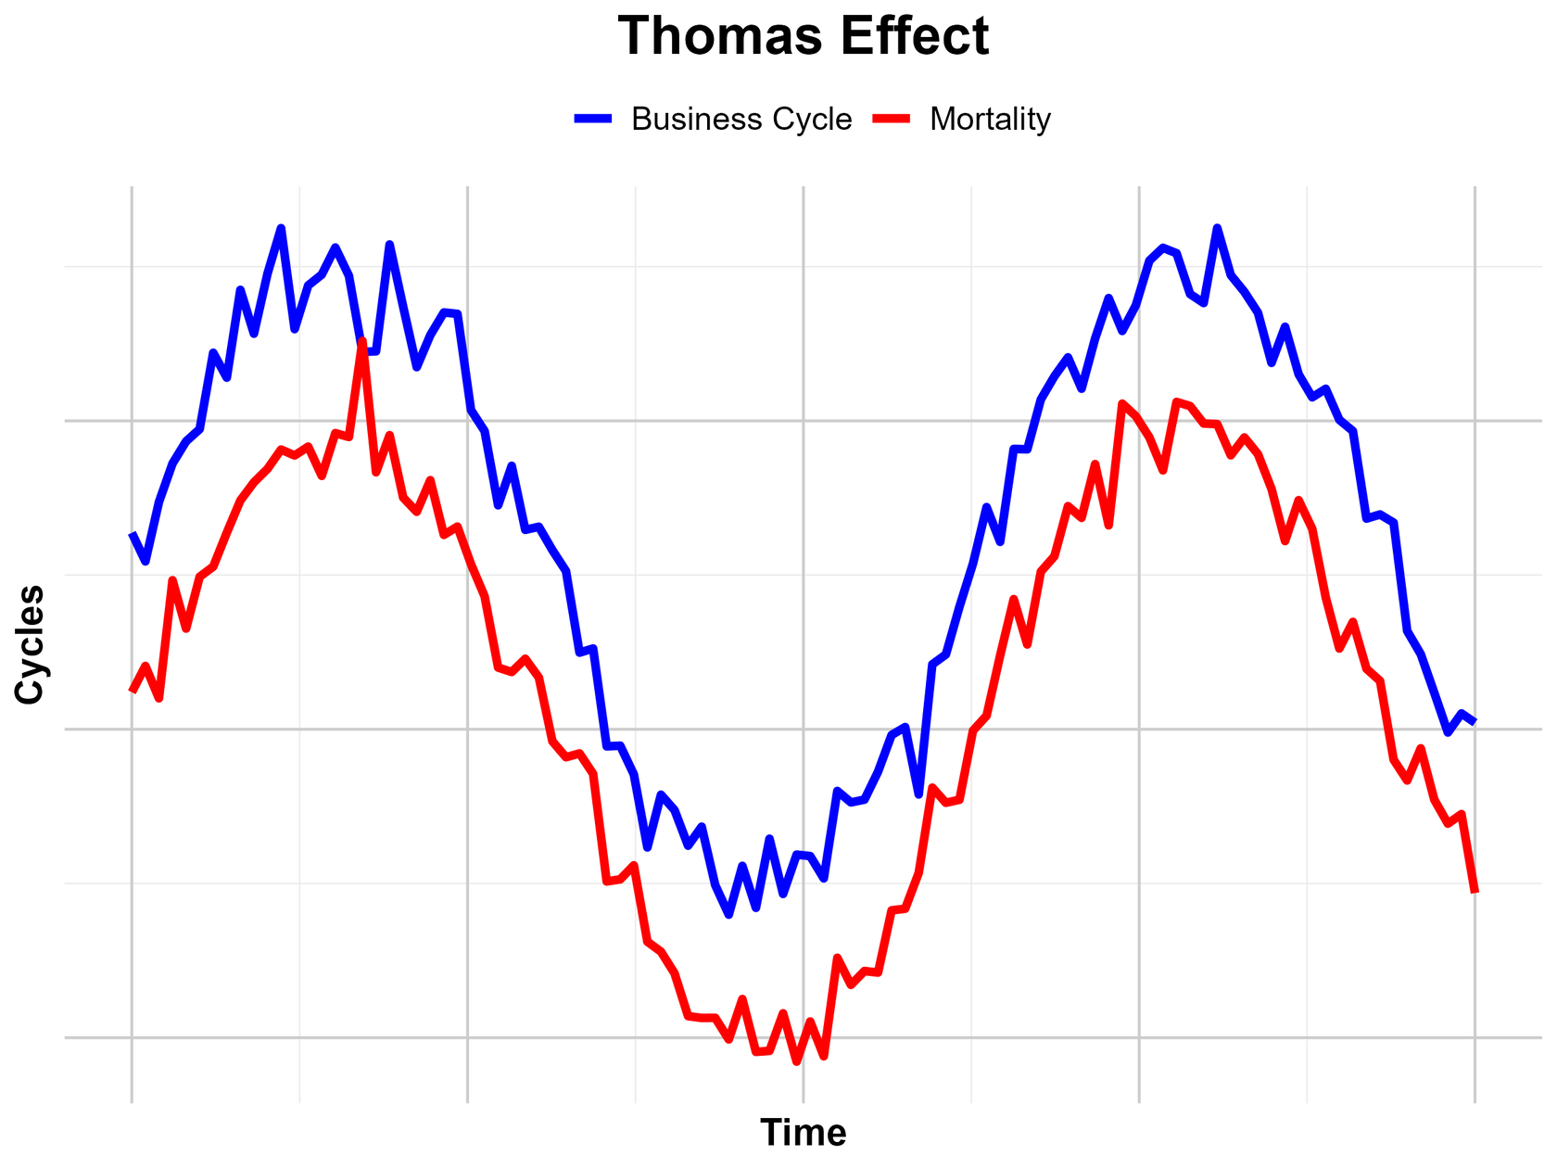


Thomas Effect (Ogburn and Thomas, 1922)
mortality
business cycle

Slide 5
Thomas Effect (Ogburn and Thomas, 1922)
mortality
business cycle

Slide 6
Thomas Effect (Ogburn and Thomas, 1922)
mortality
business cycle

Slide 7

Are crises beneficial for public health?
business cycle mortality
business cycle mortality
(just some) supporting literature (Eyer 1977; Ruhm 2000; Neumayer 2004; Tapia Granados 2005 2012, 2008; Gerdtham and Ruhm 2006; Buchmueller et al. 2007; Tapia Granados and Ionides 2008; Lin 2009; Tapia Granados and Diez Roux 2009; Ariizumi and Schirle 2012; Greenaway-McGrevy 2021; Cervini-Plá and Vall-Castelló 2021)
(and some) skeptical literature (Catalano and Bellows 2005; Falagas 2009; Stuckler et al. 2009; Kentikelenis et al. 2011; Stuckler and Basu 2013; Karanikolos et al. 2013; Brüning and Thuilliez, 2019; Sun et al. 2021)

Slide 8
Are crises beneficial for public health?
business cycle mortality
business cycle mortality
(just some) supporting literature (Eyer 1977; Ruhm 2000; Neumayer 2004; Tapia Granados 2005 2012, 2008; Gerdtham and Ruhm 2006; Buchmueller et al. 2007; Tapia Granados and Ionides 2008; Lin 2009; Tapia Granados and Diez Roux 2009; Ariizumi and Schirle 2012; Greenaway-McGrevy 2021; Cervini-Plá and Vall-Castelló 2021)
(and some) skeptical literature (Catalano and Bellows 2005; Falagas 2009; Stuckler et al. 2009; Kentikelenis et al. 2011; Stuckler and Basu 2013; Karanikolos et al. 2013; Brüning and Thuilliez, 2019; Sun et al. 2021)
What about the Great Recession? Some confermative causal approach results: Salinari and Benassi (2022); Carboni (2023); Finkelstein et al. (2025)

Slide 9
How could this be possible?
(Catalano et al. 2011; Ruhm 2000, 2016; Tapia Granados 2005; Finkelstein et al. 2025)
Reducing of
air pollution
work and car accidents
the spread of transmittable diseases
Crises induce people to
abandon unhealthy (and costly!) habits such as smoking and drinking
and to increase the time they devote to physical activity, sport, and medical care

Slide 10
Our contribution
The majority of scholars who have so far investigated the Thomas Effect in causal terms, have done it on a macro level.
Why should this be a problem?
Ecological fallacy: population-level associations do not necessarily hold at the individual level.
Policy relevance: micro-level evidence is crucial for effective policy design.
Mechanism identification: understanding behavioral and health changes requires individual-level data.

Slide 11
Our contribution
We move from macro-level to individual-level
We exploit the SHARE (Survey of Health, Ageing and Retirement in Europe) dataset, analyzing health outcomes of individuals
We focus on the Great Recession in Europe as a natural experiment

Slide 12
Research question
Does the Thomas Effect hold at the individual level in European 50+ population during the Great Recession?

Slide 13
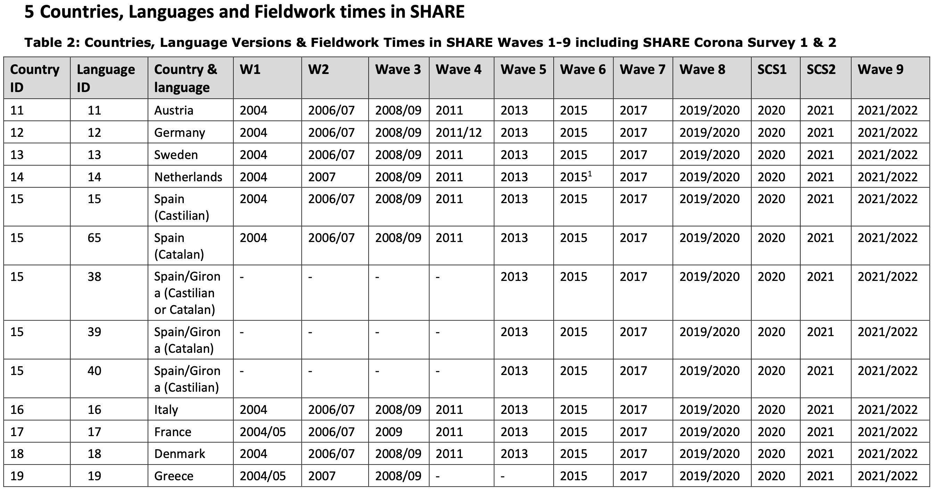
SHARE data
Pag 9. of SHARE Release Guide 9.0.0

Slide 14
SHARE data
Retrospective waves
Pag 9. of SHARE Release Guide 9.0.0

Slide 15



SHARE data
Retrospective waves
’effective’ waves
Pag 9. of SHARE Release Guide 9.0.0

Slide 16
Treatment definition
(inspired from Tapia Granados and Ionides, 2017)
Retrospective waves (3 and 7)
individuals' residence history

Slide 17
Treatment definition
(inspired from Tapia Granados and Ionides, 2017)
Retrospective waves (3 and 7)
attribution of NUTS2 or NUTS1 as appropriate
individuals' residence history

Slide 18
Treatment definition
(inspired from Tapia Granados and Ionides, 2017)
Retrospective waves (3 and 7)
attribution of NUTS2 or NUTS1 as appropriate
link to Eurostat unemployment data
individuals' residence history

Slide 19
Treatment definition
(inspired from Tapia Granados and Ionides, 2017)
Retrospective waves (3 and 7)
attribution of NUTS2 or NUTS1 as appropriate
link to Eurostat unemployment data
individuals' residence history
computation of the tertiles of 2007-2010 change in unemployment rate

Slide 20
Treatment definition
(inspired from Tapia Granados and Ionides, 2017)
Retrospective waves (3 and 7)
attribution of NUTS2 or NUTS1 as appropriate
link to Eurostat unemployment data
individuals' residence history
Group 1: No crisis/mild form
Tertile 1
computation of the tertiles of 2007-2010 change in unemployment rate
Group 2: Moderate crisis
Tertile 2
Group 3: Severe crisis
Tertile 3

Slide 21
Treatment definition
(inspired from Tapia Granados and Ionides, 2017)
Retrospective waves (3 and 7)
attribution of NUTS2 or NUTS1 as appropriate
link to Eurostat unemployment data
individuals' residence history
Control group
Group 1: No crisis/mild form
Tertile 1
computation of the tertiles of 2007-2010 change in unemployment rate
Group 2: Moderate crisis
Tertile 2
Treatment group
Group 3: Severe crisis
Tertile 3

Slide 22
SHARE data
Therefore, one of the main requirements is that the individual must reside in a NUTS that belongs to a country that has participated in all waves 1-7
X
X

Slide 23
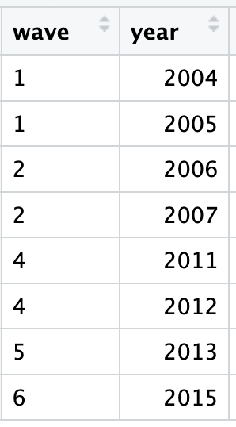
At the end…
10 countries
    Austria
    Belgium (Flemish & French)
    Denmark
    France
    Germany
    Italy
    Netherlands
    Spain
    Sweden
    Switzerland (French & German & Italian)
103 NUTS (30 NUTS1 and 73 NUTS2)
41,909 individuals
121,741 observations

Slide 24
Difference in Differences approach
Overall effect
$$y_{it}=α+φ_{nuts}+λ_{t}+δ\left({\text{Treated}}_{i} × {\text{Crisis}}_{t}\right)+{X′}_{it}γ+ε_{it}$$

Slide 25
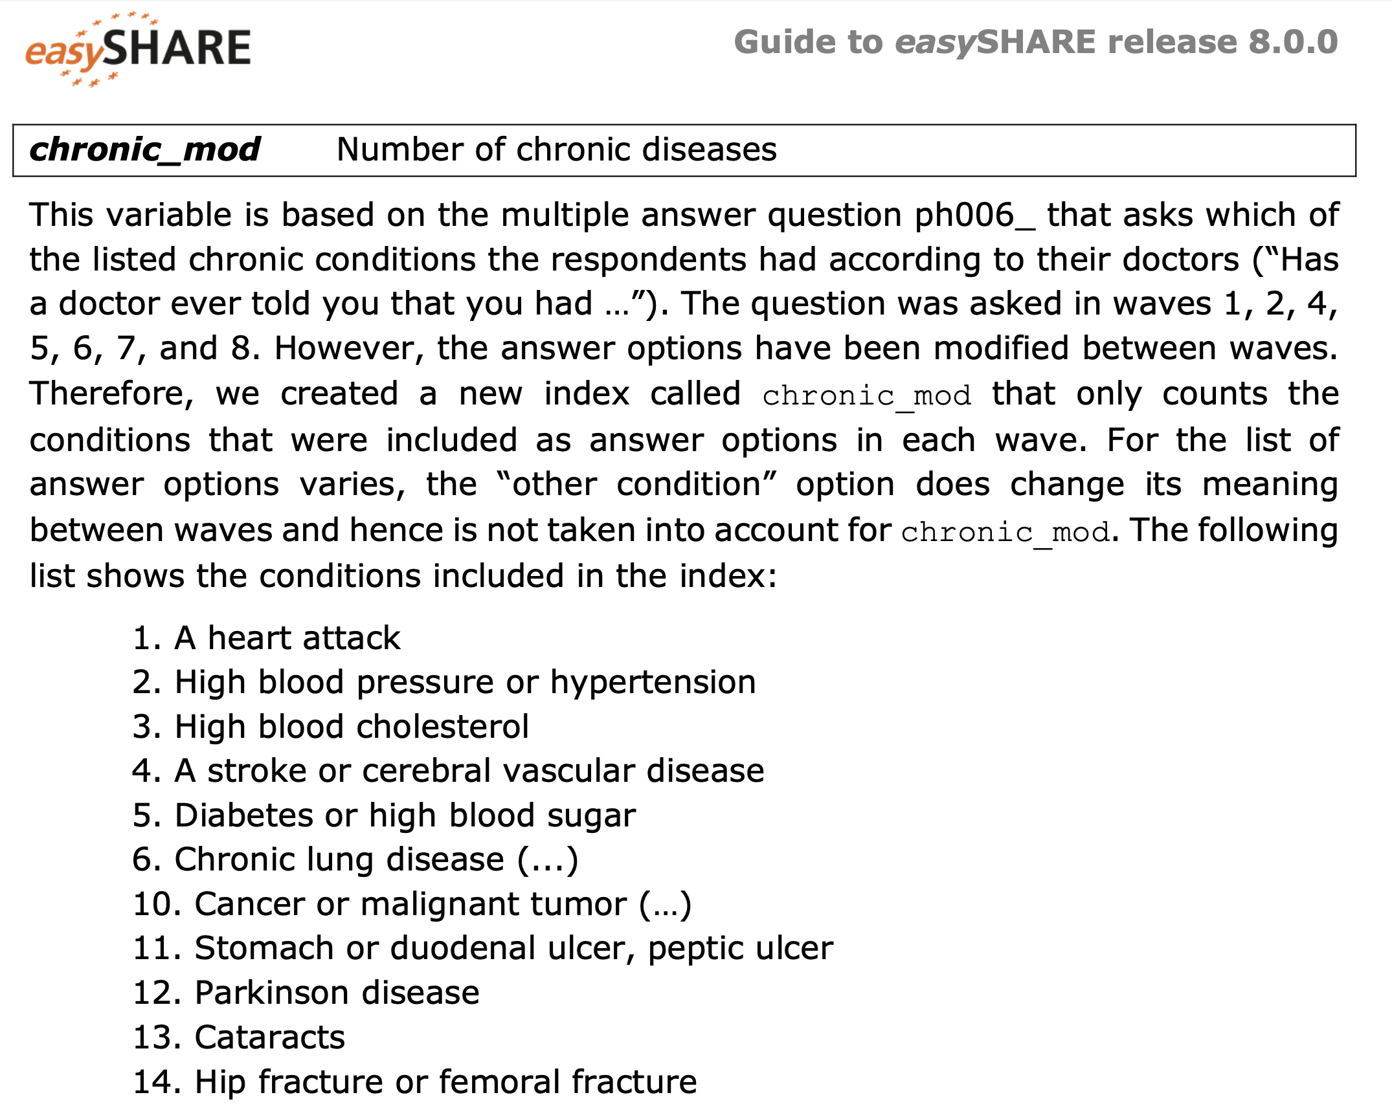
Difference in Differences approach
Overall effect
$$y_{it}=α+φ_{nuts}+λ_{t}+δ\left({\text{Treated}}_{i} × {\text{Crisis}}_{t}\right)+{X′}_{it}γ+ε_{it}$$
Multimorbidity measure

Slide 26
Difference in Differences approach
Overall effect
$$y_{it}=α+φ_{nuts}+λ_{t}+δ\left({\text{Treated}}_{i} × {\text{Crisis}}_{t}\right)+{X′}_{it}γ+ε_{it}$$
Geo-area (NUTS1/2) fixed effect

Slide 27
Difference in Differences approach
Overall effect
$$y_{it}=α+φ_{nuts}+λ_{t}+δ\left({\text{Treated}}_{i} × {\text{Crisis}}_{t}\right)+{X′}_{it}γ+ε_{it}$$
year fixed effect

Slide 28
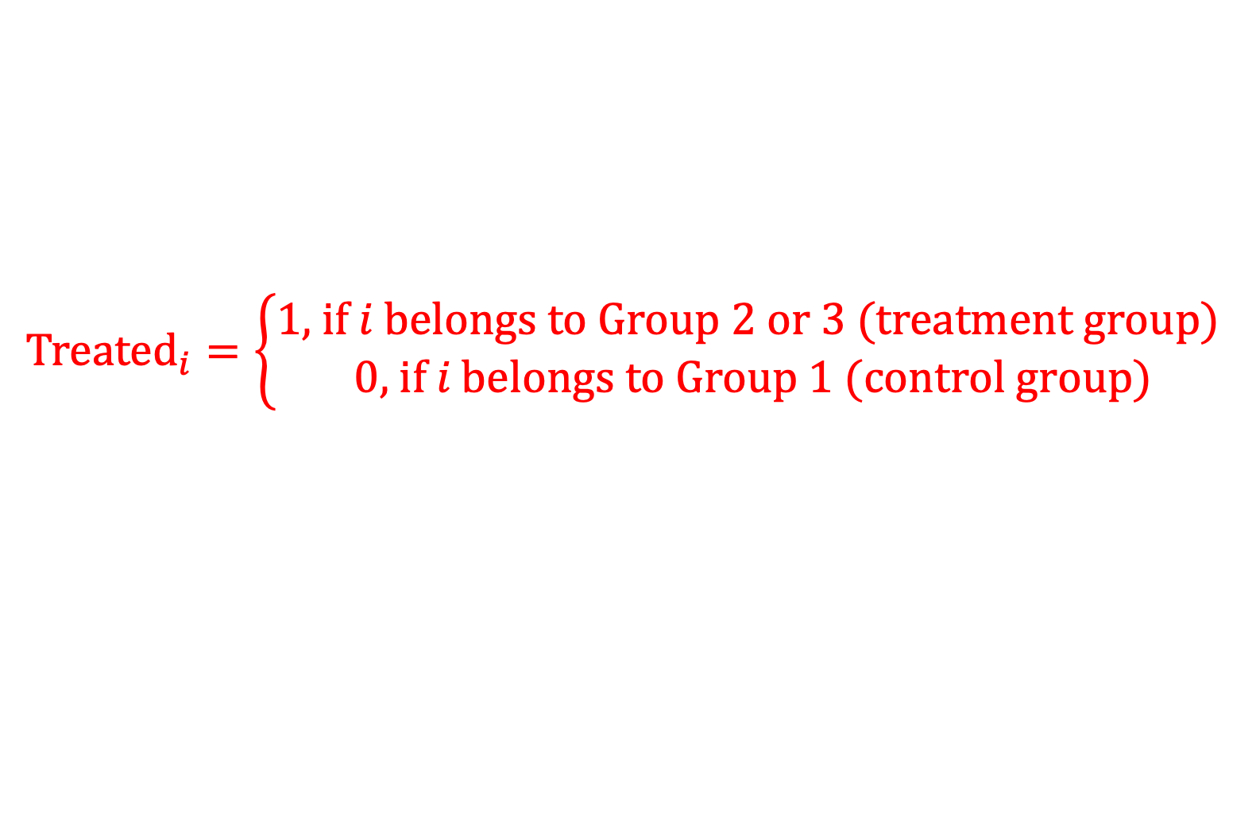
Difference in Differences approach
Overall effect
$$y_{it}=α+φ_{nuts}+λ_{t}+δ\left({\text{Treated}}_{i} × {\text{Crisis}}_{t}\right)+{X′}_{it}γ+ε_{it}$$
$${\text{Treated}}_{i}=\left\{\begin{aligned}1\text{, }\text{if} i \text{belongs} \text{to} \text{Group}\text{ 2 }\text{or}\text{ 3 (}\text{treatment} \text{group}\text{)} \\ 0\text{, }\text{if} i \text{belongs} \text{to} \text{Group}\text{ 1 (}\text{control} \text{group}\text{)}\end{aligned}\right.$$

Slide 29
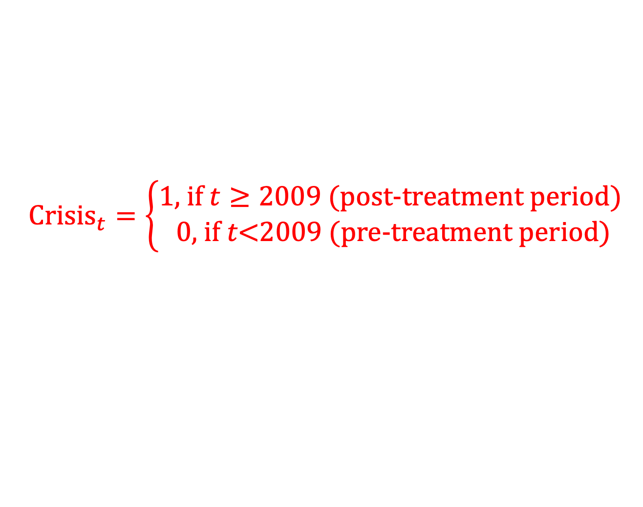
Difference in Differences approach
Overall effect
$$y_{it}=α+φ_{nuts}+λ_{t}+δ\left({\text{Treated}}_{i} × {\text{Crisis}}_{t}\right)+{X′}_{it}γ+ε_{it}$$
$${\text{Crisis}}_{t}=\left\{\begin{aligned}1\text{, }\text{if} t≥2009\text{ (}\text{post}\text{−}\text{treatment} \text{period}\text{)} \\ 0\text{, }\text{if} t\text{<2009}\text{ (}\text{pre}\text{−}\text{treatment} \text{period}\text{)}\end{aligned}\right.$$

Slide 30
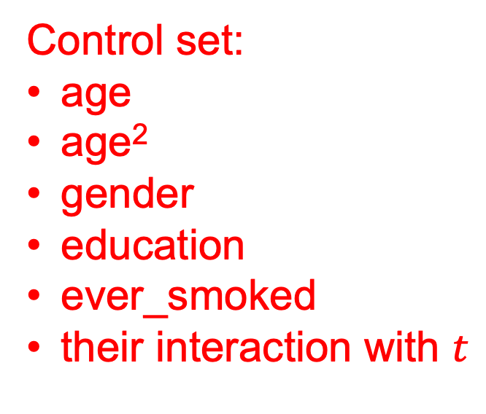
Difference in Differences approach
Overall effect
$$y_{it}=α+φ_{nuts}+λ_{t}+δ\left({\text{Treated}}_{i} × {\text{Crisis}}_{t}\right)+{X′}_{it}γ+ε_{it}$$
Control set:
age
age²
gender
education
ever_smoked
their interaction with $t$

Slide 31
Difference in Differences approach
Overall effect
$$y_{it}=α+φ_{nuts}+λ_{t}+δ\left({\text{Treated}}_{i} × {\text{Crisis}}_{t}\right)+{X′}_{it}γ+ε_{it}$$
Overall ATT (Average Treatment effect on the Treated)

Slide 32
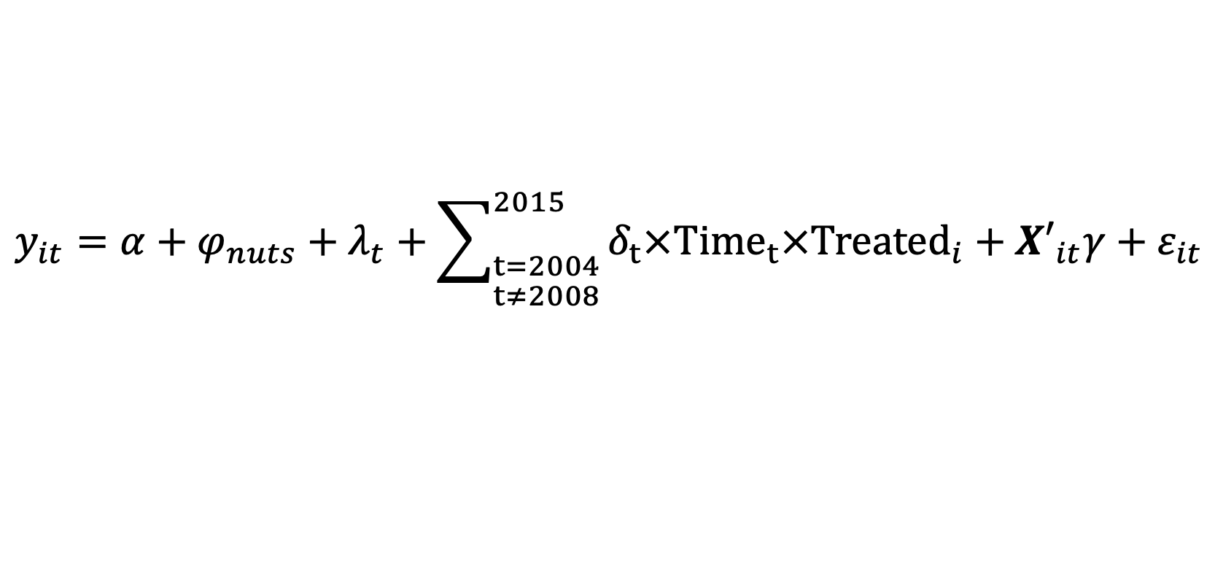
Difference in Differences approach
Dynamic effect (event study)
$$y_{it}=α+φ_{nuts}+λ_{t}+\sum_{\begin{aligned}t=2004 \\ t≠2008\end{aligned}}^{2015}{δ_{t}{×{\text{Time}}_{t}×\text{Treated}}_{i}}+{X′}_{it}γ+ε_{it}$$

Slide 33
Difference in Differences approach
Dynamic effect (event study)
$$y_{it}=α+φ_{nuts}+λ_{t}+\sum_{\begin{aligned}t=2004 \\ t≠2008\end{aligned}}^{2015}{δ_{t}{×{\text{Time}}_{t}×\text{Treated}}_{i}}+{X′}_{it}γ+ε_{it}$$
The year before the start of the Great Recession in Europe as reference year

Slide 34
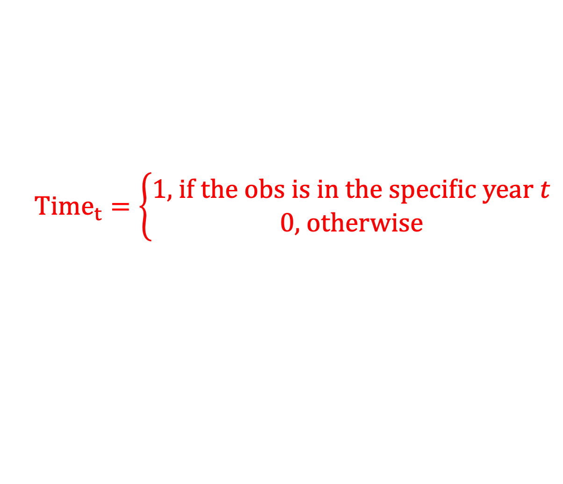
Difference in Differences approach
Dynamic effect (event study)
$$y_{it}=α+φ_{nuts}+λ_{t}+\sum_{\begin{aligned}t=2004 \\ t≠2008\end{aligned}}^{2015}{δ_{t}{×{\text{Time}}_{t}×\text{Treated}}_{i}}+{X′}_{it}γ+ε_{it}$$
$${Time}_{t}=\left\{\begin{aligned}1\text{, }\text{if} \text{the} \text{obs} \text{is} \text{in} \text{the} \text{specific} \text{year} t \\ 0\text{, }\text{otherwise}\end{aligned}\right.$$

Slide 35
Difference in Differences approach
Dynamic effect (event study)
$$y_{it}=α+φ_{nuts}+λ_{t}+\sum_{\begin{aligned}t=2004 \\ t≠2008\end{aligned}}^{2015}{δ_{t}{×{\text{Time}}_{t}×\text{Treated}}_{i}}+{X′}_{it}γ+ε_{it}$$
Dynamic ATT

Slide 36
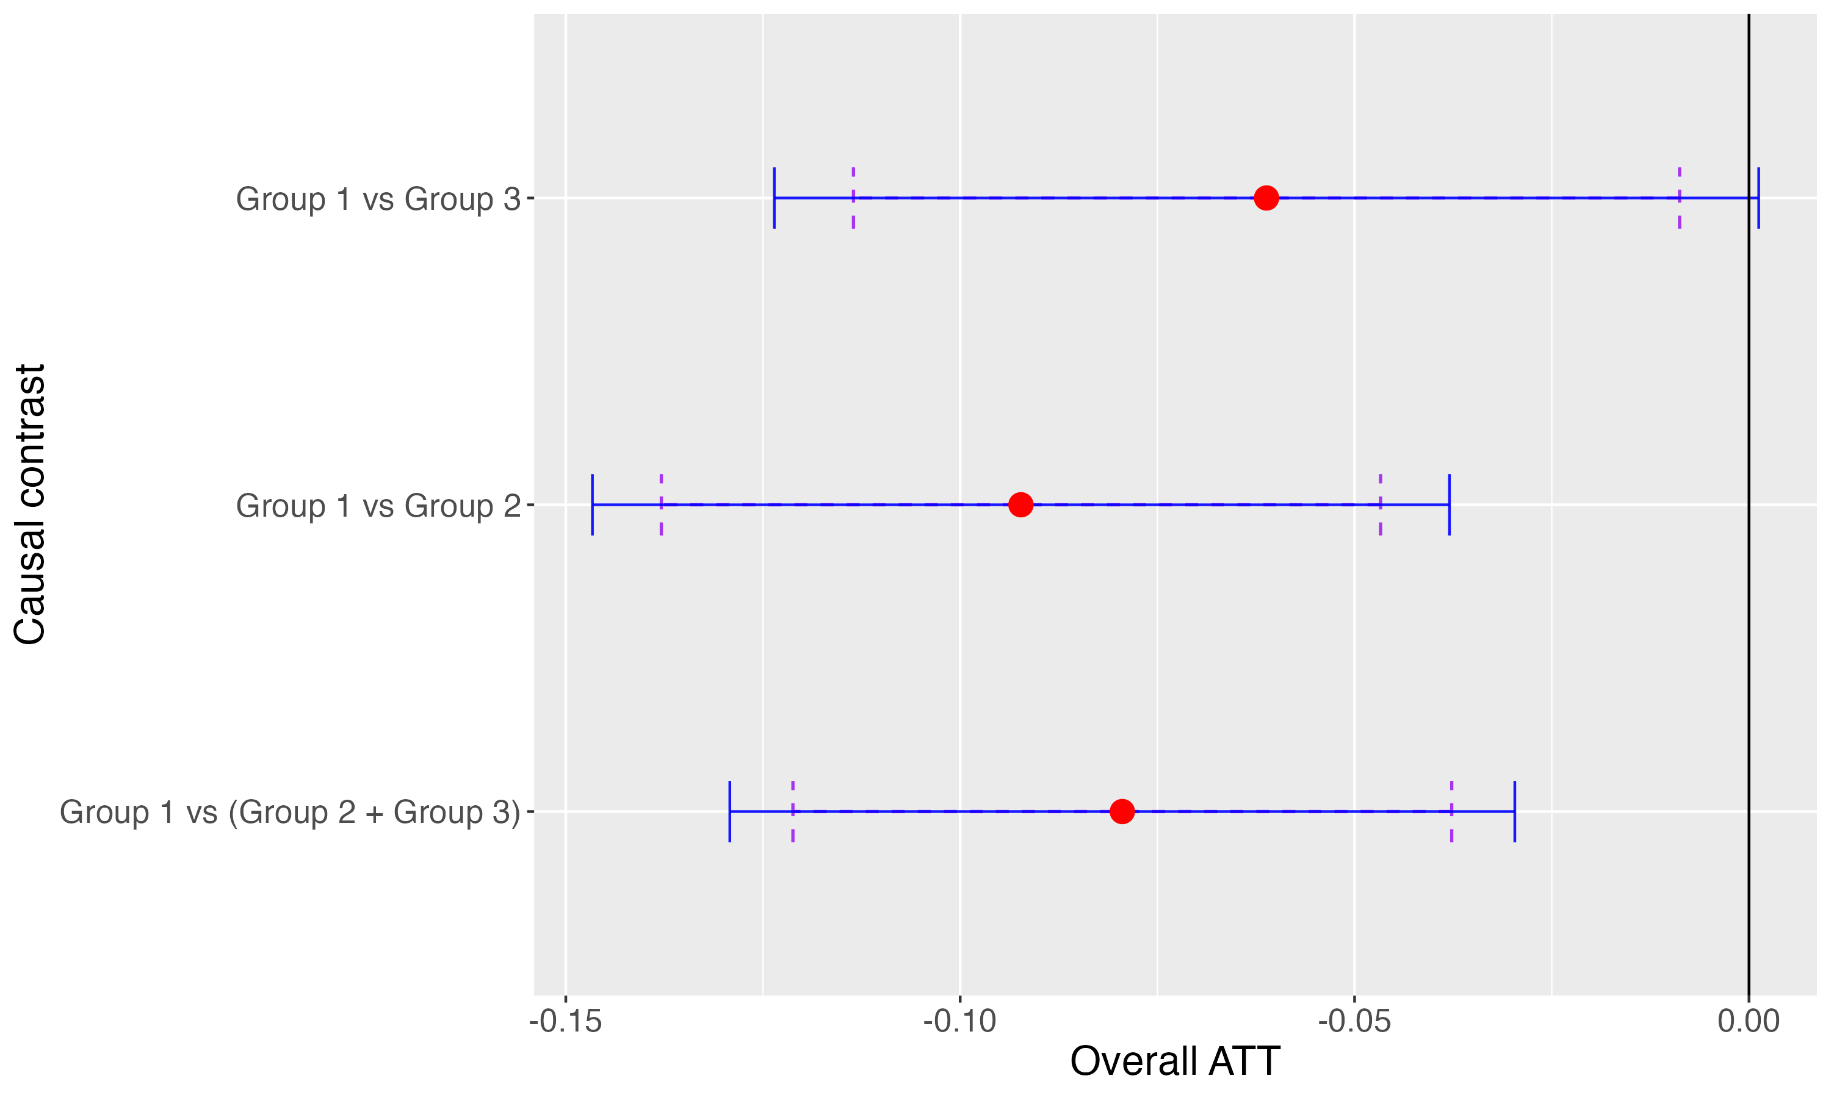
Results
Overall Effect of the Great Recession on multimorbidity in 50+ Europe population at individual level
Note: Estimation of the Overall Average Treatment Effect on the Treated (𝐴𝑇𝑇). Individuals have been classified into three main groups (No Crisis, Moderate Crisis and Severe Crisis) based on the change of unemployment rate across the Great Recession in their respective NUTS of residence: Group 1 first tertile; Group 2 second tertile; Group 3 third tertile. Vertical error lines: Solid 95% CI; Dashed 90% CI
Source: Our elaboration on SHARE data

Slide 37
Results
Overall Effect of the Great Recession on multimorbidity in 50+ Europe population at individual level
Note: Estimation of the Overall Average Treatment Effect on the Treated (𝐴𝑇𝑇). Individuals have been classified into three main groups (No Crisis, Moderate Crisis and Severe Crisis) based on the change of unemployment rate across the Great Recession in their respective NUTS of residence: Group 1 first tertile; Group 2 second tertile; Group 3 third tertile. Vertical error lines: Solid 95% CI; Dashed 90% CI
Source: Our elaboration on SHARE data

Slide 38
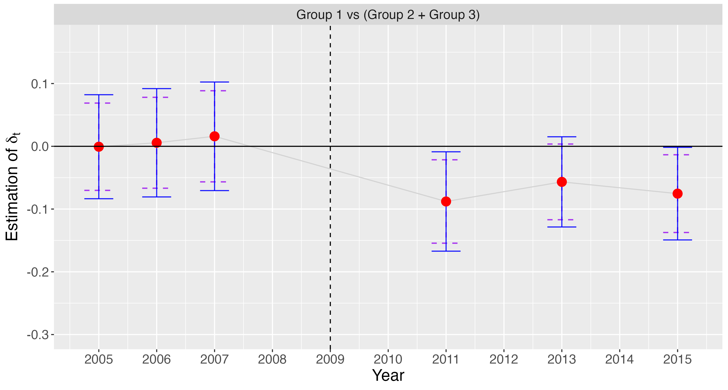
Results
Dynamic Effect of the Great Recession on multimorbidity in 50+ Europe population at individual level
Note: Estimation of the Dynamic Average Treatment Effect on the Treated (𝐴𝑇𝑇). Individuals have been classified into three main groups (No Crisis, Moderate Crisis and Severe Crisis) based on the change of unemployment rate across the Great Recession in their respective NUTS of residence: Group 1 first tertile; Group 2 second tertile; Group 3 third tertile. Vertical live indicates the start of the Great Recession in Europe. Horizontal error lines: Solid 95% CI; Dashed 90% CI
Source: Our elaboration on SHARE data

Slide 39
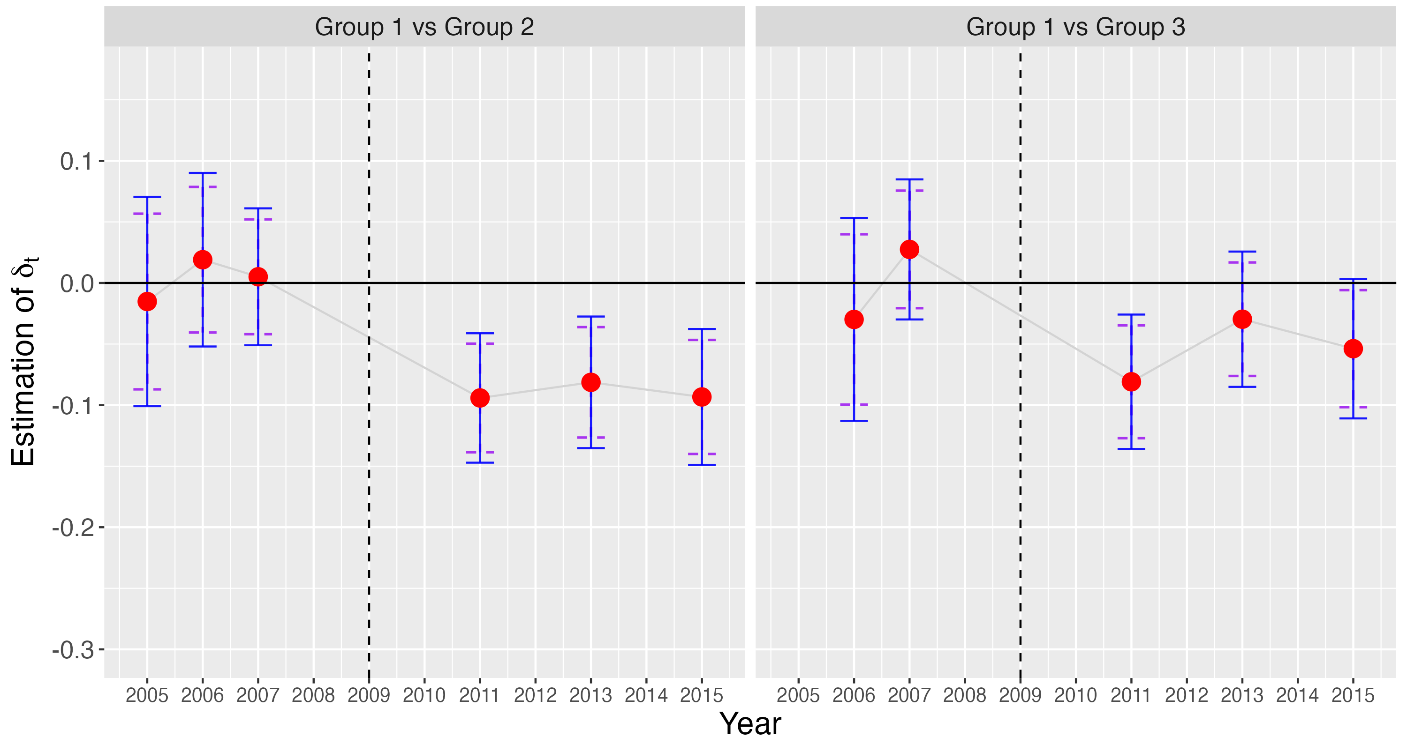
Results
Dynamic Effect of the Great Recession on multimorbidity in 50+ Europe population at individual level
Note: Estimation of the Dynamic Average Treatment Effect on the Treated (𝐴𝑇𝑇). Individuals have been classified into three main groups (No Crisis, Moderate Crisis and Severe Crisis) based on the change of unemployment rate across the Great Recession in their respective NUTS of residence: Group 1 first tertile; Group 2 second tertile; Group 3 third tertile. Vertical live indicates the start of the Great Recession in Europe. Horizontal error lines: Solid 95% CI; Dashed 90% CI
Source: Our elaboration on SHARE data

Slide 40
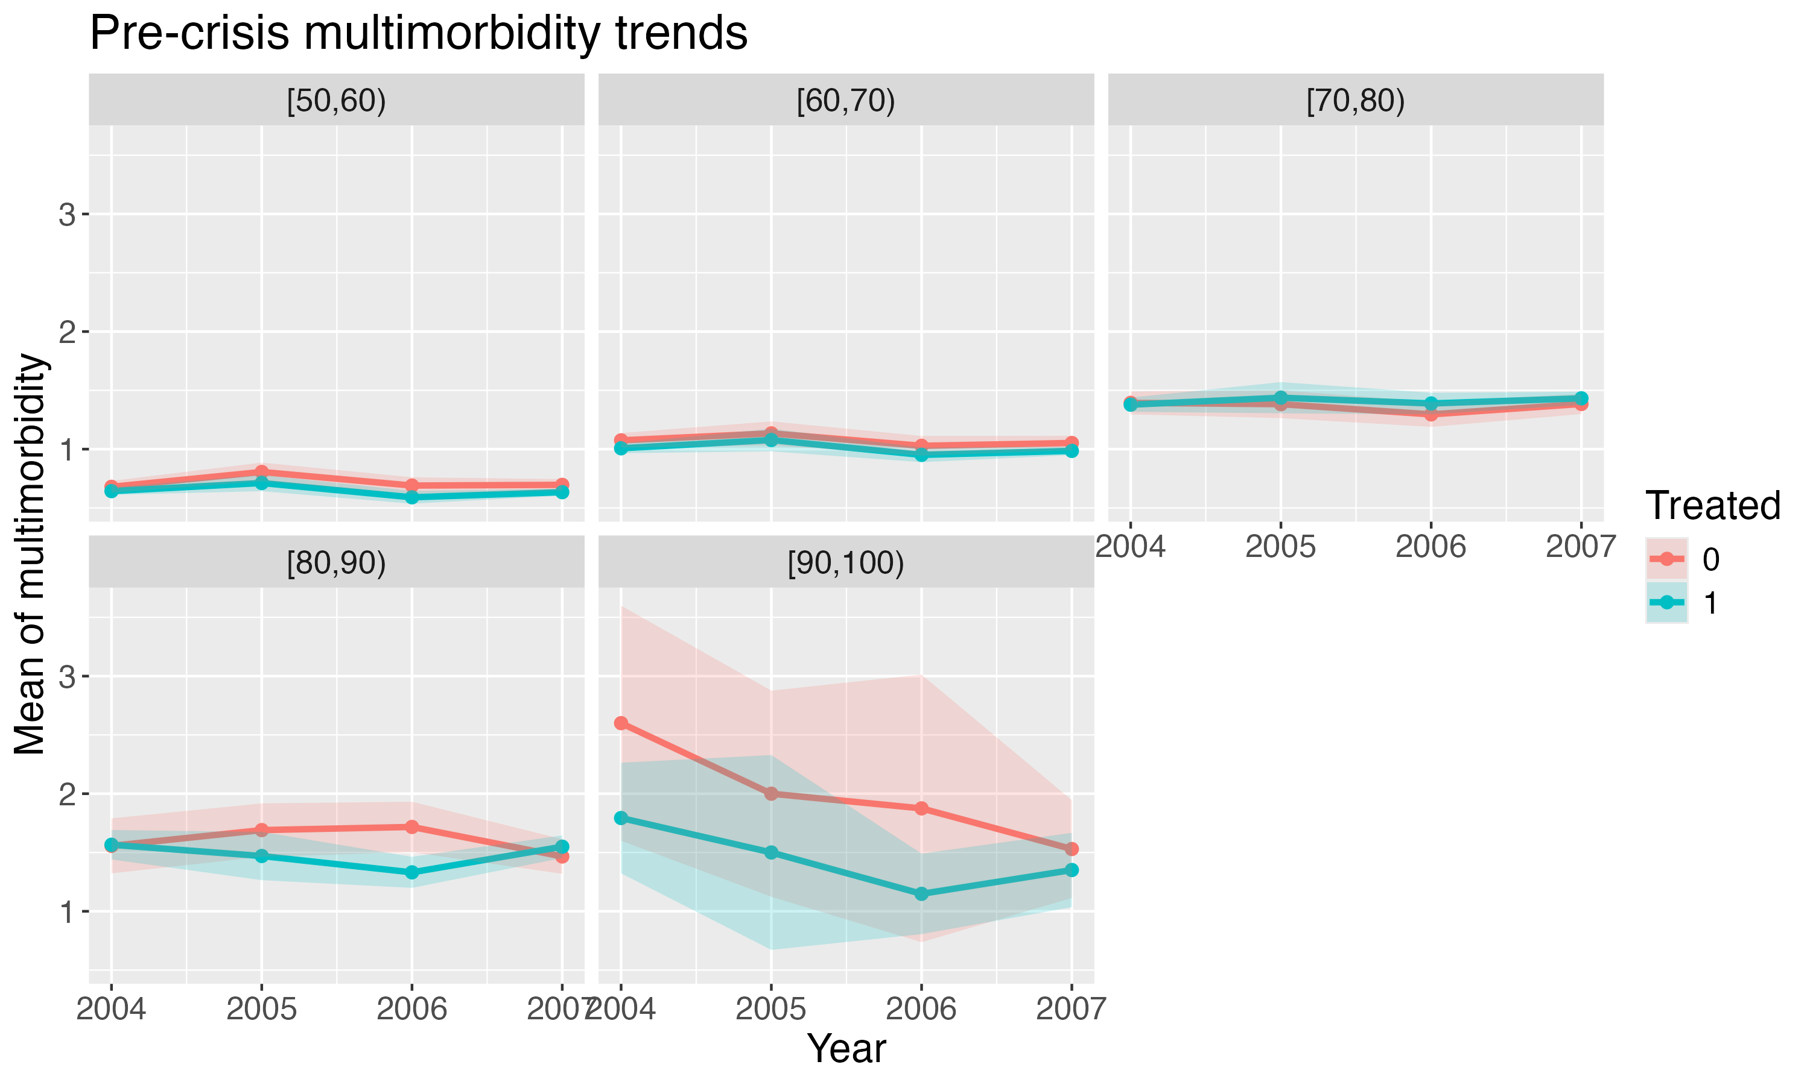
Parallel Trend Assumption

Slide 41
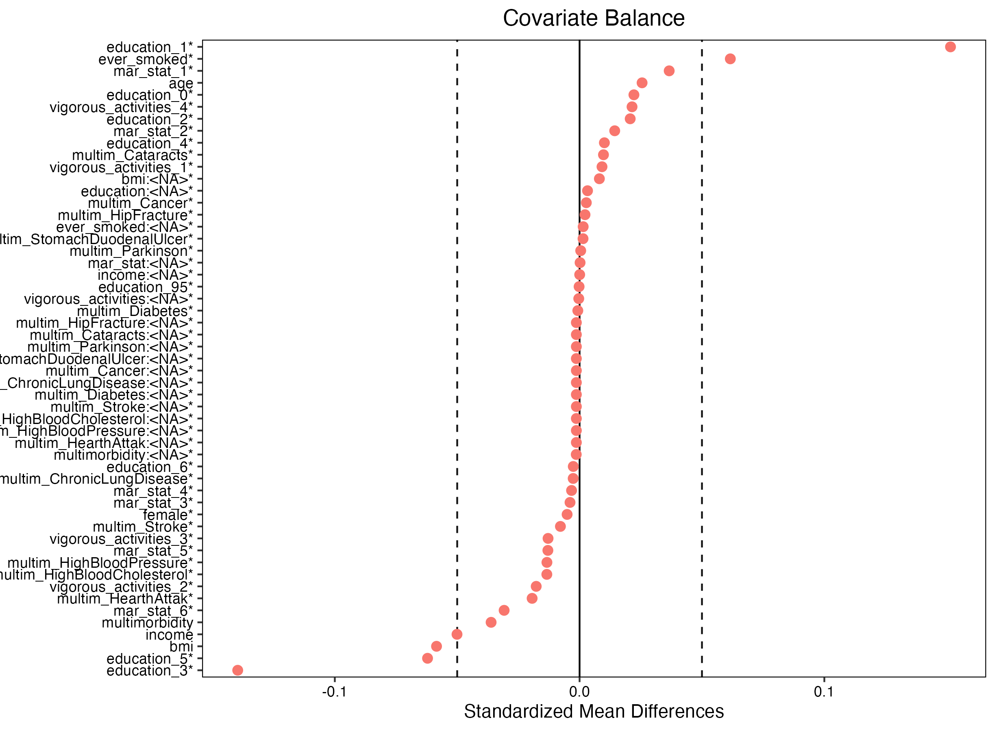
Parallel Trend Assumption
(treatment vs control in the pre-treatment period)

Slide 42
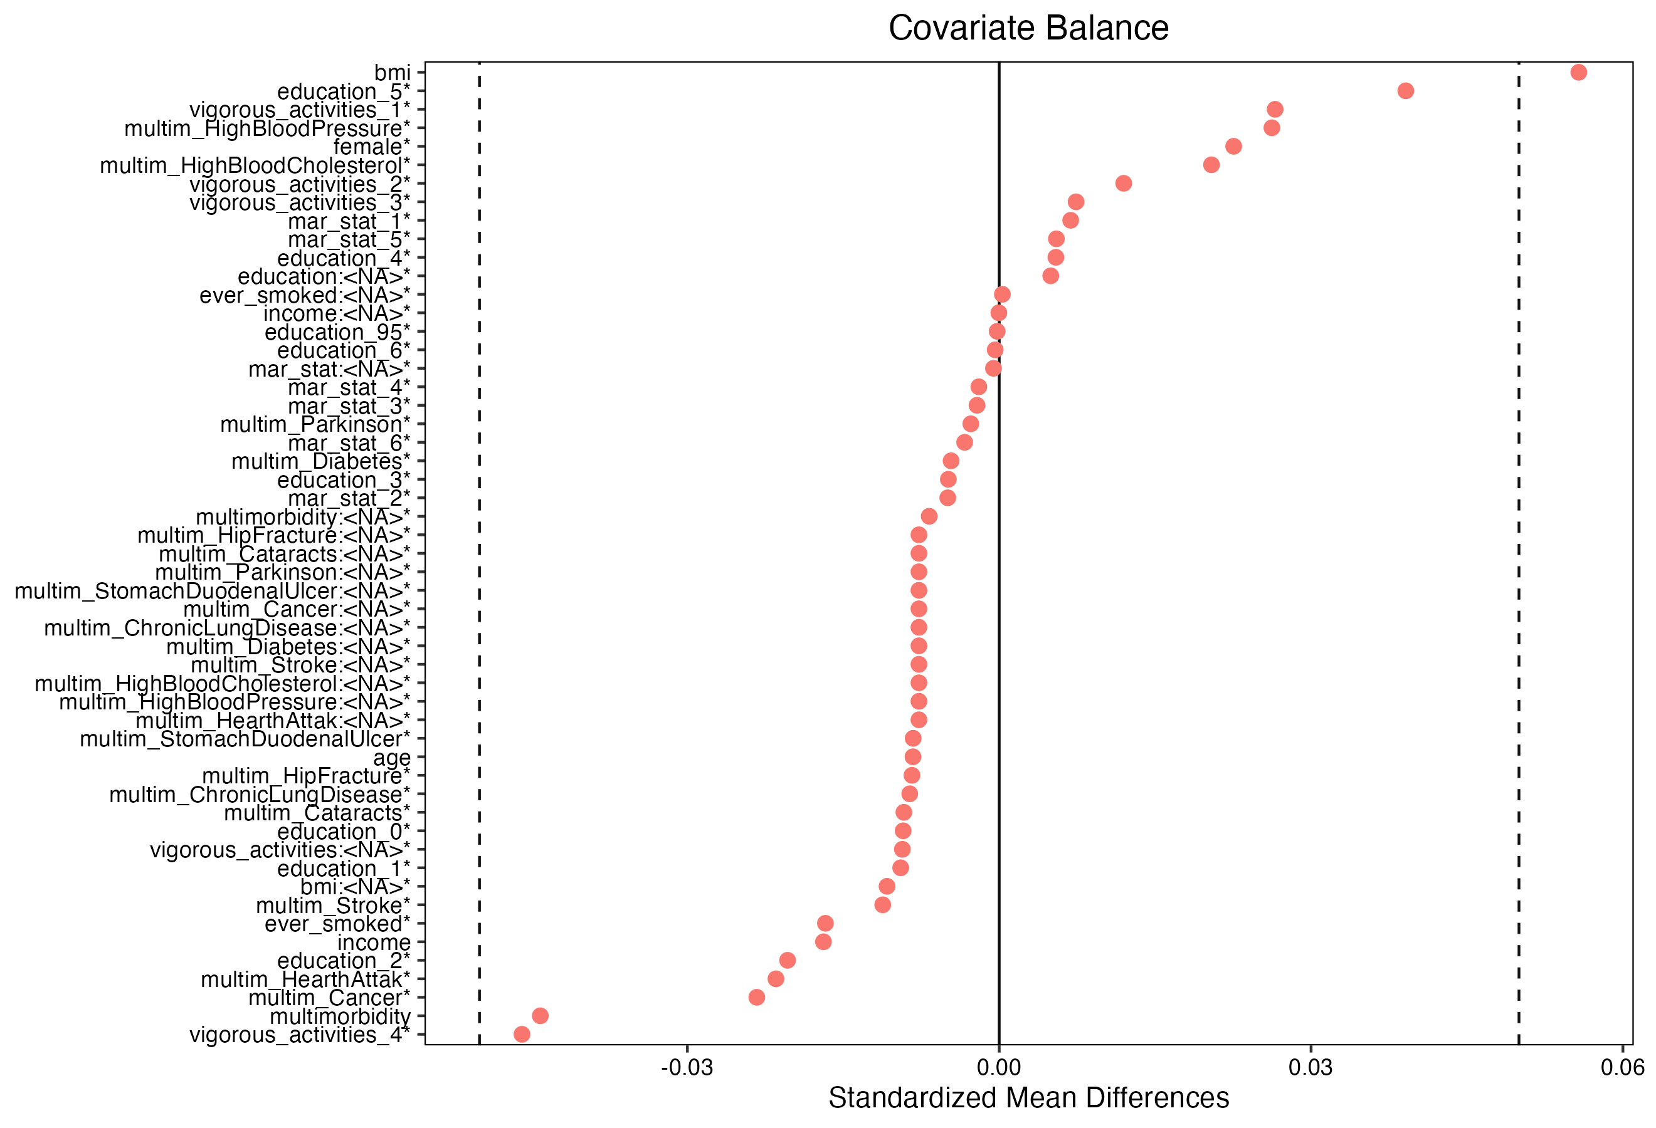
Lost to follow up of about 26%
Robustness checks
(lost vs non-lost)

Slide 43
Robustness checks
65+ subsample (instead of 50+)
We re-estimated our models on individuals aged 65+ (instead of 50+), keeping the same specification
The results are confirmed
Howerver, the effect on the elderly population is more intense and longer lasting, with the same patterns and emerging drivers

Slide 44
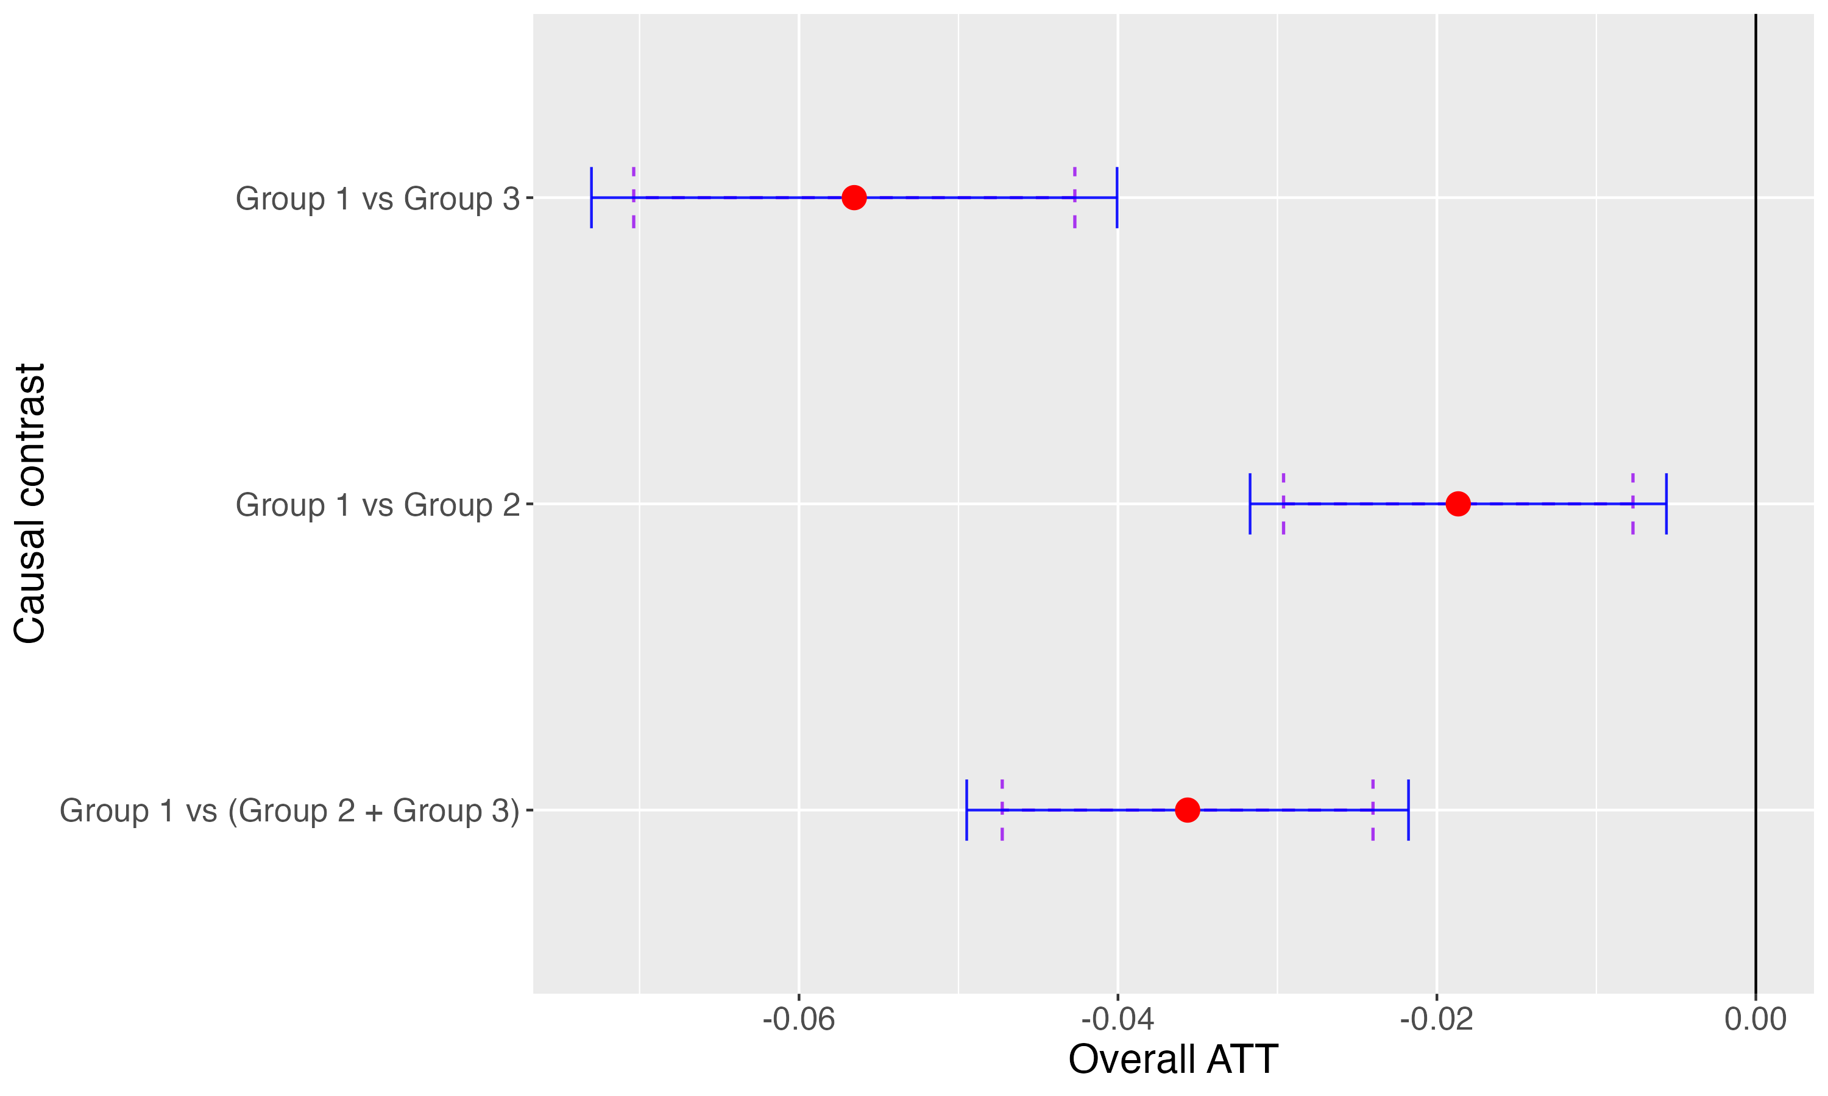
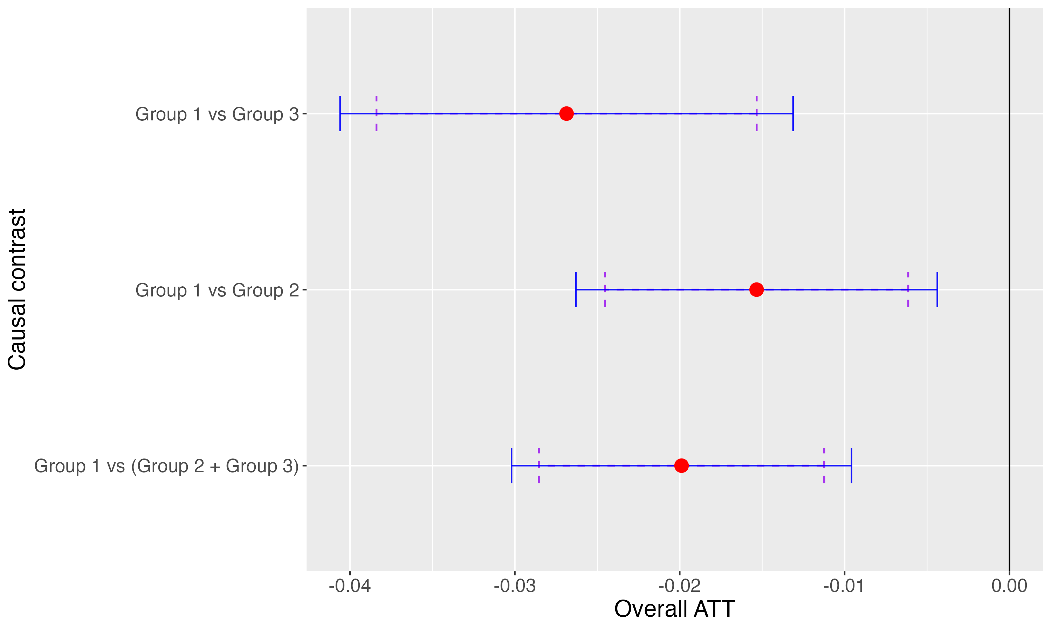
Which force (perhaps) drives the effect?
Same approach, different outcomes
smoking (indicates whether the respondents smoke at present)
doctor told you had: cataracts

Slide 45
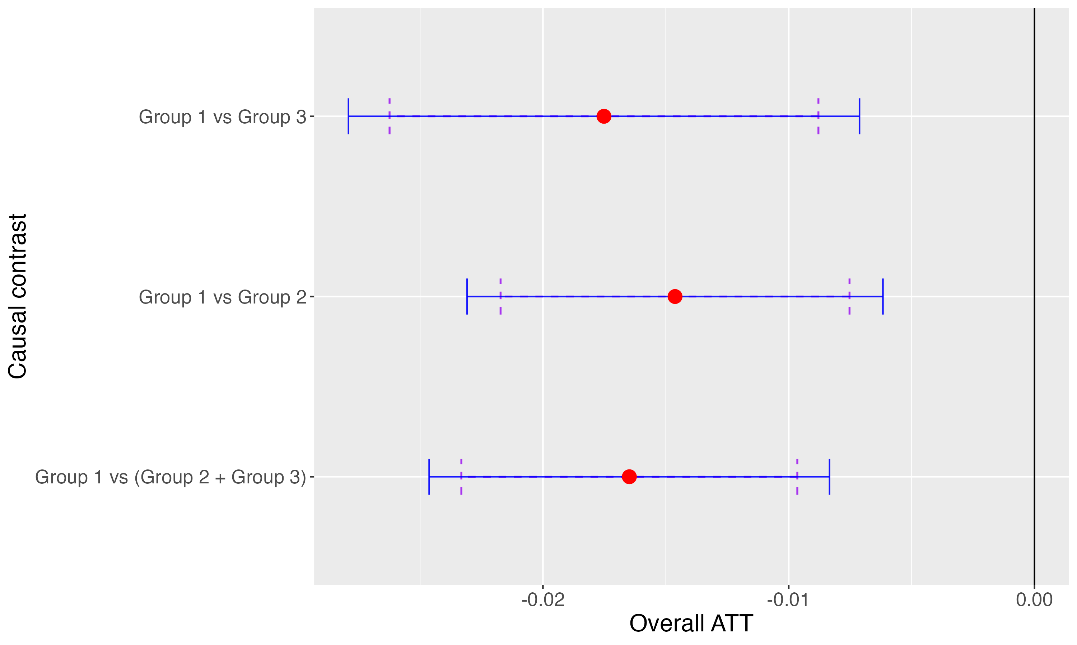
Which force (perhaps) drives the effect?
Same approach, different outcomes
Doctor told you had: cancer

Slide 46
Which force (perhaps) drives the effect?
Is the change in the value of the cancer variable over time due by data collection errors? Apparently not!
From wave 2 onwards the corrispondent question is:
[Has a doctor ever told you that you had/Do you currently have] cancer / With this we mean that a doctor has told you that you have this condition, and that you are either currently being treated for or bothered by this condition.]
So, in these terms, a change of value in an individual during the observed period does not necessarily mean an error or a false value, but the fact that the clinical picture has indeed changed.
However, we repeated the analysis without the individuals changing cancer value over time and the results remain confirmed.

Slide 47
Conclusion
Our individual-level analysis confirms the existence of the Thomas Effect: cause to the Great Recession, average health improved among European 50+
Mechanisms/drivers: patterns are consistent with reduced smoking, and lower incidence/reporting of cataract and cancers
Robustness: results hold across multiple checks

Slide 48


Gràtzias

Slide 49
European Association of Population Studies
Health, Morbidity and Mortality Working Group 2025 Annual Meeting
LIVING LONGER, LIVING BETTER? INEQUALITY IN HEALTH AND LONGEVITY
Organized by the University of Luxembourg
in collaboration with EAPS, Prague University of Economics and Business, Charles University, and Ben Gurion University
September 10-12, 2025, Belvas Campus
Great Recession, health, and inequality in Europe: reassessing the Thomas Effect at the individual level
Presenter: Gianni Carboni¹ (gcarboni3@uniss.it)
A cowork with Giovanni Busetta², Marcantonio Caltabiano², Maria Gabriella Campolo², Gabriele Ruiu¹, Giambattista Salinari¹, Alessandra Trimarchi²
¹ University of Sassari
² University of Messina

