Slide 1


Patterns of mortality and inequality of health capital (HC) in the U.S. population 1997-2019 (NHIS)
How risks of death (ROD) and Relative Health Capital (RHC) reflect social stratification and birth cohort transformations
Greek vase: Sword of Damokles
Louis CHAUVEL
CITATION OF IPUMS NHIS
Lynn A. Blewett, Julia A. Rivera Drew, Miriam L. King, Kari C.W. Williams, Natalie Del Ponte and Pat Convey. IPUMS Health Surveys: National Health Interview Survey, Version 7.1 [dataset]. Minneapolis, MN: IPUMS, 2021. https://doi.org/10.18128/D070.V7.1 site: https://www.nhis.ipums.org
Gemini fake

Slide 2
Motivation
Inequality of health is more complicated
than Inequality of income:
    Events or conditions are in general dummy 0/1 variables,
    not continuous
    No Gini index (etc.) common indicators of health inequality
    Multidimensionality (even if risk of death is the main point)
Class and cohort inequalities?
  Differentials of risks of death is a common indicator of inequality (Villermé 1830 Engels etc. )
  Lynch J. Health Inequalities: The Emergence of an International Consensus Policy Frame. In: Regimes of Inequality: The Political Economy of Health and Wealth. Cambridge University Press; 2020:48-82. https://doi.org/10.1017/9781139051576.003
  Ups and downs of U.S. health (=complicated trends), see Cases and Deaton Death of despair 2021 : stagnation of health progress and backlash, increasing inequalities, impact on young cohorts in particular for populations facing socioeconomic stressors
  (Cases and Deaton 2018 19 20 etc…)
  Available age-period-cohort models (hapc etc.) must be improved (Bell & Jones 2014)

Slide 3
Measuring Risk of Death ROD versus Health Capital HC
Defining and measuring health Inequality ➔ measured through gradients of adverse events :
    Conceptualization: Clarke P, Erreygers G. Defining and measuring health poverty. Soc Sci Med. 2020 Jan;244:112633. https://doi.org/10.1016/j.socscimed.2019.112633 Epub 2019 Oct 25.
    ➔ Occurrence of cardiovascular disease
    In our paper: risk of death ROD in the next 1, 5, etc. years ➔ measured as a logit predicted probability
Going farther:
  Absolute ROD is an exponential of age (the Gompertz law ➔ ROD = a exp(age) with a=.085)
  Its inverse absolute Health Capital aHC =1/ROD is a measure of instant life expectancy (life expectancy if we do not grow older… aHC= 500 years at age 25 ➔ the young’s illusion of longevity)
  rROD is the relative ROD, log- standardized by age group
  rROD measures the gradient of death risk within an age group
  Its inverse, relative Health Capital rHC=1/rROD has a very interesting distribution: looks like income, with a Gini index of 41% (lower for seniors) and relative poverty rate of 17.5%
  Relative Health Capital helps measure intensity of inequality of health within and between social groups

Slide 4
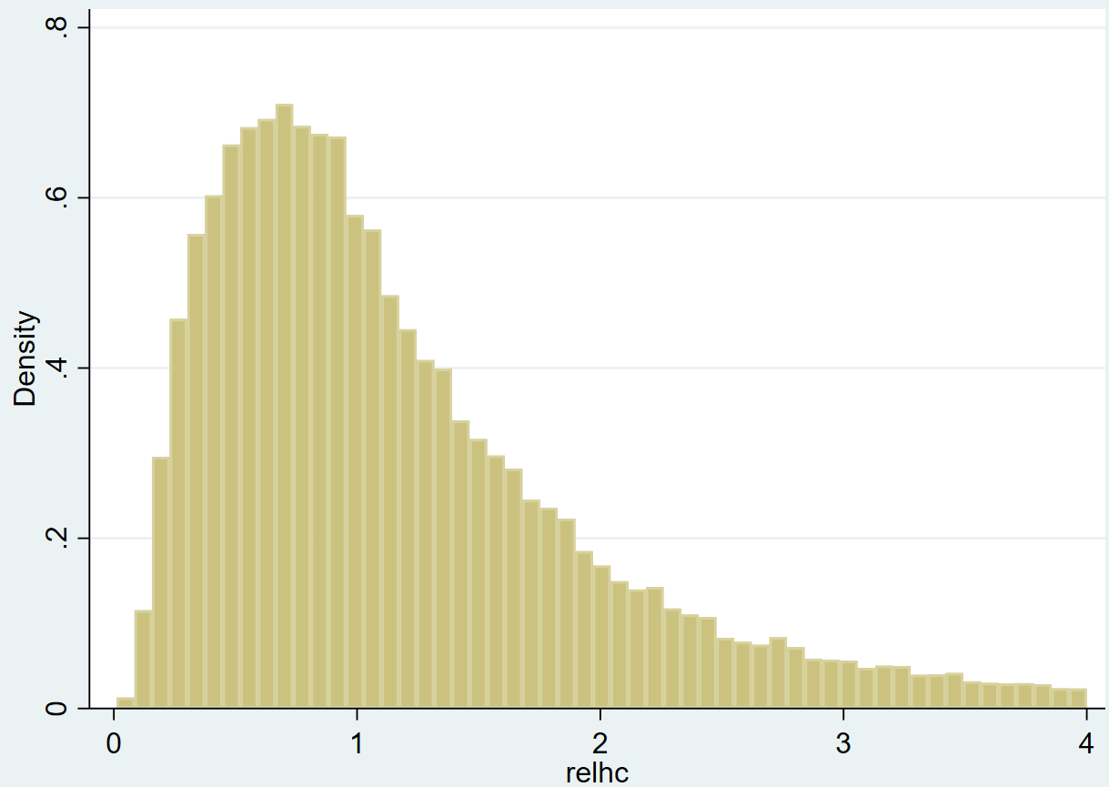
Histogram of rHC relative Health Capital

Slide 5
Data and Method
https://nhis.ipums.org/nhis/resources/2019NDI-Linkage-Methods-and-Analytic-Considerations-508.pdf
National Health Interview Surveys (cross-sectional, annual data collection)
Specific variables of NHIS Linked Mortality Files
    mortstat ➔ follow-up status
    mortdody ➔ year of death (right censored if not dead)
We build the dead5 variable : death within the next 5 years
Data quality: restricted 1997/2014 (death from 2002 to 2019) age 25-84 yo N = 390,147
Logit model of probability of death, through predicted probabilities
(we can do Poisson and predicted incidence rates )
logit dead5 i.sex i.region i.ethno i.mar i.educrec2 i.inc i.poo i.own i.bmi5 ///
/*i.flany*/ if a5==`a' & y5==`y' [pw=perw]

Slide 6
Data and Method
logit dead5 i.sex i.region i.ethno i.mar i.educrec2 i.inc i.poo i.own i.bmi5 ///
/*i.flany*/ if a5==`a' & y5==`y' [pw=perw]
Within each (age5 x year5) cell, we predict the probability of death within 5 years :
With controls by sex (2), region (4), ethnicity (W / AA / H / O : 4), marital status (4),
level of education (5), level of income (3), poverty status (3), home ownership (2), BMI (6) (+ any health limitation 0/1)
Predicted probabilities are saved, and serve as a relative measure of risk of adverse event
Optionally, we can make use of flany: “any functional limitation” reported
➔ this absorbs most of the variance ➔ not used here

Slide 7
Data and Method
List of variables
. su dead5 sex region ethno mar educrec2 inc poo own bmi5 flany a5 y5 perw, sep(0)
Variable | Obs Mean Std. dev. Min Max
-------------+---------------------------------------------------------
dead5 | 390,147 .0557867 .2295096 0 1
sex | 390,147 1.550423 .4974516 1 2
region | 390,147 2.652318 1.018971 1 4
ethno | 390,147 1.606246 .9169626 1 4
mar | 390,147 2.247827 1.528607 1 5
educrec2 | 390,147 48.06865 6.389198 41 60
inc | 390,147 1.808142 .7492011 1 3
pooryn | 390,147 2.305939 2.815414 1 9
own | 390,147 .6558374 .475095 0 1
bmi5 | 390,147 24.76907 5.236476 15 40
flany | 390,147 .354838 .4784648 0 1
a5 | 390,147 47.36789 15.72758 25 80
y5 | 390,147 2002.831 5.362536 1995 2010
perweight | 390,147 3212.341 1609.833 153 43576

Slide 8
logit dead5 i.a5 i.y5 i.sex i.region i.ethno i.mar i.educrec2 i.inc i.poo i.own i.bmi5 /*i.flany*/ [pw=perw]
Logistic regression Number of obs = 390,147
Wald chi2(38) = 23094.75
Prob > chi2 = 0.0000
Log pseudolikelihood = -2.124e+08 Pseudo R2 = 0.2232
Logit dead5
Almost everything is significant including home ownership
We save the predicted probabilities by age5 x year5 pr=rROD (relative to age/year)
----------------------------------------------------------------------------------------------------
| Robust
dead5 | Coefficient std. err. z P>|z| [95% conf. interval]
-----------------------------------+----------------------------------------------------------------
a5 |
30 | .5227388 .103649 5.04 0.000 .3195906 .7258871
35 | .8986458 .0980469 9.17 0.000 .7064774 1.090814
40 | 1.298855 .0936853 13.86 0.000 1.115235 1.482475
45 | 1.817474 .0902554 20.14 0.000 1.640577 1.994371
50 | 2.224796 .0882101 25.22 0.000 2.051908 2.397685
55 | 2.608843 .0871265 29.94 0.000 2.438078 2.779608
60 | 2.996316 .0865045 34.64 0.000 2.826771 3.165862
65 | 3.374418 .0859463 39.26 0.000 3.205966 3.54287
70 | 3.821036 .0858175 44.53 0.000 3.652836 3.989235
75 | 4.242857 .0858013 49.45 0.000 4.074689 4.411024
80 | 4.765284 .0863741 55.17 0.000 4.595994 4.934574
|
y5 |
2000 | -.0571304 .0229557 -2.49 0.013 -.1021228 -.012138
2005 | -.0861928 .0251476 -3.43 0.001 -.1354812 -.0369045
2010 | -.0738295 .0249831 -2.96 0.003 -.1227955 -.0248634
|
sex |
female | -.6836822 .0182618 -37.44 0.000 -.7194747 -.6478896
|
region |
north central/midwest | .0452583 .0262 1.73 0.084 -.0060927 .0966093
south | .1568926 .024078 6.52 0.000 .1097007 .2040845
west | .0012093 .0281261 0.04 0.966 -.0539169 .0563355
|
ethno |
2 | .0232794 .0245566 0.95 0.343 -.0248506 .0714094
3 | -.5249543 .0328551 -15.98 0.000 -.5893491 -.4605595
4 | -.3661736 .0545061 -6.72 0.000 -.4730036 -.2593436
|
…/…
----------------------------------------------------------------------------------------------------
----------------------------------------------------------------------------------------------------
| Robust
dead5 | Coefficient std. err. z P>|z| [95% conf. interval]
-----------------------------------+----------------------------------------------------------------
…/…
mar |
2 | .2130759 .0241225 8.83 0.000 .1657968 .2603551
3 | .2567751 .0239226 10.73 0.000 .2098876 .3036626
5 | .2618255 .0319256 8.20 0.000 .1992525 .3243985
|
educrec2 |
grade 12 | -.2097967 .0227358 -9.23 0.000 -.254358 -.1652354
1 to 3 years of college | -.2888777 .0259035 -11.15 0.000 -.3396476 -.2381078
4 years college/bachelor's degree | -.5234904 .0341881 -15.31 0.000 -.5904978 -.4564829
5+ years of college | -.6652651 .0412897 -16.11 0.000 -.7461915 -.5843388
|
inc |
2 | -.2812551 .0213305 -13.19 0.000 -.3230621 -.239448
3 | -.5737902 .0354702 -16.18 0.000 -.6433105 -.5042699
|
pooryn |
below poverty threshold | .2589443 .0271077 9.55 0.000 .2058142 .3120744
unk (1997+: incl. undefined) | .0973604 .0224624 4.33 0.000 .053335 .1413858
|
1.own | -.2649392 .0207507 -12.77 0.000 -.3056097 -.2242686
|
bmi5 |
20 | -.5895067 .0389785 -15.12 0.000 -.6659031 -.5131103
25 | -.8267999 .03931 -21.03 0.000 -.903846 -.7497538
30 | -.7396888 .041939 -17.64 0.000 -.8218878 -.6574898
35 | -.5479981 .0493324 -11.11 0.000 -.6446877 -.4513084
40 | -.3503276 .0680195 -5.15 0.000 -.4836434 -.2170118
|
_cons | -4.041262 .0952256 -42.44 0.000 -4.2279 -3.854623
----------------------------------------------------------------------------------------------------

Slide 9
Logit dead5
We save the predicted probabilities by age5 x year5 ➔ pr=rROD
We compute rHC relative health capital = 1/ rROD standardized by age/year
lrHC (mean zero) is a good measure of health capital
Mean lrHC by year5 and ethic group
------------------------------------------------------
| y5
| 1995 2000 2005 2010
------+-----------------------------------------------
ethno |
Whi | .0537152 .0666957 .0261688 -.0077962 (trend -)
AfAm| -.5015486 -.5077384 -.3331935 -.2810574 (trend +)
Lat | .1256597 .1306803 .1423738 .2091114 (trend +)
Oth | .1474029 -.1267811 .1613136 .3215076 (trend +)
------------------------------------------------------

Slide 10
Mean lrHC by year5 and education group
-------------------------------------------------------------------------------------------
| y5
| 1995 2000 2005 2010
-------------------------------------------+-----------------------------------------------
educational attainment recode, intervalled |
grade 11 or less | -.3341741 -.4168502 -.5429719 -.5259868 (trend -)
grade 12 | -.1163359 -.1494195 -.2751463 -.3334537 (trend -)
1 to 3 years of college | -.1088407 -.115442 .001744 -.0998418 (trend =)
4 years college/bachelor's degree | .304454 .4148887 .5533206 .4523089 (trend +)
5+ years of college | .7634917 .648397 .4278676 .7501136 (trend =)
-------------------------------------------------------------------------------------------
---------------------------------------------------------
| y5
| 1995 2000 2005 2010
---------+-----------------------------------------------
sex |
male | -.2545728 -.2466525 -.2087627 -.2324762 (trend =)
female | .2122397 .2100962 .1797844 .205005 (trend =)
---------------------------------------------------------

Slide 11
Statistical background: Age Period Cohort models
Separate the effects of age, period of measurement and cohort.
Problematic colinearity:
cohort (date of birth) = period (date of measurement) - age
(Ryder 1965, Mason et al. 1973, Mason / Fienberg 1985, Mason / Smith 1985,
Yang Yang et al. 2006 2008, Smith 2008, Pampel 2012,
Plus more recent … )
Notes:
Louis

Slide 12
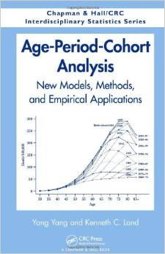
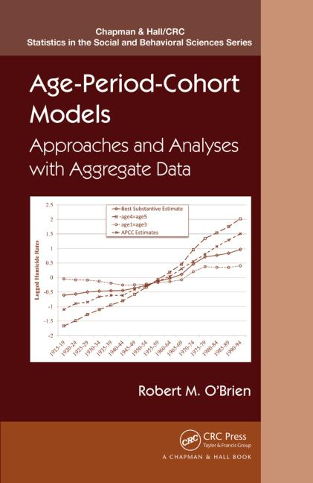
APC literature (2016-2019)
Dorius, Shawn F., Duane F. Alwin, and Julianna Pacheco. 2016. “Twentieth Century Intercohort Trends in Verbal Ability in the United States.” Sociological Science 3:383-412.
Fosse, Ethan, and Christopher Winship. 2016. “Nonparametric Bounds of Age-Period-Cohort Effects.” Unpublished paper last downloaded from https://q-aps.princeton.edu/sites/default/files/q-aps/files/apcbounds_draft.pdf on 31 March 2019.
-----. 2018. “Moore–Penrose Estimators of Age–Period–Cohort Effects: Their Interrelationship and Properties.” Sociological Science 5(14):304-334.
Luo, Liying, and James S. Hodges. 2016. “Block Constraints in Age–Period–Cohort Models with Unequal-width Intervals.” Sociological Methods & Research 45(4):700-726.
O’Brien, Robert M-----. 2015. Age-Period-Cohort Models: Approaches and Analyses with Aggregate Data. Boca Raton, FL: Chapman and Hall/CRC Press.
-----. 2016. “Model Misspecification When Eliminating a Factor in Age-period-cohort Multiple Classification Models.” Pp. 358-372 in Sociological Methodology 2016, edited by Duane F. Alwin. Thousand Oaks, CA: Sage Publishing.
-----. 2018. “Homicide Arrest Rate Trends in the United States: The Contributions of Periods and Cohorts (1965–2015).” Journal of Quantitative Criminology 34(online first).
Shen, Yinzhi, Shawn Bushway, Lucy Sorenson, and Herbert Smith. 2019. “Locking Up My Generation: Cohort Differences in Prison Sentence Spells over the Life Course.” Poster presented at the Annual Meeting of the Population Association of America, April 2019, Austin, TX.
Vaisey, Stephen, and Omar Lizardo. 2016. “Cultural Fragmentation or Acquired Dispositions? A New Approach to Accounting for Patterns of Cultural Change.” Socius: Sociological Research for a Dynamic World 2:1-15.
Yang, Guobin. 2016. The Red Guard Generation and Political Activism in China. New York: Columbia University Press.
Eyal Bar-Haim, Louis Chauvel, Anne Hartung , More Necessary and Less Sufficient: An Age-Period-Cohort Approach to Overeducation in Comparative Perspective, in Higher Education, 2019
Louis Chauvel and Anja Leist, Overweight and obesity of mid-aged cohorts: Increasing burden, increasing educational inequalities, Innovation in Aging, 2018

Slide 13

APC literature (2020-21)
Karonen, E. & Niemelä, M. Life course perspective on economic shocks and income inequality through age-period-cohort analysis: evidence from Finland. Rev. Income Wealth 66, 287–310. https://doi.org/10.1111/roiw.12409 (2020).
Dobson, A., Hockey, R., Chan, H.-W. & Mishra, G. Flexible age-period-cohort modelling illustrated using obesity prevalence data. BMC Med. Res. Methodol. 20, 16–16. https://doi.org/10.1186/s12874-020-0904-8 (2020).
Raittio, E., Helakorpi, S. & Suominen, A. L. Age-period-cohort analysis of toothbrushing frequency in finnish adults: results from annual national cross-sectional surveys from 1978 to 2014. Int. Dent. J. 71, 233–241. https://doi.org/10.1016/j.identj.2020.12.002 (2021).
Kim, NH., Kawachi, I. Age period cohort analysis of chewing ability in Korea from 2007 to 2018. Sci Rep 11, 14660 (2021). https://doi.org/10.1038/s41598-021-94086-8
Bell, Andrew. Age, Period and Cohort Effects : Statistical Analysis and the Identification Problem. 2021. Routeledge.
Etc etc

Slide 14
apc syntax in general: ssc install apcd
apcd [dep var] [control vars] [if] [weight], age(var) period(var) [glm ptions]
All glm options including
familyname Description
--------------------------------------------------
gaussian Gaussian (normal)
igaussian inverse Gaussian
poisson Poisson
etc
--------------------------------------------------
linkname Description
--------------------------------------------------
identity identity
log log
logit logit
probit probit
etc
--------------------------------------------------
14

Slide 15
Data and Method
Age-Period-Cohort analysis across years 1976-2014 and ages 20-60
Age-Period-Cohort Trended Lag Analysis (Chauvel & Schröder 2014; Bar-Haim, Chauvel, Hartung 2018)
  Five-year periods and cohorts aged 20-60 in five-year age groups
  To detect fluctuations of prevalence of d5 across years
  Age-Period-Cohort Gap-Oaxaca Analysis
  To estimate the gradient related to education across age, period, cohort
Notes:
(delete first and last five-year age group as it appears only once in the Lexis = 742,620 cases deleted; final sample 1,257,802 cases)

Slide 16
Our method A: APCD
APCD (detrended): are some cohorts above or below a linear trend of long-run economic growth? Basically, the APCD is a ‘bump detector’.
STATA ssc install apcd
=> available ado file
PLZ see more on www.louischauvel.org/apcdex.htm
Notes:
Louis

Slide 17
Our method B: the larger APC family (with STATA ssc install )
APCD (detrended): are some cohorts above or below a linear trend of long-run economic growth? Basically, the APCD is a ‘bump detector’. ssc install apcd
APCTLAG (trended by cohort once average lagged age effect fitted): which cohort increased or declined. The program is a part of the ssc install apcgo
APCGO (gap / Oaxaca): once controlled by other covariates, did the gap between group 0 and 1 changed. ssc install apcgo
APCH (hystersis) is the cohort apcd effect bump durable or not over time
Refinements to come (faster bootstraps, better controls, simplification, etc.)
Notes:
Louis

Slide 18
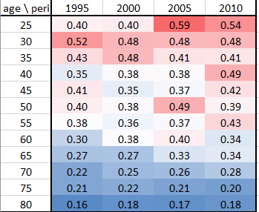
Data and Method
Gini index of rHC

Slide 19
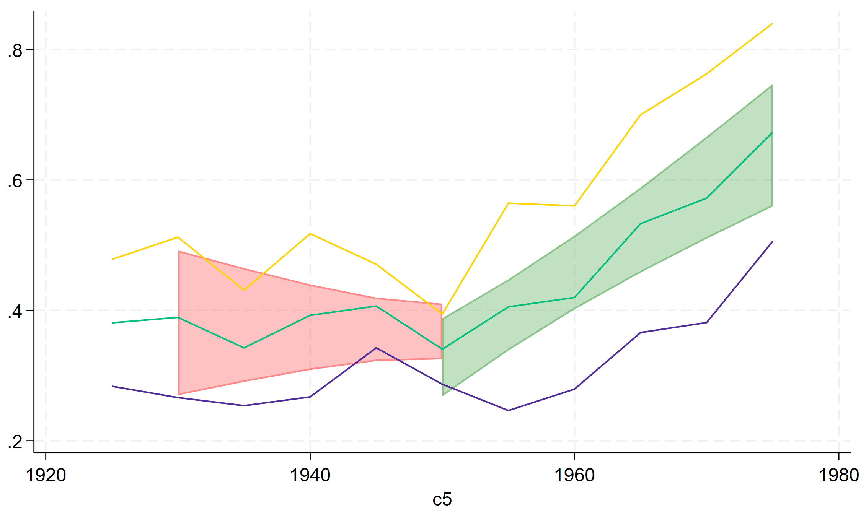
Gini index of rHC / APC DISCO

Slide 20
Data and Method
Apctlag (gini): cohort effect of gini of relative Health Capital inequality
⬅ Born before 1940
➔ Born after 1965

Slide 21
Method
0. Age-Period-Cohort model
  Unidentifiable w/o further constraints
Age-Period-Cohort Detrended¹
  Detects deviations from the linear trend of age, period and cohort
  Cannot identify actual linear trends
  Detects lucky/protected and unlucky/disadvantaged cohorts
¹ Chauvel & Schröder 2014; Chauvel, Leist, Ponomarenko 2016; Stata: ssc install apcd

Slide 22
Method
Age-Period-Cohort Trended Lag¹
  Constraints to identify social change via cohort vector
  Age linear trend constrained to average within-cohort age effect; sum of age and period vectors zero; period linear trend zero
Age-Period-Cohort Gap/Oaxaca model¹
  Blinder-Oaxaca decomposition in each cell of the Lexis table to derive differences between groups: Mean BMI of lower-educated minus mean BMI of higher-educated group
  APCT-lag to detect the intensity of the cohort gap (constant), its evolvement over time and non-linear accelerations of decelerations in the cohort trend
¹ Bar-Haim, Chauvel, Hartung, 2018; Bar-Haim et al. 2018; Stata: ssc install apcgo

Slide 23
Strategy of Data Analysis
Social trends with APC Trended Lag
rHC gaps with APC Gap Oaxaca
➔ are less educated more at risk
➔ are ethnic minorities more at risk

Slide 24
Data and Method
Apcgo (gap) lrHC gap between BA hoders and the rest cohort effect
⬅ Born before 1940
➔ Born after 1965

Slide 25
Data and Method
Apcgo (gap) lrHC gap between AA African American and white pop
⬅ Born before 1940
➔ Born after 1960

Slide 26
Discussion
Increasing health inequality
Increasing cohort gap between BA owners and the rest
DE-creasing cohort gap between African Americans and White pop
Possible explanations?
  See Cases and Deaton (despair?)
  Or new skill-class cleavages ?
Notes:
Obesity is an increasing problem of cohorts newly entering older ages, with all associated challenges to healthcare and social care systems
Obesity is an outcome of poor living conditions.
Obesity is strongly related to lack of hygiene/self-care, falls, eventually leading to functional impairments

