Slide 1

Gender inequality in physical health among Europe's top gender-equal countries: An empirical analysis using an intersectional approach.
Babul Hossain and Maria Ruiz Castell
CARES Research Team, Luxembourg Institute of Health (LIH)
Notes:
Socio-Economic and Environmental Health and Health Services
Babul: population health researcher specializing in gender and socioeconomic health disparities
Maria: Epidemiologist and researcher specializing in environmental health and health disparities.

Slide 2
Conceptualizing Gender and Health
Gender is socially constructed
Gendered health inequalities: systematic differences in health outcomes, risks, and healthcare use shaped by:
  Social and cultural norms
  Power relations and institutional structures
Health inequalities rarely result from a single factor.
Multiple intersecting identities influence health and healthcare use.

Slide 3


Gender, Health & Intersectionality
Socio-economic status
Education
Economic class/income
Working status
Occupation type
Marital status
Behaviours
Smoking & alcohol
Nutrition
Physical activity
Exposure to pollution
Availability & access to care
Identities
Ethnicity/race
Nationality
Citizenship
Migration status
Gender
Inequality in Health

Slide 4
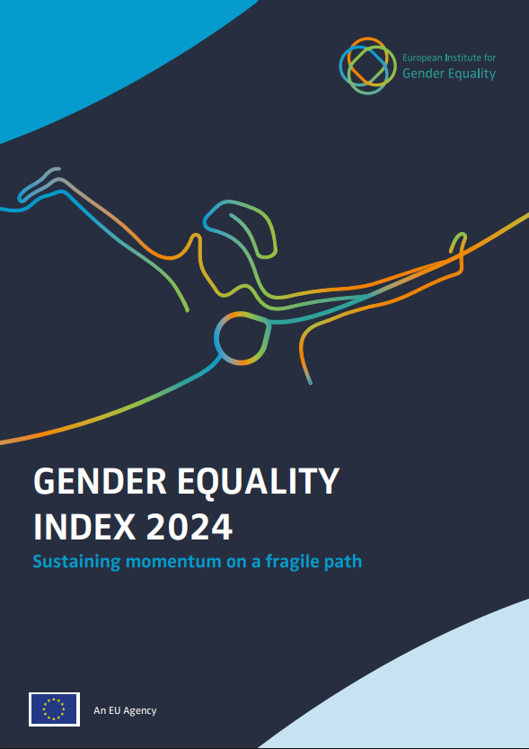
Gender equality in EU
Europe serves as an example for gender equality across various domains, including health.
The EU Gender Equality Report (2024) highlights marked heterogeneity across domains in EU countries, particularly in health.

Slide 5
Questions of interest
    Question 1: Do gender gaps in multimorbidity exist in the top gender-equal EU countries? If so, do they remain after controlling for sociodemographic characteristics and other covariates?
    Question 2: Which intersectional groups based on sociodemographic characteristics revealed gender gaps in multimorbidity in the top six gender-equal EU countries?

Slide 6
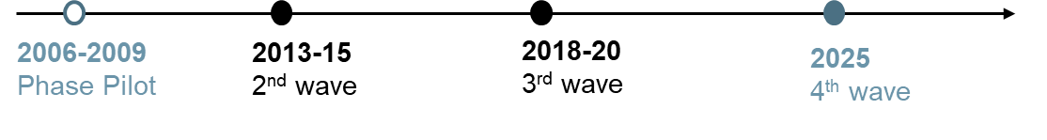
Data source- European Health Interview Survey (EHIS)
Cross-sectional observational study in the general population for residents ≥ 15 years (exclusion: collective housing/ institution) - voluntary participation
Developed by EUROSTAT and conducted every 5 years, using the same methodology (high degree of comparability).
This research used the 3rd wave of the EHIS survey.

Slide 7
Outcome- Multimorbidity
EHIS provides information on 14 self-reported diseases and chronic conditions experienced within the past 12 months:
    Asthma
    Chronic Obstructive Pulmonary Disease (COPD)
    Myocardial infarction
    Angina pectoris
    High blood pressure
    Stroke
    Arthrosis
    Lower back disorders
    Neck disorders
    Diabetes
    Allergies
    Liver cirrhosis
    Urinary incontinence
    Kidney problem
  Multimorbidity was defined as the co-occurrence of two or more of the chronic health conditions listed above.

Slide 8
Sociodemographic characteristics and covariates
Sociodemographic characteristics-
        Gender (men and women)
        Age group (15-44, 45-64, and 65+)
        Educational level (low, medium, and high based on ISCED classification)
        Immigration status (non-immigrant and immigrant)
Other covariates-
        Smoking (currently smoking and currently not smoking)
        Alcohol consumption (currently drinking and currently not drinking)
        Poor social support (yes and no)
        Living alone status (yes and no)
Top six gender-equal EU countries (Sweden, Denmark, Netherlands, Spain, Belgium and Luxembourg).

Slide 9
Intersectional groups
Gender
Education
Immigration
Age
A total of 36 intersectional groups, derived from the intersection of gender, age group, educational level, and immigration status (2 × 3 × 3 × 2= 36)
X

Slide 10
Descriptive statistics
Rank in gender equality in EU (2024) | Country | Women (%) | 65+ years (%) | High educated (%) | Immigrant (%)
1 | Sweden | 50.2 | 24.4 | 32.8 | 19.7
2 | Denmark | 50.9 | 23.3 | 45.3 | 8.3
3 | Netherlands | 50.4 | 22.3 | 31.3 | 12.4
4 | Spain | 51.3 | 20.9 | 30.1 | 14.5
5 | Belgium | 51.1 | 21.3 | 38.8 | 14.4
7 | Luxembourg | 49.6 | 16.4 | 48.9 | 49.1
Note: Sampling were were applied.
Ranks were based on 2024 EU Gender Equality Report by European Institute for Gender Equality.
France rank 6th in gender equality ranking but no included due to no available information.
Notes:
were applied to examine risk of multimorbidity among women relative to men while adjusting for sociodemographic characteristics across these countries.
were used to explore how the probability of multimorbidity varies between gender by sociodemographic characteristics in these countries

Slide 11
Gender gap in multimorbidity
Rank in gender equality in EU (2024) | Country | Women (%) | Men (%) | Gender gap (women- men) (Percentage point)
1 | Sweden | 35.8 | 26.05 | 9.75
2 | Denmark | 29.15 | 24.89 | 4.26
3 | Netherlands | 30.47 | 21.93 | 8.54
4 | Spain | 27.98 | 19.68 | 8.30
5 | Belgium | 36.96 | 28.43 | 8.53
7 | Luxembourg | 38.31 | 31.59 | 6.72
Note: Sampling were were applied.
Ranks were based on 2024 EU Gender Equality Report by European Institute for Gender Equality.
France rank 6th in gender equality ranking but no included due to no available information.

Slide 12
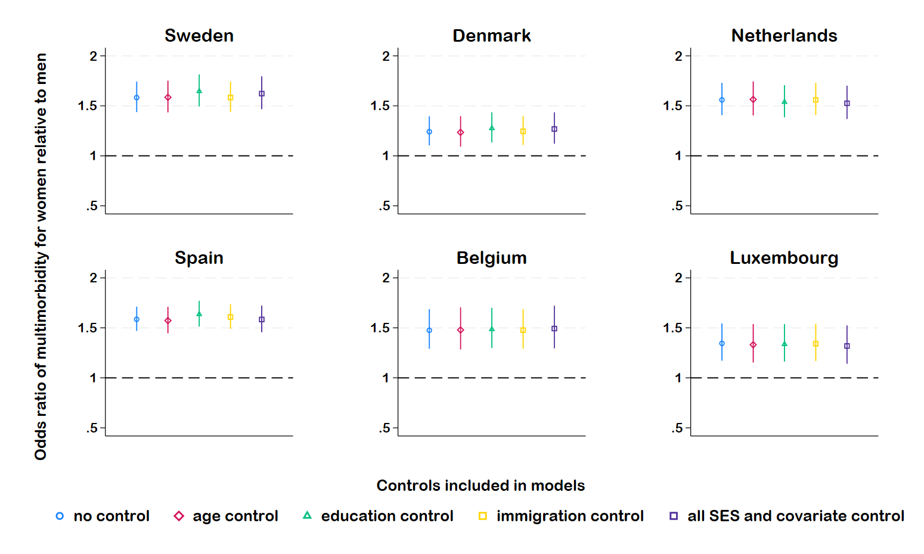
Gender gap in multimorbidity
Note: Estimates were based on logistic regression models.

Slide 13
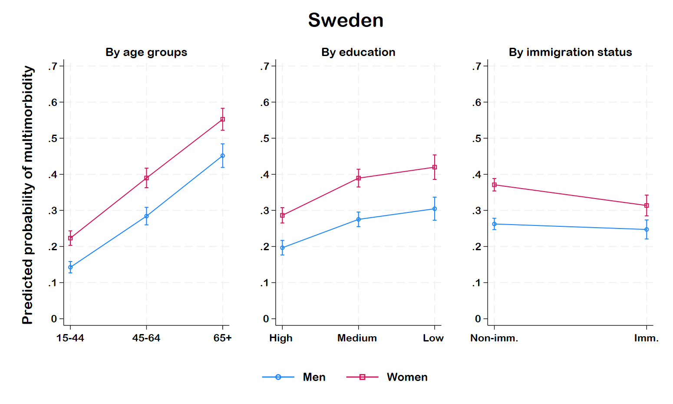
Intersectional gender gap- Sweden
Age- Across all age groups of women.
Education- Across all educational groups of women.
Immigration-Non-immigrant women.
Note: Estimates based on multivariate logistic model controlling covariates (smoking, alcohol consumption, poor social support and living alone status). Non-imm.= Non-immigrant, Imm.= Immigrant

Slide 14
Highest and lowest PP- Sweden
Intersectional group | Gender |  | Age |  |  | Educational level |  |  | Immigration
Lowest PP of multimorbidity | Men | Women | 15-44 | 45-64 | 65+ | High | Medium | Low | Non-imm. | Imm.
1
2
3
Highest PP of multimorbidity
1
2
3
Note: Based on the overlapping of sociodemographic characteristics, 36 mutually exclusive intersectional groups were considered.
Estimates based on multivariate logistic model controlling covariates (smoking, alcohol consumption, poor social support and living alone status).
Only significant groups were reported.
PP= Predicted probability, Non-imm.= Non-immigrant, Imm.= Immigrant

Slide 15
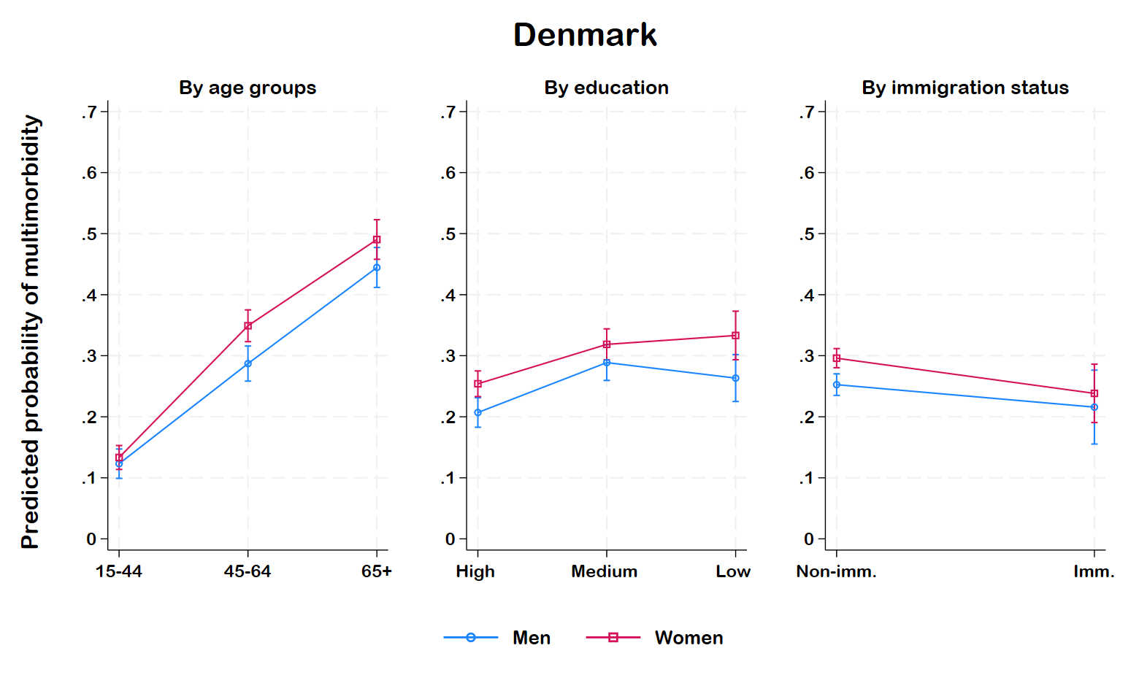
Intersectional gender gap- Denmark
Age: 45-64 years of age for women.
Education- No significant gender gap.
Immigration- Non-immigrant women.
Note: Estimates based on multivariate logistic model controlling covariates (smoking, alcohol consumption, poor social support and living alone status). Non-imm.= Non-immigrant, Imm.= Immigrant

Slide 16
Highest and lowest PP- Denmark
Intersectional group | Gender |  | Age |  |  | Educational level |  |  | Immigration
Lowest PP of multimorbidity | Men | Women | 15-44 | 45-64 | 65+ | High | Medium | Low | Non-imm. | Imm.
1
2
3
Highest PP of multimorbidity
1
2
3
Note: Based on the overlapping of sociodemographic characteristics, 36 mutually exclusive intersectional groups were considered.
Estimates based on multivariate logistic model controlling covariates (smoking, alcohol consumption, poor social support and living alone status).
Only significant groups were reported.
PP= Predicted probability, Non-imm.= Non-immigrant, Imm.= Immigrant

Slide 17
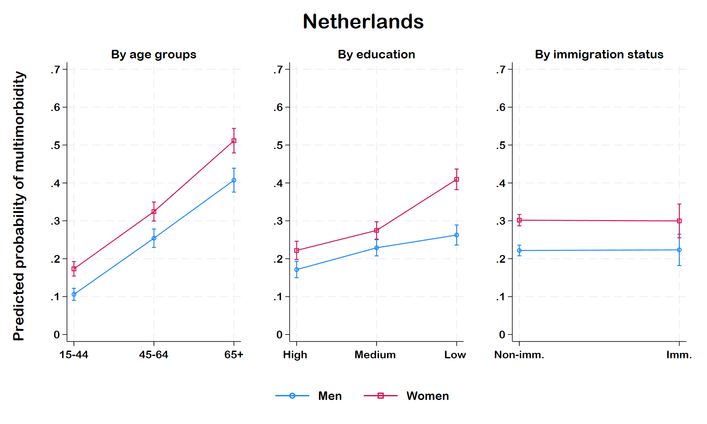
Intersectional gender gap- Netherlands
Age- Across all age groups of women.
Education- low educated women
Immigration- Non-immigrant women.
Note: Estimates based on multivariate logistic model controlling covariates (smoking, alcohol consumption, poor social support and living alone status). Non-imm.= Non-immigrant, Imm.= Immigrant

Slide 18
Highest and lowest PP- Netherlands
Intersectional group | Gender |  | Age |  |  | Educational level |  |  | Immigration
Lowest PP of multimorbidity | Men | Women | 15-44 | 45-64 | 65+ | High | Medium | Low | Non-imm. | Imm.
1
2
3
Highest PP of multimorbidity
1
2
3
Note: Based on the overlapping of sociodemographic characteristics, 36 mutually exclusive intersectional groups were considered.
Estimates based on multivariate logistic model controlling covariates (smoking, alcohol consumption, poor social support and living alone status).
Only significant groups were reported.
PP= Predicted probability, Non-imm.= Non-immigrant, Imm.= Immigrant

Slide 19
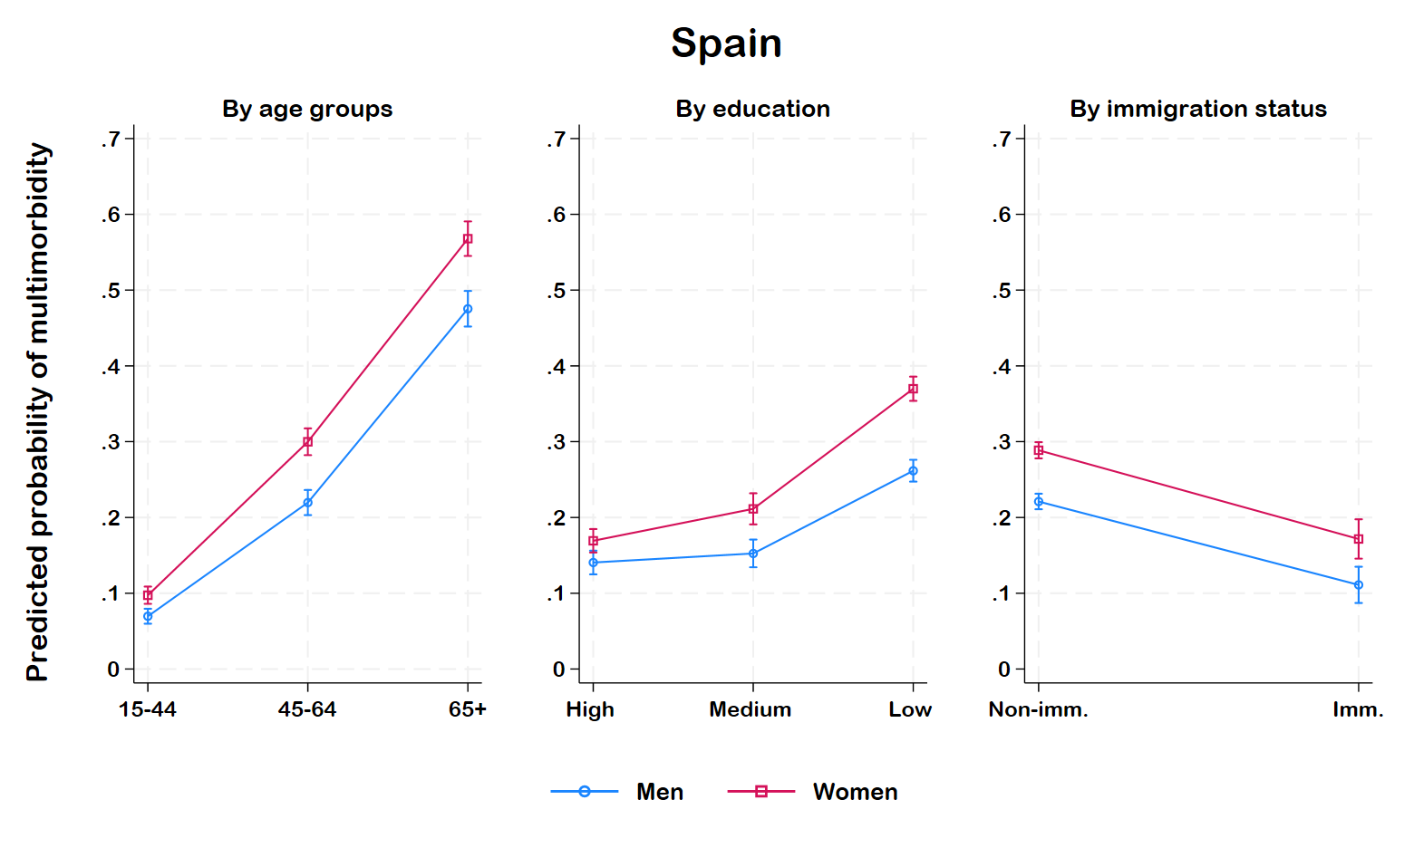
Intersectional gender gap- Spain
Age- 45-64 and 65+ years of age for women.
Education- Medium and low-educated women.
Immigration- Irrespective of immigration status, women
Note: Estimates based on multivariate logistic model controlling covariates (smoking, alcohol consumption, poor social support and living alone status). Non-imm.= Non-immigrant, Imm.= Immigrant

Slide 20
Highest and lowest PP- Spain
Intersectional group | Gender |  | Age |  |  | Educational level |  |  | Immigration
Lowest PP of multimorbidity | Men | Women | 15-44 | 45-64 | 65+ | High | Medium | Low | Non-imm. | Imm.
1
2
3
Highest PP of multimorbidity
1
2
3
Note: Based on the overlapping of sociodemographic characteristics, 36 mutually exclusive intersectional groups were considered.
Estimates based on multivariate logistic model controlling covariates (smoking, alcohol consumption, poor social support and living alone status).
Only significant groups were reported.
PP= Predicted probability, Non-imm.= Non-immigrant, Imm.= Immigrant

Slide 21
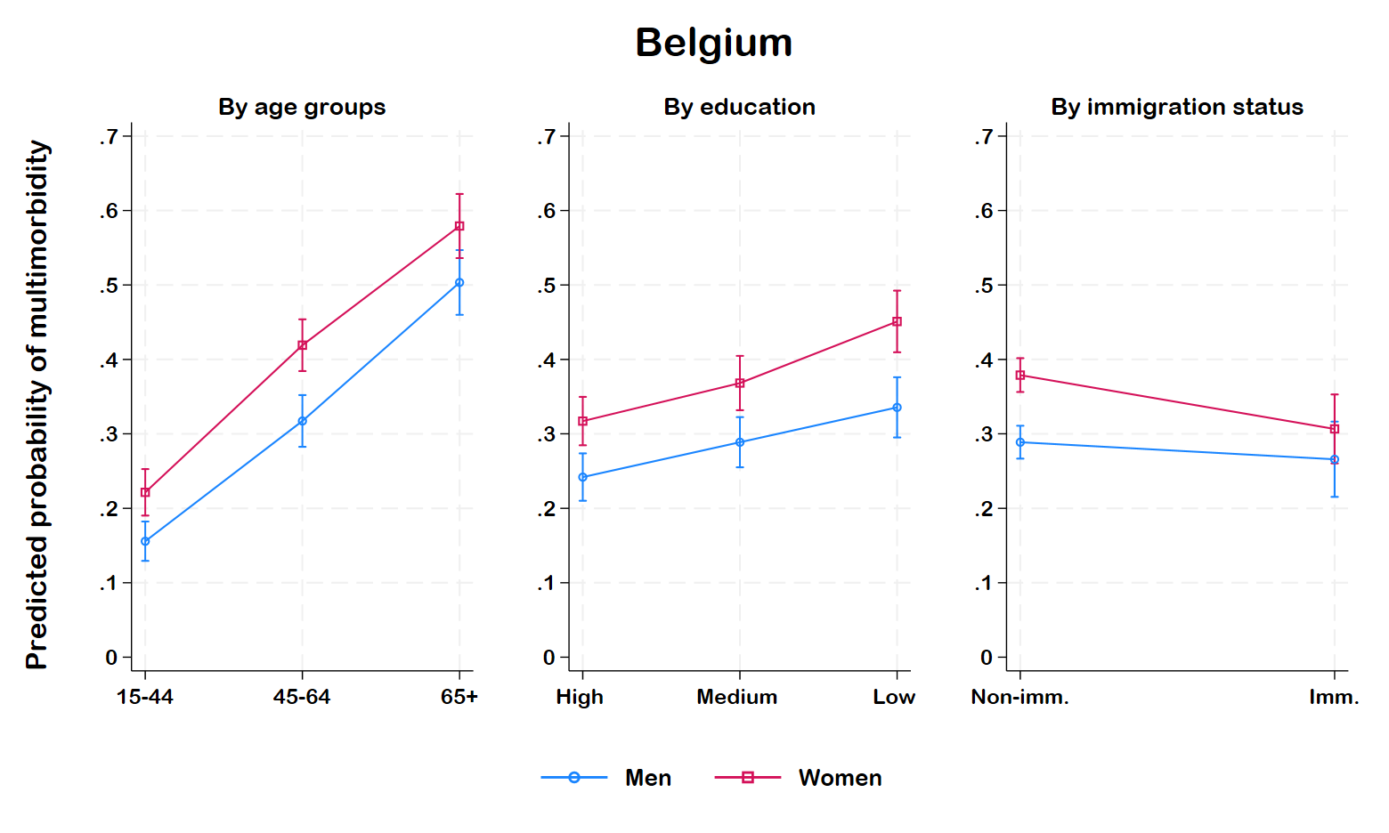
Intersectional gender gap- Belgium
Age: 15-44 and 45-64 years old women.
Education- Across all groups of women.
Immigration- Non-immigrant women.
Note: Estimates based on multivariate logistic model controlling covariates (smoking, alcohol consumption, poor social support and living alone status). Non-imm.= Non-immigrant, Imm.= Immigrant

Slide 22
Highest and lowest PP- Belgium
Intersectional group | Gender |  | Age |  |  | Educational level |  |  | Immigration
Lowest PP of multimorbidity | Men | Women | 15-44 | 45-64 | 65+ | High | Medium | Low | Non-imm. | Imm.
1
2
3
Highest PP of multimorbidity
1
2
3
Note: Based on the overlapping of sociodemographic characteristics, 36 mutually exclusive intersectional groups were considered.
Estimates based on multivariate logistic model controlling covariates (smoking, alcohol consumption, poor social support and living alone status).
Only significant groups were reported.
PP= Predicted probability, Non-imm.= Non-immigrant, Imm.= Immigrant

Slide 23
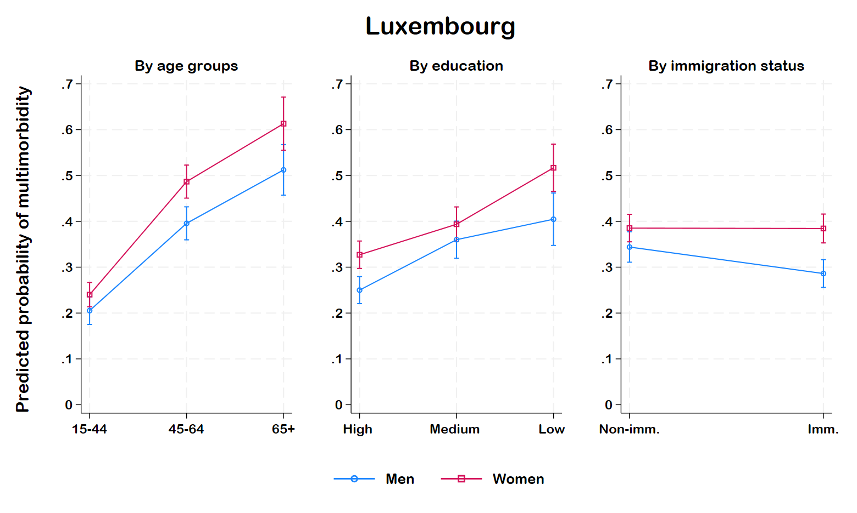
Intersectional gender gap- Luxembourg
Age- 45-64 years old women.
Education- High educated women
Immigration- Immigrant women
Note: Estimates based on multivariate logistic model controlling covariates (smoking, alcohol consumption, poor social support and living alone status). Non-imm.= Non-immigrant, Imm.= Immigrant

Slide 24
Highest and lowest PP- Luxembourg
Intersectional group | Gender |  | Age |  |  | Educational level |  |  | Immigration
Lowest PP of multimorbidity | Men | Women | 15-44 | 45-64 | 65+ | High | Medium | Low | Non-imm. | Imm.
1
2
3
Highest PP of multimorbidity
1
2
3
Note: Based on the overlapping of sociodemographic characteristics, 36 mutually exclusive intersectional groups were considered.
Estimates based on multivariate logistic model controlling covariates (smoking, alcohol consumption, poor social support and living alone status).
Only significant groups were reported.
PP= Predicted probability, Non-imm.= Non-immigrant, Imm.= Immigrant

Slide 25
Summary
  Women had more multimorbidity than men.
  Women experience higher multimorbidity than men, even after adjusting for sociodemographic factors and covariates.
  Young, highly educated non-immigrant men commonly showed the lowest multimorbidity.
  Old, low-educated, and mostly immigrant women commonly showed the highest multimorbidity.

Slide 26
Limitations and future scope
  The goal was to provide a snapshot so no causality can be inferred from this research.
  The analysis does not capture changes over time; results from the upcoming 2025 EHIS survey may further provide valuable insights.
  Only focused on binary gender, and further research is needed for other gender identities.

Slide 27

Acknowledgement
  This research was supported by the Ministry for Gender Equality and Diversity (MEGA) and the Ministry of Higher Education and Research (MESR) in Luxembourg.

Slide 28
THANK YOU
Babul Hossain, PhD
Postdoctoral fellow, CARES
Babul.hossain@lih.lu
Maria Ruiz-Castell, PhD
Group leader of Socio-Economic and Environmental Health and Health Services Research Unit (CARES)
Maria.ruiz@lih.lu

Slide 29
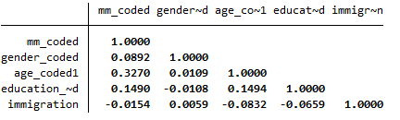
Correlation matrix

Slide 30
Intersectional group sample

