Slide 1
Benchmarking small-area mortality models for cause-of-death data
Rok Hrzic & Avi Magid
Department of International Health, Care and Public Health Research Institute, Maastricht University
EAPS HMMWG meeting, 12 September 2025, Luxembourg

Slide 2
Introduction
Mortality research in (ever-)small(er) geographic areas enhances public health decision-making
Challenges: sparse data, stochasticity → modelling needed!
More pronounced in CoD research (smaller counts)
What should a local-level practitioner use?

Slide 3
Literature review – overview
Examined a sample of 14 studies using Hierarchical Bayes for CoD mortality estimates in small areas: Barceló et al. (2009), Cano-Serral et al. (2009), Borrell et al. (2010), Foreman et al. (2012), Hoffmann et al. (2014), Castillo-Carniglia et al. (2015), Santana et al. (2015), Dwyer-Lindgren et al. (2017), Foreman et al. (2017), Gotsens et al. (2020), Gayawan et al. (2021, 2022), Martinez-Beneito et al. (2021), Rashid et al. (2024)

Slide 4
Literature review – summary
Model specification
Besag-York-Mollié (BYM) for space
variation in age and period treatment (stratification versus cubic spline or random walk)
Joint CoD estimation models were quite rare and are not discussed today
Fitted with Integrated nested Laplace approximations (INLA), less commonly via simulation (Stan/JAGS)

Slide 5
Literature review – example
Gotsens et al. (2020) examined socioeconomic inequalities in cause-specific mortality across census tracts in seven Spanish cities in three periods (including the 2008 economic crisis)
Model: BYM spatial component, stratified by city, sex, period, and cause
Heterogeneous effects of the 2008 crisis on socioeconomic inequalities by cause.

Slide 6
Objective
Compare the performance of commonly used model specifications in small-area cause-specific mortality studies.
Recommend a practical approach for analysts in local governments or health authorities

Slide 7
Methods – Models benchmarked
 | Space specification | Age specification | Period specification
Model 1 | Spatial autoregressive model (BYM) | Stratifier only | Stratifier only
Model 2 | Spatial autoregressive model (BYM) | Cubic spline (TOPALS) | Stratifier only
Model 3 | Spatial autoregressive model (BYM) | Cubic spline (TOPALS) | RW1
Implemented in R, using the package R-INLA with a modified Laplace approximation

Slide 8
Methods - Data
Simulated death counts: d_{a,s,y,c,r}
a = age group (0, 1-4, …, 95+),
s = sex (m,f),
y = year (2000-2019),
c = cause (cardiovascular, cancer, external, other),
r = region (R001-R100)

Slide 9
Methods - Data
m_{a,s,y,c} were extracted from the Human Cause-of-Death Data series data for CZE, EST, LTU, LVA, POL
Mean m_{a,s,y,c} was calculated
Simulated p_{a,s,y} between 10,000 and 20,000 were generated, assuming static population sizes over time with an ESP2013 age structure
d_{a,s,y,c,r} were generated by drawing from a Poisson distribution, assuming lambda = m_{a,s,y,c} p_{a,s,y}

Slide 10
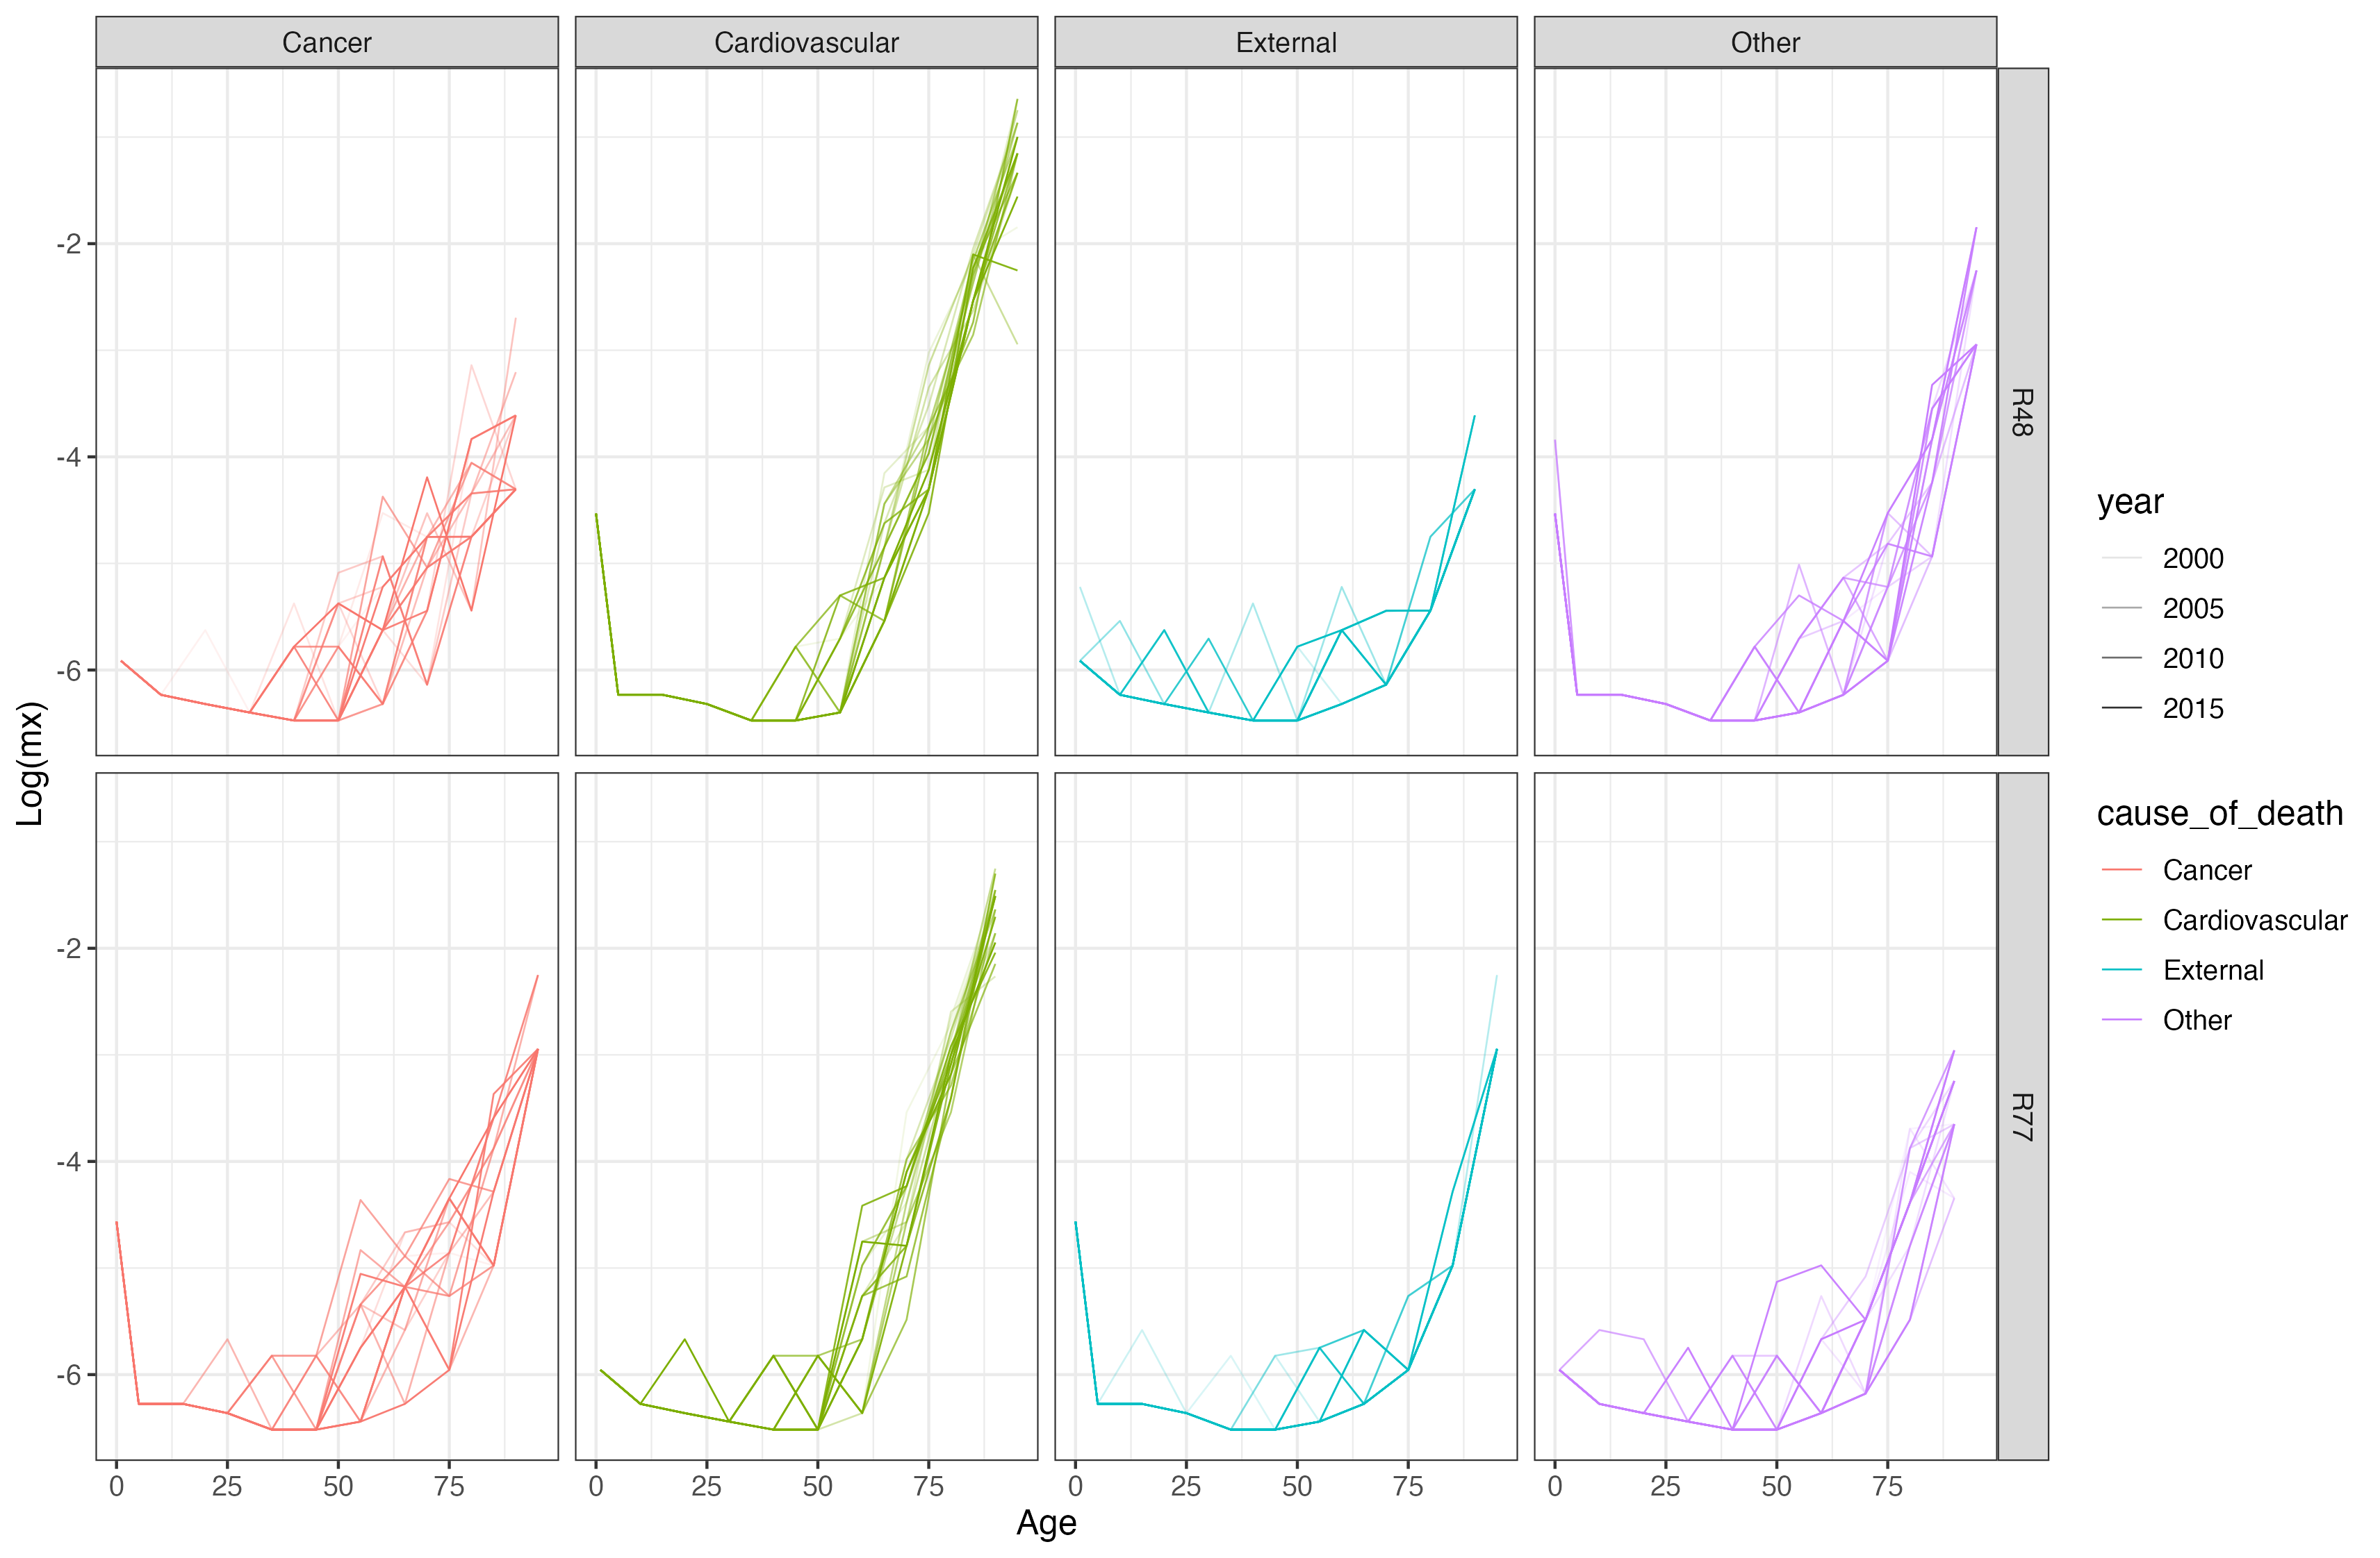
Simulated mortality schedules

Slide 11
Methods – Outcomes
Precision: RMSE and CV
Uncertainty: coverage probability and average UI width
Coherence: aggregation ratio
Runtime: wall-clock time in seconds
N = 10 runs, Apple M1 processor, 16 GB RAM

Slide 12
Results - summary
 | Precision |  | Uncertainty intervals |  | Coherence |  | Computation
Model | Root mean squared error | Coefficient of variation | Coverage probability | Average interval width | Aggregation ratio | Time to fit one stratum model (seconds) | Total time (minutes)
Model 1 | 0.83 (0.2, 3.52) | 0.84 (0.28, 1.02) | 1 (0.96, 1) | 4.84 (3.34, 14.17) | 1 (1, 1) | 2.42 (2.35, 2.47) | 80.9 (77.1, 100.3)
Model 2 | 0.84 (0.19, 3.62) | 0.84 (0.29, 1.04) | 0.99 (0.96, 1) | 4.82 (3.24, 13.9) | 1 (0.91, 1.1) | 5.64 (4.83, 6.39) | 4.50 (4.47, 4,53)
Model 3 | 0.82 (0.11, 3.71) | 0.83 (0.28, 1.04) | 0.99 (0.95, 1) | 4.8 (3.15, 13.83) | 1 (0.91, 1.1) | 14.78 (9.94, 17.93) | 0.56 (0.55, 0.57)
Note: benchmark UI report on the variation in estimate precision, uncertainty, and coherence across runs, regions, sexes, years, and regions

Slide 13
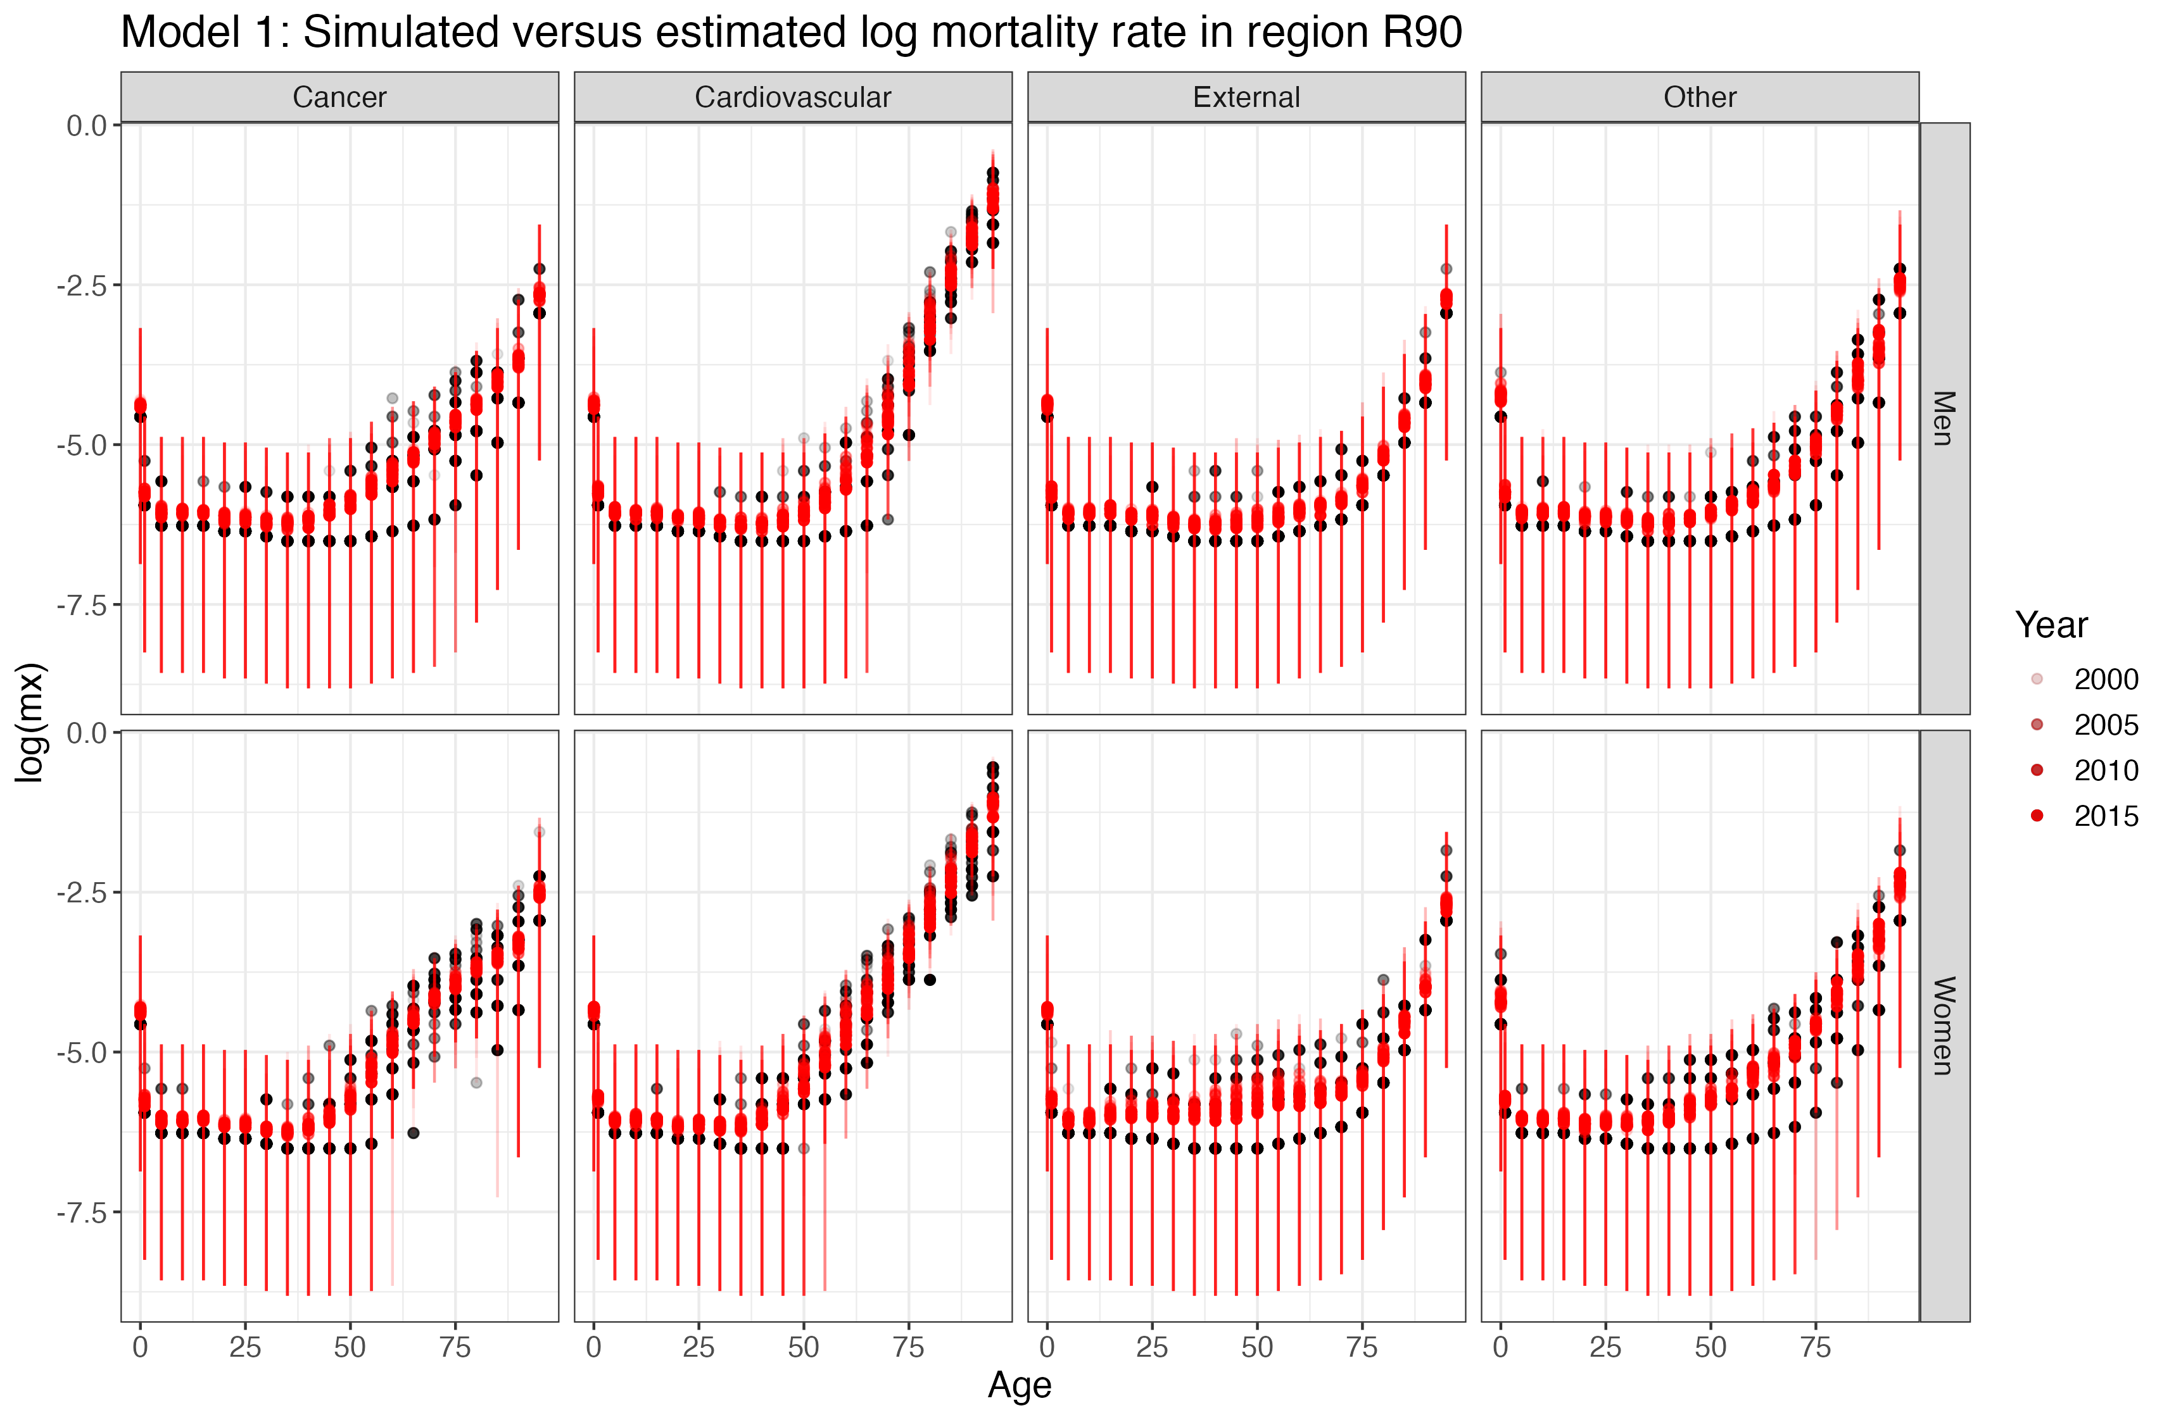

Slide 14
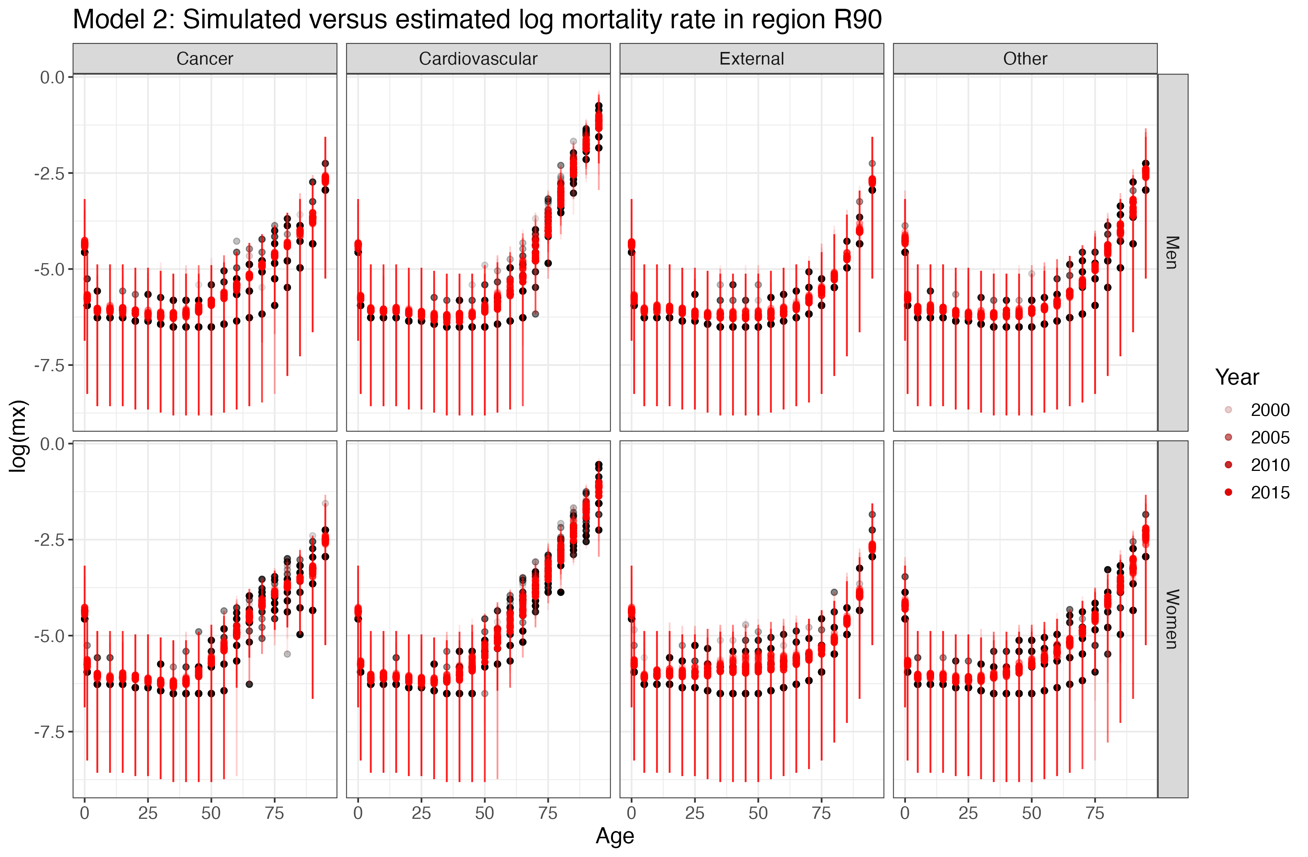

Slide 15
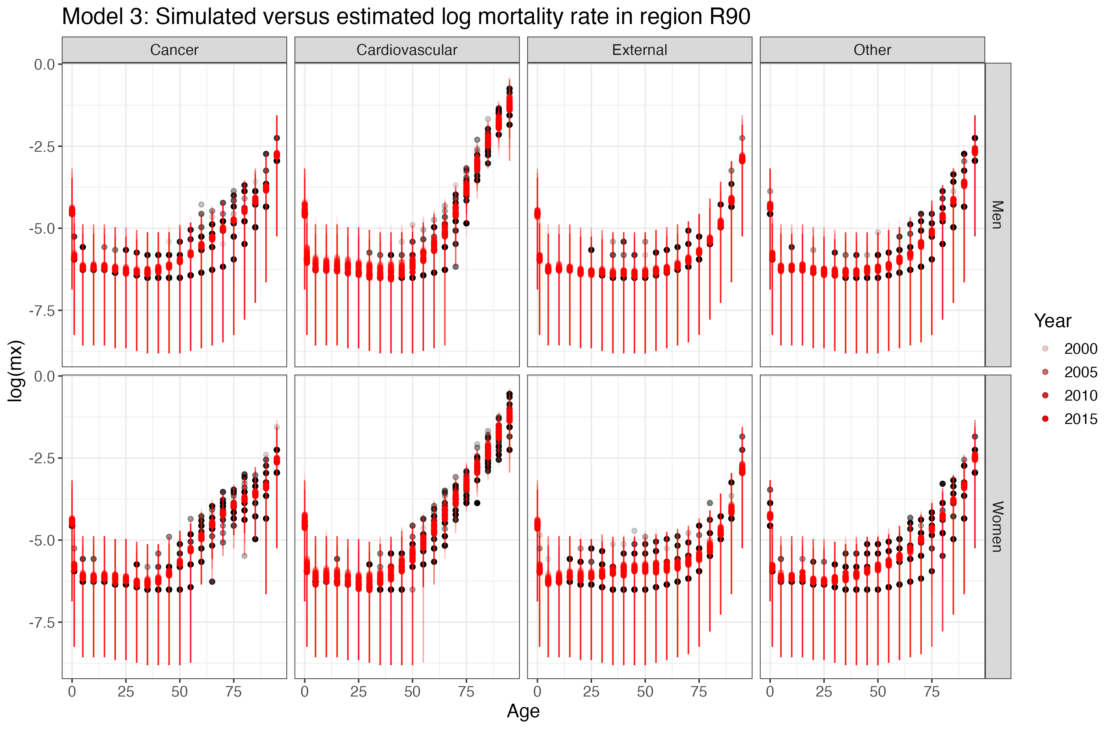

Slide 16
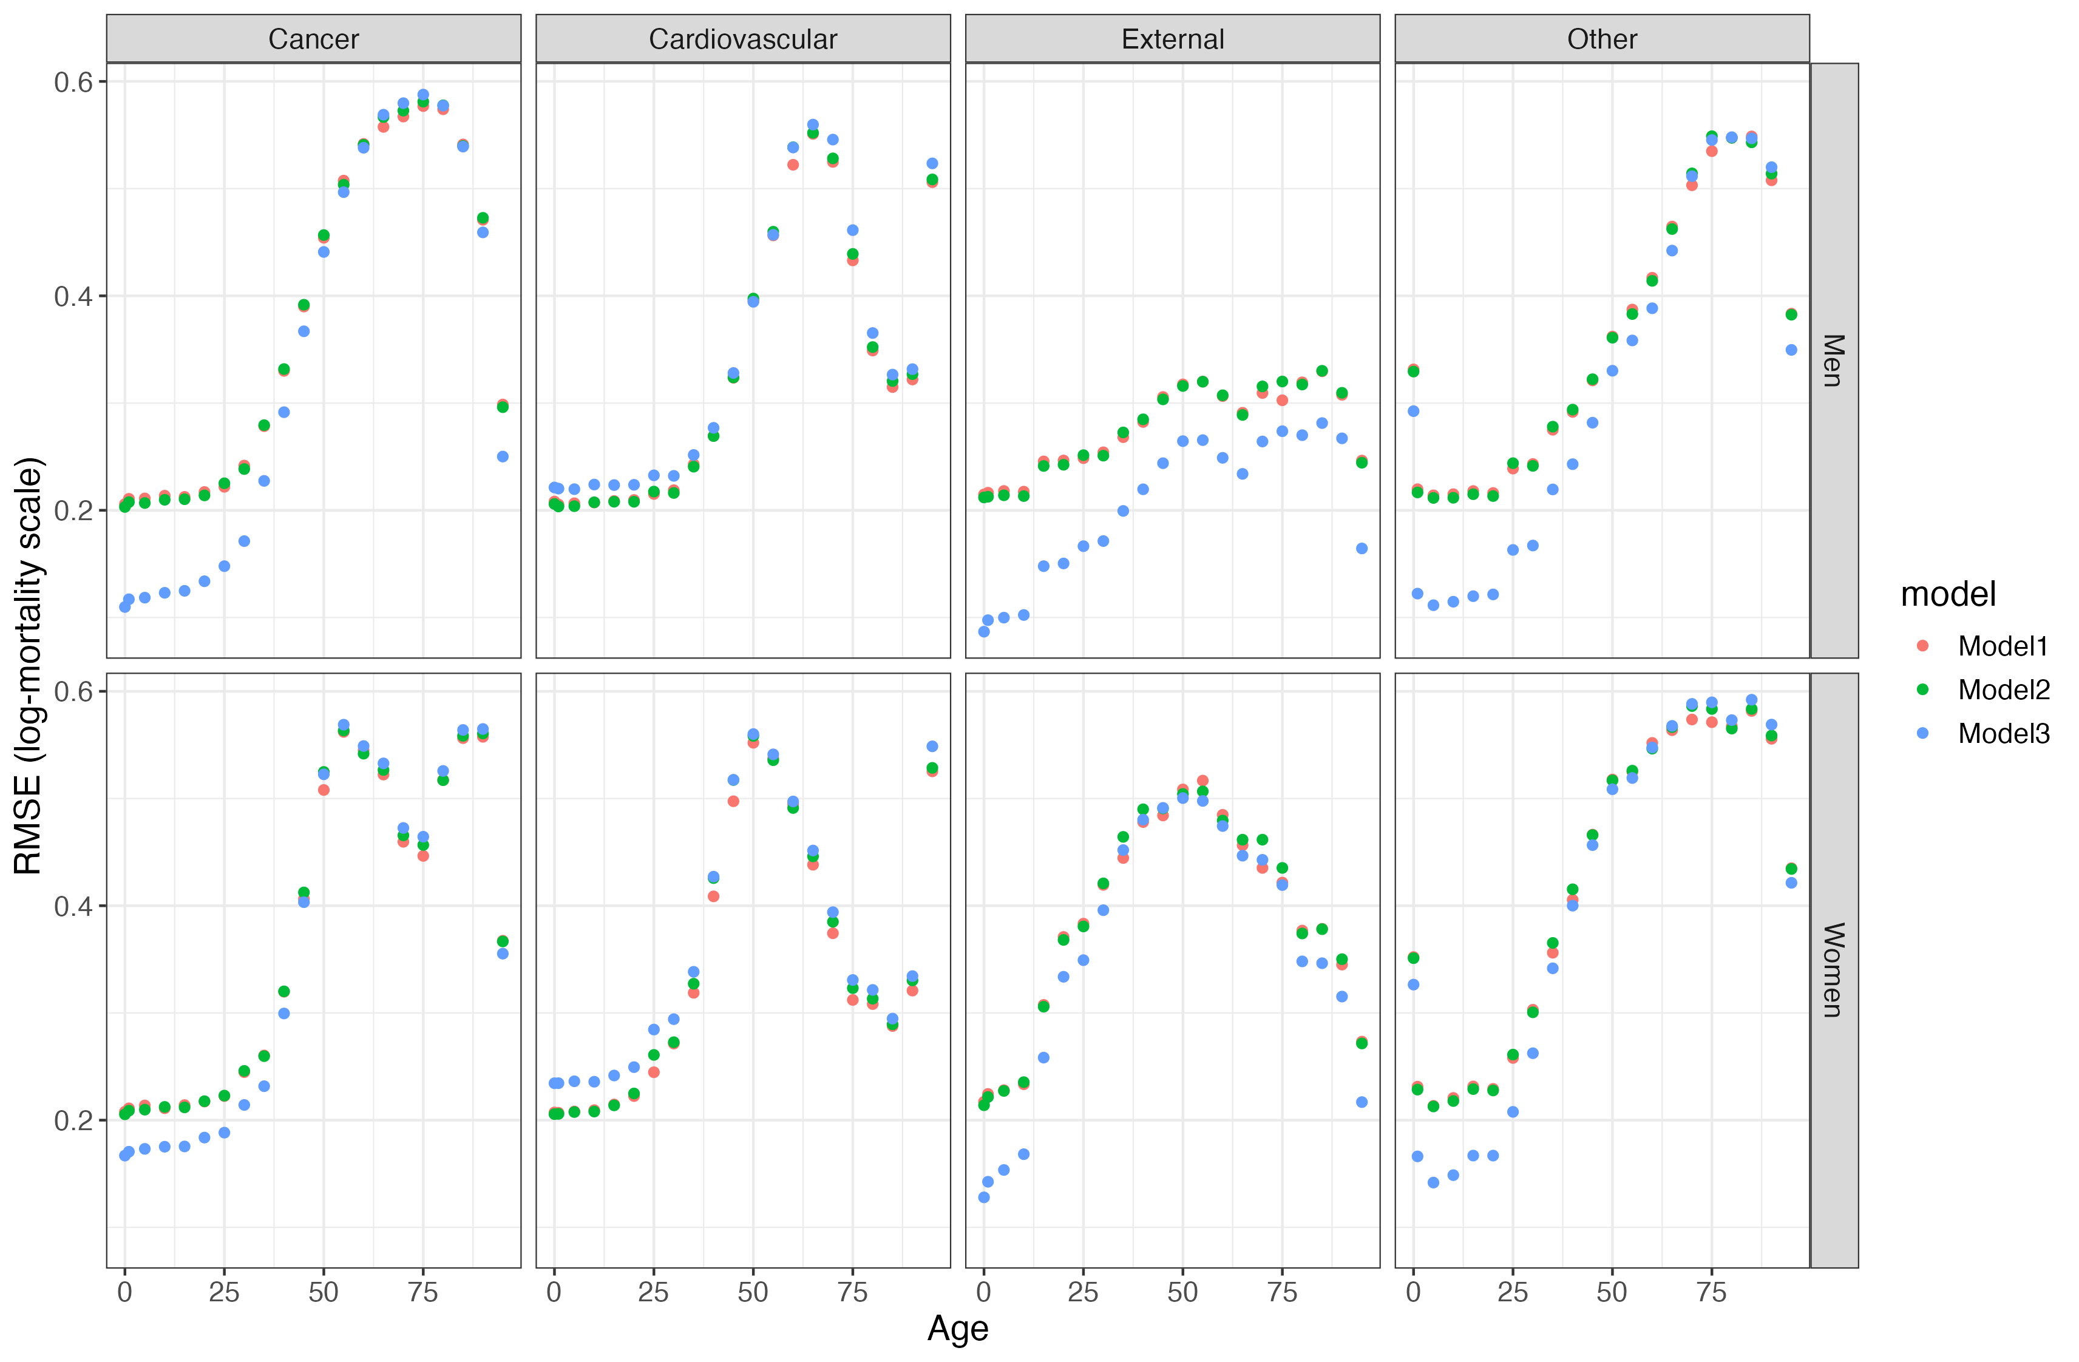
Precision: Root mean squared error

Slide 17
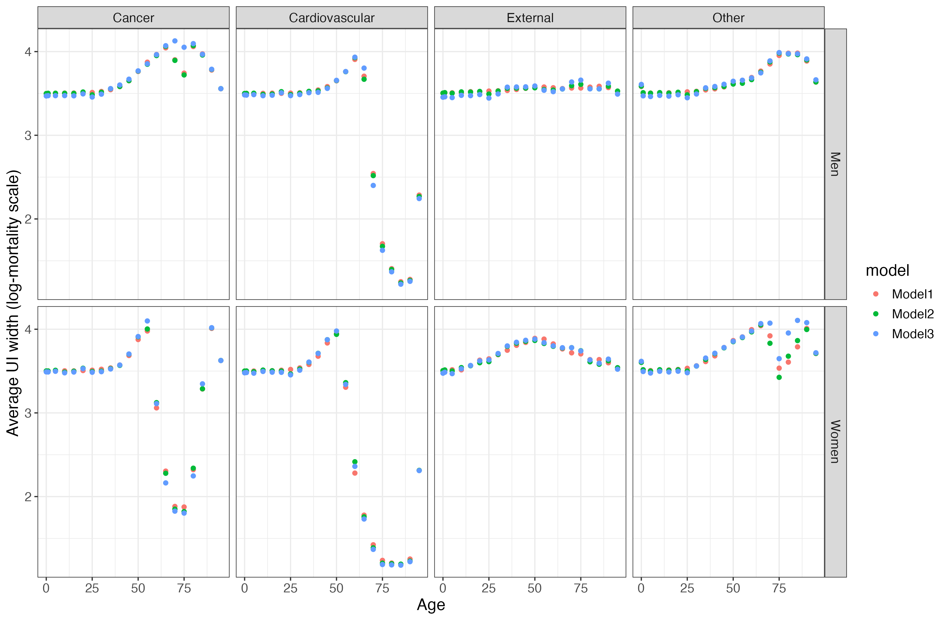
Average uncertainty interval width

Slide 18
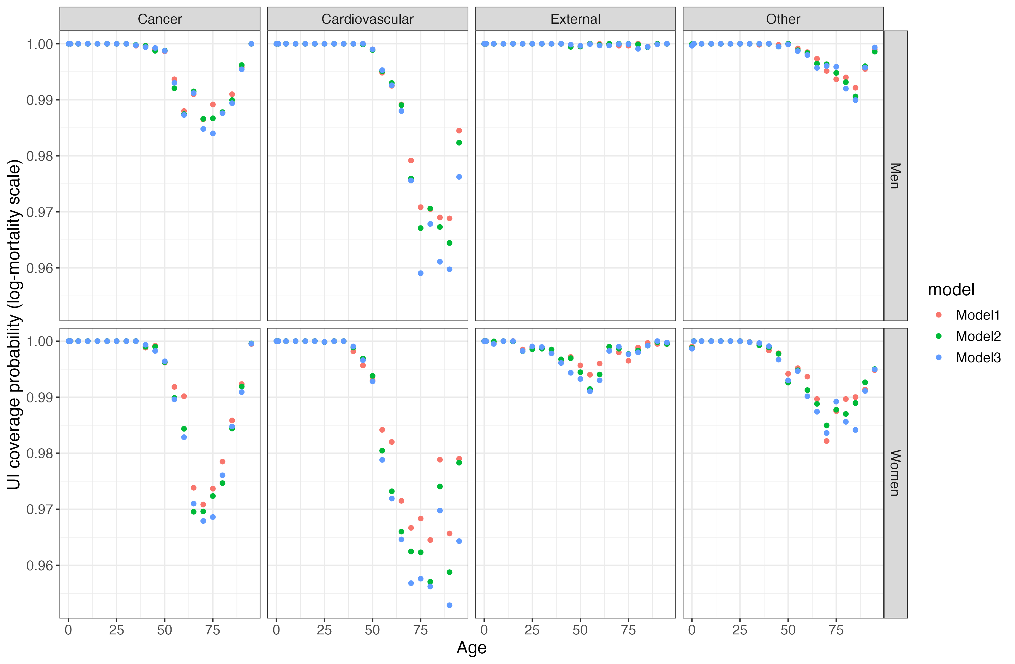
Coverage probability of the estimated UI

Slide 19
Conclusions
Performance varies across ages and CoDs, but not models; wide CIs
Simplicity paradox
The simplest specifications take the longest to fit due to the large number of strata
Small-area mortality models can be utilised by researchers with limited access to high-performance computing
Next step: examine joint estimation of CoDs and raking

