Slide 1






The contribution of obesity to life expectancy with and without cardiovascular diseases by sex, education, and autonomous communities in Spain
Jeroen Spijker^{1,2*}, Jordi Gumà², Aïda Solé-Auró³, Sergi Trias², Iñaki Permanyer²
¹Universitat Internacional de Catalunya
²Centre d’Estudis Demogràfics-CERCA
³Universitat Pompeu Fabra
*corresponding author: jspijker@ced.uab.es @popageing

Slide 2
Background
Cardiovascular diseases (CVDs) are the leading cause of death in terms of years of life lost for females and second for males in Spain (Haro et al., 2014).
Overweight and obesity have emerged as a critical metabolic risk factor in the context of CVDs, particularly at older age (Singh et al. 2013).
Obesity affects not only lifespan but also quality of life (Cameron et al. 2011).
In 2017-20, 19.4% of men and 18.6% of women aged 35-84 in Spain were obese.

Slide 3
Research gap and objective
The contribution of high BMI to health disparities remains underexplored, particularly amid persistent gender, educational and regional inequalities.
→ The objective is to estimate the contribution of overweight and obesity to years lived with and without CVD in Spain across three periods (2001-2006, 2009-2014, and 2017-2023). Until now we’ve only prepared the data for the 2017-2019/20 period.
We focus on gender, education and differences by autonomous communities (CCAA)

Slide 4
Data Source
Cause-specific mortality and population data stratified by age, sex and CCAA are obtained from the Spanish Statistical Office.
The following CVD-related causes of death are analysed (as the relative risks of high BMI were published in the article by the GBD 2016 Risk Factors Collaborators (2017)):
Hypertensive heart disease (I11)
Ischaemic heart disease (I20-25)
Atrial fibrillation and flutter (ICD-10 I48)
Haemorrhagic stroke (ICD-10 I6I)
Ischaemic stroke (ICD-10 I63)
Notes:
Atrial fibrillation and atrial flutter are both abnormal heart rhythms originating in the atria, the upper chambers of the heart. While both involve rapid and irregular heartbeats, atrial fibrillation is characterized by an erratic and disorganized quivering of the atria, whereas atrial flutter involves a more regular but still rapid, "fluttering" rhythm. Both conditions can lead to similar symptoms, including palpitations, shortness of breath, dizziness, and an increased risk of stroke.

Slide 5
Data Source
BMI distributions are calculated from the 2017 Spanish National Health Survey and 2019/20 waves of the European Health Interview Survey (data are pooled).
Analyses are restricted to individuals aged 35-84 to ensure educational completion and sufficient deaths.
Educational categories:
1. ≤ Primary
2. Secondary/Medium Vocational
3. University/Higher Vocational
The 85+ population is excluded due to underrepresentation of morbidity data.

Slide 6
Method (I)
Obesity is defined using the standard BMI threshold of ≥30 kg/m².
Relative Risks (RRs) for CVD-related mortality due to high BMI are obtained from the GBD 2016 Risk Factors Collaborators’ (2017) meta-analyses based on individual/pooled cohort studies.
GBD estimated RRs per 5-unit change in BMI (with BMI 20-24.9 as reference) for each disease and age group (RR were not provided by sex for these causes), e.g.:
We applied the RR to overweight and double the value to obesity (BMI 30+)
Ischaemic heart disease | I20-I25 | 5 kg/m2 | 35-39 | 1.724
Ischaemic heart disease | I20-I25 | 5 kg/m2 | 40-44 | 1.599
Ischaemic heart disease | I20-I25 | 5 kg/m2 | 45-49 | 1.567
Ischaemic heart disease | I20-I25 | 5 kg/m2 | 50-54 | 1.520
Ischaemic heart disease | I20-I25 | 5 kg/m2 | 55-59 | 1.466
Ischaemic heart disease | I20-I25 | 5 kg/m2 | 60-64 | 1.414
Ischaemic heart disease | I20-I25 | 5 kg/m2 | 65-69 | 1.364
Ischaemic heart disease | I20-I25 | 5 kg/m2 | 70-74 | 1.319
Ischaemic heart disease | I20-I25 | 5 kg/m2 | 75-79 | 1.274
Ischaemic heart disease | I20-I25 | 5 kg/m2 | 80-84 | 1.170
Notes:
The GBD publication talks about RR not Hazard Ratios, which makes sense as:
RR is the ratio of the probability of an event occurring in an exposed group compared to the probability of the event occurring in a non-exposed group (over the life course).
HR is a measure of the relative hazard (or instantaneous risk) of an event occurring at any given time (e.g. effect of a drug).

Slide 7
Method (II)
Population Attributable Fractions (PAFs) are calculated & applied to CVD mortality rates to estimate the fraction attributable to obesity.
Cause-elimination life tables are constructed to estimate PGLE from no CVD with and without overweight/obesity attributed to CVD.

Slide 8
Results – BMI by Sex
Ages 35-84. Spain 2017/2019-20
Men Women
0.4% 1.8%
30.4% 45.9%
49.8% 33.8%
19.4% 18.6%
Underweight
Normal weight
Overweight
Obesity

Slide 9
Results – BMI by sex and education
Ages 35-84. Spain 2017/2019-20
Men Women
Low Mid High Low Mid High
0.5% 0.3% 0.3% 1.0% 2.0% 2.9%
26.2% 30.0% 37.1% 31.6% 50.7% 64.3%
49.7% 50.5% 48.9% 40.5% 32.1% 24.0%
23.5% 19.1% 13.7% 26.9% 15.1% 8.8%
Underweight
Normal weight
Overweight
Obesity

Slide 10
Results – % overweight by sex and CCAA
Men
Women
(6)
(5)
(6)
(6)
(5)
(6)
Ages 35-84. Spain 2017/2019-20

Slide 11
Results – % obesity by sex and CCAA
Men
Women
(6)
(5)
(6)
(6)
(5)
(6)

Slide 12
Results – % normal weight by sex and CCAA
Men
Women
(6)
(5)
(6)
(6)
(5)
(6)
Ages 35-84. Spain 2017/2019-20

Slide 13
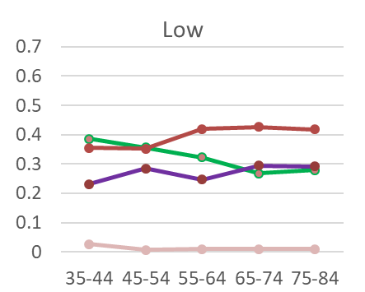
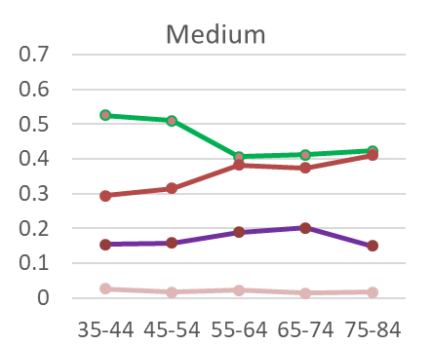
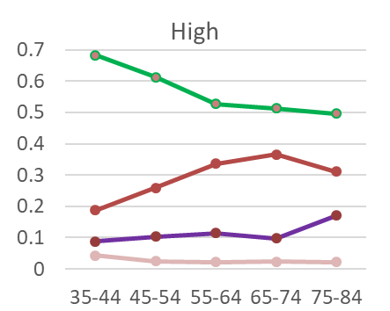
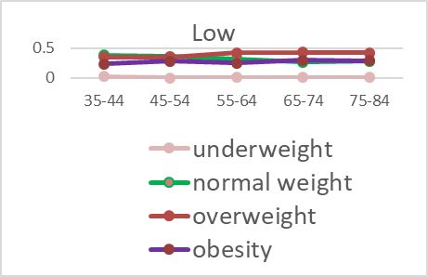
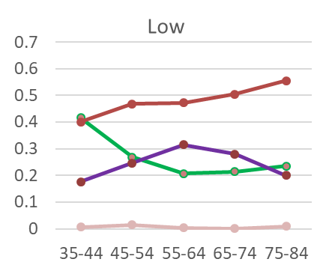
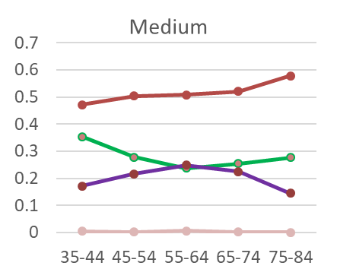
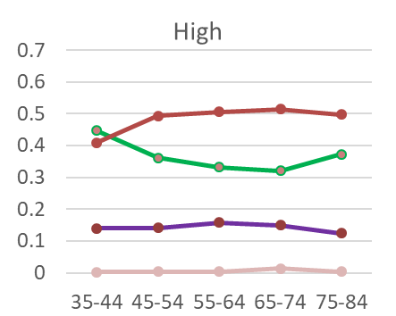
Results – BMI categories by age and education
BMI
Prevalence
Women Men

Slide 14
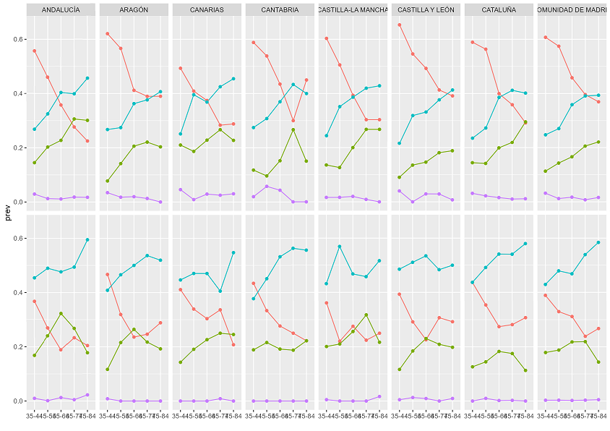

Results – BMI categories by age and CCAA
0.6
0.4
0.2
0.0
0.6
0.4
0.2
0.0
Prevalence
Women Men
Ages 35-84. Spain 2017/2019-20
Age

Slide 15
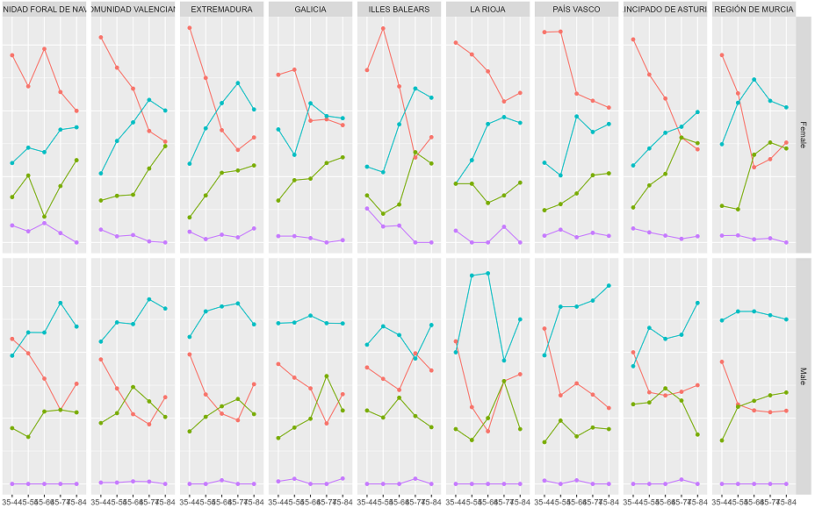
Results – BMI by age and CCAA
0.6
0.4
0.2
0.0
0.6
0.4
0.2
0.0
Prevalence
Women Men
Ages 35-84. Spain 2017/2019-20
Age

Slide 16
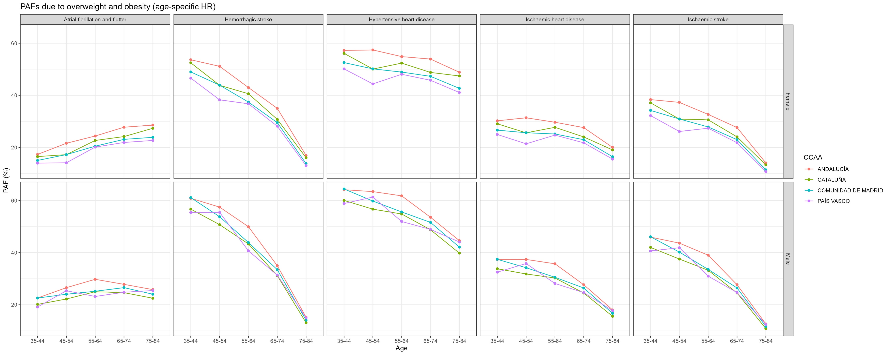
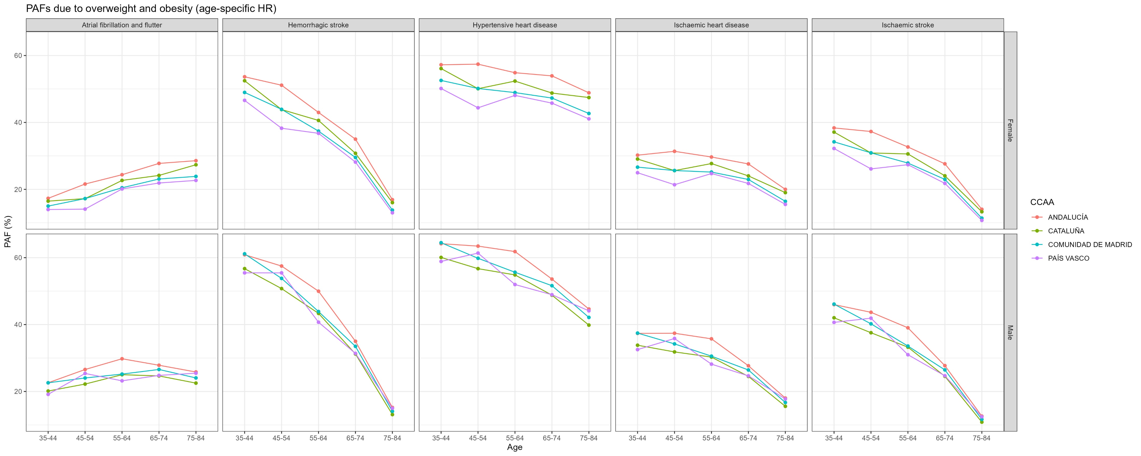
Results – PAF due to overweight and obesity for 5 cardiovascular diseases by age, sex & 4 CCAA
0.6
0.4
0.2
0.6
0.4
0.2
PAF (%)
Age
Notes:
Sergi, RR para obesidad es 2 veces overweight, no?

Slide 17
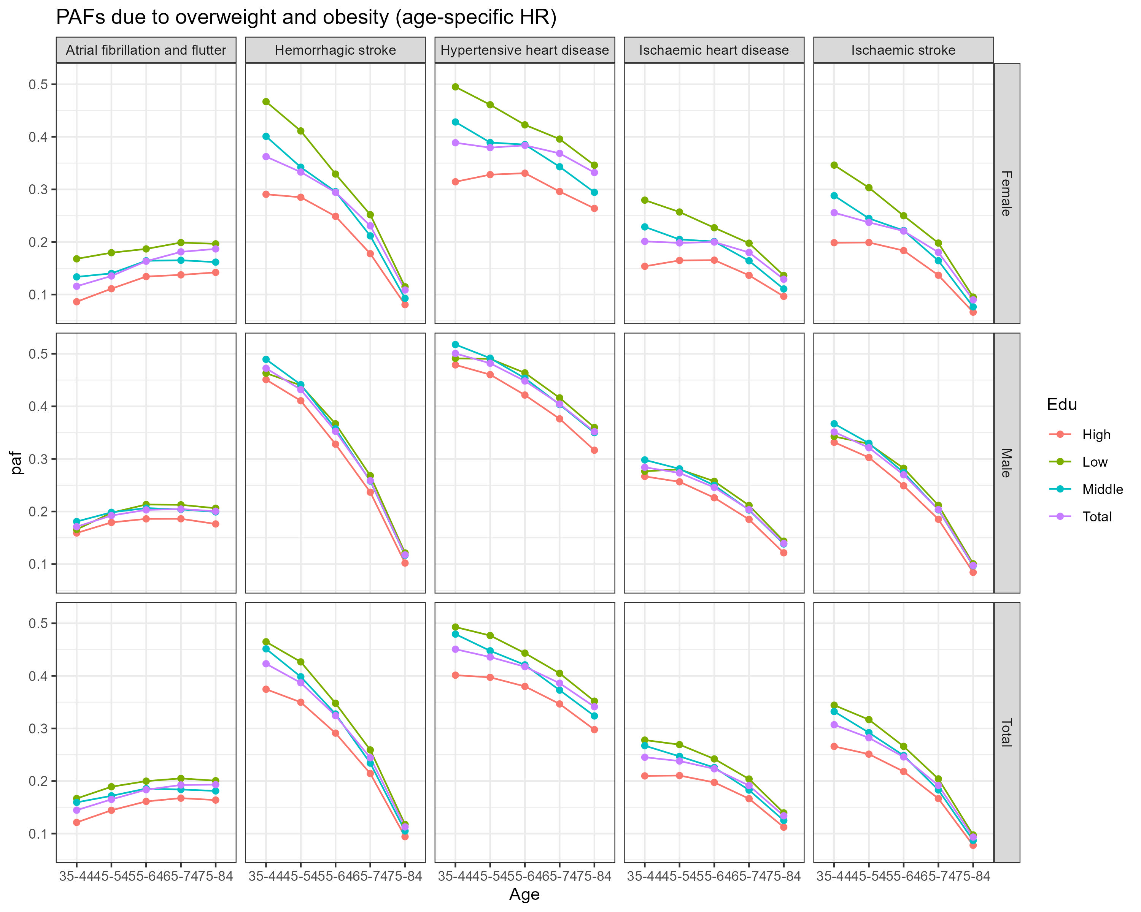
Results – PAF due to overweight and obesity for 5 cardiovascular diseases by age, sex & education
0.5
0.4
0.3
0.2
0.1
0.5
0.4
0.3
0.2
0.1
0.5
0.4
0.3
0.2
0.1
PAF (%)
Age

Slide 18
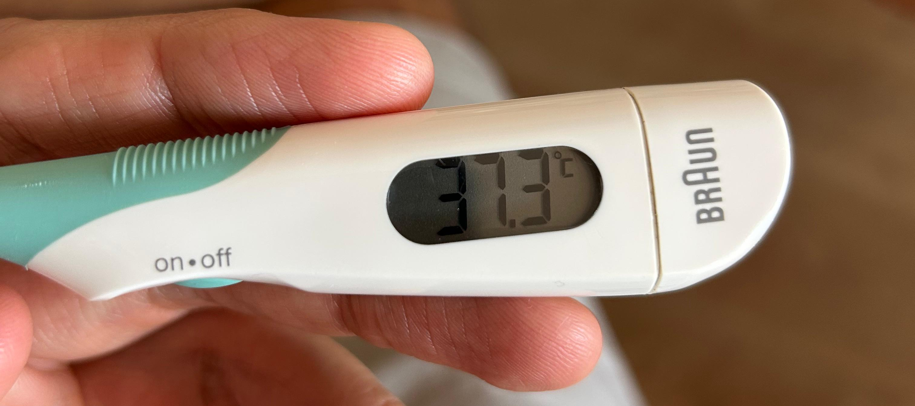
Results – Obesity and Cardiovascular Disease-Free Life Expectancy (I)

Slide 19
Results – Obesity and Cardiovascular Disease-Free Life Expectancy (II)
Study | Obesity Category | Cardiovascular Disease Risk (Hazard Ratio/Relative Risk) | Years Lost / Cardiovascular Disease-Free | Population Group
Fekri et al., 2019 | Overweight Obesity | HR 1.42 (1.21–1.66) HR 1.64 (1.37–1.96) | Men: 4.1 years fewer (CI: -6.3,-1.3) Women: 4.3 years fewer (CI: -6.4,-2.0) | Iran Adults age 30 years+
Dhana et al., 2016 | Obesity | HR 1.57 (1.17–2.11) men HR 1.49 (1.19–1.86) women | Men: 2.6 years fewer (CI: -4.8, -0.4) Women: 1.9 years fewer (CI: -3.3,-0.9) | Rotterdam Adults age 55 years+
Pardo Silva et al., 2006 | Obesity |  | Men: 6.0 years fewer (CI: 4.1–8.1); Women: 8.4 years fewer (CI: 6.2–10.8) | Framingham Adults at age 45

Slide 20
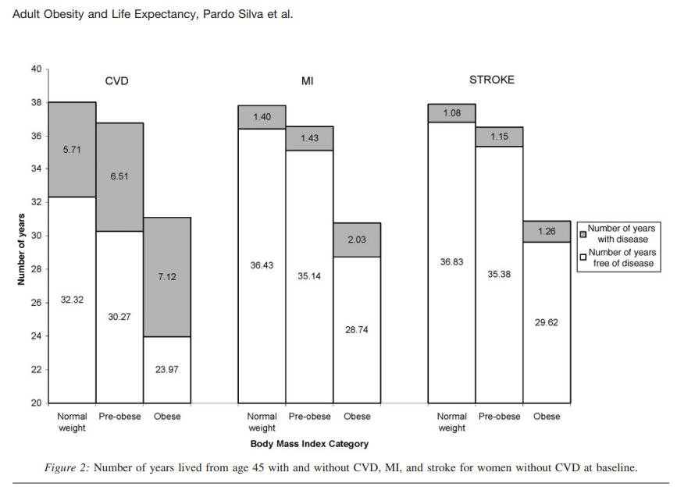
Results – Obesity and Cardiovascular Disease-Free Life Expectancy (III)

Slide 21
Discussion
Overweight and obesity associated with mortality in men and women? (not the case in Rotterdam (longitudinal data); Dhana et al 2016), but had an impact in 26 European national population based on secondary analysis of population-level obesity and mortality data; Vidra et al 2019)
But we expect to find overweight and obesity to be associated with more years lost due to CVD
Men and lower-educated groups are most affected
Regarding regional differences in Spain, CCAA in the South have higher prevalence of overweight/obesity, Madrid and the Basque country have the lowest prevalence.
Persistent high prevalence + widening inequalities threaten healthy longevity
Policies must combine population-wide prevention with targeted support for vulnerable groups

Slide 22
Still to do
* Update the 2017-20 results with the 2023 data
* Repeat for earlier periods (2001-2006, 2009-2014) to assess changes over time

Slide 23
Acknowledgements: This study is supported by the Centro Internacional sobre el Envejecimiento (CENIE); the National R&D Plan (PID2023-152779OB-I00) of the Spanish Ministry of Science and Innovation, and the Catalan Government under the CERCA program.
Gracias/Thank you!
Jeroen Spijker
Jordi Gumà
Aïda Solé-Auró
Sergi Trias
Iñaki Permanyer
^{Email: jspijker@ced.uab.es}
^{@popageing}

