Slide 1




Working Longer, Living Longer? Retirement Timing, Migration Background and Mortality in Sweden
Sven Drefahl – Stockholm University (Sweden)
Eleonora Trappolini – Sapienza University of Rome (Italy)
Luxembourgh, EAPS HMMWG Workshop
September 10-12, 2025
Notes:
Good morning everyone, and thank you for being here. My name is [Your Name], and today I’ll be presenting the work I carried out together with Sven Drefahl, titled [Title of the Work]."

Slide 2
Background
Population ageing is transforming labour markets and pension systems across high-income countries
Governments are promoting later retirement as a strategy to ensure welfare state sustainability
In recent years, growing interest in the health consequences of work and retirement:
- working/later retirement is often linked to improved health outcomes through continued social engagement, routine and income stability (Klumb et al. 2004; Stenholm et al. 2014; van
der Noordt et al. 2014);
- retirement, especially early retirement (Quaade et al. 2002) is linked to an increased risk of mortality (Carlsson et al. 2012; Kühntopf & Tivig 2012; Sewdas et al. 2020)
- older adults are redifining retirement by combining part-time employment with pension benefits, becoming ”working retirees” (Brydsten & Stattin 2025)
Notes:
For some, this partial retirement is a voluntary bridge to full retirement, while for others it reflects financial necessity and the need to avoid old-agepoverty.
The generalizability of these findings remains uncertain. Much of the existing research focuses on native-born populations and pays limited attention to differences across populations. While a large body of literature has examined migrants’ labour market integration, far less is known about the health implications of extended working lives among immigrants

Slide 3
Background
Immigration has been seen as the solution (in the short-run – at least) to mitigate the ageing workforce; in the longer run it adds to the complexity of ageing societies: migrants are ageing too!
Among immigrants: later retirement is well-established across high-income countries
- Fragmented employment histories, employment instability and lower pension entitlements, leading to delayed retirement more out of economic necessity than choice (Harrysson et al. 2016)
Immigration is diversifying the older population and raising new questions about retirement patterns, pension adequacy, and health inequalities in later life (Baxter et al. 2021; Sewdas et al. 2020)

Slide 4
Background
Immigration has been seen as the solution (in the short-run – at least) to mitigate the ageing workforce; in the longer run it adds to the complexity of ageing societies: migrants are ageing too!
Among immigrants: later retirement is well-established across high-income countries
- Fragmented employment histories, employment instability and lower pension entitlements, leading to delayed retirement more out of economic necessity than choice (Harrysson et al. 2016)
Immigration is diversifying the older population and raising new questions about retirement patterns, pension adequacy, and health inequalities in later life (Baxter et al. 2021; Sewdas et al. 2020)
To what extent do all individuals benefit equally from extended working lives?

Slide 5
Late retirement: native-born vs. foreign-born workers
For native-born workers, late retirement typically reflect:
- Financial security and personal choice
- Good health that supports continued work
- Rewarding and fulfilling careers
- Positive selection effects
For foreign-born workers, late retirement often reflects:
- Economic necessity and limited financial options
- Restricted access to retirement benefits
- Insufficient pension accumulation
- Physical, mental and financial challenges

Slide 6
Aim
How does working longer is associated with all-cause mortality in Sweden?
How does it differ between native- and foreign-born individuals?

Slide 7
The Swedish context
Flexible retirement system that allows individuals aged 65 and older to choose among different pathways rather than binary work/retirement decisions
Three retirement options available:
- Full retirement with complete pension benefits
- Partial retirement with proportional pension linked to reduced working hours
- Continued full-time work without drawing pension benefits

Slide 8
Data (1/2)
Administrative register data for the entire Swedish population
Data on deaths retrieved from the Cause of Death Register provided by the National Board of Health and Welfare
Demographic variables (birth date, country of birth, sex, marital status, education) retrieved from the Population Register
Income data (pension income) retrieved from the Longitudinal Integrated Database for Health Insurance and Labour Market Studies (LISA)
We analyse the period between January 1, 1996, and December 31, 2021
The study population includes all individuals aged 65-70 (N = 3,363,914 individuals). The starting age of 65 common reference point in studies of retirement (Kridahl 2014). Age 70 was chosen as the upper limit → almost all individuals have retired by that age
Notes:
2021 represents the final year for which our dataset contained information from the LISA database.

Slide 9
Data (2/2)
Outcome variable: all-cause mortality → The date of death is recorded with daily precision
Two explicative variables:
1) pension groups: no pension, partial pension and full pension
2) area of origin of individuals (place of birth): natives (born in Sweden), migrants from HIC and migrants from LMIC
Other independent variables:
3) education (primary schooling, secondary education, post-secondary education, missing information)
4) marital status (never married, married, divorced, widowed)

Slide 10
Operationalisation of the “pension groups”
Share of pension incomes in the total income for each individual and each calendar year
→ The measure refers to the calendar year an individuals turns age x, not to when an individual is exactly age x. Pension income in each year is defined as the total income from age-related pensions as recorded in LISA
All types of income are lagged by one year as income information in the year of death is often missing and unreliable
Individuals without any pension income (No pension)
Individuals with some pension income (Partial pension)
Individuals whose totale income consists only of pension income (Full pension)
(Carlsson et al. 2012)
$$\text{Pension} \text{Share}=\frac{\text{Pension} \text{Income}}{\text{Pension} \text{Income}+\text{Labour} \text{Income}+\text{Social} \text{Income}}$$
Notes:
The first main independent variable of interest is a grouped measure of the share of pension income in the total income. The measure is calculated separately for each individual and each calendar year, which means that the measure refers to the calendar year an individual turns age x, not to when an individual is exactly age x.

Slide 11
Method
Cox proportional hazard models with age as the time-scale stratified by sex
→ Sex and area of origin are time-constant variables; all other independent variables are time-varying covariates in the analyses
1st model: the two explicative independent variables of interest (share of pension income in the total income group and area of origin) and all other independent variables
2nd model: full interaction between the two explicative variables while controlling for all other independent variables

Slide 12
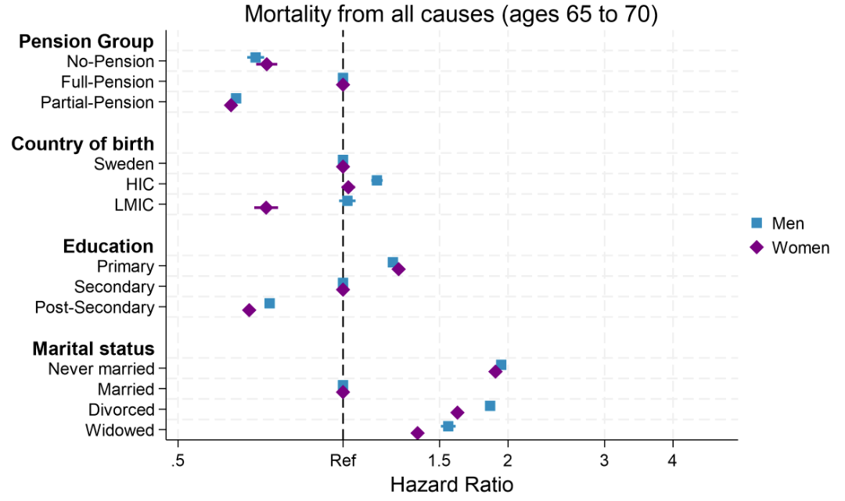
Results

Slide 13
Predicted risk of dying (Men)
The model also controls for: education and marital status

Slide 14
Predicted risk of dying (Women)
The model also controls for: education and marital status

Slide 15
Discussion
Those with full pension experience the highest mortality among pension groups
Working longer or Partial retirement is advantageous similarly for both men and women: extended labour market participation could provide health benefits (Oshio & Shimizutani 2023; Welsh et al. 2016)
Swedish migrant mortality patterns in line with previous studies (e.g. Callaway et al. 2024; Wallace & Drefahl 2024)
→ higher mortality especially among men from HIC : the mortality disadvantage of the Finnish-born population in Sweden (Honkaniemi et al. 2017)
→ lower mortality especially among women from LMIC: healthy migrant effect and survivor bias (Razum & Rohrmann 2002; Wallace & Wilson 2022), protective biological, cultural and behavioural factors (Juárez et al. 2022: Zarulli et al. 2018) may contribute to reduced mortality
Notes:
This may reflect the healthy migrant effect, with positive selection and survivor bias leading to a particularly robust subgroup at retirement age. In addition, It is possible that biological and behavioral differences help women better manage stressful situations, adapt to new life circumstances and cultures, and derive benefits from their new life circumstances that may contribute to reduced mortality. Finally, extended labour market participation among those with partial or no pensions could provide unexpected health benefits through routine, social engagement, and physical activity.

Slide 16
Thanks for your attention!
eleonora.trappolini@uniroma1.it
We acknowledge funding from Next Generation EU, in the context of the National Recovery and Resilience Plan, Investment PE8 – Project Age-It: “Ageing Well in an Ageing Society” [DM 1557 11.10.2022].
The views and opinions expressed are only those of the authors and do not necessarily reflect those of the European Union or the European Commission. Neither the European Union nor the European Commission can be held responsible for them.
This resource was co-financed by the Next Generation EU.

Slide 17
Appendix

Slide 18
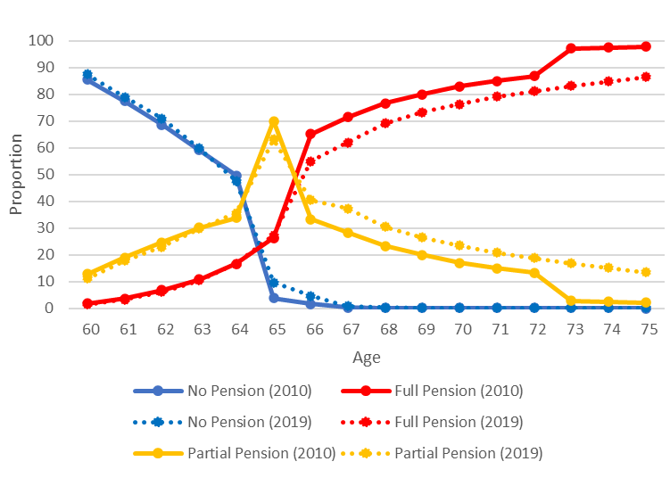
Transition to retirement (2010 vs. 2019)
Pension groups are defined by the year individuals turn age x

Slide 19
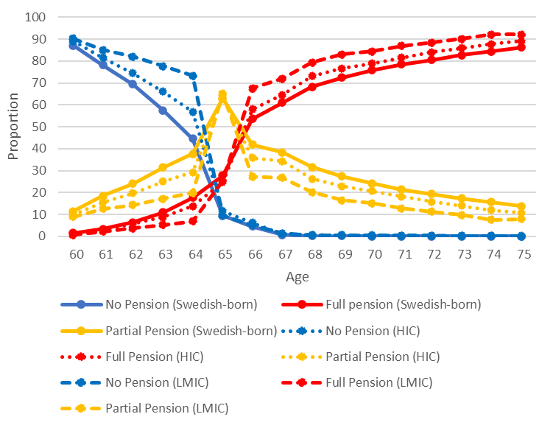
Transition to retirement in 2019 (Swedish-born vs. Foreign-born)
Pension groups are defined by the year individuals turn age x

Slide 20
Interaction: pension group * migrant status (Men)
 | HR | 95%CI
Pension group (ref. full pension)
No-Pension | 0.69 | [0.67,0.72]
Partial-Pension | 0.64 | [0.63,0.65]
Migrant status (ref. Sweden)
HIC | 1.15 | [1.12,1.18]
LMIC | 1.01 | [0.97,1.06]
Interaction term: pension group*migrant status (ref. No-Pension # Sweden)
No-Pension # HIC | 0.99 | [0.91,1.09]
No-Pension # LMIC | 1.05 | [0.93,1.18]
Full-Pension # Sweden | 1.00 | [1.00,1.00]
Full-Pension # HIC | 1.00 | [1.00,1.00]
Full-Pension # LMIC | 1.00 | [1.00,1.00]
Partial-Pension # Sweden | 1.00 | [1.00,1.00]
Partial-Pension # HIC | 1.01 | [0.95,1.07]
Partial-Pension # LMIC | 0.99 | [0.91,1.08]
Observations | 3326252
N_fail | 88962
risk | 2144724603
The model also controls for: education and marital status

Slide 21
Interaction: pension group * migrant status (Women)
 | HR | 95%CI
Pension group (ref. full pension)
No-Pension | 0.71 | [0.68,0.75]
Partial-Pension | 0.62 | [0.61,0.63]
Migrant status (ref. Sweden)
HIC | 1.01 | [0.98,1.04]
LMIC | 0.70 | [0.66,0.74]
Interaction term: pension group*migrant status (ref. No-Pension # Sweden)
No-Pension # HIC | 1.11 | [1.00,1.23]
No-Pension # LMIC | 1.13 | [0.96,1.34]
Full-Pension # Sweden | 1.00 | [1.00,1.00]
Full-Pension # HIC | 1.00 | [1.00,1.00]
Full-Pension # LMIC | 1.00 | [1.00,1.00]
Partial-Pension # Sweden | 1.00 | [1.00,1.00]
Partial-Pension # HIC | 1.04 | [0.98,1.12]
Partial-Pension # LMIC | 1.15 | [1.00,1.31]
Observations | 3441165
N_fail | 57883
risk | 2250151026
The model also controls for: education and marital status

Slide 22
Robustness check: healthy individuals Men
 | Men |  | Healthy Men
Pension group (ref. Full pension)
No-Pension | 0.69 | [0.67,0.72] | 0.57 | [0.54,0.61]
Partial-Pension | 0.64 | [0.63,0.65] | 0.69 | [0.67,0.71]
Origin area (ref. Sweden)
HIC | 1.15 | [1.12,1.18] | 1.18 | [1.12,1.23]
LMIC | 1.01 | [0.97,1.06] | 1.16 | [1.09,1.25]
Interaction: pension group*origin area (ref. Sweden)
No-Pension # Sweden | 1.00 | [1.00,1.00] | 1.00 | [1.00,1.00]
No-Pension # HIC | 0.99 | [0.91,1.09] | 1.11 | [0.94,1.31]
No-Pension # LMIC | 1.05 | [0.93,1.18] | 0.96 | [0.77,1.19]
Full-Pension # Sweden | 1.00 | [1.00,1.00] | 1.00 | [1.00,1.00]
Full-Pension # HIC | 1.00 | [1.00,1.00] | 1.00 | [1.00,1.00]
Full-Pension # LMIC | 1.00 | [1.00,1.00] | 1.00 | [1.00,1.00]
Partial-Pension # Sweden | 1.00 | [1.00,1.00] | 1.00 | [1.00,1.00]
Partial-Pension # HIC | 1.01 | [0.95,1.07] | 0.98 | [0.89,1.07]
Partial-Pension # LMIC | 0.99 | [0.91,1.08] | 0.82 | [0.72,0.94]
Observations | 3326252 |  | 1974381
N_fail | 88962 |  | 35863
risk | 2144724603 |  | 1290272112
To account for confounding from medical problems, we restricted the analysis to subjects who were gainfully employed at the year they turn 60 and healthy, which means that we excluded subjects who during their 60th year:
had >14 consecutive days of sickness absence
received rehabilitation benefits
had disability pension
The model also controls for: education and marital status

Slide 23
Robustness check: healthy individuals Women
 | Women |  | Healthy Women
 | HR | 95% CI | HR | 95% CI
Pension group (ref. Full pension)
No-Pension | 0.71 | [0.68,0.75] | 0.66 | [0.61,0.71]
Partial-Pension | 0.62 | [0.61,0.63] | 0.66 | [0.63,0.68]
Origin area (ref. Sweden)
HIC | 1.01 | [0.98,1.04] | 1.06 | [0.99,1.13]
LMIC | 0.70 | [0.66,0.74] | 0.88 | [0.79,0.97]
Interaction: pension group*origin area (ref. Sweden)
No-Pension # Sweden | 1.00 | [1.00,1.00] | 1.00 | [1.00,1.00]
No-Pension # HIC | 1.11 | [1.00,1.23] | 1.01 | [0.81,1.25]
No-Pension # LMIC | 1.13 | [0.96,1.34] | 1.19 | [0.86,1.64]
Full-Pension # Sweden | 1.00 | [1.00,1.00] | 1.00 | [1.00,1.00]
Full-Pension # HIC | 1.00 | [1.00,1.00] | 1.00 | [1.00,1.00]
Full-Pension # LMIC | 1.00 | [1.00,1.00] | 1.00 | [1.00,1.00]
Partial-Pension # Sweden | 1.00 | [1.00,1.00] | 1.00 | [1.00,1.00]
Partial-Pension # HIC | 1.04 | [0.98,1.12] | 1.00 | [0.89,1.13]
Partial-Pension # LMIC | 1.15 | [1.00,1.31] | 1.06 | [0.86,1.32]
Observations | 3441165 |  | 1702934
N_fail | 57883 |  | 19201
risk | 2250151026 |  | 1133329231
The model also controls for: education and marital status

Slide 24
Migrants’ integration in the labour market
Different models for migrants’ integration in the labour market (Reyneri & Fullin, 2011; Adserà et al., 2020; Alderotti et al., 2023)
Northern Europe
Highly regulated labour market with low demand for low-skilled labour
Migrants have lower employment probabilities compared to natives
However, they face less disadvantage in job quality once employed
Southern Europe
High demand for low-skilled labour, but lower regulation in the lowest job segments (Reyneri, 2004)
Migrants have better access to employment than in Northern Europe
However, they face a higher risk of being trapped in low-quality, secondary labour market jobs (Fellini & Guetto, 2018; Guetto, 2018)

Slide 25
Migrants’ in the Italian labour market
Italy’s labour market still has a strong demand for:
Low-skilled, flexible, and often irregular jobs
Low-paid jobs with poor social recognition
Changing occupational expectations among natives:
Young and educated native workers are aiming for more qualified job segments
Migrants as a substitute labour force in traditional sectors:
Agriculture, construction, hospitality, small trade, and manufacturing
Beyond substitution, migrants have also created new labour demand:
Expansion of low-cost, precarious employment in care services and domestic work
Drivers of this demand:
Aging population
Increasing female labour market participation
Changing family models and lifestyles
Limited public support for care and family policies
(Fellini & Fullin, 2018; Sciortino, 2004)

