Slide 1



Income Disparities in Disease Pairings Among Premature Deaths
Bety Ukolova, Julien Tomas
ukolovae@natur.cuni.cz

Slide 2
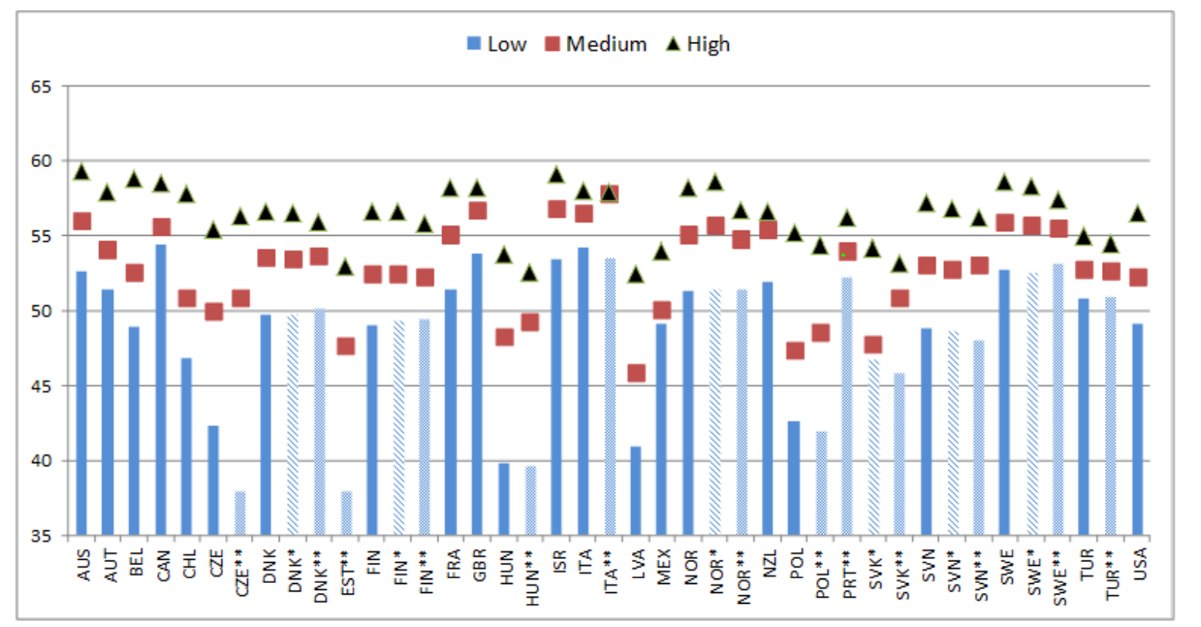
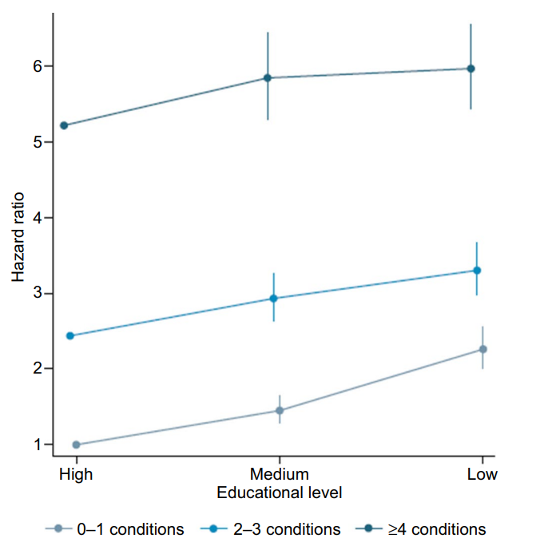
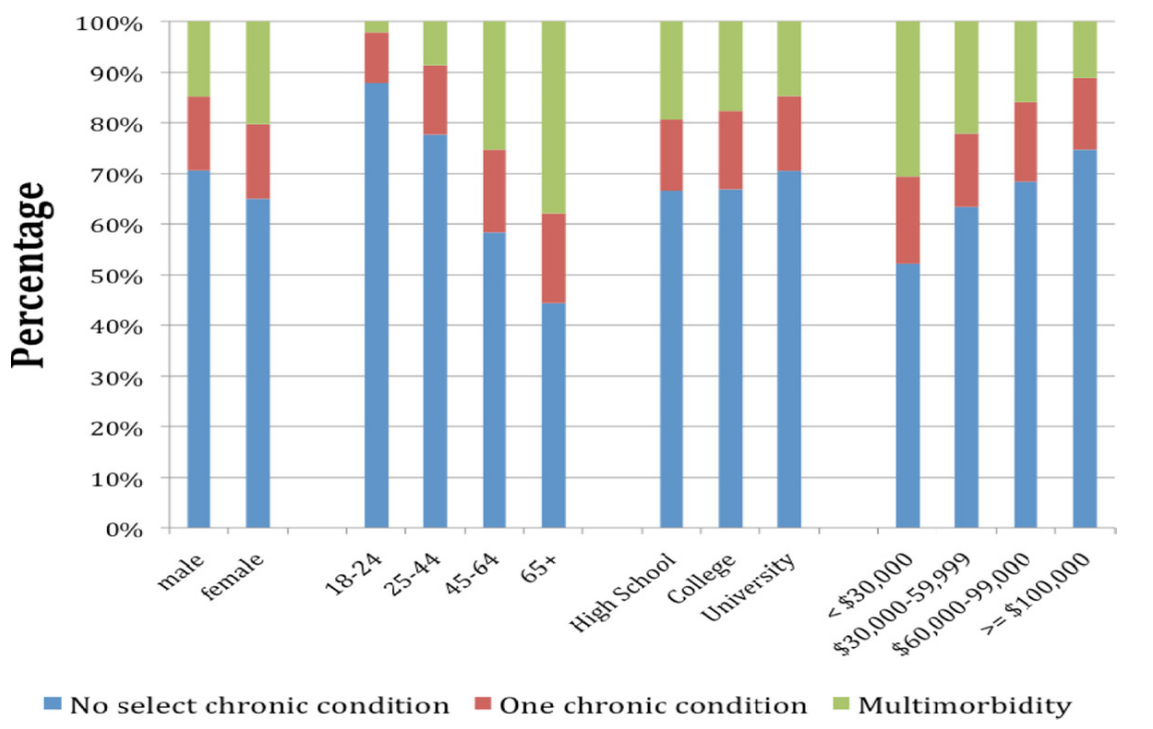
Pro-rich gaps in health (We know that…)
A
B
C
A: Educational disparities in life expectancy, Europe, 2017 [1]
B: Association between educational level multimorbidity group and mortality hazard ratio [2]
C: The percentage adult population with and without multimorbidity by sex, age group, educational level and household income of the Health Quality Council of Alberta 2011 survey [3]

Slide 3
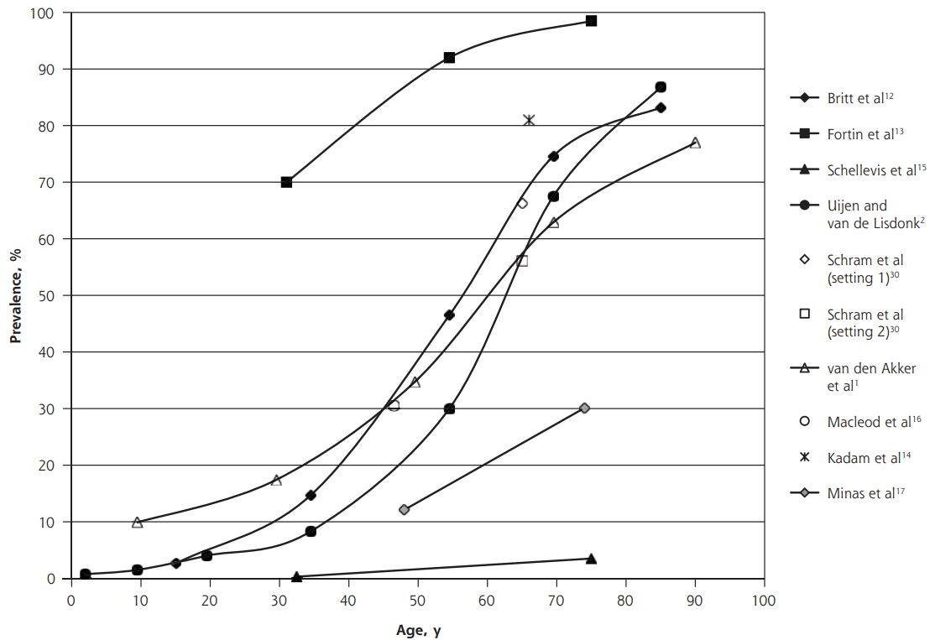
Knowladge gap
Cross-sectional studies (surveys)
Focus on elderly population (65+) – different levels of selection across SES groups (different probabilities of survival till 65 for low and high SES groups)
(Multi)morbidity analyzed by restricted lists of diseases
Conceptualization of SES
Critical gap evidence of multimorbidity by socioeconomic disadvantage
[4-7]
Old-age social conditions
LE at age 30 in Denmark in 2010/11 by education:
Low = 49.1; High = 54.4 [8]
Early life social conditions
Old-age health outcome
Old-age social conditions
Early life social conditions
Old-age health outcome
Old-age social conditions
Early life social conditions
Old-age health outcome
Mean =16 (IQR 9-27)) [4]
[9]

Slide 4
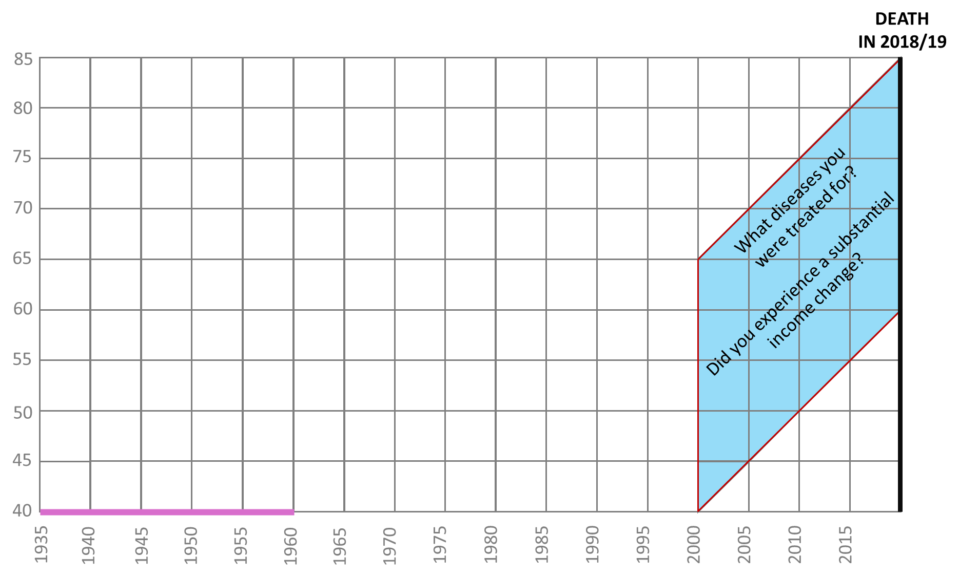
Research focus
How do inequalities in multimorbidity by income manifest among individuals who, despite their SES, died around the same time and prematurely between the ages of 60 and 85?
Study population:
Select only those remaining either low income or high income since 2000 until death
N = 36 456
How income develops over time:

Slide 5
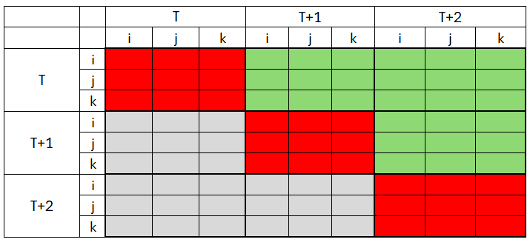

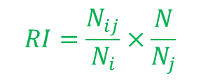
Method
How do inequalities in multimorbidity by income manifest among individuals who, despite their SES, died around the same time and prematurely between the ages of 60 and 85?
Disease Measure: From LPR registries, primary and secondary diagnoses (2000-2018/19), all 3-digit ICD codes (cca 2 000 diagnosis)
Disease Analysis: (i) Disease cooccurrences; (ii) Transitions between diseases
Disease cooccurrences: odds ratios
Transitions between diseases: risk increase
$$OR=\frac{\frac{N_{ij}}{N_{¬ij}}}{\frac{N_{i¬j}}{N_{¬i ¬j}}}$$
$$RI=\frac{N_{ij}}{N_{i}}×\frac{N}{N_{j}}$$

Slide 6
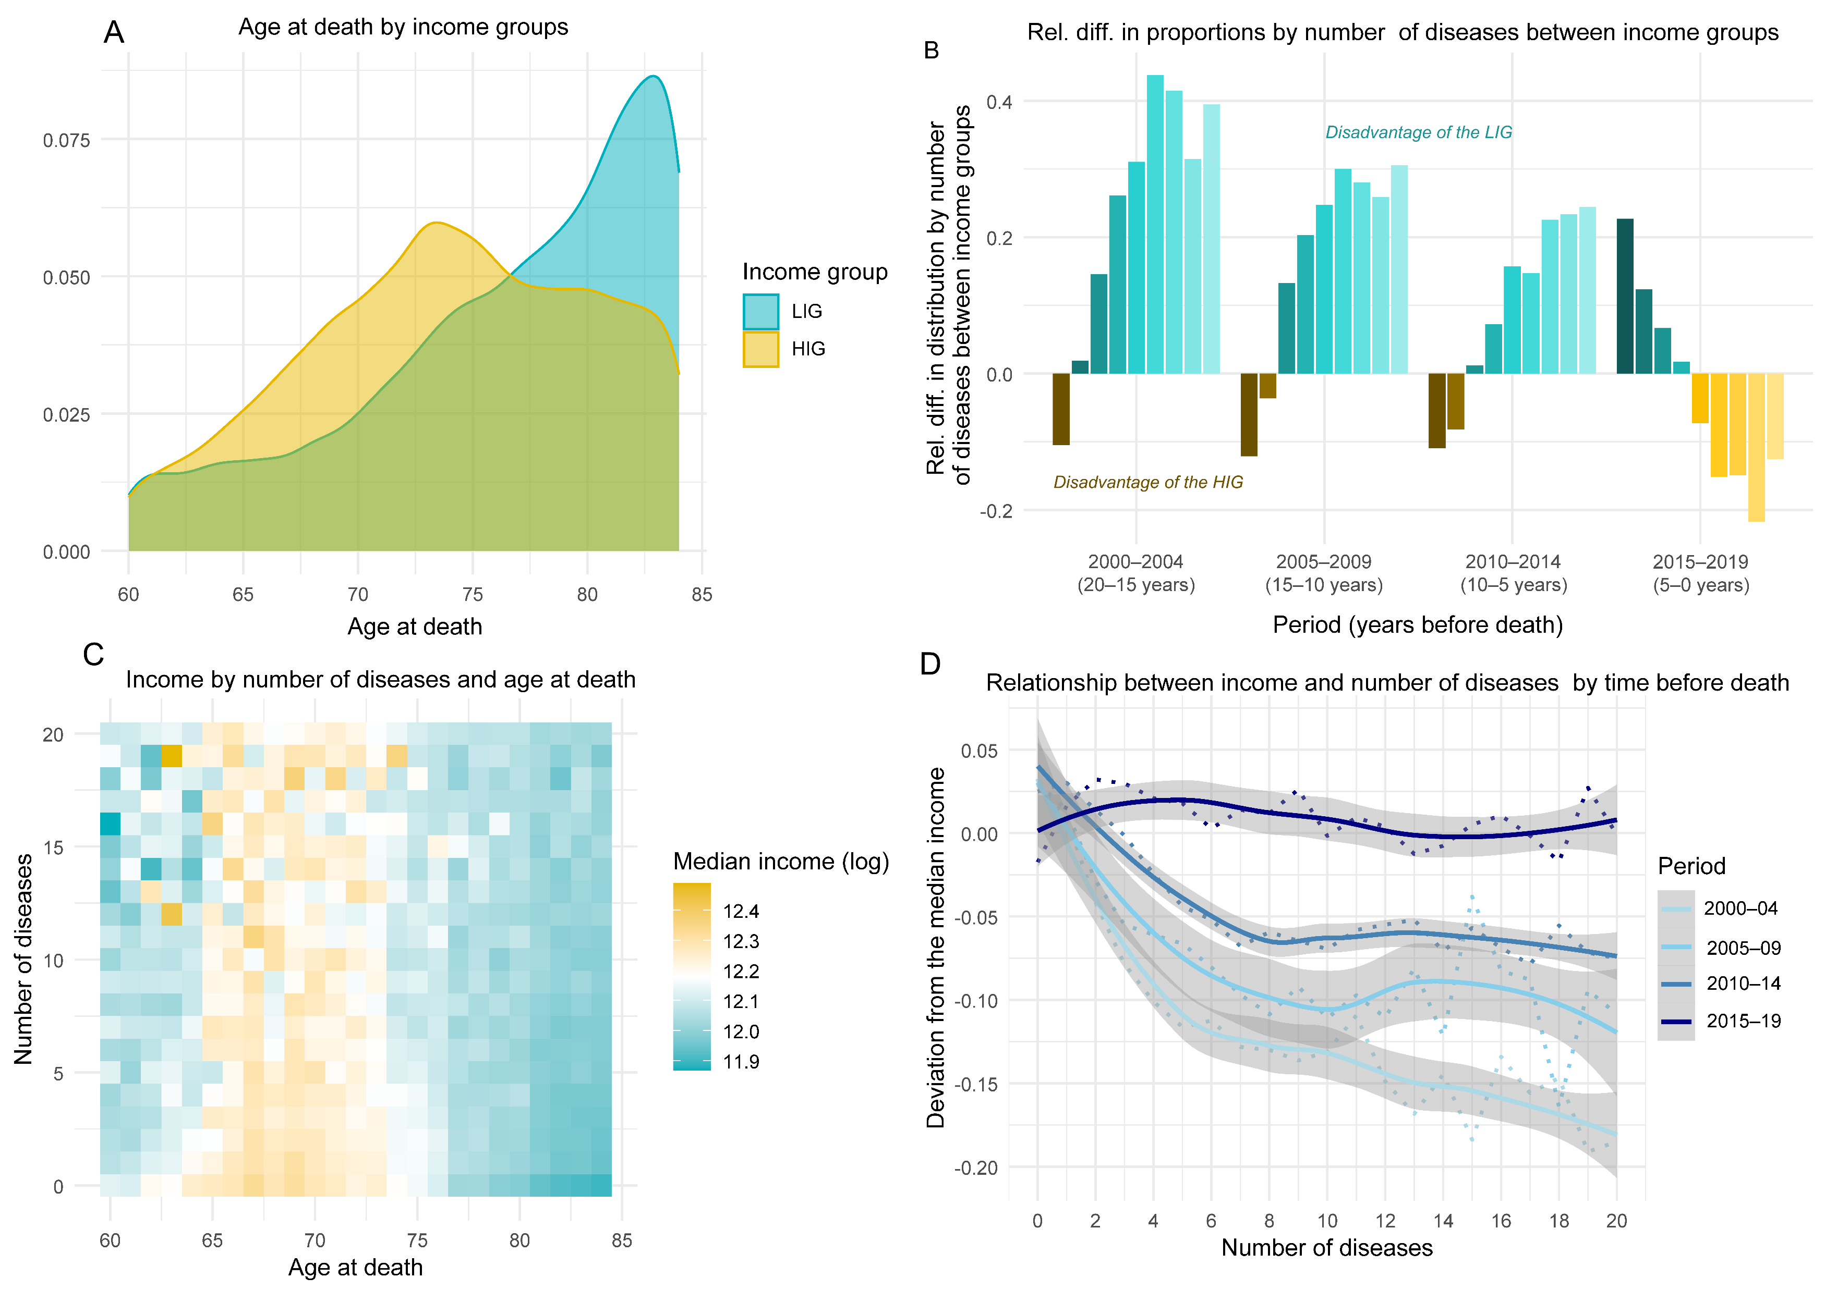
10
10
10
1
1
1
1
10

Slide 7
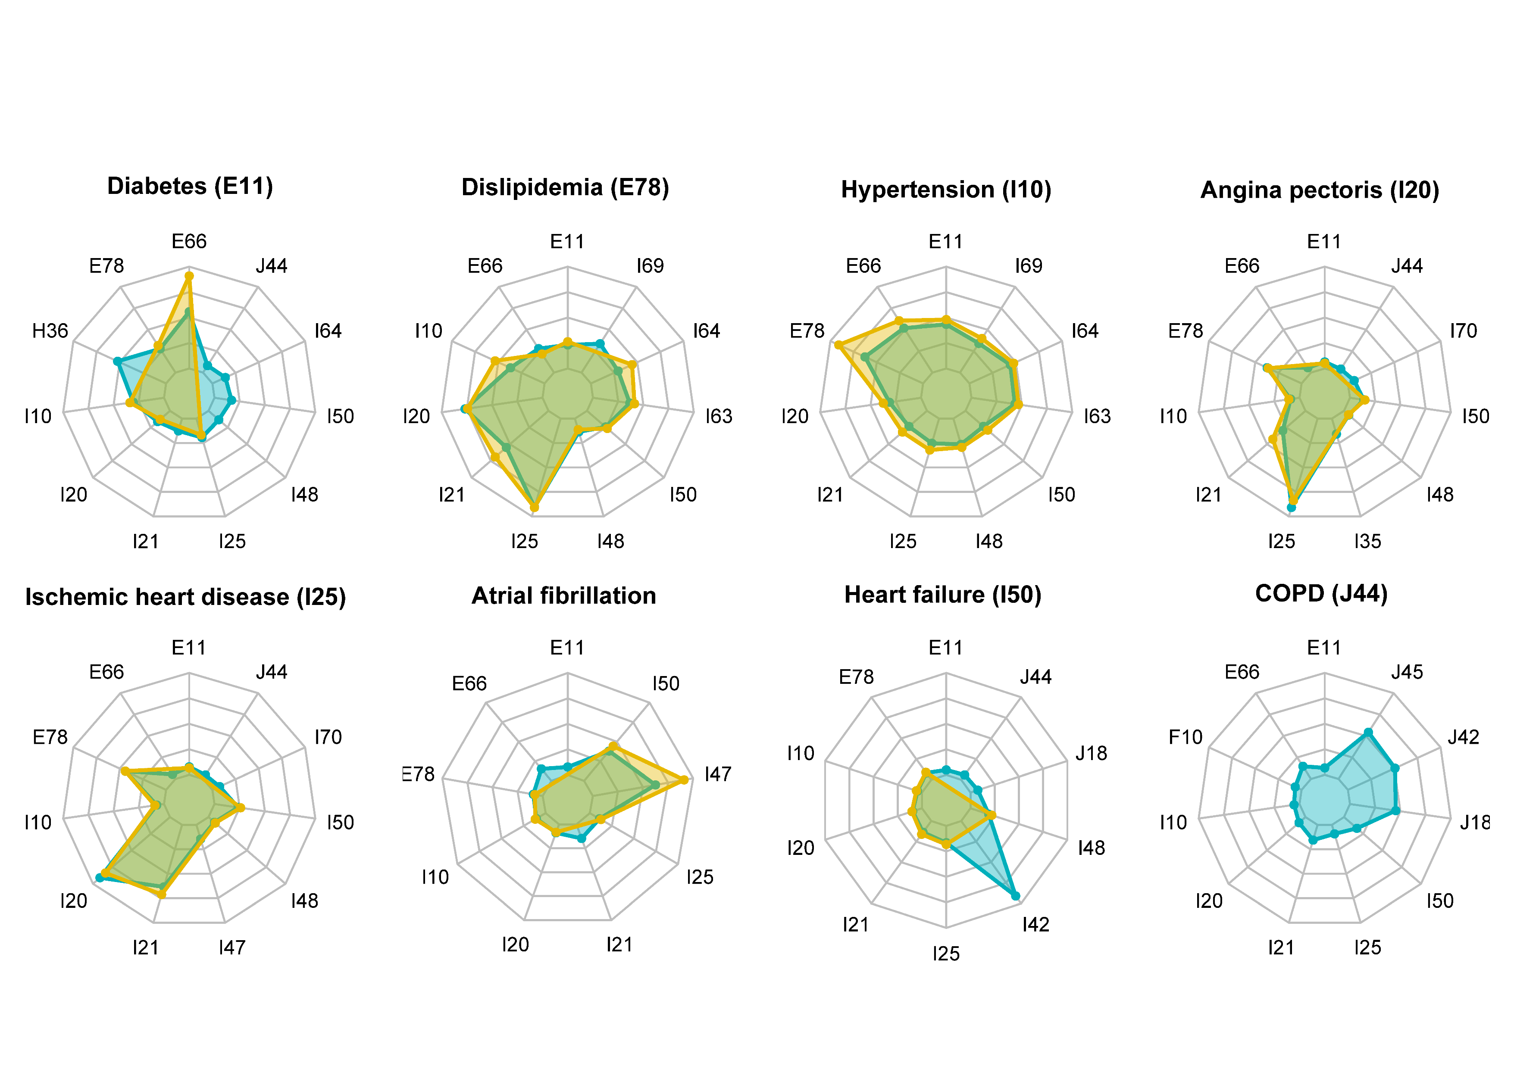
Result: disease coocurrence
Associations with leading diseases 20–15 years before death

Slide 8
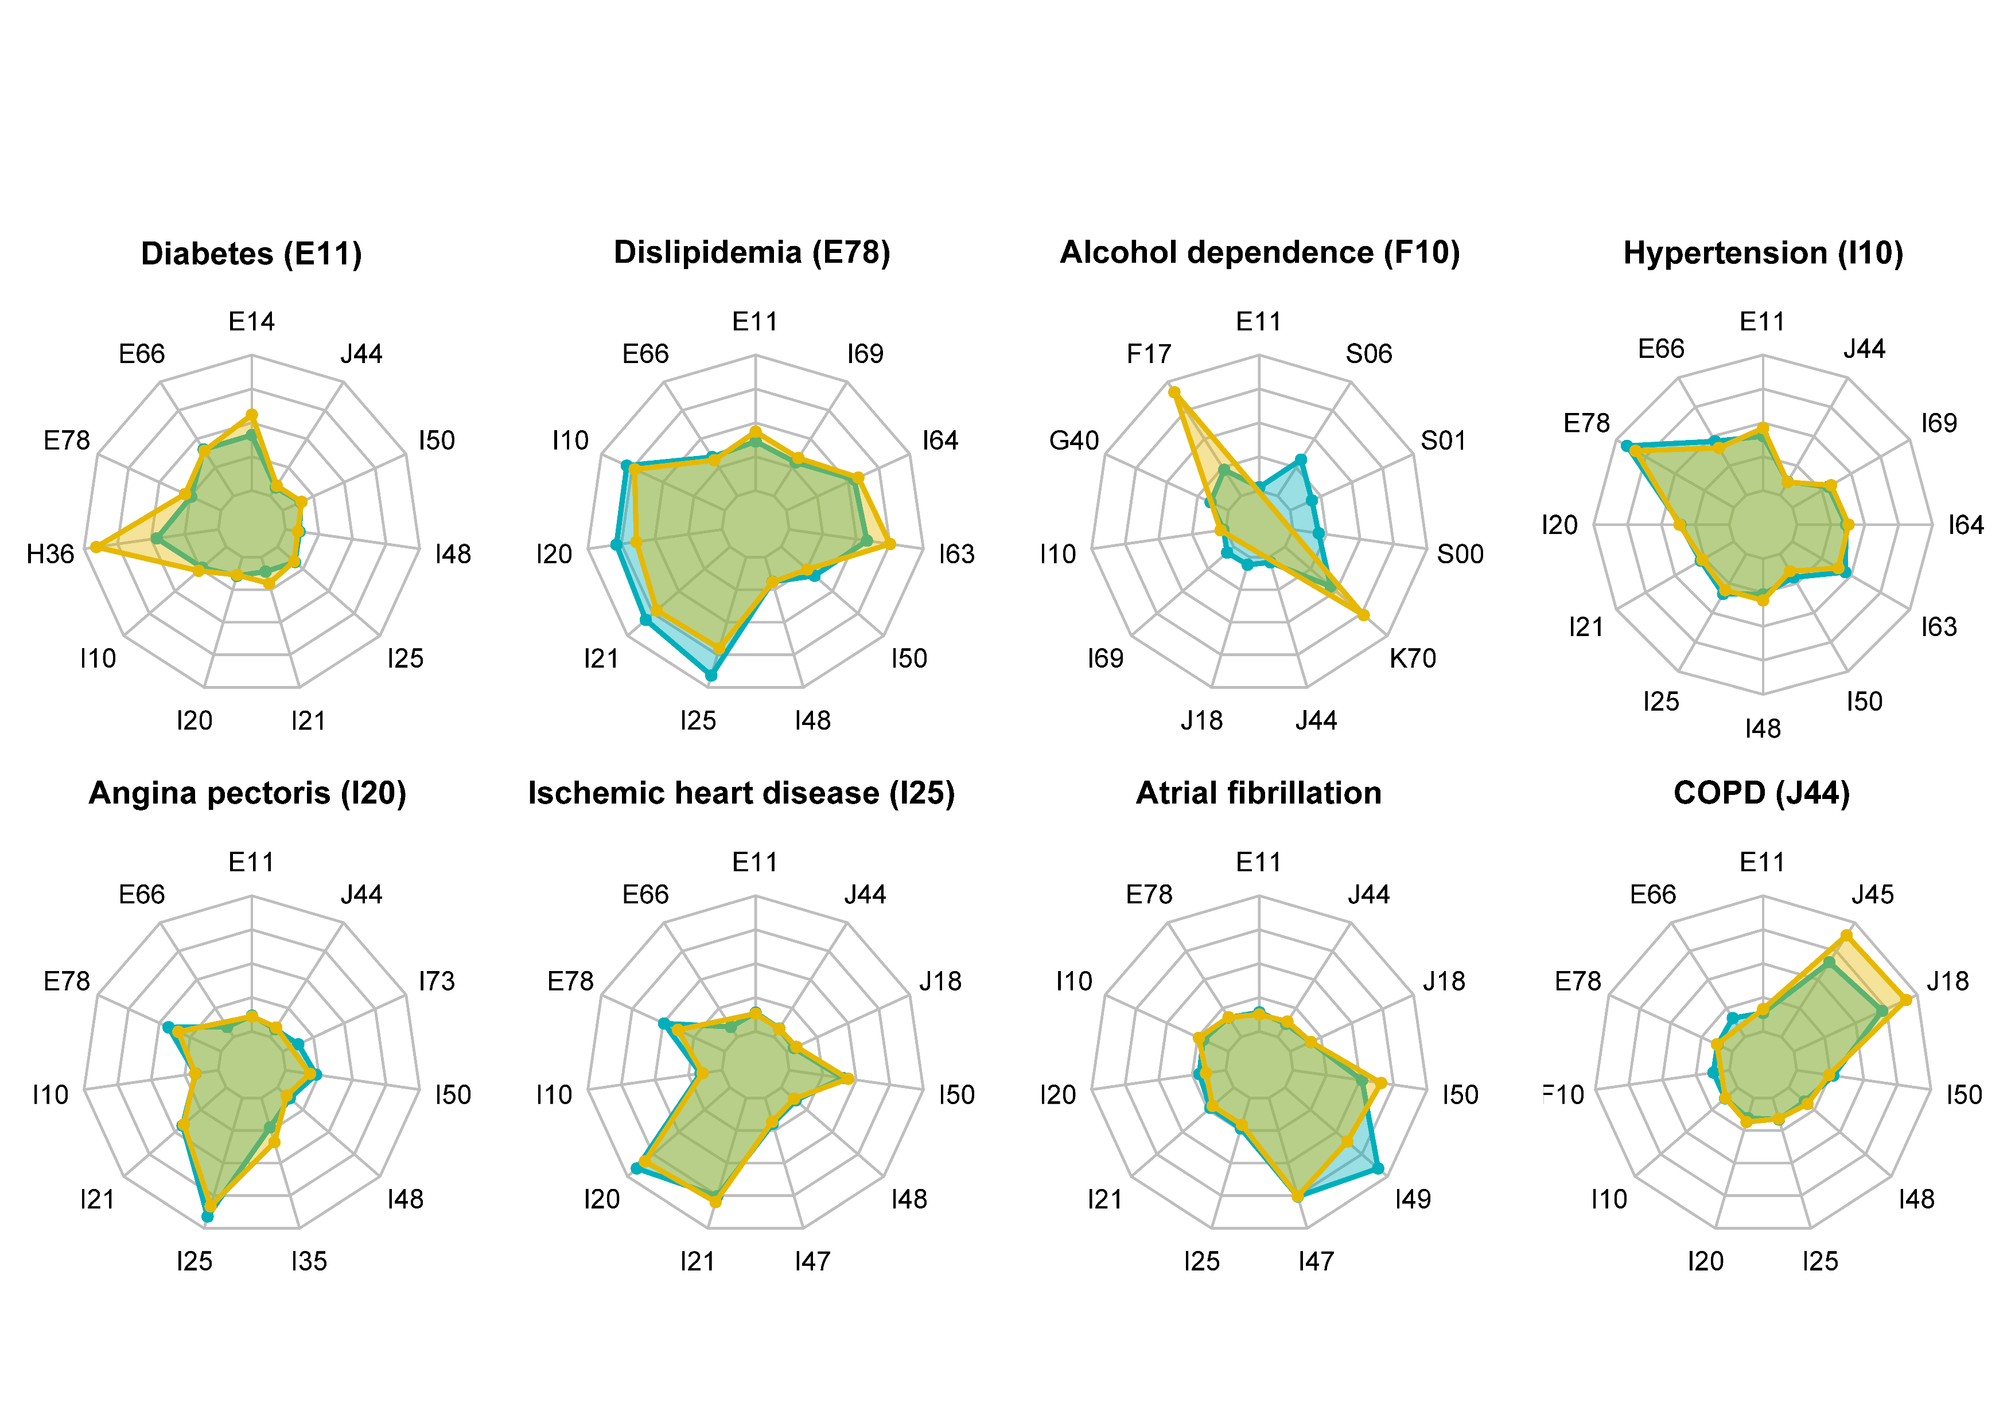
Result: disease coocurrence
Associations with leading diseases 15–10 years before death

Slide 9
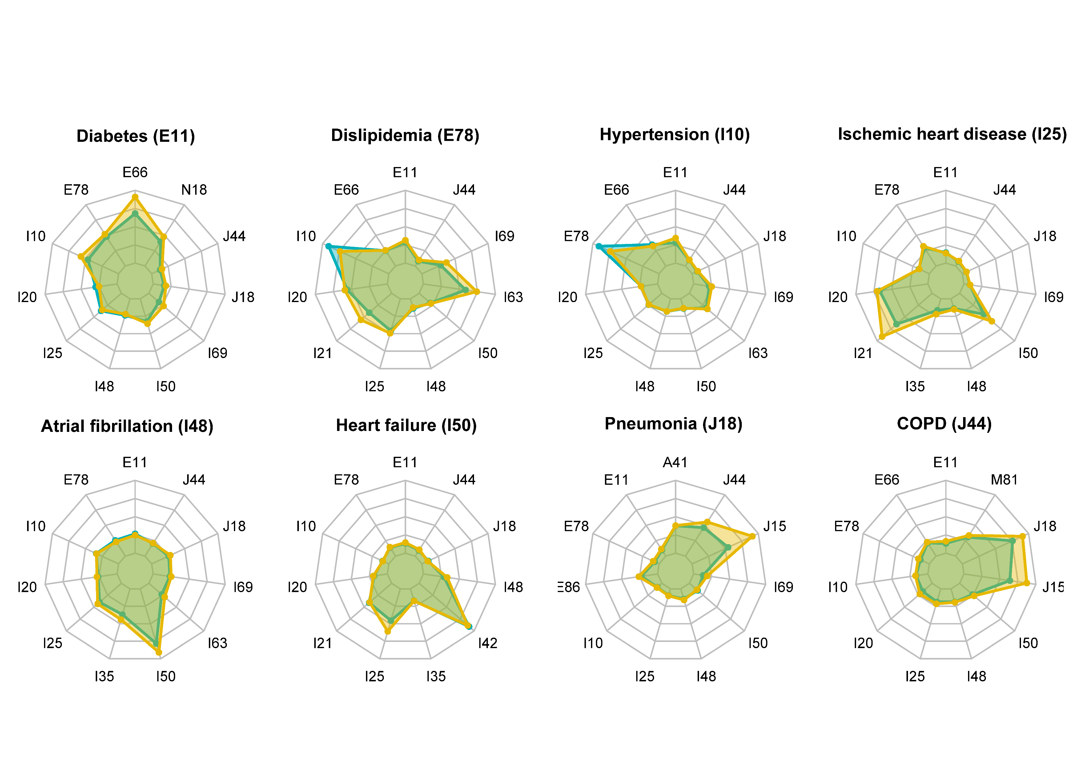
Result: disease coocurrence
Associations with leading diseases 10–5 years before death

Slide 10
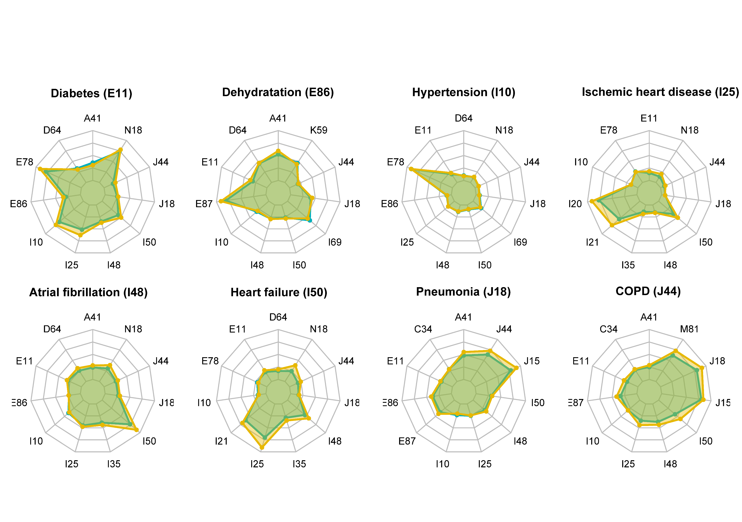
Result: disease coocurrence
Associations with leading diseases 5–0 years before death

Slide 11
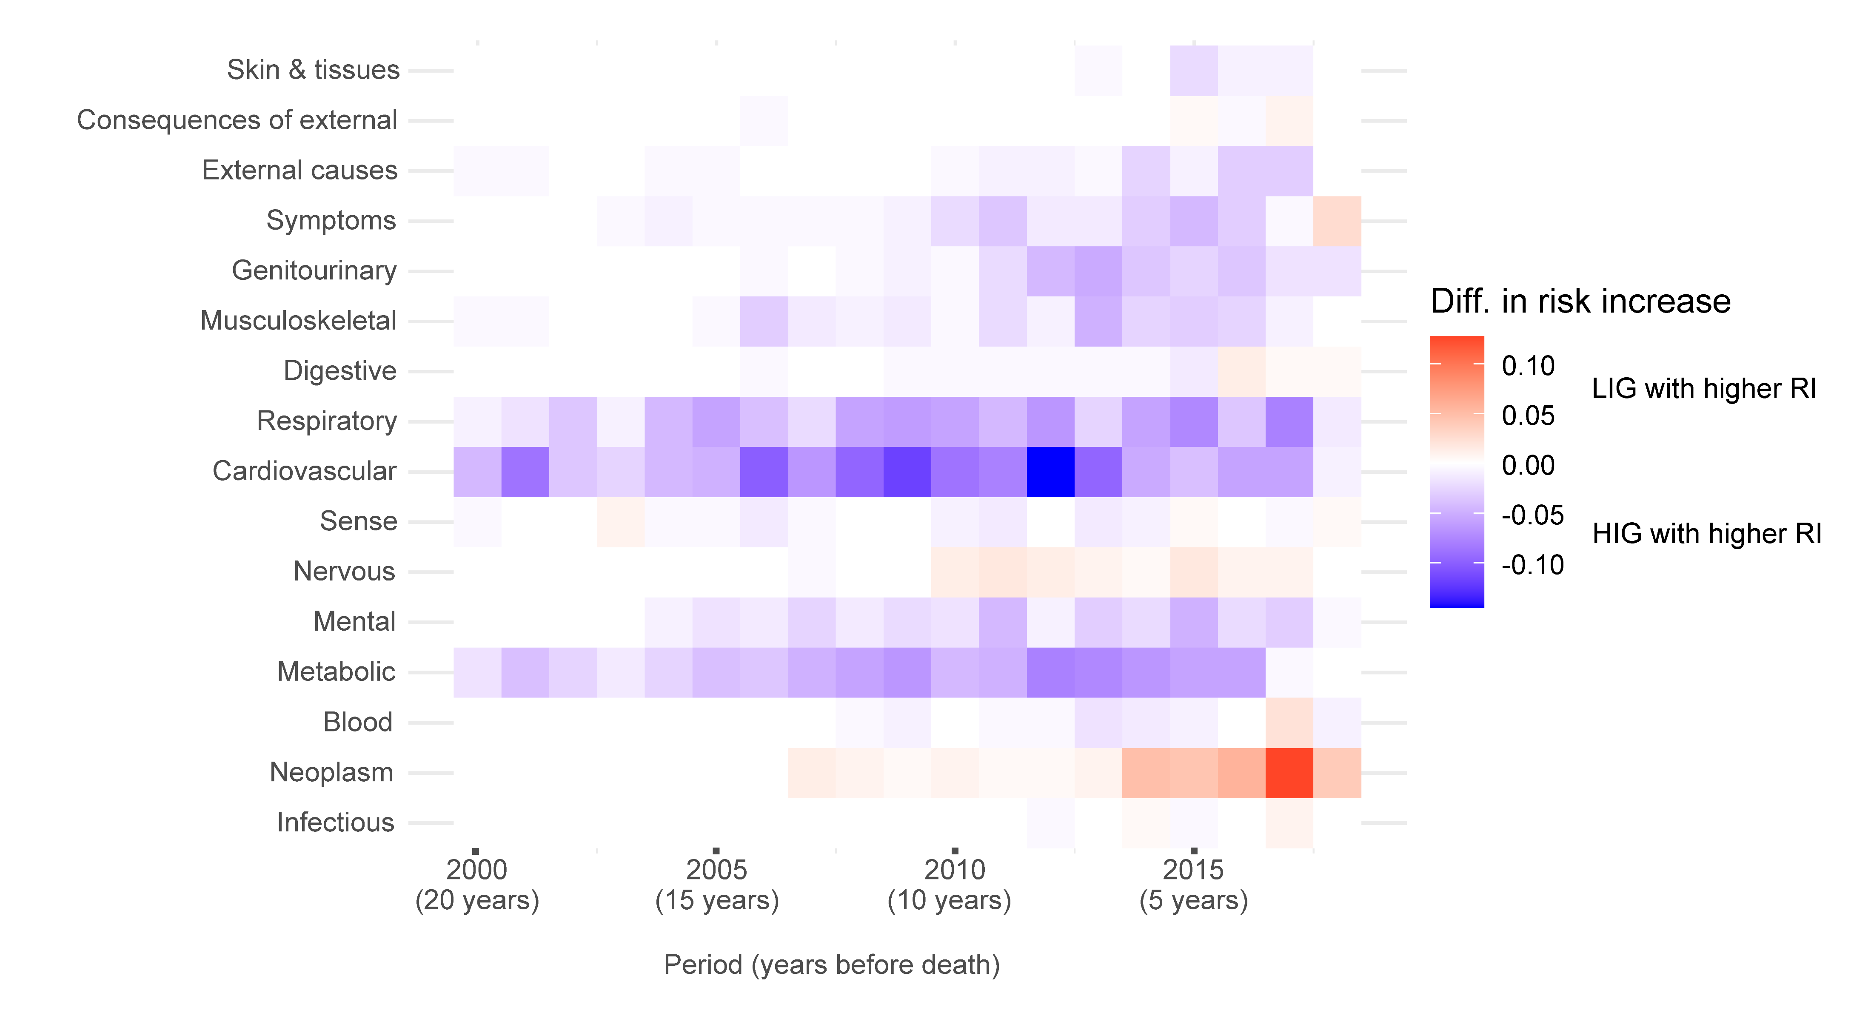
Result: disease transitions (accumulation)
Risk increase: summary for disease pairs with at least 2 fold difference between LIG and HIG

Slide 12
Conclusion
Results show a consistent pattern of widening 'pro-poor gaps' nearing end of life, characterized by earlier death, increased multimorbidity and stronger disease associations in the HIG during the final years before death.
Why?
Different rates of engaging with health care services by SES (Unmet need for access to health care due to non-health-system reasons is high in Denmark)
Premature death are very specific group of people
LIG die even earlier than 60
Different causes of death: LIG die more from typical multimorbidities of HIG (stroke (I64), coronary artery disease (I25), myocardial infarction (I21), and heart failure (I50)), HIG die more from cancer, Parkinson, dementia
So far pro-rich gaps were exagerbated due to not accounting for LIG due to poor health subgroup
etc...

Slide 13
10
10
10
1
1
1
1
10
Thank you.

Slide 14
References
[1] Murtin, F. et al. (2017), “Inequalities in longevity by education in OECD countries: Insights from new OECD estimates”, OECD Statistics Working Papers, No. 2017/02, OECD Publishing, Paris, https://doi.org/10.1787/6b64d9cf-en.
[2] Lund Jensen, N., Pedersen, H. S., Vestergaard, M., Mercer, S. W., Glümer, C., & Prior, A. (2017). The impact of socioeconomic status and multimorbidity on mortality: a population-based cohort study. Clinical epidemiology, 279-289.
[3] Agborsangaya, C. B., Lau, D., Lahtinen, M., Cooke, T., & Johnson, J. A. (2012). Multimorbidity prevalence and patterns across socioeconomic determinants: a cross-sectional survey. BMC public health, 12(1), 201.
[4] Alfonzo, L. F., King, T., You, E., Contreras-Suarez, D., Zulkelfi, S., & Singh, A. (2022). Theoretical explanations for socioeconomic inequalities in multimorbidity: a scoping review. BMJ open, 12(2), e055264.
[5] Lund Jensen, N., Pedersen, H. S., Vestergaard, M., Mercer, S. W., Glümer, C., & Prior, A. (2017). The impact of socioeconomic status and multimorbidity on mortality: a population-based cohort study. Clinical Epidemiology, 9, 279–289. https://doi.org/10.2147/CLEP.S129415
[6] Alvarez-Galvez, J., Ortega-Martin, E., Carretero-Bravo, J., Perez-Munoz, C., Suarez-Lledo, V., & Ramos-Fiol, B. (2023). Social determinants of multimorbidity patterns: A systematic review. Frontiers in Public Health, 11, 1081518.
[7] Skou, S. T., Mair, F. S., Fortin, M., Guthrie, B., Nunes, B. P., Miranda, J. J., ... & Smith, S. M. (2022). Multimorbidity. Nature reviews Disease primers, 8(1), 48.
[8] Luy, M., Zannella, M., Wegner-Siegmundt, C. et al. The impact of increasing education levels on rising life expectancy: a decomposition analysis for Italy, Denmark, and the USA. Genus 75, 11 (2019). https://doi.org/10.1186/s41118-019-0055-0
[9] Fortin, M., Stewart, M., Poitras, M. E., Almirall, J., & Maddocks, H. (2012). A systematic review of prevalence studies on multimorbidity: toward a more uniform methodology. The Annals of Family Medicine, 10(2), 142-151.
[10] Goh, K. I., Cusick, M. E., Valle, D., Childs, B., Vidal, M., & Barabási, A. L. (2007). The human disease network. Proceedings of the National Academy of Sciences, 104(21), 8685-8690.

Slide 15
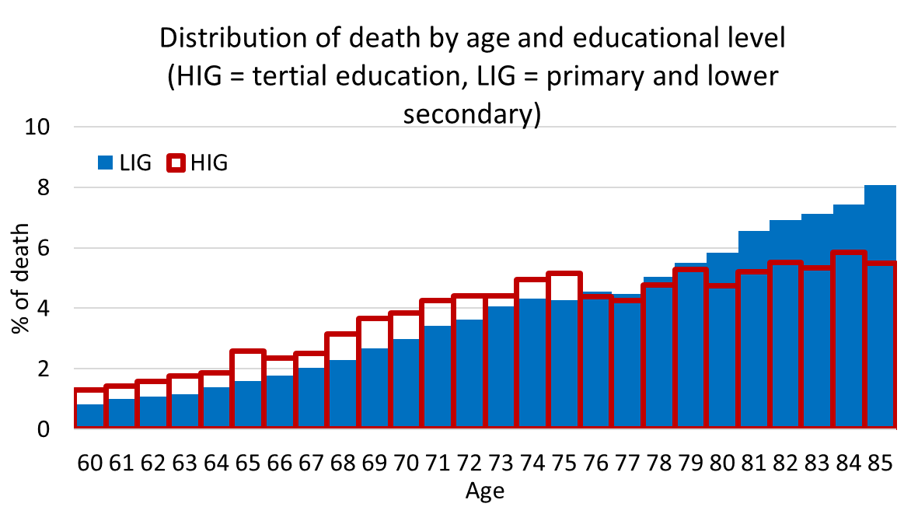

Slide 16
Result: disease transitions (accumulation)
Risk increase ratios: Example of Diabetes
First diagnosis | Second diagnosis | Between 2000-04 and 2005-09 | Between 2005-09 and 2010-14 | Between 2010-14 and 2015-19
Diabetes (E11) | Pneumonia (J18) | 0.40 | 0.87 | 0.89
 | Obesity (E66) | 0.56 | 0.72 | 0.74
 | COPD (J44) | 0.58 | 0.72 | 0.83
 | Heart failure (I50) | 0.60 | 0.88 | 0.81
 | Atrial fibrilation (I48) | 0.72 | 1.18 | 0.83
 | Angina pectoris (I20) | 0.77 | 1.04 | 0.87
 | Lipidemia (E78) | 0.79 | 0.94 | 0.81
 | Chronic ischemic heart dis. (I25) | 0.86 | 0.95 | 0.78
 | Hypertension (I10) | 0.93 | 0.83 | 0.89
Above 1 → increased risk of having the second disease in low income group
Below 1 → increased risk of having the second disease in high income group

Slide 17
Result: disease transitions (accumulation)
Risk increase ratios: Example of Hypertension
First diagnosis | Second diagnosis | Between 2000-04 and 2005-09 | Between 2005-09 and 2010-14 | Between 2010-14 and 2015-19
Essential hypertension (I10) | Cerebral infarction (I63) | 0.57 | 0.87 | 0.92
 | COPD (J44) | 0.63 | 0.90 | 0.92
 | Pneumonia (J18) | 0.63 | 0.92 | 0.98
 | Obesity (E66) | 0.65 | 0.93 | 0.98
 | Atherosclerosis (I70) | 0.72 | 0.77 | 0.84
 | Acute myocardial infarction (I21) | 0.73 | 0.75 | 0.96
 | Dorsalgia (M54) | 0.73 | 0.84 | 1.23
 | Atrial fibrillation (I48) | 0.81 | 0.95 | 0.96
 | Sequelae of cerebrovascular disease (I69) | 0.83 | 0.82 | 0.89
 | Other peripheral vascular disease (I73) | 0.91 | 0.79 | 0.87
 | Diabetes (E11) | 0.92 | 0.87 | 0.88
 | Heart failure (I50) | 0.92 | 1.05 | 0.93
 | Arthrosis of knee (M17) | 0.96 | 0.91 | 0.91
 | Ischemic heart dis. (I25) | 0.97 | 0.92 | 0.96
 | Lipidemia (E78) | 1.01 | 0.96 | 0.95
 | Nonrheumatic aortic valve disorders (I35) | 1.03 | 1.01 | 0.92
 | Angina pectoris (I20) | 1.12 | 0.96 | 1.07
Above 1 → increased risk of having the second disease in low income group
Below 1 → increased risk of having the second disease in high income group

Slide 18
Result: disease transitions (accumulation)
Risk increase ratios: Example of Acute myocardial infarction
First diagnosis | Second diagnosis | Between 2000-04 and 2005-09 | Between 2005-09 and 2010-14 | Between 2010-14 and 2015-19
Acute myocardial infarction (I21) | Diabetes (E11) | 0.51 | 0.66 | 0.83
 | Angina pectoris (I20) | 0.67 | 0.79 | 0.76
 | Lipidemia (E78) | 0.68 | 0.72 | 0.83
 | Hypertension (I10) | 0.69 | 0.89 | 1.01
 | Heart failure (I50) | 0.77 | 0.79 | 0.79
 | Ischemic heart dis. (I25) | 0.86 | 0.81 | 0.83
Above 1 → increased risk of having the second disease in low income group
Below 1 → increased risk of having the second disease in high income group

Slide 19
Result: disease transitions (accumulation)
Risk increase ratios: Example of Pneumonia
First diagnosis | Second diagnosis | Between 2000-04 and 2005-09 | Between 2005-09 and 2010-14 | Between 2010-14 and 2015-19
Pneumonia (J18) | Ischemic heart dis. (I25) | 0.68 | 0.78 | 0.95
 | Atrial fibrillation (I48) | 0.75 | 1.01 | 0.92
 | COPD (J44) | 0.57 | 0.75 | 0.77
Risk increase ratios: Example of COPD
First diagnosis | Second diagnosis | Between 2000-04 and 2005-09 | Between 2005-09 and 2010-14 | Between 2010-14 and 2015-19
COPD (J44) | Pneumonia (J18) | 0.59 | 0.63 | 0.82
 | Hypertension (I10) | 0.66 | 0.92 | 0.98
 | Ischemic heart dis. (I25) | 0.68 | 0.97 | 0.93
Above 1 → increased risk of having the second disease in low income group
Below 1 → increased risk of having the second disease in high income group

