Slide 1

Living longer in poorer health? Health expectancy in Israel in cross-national comparison, 2013–2022
Yan Zheng & Isaac Sasson
Department of Sociology and Anthropology
Tel Aviv University
EAPS HMM-WG 2025
Luxembourg

Slide 2
Background
The relationship between LE and HLE/DFLE varies considerably across high-income countries
Gains in LE have slowed down in many low-mortality countries over the past decade
Israel exhibits high e₀ relative to Western & Northern Europe (and on par with respect to e₆₅)
Less clear how Israel fares with respect to HLE and DFLE
Notes:
Few studies have examined HLE and DFLE in Israel aside from GBD etc.

Slide 3
Objectives
Compare
recent trends across Israel and select European countries
Examine
the relationship between LE, HLE and DFLE at age 65
Evaluate
the impact of the Covid pandemic on HLE and DFLE

Slide 4
Methodology
Data
SHARE (Waves 5–9); ELSA (UK, Waves 6–10); Eurostat; Israel CBS; UK ONS
Measures of HLE and DFLE at 65
Self-rated health > Fair
ADL-free
IADL-free
Analytic approach
Sullivan’s method, decompose change in HLE/DFLE to contributions from morbidity and mortality

Slide 5
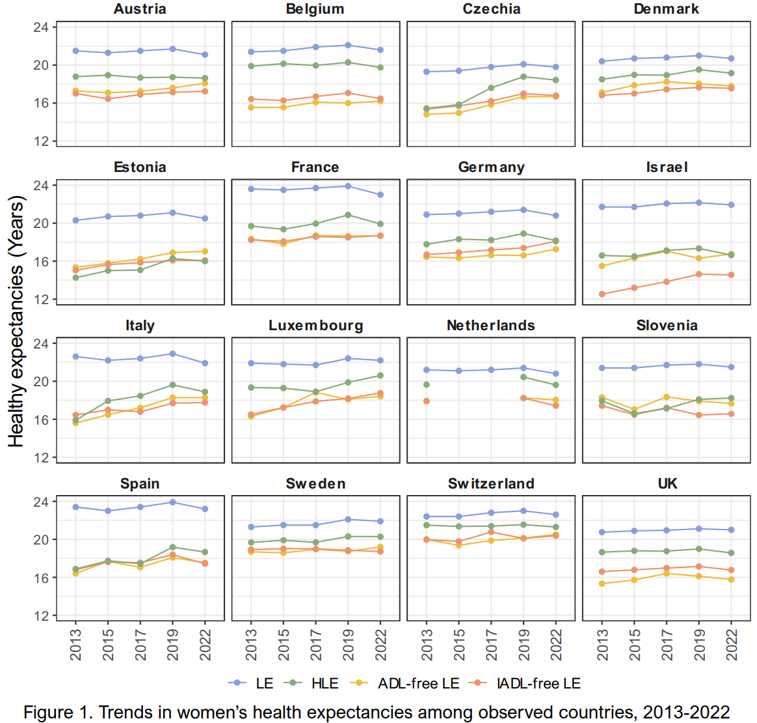
Trends in LE, HLE, and DFLE, Women 2013–2022
Average change
 | 2013–2019 | 2019–2022
e₆₅ | 0.5 | -0.5
HLE | 1.2 | -0.3
ADL-free | 0.9 | 0.1
IADL-free | 0.8 | 0.0
In 2019, Israel ranked 6th in e₆₅ but last in IADL-free LE and next to last in HLE

Slide 6
Key Findings (Women)
LE > HLE > IADL-free LE > ADL-free LE
e₆₅ increased by 0.5 years on average from 2013 to 2019
Greater increases in HLE and DFLE compared to e₆₅
Covid reduced e₆₅ more than HLE and almost no impact on DFLE
Israel exhibits the largest gap between LE and HLE/DFLE

Slide 7
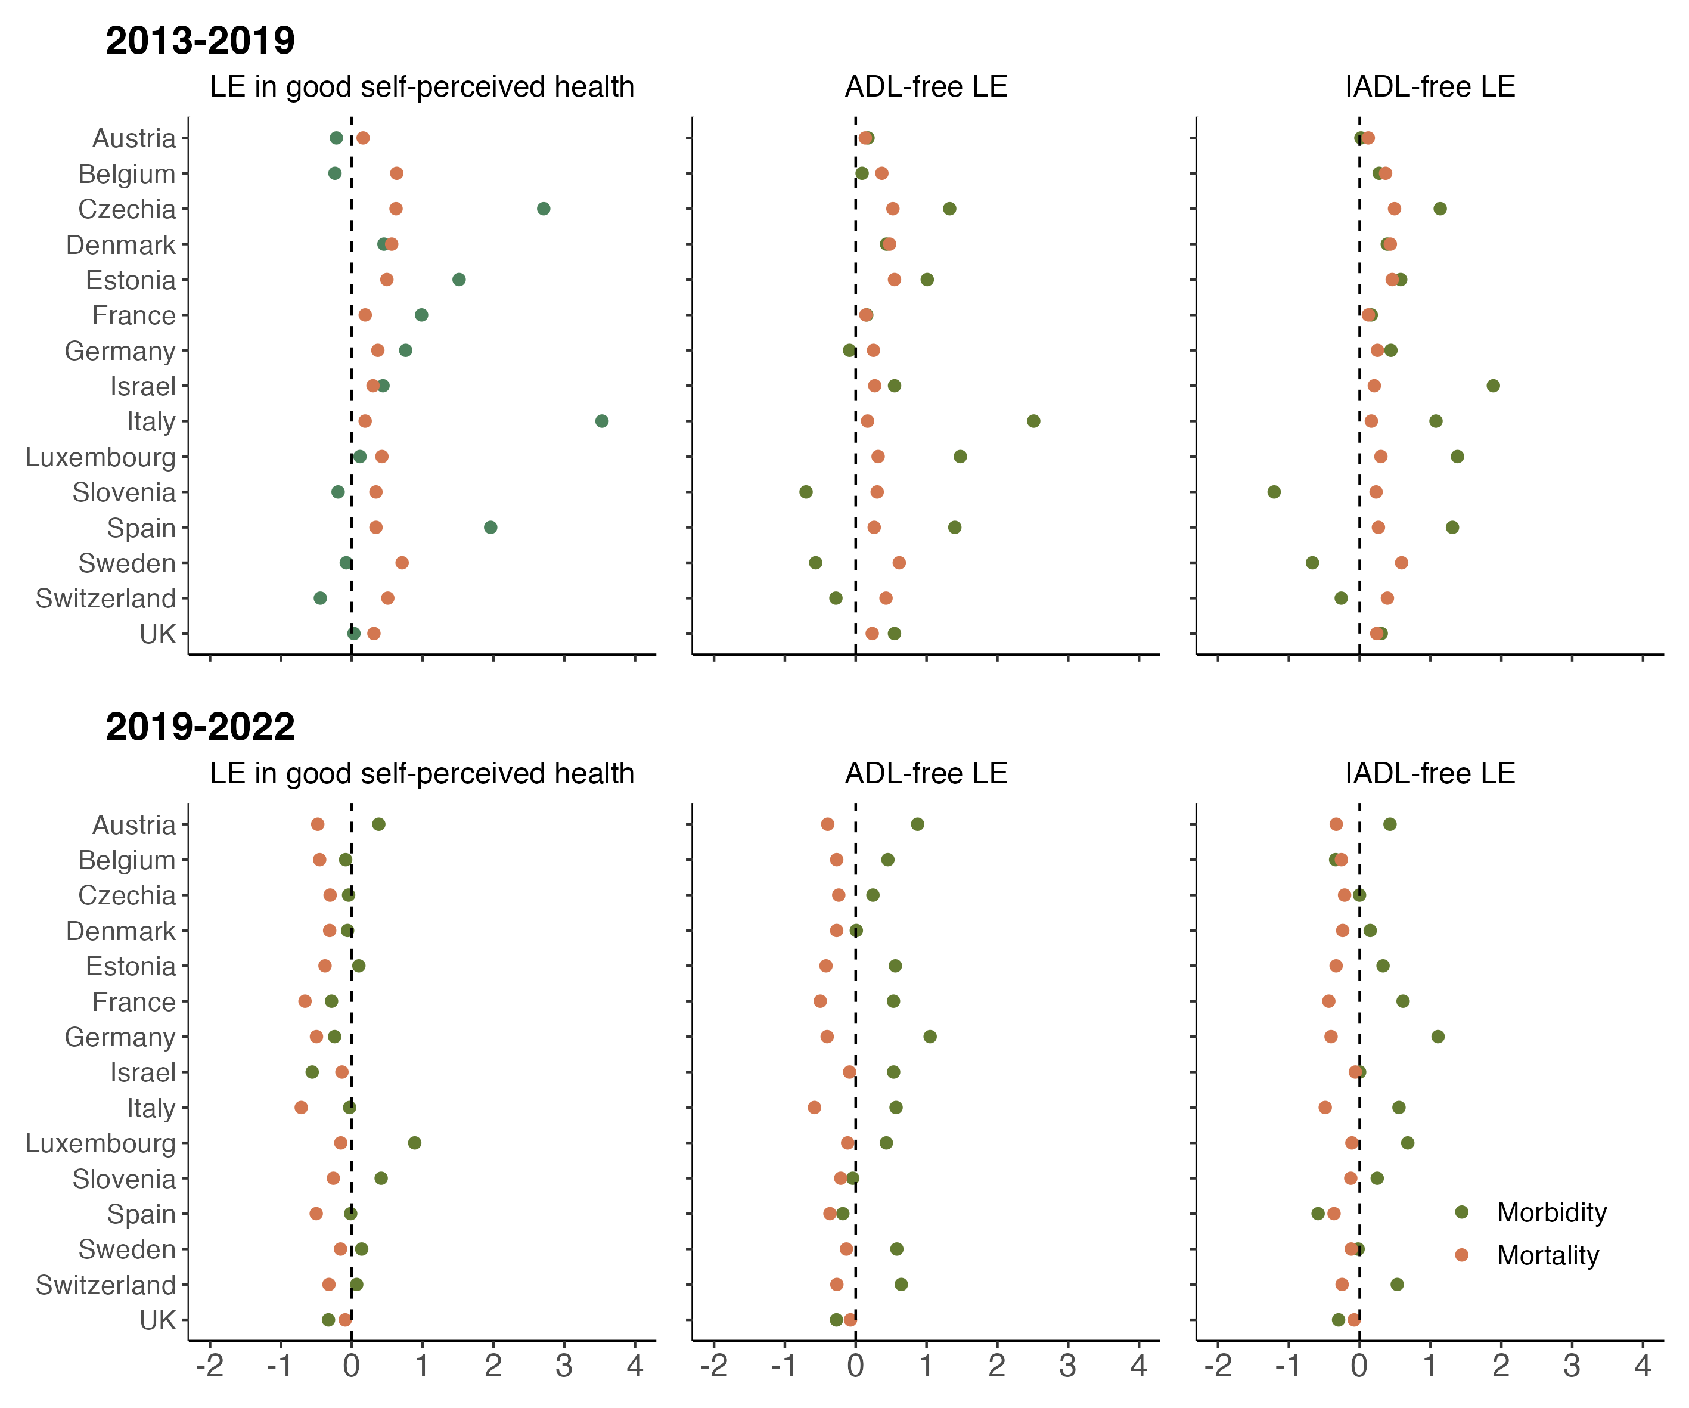
Mortality and morbidity contribution to changes in health expectancy, Women
Pre-Covid, changes in mortality contributed to gains in both HLE and DFLE
Changes in morbidity had large positive contributions in some countries
During Covid, mortality change had a negative contribution across the board
Changes in disability prevalence offset some of the negative impact of mortality

Slide 8
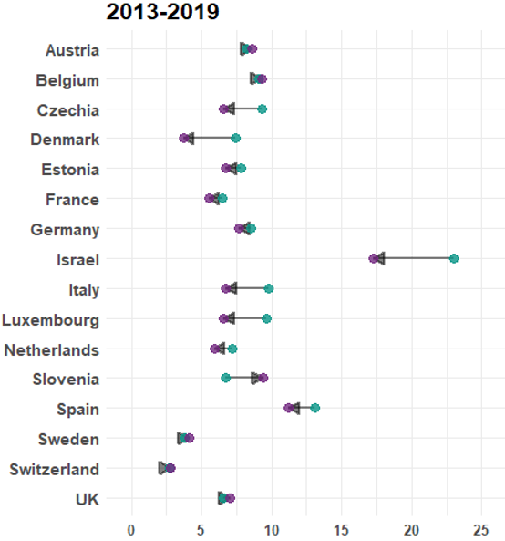
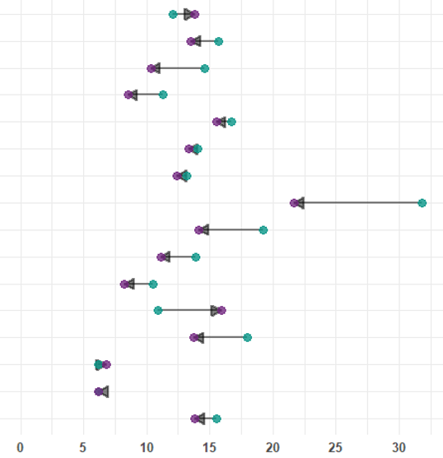
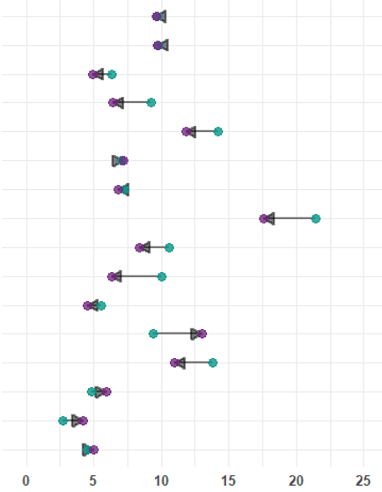

Prevalence of IADL components across countries, Women 2019
Prepare hot meal
Shop for groceries
Manage money
* Standardized prevalence ages 65+ using Europe Standard Population 2013

Slide 9
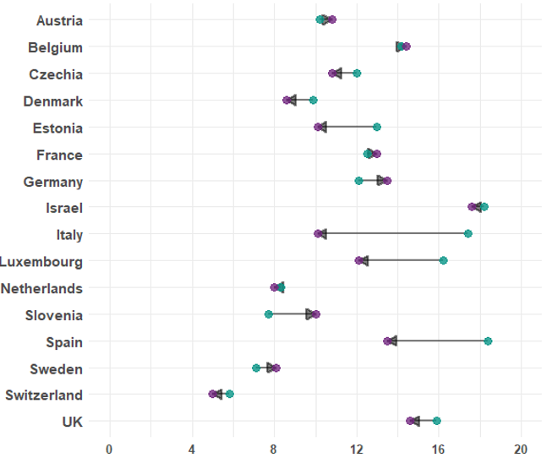
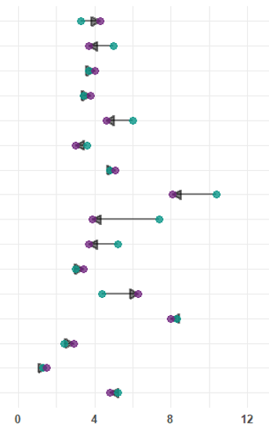
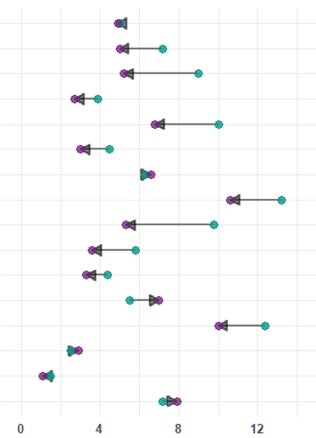
Prevalence of ADL components across countries, Women 2019
Dress
Walk across a room
Get in/out of bed
* Standardized prevalence ages 65+ using Europe Standard Population 2013

Slide 10
Conclusions
Pre-Covid gains in HLE and DFLE outpaced increases in e₆₅
Covid reversed or interrupted progress (mostly in mortality)
Peculiar case of Israel resembling morbidity-mortality paradox
Potential effect of population heterogeneity?

Slide 11
Funding
Israel Science Foundation (Grant No. 2532/22)
Israel Ministry of Innovation, Science & Technology
Healthy Longevity Research Center at Tel Aviv University

Slide 12
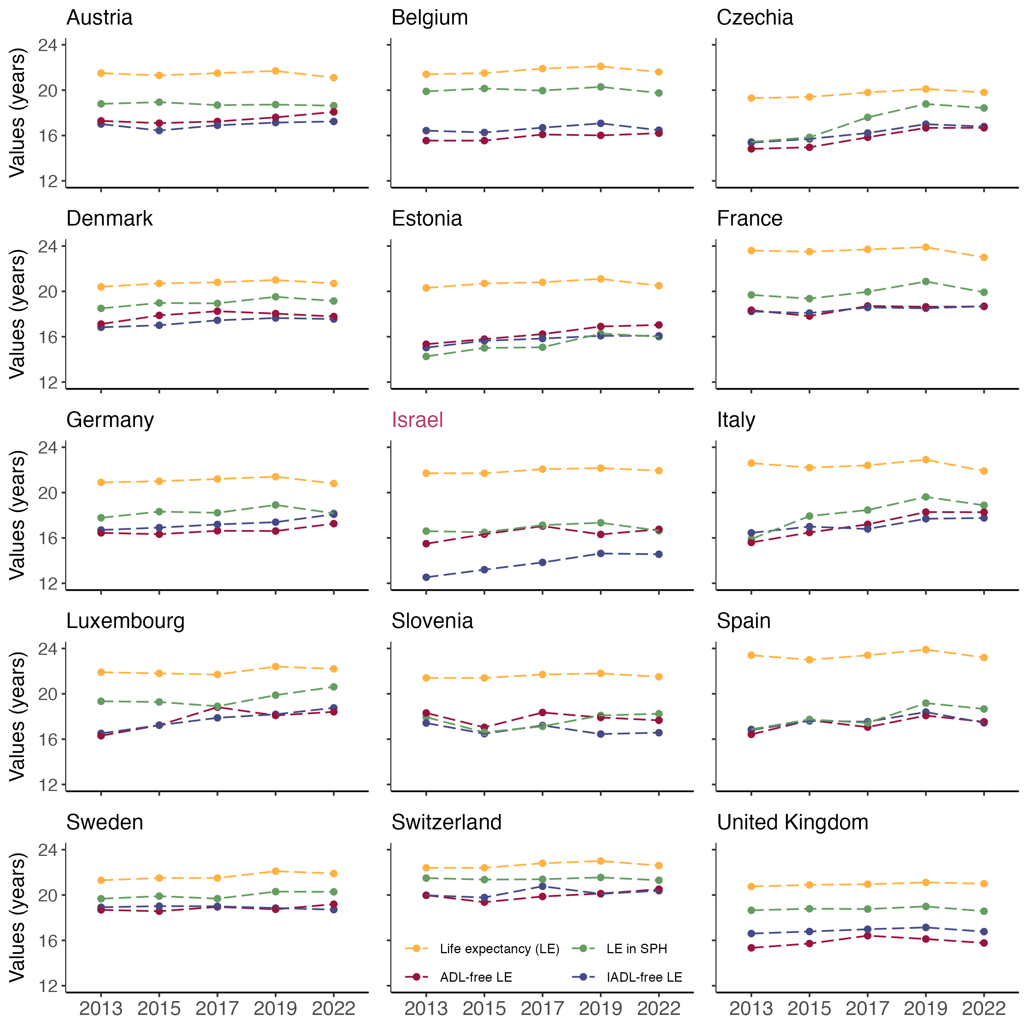
Trends in LE, HLE, and DFLE, Women 2013–2022
Average change
 | 2013–2019 | 2019–2022
e₆₅ | 0.5 | -0.5
HLE | 1.2 | -0.3
ADL-free | 0.9 | 0.1
IADL-free | 0.8 | 0.0

Slide 13
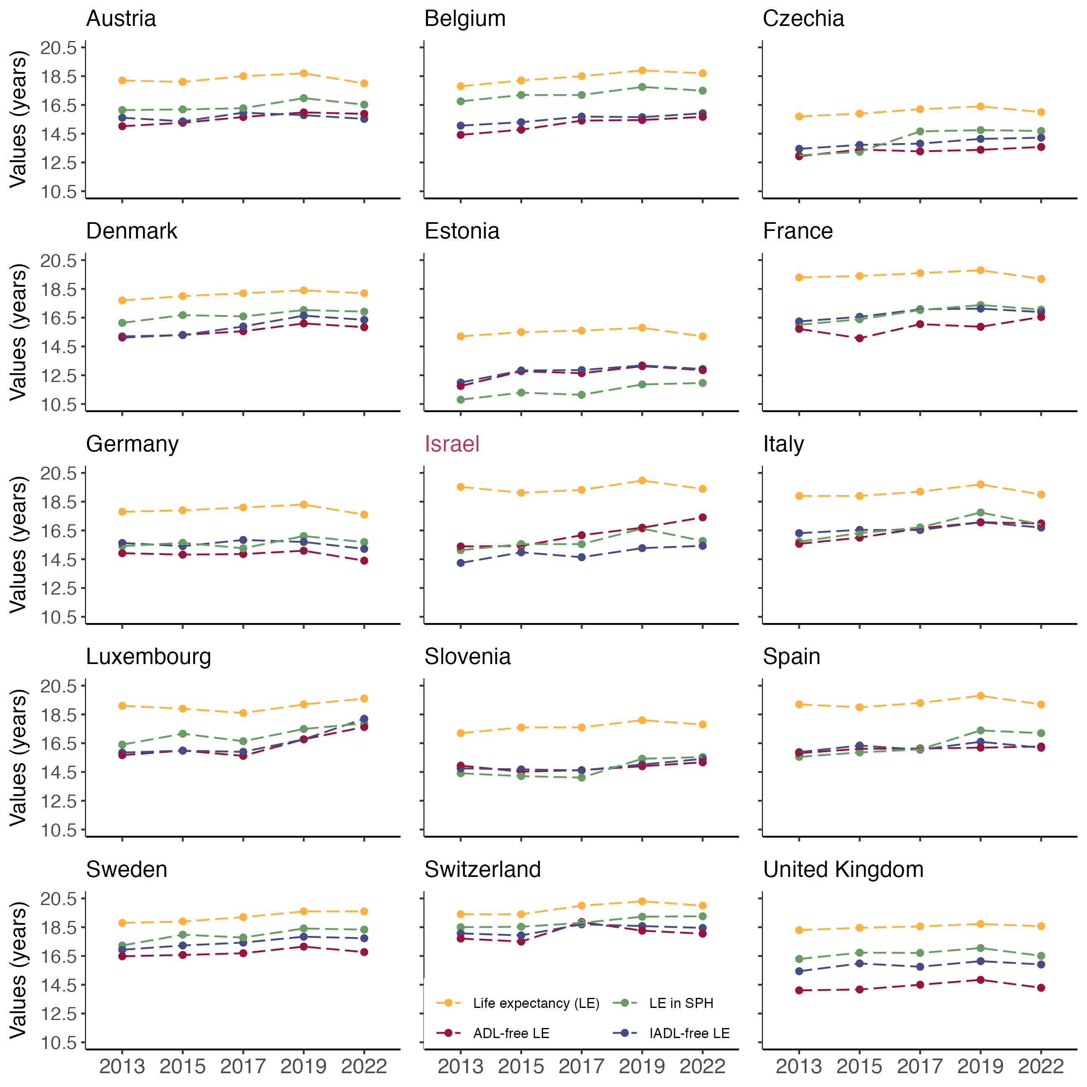
Trends in LE, HLE, and DFLE, Men 2013–2022
Average change
 | 2013–2019 | 2019–2022
e₆₅ | 0.6 | -0.4
HLE | 1.2 | -0.2
ADL-free | 0.8 | 0.0
IADL-free | 0.7 | 0.0

Slide 14
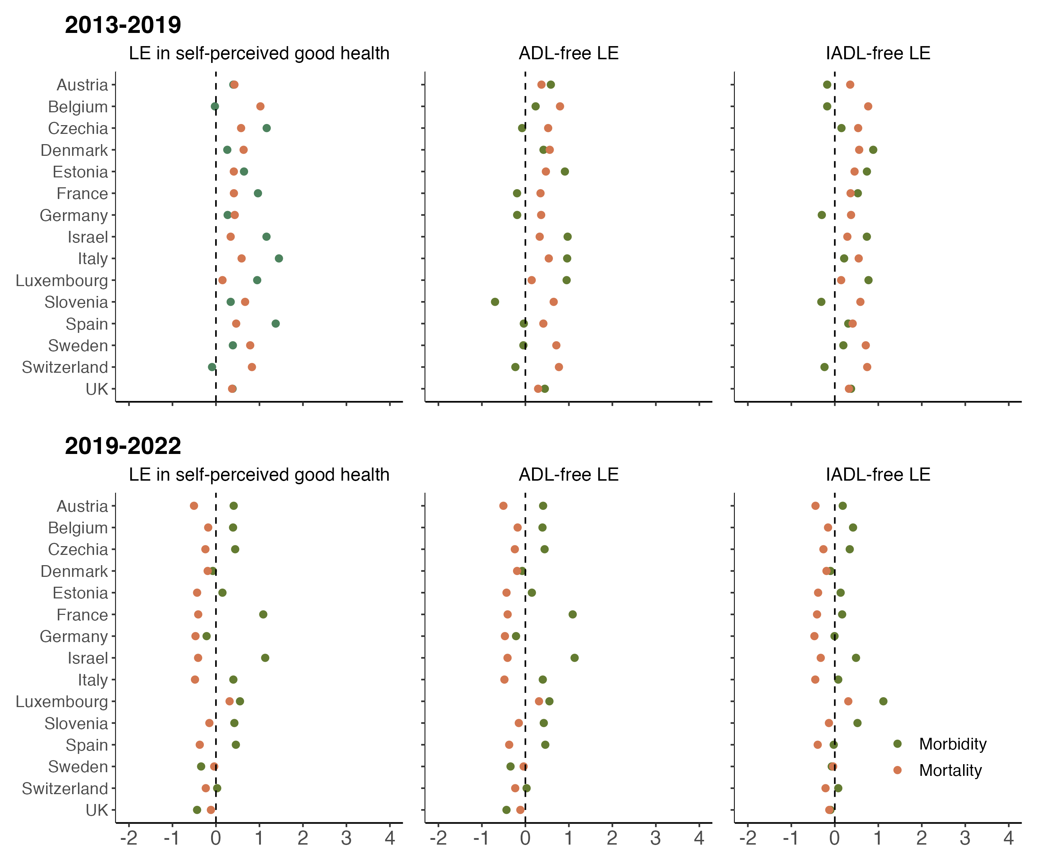
Mortality and morbidity contribution to changes in health expectancy, Men

