Slide 1

Neighborhood Environment and Short-Time Changes in Health Among the Oldest Old
Dr. Jaroslava Zimmermann
Prof. Dr. Gizem Hülür
EAPS 2025
Health, Morbidity, and Mortality Working Group Workshop
University of Luxemburg, Belval Campus
September 10-12

Slide 2
Background

Slide 3

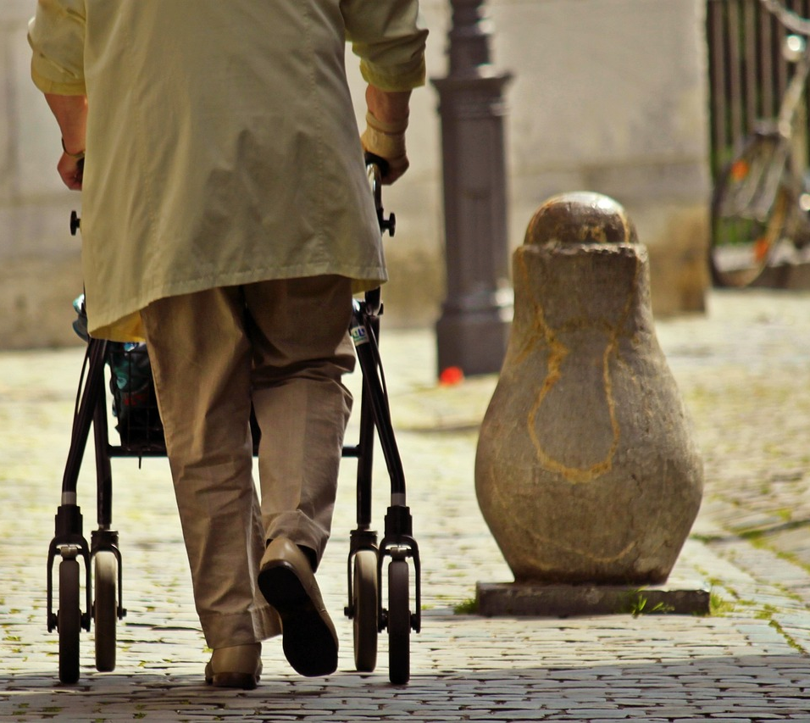
Neighborhood Environment and Aging
Aging → decline of individual resources and competencies
Increasing vulnerability towards environmental stressors (Lawton 1982)
Daily activities concentrate within neighborhoods
Functional abilities (FA) and cognitive function (CF) → key aging outcomes
FA & CF depend on environmental conditions (WHO 2015)
FA & CF → different trajectories in older age (Raimo et al. 2024)

Slide 4
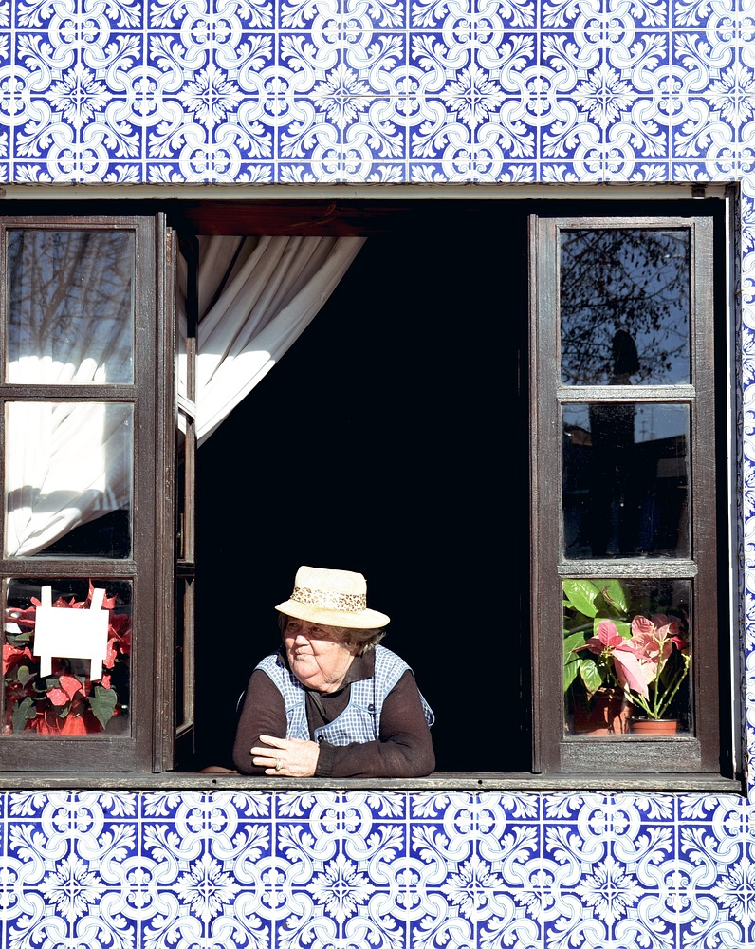
Neighborhood Environment and Aging
Relevance of physical and social environment in older age (Bronfenbrenner 1979, Lawton & Nahemow 1973; Wahl et al. 2012)
Adverse physical neighborhood environments → accumulation of psychological distress (Aneshensel et al., 2016)
Chronic stress → negative effect on FA and CF (D'Amico et al. 2020, Guidi et al. 2021)
Emotional and cognitive connectedness to place → beneficial for aging outcomes (Chaudhury & Oswald 2019, Wahl et al. 2012)

Slide 5
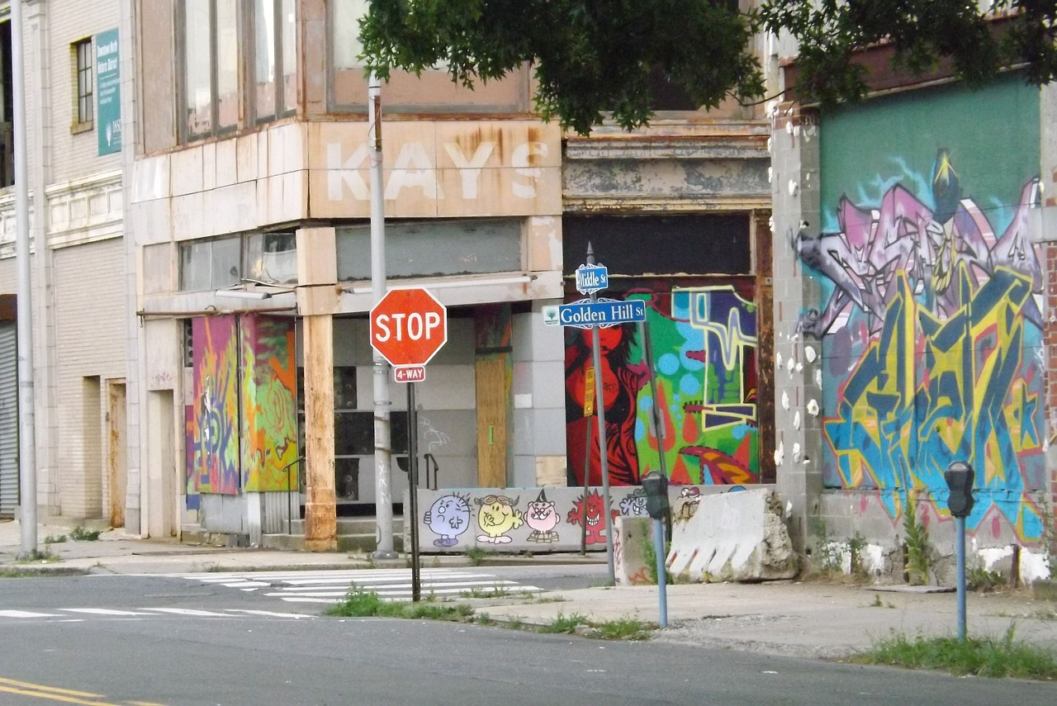
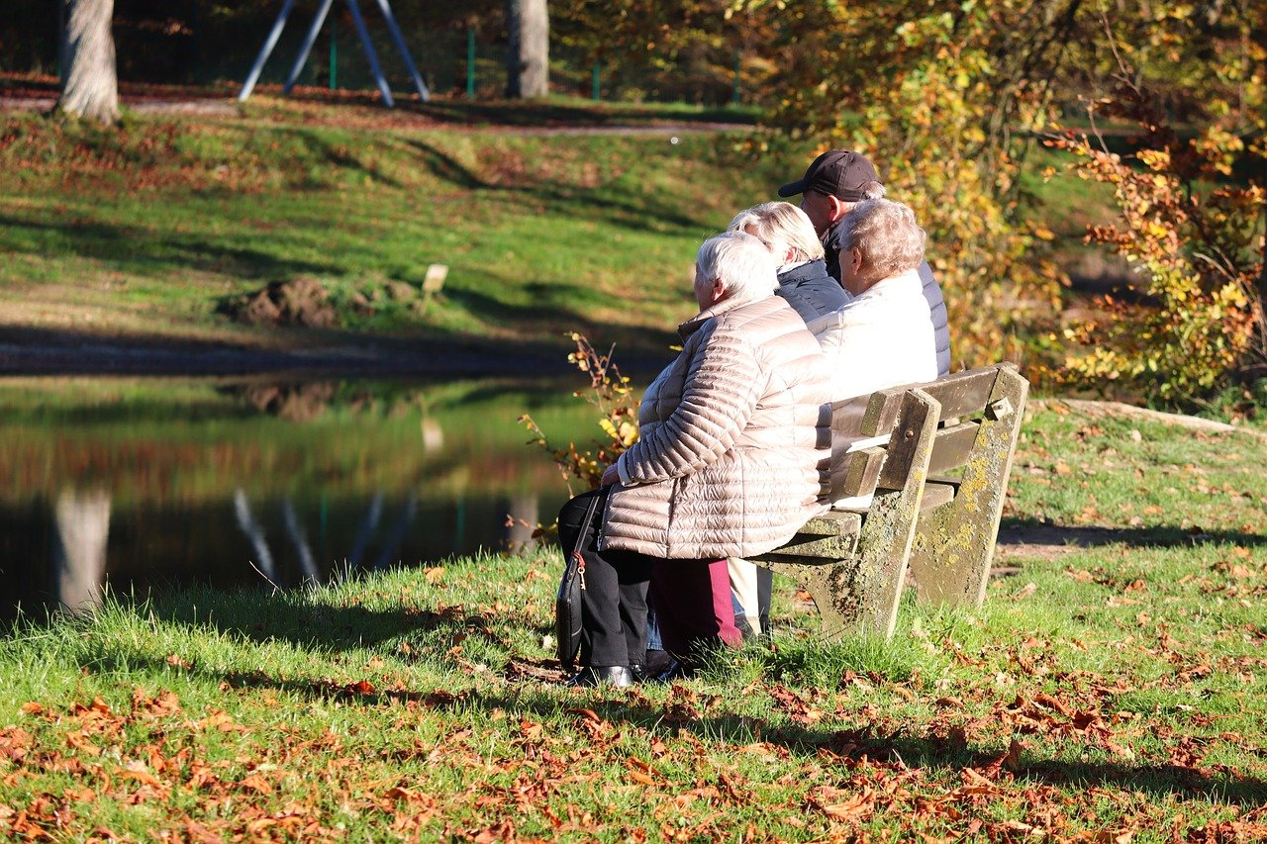
Neighborhood Environment, Functional Abilities and Cognitive Function
Poor physical neighborhood environment FA & CF (Molaei et al. 2024, Rachele et al. 2019, Chen et al. 2022, Song et al. 2024)
e.g., poor infrastructure, physical disorder, low walkability
More favorable social neighborhood environment FA & CF (Molaei et al. 2024, Besser et al. 2017, Sullivan et al. 2024)
e.g., neighborhood trust, sense of belonging, social participation

Slide 6
Research Aim
To examine the role of physical and social neighborhood environment for levels and changes in FA and CF using representative longitudinal data of the oldest old living in North Rhine-Westphalia.

Slide 7
Methods

Slide 8
Study Design
Population-based panel study “Quality of Life and Well-being of the Very Old in North Rhine-Westphalia” (NRW80+)
Study sample: 912 individuals aged 80 years or older
Data collection: 2017/2018 (Wave 1) and 2019/2020 (Wave 2)
Computer-assisted personal interviews
Current study: only participants with at least one valid value for the assessment at each wave
Final analytic samples: N=797 (FA ) and N=840 (CF)

Slide 9
Outcome Variables
Functional abilities
self-reported independence in instrumental activities of daily living (Lawton and Brody 1969)
7 items: using the telephone, organizing routes outside of the walking range, buying food and clothes, preparing meals, doing housework, taking medication, and handling finances
answer options: not possible without help (0), some help needed (1), or no help needed (2)
Cognitive function
DemTect screening tool (Kalbe et al. 2004)
5 tasks: immediate recall (0-20), number transcoding (0-4), word fluency (number of named items), digit span backwards (0-6), and delayed recall (0-10)
Z-standardized scores based on weighted sample mean and standard deviation at Wave 1

Slide 10
Independent Variables: Physical Neighborhood Environment
Neighborhood quality
Interviewer-rated measure: availability of warm materials, diverse vegetation, or places offering shade
Answer options: not attractive at all (1) to very attractive (4)
Neighborhood infrastructure
Interviewer-rated measure: availability of benches, pedestrian sidewalks, handrails, or outdoor lighting
Answer options: not functional at all (1) to very functional (4)
Walkability
Self-rated suitability of external living environment for walking
Answer options: not suitable at all (1) to very suitable (4)

Slide 11
Independent Variables: Social Neighborhood Environment
Place attachment
feeling connected to the outdoor living environment
Answer options: not close at all (1) to very close (4)
Social cohesion
trusting the neighbors (inside and outside the residential building)
Answer options: strongly disagree (1) to strongly agree (5)

Slide 12
Empirical Analyses
Testing measurement invariance in FA and CF over time
Single indicators were linked with latent variables at each time of measurement
Comparing fit indices of configural, metric, and scalar models (Widaman et al. 2010)
CF (continuous scale): maximum likelihood estimator with robust standard errors
FA (ordinal scale): weighted least squares mean and variance adjusted estimator with probit link
Latent change score models for FA and CF
Latent variables at W1 → indicators measured in W1
Latent difference variables → change in outcomes between W1 and W2
Latent change score models for FA and CF with predictors (physical and social neighborhood)
Controls: age, sex, partnership status, living alone, length of residency, living in a nursing facility, physical activity, and individual SES

Slide 13
Results

Slide 14
Sample Description
Independent variables | Functional abilities (N = 840) Mean (SD) | Cognitive function (N = 797) Mean (SD)
Neighborhood infrastructure (mean value: W1, W2) | 2.02 (0.65) | 2.02 (0.65)
Neighborhood quality (mean value: W1, W2) | 2.08 (0.64) | 2.09 (0.65)
Walkability W1 | 1.80 (0.98) | 1.83 (0.98)
Walkability difference between W2 and W1 | -0.10 (1.02) | -0.11 (1.04)
Place attachment W1 | 2.19 (0.96) | 2.20 (0.95)
Place attachment difference between W2 and W1 | 0.01 (1.08) | 0.02 (1.09)
Social cohesion W1 | 3.21 (1.03) | 3.24 (1.01)
Social cohesion difference between W2 and W1 | -0.05 (0.98) | -0.05 (0.95)
Note. Weighted data. W1 = Wave 1; W2 = Wave 2.

Slide 15
Sample Description
Control variables | Functional abilities (N = 840) % or Mean (SD) | Cognitive function (N = 797) % or Mean (SD)
Sex W1 (Female) | 62.50% | 62.30%
Age W1 (in years) | 85.39 (4.03) | 85.27 (4.02)
Socioeconomic status W1 | 42.03 (20.93) | 42.55 (21.20)
Length of residency W1 (in years) | 38.70 (26.98) | 38.95 (27.0)
Married/partnered W1 | 41.30% | 41.90%
Living alone W1 | 47.70% | 48.50%
Living in a nursing facility W1 | 11.10% | 10.70%
At least weekly physically active W1 | 84.90% | 85.40%
Note. Weighted data. W1 = Wave 1.

Slide 16
Latent Change Score Model: Functional Abilities (N = 840)
 | Level |  |  | Change
 | Est | SE | Std | Est | SE | Std
Physical neighborhood characteristics
Neighborhood infrastructure | 0.06 | 0.19 | 0.02 | -0.12 | 0.12 | -0.07
Neighborhood quality | 0.08 | 0.17 | 0.02 | -0.02 | 0.12 | -0.01
Walkability W1 | 0.33 | 0.13 | 0.14 | -0.03 | 0.08 | -0.03
Walkability difference |  |  |  | 0.26 | 0.09 | 0.25
Social neighborhood characteristics
Place attachment W1 | 0.14 | 0.14 | 0.06 | -0.12 | 0.11 | -0.11
Social cohesion W1 | 0.07 | 0.11 | 0.03 | 0.07 | 0.08 | 0.07
Place attachment difference |  |  |  | 0.00 | 0.07 | 0.00
Social cohesion difference |  |  |  | 0.13 | 0.09 | 0.12
R-Square | 0.45 |  |  | 0.21
RMSEA | 0.03
CFI | 0.97
Note. Panel-weighted data. W1 = Wave 1. Parameters which were statistically significant at the p < .05 level are shown in bold font.
Model was adjusted for sex, age, socioeconomic status, length of residency, partnership status, living alone, living in a nursing facility, physical activity.

Slide 17
Latent Change Score Model: Cognitive Function (N=797)
 | Level |  |  | Change
 | Est | SE | Std | Est | SE | Sd
Physical neighborhood characteristics
Neighborhood infrastructure | 0.10 | 0.07 | 0.10 | -0.02 | 0.06 | -0.04
Neighborhood quality | -0.02 | 0.07 | -0.02 | -0.02 | 0.05 | -0.04
Walkability W1 | -0.04 | 0.03 | -0.06 | 0.01 | 0.03 | 0.02
Walkability difference |  |  |  | 0.00 | 0.03 | -0.01
Social neighborhood characteristics
Place attachment W1 | 0.05 | 0.04 | 0.08 | -0.04 | 0.03 | -0.10
Social cohesion W1 | -0.01 | 0.03 | -0.02 | 0.08 | 0.03 | 0.25
Place attachment difference |  |  |  | -0.01 | 0.02 | -0.04
Social cohesion difference |  |  |  | 0.03 | 0.03 | 0.08
R-Square | 0.33 |  |  | 0.09
RMSEA | 0.03
CFI | 0.94
SRMR | 0.04
Note. Panel-weighted data. W1 = Wave 1. Parameters which were statistically significant at the p < .05 level are shown in bold font.
Model was adjusted for sex, age, socioeconomic status, length of residency, partnership status, living alone, living in a nursing facility, physical activity.

Slide 18
Discussion

Slide 19
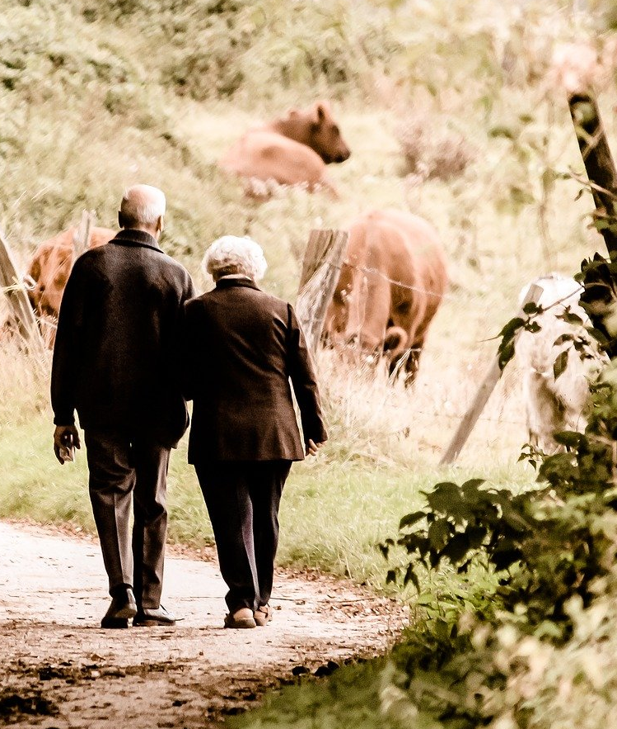
The Neighborhood Environment Matters!
Neighborhood environment predicted disparities in short-time health changes
The predictors differed between FA and CF outcomes
Better physical environment (walkability) → higher baseline FA
Walkable environment promotes physical activity (Barnett et al. 2017)
Positive walkability ratings due to experiencing fewer barriers
Improvement in walkability → less FA decline over time
Adjustments of residential environment
Proactive adaptation strategies (e.g., starting to use a walking aid)

Slide 20
The Neighborhood Environment Matters!
Better social environment (social cohesion) → less CF decline over time
Previous longitudinal studies found no associations (Sharifian et al. 2020; Tang et al. 2020)
Cultural and/or age-related differences
Emotional connection to neighborhood → protective effect on healthy aging (Chaudhury & Oswald 2019; Wahl et al. 2012)
Social relationships → buffer adverse health consequences of chronic and acute stressors (Thoits 2011)
Neighborhood infrastructure and quality, place attachment → no association with FA or CF
Inconsistent with previous studies (e.g., Molaei et al. 2024; Rachele et al. 2019; Song et al. 2024; Sullivan et al. 2024)

Slide 21
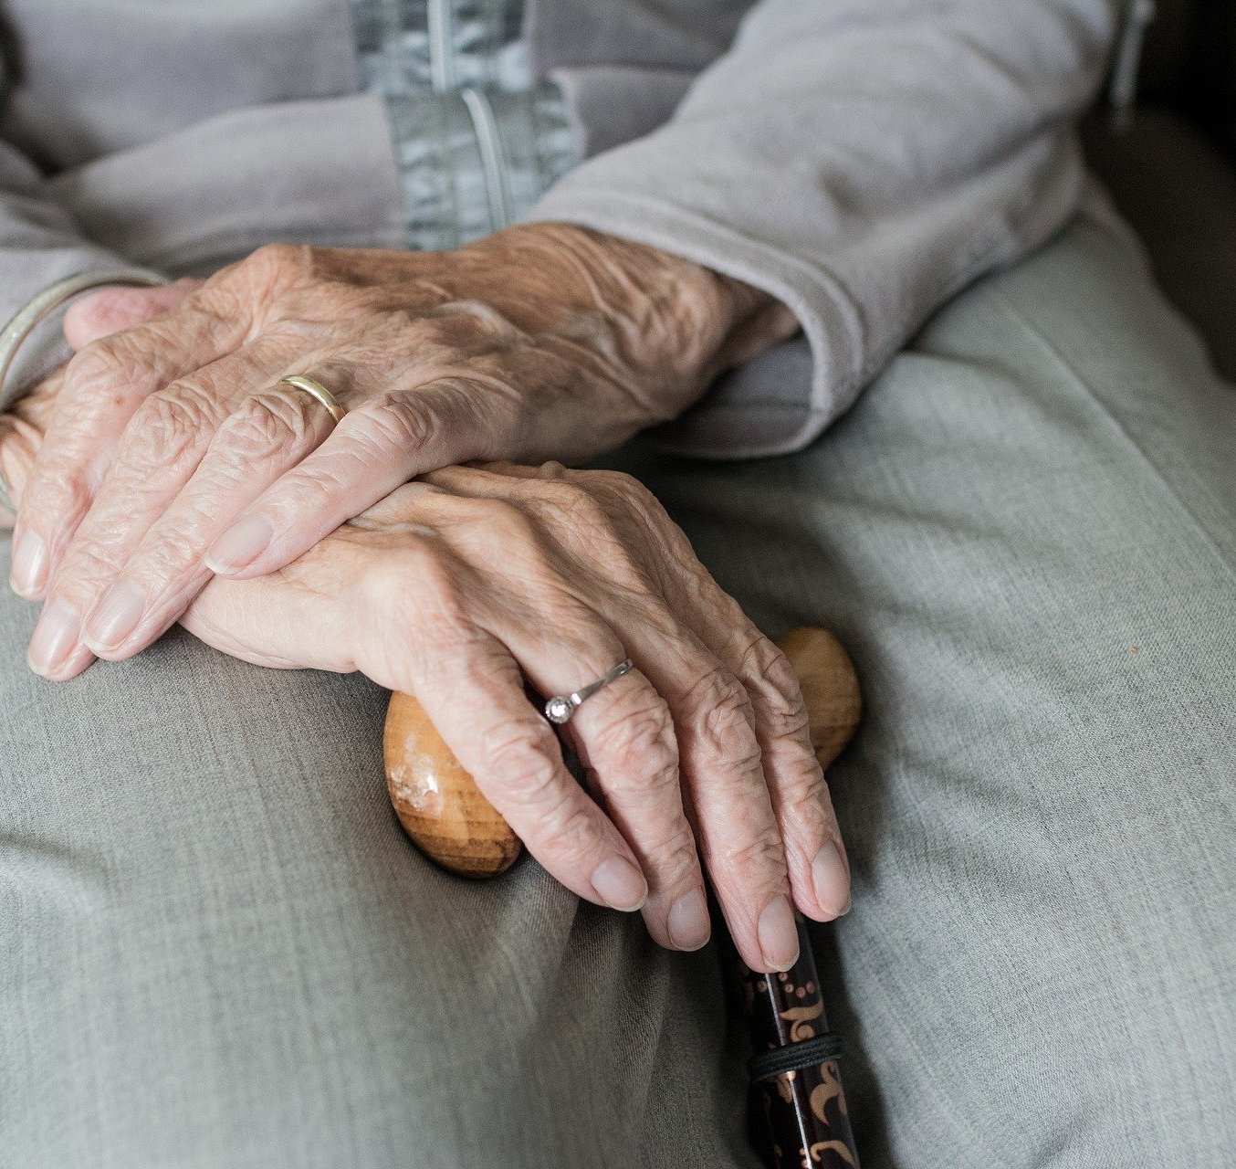
Limitations
Only interviewer-reported and perceived neighborhood ratings
Neighborhood self-selection not considered
Only short-term health changes
Different cognitive domains not considered

Slide 22
References
Aneshensel, C. S., Harig, F., & Wight, R. G. (2016). Aging, Neighborhoods, and the Built Environment. In L. K. George & K. F. Ferraro (Eds.), Handbook of Aging and the Social Sciences (Eighth Edition, pp. 315–335). Elsevier AP. https://doi.org/10.1016/B978-0-12-417235-7.00015-9
Barnett, D. W., Barnett, A., Nathan, A., van Cauwenberg, J., & Cerin, E. (2017). Built environmental correlates of older adults' total physical activity and walking: A systematic review and meta-analysis. The International Journal of Behavioral Nutrition and Physical Activity, 14(1), 103. https://doi.org/10.1186/s12966-017-0558-z
Besser, L. M., McDonald, N. C., Song, Y [Y.], Kukull, W. A., & Rodriguez, D. A. (2017). Neighborhood Environment and Cognition in Older Adults: A Systematic Review. Am J Prev Med, 53(2), 241–251. https://doi.org/10.1016/j.amepre.2017.02.013
Bronfenbrenner, U. (1979). The Ecology of Human Development: Experiments by Nature and Design. Harvard University Press.
Chaudhury, H., & Oswald, F. (2019). Advancing understanding of person-environment interaction in later life: One step further. Journal of Aging Studies, 51, 100821. https://doi.org/10.1016/j.jaging.2019.100821
Chen, X., Lee, C., & Huang, H. (2022). Neighborhood built environment associated with cognition and dementia risk among older adults: A systematic literature review. Social Science & Medicine, 292, 114560. https://doi.org/10.1016/j.socscimed.2021.114560
D'Amico, D., Amestoy, M. E., & Fiocco, A. J. (2020). The association between allostatic load and cognitive function: A systematic and meta-analytic review. Psychoneuroendocrinology, 121, 104849. https://doi.org/10.1016/j.psyneuen.2020.104849
Guidi, J., Lucente, M., Sonino, N., & Fava, G. A. (2021). Allostatic Load and Its Impact on Health: A Systematic Review. Psychotherapy and Psychosomatics, 90(1), 11–27. https://doi.org/10.1159/000510696
Kalbe, E., Kessler, J., Calabrese, P., Smith, R., Passmore, A. P., Brand, M., & Bullock, R. (2004). Demtect: A new, sensitive cognitive screening test to support the diagnosis of mild cognitive impairment and early dementia. International Journal of Geriatric Psychiatry, 19(2), 136–143. https://doi.org/10.1002/gps.1042
Lawton, M. P. (1982). Competence, environmental press, and the adaption of older people. In M. P. Lawton, P. G. Windley, & T. O. Byerts (Eds.), Aging and the Environment: Theoretical Approaches (pp. 33–59). Springer.
Lawton, M. P., & Brody, E. M. (1969). Assessment of older people: self-maintaining and instrumental activities of daily living. The Gerontologist, 9(3), 179–186.
Lawton, M. P., & Nahemow, L. (1973). Ecology and the aging process. In C. Eisdorfer & M. P. Lawton (Eds.), The psychology of adult development and aging (pp. 619–674). American Psychological Association.
Molaei, P., Alidadi, M., Badland, H., & Gunn, L. (2024). Associations between the urban neighbourhood built and social environment characteristics with physical functioning among mid- and older-aged adults: A systematic review. Social Science & Medicine (1982), 362, 117412. https://doi.org/10.1016/j.socscimed.2024.117412
Rachele, J. N., Sugiyama, T., Davies, S., Loh, V. H. Y., Turrell, G., Carver, A., & Cerin, E. (2019). Neighbourhood built environment and physical function among mid-to-older aged adults: A systematic review. Health & Place, 58, 102137. https://doi.org/10.1016/j.healthplace.2019.05.015
Raimo, S., Maggi, G., Ilardi, C. R., Cavallo, N. D., Torchia, V., Pilgrom, M. A., Cropano, M., Roldán-Tapia, M. D., & Santangelo, G. (2024). The relation between cognitive functioning and activities of daily living in normal aging, mild cognitive impairment, and dementia: A meta-analysis. Neurological Sciences : Official Journal of the Italian Neurological Society and of the Italian Society of Clinical Neurophysiology, 45(6), 2427–2443. https://doi.org/10.1007/s10072-024-07366-2
Sharifian, N., Spivey, B. N., Zaheed, A. B., & Zahodne, L. B. (2020). Psychological distress links perceived neighborhood characteristics to longitudinal trajectories of cognitive health in older adulthood. Social Science & Medicine (1982), 258, 113125. https://doi.org/10.1016/j.socscimed.2020.113125
Song, Y [Yiling], Liu, Y [Yunxi], Bai, X., & Yu, H. (2024). Effects of neighborhood built environment on cognitive function in older adults: A systematic review. BMC Geriatrics, 24(1), 194. https://doi.org/10.1186/s12877-024-04776-x
Sullivan, A., Armendariz, M., & Thierry, A. D. (2024). A scoping review of neighborhoods and cognitive health disparities among US midlife and older adults. Journal of Aging and Health(3-4), 257. https://doi.org/10.1177/08982643231185379
Tang, F., Zhang, W., Chi, I., Li, M., & Dong, X. Q. (2020). Importance of activity engagement and neighborhood to cognitive function among older Chinese Americans. Research on Aging, 42(7-8), 226–235. https://doi.org/10.1177/0164027520917064
Thoits, P. A. (2011). Mechanisms linking social ties and support to physical and mental health. Journal of Health and Social Behavior, 52(2), 145–161. https://doi.org/10.1177/0022146510395592
Wahl, H.‑W., Iwarsson, S., & Oswald, F. (2012). Aging well and the environment: Toward an integrative model and research agenda for the future. The Gerontologist, 52(3), 306–316. https://doi.org/10.1093/geront/gnr154
Widaman, K. F., Ferrer, E., & Conger, R. D. (2010). Factorial invariance within longitudinal structural equation models: Measuring the same construct across time. Child Development Perspectives, 4(1), 10–18. https://doi.org/10.1111/j.1750-8606.2009.00110.x
World Health Organization. (2015). World report on ageing and health.

Slide 23

Thank you for your attention!

Slide 24
Back-Up

Slide 25
Results From Latent Change Score Models Predicting Level and Change in Functional Abilities in the Oldest Old (N=840)
 | Level |  |  | Change
 | Est | SE | Std | Est | SE | Std
Sex W1 (female) | -0.417 | 0.183 | -0.087 | 0.261 | 0.148 | 0.121
Age W1 | -0.128 | 0.032 | -0.223 | -0.007 | 0.014 | -0.028
SES W1 | 0.014 | 0.005 | 0.129 | 0.000 | 0.003 | -0.002
Length of residency W1 | 0.004 | 0.004 | 0.050 | 0.004 | 0.003 | 0.109
Married/partnered W1 | 1.395 | 0.383 | 0.297 | -0.351 | 0.223 | -0.166
Living alone W1 | 1.391 | 0.343 | 0.300 | -0.195 | 0.177 | -0.093
Living in a nursing facility W1 | -1.451 | 0.441 | -0.197 | 0.554 | 0.307 | 0.167
At least weekly physical activity W1 | 1.312 | 0.321 | 0.203 | -0.384 | 0.160 | -0.132
Neighborhood infrastructure ª | 0.059 | 0.187 | 0.016 | -0.118 | 0.123 | -0.073
Neighborhood quality ª | 0.077 | 0.170 | 0.021 | -0.015 | 0.115 | -0.009
Walkability W1 | 0.327 | 0.128 | 0.138 | -0.032 | 0.075 | -0.030
Walkability difference ^{b} |  |  |  | 0.259 | 0.094 | 0.254
Place attachment W1 | 0.140 | 0.136 | 0.058 | -0.120 | 0.114 | -0.110
Social cohesion W1 | 0.066 | 0.110 | 0.030 | 0.066 | 0.084 | 0.066
Place attachment difference ^{b} |  |  |  | 0.004 | 0.072 | 0.004
Social cohesion difference ^{b} |  |  |  | 0.128 | 0.089 | 0.120
R-Square | 0.449 |  |  | 0.211
RMSEA | 0.029
CFI | 0.974

Slide 26
Results From Latent Change Score Models Predicting Level and Change in Cognitive Function in the Oldest Old (N=797)
 | Level |  |  | Change
 | Est | SE | Std | Est | SE | Std
Sex W1 (female) | 0.160 | 0.066 | 0.119 | 0.028 | 0.042 | 0.042
Age W1 | -0.013 | 0.003 | -0.083 | -0.005 | 0.002 | -0.064
SES W1 | 0.009 | 0.002 | 0.286 | 0.000 | 0.001 | -0.014
Length of residency W1 | 0.003 | 0.001 | 0.135 | 0.002 | 0.001 | 0.153
Married/partnered W1 | 0.313 | 0.123 | 0.236 | 0.140 | 0.078 | 0.215
Living alone W1 | 0.310 | 0.113 | 0.237 | 0.098 | 0.091 | 0.152
Living in a nursing facility W1 | -0.464 | 0.194 | -0.219 | 0.267 | 0.151 | 0.257
At least weekly physical activity W1 | 0.202 | 0.108 | 0.109 | 0.022 | 0.078 | 0.024
Neighborhood infrastructure ª | 0.100 | 0.065 | 0.099 | -0.021 | 0.059 | -0.043
Neighborhood quality ª | -0.024 | 0.065 | -0.023 | -0.018 | 0.051 | -0.037
Walkability W1 | -0.037 | 0.032 | -0.055 | 0.005 | 0.030 | 0.016
Walkability difference ^{b} |  |  |  | -0.004 | 0.027 | -0.013
Place attachment W1 | 0.053 | 0.040 | 0.077 | -0.035 | 0.029 | -0.104
Social cohesion W1 | -0.014 | 0.028 | -0.022 | 0.078 | 0.031 | 0.245
Place attachment difference ^{b} |  |  |  | -0.012 | 0.021 | -0.041
Social cohesion difference ^{b} |  |  |  | 0.026 | 0.028 | 0.076
R-Square | 0.330 |  |  | 0.094
RMSEA | 0.027
CFI | 0.942
SRMR | 0.041

